Slide 1
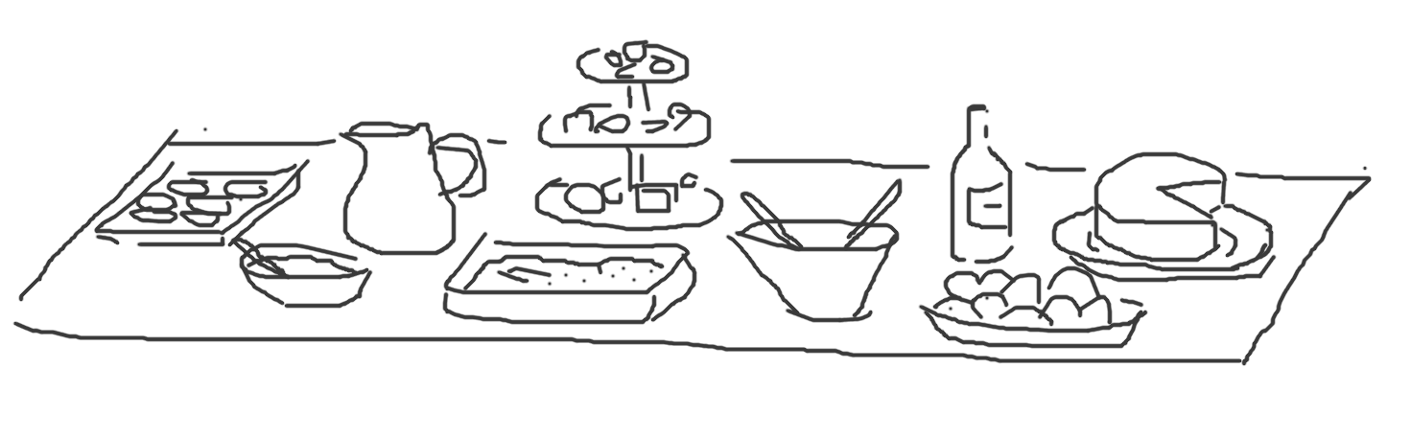
init
status
diff
add
commit
push
pull
merge
checkout
Clone
branch
rebase
Pull request

