Slide 1
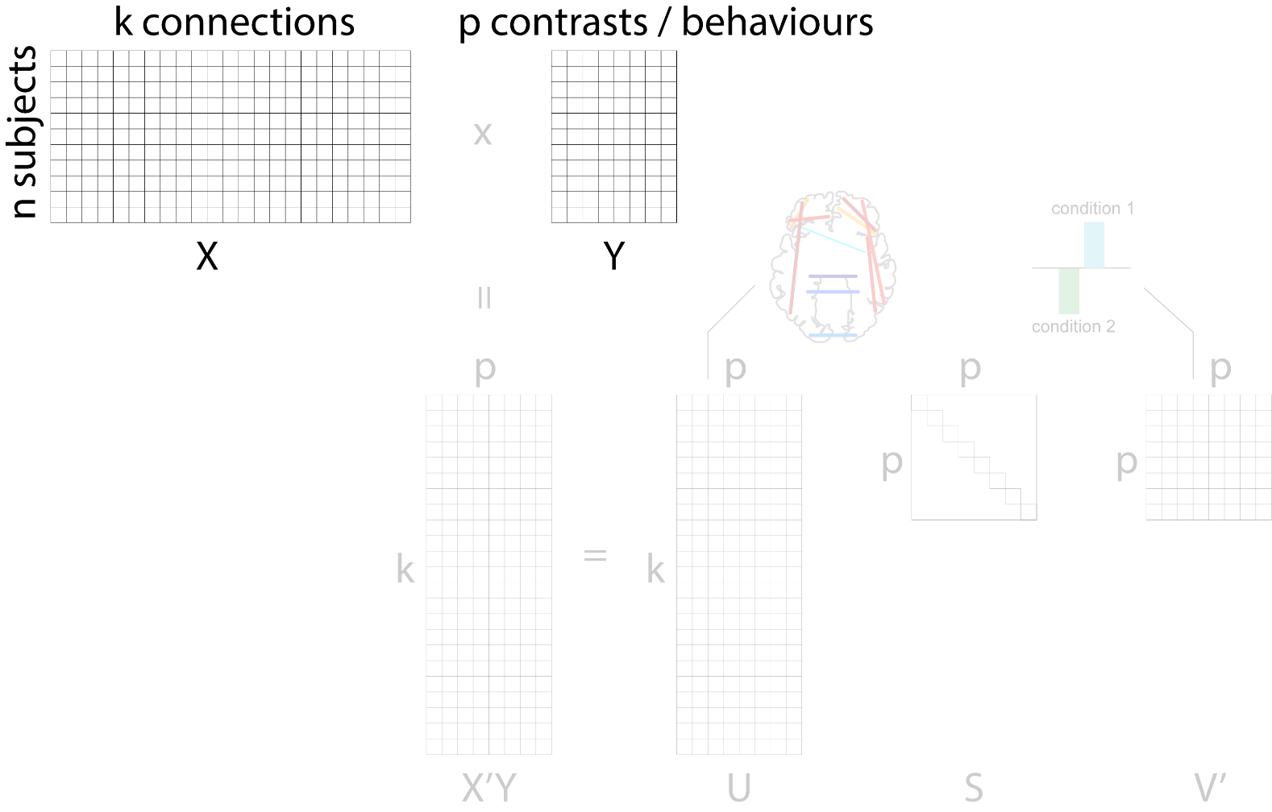
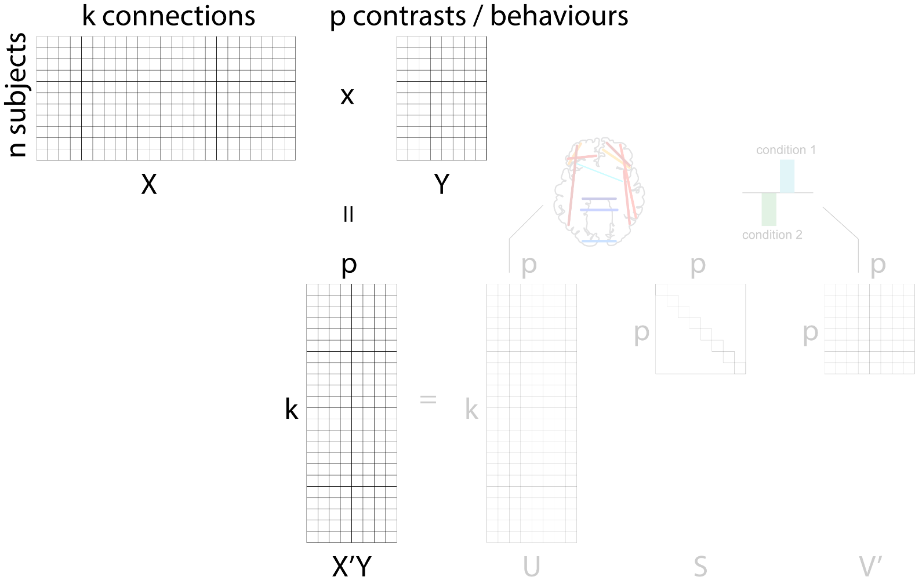
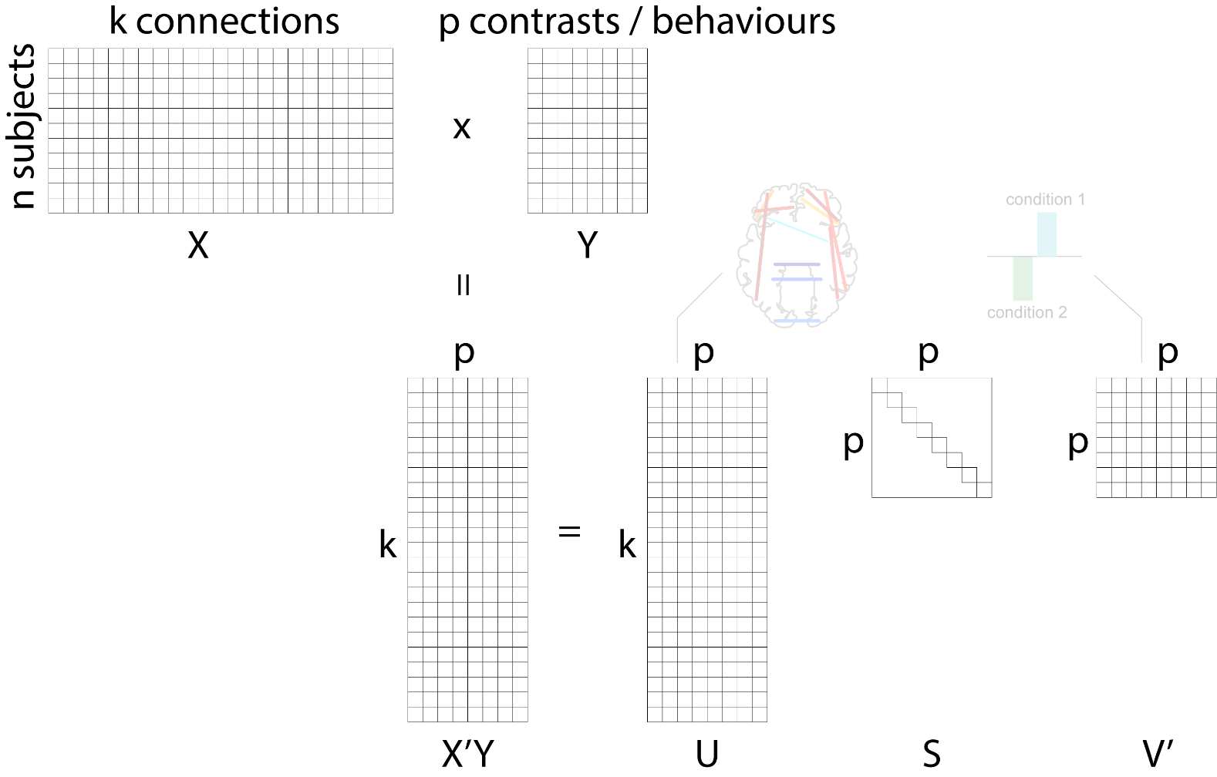
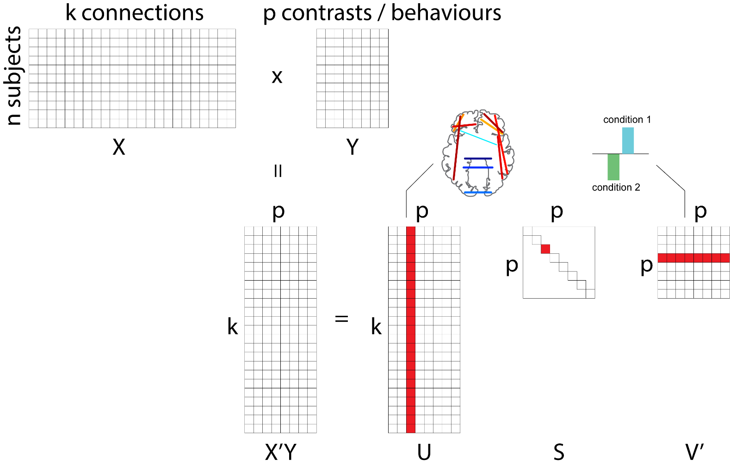
Partial least squares
in PCA, you decompose the original data matrix X
in PLS, you decompose a correlation matrix (X’Y) between two data matrices X and Y
get multiple latent variables (aka components, modes, variates)
  singular vectors represent the optimal weighing of original variables,
  e.g. patterns of connectivity + patterns of behaviour
  singular value represents the proportion of X-Y covariance accounted for by the pairing
Wold et al. (1982; 1984) Math Stat Chem

Slide 2


v voxels
p pipeline choices
g observations
(analysis teams)
g observations
(analysis teams)
x
X
Y
p
p
p
p
p
p
v
=
v
x
x
X’Y
U
S
V’

