Slide 1


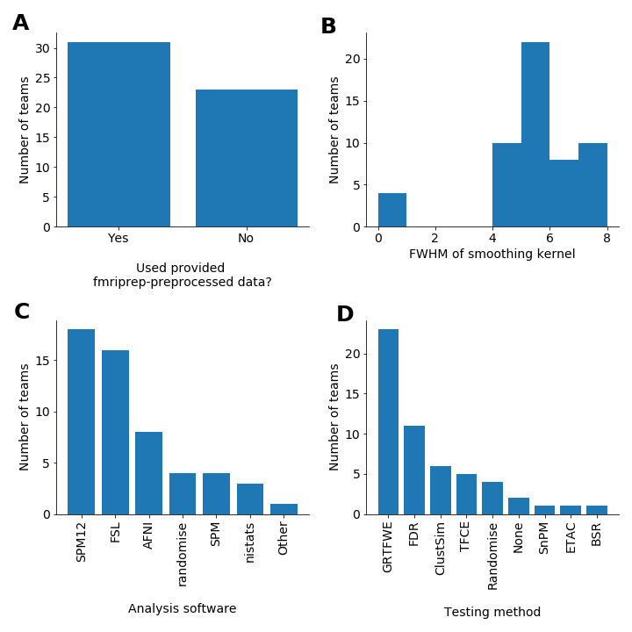
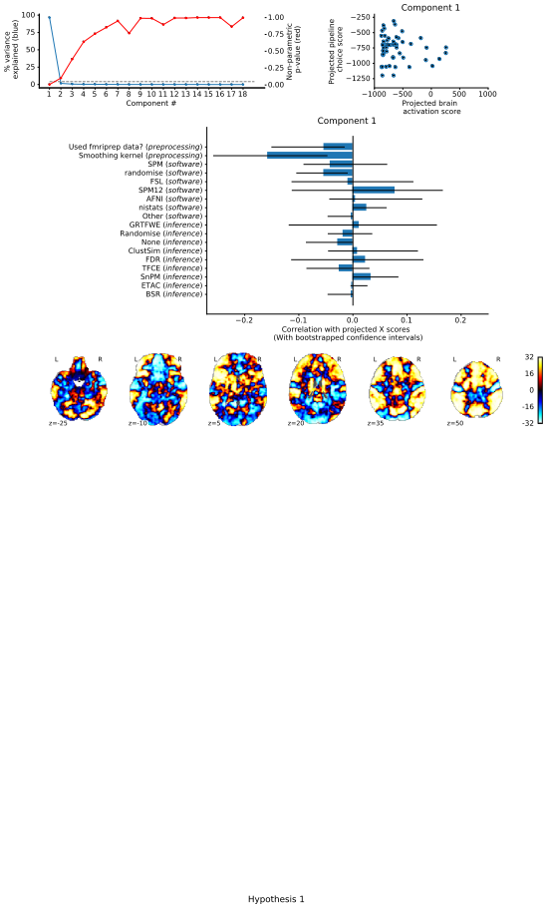
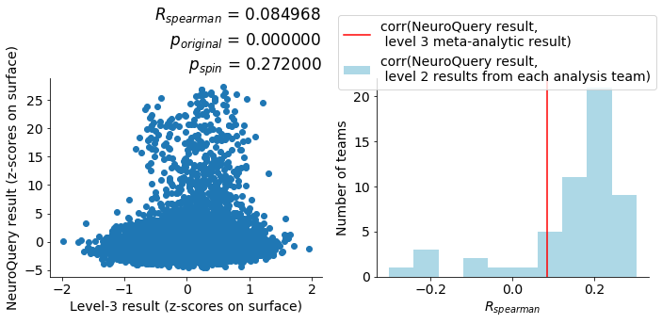
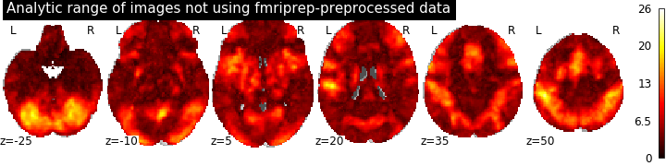
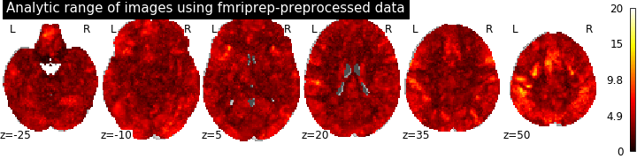

Analytic variability in fMRI:
Multivariate and meta-analytic approaches to the problem and solution
Kendra Oudyk¹, Alexandre Pérez¹ , Peer Herholz¹ , Boris Bernhardt¹, Bratislav Misic¹, Jean-Baptiste Poline¹
¹Montréal Neurological Institute, McGill University, Montréal, Québec, Canada
Background
Simulations have shown that analysis choices may influence results in research using functional magnetic resonance imaging (fMRI)^{carp}.
Until recently, it was unclear how much analytic variability there is in the field, between actual researchers.
Purpose
Here, we complement the work by BBBB an colleagues ^{nature}, demonstrating the use of a multivariate analysis for investigating analytic variability.
Further, we explore a novel meta-analysis-comparison method for evaluating the meta-analytic result as a potential solution.
Data
We used the data from the Neuroimaging Analysis Replication and Prediction Study (NARPS)^{cite},
in which many research teams analyzed the same task-fMRI dataset. That dataset had the following properties:
Participants: 108, with 54 in each condition
Task: Mixed-gambles task, which involves choosing whether to take a gamble^{(Tom, 2007)}
Conditions: 1) Equal Range (range of possible gains = range of possible losses)
2) Equal Indifference (range of possible gains = 2 * range of possible losses)
In NARPS, 70 analysis teams performed whole-brain corrected analyses of task-related activation, using the raw or preprocessed data.
In the present study, we used 2 group-level z-maps from 55 analysis team, both from a test of the positive effect of gain (winning a gamble), one for each condition. We used the Equal-Indifference maps for the main analysis, and the Equal-Range maps for replication.
Figure 1A-D shows the number of teams that made various analysis choices.
1A
1B
1C
1D
(Code: github.com/koudyk/narps_meta).
Assessing the problem
Exploring a solution
To assess the association between methodological choices and the whole-brain group-level results,
we used
- Partial least squares to ???????????
- Permutation testing of significance of each component (see Figure 2A)
- Bootstrap resampling with replacement to test the
stability of each variable’s contribution to a component (see Figure 2C)
To explore whether the consensus result across teams was more accurate than the individual group-level maps, we used
- A fixed-effects general linear model to find the
consensus across teams
- NeuroQuery (Dockès, 2018) to find the
consensus from the literature
- Spearman correlation to measure the similarity between
the two consensus maps (see Figure 3A)
- Spin permutation^{cite} to test significance of the similarity
(see Figure 3B)
2A
2B
3A
3A
3B
2C
Conclusion
Siblabla
2D
References
¹d
²d
³d
⁴d

