Slide 1


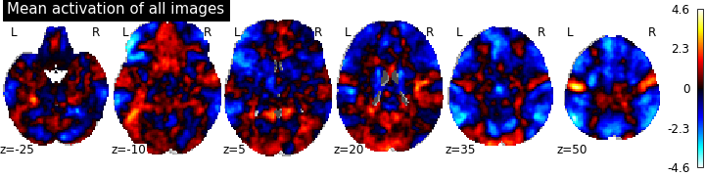
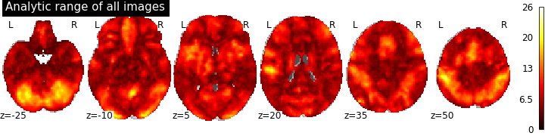
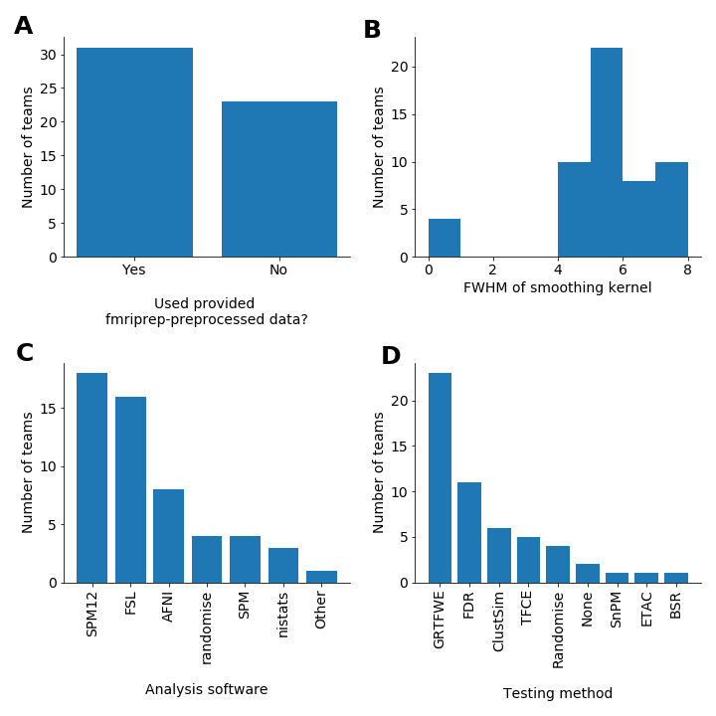
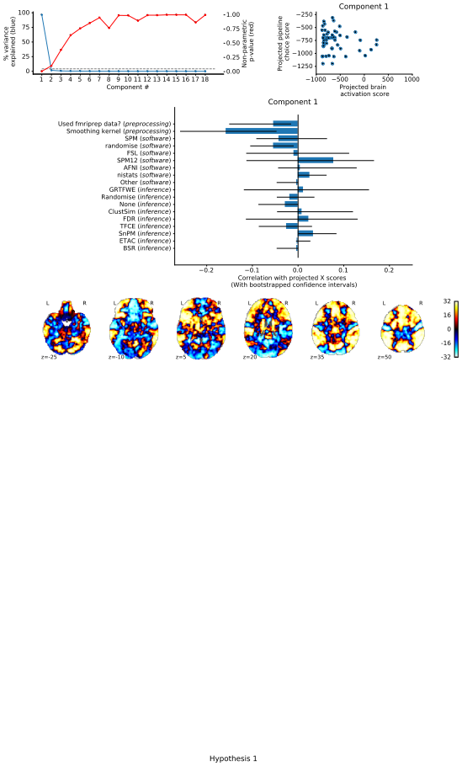
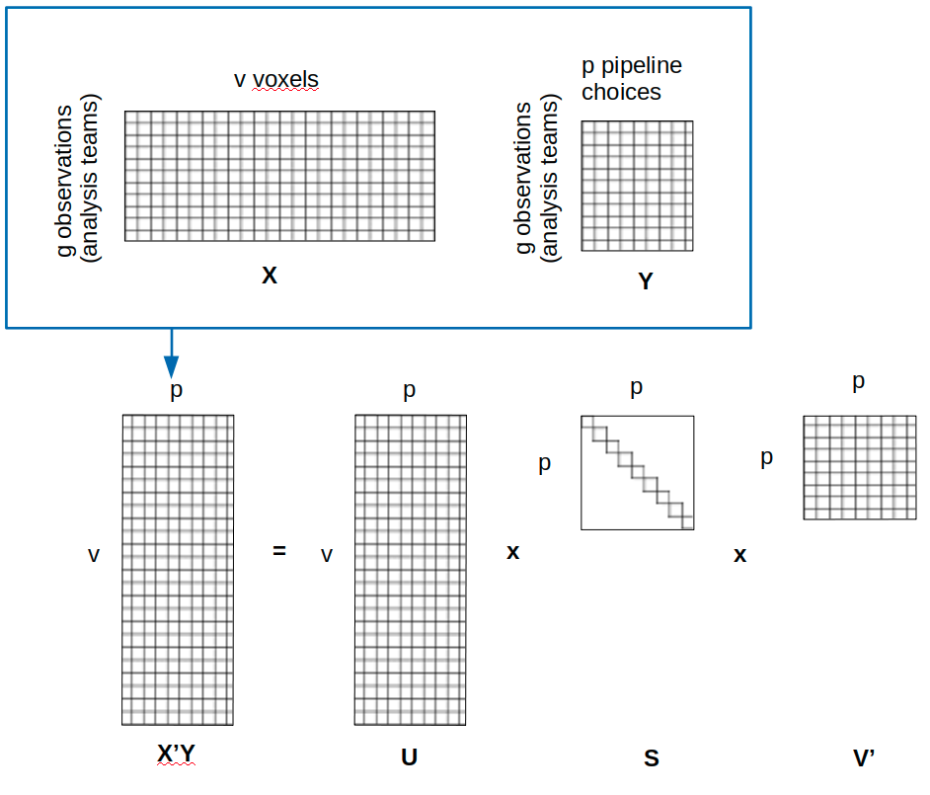

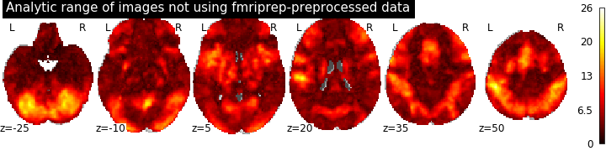
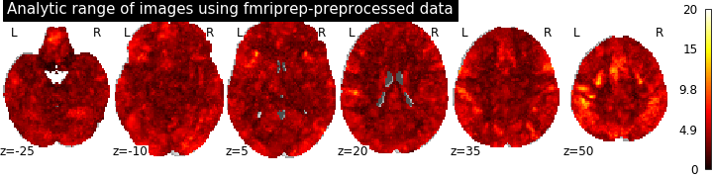
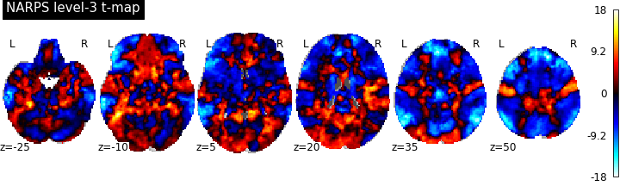
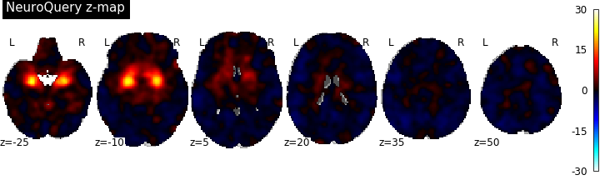
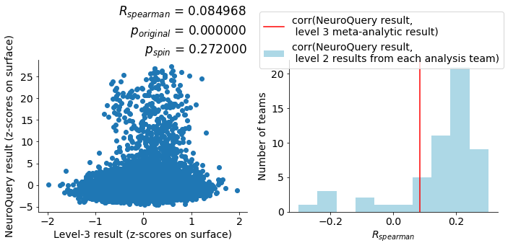
Analytic variability in fMRI:
Multivariate and meta-analytic approaches to the problem and solution
Kendra Oudyk¹, Alexandre Pérez¹ , Peer Herholz¹ , Boris Bernhardt¹, Bratislav Misic¹, Jean-Baptiste Poline¹
¹Montréal Neurological Institute, McGill University, Montréal, Québec, Canada
Background
Simulations have shown that analysis choices may influence results in research using functional magnetic resonance imaging (fMRI)¹.
Until recently, it was unclear how much analytic variability there is in the field, between actual researchers.
Purpose
Here, we complement the work by Botvinik-Nezer and colleagues², demonstrating the use of a
multivariate analysis for investigating analytic variability.
Further, we explore a novel meta-analysis-comparison method for evaluating the
meta-analytic result as a potential solution to analytic variability.
Data
Neuroimaging Analysis Replication and Prediction Study (NARPS)² was the source of our data. In that study, 70 analysis teams analyzed the same task-fMRI dataset, performing whole-brain corrected analyses of task-related activation, using the raw or preprocessed data.
The original fMRI dataset had the following properties:
Participants: 108, with 54 in each condition
Task: Mixed-gambles task, which involves choosing whether to take a gamble^{(Tom, 2007)}
Conditions: 1) Equal Range (range of possible gains = range of possible losses)
2) Equal Indifference (range of possible gains = 2 * range of possible losses)
In the present study, we used 2 group-level z-maps from 55 analysis teams, both from a test of the positive effect of gain (winning a gamble), one for each condition. We used the Equal-Indifference maps for the main analysis, and the Equal-Range maps for replication (not shown here).
(Code: github.com/koudyk/narps_meta).
Data
Descriptive
statistics
Figure 1A and 1B respectively show the mean activation and the analytic range of the group-level z-maps.
Figure 1C-1F show the number of teams that made various analysis choices.
1A
Mean activation across analysis teams (z-scores)
1B
Analytic range across analysis teams (z-scores)
1C
1D
1E
1F
Assessing the problem
(2A) We used partial least squares to assess the association between methodological choices and the whole-brain group-level results.
This figure illustrates the use of partial least squares on this data.
2A
v voxels
- Partial least squares to ???????????
We used partial least squares to assess the association between methodological choices and the whole-brain group-level results
(2B-C) We used permutation testing to assess the significance of each component.
Only the first component was significant.
2B
2C
Conclusion
Siblabla
Significance threshold
To assess the association between methodological choices and the whole-brain group-level results,
we used
- Partial least squares to ???????????
- Permutation testing of significance of each component (see Figure 2A)
- Bootstrap resampling with replacement to test the stability of each variable’s contribution to a
component (see Figure 2C)
(2D) Within the first component, we used bootstrap resampling with replacement to test the stability of each analysis variable’s contribution to the component.
The variables with a stable contribution were
Whether they used the provided preprocessed data or did their own preprocessing,
The FWHM of their smoothing kernel
Whether they used randomise as their analysis software.
2D
(2E) We followed up by comparing the analytic range of maps that did and did not use the provided preprocessed data.
It appears that the analytic range is more spatially uniform across the teams that used the provided preprocessed data.
2E
Analytic range (z-scores) of images from teams that did their own preprocessing
Analytic range (z-scores) of images from teams that used the provided fMRIprep-preprocessed data
Exploring a solution
Here, we explore whether the consensus result across teams was more accurate than the individual group-level maps, with ‘accuracy’ defined as similarity (correlation) to the consensus map from the literature.
(3A) We used a fixed-effects general linear model to find the consensus across teams.
(3B) We used NeuroQuery (Dockès, 2018 to find the consensus from the literature, searching for “Loss aversion in decision-making under risk”, which is part of the title of the original paper using the task with fMRI³.
(3C) We used Spearman correlation to measure the similarity between the two consensus maps, and spin permutation^{cite.} to test for significance
There was almost no correlation, and it was not significant.
(3D) We also performed Spearman correlations between the NeuroQuery result and the result map from each analysis team.
The consensus result across analysis teams was not more highly correlated with the consensus from the literature than were the maps from individual teams.
3A
Consensus across analysis teams (t-map)
3B
Consensus from the literature (z-map)
3C
3D
Correlation between the NeuroQuery map
and the consensus map across teams.
d
Correlations between the NeuroQuery map
and the maps from individual analysis teams.
Discussion
Our multivariate analysis for investigating analytic variability suggests that the more important analysis choices were
Whether the team used the fmriprep-preprocessed data,
The size of their smoothing kernel, and
Whether they used randomise to produce their statistical images (in FSL).
Note that in the replication of these analyses in the second task condition (with separate participants), the smoothing kernel did not make a stable contribution to the first component.
Notably, while the original publication using this dataset² also found that variability in results was related to the smoothing kernel and some choices of analysis software, they reported no significant effect for the use of the provided preprocessed data versus performing custom preprocessing.
Our evaluation of the meta-analytic result as a potential solution to analytic variability did not show that the consensus across teams was more ‘accurate’ than the results from individual teams. However, our use of the consensus result from the literature as the ground-truth for evaluating accuracy may not be ideal.
Code
Code for this project is available at github.com/koudyk/narps_meta, and draws extensively from code by Ross Markello (https://netneurotools.readthedocs.io/en/latest/auto_examples/plot_mirchi_2018.html) and BrainSpace (https://brainspace.readthedocs.io/en/development/generated/brainspace.null_models.spin.SpinPermutations.html)
References
¹Carp, J. (2012). On the plurality of (methodological) worlds: estimating the analytic flexibility of FMRI experiments. Frontiers in neuroscience, 6, 149.
²Botvinik-Nezer, R., Holzmeister, F., Camerer, C.F., Dreber, A., Huber, J., Johannesson, M., Kirchler, M., Iwanir, R., Mumford, J.A., ..., Nichols, T.E., Poldrack, R.A., Schonberg, T. (2020). Variability in the analysis of a single neuroimaging dataset by many teams. Nature. https://doi.org/10.1038/s41586-020-2314-9.
³Tom, S. M., Fox, C. R., Trepel, C., & Poldrack, R. A. (2007, January). The Neural Basis of Loss Aversion in Decision-Making Under Risk. Science, 315 (5811), 515–518. Retrieved 2019-10- 26, from http://www.sciencemag.org/cgi/doi/10.1126/science.1134239 doi: 10.1126/science.1134239
Acknowledgements
This work was partially funded by the National Institutes of Health (NIH) NIH-NIBIB P41 EB019936 (ReproNim) NIH-NIMH R01 MH083320 (CANDIShare) and NIH RF1 MH120021 (NIDM), the National Institute Of Mental Health under Award Number R01MH096906 (Neurosynth), as well as the Canada First Research Excellence Fund, awarded to McGill University for the Healthy Brains for Healthy Lives initiative and the Brain Canada Foundation with support from Health Canada. Author KO is funded through the Fonds de la recherche en santé du Québec.

