Slide 1
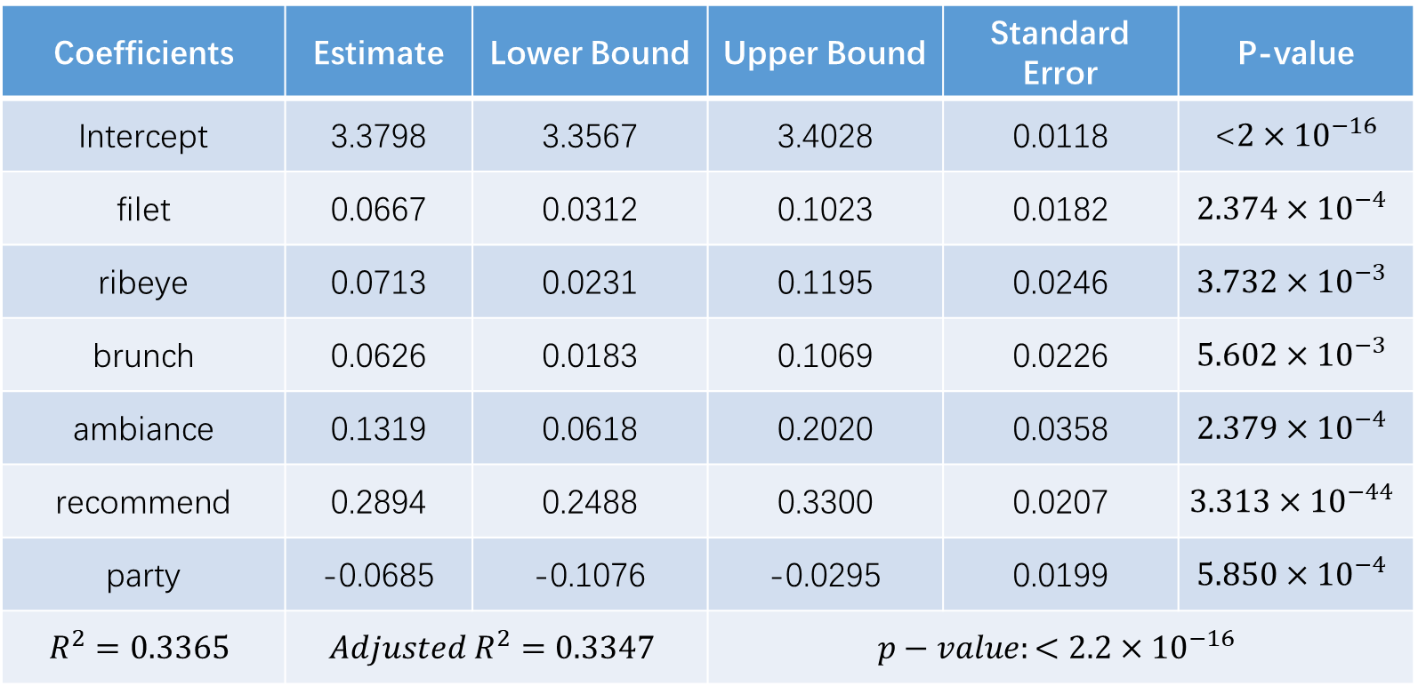
Coefficients | Estimate | Lower Bound | Upper Bound | Standard Error | P-value
Intercept | 3.3798 | 3.3567 | 3.4028 | 0.0118 | <$2×{10}^{−16}$
filet | 0.0667 | 0.0312 | 0.1023 | 0.0182 | $$2.374×{10}^{−4}$$
ribeye | 0.0713 | 0.0231 | 0.1195 | 0.0246 | $$3.732×{10}^{−3}$$
brunch | 0.0626 | 0.0183 | 0.1069 | 0.0226 | $$5.602×{10}^{−3}$$
ambiance | 0.1319 | 0.0618 | 0.2020 | 0.0358 | $$2.379×{10}^{−4}$$
recommend | 0.2894 | 0.2488 | 0.3300 | 0.0207 | $$3.313×{10}^{−44}$$
party | -0.0685 | -0.1076 | -0.0295 | 0.0199 | $$5.850×{10}^{−4}$$
$$R^{2}=0.3365$$ | $$Adjusted R^{2}=0.3347$$ |  | $$p−value:<2.2×{10}^{−16}$$

