Slide 1
Improving Question Answering via Knowledge Graph Retrieval based on Ontology Information
Zhang Chaofan
2025/09/30
Data Engineering Lab, IPS, Waseda Univ.

Slide 2
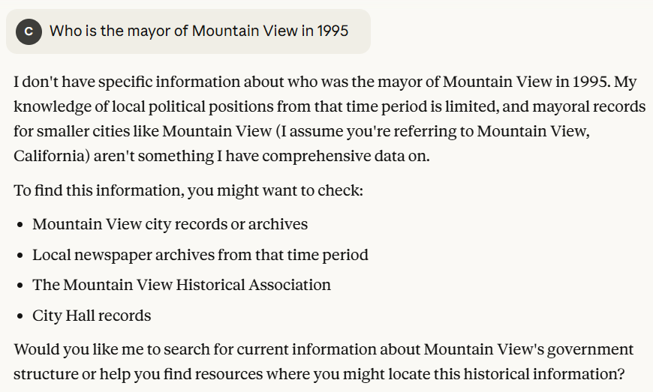
Introduction
Current LLM’s Limitations
Long-tail knowledge
Figure 1. Example of LLM cannot answer long-tail question
Lack Interpretability
LLMs represent knowledge implicitly in their parameters, which is difficult to validate [1].
2
Notes:
Current large language models (LLMs) face two major limitations. First, they often struggle with "long-tail" knowledge—highly specific or obscure information. For example, as shown in Figure 1, when asked, "Who was the mayor of Mountain View in 1995?" Claude 4 replies, "I don't have specific information..." This demonstrates their inability to answer niche questions. The second limitation is a lack of interpretability. LLMs are essentially "black boxes"; we cannot trace how they arrive at an answer, making it impossible to verify the reasoning process.

Slide 3
Introduction
Retrieval-Augmented Generation’s Pros and Cons
Pros:
Interpretability
Contextual depth
High factual accuracy
Cons:
Neglecting Relationships
Redundant Information
Lacking Global Information
3
Notes:
RAG enhances LLM responses by dynamically retrieving relevant facts from external sources, improving both accuracy and depth. However, it has key limitations: First, it neglects relationships, failing to capture structured connections like citations between papers. Second, it often retrieves redundant information, creating lengthy contexts that cause the "lost-in-the-middle" effect. Finally, it lacks a global view, as it only accesses a subset of documents, struggling with tasks like query-focused summarization.

Slide 4
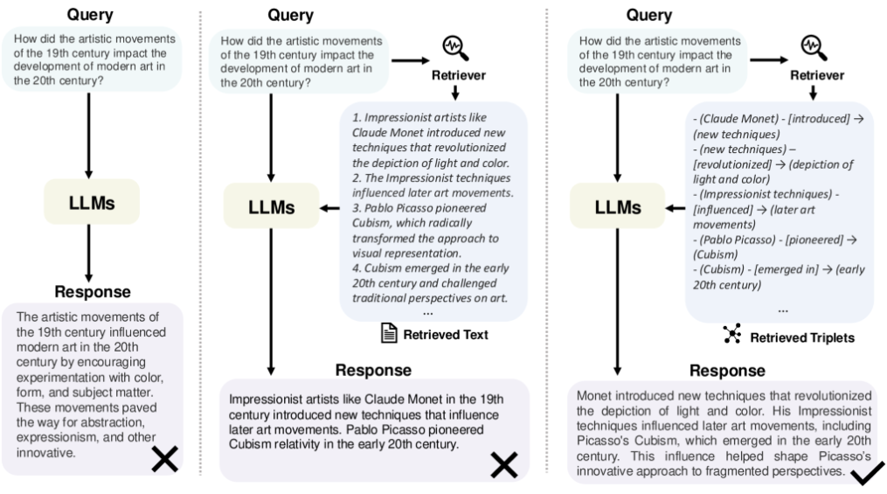
Introduction
Comparison Among LLM, RAG And KG-RAG in Question Answering Task
KG-RAG overcomes RAG’s limitations by importing Knowledge Graph
Direct LLM suffers from shallow responses.
RAG gives a specific answer but struggles to emphasize “influence” relations.
KG-RAG can generate a precise answer.
Figure 2. Comparison among Direct LLM, RAG and KG-RAG [2]
4
Notes:
Given a user query, direct answering by LLMs may suffer from shallow responses or lack of specificity. RAG addresses this by retrieving relevant textual information, somewhat alleviating the issue. However, due to the text’s length and flexible natural language expressions of entity relationships, RAG struggles to emphasize “influence” relations, which is the core of the question. While, GraphRAG methods leverage explicit entity and relationship representations in graph data, enabling precise answers by retrieving relevant structured information.

Slide 5
Introduction
Current KG-RAG’s limitations in Question Answering Task
Existing KG-RAG methods suffer from several limitations:
Loss of structural and semantic coherence.
A knowledge graph consists of a head entity, a relation and a tail entity.
Difficult to express emotion, semantic and inherent hierarchy [3].
How to make LLM learn the knowledge graph?
LLMs are pre-trained on text corpora, struggled with structured triple-form text [4].
Naïve linear concatenation ignores semantics of the question.
5
Notes:
A knowledge graph consists of a head entity, a relation and a tail entity, which often disregards the inherent hierarchical relationships, entity classifications, and semantic dependencies present in the original data, leading to a loss of structural and semantic coherence in the resulting knowledge representation, so it is difficult to express emotion, semantic and inherent hierarchy. And also, for LLMs are pre-trained on text corpora, they are struggled with structured triple-form text, but traditional naïve linear concatenation ignores semantics of the question and lack a logical organization that aligns with the question’s reasoning path.

Slide 6
Introduction
Research’s Goal and Current Result
This Research’s Goal:
To solve the problems mentioned before, we introduce:
Triple-level Schema embedded to provide hierarchy and semantic coherence.
We take advantage of OSKGC [5] to align a triple with a triple-level schema.
Chain-of-Thought(CoT) used to make LLM learn better about the triple
We use CoT to rewrite the triples and questions, make LLM use the right part of triple to answer the question.
Current Result:
The experiment shows that proposed method performs better than standard LLM and traditional KG-RAG in:
Answer accuracy improved by an average of 50% compared to standard LLM.
Answer accuracy improved by an average of 20% compared to standard KG-RAG.
6
Notes:
This research aims to solve the mentioned problems by embedding triple-level schema into the vector, which provides hierarchy and semantic coherence, and we use chain of thought to rewrite the question and triples, make LLM answer more accuracy. The experiment result demonstrates the answer accuracy improved by an average of 50% compared to standard LLM and 20% compared to standard KG-RAG.

Slide 7
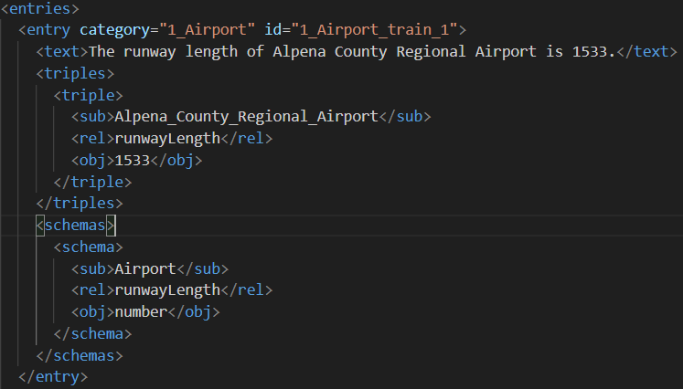
Introduction
OSKGC
We take advantage of OSKGC [5] in our work, so we introduce this work here.
OSKGC is a benchmark dataset designed for knowledge graph construction based on a predefined ontology schema provided by Wang Dali et al.
It consists of three core components:
Text-triple-schema data pairs(57 classes, like Airport, Athlete, Film, etc.)
Predefined ontology schemas
A unified ontology hierarchy
Figure 3. Instance-level schema and triple of OSKGC dataset
7
Notes:
OSKGC is a benchmark dataset designed for knowledge graph construction based on a predefined ontology schema provided by Wang Dali et al. It consists of three core components, text-triple-schema data pairs, which include 57 different types, predefined ontology schemas and a unified ontology hierarchy. Figure 3 shows an instance level schema and triple, you can see that for every entry, it has a text, a triple and a schema.

Slide 8
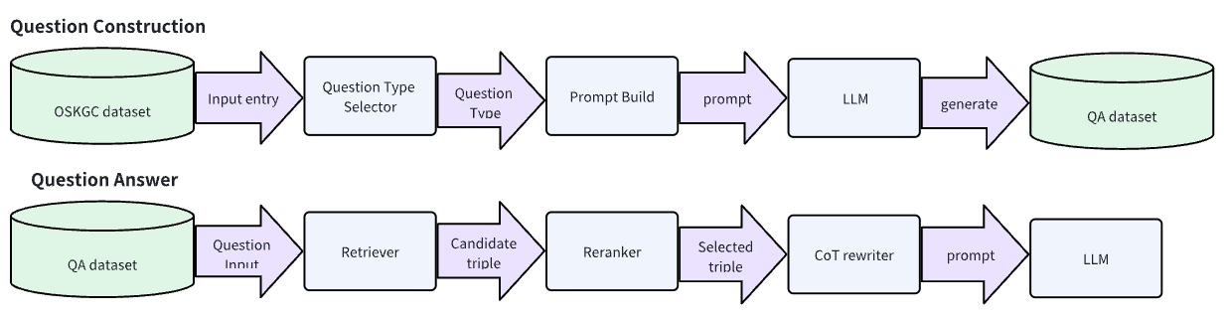
OVERVIEW
Overview of proposed KG-RAG system
Figure 4. Pipeline of proposed work
8
Notes:
This slide outlines our two-stage framework. First, in the Question Construction stage, we leverage the OSKGC dataset. For each entity, a question type is selected, and a tailored prompt is sent to GPT-4o to generate a high-quality QA pair. Second, in the Question Answering stage, these QA pairs are used to evaluate our proposed KG-RAG pipeline, which consists of three core modules: a Retriever, a Reranker, and a Chain-of-Thought Rewriter.

Slide 9
Methodology
Initializing Vector Database
KG Embedding
Embedding Model: BGE-M3.
Embedding Content:
Text: To help LLM learn the context of the triple, we embed the text like 'An instance of a 'VicePresident' named 'Alberto Teisaire' has a relation 'office' with an instance of a 'PoliticalFunction' which is 'Provisional President of the Argentine Senate‘’.
Meta Information: schema and triple.
schema-based linearization
9
Notes:
Before we talk about question construct part and question answering part, I introduce how we embed the triples with schema. We take advantage of OSKGC, which provides both triple and schema. We employ a template to convert each knowledge triple and its corresponding entity types into a piece of contextualized natural language. Meanwhile, both the triples and their source schema are embedded as metadata into the vector database to facilitate subsequent retrieval.

Slide 10
Methodology
QA Dataset Construction
Why we need to construct a QA dataset?
Taking advantage of OSKGC.
OSKGC dataset covers 57 distinct data categories.
Common knowledge and long-tail knowledge included.
General-purpose QA datasets don’t cover enough data
Generate entity type question
OSKGC contains triple-level schema, general-purpose QA datasets don’t
We use schema to let LLM know the hierarchy of the entity and provide LLM ability to answer entity type questions.
10
Notes:
First, let we talk about why we need to construct a QA dataset, why we don’t use an existing one? There are two reasons, firstly, we want to take advantage of OSKGC, OSKGC covers 57 distinct data categories, so common knowledge and long-tail knowledge included in this dataset, general QA datasets may not contain so many different types of question-answer pair. Second, what OSKGC differs from general QA datasets is it offers triple-level schemas, therefore we can use schema to let LLM know the hierarchy of the entity and provide LLM ability to answer entity type questions.

Slide 11
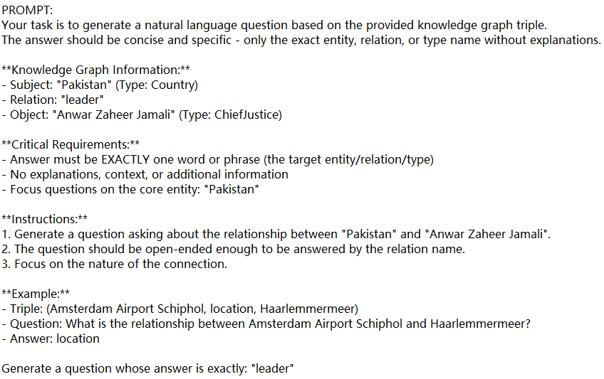
Methodology
QA Dataset Construction
Prompt Design
To generate four types of questions, asking subject, relationship, object and entities’ type respectively, four kinds of prompts designed.
Typical Instructions
Triple and schema (entity type)
Requirement
Type of question to be generated
One example
11
Figure 5. Example of the prompt
Notes:
Then we move to the prompt design part, to generate four types of questions, asking subject, relationship, object and entities’ type respectively, we design a prompt template as follows. It consists of five parts, the first one is a typical instructions, then the triple and schema which are retrieved from OSKGC dataset, after that we emphasize the requirement and instructions, also we give one shot to show how to generate a QA pair.

Slide 12
Methodology
QA Dataset Construction
Output Generation
Output data: Question-Answer pairs, which consists of four types, question about triples’ subject, object, relationship and entities’ type respectively.
Question Type | Example Question | Answer
Subject Question | Who wrote A Fistful of Dollars? | Sergio Leone
Object Question | What film was written by Sergio Leone | A Fistful of Dollars
Relation Question | What is the relationship between A Fistful of Dollars and Sergio Leone | writtenBy
Type Question | What type of entity is A Fistful of Dollars | Film
12
Notes:
This page shows an example of four different types of questions.

Slide 13
Methodology
QA Dataset Construction Evaluation
In the future work, we’ll find an automatic measurement method!
Evaluation Metrics
Correctness: GPT-4o could make mistakes, for example:
Text: The runway length of Al Asad Airbase is 3090 meters
Triple: (AI Asad Airbase, runwayLength, 3090)
Schema: (Airport, runwatLength, number)
Correctness denotes whether the question can be answered correctly by the generated answer.
Source Text
Question Type Selector
Generate Question Asking Relation
Generate QA pair
Q: What is the runway length of Al Asad Airbase in meters?
A: runwayLengthMeter
Can’t answer this question with the generated answer!
13
Notes:
For GPT-4o may make mistakes, we measure the generated QA pairs’ quality manually. It is an example of a bad case generated by GPT-4o, the answer cannot answer the question.

Slide 14
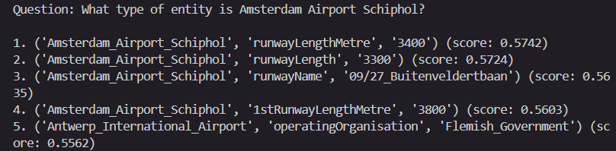
Methodology
Question Answering System
Retrieval
Hybrid Retrieval: Keyword Retrieval+Embedding-Based Retrieval(EBR).
Result Fusion: Reciprocal Rank Fusion(RRF) ranks documents based on their position in each result list.
Why hybrid retrieval: Combine the semantic understanding of dense retrieval(EBR) with lexical precision of sparse retrieval(keyword retrieval).
Reranker
BGE Reranker: A high-precision Cross-Encoder model.
Figure 5. Example of ranked data
14
Notes:
Now let’s move to the next part. In this part I’ll introduce our RAG system. Our framework consists of three key modules: retrieval, re-ranking, and rewriting. In the retrieval phase, we adopt a hybrid strategy that combines both keyword-based and embedding-based methods. The results from these two approaches are then integrated using the Reciprocal Rank Fusion (RRF) algorithm. This hybrid design allows us to leverage the semantic understanding of dense retrieval alongside the lexical precision of sparse retrieval. For re-ranking, we employ the BGE Reranker, a high-precision cross-encoder model, to further refine the results. Finally, to enhance the LLM's comprehension of the retrieved structured data, we introduce a Rewriter module, which is inspired by a previous paper.

Slide 15
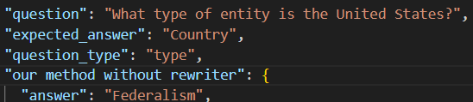
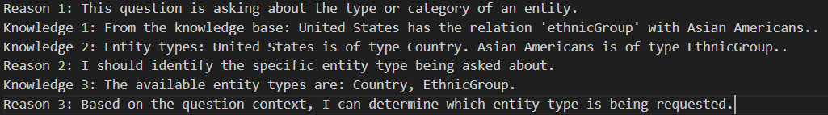
Methodology
Question Answering System
Rewriter
LLM will not always understand structured triple and schema
Chain of Thought(CoT) based knowledge rewriter:
Rewrite question:
Figure 6. LLM will not always perform well with structured knowledge
Figure7. Example of CoT rewriter
15
Notes:
This slide demonstrates why the CoT Rewriter is needed. Figure 5 shows a key issue: when RAG fetches many knowledge triples, the LLM can get confused by the excess information and select the wrong context for its answer. Our solution is the CoT Rewriter. It reframes the question and triples using a chain of thought, which significantly improves the LLM's ability to understand the task and the relevant knowledge

Slide 16
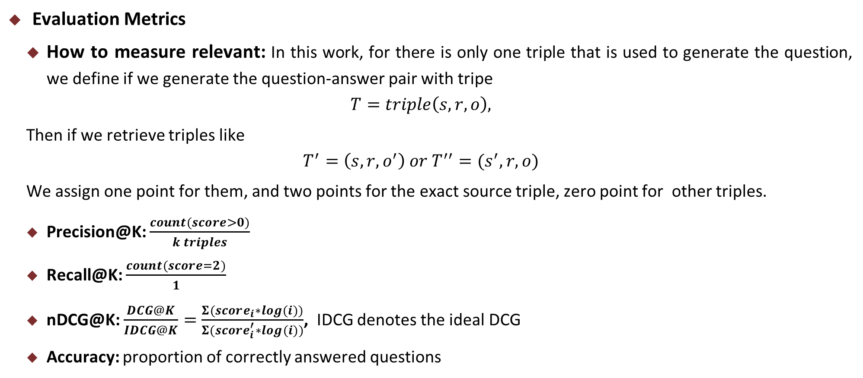
Methodology
QA System Performance Evaluation
Evaluation Metrics
How to measure relevant: In this work, for there is only one triple that is used to generate the question, we define if we generate the question-answer pair with tripe
$$T=triple\left(s,r,o\right),$$
Then if we retrieve triples like
$$T^{′}=\left(s,r,o^{′}\right) or T^{′′}=(s^{′},r,o)$$
We assign one point for them, and two points for the exact source triple, zero point for other triples.
Precision@K: $\frac{count(score>0)}{k triples}$
Recall@K: $\frac{count(score=2)}{1}$
nDCG@K: $\frac{DCG@K}{IDCG@K}=\frac{Σ(score_{i}∗log(i))}{Σ(score_{i}^{′}∗log(i))}$, IDCG denotes the ideal DCG
Accuracy: proportion of correctly answered questions
16
Notes:
This slide outlines our evaluation methodology for the QA system. First, I will define "relevance." Since each question in our dataset is generated from a specific knowledge triple, we score a retrieved triple as follows: 2 points if it is the exact source triple, 1 point if it shares two elements with the source, and 0 points otherwise. Based on this scoring, we computed standard metrics: Precision@K, Recall@K, and NDCG@K and accuracy.

Slide 17
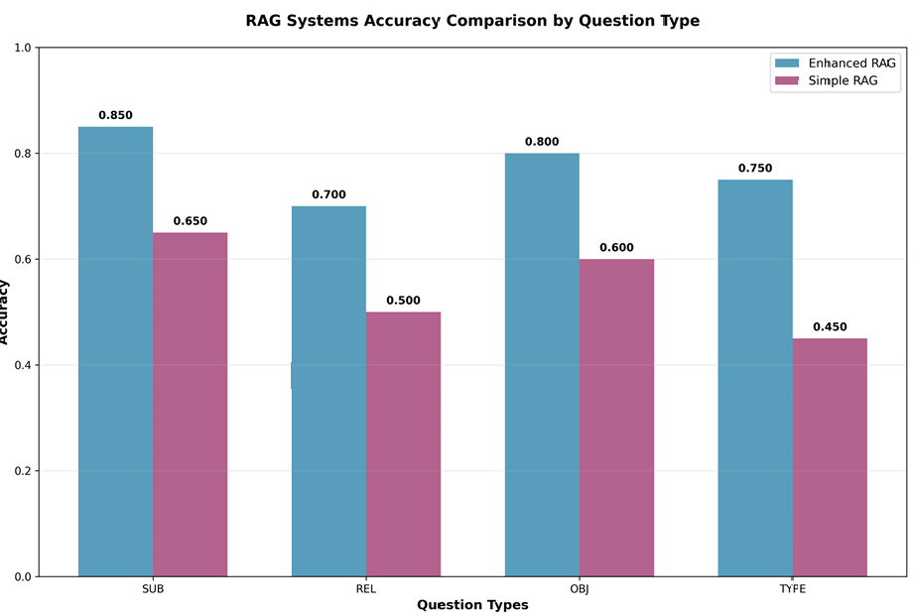
Result
QA System Performance Evaluation
Evaluation Result
Enhanced RAG is our proposed method
Simple RAG is a RAG without CoT rewriter and schema-based linearization
Figure 8. Accuracy of two RAG systems
17
Notes:
As shown in Figure 8, our proposed system demonstrates superior performance over the standard RAG baseline across all four question types. Notably, it achieves an approximately 20% accuracy improvement on questions targeting the subject, relation, or object, and about a 30% improvement on questions concerning type.

Slide 18
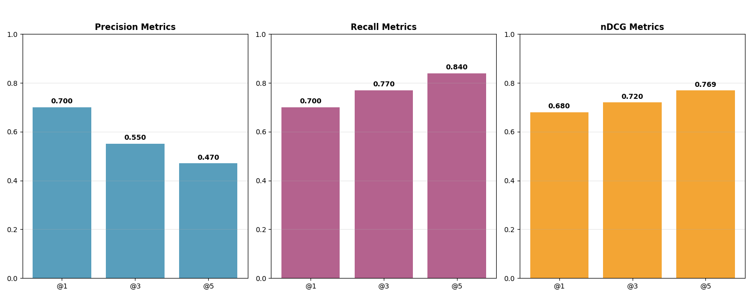
Result
QA System Performance Evaluation
More work will be done to improve the metrics
Evaluation Result
Figure 9. Evaluation metrics of our method
18
Notes:
Figure 9 presents the results of our method on Precision@K, Recall@K, and NDCG@K. The results indicate that there is still potential for further enhancement in our RAG system's performance

Slide 19
Conclusion
Conclusion
Proposed work improves LLM’s understanding by introducing
Schema-based triple embedding method
CoT rewriter
Hybrid retrieval method
Enhance the traditional KG-RAG system, enabling it to answer questions about entity types.
Future Work
Design better retrieval and reranker algorithm to improve the RAG performance
Automatic evaluation method need to be designed for question-answer pair evalution.
Experiment should be done on other LLM models like Gemini, Qwen etc.
19
Notes:
Figure 8 presents the results of our method on Precision@K, Recall@K, and NDCG@K. The results indicate that there is still potential for further enhancement in our RAG system's performance

Slide 20
References
[1] Han, H., Shomer, H., Wang, Y., Lei, Y., Guo, K., Hua, Z., Long, B., Liu, H., & Tang, J. (2025). RAG vs. GraphRAG: A Systematic Evaluation and Key Insights. ArXiv, abs/2502.11371.
[2] Boci Peng, Yun Zhu, Yongchao Liu, Xiaohe Bo, Haizhou Shi, Chuntao Hong, Yan Zhang, and Siliang Tang. 2024.Graph retrieval-augmented generation: A survey.
[3] Tiwari, Yash et al. “OntoRAG: Enhancing Question-Answering through Automated Ontology Derivation from Unstructured Knowledge Bases.” ArXiv abs/2506.00664 (2025).
[4] Yike Wu, Yi Huang, Nan Hu, Yuncheng Hua, Guilin Qi, Jiaoyan Chen, and Jeff Pan. 2024.CoTKR: Chain-of-Thought Enhanced Knowledge Rewriting for Complex Knowledge Graph Question Answering. In Proceedings of the 2024 Conference on Empirical Methods in Natural Language Processing. 3501–3520.
[5] https://github.com/HeraclesWang
20

Slide 21
Thanks for listening!
Data Engineering Lab, IPS, Waseda Univ.
Notes:
That’s all for my presentation, thanks for listening

