Slide 1
Mapping Wikipedia Categories and lists to DBpedia Classes by Utilizing LLMs and Hierarchy Information
Midterm Progress Report
2024/10/1
SHAN Kexiang, 44231015
Data Engineering Lab, IPS, Waseda Univ.

Slide 2
Outline
Abstract
Background
Problem definition
Methodology
Experiment
Future Work
Outline

Slide 3
Abstract
We introduce a method for mapping Wikipedia categories and lists to DBpedia ontology using LLMs and hierarchical data from CaLiGraph.
By using the LLM2Vec model to generate embeddings that rank class candidates we can traverse the DBpedia ontology tree
Hierarchical structure from CaLiGraph refines the algorithm's focus, selecting relevant classes at each level for more accurate mapping.
The result is selected from candidates by LLM and hierarchy information.
The result is tested on a benchmark dataset of 3000 annotated CaLiGraph-DBpedia pairs, this model outperforms the baseline by 60% in accuracy, proving effective for large-scale mapping.
Notes:
Approach: Utilizes LLMs and hierarchical information from CaLiGraph to map Wikipedia categories/lists to DBpedia classes.
Method: Starts with ontology tree traversal, uses LLM2Vec for embeddings, refines class selection using hierarchy.
Results: Achieves 60% better accuracy than baseline on a 3000 pair benchmark dataset, highlighting the integration of LLMs with hierarchical data's effectiveness.

Slide 4
Background

Slide 5
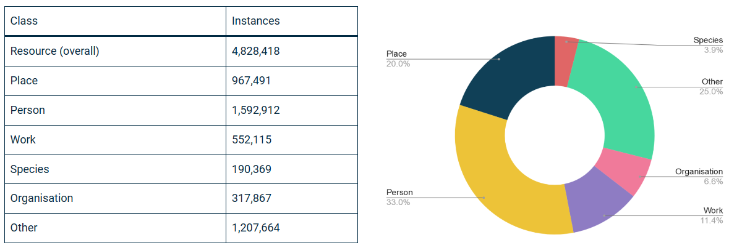
DBpedia
DBpedia is a project aiming to extract structured information from Wikipedia articles. The DBpedia ontology is a structured representation which defines a set of classes, properties and relationships to describe and organize the information.
https://www.dbpedia.org/resources/ontology/
Notes:
DBpedia is a project aiming to extract structured information from Wikipedia articles. The DBpedia ontology is a structured representation which defines a set of classes, properties and relationships to describe and organize the information.

Slide 6
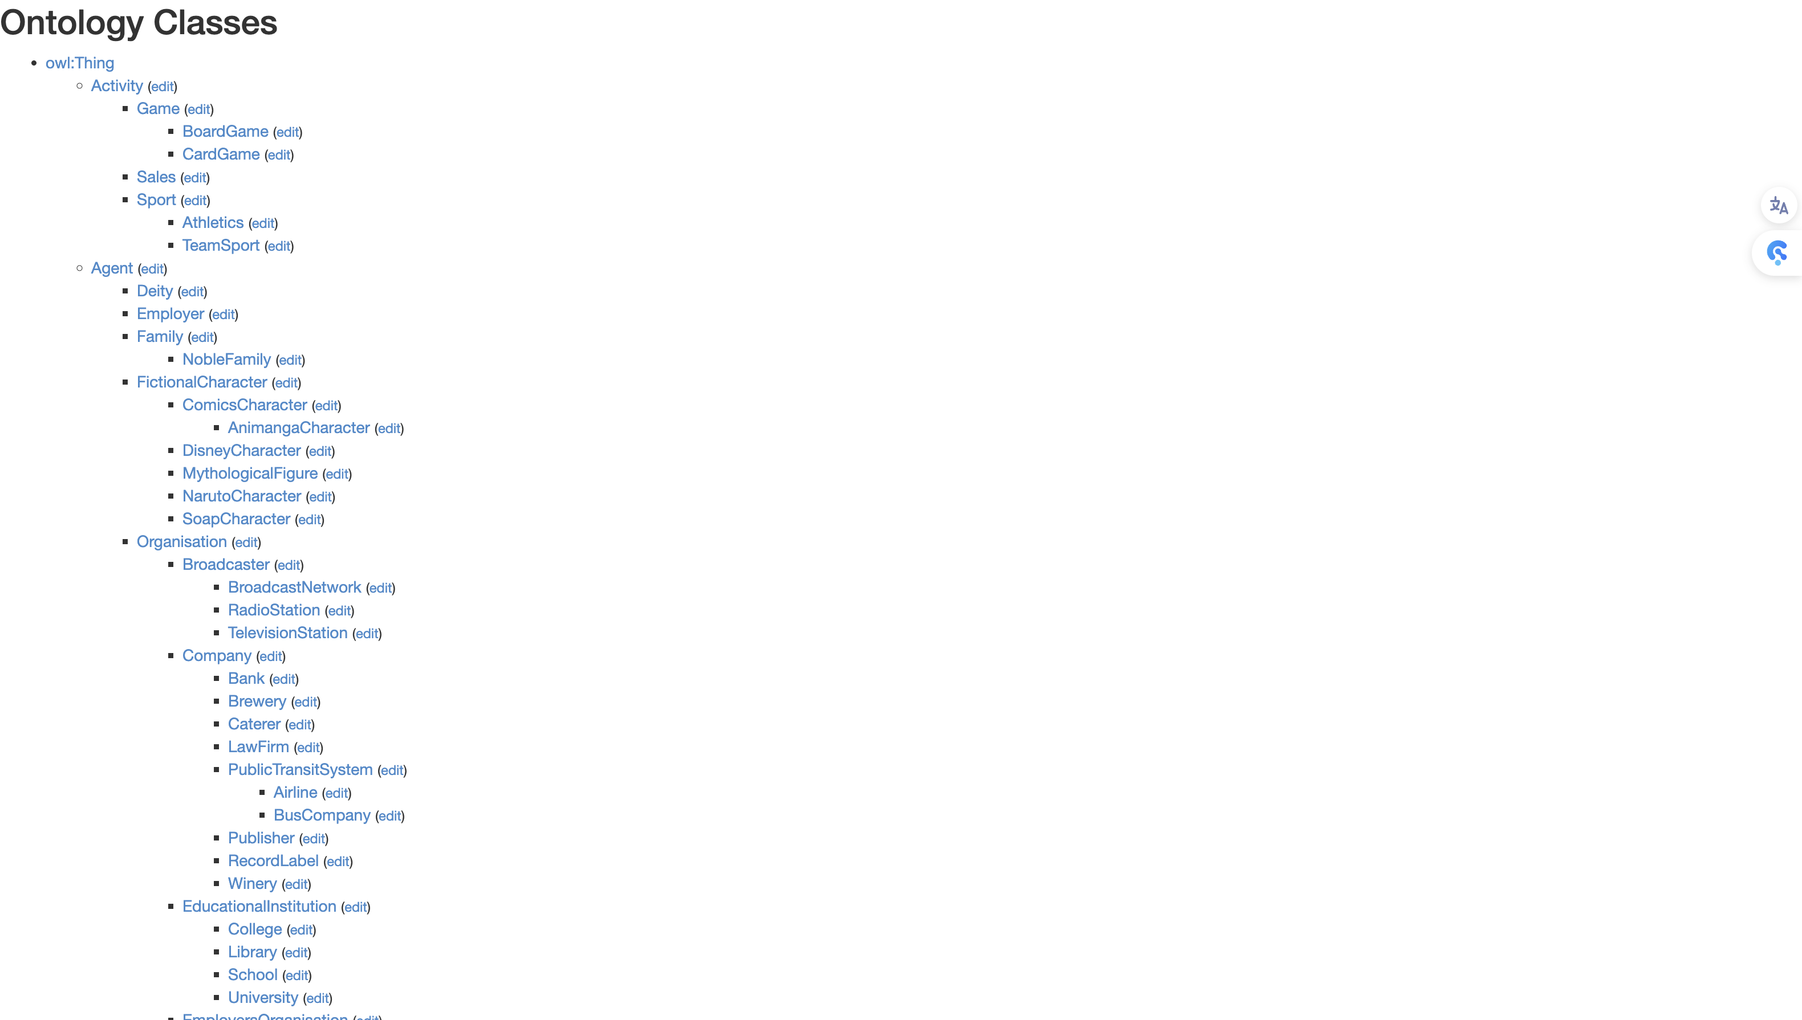
DBpedia Ontology
A hierarchy Ontology Tree
Numbers:788 ontologies
Max Levels: 8
Notes:
DBpedia has an ontology tree which has 788 ontologies with 8 levels, so we can utilize this feature.

Slide 7
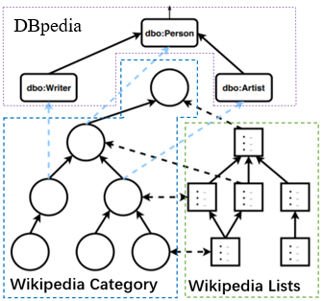
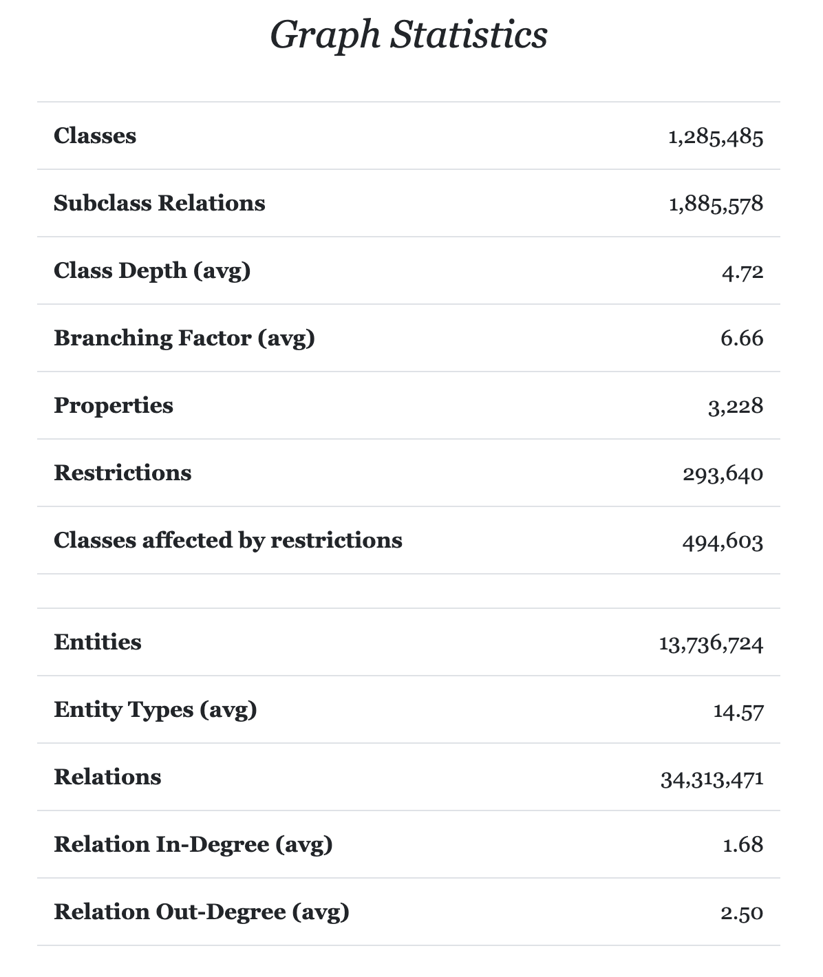
CaLiGraph
CaLiGraph is a large knowledge graph compiled from the DBpedia ontology and Wikipedia categories & list pages, enriching DBpedia with additional information of entities.
CaLiGraph’s taxonomy with DBpedia as a backbone. [1]
[1] Nicolas Heist and Heiko Paulheim. Entity Extraction from Wikipedia List Pages.
In Extended Semantic Web Conference. Springer, 327–342, 2020.
Notes:
CaLiGraph is a large knowledge graph compiled from the DBpedia ontology and Wikipedia categories & list pages, enriching DBpedia with additional information of entities.

Slide 8
LLM2Vec
LLM2Vec^{[3]}
Advantages of using LLM2Vec
Is a method approach that can transform any decoder-only LLM into a strong text encoder
Core idea:
1)Enabling bidirectional attention,
2)Training with masked next token prediction
3) Unsupervised contrastive learning.
LLM2Vec has the capacity to handle substantially larger amounts of contextual information compared to other sentence embedding methods, offering a clear advantage over alternative techniques.
Thus, we can incorporate large auxiliary information (Hierarchy Information) to enhance embedding.
We can leverage the base knowledge from the large language model
[2] BehnamGhader, Parishad, et al. "Llm2vec: Large language models are secretly powerful text encoders." arXiv preprint arXiv:2404.05961 (2024).
Notes:
LLM2Vec has the capacity to handle substantially larger amounts of contextual information compared to other sentence embedding methods, offering a clear advantage over alternative techniques.
Thus, we can incorporate large auxiliary information (Hierarchy Information) to enhance embedding.
We can leverage the base knowledge from the large language model

Slide 9
Related work
Pre-trained language models (PLMs) such as BERT are pre-trained on a large-scale corpus through unsupervised learning, which can be applied to a wide range of downstream NLP tasks and can be fine-tuned to fit a specific task.
Distant supervision is a strategy in which training samples are labeled automatically based on certain rules.
SLHCat [4] utilized distant supervision to fine-tune a BERT classifier for ontology mapping, while the accuracy still needs to be improved.
LLM2Vec a simple unsupervised approach that can transform any decoder-only LLM into a strong text encoder
[3] Zhaoyi Wang, Zhenyang Zhang, Jiaxin Qin, and Mizuho Iwaihara. SLHCat: Mapping Wikipedia Categories and Lists to DBpedia by Leveraging Semantic, Lexical, and Hierarchical Features. In Proceedings of ICADL 2023, LNCS Vol. 14457, pp. 133-148, 2023.
Notes:
Pre-trained language models (PLMs) such as BERT are pre-trained on a large-scale corpus through unsupervised learning, which can be applied to a wide range of downstream NLP tasks and can be fine-tuned to fit a specific task.
Distant supervision is a strategy in which training samples are labeled automatically based on certain rules.
SLHCat [4] utilized distant supervision to fine-tune a BERT classifier for ontology mapping, while the accuracy still needs to be improved.
LLM2Vec a simple unsupervised approach that can transform any decoder-only LLM into a strong text encoder

Slide 10
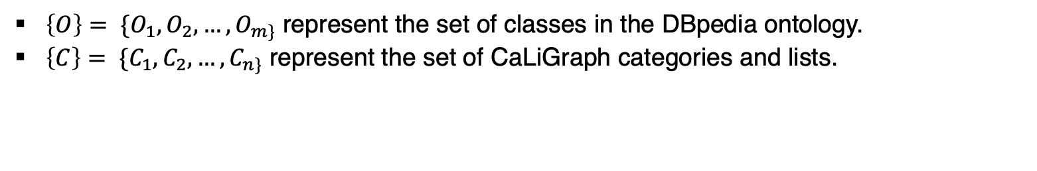

Problem definition
Definition
Ontology and Category Structures Definition
$\left\{O\right\}= \{O_{1}, O_{2}, …, O_{m\}}$ represent the set of classes in the DBpedia ontology.
$\left\{C\right\}= \{C_{1}, C_{2}, …, C_{n\}}$ represent the set of CaLiGraph categories and lists.
Hierarchy Information from CaLiGraph
$$H: \left\{C\right\}→{\left\{T, P, C, S\right\}}^{ }$$
is a function that provides hierarchical information from CaLiGraph for each class
T: Path traced back to Thing (root node) for given node
P: Parent nodes’s neigbors for given node
C: Children nodes for given node
S: Neighbors(siblings) for given node
Notes:
Let’s begin by defining the problem.
First, we define two sets:
• O, which represents the set of classes in the DBpedia ontology,
• and C, which represents the set of categories and lists in CaLiGraph.
Next, we utilize hierarchy information from CaLiGraph. This hierarchy is divided into four components:
• T: This is the path traced back to the root node, called “Thing,” for a given node.
• P: Represents the parent nodes’ neighbors for a given node.
• C: Refers to the children nodes for the given node.
• S: These are the sibling nodes or neighbors for the given node.

Slide 11
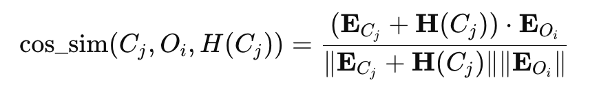





Problem definition
LLM2Vec Embedding Scoring
$$S_{LLM2Vec}$$
is a scoring function using the LLM2Vec
$$S_{LLM2Vec}(C_{j}, O_{i},H(C_{j}))$$
=
is the combined embedding of the classes and its hierarchy information from CaLiGraph.
is the embedding of the DBpedia ontology class
is the norm (magnitude) of the vector
Notes:
Next, let’s discuss the LLM2Vec Embedding Scoring.
We define the scoring function S_{\text{LLM2Vec}} , which leverages the LLM2Vec approach.
The scoring between a category C_j , a class O_i , and its hierarchical information H(C_j) is calculated using cosine similarity:

Slide 12
Problem definition
CaLiGraph is constructed by Cat2Ax [2]. However, the mapping of Cat2Ax is too general.
Our goal is to find the most specific DBpedia class for each CaLiGraph class.
CaLiGraph Subgraph
DBpedia Ontology Tree
Politician
Person
Political_person
Man
general
Politician
President
most specific
President
Minister
Congressman
American_liberal
Barack Obama
….
20th-centuary_politician
21st-century_African-American_man
[2] Nicolas Heist and Heiko Paulheim. Uncovering the Semantics of Wikipedia Categories. In International Semantic Web Conference, pp. 219–236. Springer, 2019.
Notes:
Let’s now focus on the construction of CaLiGraph. This graph is created using Cat2Ax, but the issue is that the mapping produced by Cat2Ax is too general.
Our primary goal is to refine this mapping and identify the most specific DBpedia class for each CaLiGraph class.
To illustrate, in CaLiGraph, we start with the root class Thing, and as we move down the hierarchy, we reach more specific classes like President. At the most specific level, we may find instances such as Barack Obama.
On the other hand, in DBpedia, classes such as Politician are more general. Our task is to bridge this gap and map more specific classes like President, while also ensuring the distinctions between sibling classes such as Minister and Congressman.

Slide 13
Approach

Slide 14



Overview
Root phrase extraction
fine-tuning
SLHCat
Sentence embedding
BERT
Type inheritance
>0.99 similarity cosine similarity candidates
LLM
Hierarchy Information
From
CaLiGraph
DBpedia class
CaLiGraph class
candidates
Dbpedia ontologies
CaliGraph classes
LLM2Vec model
Text Embeddings
Candidate Beam Search
Notes:
Now, let’s move on to the overview of the approach.
We begin by extracting the CaLiGraph class. For each class, we retrieve hierarchy information from CaLiGraph, which includes details about parent and child relationships. This information is then passed into the LLM2Vec model to generate text embeddings.
Meanwhile, on the left, we have the SLHCat model, which focuses on:
• Root phrase extraction
• Sentence embedding
• Type inheritance
The SLHCat model is fine-tuned using BERT, and we then compare LLM2Vec embeddings using cosine similarity. If the similarity score is greater than 0.99, we consider it a candidate match.
We also perform a candidate beam search on DBpedia ontology Tree, incorporating hierarchy information from CaLiGraph to find potential candidates. Following this, a large language model (LLM) is used to select the final candidate, ensuring an optimal and accurate alignment with the DBpedia class.

Slide 15
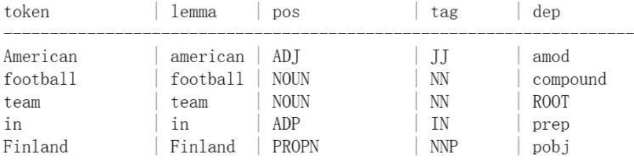
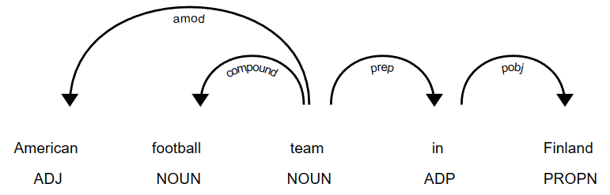
Overview
Root phrase extraction
POS tagging refers to categorizing the word in a text into a particular part of speech, depending on the definition of the word and its context.
Dependency parsing refers to the process of examining the dependencies between the words of a sentence to analyze its grammatical structure.
Sentence embedding
LLM2Vec sentence embedding can capture semantic relatedness between the CaLiGraph and DBpedia vector representations within the shared vector space.
Type inheritance
CaLiGraph uses DBpedia as an upper-level taxonomy and categorizes general classes of DBpedia into more specific classes. As a result, each CaLiGraph class has ancestor classes that directly correspond to DBpedia classes, which exactly match with DBpedia classes.
$S_{LLM2Vec}=cos⁡_sim(R,O)$ = $\frac{R∗O}{\left|R\right||O|}$
[3] Zhaoyi Wang, Zhenyang Zhang, Jiaxin Qin, and Mizuho Iwaihara. SLHCat: Mapping Wikipedia Categories and Lists to DBpedia by Leveraging Semantic, Lexical, and Hierarchical Features. In Proceedings of ICADL 2023, LNCS Vol. 14457, pp. 133-148, 2023.
Notes:
1. Root Phrase Extraction
We use Part-Of-Speech tagging to identify parts of speech and dependency parsing to analyze word relationships within a sentence’s structure.
2. Sentence Embedding
Using LLM2Vec, we capture the semantic relatedness between CaLiGraph and DBpedia in a shared vector space.
3. Type Inheritance
CaLiGraph uses DBpedia’s taxonomy, where each CaLiGraph class has ancestor classes that directly map to DBpedia classes, ensuring accurate alignment.

Slide 16
Distant supervision
In previous work, DBpedia class candidates are generated in different ways. The mapping pair with cosine similarity score close to 1 (> 0.99) is considered as confident mapping.
If the cosine similarity score is less than 1, the mapping pair is selected following the rules below:
Class A
Method 1
Method 2
Method 3
Class B
Class A
Class B
Class C
rule 1: deepest in the path
rule 2: majority voting
Notes:
In previous work, DBpedia class candidates were generated in different ways. A mapping pair with a LLM2Vec cosine similarity score greater than 0.99 is considered a confident match.
However, when the cosine similarity score is below 1, we select the mapping pair based on two rules:
1. Deepest in the path: Choose the class that is the deepest in the hierarchy.
2. Majority voting: If multiple methods suggest candidates, we select the one that receives the most votes.

Slide 17
Hierarchy information in CaLiGraph
Hierarchy information Examples for
Barack Obama
These are hierarchy information we are using
T: Shortest Path traced back to Thing (root node)
B: Parent nodes in T’s neigbors: random N examples
C: Children nodes: random N examples
S: Neighbors(siblings): random N examples
Thing
…
President
American_liberal
…
Barack Obama
Bill Clinton
These hierarchy information will be
1. Randomly select N node
2. as part of class embedidng
3. added into final selection prompt template as auxilary information to select the most specifc ontology
…
Null
Notes:
Here’s how we use hierarchy information in CaLiGraph, using Barack Obama as an example.
We gather the following hierarchy information:
1. T: The shortest path traced back to the root node, “Thing.”
2. B: Parent nodes’ neighbors—random examples.
3. C: Children nodes—random examples.
4. S: Sibling nodes—random examples.
This hierarchy information is:
• Randomly selected,
• Incorporated into the class embedding,
• And added to the final selection prompt to help find the most specific ontology match.

Slide 18
Hierarchy information in CaLiGraph
$H\left(C_{j}\right)$ for “Barack Obama” : N = 5
T: Shortest Path traced back to Thing (root node) | [‘Thing’, ‘Species’, “’Eukaryote‘, ‘Person’, …,omit node … ‘President_of_the_United_States_by_other_offices_held’, “Barack Obama”]"
B: Parent nodes in T’s neigbors: random N examples | [“American_liberal”, “Living_person”, “United_States_Democratic_Party_presidential_candidate”, “21st-century_African-American_man”, “President_of_the_United_States_by_other_offices_held”]
C: Children nodes: random N examples | Null
S: Neighbors(siblings): random N examples | [“Bill_Clinton”, “William_Mckinley”, “George_Washington”, “James_a._Garfield”, “Gerald_Ford”]
Notes:
This is hierarchy information example for “Barack Obama”

Slide 19

Approach: LLM2Vec embedding
Caligraph class embedding with hierarchy infomation
Each Vector size: 1x4096 Tensor
Combined Text
Embedding Vectors
“1320s establishment in France”:
{[-0.203125, 2.671875 …, -2.5625]}
Hierarchy Information
“131706 disestablishment in England”:
{[0.243125, -3.632855 …, -1.6334]}
……………
Classes from Caligraph
DBpedia Ontology embedding
Each Vector Size: 1x4096 Tensor
LLM2Vec
Model
“Activity”:
{[-3.203115, -4.96875 …, -2.3906]}
Ontologies from DBpedia
“Person”:
{[2.25515, 2.44875 …, 2.3906]}
Embedding Vectors
……………
Notes:
In this approach, we use LLM2Vec embeddings.
We begin by combining hierarchy information and CaLiGraph classes into text. This is then input into the LLM2Vec model, which generates embedding vectors for the combined information.
On the other side, we use DBpedia ontologies to create embeddings for DBpedia classes. Each embedding is represented as a vector, with both sets of embeddings—CaLiGraph and DBpedia—being in the same vector space.
This allows us to compare the embeddings and find the best alignment between CaLiGraph classes and DBpedia classes.

Slide 20
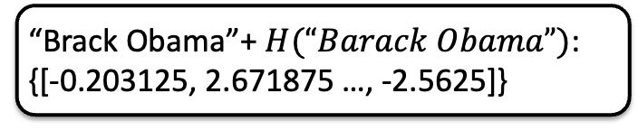

Approach: LLM2Vec Embedding Calculation
“Brack Obama”+ $H(“Barack Obama”)$:
{[-0.203125, 2.671875 …, -2.5625]}
“Activity” embedding:
{[-3.203115, -4.96875 …, -2.3906]}
$$S_{LLM2Vec}(C_{j}, O_{i},H(C_{j}))$$
=
LLM2Vec Score: 0.348
Notes:
For example, we take the embedding for Barack Obama, combined with its hierarchy information H(Barack Obama) , and calculate its cosine similarity with the embedding for “Activity” from DBpedia.
In this case, the LLM2Vec score is 0.348, indicating the degree of similarity between the two embeddings.

Slide 21
Beam Search
Mechanism:
Exploration: At each step, multiple potential sequences are evaluated.
Beam Width (K): Only the top-k highest scoring candidates are kept.
Search Space Limitation: It balances between considering multiple possibilities and computational efficiency by restricting the number of candidates.
Narrow down
Notes:
This slide explains the mechanism of Beam Search.
1. Exploration: At each step, we evaluate multiple potential sequences.
2. Beam Width (K): We only keep the top-K highest scoring candidates.
3. Search Space Limitation: It balances between exploring many possibilities and maintaining computational efficiency by limiting the number of candidates.
4. Narrowing Down: This process helps us gradually reduce the candidate pool to find the best match.

Slide 22
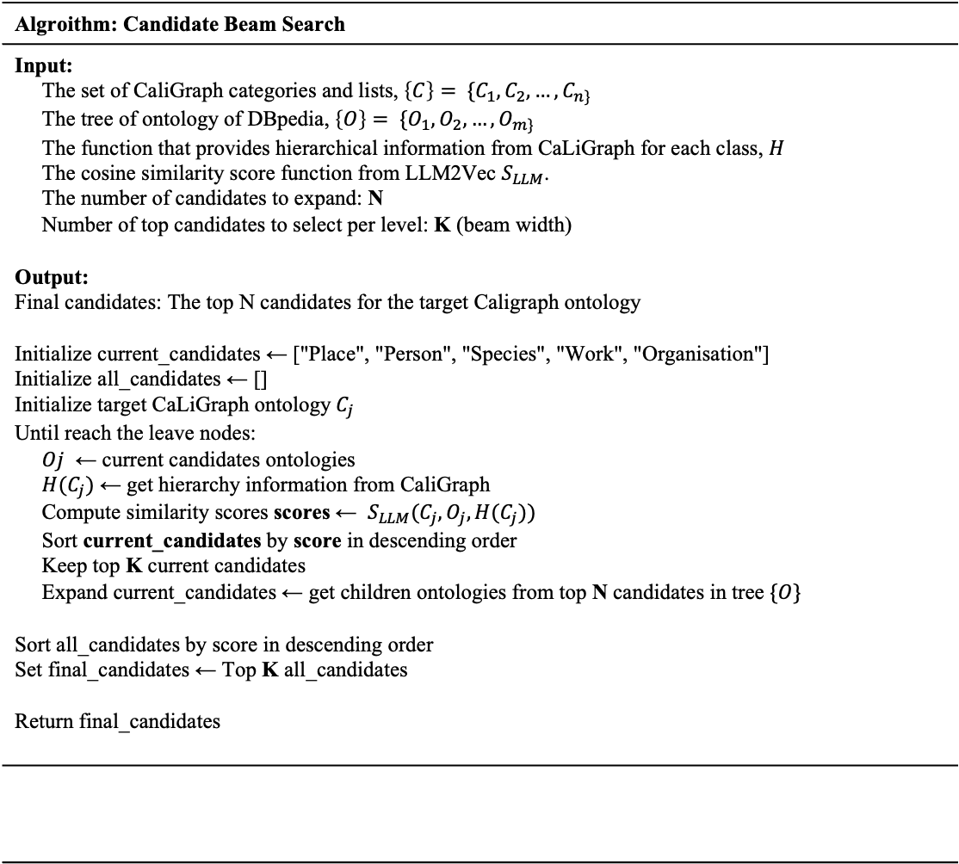
Approach: Candidate Beam Search
Algroithm: Candidate Beam Search
Input: The set of CaliGraph categories and lists, $\left\{C\right\}= \{C_{1}, C_{2}, …, C_{n\} }$ The tree of ontology of DBpedia, $\left\{O\right\}= \{O_{1}, O_{2}, …, O_{m\}}$ The function that provides hierarchical information from CaLiGraph for each class, $H$ The cosine similarity score function from LLM2Vec $S_{LLM}$. The number of candidates to expand: N Number of top candidates to select per level: K (beam width) Output: Final candidates: The top N candidates for the target Caligraph ontology Initialize current_candidates ← ["Place", "Person", "Species", "Work", "Organisation"] Initialize all_candidates ← [] Initialize target CaLiGraph ontology$C_{j}$ Until reach the leave nodes: $Oj$ ← current candidates ontologies $H(C_{j})$ ← get hierarchy information from CaliGraph Compute similarity scores scores ← $S_{LLM}(C_{j}, O_{j},H(C_{j}))$ Sort current_candidates by score in descending order Keep top K current candidates Expand current_candidates ← get children ontologies from top N candidates in tree $\{O\}$ Sort all_candidates by score in descending order Set final_candidates ← Top K all_candidates Return final_candidates
We implemented a modified beam search to search candidates with the following steps and changes:
1. Initial Candidates: We start by selecting a set of major nodes rather than root node.
2. Scoring and Selection: During each iteration, the current candidates are scored and ranked, followed by selecting the top K candidates.
3. Expansion: The top candidates are then expanded and add their children node to current candidates set
4. Termination Condition: This process continues until reach leave node
Notes:
We’ve implemented a modified beam search to find candidates. The process follows these steps:
1. Initial Candidates: We begin by selecting a set of major nodes instead of starting from the root.
2. Scoring and Selection: In each iteration, the current candidates are scored, ranked, and we select the top K candidates.
3. Expansion: The top candidates are expanded, and their child nodes are added to the candidate pool.
4. Termination Condition: The process continues until we reach the leaf nodes, finalizing the best candidates.
This approach helps us efficiently narrow down and identify the best matches for CaLiGraph classes.

Slide 23
Approach: Candidate Beam Search
Search can from from major nodes ["Place", "Person", "Species", "Work", "Organisation"]
N = 2, M (Beam width) = 5
Start
Thing
Example: “Brack Obama”
Place
Person
Species
Activity
Work
Organisation
...
Writer
Americanleader
Politician
...
WrittenWork
Document
...
President
VicePresident
...
The ontology colored as yellow is current candidates, The ontology colored as red has higher score
Person and Work has the higher score in the current candidates thus we are going to expand to add to current candidates set
Notes:
The ontology colored as yellow is current candidates, The ontology colored as red has higher score
Person and Work has the higher score in the current candidates thus we are going to expand to add to current candidates set

Slide 24
Approach: Candidate Beam Search
Search can from from major nodes ["Place", "Person", "Species", "Work", "Organisation"]
N = 2, M (Beam width) = 5
Start
Thing
Example: “Brack Obama”
Place
Person
Species
Activity
Work
Organisation
...
Writer
Americanleader
Politician
...
WrittenWork
Document
...
President
VicePresident
...
The ontology colored as yellow is current candidates, The ontology colored as red has higher score
American and Politician has the higher score and Politician is not leaf node in the current candidates thus we are going to expand to add to current candidates set.
Notes:
The ontology colored as yellow is current candidates, The ontology colored as red has higher score
American and Politician has the higher score and Politician is not leaf node in the current candidates thus we are going to expand to add to current candidates set.

Slide 25
Approach: Candidate Beam Search
Search can from from major nodes ["Place", "Person", "Species", "Work", "Organisation"]
N = 2, M (Beam width) = 5
Start
Thing
Example: “Brack Obama”
Place
Person
Species
Activity
Work
Organisation
...
Writer
Americanleader
Politician
...
WrittenWork
Document
...
President
VicePresident
...
The ontology colored as yellow is current candidates, The ontology colored as red has higher score
President and VicePresident has the higher score and both President and VicePresident are leave node current candidates thus we are going to expand to add to current candidates set.
Notes:
The ontology colored as yellow is current candidates, The ontology colored as red has higher score
President and VicePresident has the higher score and both President and VicePresident are leave node current candidates thus we are going to expand to add to current candidates set.

Slide 26
Prompt Template
{Person,AmericanLeader, Politician,President, VicePresident}
Given the candidate DBpedia ontology classes for the class:
{candidate_class} and hierarchy information from CaLIgraph for the entity {hierarchy_info}
Please select the most appropriate ontology class from the candidate list as the final ontology for the class [{class}].
Candidates
Hierarchy Information
Notes:
his is the prompt template used for selecting the final ontology class.
We provide:
• A set of candidates (e.g., Person, Politician, President).
• The corresponding hierarchy information from CaLiGraph.
The prompt asks to select the most appropriate ontology class from the candidate list, based on the hierarchy information provided, to determine the final ontology class for the entity.

Slide 27
Final Selection
Hierarchy Information
Insert into
Prompt template
DBpedia class
Candidates
Using LLM to do final selection
LLM:
Llama3.1 8B
Qwen2.0 7B
Notes:
In the final selection process:
• We insert the hierarchy information and the list of candidates into the prompt template.
• This prompt is then fed into the large language model (LLM), such as Llama 3.1 or Qwen 2.0.
• The LLM evaluates the candidates and selects the most appropriate DBpedia class.

Slide 28
Current Progress Report
28

Slide 29
Experimental Setting
LLM2vec model
Meta-Llama-3-8B-Instruct-mntp-unsup-simcse
Final Selection Model:
llama3.1:8b-instruct-q8_0
seed=0,
temperature=0.0,
Or
Qwen2:8B
seed=0,
temperature=0.0,
top-k candidates by searching from LLM2Vec: 10

Slide 30
Dataset
For fine-tuning the BERT classifier, 3000 CaLiGraph classes were randomly sampled. Then distant supervision was used to construct mapping pairs [4]. We also extract few-shot examples from these mappings.
The 3000 test samples, which are disjoint from training samples, are labeled and cross-checked by three annotators.
Dataset | BERT classifier |  | Test set
 | Training set | Validation set
CaLiGraph–DBpedia mapping pairs | 2700 | 300 | 3000
[3] Zhaoyi Wang, Zhenyang Zhang, Jiaxin Qin, and Mizuho Iwaihara. SLHCat: Mapping Wikipedia Categories and Lists to DBpedia by Leveraging Semantic, Lexical, and Hierarchical Features. In Proceedings of ICADL 2023, LNCS Vol. 14457, pp. 133-148, 2023.

Slide 31
Results of selection from candidates
Model | Macro-Precision | Macro-Recall | Macro-F1 | Micro-Precision | Micro-Recall | Micro-F1 | Accuracy
Cat2Ax (base line) | 0.342 | 0.335 | 0.321 | 0.528 | 0.492 | 0.509 | 0.492
SLHCat | 0.625 | 0.658 | 0.608 | 0.774 | 0.743 | 0.758 | 0.743
^{Previous work from Zou}
ChatGPT + candidates + few-shot examples | 0.758 | 0.738 | 0.723 | 0.827 | 0.803 | 0.815 |  | 0.803
Llama2-7B with few-shot examples labeled by human annotators | 0.742 | 0.742 | 0.723 | 0.859 | 0.829 | 0.844 |  | 0.829
Our Approach
SimCSE model: sup-simcse-bert-base-uncased
Zeroshot | 0.599 | 0.567 | 0.551 | 0.728 | 0.571 | 0.64 | 0.571
Llama-3.1-8B | with LLM2Vec model: Meta-Llama-3-8B-Instruct-mntp-unsup-simcse
zeroshot | 0.603 | 0.541 | 0.542 | 0.744 | 0.603 | 0.666 | 0.674
zero shot with hierarchy information | 0.658 | 0.656 | 0.63 | 0.763 | 0.676 | 0.717 | 0.808
Qwen2-7B
zeroshot | 0.596 | 0.538 | 0.537 | 0.748 | 0.576 | 0.651 | 0.677
zero shot with hierarchy information | 0.656 | 0.579 | 0.592 | 0.856 | 0.612 | 0.714 | 0.73
[5] Mapping Wikipedia Categories and Lists to DBpedia Ontology with Large Language Models, July 2024
Notes:
This table summarizes the results of selection from candidates across different models.
• The baseline model (Cat2Ax) has lower macro and micro scores, with an accuracy of 0.492.
• SLHCat shows significant improvement with an accuracy of 0.743.
• In previous work, ChatGPT with candidates and few-shot examples achieves an accuracy of 0.803, while Llama2-7B reaches 0.829 with human-labeled examples.
For our approach:
• Using LLM2Vec with Llama-3.1-8B, we achieve 0.808 accuracy with hierarchy information, improving on the zero-shot performance.
• Similarly, Qwen2-7B with hierarchy information boosts the precison to 0.856
This demonstrates that incorporating hierarchy information significantly improves selection accuracy.

Slide 32
Reasons for Suboptimal Performance of Our Approach
Compared with the
Lack of Few-Shot Learning Examples in Final Selection Process:
Part of hierarchy information is irrelevant with mapping
Lack of Fine-Tuning for the Specific Mapping Task:
Limited Capability of the Open Source Model Compared to State-of-the-Art Models such as ChatGPT:
Notes:
Compared with the
Lack of Few-Shot Learning Examples in Final Selection Process:
The final selection process lacks few-shot learning examples, limiting the model’s ability to generalize and adapt to unseen data, which could enhance accuracy.
Part of hierarchy information is irrelevant with mapping:
Even thought the LLM2Vec can handle a lot of contextual information, we need a method to select useful hierarchy information
Lack of Fine-Tuning for the Specific Mapping Task:
The LLM2Vec model is not fine-tuned for our mapping task
Limited Capability of the Open Source Model Compared to State-of-the-Art Models such as ChatGPT:
The final selection model (Llama and Qwen) lacks the capacity of state-of-the-art models like ChatGPT

Slide 33
Conclusion

Slide 34
Future work
There are something we need to do in the future
Using the description of the DBpedia ontology Tree
Design a better way to select hierarchy information
Finetune the LLM2Vec with the knowledge graph data
Ablation Analysis on Different Hierarchical Information
Notes:
In future work, we plan to enhance the model by incorporating DBpedia ontology descriptions directly into the embeddings, improving candidate search accuracy. We will also refine the selection of CaLiGraph hierarchy information, moving away from random selection to a more targeted approach that optimizes embeddings. Additionally, we aim to fine-tune the LLM2Vec model using CaLiGraph and DBpedia data to better tailor it for the specific task of ontology mapping. Finally, we will conduct an ablation study to assess the impact of different hierarchy information types on model performance, helping us identify the most valuable inputs for accurate results.

