Slide 1
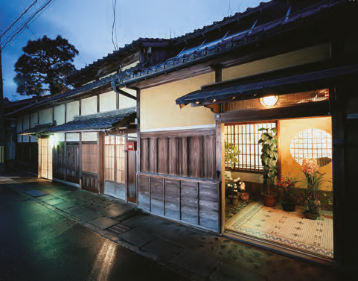
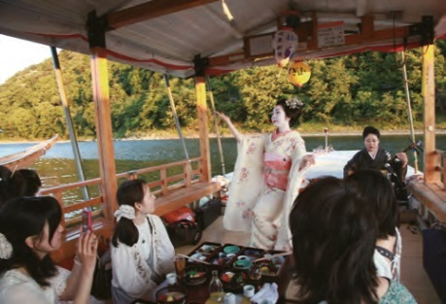



Call for applications: Presenters for Japan Heritage International Forum!
Would you like to experience Japanese culture and convey its appeal to the world?
The Agency for Cultural Affairs recognizes as Japan heritage the stories of Japan’s culture/traditions told through the historical appeal and distinct features of regions. During this current fiscal year, the agency will hold a forum dedicated to conveying Japan’s heritage mainly to countries in Europe and the U.S. We seek foreign students studying in Japan who are willing to learn Japanese culture in Japan heritage workshops and report the results at the forum. We also plan interviews in the media of the students’ home countries.
Implementation Overview
◆ Preferred training region： You can download the file from the below URL. Password: eich9Zu`
https://mladbin.mext.go.jp/mb/cgi-bin/index.cgi/download/hPlYS9EIOqaRCksu-vsmAQ/w0M4g8WATn-cDbeHW0Z8hQ/
◆Eligibility
・ Students who study in Japan and are from Australia, the U.S., Canada, the U.K., France, Germany
・ Those with conversation-level Japanese proficiency are preferred (English proficiency is required)
・ Those who can give a presentation in English on the results of training at the Japan Heritage
International Forum to be held separately
・ Those who are able to attend all the events in the schedule below
◆Number of students sought: 3
◆Application method (please send the application materials by e-mail)
Please fill out the required information on the attached application form and submit it to cie-staff@list.waseda.jp by October 31, 2016 (for the contact information, please see below).
◆ Selection method
Applications will be screened based on the details of the application form on the back of this document. Applicants will be notified of the result by email around mid-November.
◆ Schedule
December or January Prior briefing (with interpreting)
(We will contact you later with the date, time and venue)
January, February Japan heritage workshops (day trip or overnight)
February Drawing up presentation materials for the Japan Heritage International Forum
March 7 Japan Heritage International Forum (report on training results/simultaneous interpreting)
◆ Japan Heritage International Forum (Tokyo International Forum)
＜ Program＞
・ Keynote address: David Atkinson (Member of the Japan Heritage Screening Committee)
・ Japan heritage research presentation
Presentation of results of the Japan heritage workshops (group presentation by all three presenters)
・ Panel discussion
Exchange of views among overseas travel agencies, overseas journalists, members of the Japan Heritage Screening Committee, government officials and others
・ Reception Exchange of views among participants
◆ Transportation and other costs
・Transportation: We will cover actual transportation costs
・ Honorarium: To be paid
Host:
Agency for Cultural Affairs,
Government of Japan
【Contact】: Monuments and Sites Division at Agency for Cultural Affairs / Email: japan- heritage@bunka.go.jp
Center for International Education at Waseda University E-mail: cie-staff＠list.waseda.jp】

Slide 2
Application
Furigana |  |  |  |  |  |  |  |  | Gender | (Photo)
Name | (Surname) |  |  |  | (Given name) |  |  |  | M F
Date of Birth |  | Year |  | Month |  | Day | Home Country
Phone Number |  |  |  |  |  |  | Email address
Language Proficiency | Japanese | 1. Conversation level 2. Below conversation level |  | Qualifications |  |  | Major
Preferred region to visit (choose from attached sheet and fill in the number)（※） | First Choice |  | Second Choice |  | Third Choice |  | Fourth Choice |  | Fifth Choice
Objective
Self-PR
Please state your thinking on how to make Japanese heritage sites attractive.
Other comments or opinions
※ Please understand that we may not be able to meet your preference.

