Slide 1
A Survey of Graph Meets Large Language Model:
Progress and Future Directions
Yuhan Li, Zhixun Li, Peisong Wang, Jia Li, Xiangguo Sun, Hong Cheng, Jeffrey Xu Yu.
A Survey of Graph Meets Large Language Model: Progress and Future Directions.
arXiv preprint arXiv:2311.12399, 2024.
Chen Chen
2024.04.25
Data Engineering Lab, IPS, Waseda Univ.
Notes:
Hello everyone, I am Chen Chen, Today I want to share a paper which called “A survey of Graph Meets Large Language Model: Progress and Future Directions”. This paper present a comprehensive review and analysis of existing methods that integrate LLMs with graphs. Through this paper we can get some inspiration for future research.

Slide 2
Outline
Introduction
Taxonomy
(1) LLM as Enhancer
(2) LLM as Predictor
(3) GNN-LLM Alignment
Future Directions
Conclusion
Notes:
I will divided into four parts to introduce this paper.
The second part proposes a new taxonomy /tækˈsɒnəmi/ , which organizes existing methods into three categories based on the role (i.e., enhancer, predictor, and alignment component) played by LLMs in graph-related tasks. It is a crucial part in the paper and I will also give it special emphasis during the presentation.

Slide 3
Pros and Cons for LLMs and GNNs
Large language models (LLMs), such as BERT and GPT4, have shown great performance in various NLP tasks, such as question answering and text generation. However, LLMs primary focus on text sequences, it is challenging for them to capture structural information present in graph data.
Graph Neural Networks(GNNs) have emerged as one of the most popular choices for processing and analyzing graph data, which are proficient at capturing structural information. Meanwhile, GNNs are difficult to express the full complexities of the nodes.
Notes:
For Large language model, such as BERT and GPT4,…
For graph neural /njʊərəl/ networks, they have emerged as…Meanwhile, GNNs are difficult to express the full complexities of the nodes.
It means that If nodes have some text attributes, the traditional GNN may lose /lu:z/ or overlook this text attributes.

Slide 4





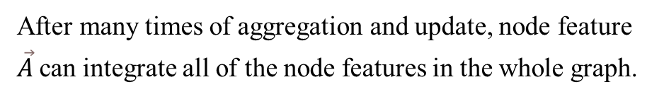


Brief Introduction for GNN
$$\vec{B}$$
B
For node A:
$$\vec{C}$$
$$\vec{E}$$
$$aggregation: N=b×\vec{B}+c×\vec{C}+d×\vec{D}$$
$$\vec{A}$$
A
C
E
$$update:A_{information}=σ×W×\left(\vec{A}+α×N\right)$$
node feature
$$\vec{D}$$
After many times of aggregation and update, node feature $\vec{A}$can integrate all of the node features in the whole graph.
D
In the aggregation step, each node collects and combines information from its neighboring nodes.
In the node update step, each node incorporates the aggregated information from its neighbors along with its current state to update its own representation or state using a neural network function.
Notes:
Perhaps it’s not necessary, but I still want to make a brief introduction of GNN for the following discussion.
The core idea of GNN is through many times of aggregation and update operation to make every node can integrate all of the other node feature in the whole graph.
It can make GNN acquire expressive representation at the node, edge and so on.
As shown in the figure, we take node A as example.
In the aggregation/æɡrɪˈɡeɪʃn/ step, N denotes the feature information aggregated from the neighbors of node A, in this formular, the lowercase b, c, d are the parameters /pəˈræmɪtəz/ based on the wights of neighboring nodes.
In the update step, $σ$ denotes the active function(such as the sigmoid or relu), W denotes the parameters which model needs to train.$α$ represents the weight we want to set for node A’s neighbors.
In this figure, after the first round, the feature vector of node A has integrated the information from nodes A, B, C, and D.
After the second round, the feature vector of node A has integrated the information from node A,B,C,D,E, because of in the first round, the feature vector of node C has get the information from node E.

Slide 5
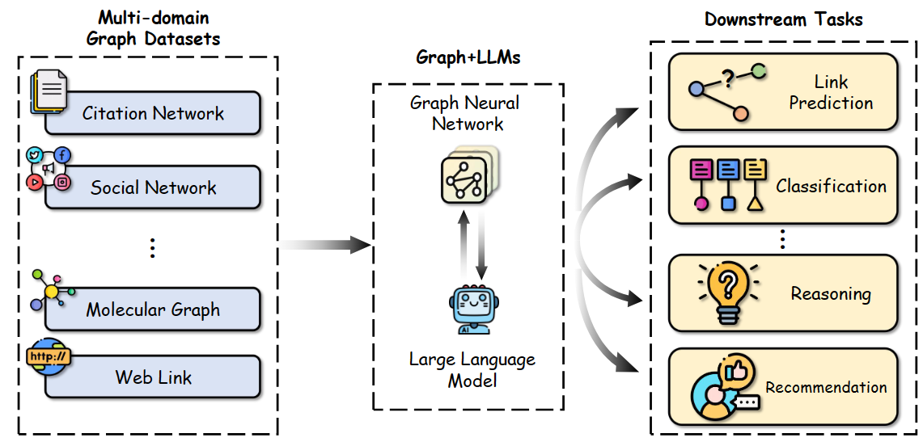
Integrating LLMs with GNNs
Combining GNNs with LLMs can leverage the robust textual understanding of LLMs while harnessing GNNs’ ability to capture structural relationships, leading to more comprehensive and powerful graph learning.
Figure 1: Across a myriad of graph domains, the integration of graphs and LLMs demonstrates success in various downstream tasks.
Notes:
As shown in the figure, across a myriad /mɪriəd/ of graph domains, the integration of graphs and LLMs demonstrates success in various downstream tasks. (such as link prediction, classification, reasoning and so on)

Slide 6
Taxonomy
(1) LLM as Enhancer, where LLMs are used to enhance the classification performance of GNNs;
(2) LLM as Predictor, where LLMs utilize the input graph structure information to make predictions;
(3) GNN-LLM Alignment, where LLMs semantically enhance GNNs through alignment techniques.
Notes:
The paper propose a taxonomy/tækˈsɒnəmi/ that organizes representative techniques involving both graph and text modalities /məʊˈdælətiz/ into three main categories:
The first is LLM as Enhancer,….
The second is LLM as Predictor,…..
The third is GNN-LLM Alignment….. where LLMs semantically /sɪˈmæntɪkli/

Slide 7
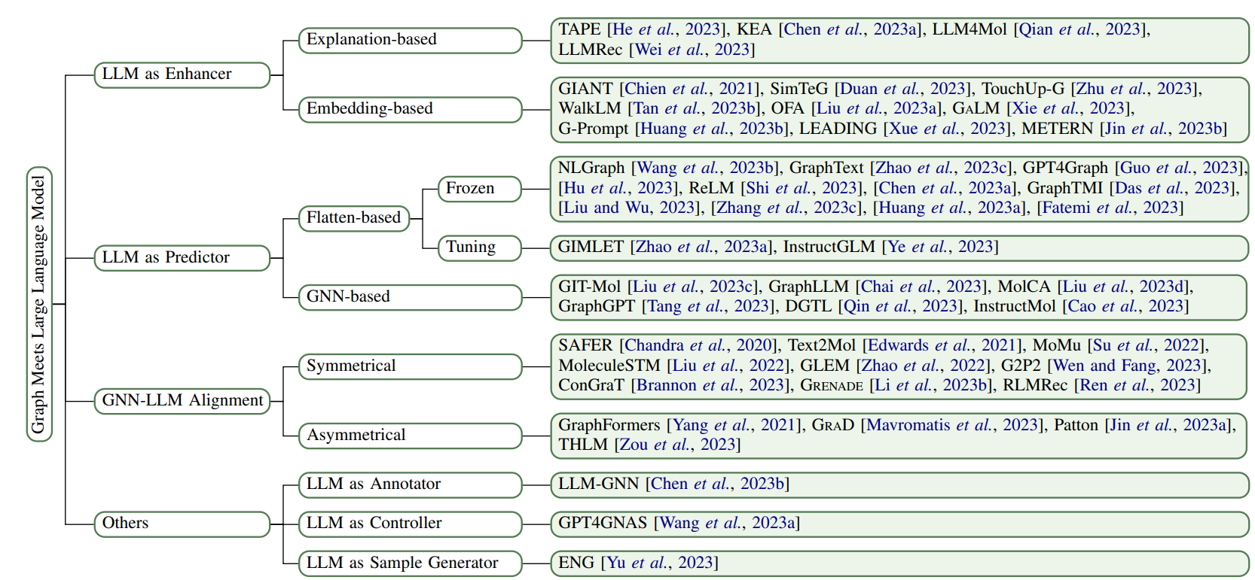
Example of Taxonomy
Figure 2: A taxonomy of models for solving graph tasks with the help of large language models (LLMs) with representative examples.
Notes:
The figure shows the taxonomy of models for solving graph tasks with the help of large language models (LLMs) with representative examples.
I will provide a detailed overview for each categories as the framework depicted /dɪˈpɪkt/ in the figure.

Slide 8
(1) LLM as Enhancer
Notes:
The first is LLM as enhancer.

Slide 9
LLM as Enhancer
LLMs enhance the performance of GNNs on TAGs(text-associated graph).
LLM-as-enhancer approaches correspond to enhancing the quality of node embeddings with the help of powerful LLMs.
The approaches that utilize LLM as an enhancer can be categorized into two branches:
(1) Explanation-based Enhancement;
(2) Embedding-based Enhancement;
Notes:
As enhancer, LLMs enhance the performance of GNNs on TAGs(text-associated graph).
TAG is the text-associated graph, which means in this graph, every nodes or edges may have text descriptions /dɪˈskrɪpʃn/ .
The core idea of LLM-as-enhancer approaches is to enhancing the quality of node embeddings with the help of powerful LLMs.
…

Slide 10
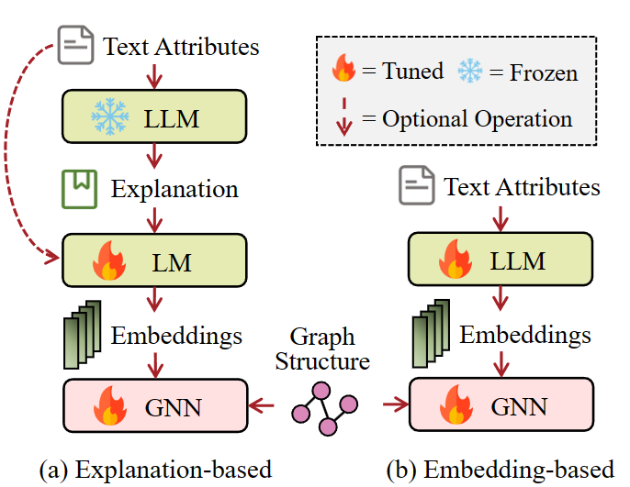

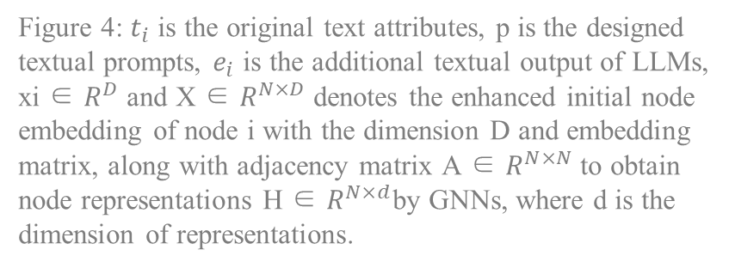
LLM as Enhancer
1) Explanation-based Enhancement
Generally they prompt LLMs to generate semantically enriched additional information, such as explanations, knowledge entities, and pseudo labels.
Figure 4: $t_{i}$ is the original text attributes, p is the designed textual prompts, $e_{i}$ is the additional textual output of LLMs, xi ∈ $R^{D}$ and X ∈ $R^{N×D}$ denotes the enhanced initial node embedding of node i with the dimension D and embedding matrix, along with adjacency matrix A ∈ $R^{N×N}$ to obtain node representations H ∈ $R^{N×d}$by GNNs, where d is the dimension of representations.
Figure 3: The illustration of LLM-as-enhancer approaches: (a) explanation-based enhancement
Notes:
The core idea of the explanation-based enhancer is to prompt LLMs to generate semantically enriched additional information.
We integrate the pipeline figure with the formulas to understand.
In the step of enhancement, we input original text attributes and designed textual prompts into the LLM, the output $e_{i}$ is the additional textual information, such as explanations, knowledge entities, and pseudo-labels /suːdəʊ/.
And then, we input $e_{i}$ and original text attributes into the language model, the output xi denotes the enhanced initial node embedding of node i with the dimension D and embedding matrix /ˈmeɪtrɪks/,
(the language model in this process can be a completely new language model or be a pre-trained language model.)
After that, in the step of graph learning, we input X along with adjacency /əˈdʒeɪsənsi/ matrix A into the GNN to obtain node representation H.

Slide 11
LLM as Enhancer
1) Explanation-based Enhancement
TAPE [1] prompts LLMs to generate explanations and pseudo labels to augment textual attribute. After that, relatively small language models are fine-tuned on both original text data and explanations to encode text semantic information as initial node embeddings.
[1] Xiaoxin He, Xavier Bresson, Thomas Laurent, and Bryan Hooi. Explanations as features: Llm-based features for text-attributed graphs. arXiv preprint arXiv:2305.19523, 2023.
Notes:
for example, the model called TAPE prompts LLMs to generate …
Augment /ɔːɡˈment/

Slide 12

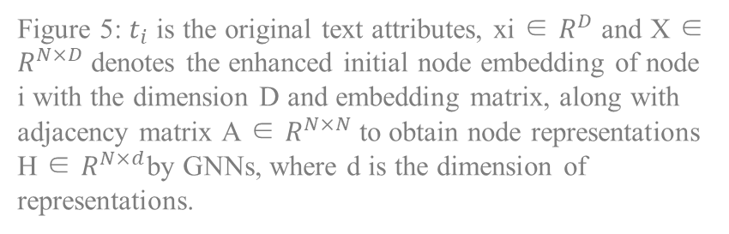
LLM as Enhancer
2) Embedding-based Enhancement
Embedding-based enhancement approaches directly utilize LLMs to output text embeddings as initial node embeddings for GNN training.
Figure 5: $t_{i}$ is the original text attributes, xi ∈ $R^{D}$ and X ∈ $R^{N×D}$ denotes the enhanced initial node embedding of node i with the dimension D and embedding matrix, along with adjacency matrix A ∈ $R^{N×N}$ to obtain node representations H ∈ $R^{N×d}$by GNNs, where d is the dimension of representations.
Figure 3: The illustration of LLM-as-enhancer approaches: (b) Embedding-based enhancement.
Notes:
The core idea of the embedding-based enhancer is to directly utilize LLMs to output text embeddings as initial node embeddings for GNN training.
In the step of enhancement, we input the original text attributes into LLM, and output xi denotes the enhanced initial node embedding of node i with the dimension D and embedding matrix,
After that, in the step of graph learning, we input X along with adjacency/əˈdʒeɪsənsi/ matrix/ˈmeɪtrɪks/, A into the GNN to obtain node representation H.

Slide 13
LLM as Enhancer
2) Embedding-based Enhancement
GALM [2] pre-trains PLMs and GNN aggregator on a given large graph corpus to capture the information that can maximize utility towards massive applications and then fine-tunes the framework on a specific downstream application to further improve the performance.
[2] Han Xie, Da Zheng, Jun Ma, Houyu Zhang, Vassilis N Ioannidis, Xiang Song, Qing Ping, Sheng Wang, Carl Yang, Yi Xu, et al. Graph-aware language model pre-training on a large graph corpus can help multiple graph applications. arXiv preprint arXiv:2306.02592, 2023.
Notes:
for example, the model called GALM(Graph-aware language model ) pre-trains PLMs and GNN aggregator /æɡrɪɡeɪtə(r)/ on a given large graph corpus /ˈkɔːpəs/ to capture the information that can maximize /mæksɪmaɪz/ utility /juːˈtɪləti/ towards massive applications and then fine-tunes the framework on a specific downstream application to further improve the performance.

Slide 14
Pros and Cons for LLM as Enhancer
LLM-as-enhancer approaches have demonstrated superior performance on TAG, being able to effectively capture both textual and structural information.
LLM-as-enhancer approaches pave the way for using closed-source LLMs to assist graph-related task(specifically for explanation-based enhancement).
LLM-as-enhancer approaches entail significant overhead when dealing with large-scale datasets.
Notes:
LLM-as-enhancer approaches have demonstrated superior /suːˈpɪəriə(r)/ performance on TAG(text-associated graph), being able to effectively capture both textual and structural information.
Besides, they pave the way for using closed-source LLMs to assist graph-related task(specifically for explanation-based enhancement).
However, LLM-as-enhancer approaches entail significant overhead when dealing with large-scale/skeɪl/ datasets.

Slide 15
(2) LLM as Predictor
Notes:
The second is LLM as predictor.

Slide 16
LLM as Predictor
LLM-as-predictor approaches utilize LLMs to make predictions for a wide range of graph-related tasks within a unified generative paradigm.
However, applying LLMs to graph modalities presents unique challenges, because graph data often lacks straightforward transformation into sequential text, as different graphs define structures and features in different ways.
The approaches that utilize LLM as a predictor can be categorized into two branches, depending on whether they employ GNNs to extract structural features for LLMs:
(1) Flatten-based Prediction;
(2) GNN-based Prediction;
Notes:
As predictor, approaches utilize LLMs to make predictions for a wide range of graph-related tasks within a unified generative paradigm/pærədaɪm/.
……

Slide 17
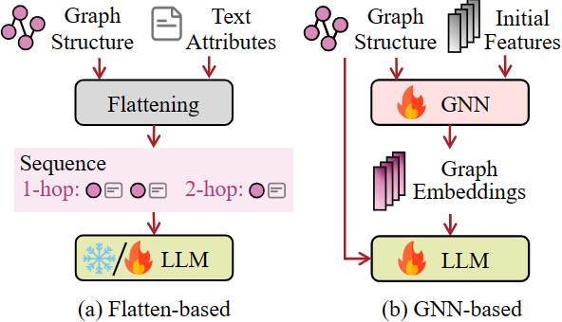

LLM as Predictor
1) Flatten-based Predictor
Generally they flatten the graph into textual descriptions, which facilitates direct processing of graph data by LLMs through text sequences.
Figure 7: ν, ε, τ, J denotes the set of nodes, edges, node text attributes, and edge text attributes, respectively. p indicates the instruction prompt for the current graph task and ̃Y is the predicted label. Flatten function Flat(·) to transform a graph structure into a sequence of nodes or tokens Gseq, parsing function Parse(·) is then applied to retrieve the predicted label from the output generated by LLMs.
Figure 6: The illustration of LLM-as-predictor approaches: (a) Flatten-based prediction.
Notes:
The core idea of the flatten-based predictor is to flatten the graph into textual descriptions, which facilitates /fəˈsɪlɪteɪts/ direct processing of graph data by LLMs through text sequences.
In the step of flatten, we input the set of nodes, edges, node text attributes, and edge text attributes into flatten function, the output is a sequence of nodes or tokens which we use Gseq to represent.
After that, in the step of prediction, we input Gseq and p which indicates the instruction prompt for the current graph task into LLM, and then we apply the output generated by LLM to retrieve the predicted label.

Slide 18
LLM as Predictor
1) Flatten-based Prediction
Given that the output of LLMs often involves their reasoning and logic processes, particularly in the chain-of-thought (CoT) scenario, Graphtext[4] utilize regular expressions to extract the predicted label from the output.
[4] Jianan Zhao, Le Zhuo, Yikang Shen, Meng Qu, Kai Liu, Michael Bronstein, Zhaocheng Zhu, and Jian Tang. Graphtext: Graph reasoning in text space. arXiv preprint arXiv:2310.01089, 2023.
Notes:
Given that the output of LLMs often involves their reasoning and logic processes, particularly in the chain/tʃeɪn/-of-thought (CoT) scenario/səˈnɑːriəʊ/,
For example, the model called Graphtext utilize regular expressions to extract the predicted label from the output.

Slide 19

LLM as Predictor
2) GNN-based Predictor
GNN-based prediction leverages the advantages of GNNs to incorporate inherent structural characteristics and dependencies present in graph data with LLMs, allowing LLMs to be structure-aware.
Figure 8: X denotes the node embedding matrix, A is the adjacency matrix, and H denotes the structure-aware embeddings associated with the graph.
Figure 6: The illustration of LLM-as-predictor approaches: (b) GNN-based prediction.
Notes:
The core idea of the GNN-based predictor is to leverage the advantages of GNNs to incorporate inherent/ɪnˈherənt/ structural characteristics and dependencies present in graph data with LLMs, allowing LLMs to be structure-aware.
In the step of graph learning, we input the node embedding matrix/meɪtrɪks/ and adjacency/əˈdʒeɪsənsi/ matrix into GNN, the output is the structure-aware embeddings associated with the graph.
After that, in the step of prediction, we input the structure-aware embeddings and p which indicates the instruction prompt for the current graph task into LLM, and then we apply a parser/ˈpɑːzə(r)/ function to extract the output from LLMs.

Slide 20
LLM as Predictor
2) GNN-based Predictor
GraphLLM[5] derives the graph-enhanced prefix by applying a linear projection to the graph representation during prefix tuning, allowing the LLM to synergize with the graph transformer to incorporate structural information crucial to graph reasoning.
[5]Ziwei Chai, Tianjie Zhang, Liang Wu, Kaiqiao Han, Xiaohai Hu, Xuanwen Huang, and Yang Yang. Graphllm: Boosting graph reasoning ability of large language model. arXiv preprint arXiv:2310.05845, 2023
Notes:
For example, the model called GraphLLM derives the graph-enhanced prefix/ˈpriːfɪks/ by applying a linear/lɪniə(r)/ projection to the graph representation during prefix tuning/ˈtjuːnɪŋ/, allowing the LLM to synergize/ˈsɪnəˌdʒaɪz/加强 with the graph transformer to incorporate structural information crucial to graph reasoning.

Slide 21
Pros and Cons for LLM as Predictor
LLM-as-enhancer approaches have encoded graph-structured information into a format that LLMs can comprehend and manipulate effectively and efficiently.
Flatten-based prediction may have an advantage in terms of effectiveness, while GNN-based prediction tends to be more efficient.
In flatten-based prediction, the input length limitation of LLMs restricts each node’s access to only its neighbors within a few hops, making it challenging to capture long-range dependencies.
GNN-based prediction, training an additional GNN module and inserting it into LLMs for joint training is challenging due to the problem of vanishing gradients in the early layers of deep transformers.
Notes:
Manipulate /məˈnɪpjuleɪt/
Hop /hɒp/
module/ˈmɒdjuːl/
Gradient /ˈɡreɪdiənt/
Layer /ˈleɪə(r)/

Slide 22
(3) GNN-LLM Alignment
Notes:
The third is LLM as alignment component.

Slide 23
GNN-LLM Alignment
Aligning the embedding spaces of GNNs and LLMs is an effective way to integrate the graph modality with the text modality.
GNN-LLM alignment ensures that each encoder’s unique functionalities are preserved while coordinating their embedding spaces at a specific stage.
The techniques for aligning GNNs and LLMs can be categorized into two branches:
(1) Symmetric;
(2) Asymmetric;
Notes:
modality/məʊˈdæləti/
functionalities/fʌŋkʃəˈnæləti/
Coordinating /kəʊˈɔːdɪneɪtɪŋ/
Symmetric /sɪˈmetrɪk/
Asymmetric /ˌeɪsɪˈmetrɪk/

Slide 24
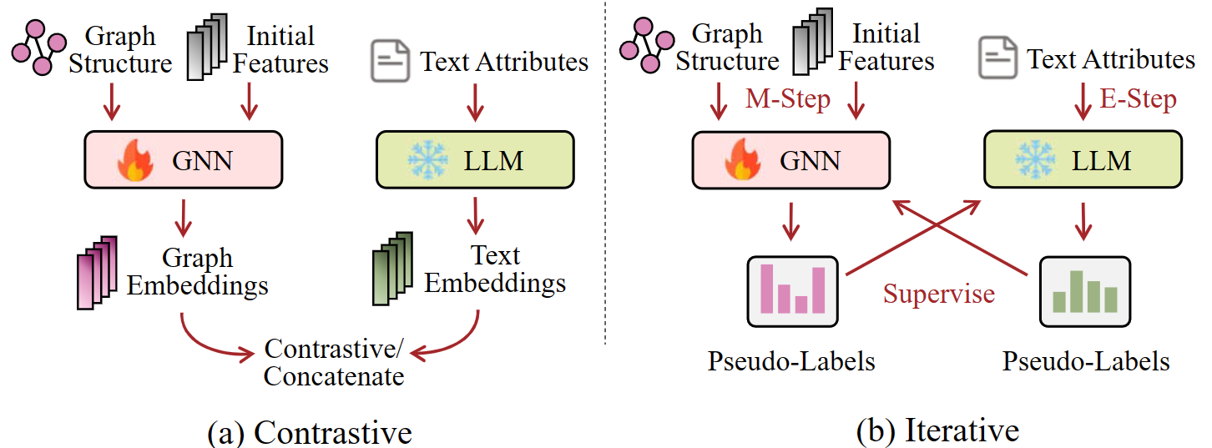
GNN-LLM Alignment
1) Symmetric
Symmetric alignment refers to the equal treatment of the graph and text modalities during the alignment process. These approaches ensure that the encoders of both modalities achieve comparable performance in their respective applications.
Figure 9: The illustration of GNN-LLM-Alignment approaches: a) Contrastive, symmetric alignment which applies concatenation or contrastive learning to graph embeddings and text embeddings; b) Iterative, belongs to symmetric alignment, aiming to implement iterative interactions on embeddings of two modalities.
Notes:
Symmetric /sɪˈmetrɪk/
modalities/məʊˈdælətiz/

Slide 25
GNN-LLM Alignment
1) Symmetric
Text2Mol [6] proposes a cross-modal attention mechanism to achieve early fusion of graph and textual embeddings.
Implemented through a transformer decoder, Text2Mol uses the LLM’s output as a source sequence and the GNN’s output as a target sequence. This setup allows the attention mechanism to learn multimodal association rules. The decoder’s output is then utilized for contrastive learning, paired with the processed outputs from the GNN.
[6] Carl Edwards, ChengXiang Zhai, and Heng Ji. Text2mol: Cross-modal molecule retrieval with natural language queries. In EMNLP, pages 595–607, 2021.
Notes:
For example, the model called Text2Mol proposes a cross-modal attention mechanism/ˈmekənɪzəm/ to achieve early fusion/ˈfjuːʒ(ə)n/ of graph and textual embeddings.
……

Slide 26
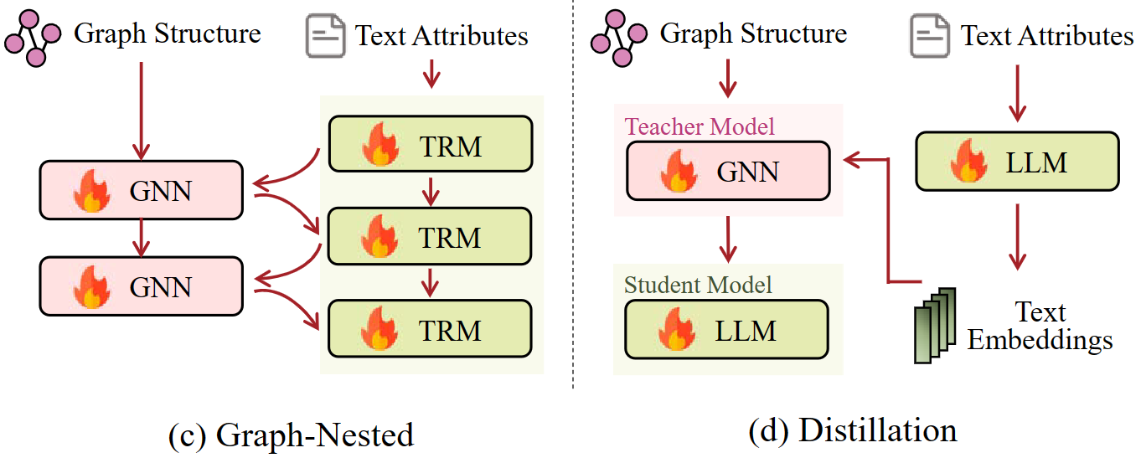
GNN-LLM Alignment
2) Asymmetric
Asymmetric alignment focuses on allowing one modality to assist or enhance the other.
These approaches involves leveraging the capabilities of GNNs to process structural information to reinforce LLMs.
Figure 11: The illustration of GNN-LLM-Alignment approaches: ; c) Graph-nested, a symmetric alignment which interweaves GNNs with Transformers. d) Distillation, belongs to asymmetric alignment, which uses GNN as a teacher to train language models to be graph-aware.
Notes:
Asymmetric /ˌeɪsɪˈmetrɪk/
capabilities/ˌkeɪpəˈbɪlətiz/

Slide 27
GNN-LLM Alignment
2) Asymmetric
Graph-former[7] demonstrates asymmetric alignment through the integration of GNNs into each transformer layer. Within each layer of the LLM, the node embedding is obtained from the first token-level embedding, which corresponds to the [CLS] token. The process involves gathering embeddings from all relevant nodes and applying them to a graph transformer. The output is then concatenated with the input embeddings and passed on to the next layer of the LLM.
[7] Junhan Yang, Zheng Liu, Shitao Xiao, Chaozhuo Li, Defu Lian, Sanjay Agrawal, Amit Singh, Guangzhong Sun, and Xing Xie. Graphformers: Gnn-nested transformers for representation learning on textual graph. NeurIPS, 34:28798–28810, 2021.
Notes:
For example, the model called Graph-former demonstrates asymmetric alignment through the integration of GNNs ……
Asymmetric /ˌeɪsɪˈmetrɪk/
Layer /ˈleɪə(r)/
[CLS] token：“classification token”
concatenated/kɒnˈkætɪˌneɪt/

Slide 28
Pros and Cons for GNN-LLM Alignment
Symmetric alignments treat each modality equally, with the objective of enhancing GNNs and LLMs simultaneously. This leads to encoders that can effectively handle tasks involving both modalities, leveraging their individual encoding strengths to improve modality-specific representations.
Asymmetric methods enhance LLMs by inserting graph encoders into transformers or directly using GNNs as teachers.
Alignment techniques face challenges when dealing with data scarcity. Only a few graph datasets (i.e., molecular datasets) contain native graph-text pairs, limiting the applicability of these methods.
Notes:
Symmetric /sɪˈmetrɪk/
Simultaneously /ˌsɪm(ə)lˈteɪniəsli/
Asymmetric /ˌeɪsɪˈmetrɪk/
Scarcity /ˈskeəsəti/
Molecular /məˈle cu lə(r)/
applicability/əˌplɪkəˈbɪləti/

Slide 29
Future Directions
Notes:
Next, the paper discuss the remaining limitations of leveraging LLM’s ability to comprehend graph data and list some directions for further exploration in subsequent research.
I will select three points to introduce in the following.

Slide 30
Future Directions
1. Dealing with non-TAG
Exploring how to leverage the powerful generalization capabilities of LLMs to help in constructing graph foundation models is a valuable research direction.
PeMS03[8] is a traffic network, each node represents an operational sensor, while in a superpixel graph[9], each node represents a superpixel. These datasets do not have attached text attributes on each node, and it is also challenging to describe the semantic meaning of each node using human-understandable language.
[8] Chao Song, Youfang Lin, Shengnan Guo, and Huaiyu Wan. Spatial-temporal synchronous graph convolutional networks: A new framework for spatial-temporal network data forecasting. In AAAI, pages 914–921, 2020.
[9] Vijay Prakash Dwivedi, Ladislav Rampa´sek, Michael Galkin, Ali Parviz, Guy Wolf, Anh Tuan Luu, and Dominique Beaini. Long range graph benchmark. NeurIPS, 35:22326–22340, 2022.
Notes:
The first is Exploring how to leverage the powerful generalization capabilities of LLMs to help in constructing graph foundation models.
For example, some datasets do not have attached text attributes on each node, such as PeMS03, it is a traffic network, each node represents an operational sensor.
Or in a superpixel /ˈpɪksl/ graph, each node represents a superpixel.
For these datasets, it is challenging to describe the semantic meaning of each node using human-understandable language.

Slide 31
Future Directions
2. Dealing with data leakage
Given that LLMs undergo pre-training on extensive text corpora, it’s likely that LLMs may have seen and memorized at least part of the test data of the common benchmark datasets, especially for citation networks.
Recently[10] proves that specific prompts could potentially enhance the “activation” of LLMs’ corresponding memory, thereby influencing the evaluation.
[10] Zhikai Chen, Haitao Mao, Hang Li, Wei Jin, Hongzhi Wen, Xiaochi Wei, Shuaiqiang Wang, Dawei Yin, Wenqi Fan, Hui Liu, et al. Exploring the potential of large language models (llms) in learning on graphs. arXiv preprint arXiv:2307.03393, 2023.
Notes:
The second is that LLMs undergo pre-training on extensive text corpora/ˈkɔːpərə/, it’s likely that LLMs may have seen and memorized at least part of the test data of the common benchmark datasets, especially for citation /saɪˈteɪʃ(ə)n/ networks.
Some papers have proved that specific prompts /prɒmpts/ could potentially enhance the “activation” of LLMs’ corresponding memory, thereby influencing the evaluation.

Slide 32
Future Directions
3. Improving efficiency
LLMs may encounter inefficiencies in terms of time and space, particularly compared to dedicated graph learning models such as GNNs that inherently process graph structures
While accessing LLMs through APIs (i.e., ChatGPT and GPT-4), the billing model incurs high costs for processing large-scale graphs. Additionally, both training and inference for locally deployed open-source LLMs require significant time consumption and substantial hardware resources.
We believe that more efficient methods may unlock more power of applying LLMs on graph-related tasks with limited computational resources.
Notes:
The third is that …
Inefficiencies /ˌɪnɪˈfɪʃnsi/
Inherent /ɪnˈherənt/
Scale /skeɪl/

Slide 33
Conclusion

Slide 34
Conclusion
Taxonomy. This paper introduce a novel taxonomy that categorizes techniques involving both graph and text modalities into three categories based on the different roles played by LLMs, 1) LLM as Enhancer; 2)LLM as predictor; and 3) LLM as alignment component.
Categorization and review. This paper systematically review the representative studies according to the taxonomy.
Summary of challenges and future directions. This paper discuss some limitations and highlight several future research directions.
Notes:
In summary,
This paper introduce a novel /ˈnɒv(ə)l/ taxonomy /tækˈsɒnəmi/ that categorizes techniques involving both graph and text modalities into three categories based on the different roles played by LLMs, 1) LLM as Enhancer; 2)LLM as predictor; and 3) LLM as alignment component.
And then systematically review the representative studies according to the taxonomy/tækˈsɒnəmi/.
At last, we discuss some limitations and highlight several future research directions.

Slide 35
Thank you for listening!
Notes:
That’s all
Thank you for your listening

