Slide 1
Instruction Tuning for LLMs —— serving zero-shot learners FLAN as example
References:
[1] FINETUNED LANGUAGE MODELS ARE ZERO-SHOT LEARNERS (2021)
[2] Instruction Tuning for Large Language Models: A Survey (2024)
CHEN Lanyu, 44231575
Data Engineering Lab, IPS, Waseda Univ.

Slide 2
Outline
1. Introduction
2. General Methodology (Instruction Tuning)
3. FLAN
3.1 Intro. of FLAN
3.2 Methodology of FLAN
3.3 Result and Evaluation of FLAN
4. Conclusion and Thinking
Outline

Slide 3
1 Introduction

Slide 4
1 Introduction
Major issue of LLMs
In recent years, the field of large language models (LLMs) such as GPT-3, PaLM, and LLaMA has made a remarkable progress.
However, one of the major issues with LLMs is the mismatch between the training objective and users’ objective.
To address the mismatch, instruction tuning (IT) is proposed.

Slide 5
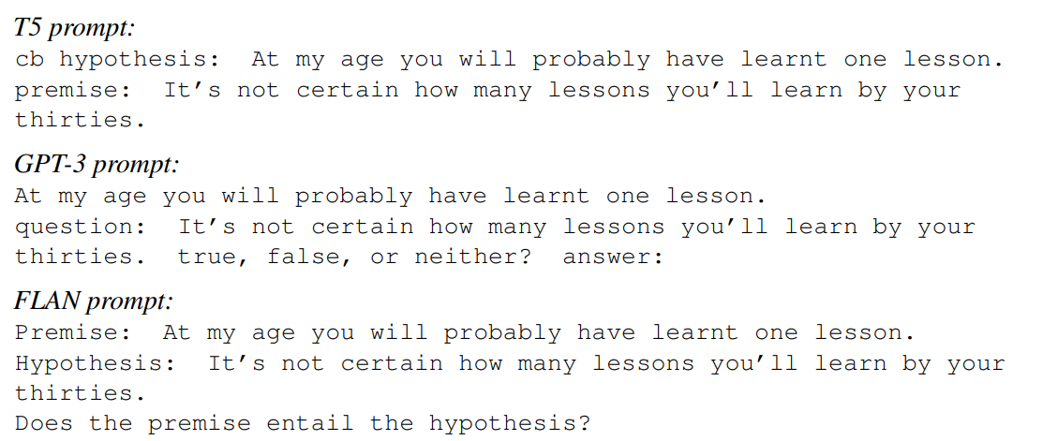
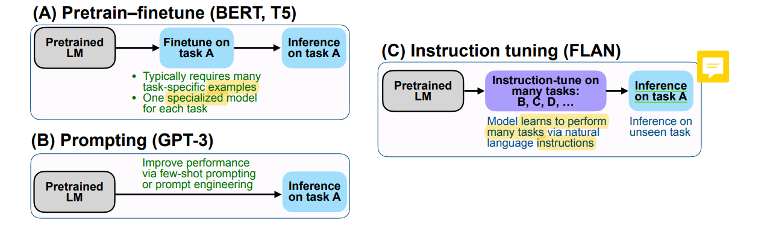
1 Introduction
Advance of Instruction Tuning
Bridges the gap:
Finetuning an LLM on the instruction dataset bridges the gap between the next-word prediction objective of LLMs and the users’ objective of instruction following.
Helps to Intervene model’s behaviors: constrain the model’s outputs align with the desired response
Without extensive retraining or architectural changes: IT is efficient and can help LLMs adapt to a specific domain without extensive retraining or architectural changes.
Make the model better understand the requirements of the task
Guide the model to generate accurately

Slide 6
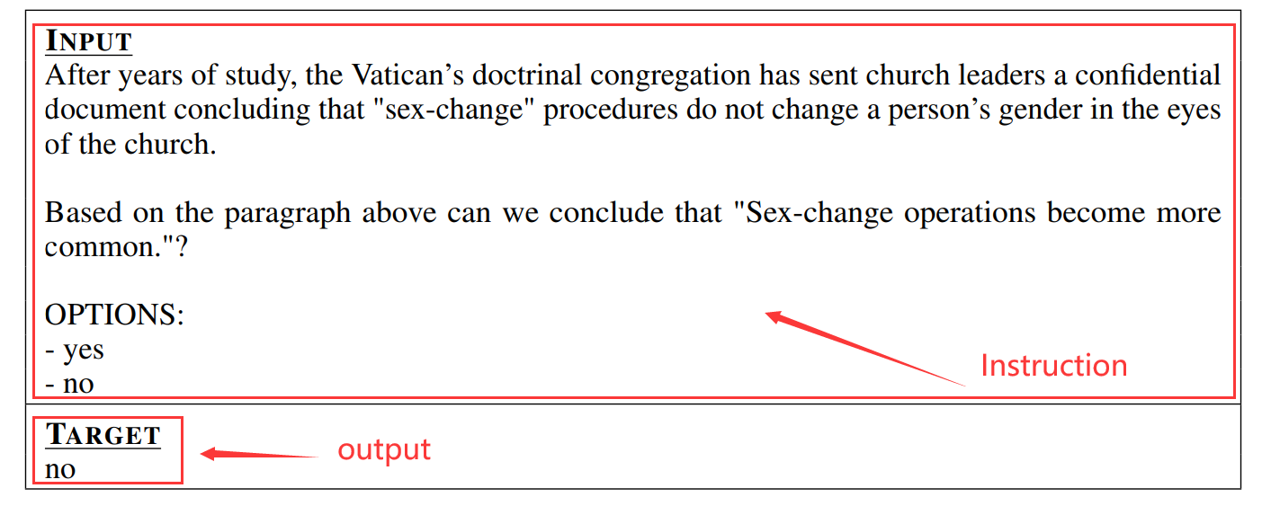
1 Introduction
Instruction tuning
Instruction tuning involves training LLMs using (INSTRUCTION, OUTPUT) pairs.
INSTRUCTION: represents the human instruction to the model
OUTPUT: represents the desired output that follows the INSTRUCTION.

Slide 7
2 General Methodology (Instruction Tuning)

Slide 8
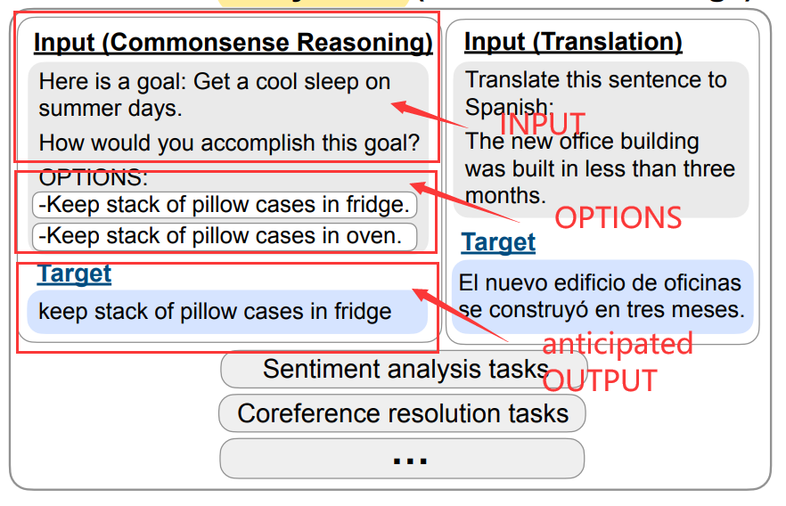
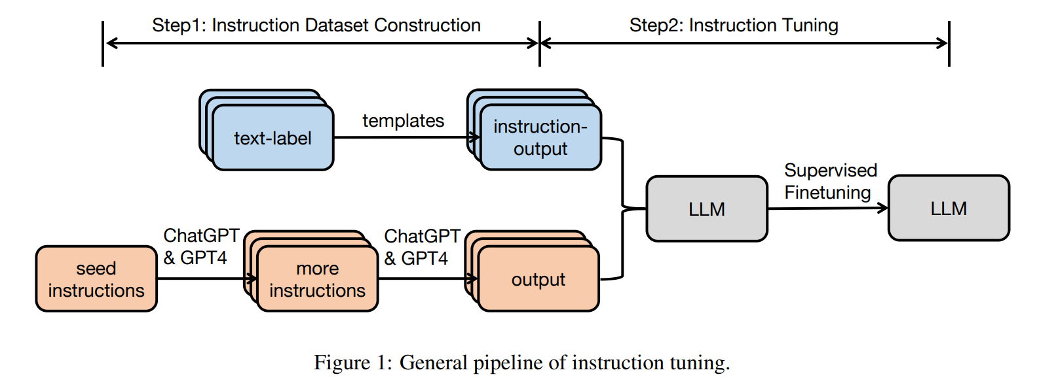
2 General methodology employed in instruction tuning
2.1 Instruction Dataset Construction (two methods)
consists of three elements
An instruction
An optional input
An anticipated output
There are generally two methods for constructing instruction datasets
- 1. Data integration from annotated natural language datasets (FLAN, P3)
- 2. Generating outputs using LLMs (InstructWild, Self-Instruct)
Text-label pairs → (instruction, output) pairs
(Instrcution, output)
expanded
2.2 Instruction Tuning
be directly fine-tuned in a fully supervised manner

Slide 9
Instruction tuning datasets
Natural Instructions; Super-Natural Instruction
(Mishra et al., 2021) Cross-task generalization via natural language crowdsourcing instructions. arXiv preprint arXiv:2104.08773
P3 (Public Pool of Prompts) ;xP3
(Sanh et al., 2021) Multitask prompted training enables zero-shot task generalization. arXiv preprint arXiv:2110.08207.
FLAN (Finetuned Language Net)
(Jason et al., 2022) FINETUNED LANGUAGE MODELS ARE ZERO-SHOT LEARNERS
Dolly、OpenAssistant Conversations
Alpaca、WizardLM / Evol-Instruct. 、Orca and Orca-2

Slide 10
3 FLAN

Slide 11
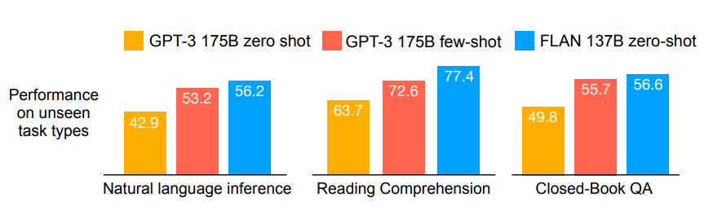
3.1 Intro. of FLAN
Flan(Finetuned Language Net) is an instruction-tuned model proposed by Google Research to improve the zero-shot performance of LLMs.
They take a pretrained language model of 137B parameters and perform instruction tuning
finetuning the model on a mixture of more than 60 NLP datasets

Slide 12
3.2 Methodology of FLAN

Slide 13
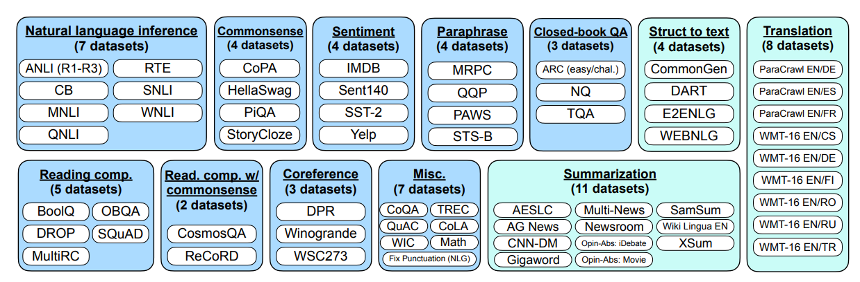
3.2 Methodology of FLAN
Creating an instruction tuning dataset: from scratch → is resource-intensive
they transform existing datasets from the research community into an instructional format.
All of these datasets were categorized into one of twelve task clusters, tasks in same cluster are of same type.
62 text datasets
both language understanding and language generation tasks

Slide 14
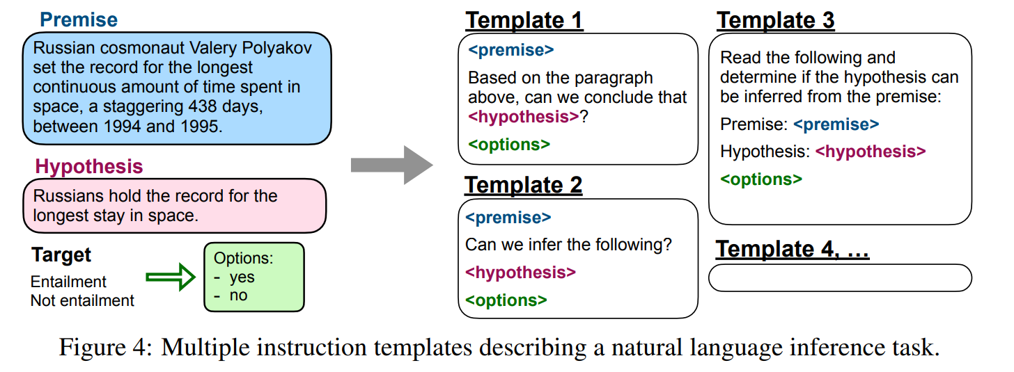
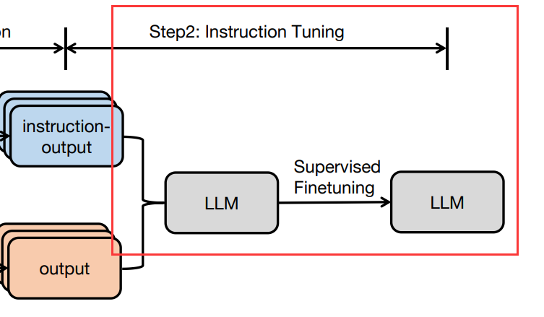
3.2 Methodology of FLAN
For each dataset: compose 10 unique templates (multiple instruction templates)
most of them described the original task ;
at least three of them are “turned the task around” task
(e.g., for sentiment classification it include templates asking to generate a movie review)
ask in different instruction formats
They then instruction tune a pretrained language model on the mixture of all datasets

Slide 15
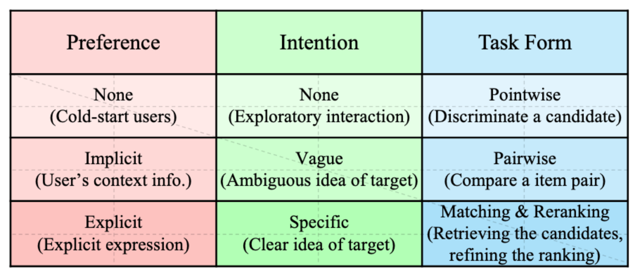
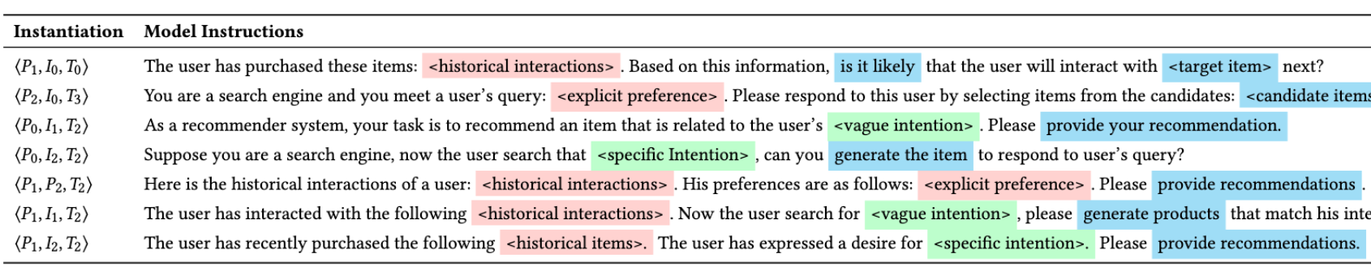
WHY “turned the task around” task matters?
WHY “turned the task around” task matters?
Recommendation system using IT as example:
Transforms users’ preferences, intentions and task form into instructions, and uses these instructions to fine-tune an LLM
Zhang J, Xie R, Hou Y, et al. Recommendation as instruction following: A large language model empowered recommendation approach[J]. arXiv preprint arXiv:2305.07001, 2023.

Slide 16
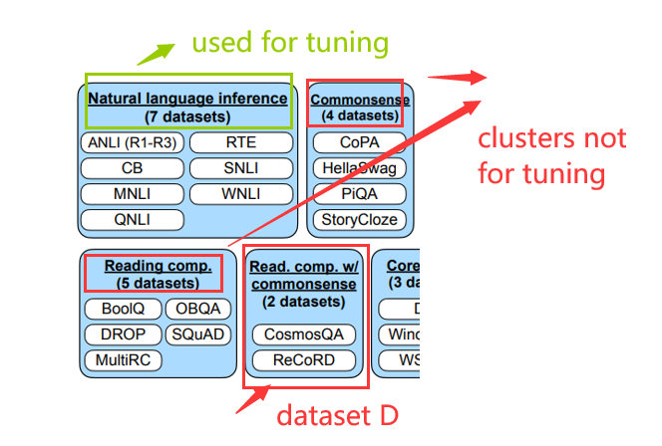
3.2 Methodology of FLAN
Performances on unseen tasks
Interested in how FLAN performs on tasks not seen in instruction tuning
- To define what counts as an unseen task?
Use a conservative definition that leverages the task clusters
At evaluation time, we only consider dataset D unseen
if no datasets from any task clusters that D belongs to were seen during instruction tuning.
For instance, if D is an entailment task, then no entailment datasets appeared in instruction tuning, and we instruction-tuned on all other clusters.
Evaluation the unseen tasks

Slide 17
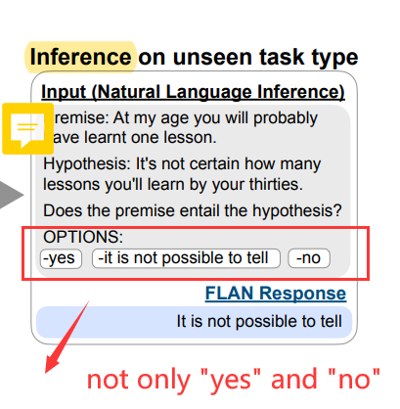
3.2 Methodology of FLAN
CLASSIFICATION WITH OPTIONS
For classification tasks, prior work only used a rank classification approach, for example, only two outputs (“yes” and “no”) are considered and the higher probability one is taken as the model’s prediction.
However, it’s imperfect.
Due to different ways of saying each answer,
they may cause an undesired distribution of probability mass for answers
(e.g., a large number of alternative ways of saying “yes” may lower the probability mass assigned to “yes”).
They include an options suffix, they append the token OPTIONS to the end of a classification task along with a list of the output classes for that task.

Slide 18
3.2 Methodology of FLAN
Model architecture and pretraining
use LaMDA-PT, a dense left-to-right, decoder-only transformer language model of 137B parameters
Instruction tuning procedure
The IT pipeline mixes all datasets and randomly samples from each dataset
To balance the different sizes of datasets:
limit the number of training examples per dataset to 30k (for some large dataset)
follow the examples-proportional mixing scheme with a mixing rate maximum of 3k(for small dataset)
Finetune all models for 30k gradient steps with a batch size of 8,192 tokens using Adafactor optimizer with learning rate of 3e-5
The input sequence: 1024; target sequence lengths: 256

Slide 19
3.3 Result and Evaluation
19

Slide 20
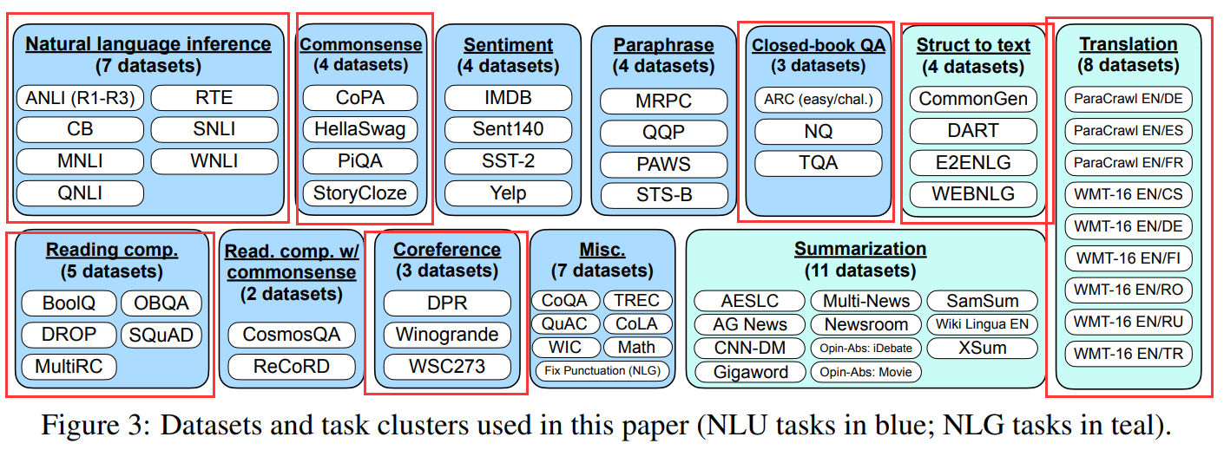
3.3 Evaluation
We evaluate FLAN on natural language inference, reading comprehension, closed-book QA, translation, commonsense reasoning, coreference resolution, and struct-to-tex.
It evaluates on unseen tasks by grouping datasets into task clusters and holding out each cluster for evaluation while instruction tuning on all remaining clusters

Slide 21
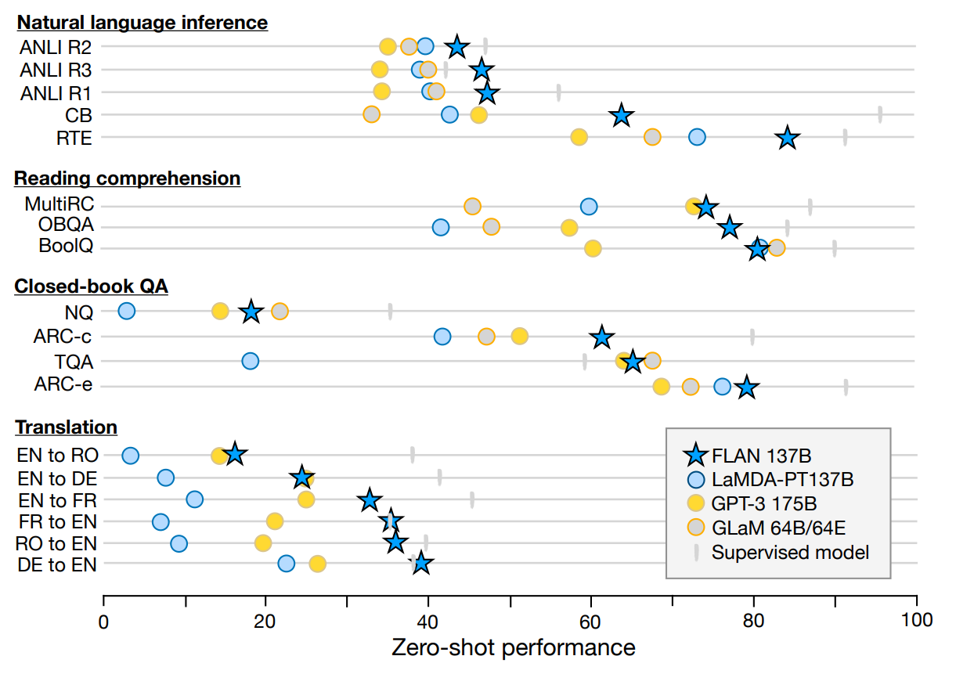
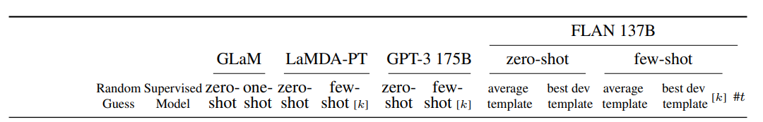
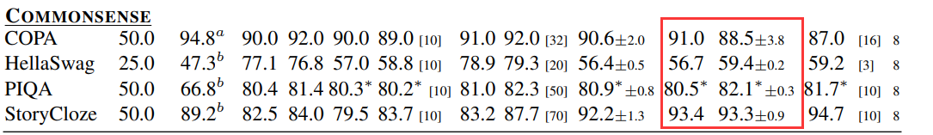
3.3 Result
For each dataset, evaluate the mean of performance on all templates
For comparison:
zero and few-shot performances of LaMDA-PT using the same prompts as GPT-3
zero-shot performances of GPT-3 175B
zero-shot performances of GLaM 64B/64E
Supervised models were either T5, BERT, or translation models

Slide 22
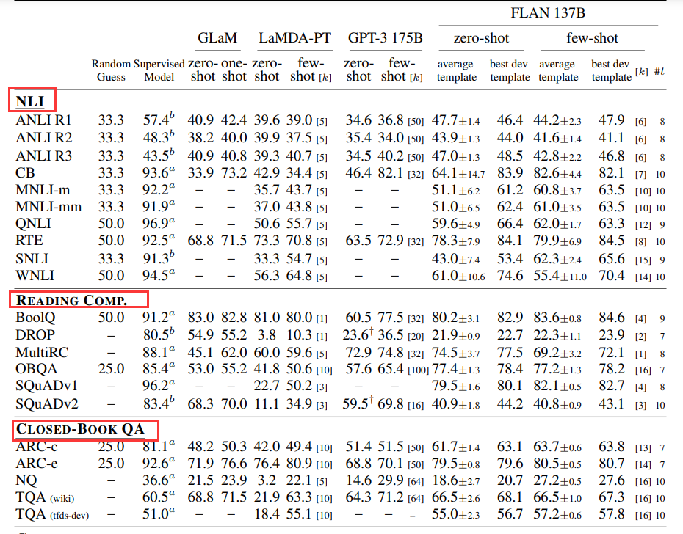
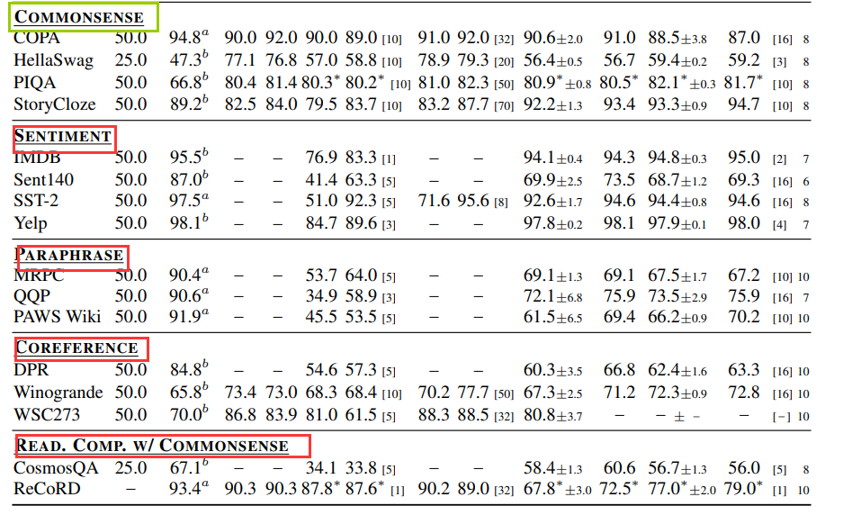
3.3 Result
effective on tasks naturally described as instructions; (NLI, QA, translation)
less effective on tasks directly formulated as language modeling(commonsense reasoning)

Slide 23
Ablation studies
Ablation studies reveal that number of finetuning datasets, model scale, and natural language instructions are key to the success of instruction tuning.
1. Number of instruction tuning cluster
2. Scaling lows
3. Role of Instructions

Slide 24
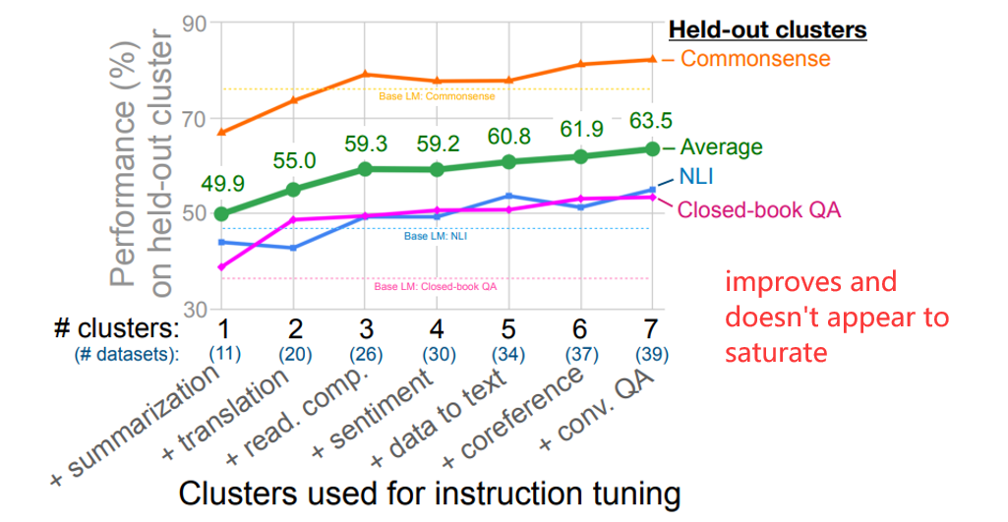
Ablation studies —— Number of instruction tuning cluster
In this first ablation, it examines how performance is affected by the number of clusters and tasks used in instruction tuning

Slide 25
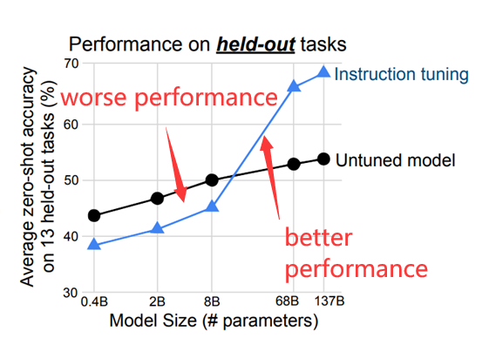
Ablation studies —— Scaling laws
In this second ablation, we next explore how the benefits of instruction tuning are affected by model scale
WHY hurts performance for small-scale models?
For small-scale models, learning many tasks used during instruction tuning fills the entire model capacity

Slide 26
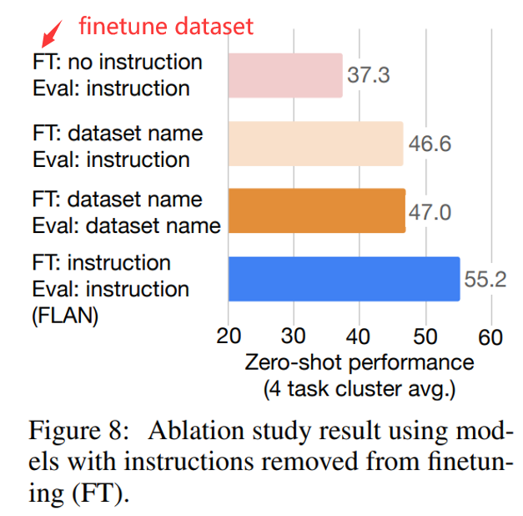
Ablation studies —— Role of instructions
In a final ablation study, we explore the role of instructions during finetuning
Can model perform well without instructions?
Therefore, considering two finetuning(FT) setups without instructions
In a no template setup, only inputs and outputs were given to the model
2. In a dataset name setup, each input is prepended with the name of the task and dataset
e.g., for translation the input would be “The dog runs.” and the output would be “Le chien court.”
“[Translation: WMT’14 to French] The dog runs.”)
—both ablation configurations performed substantially worse than FLAN

Slide 27
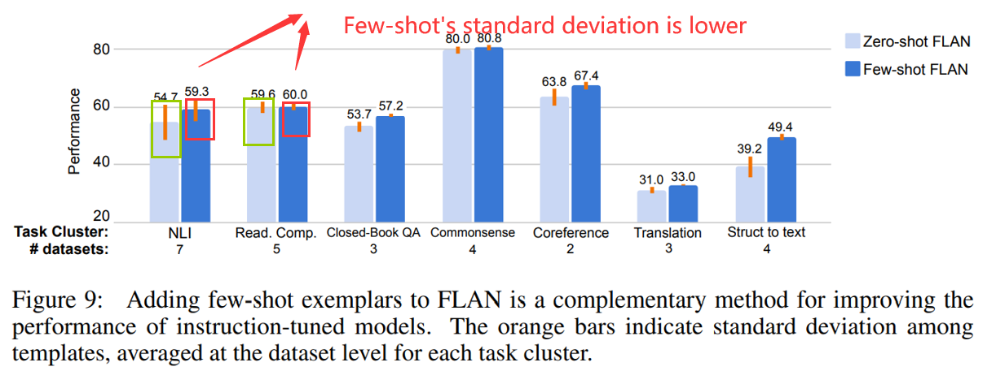
Instructions with few-shot exemplars
Here, we study how instruction tuning can be used when few-shot exemplars are available at inference time
Few-shot exemplars improve the performance on all task clusters, compared with zero-shot FLAN;
Standard deviation is lower for few-shot FLAN, indicating reduced sensitivity to prompt engineering
orange bars indicate standard deviation among templates

Slide 28
Conclusion

Slide 29
Conclusion and future work
Conclusion
FLAN ---- a instruction-tuning model that combines aspects of both the pretrain–finetune and prompting paradigms
Improves performance in unseen tasks(zero-shot) against an untuned model and surpasses zero-shot GPT-3 on the majority of tasks
Ablation studies reveal:
performance on unseen tasks improves with the number of instruction tuning task clusters
performance improvements emerges only with sufficient model scale
can be combined with other prompting methods such as few-shot prompting

Slide 30
Conclusion and future work
Limitations
Subjectivity: a degree of subjectivity in assigning tasks to clusters
Limited: only explore the use of relatively short instructions of a single sentence
Cost: 137B, costly to serve
Future work
gathering/generating more task clusters for finetuning
cross-lingual experiments
generate data for training downstream classifiers

Slide 31
Thank you for listening

