Slide 1
KGGen: Extracting Knowledge Graphs from Plain Text with Language Models
HUANG JIAHUI
2025/10/16
Data Engineering Lab, IPS, Waseda Univ.
Notes:
Hello everyone, I am Huang Jiahui. Today I will present a review and discussion about a paper called “KGGen: Extracting Knowledge Graphs from Plain Text with Language Models”. This study focuses on how we can use large language models to automatically construct high-quality knowledge graphs from unstructured text.

Slide 2
Outline
Introduction
Methodology
Experiment
Conclusion
Outline
Notes:
The presentation will follow four main sections:
First, I’ll introduce the background and motivation of knowledge graph extraction.
Then, I’ll describe the methodology proposed in the paper, including the KGGen framework.
After that, we’ll look at the experiments and benchmark results.
Finally, I’ll summarize the findings and discuss future work.

Slide 3
Introduction
Knowledge Graphs (KGs) consist of a set of subject-predicate-object triples
Example: (cryptocurrencies, enhance, security)
Most real-world KGs are far from complete
Scarcity and incompleteness
Questionable quality
Noise info
Lack of domain-specific knowledge
Hallucinations
3
Notes:
Knowledge graphs, or KGs, are structured representations composed of subject–predicate–object triples, such as (cryptocurrencies[krɪptoʊkɜːrənsi], enhance, security).
However, existing KGs like Wikidata and DBpedia suffer from scarcity[ˈskersəti] and incompleteness and low domain coverage. Automatically generated graphs often contain noise or even hallucinated facts. Therefore, there is a strong need for a new approach to build dense and accurate KGs from raw text.

Slide 4
Introduction
Existing methods for extracting KGs from plain text
OpenIE
Generates a “dependency parse” for each sentence
A learned classifier then traverses each edge in the dependency parse
Not require its input text to have a specific structure
GraphRAG
Integrated graph-based knowledge retrieval with language models
Generating KGs from plain text to use as its database
Prompting LMs to extract node-entities and relationships
Aggregates well-connected nodes into communities
4
Notes:
Existing methods for extracting KGs from plain text are OpenIE and GraphRAG.
OpenIE, which parses sentences and identifies triples using linguistic rules. It does not rely on text structure, which makes it flexible.
Microsoft’s GraphRAG integrated graph-based knowledge retrieval with language models. It generates nodes and relations using prompt-based extraction, then summarizes related nodes into communities.

Slide 5
Methodology
KGGen: Text-to-Knowledge-Graph
Overview
An open-source package that uses LMs to extract high-quality KGs from plain text
A multi-stage approach involving an LLM (in this case, GPT-4o)
3 Modules
Generate: Entity and Relation Extraction
Aggregate: Aggregation
Cluster: Entity and Edge Clustering
5
Notes:
To overcome these limitations, the authors propose KGGen, a text-to-knowledge-graph generator that uses large language models to automatically construct structured, dense, and high-quality graphs from plain text. The framework consists of three main modules:
Generate – entity and relation extraction,
Aggregate – consolidation of multiple graphs,
Cluster – merging synonymous entities. This pipeline ensures better coherence and reduces redundancy.

Slide 6
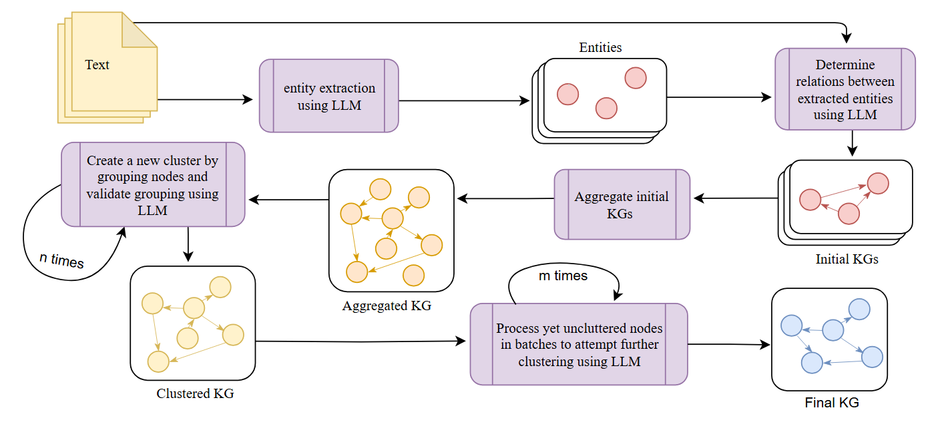
Methodology
Figure 1: KGGen extraction method
6

Slide 7
Generate: Entity and Relation Extraction
2-step approach
1st step: take unstructured text as input and invoke the GPT-4o model to output detected entities
2nd step: invoke a second LLM call to output the subject-predicate-object relations
LLM
LLM
Unstructured Text
Entities
Initial KGs
7
Notes:
In the first module, KGGen extracts entities and relations in two stages.
First, it takes unstructured text as input and invoke the GPT-4o model to extract entities.
In the second step, it invokes a second LLM call to output the subject-predicate-object relations
This two-step design improves consistency between entities and their relationships.

Slide 8
Aggregate: Aggregation
Collect all the unique entities and edges across all source graphs
Combine them into a single graph
All entities and edges are normalized to be in lowercase letters only
Reduces redundancy
Initial KGs
Aggregated KGs
8
Notes:
The second module is aggregation module.
This module collect all the unique entities and edges across all source graphs and normalizes all entities and relations to lowercase and removes duplicates.
This step ensures that the resulting graph is more compact and unified before clustering.

Slide 9
Cluster: Entity and Edge Clustering(Key Innovation)
Aggregated KG is a raw graph containing duplicate or synonymous entities and possibly redundant edges
Merge nodes and edges representing the same real-world entity or concept
Use an iterative LLM-based approach to clustering(inspired by humans)
Use LLM-as-a-Judge call to validate
9
Notes:
The clustering module is the key innovation of KGGen. Since the aggregated KG is a raw graph containing duplicate or synonymous entities and possibly redundant edges, it is necessary to merges entities that refer to the same concept.
In this module, we use an iterative LLM-based approach to clustering( which is inspired by humans) and use LLM-as-a-Judge call to validate
The LLM plays two roles here: it proposes clusters and then acts as a semantic[sɪˈmæntɪk] judge to validate them.

Slide 10
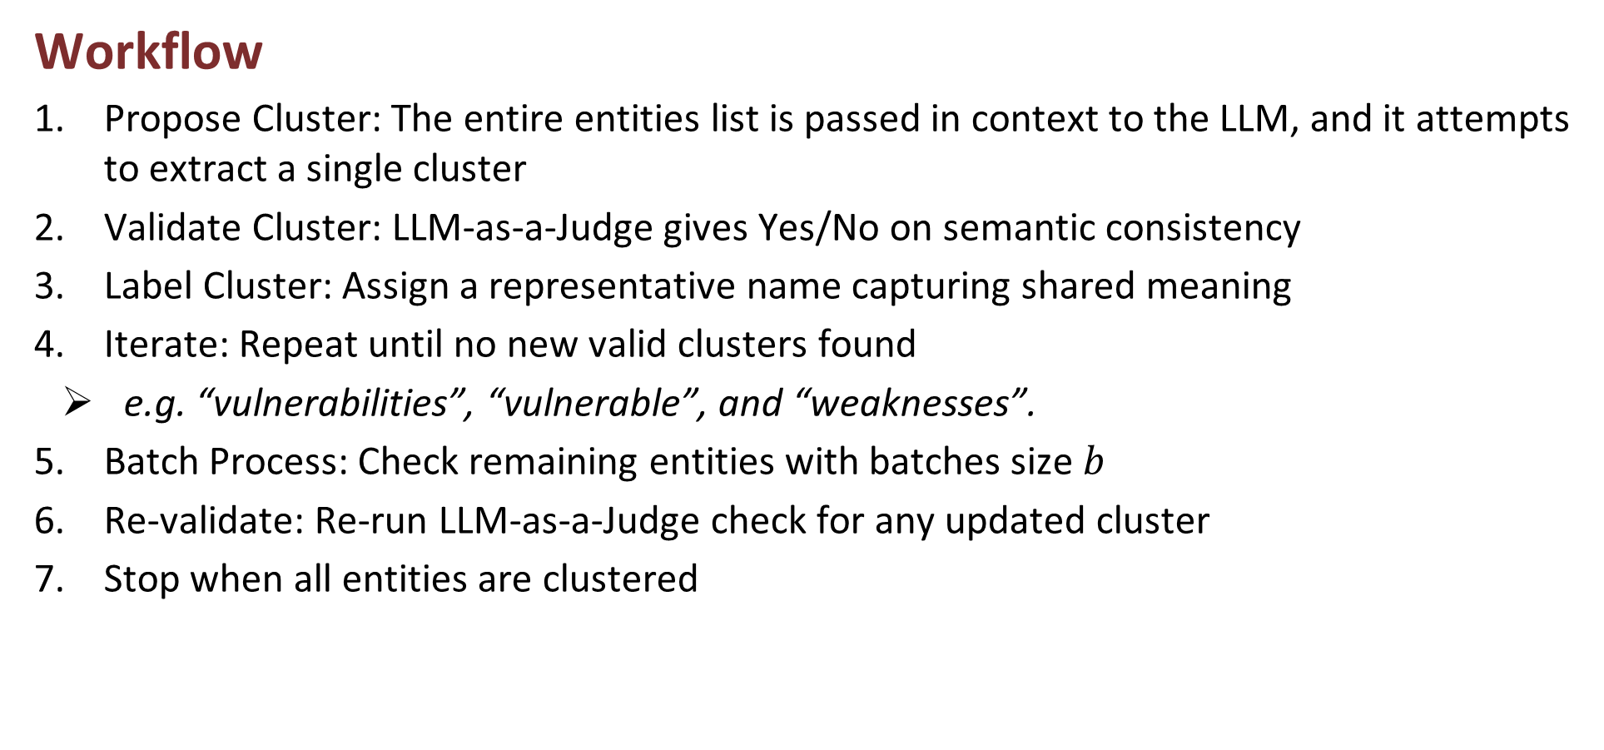
Cluster: Entity and Edge Clustering(key innovation)
Workflow
Propose Cluster: The entire entities list is passed in context to the LLM, and it attempts to extract a single cluster
Validate Cluster: LLM-as-a-Judge gives Yes/No on semantic consistency
Label Cluster: Assign a representative name capturing shared meaning
Iterate: Repeat until no new valid clusters found
e.g. “vulnerabilities”, “vulnerable”, and “weaknesses”.
Batch Process: Check remaining entities with batches size $b$
Re-validate: Re-run LLM-as-a-Judge check for any updated cluster
Stop when all entities are clustered
10
Notes:
Here shows the workflow of clustering.
4. It iteratively merges entities that refer to the same concept — for example, “vulnerability”, “vulnerable”, and “weakness”.

Slide 11
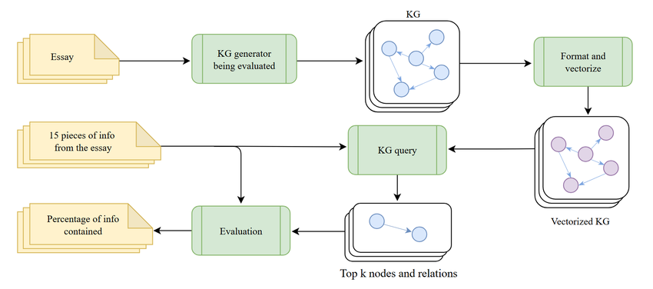
Benchmark: MINE
Measure of Information in Nodes and Edges
The first benchmark that measures a knowledge-graph extractor’s ability to capture and distill a body of text into a KG
Figure 2: Evaluation process used in MINE
11
Notes:
To evaluate KGGen, the authors developed a benchmark-MINE, short for Measure of Information in Nodes and Edges. It is the first systematic benchmark for text-to-KG extraction. Figure2 illustrates the complete evaluation process used in MINE.
Text Input Phase: The system receives 100 texts generated or selected by a language model, each approximately 1,000 words long.
Fact Extraction Phase: The language model extracts 15 facts (subject-verb-object structure) from each text.
Knowledge Graph Generation Phase: The knowledge graph is generated using the tested
Query and Verification Phase: The most relevant nodes are retrieved based on semantic similarity, and the language model determines whether each fact can be inferred from the relationships in the graph.
Output Phase: The MINE score (i.e., the proportion of correctly inferred facts) is calculated for each extraction method.

Slide 12
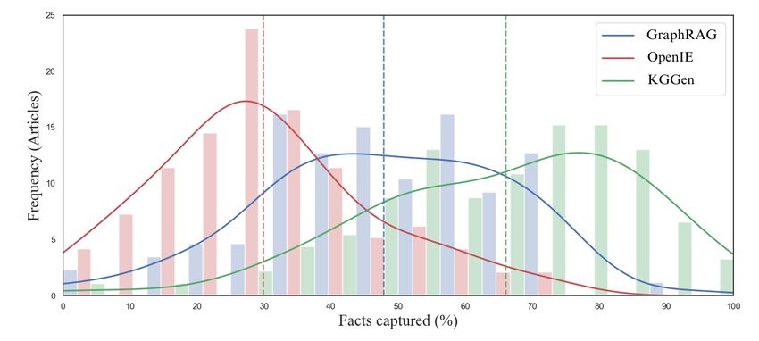
Experiment
Result
KGGen | GraphRAG | OpenIE
66.07% | 47.8% | 29.84%
Figure 3: Distribution of MINE scores across 100 articles for GraphRAG, OpenIE, and KGGen
12
Notes:
Let’s move to the experiment results.
Figure3 shows the distribution of MINE scores across 100 articles for GraphRAG, OpenIE, and KGGen.
KGGen achieves an average accuracy of 66.07%, significantly outperforming GraphRAG and OpenIE.

Slide 13
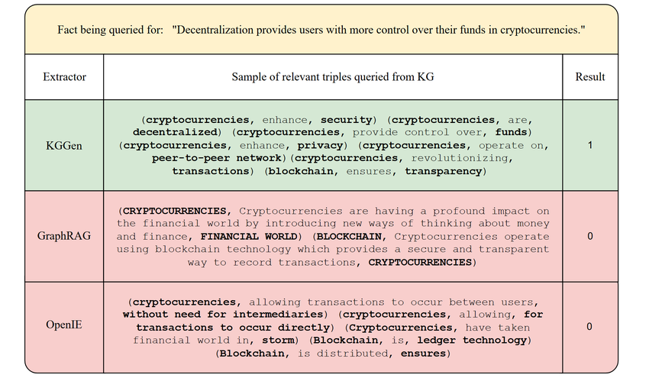
Experiment
Figure 4: An example query from the MINE benchmark, along with relevant relations in the KGs extracted by KGGen, GraphRAG, and OpenIE
13
Notes:
Fig4 shows an example query from the MINE benchmark, along with relevant relations in the KGs extracted by KGGen, GraphRAG, and OpenIE. Note that the relation triples extracted by KGGen contain the fact being queried for, whereas the KGs extracted by GraphRAG and OpenIE do not. The relation types extracted by KGGen are more concise and generalize more easily than those from GraphRAG and OpenIE.

Slide 14
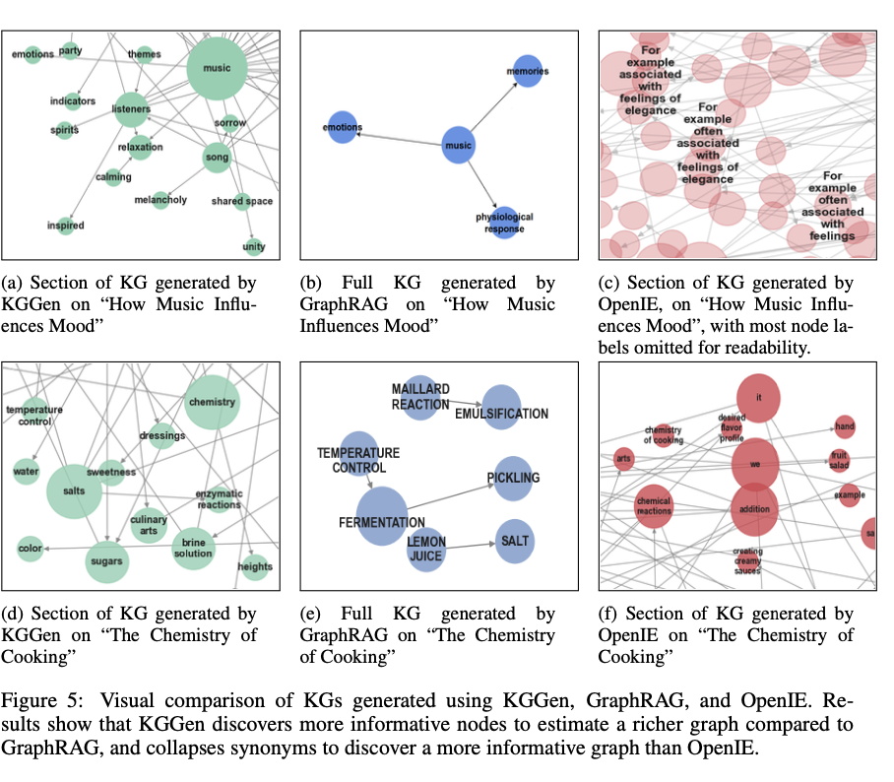
Experiment
GraphRAG
Generates a minimal number of nodes and connections
Omission of critical relationships and information
OpenIE
Redundant and generic nodes
KGGen
KGs are dense and coherent
Capturing critical relationships and information
14
Notes:
Fig5 shows the visual comparison of KGs generated by KGGen, GraphRAG and OpenIE.
The comparison further shows that KGGen produces dense and coherent graphs, while GraphRAG’s are too sparse[spɑːrs] (which may lead to the omission of critical information) , and OpenIE’s are too redundant or contain generic nodes like “it” or “are.”

Slide 15
Conclusion
KGGen
KGGen integrates three complementary processes (Generate → Aggregate → Cluster) that collectively enhance both precision and semantic density
LLM-as-a-Judge
Creatively use LLMs to evaluate and refine the KG
This self-evaluation mechanism mimics human-level semantic judgment
Benchmark: MINE
The first benchmark that measures a knowledge-graph extractor’s ability to capture and distill a body of text into a KG
15
Notes:
To summarize, KGGen integrates three complementary processes (Generate → Aggregate → Cluster) that collectively enhance both precision and semantic density which is critical for building high-quality knowledge graphs from plain text.
The authors creatively use LLM-as-a-Judge to evaluate and refine the KG
The proposed benchmark MINE is the first benchmark to measure a KG extractor’s ability to capture and distill a body of text into a KG.

Slide 16
Future Work
Limitation
KGGen: Over or under-clustering
MINE: Short corpora
Future Work
Explore more advanced clustering mechanisms to improve the quality of KGs
Extend to larger corpora in the future to verify its practicality in constructing real large-scale knowledge graphs
16
Notes:
Although KGGen beats existing methods by significant margins, the graphs still exhibit problems.
The clustering phase occasionally merges distinct concepts (over-clustering) or fails to merge synonyms (under-clustering)
More research into better forms of clustering could improve the quality of our KGs.
Additionally, the benchmark, MINE, currently measures performance on relatively short corpora, whereas KGs are primarily used to handle massive amounts of information efficiently.
Future work will extend to larger corpora to verify its practicality in constructing real large-scale knowledge graphs

Slide 17
Reference
[1] Mo, Belinda, et al. "KGGen: Extracting Knowledge Graphs from Plain Text with Language Models." arXiv preprint arXiv:2502.09956 (2025).
[2] Huang, Haoyu, et al. "Can LLMs be Good Graph Judge for Knowledge Graph Construction?." arXiv preprint arXiv:2411.17388 (2024).
[3] Anuyah, Sydney, et al. "Automated Knowledge Graph Construction using Large Language Models and Sentence Complexity Modelling." arXiv preprint arXiv:2509.17289 (2025).
17
Notes:
Here are the main references cited in this presentation

Slide 18
Thank You
Data Engineering Lab, IPS, Waseda Univ.
Notes:
That’s all for my presentation, thank you for listening

