Slide 1
Game Review Recommendation via Personalized Sentiment-Aware Graphs with Lightweight LLM Profiling
HUANG JIAHUI
2025/09/25
Data Engineering Lab, IPS, Waseda Univ.

Slide 2
Outline
Abstract
Background
Problem definition
Methodology
Experiment
Future Work
Outline

Slide 3
Introduction — Why It Matters
Traditional recommenders use clicks and purchases
Miss rich details in review text
e.g., gameplay, graphics, stability
Our goal: Use review text — make recommendations more accurate and transparent
3

Slide 4

Introduction — A Motivating Example
“This is a great game to play when you want a little something different from your sims. Including missions, fatalities and lots of active game play. Great price on Amazon.”
What We Want to Capture
Purchase data only shows: The user bought the game.
Review text reveals specific preferences:
Likes Gameplay Variety
Prefers Active Gameplay
Is sensitive to Price/Value
4

Slide 5
Introduction — Related Work
How Our Approach is Different
Existing Work - PURE Framework(Bang and Song, 2025)
LLM builds profile; LLM re-ranks
Pros: strong language priors
Cons: cost, variance, latency
Our Approach:
Closed-world 7-aspect labels
LLM offline (500 reviews)
Rely on a deterministic alignment score for ranking.
5

Slide 6
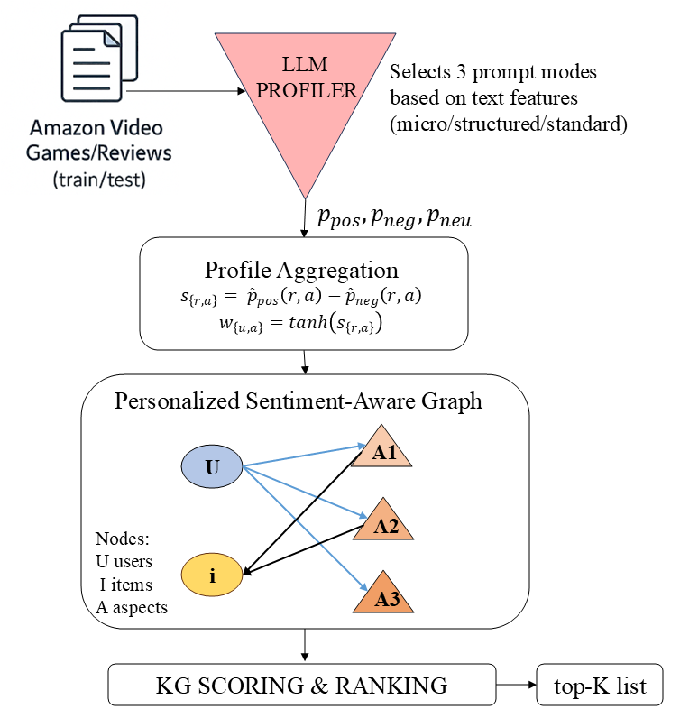
APPROACH
Overview
Review = user, item, time, rating, text
Goal: rank items + short aspect explanation
Schema (7) + OVERALL fallback
Aspect | Example
preference.fit | genre, difficulty
aesthetics.visual | graphics, art style
aesthetics.audio | soundtrack, voice acting
hci.interaction | controls, UI
market.perception | price, value
software.quality | bugs, performance
cultural.impact | story, community
6

Slide 7
APPROACH
LLM profiler
Closed-world constraint
3 modes: micro / structured / standard
MICRO prompt (very short text)
Task:
- Return ONE or TWO aspects max from CandidateAspectIDs (prefer preference.fit or market.perception for micro texts).
- Provide p_pos, p_neg, p_neu (sum = 1) and a short evidence_span.
- If text is generic praise (e.g., "Perfect", "Excellent"), map to preference.fit with high p_pos.
STANDARD prompt (vector scoring)
Task:
- For EVERY aspect in CandidateAspectIDs, score (p_pos, p_neg, p_neu) summing to 1.
- Quote a short evidence_span for non-neutral aspects; if no evidence, use empty string and keep high p_neu.
- DO NOT invent new aspect names. Use the given IDs exactly.
STRUCTURED prompt (Pros/Cons style)
Task:
- Parse lines (e.g., "Pros:", "Cons:", "1.", "-") into sentences.
- For EACH sentence, assign exactly one aspect from CandidateAspectIDs and a polarity in {pos,neg,neu} with a short evidence_span.
- Then AGGREGATE by aspect to produce probabilities (p_pos, p_neg, p_neu) that sum to 1 per aspect.
7

Slide 8
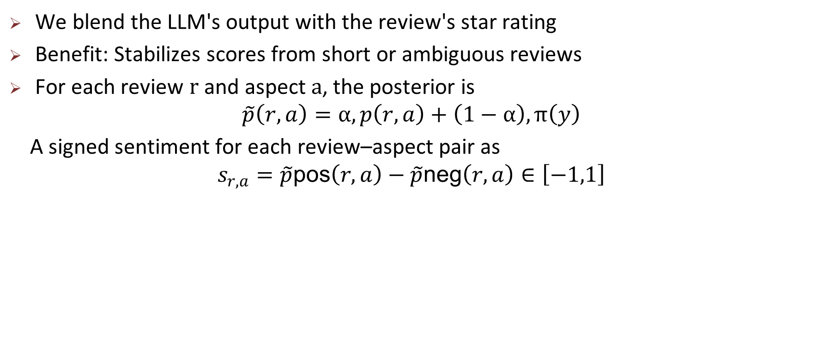

APPROACH
Rating-prior fusion
We blend the LLM's output with the review's star rating
Benefit: Stabilizes scores from short or ambiguous reviews
For each review $r$ and aspect $a$, the posterior is
$$\tilde{p}\left(r,a\right)=α,p\left(r,a\right)+\left(1−α\right),π\left(y\right)$$
A signed sentiment for each review–aspect pair as
$$s_{r,a}=\tilde{p}\text{pos}\left(r,a\right)−\tilde{p}\text{neg}\left(r,a\right)∈\left[−1,1\right]$$
Aggregation
Combine per-review aspect scores into unified User Profiles and Item Profiles
For a user u and aspect a, the weight is
$$w_{\left\{u,a\right\}}=tanh\left(s_{\left\{r,a\right\}}\right)$$
on the item i side: aspect support as
$${supp}_{i,a}=\left|\left\{r∈R\left(i\right): s_{\left\{r,a\right\}}≠0\right\}\right|$$
8

Slide 9
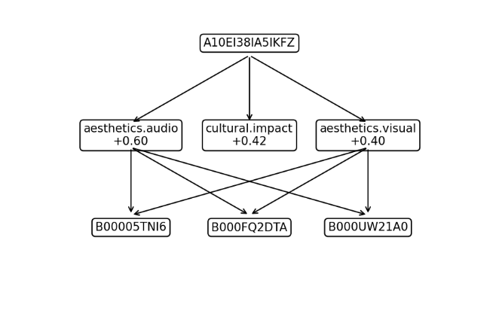
APPROACH
PSAG graph
Nodes: Users, Items, Aspects, Reviews
Edges: Capture preferences (PREFERS), features (HAS_ASPECT), and interactions.
User
items
PSAG Example
9

Slide 10
APPROACH
Deterministic Alignment
Scoring Logic: We align a user's positive aspect preferences with an item's aspect support.
Essentially an inner product:
Score(u,i)=∑ a∈Aspects​ UserPref(u,a)×ItemSupport(i,a)
Explanation Generation: The aspects that contribute most to the score generate the rationale.
Example: "Recommended because you like good graphics."
10

Slide 11
Experiment
Experimental setup
Dataset: Amazon Video Games (~500k reviews)
Protocol: Sampled ranking (1 positive + 99 negatives per user)
Metrics: HR@10, NDCG@10
LLM Usage:
GPT-4o-mini profiled 500 reviews offline.
No LLM calls during online inference/ranking
11

Slide 12
Experiment
Preliminary Results and Issues
 | HR@10 | NDCG@10
TopPop (Baseline) | 0.4135 | 0.2508
Our Method (PSAG-Align) | 0.4179 | 0.3678
A small gain in Hit Rate (HR), but a strong improvement in NDCG.
This means our method pushes the correct item higher up in the top-10 list.
12
Notes:
Gradual integration: If the effect is better, change Review Extractor to "only split sentences into vectorized + tags when encountering long reviews", and downgrade the responsibility of Profile Updater to "metadata maintainer" - the real evidence is taken on demand from the vector library.

Slide 13
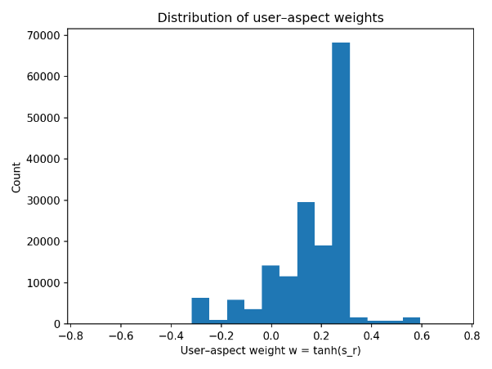
Experiment
What the profiler looks like
Aspect | Positive | Neutral
preference.fit | 250 | 24
aesthetics.visual | 80 | 8
aesthetics.audio | 25 | 5
market.perception | 76 | 9
cultural.impact | 13 | 0
hci.interaction | 55 | 5
software.quality | 33 | 4
OVERALL | 75 | 4
Sentiment polarity is informative:Overall sentiment is mildly positive (~70%), which aligns with star ratings.
Negative signals provide strong cues for aversion, often related to hci.interaction (controls), software.quality (bugs), and market.perception (price).
13

Slide 14
Experiment
Limitations
Partial LLM coverage
Dictionary triggers may miss nuance
Sampled ranking depends on negatives
14

Slide 15
Conclusion
What We Achieved
Method: We proposed a lightweight LLM profiler used offline with a deterministic graph-alignment score for ranking.
Novelty: Achieves text-aware recommendation without expensive online LLM calls.
Result: Significantly improved ranking quality (NDCG@10 from 0.2508 to 0.3678).
Impact: Demonstrates an effective, practical, and explainable approach.
Future Plan
Scale Up: Increase LLM profiling coverage beyond 500 reviews to measure performance gains.
Tune: Optimize the alignment score (e.g., prior strength, top-k aspects per user).
Explain: Improve the text generation for explanations grounded in graph paths.
15

