Slide 1
Research progress
Wang Dali
2025.9.30
Data Engineering Lab, IPS, Waseda Univ.

Slide 2
Content
Several attempts to incorporate relations as hints into the entity typing step
Experimental results

Slide 3
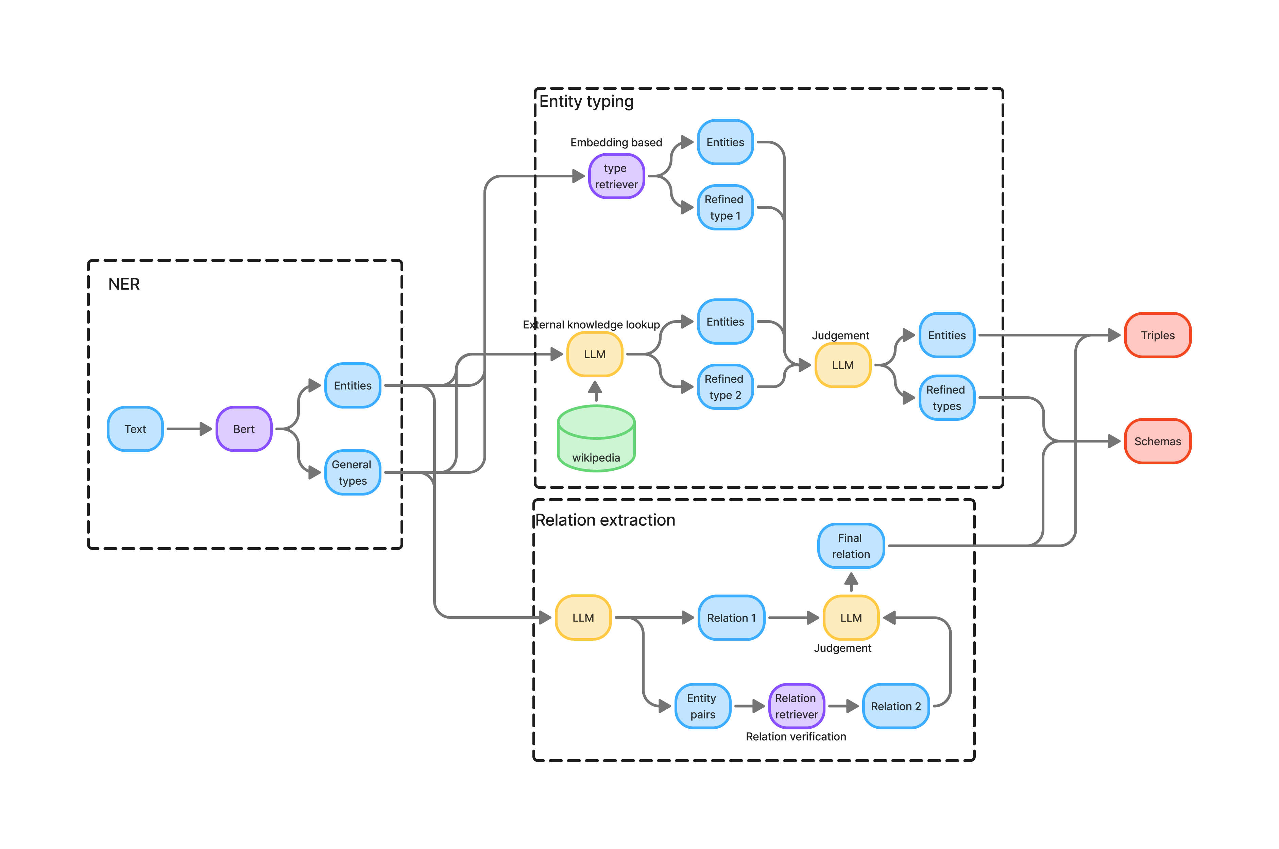
Overview of the framework (Recap)

Slide 4
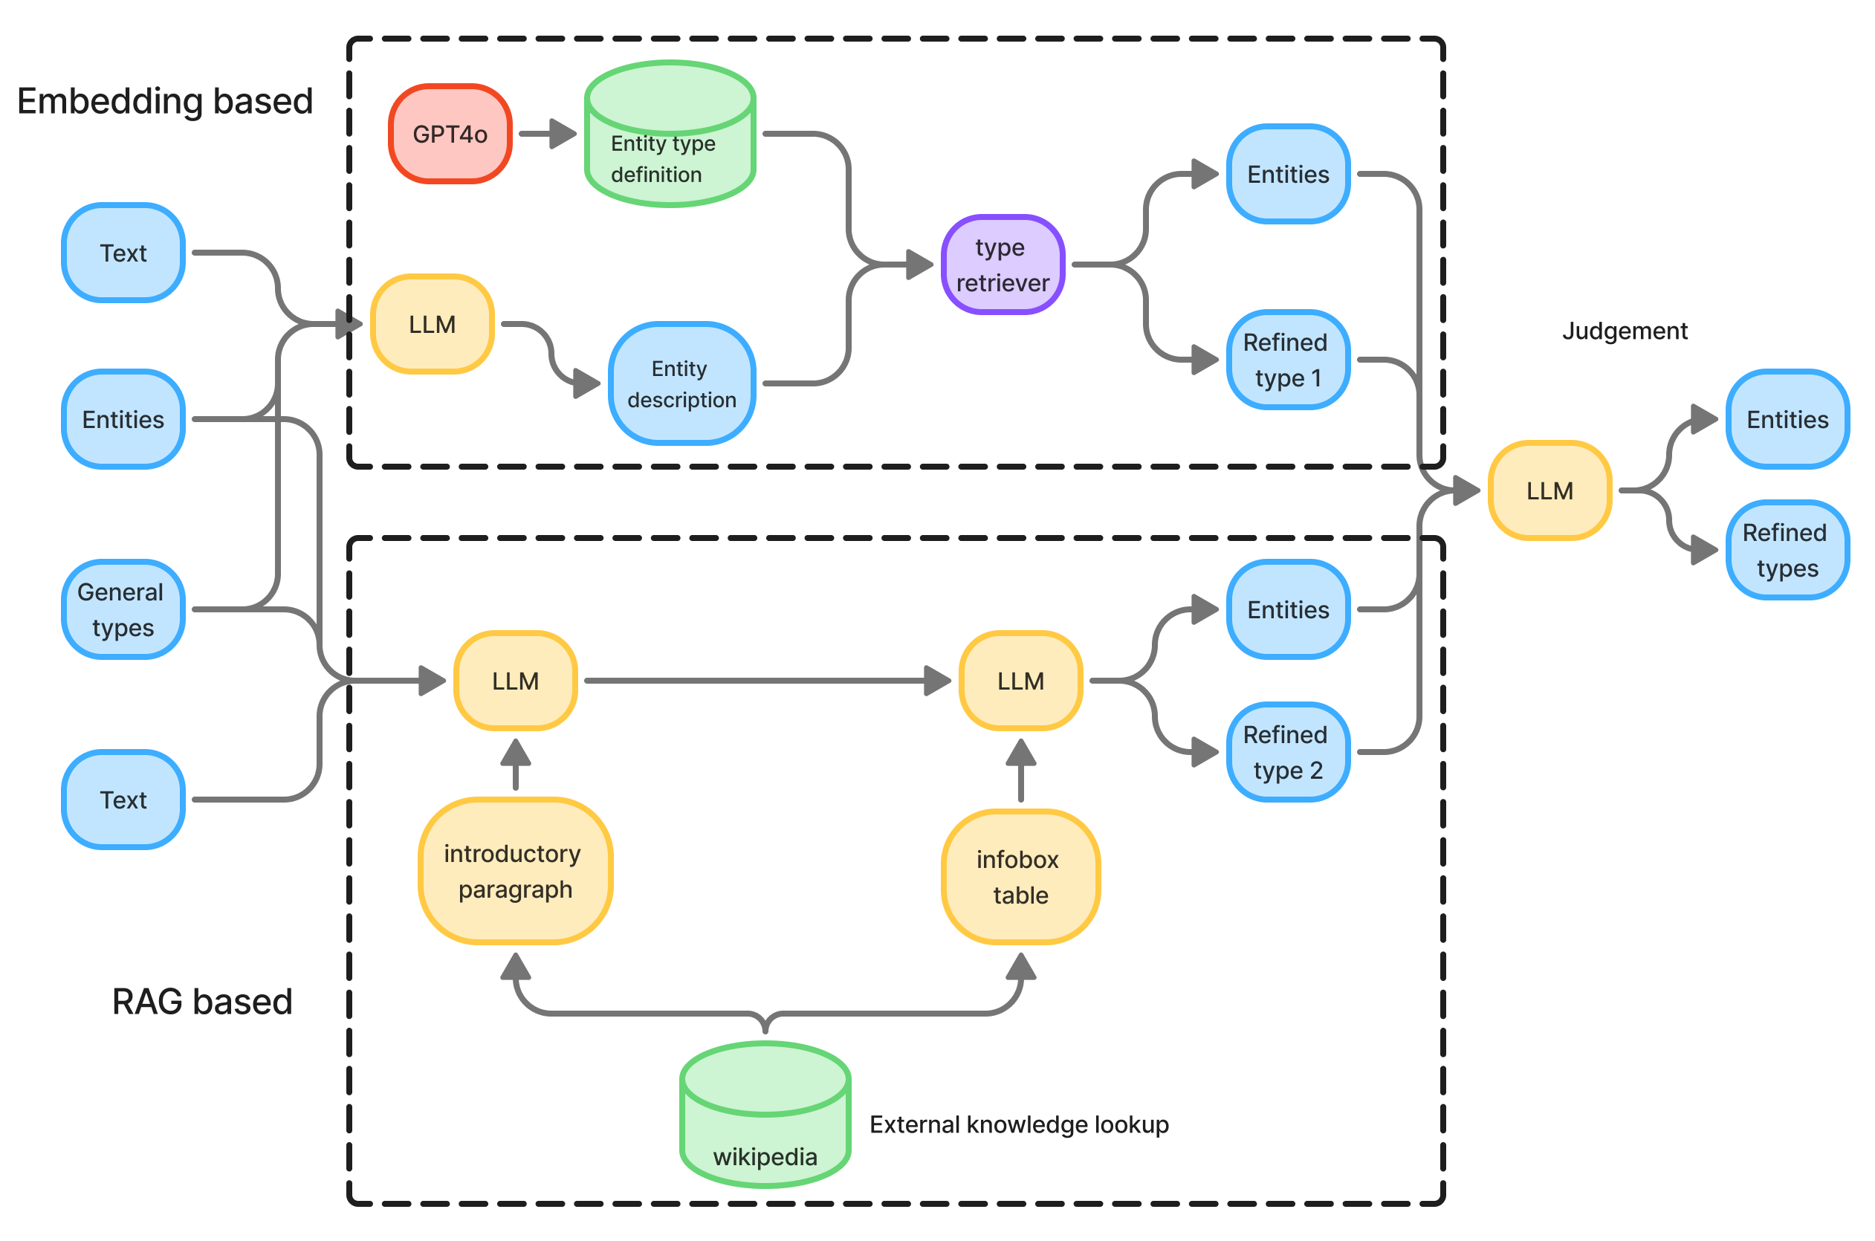
Internal details of entity typing (Recap)
Mainly consists of two parts: entity type refinement and entity type judgment
The embedding-based and RAG-based methods process the input entities and general entity types in parallel
entity type refinement
entity type judgment

Slide 5
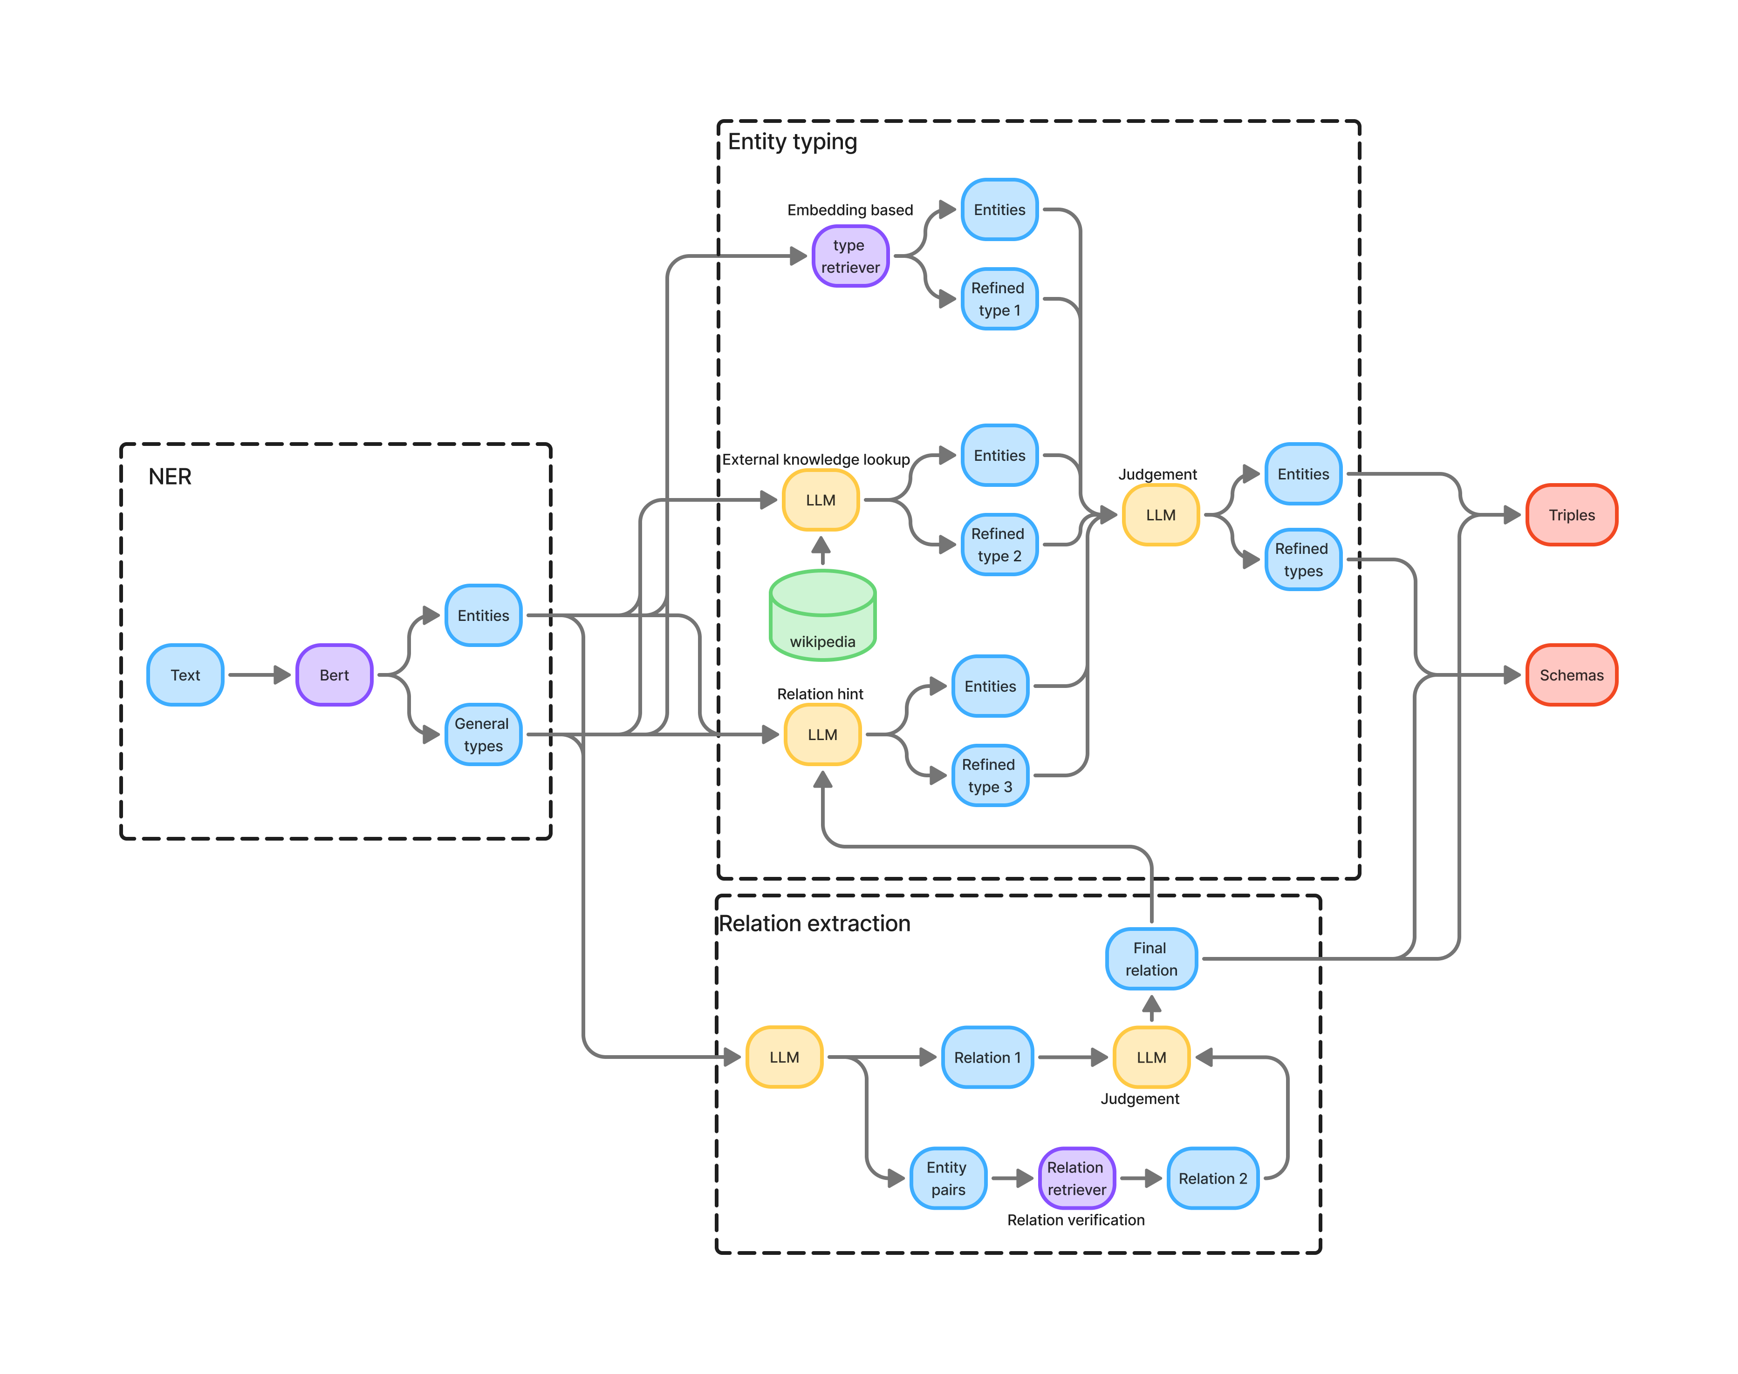
Overview of Attempt 1
Incorporating the relation hint into entity type refinement
Processing in parallel with embedding-based typing and RAG-based typing
Judging the outputs of the three to determine the final entity type
embedding-based typing
RAG-based typing
relation hint

Slide 6
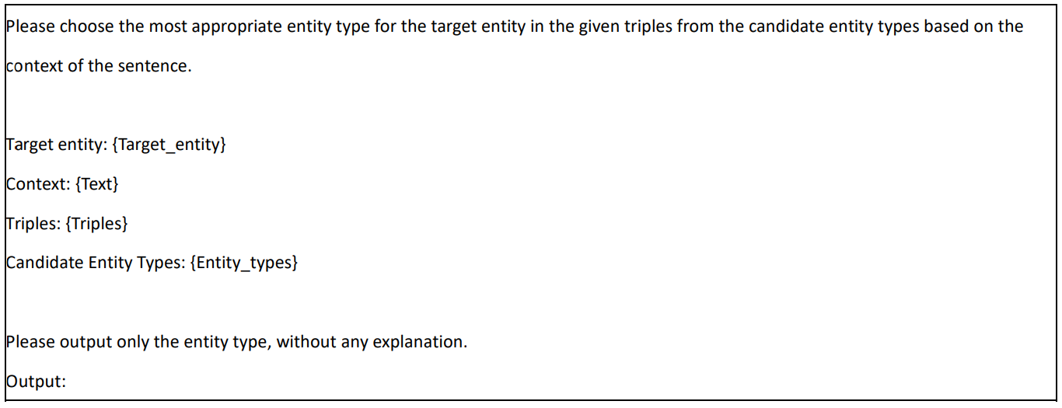
Prompt for Attempt 1
Incorporating the relation hint into entity type refinement
Typing one target entity at a time
Introduce the relation hint in the form of triples. The triples include all triples containing the target entity in the data entry, which can be one or multiple.
Includes all descendant types of the target entity’s general type in the hierarchy, which are written in the same format as in the baseline experiment to indicate hierarchical relations.

Slide 7
Experimental results of Attempt 1
Model | Llama3-8b |  |  |  | Phi-3-small |  |  |  | Qwen2.5-7b |  |  |  | Mistral-7b
setting | latest | last | pipline | joint | latest | last | pipline | joint | latest | last | pipline | joint | latest | last | pipline | joint
precision↑ | 0.652 | 0.644 | 0.464 | 0.392 | 0.572 | 0.562 | 0.349 | 0.485 | 0.708 | 0.676 | 0.544 | 0.572 | 0.611 | 0.589 | 0.464 | 0.479
recall↑ | 0.861 | 0.846 | 0.683 | 0.815 | 0.822 | 0.803 | 0.685 | 0.812 | 0.881 | 0.848 | 0.801 | 0.861 | 0.85 | 0.829 | 0.758 | 0.821
Micro F1↑ | 0.742 | 0.731 | 0.553 | 0.530 | 0.674 | 0.661 | 0.463 | 0.607 | 0.785 | 0.752 | 0.648 | 0.687 | 0.711 | 0.689 | 0.576 | 0.605
Macro F1↑ | 0.751 | 0.743 | 0.493 | 0.601 | 0.703 | 0.691 | 0.460 | 0.627 | 0.803 | 0.765 | 0.649 | 0.701 | 0.727 | 0.716 | 0.571 | 0.646
SS↑ | 0.478 | 0.575 | 0.264 | 0.228 | 0.44 | 0.562 | 0.299 | 0.423 | 0.552 | 0.632 | 0.485 | 0.440 | 0.423 | 0.534 | 0.381 | 0.471

Slide 8
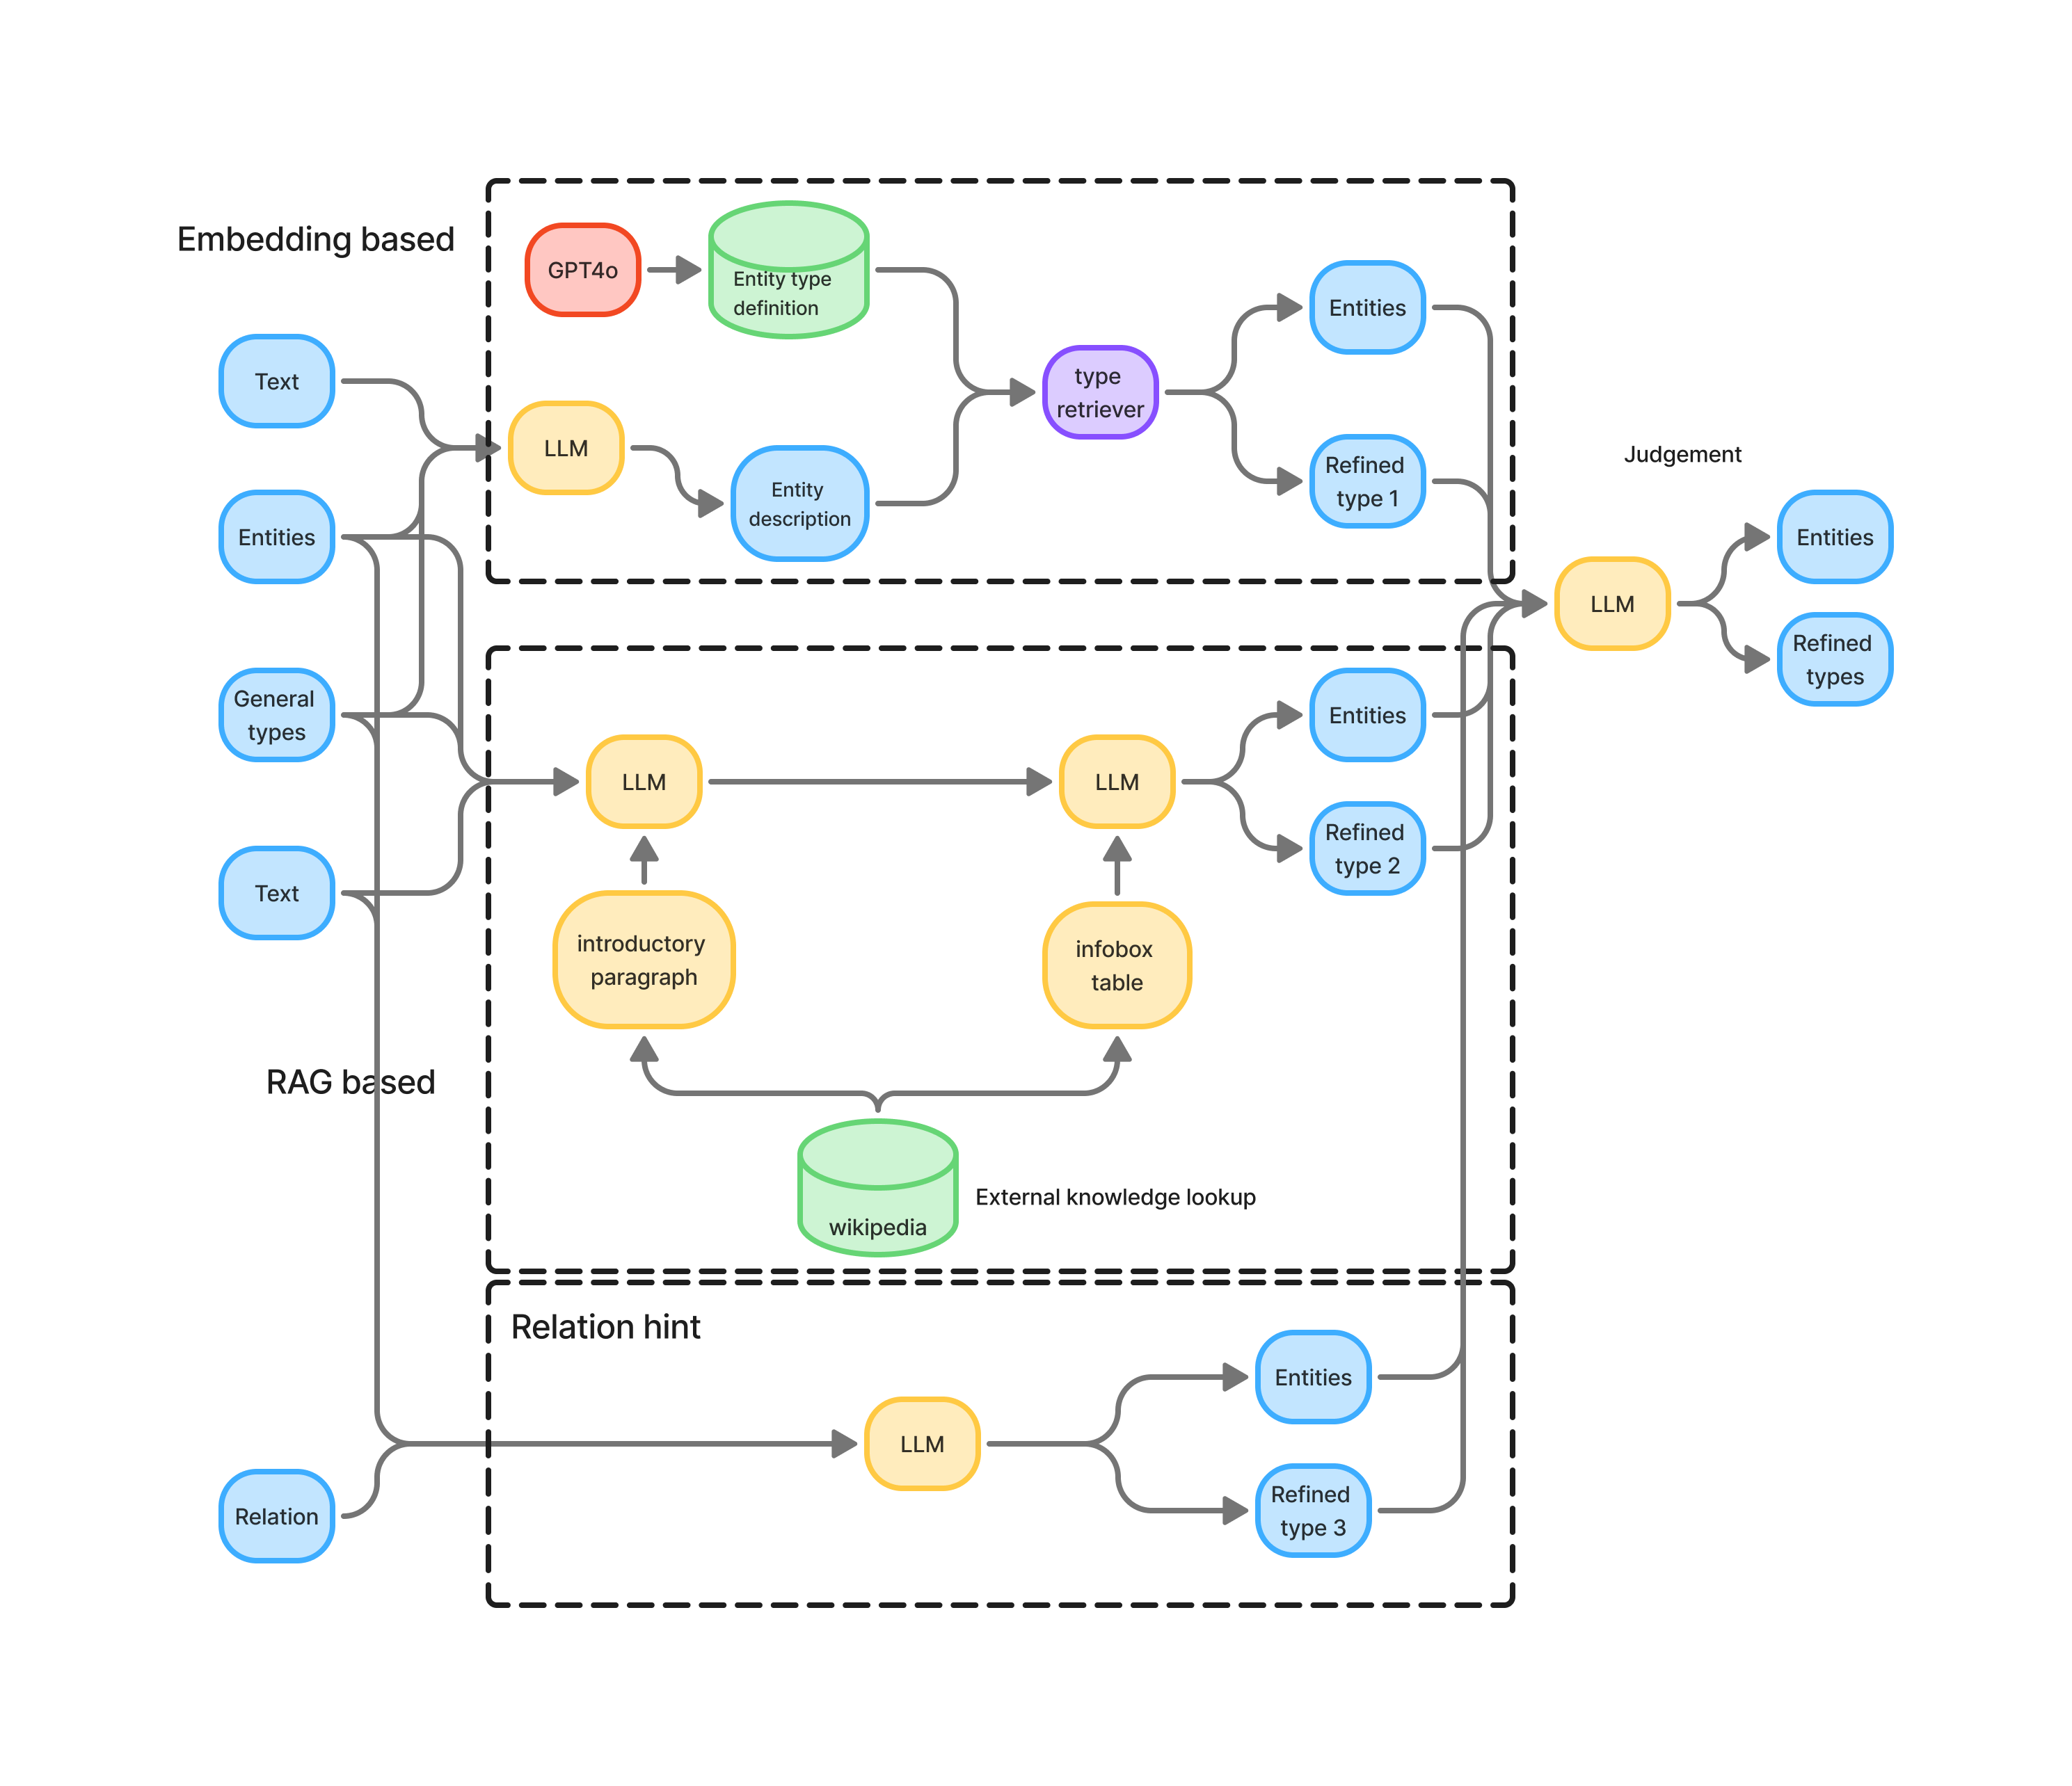
Analysis of the reason for performance degradation
The reference information provided to the LLM by the relation hint is less than that provided by the parallel embedding-based and RAG-based typing
No fine-tuned model and no external knowledge
Using equal weights to judge the outputs of the three methods affected the results

Slide 9
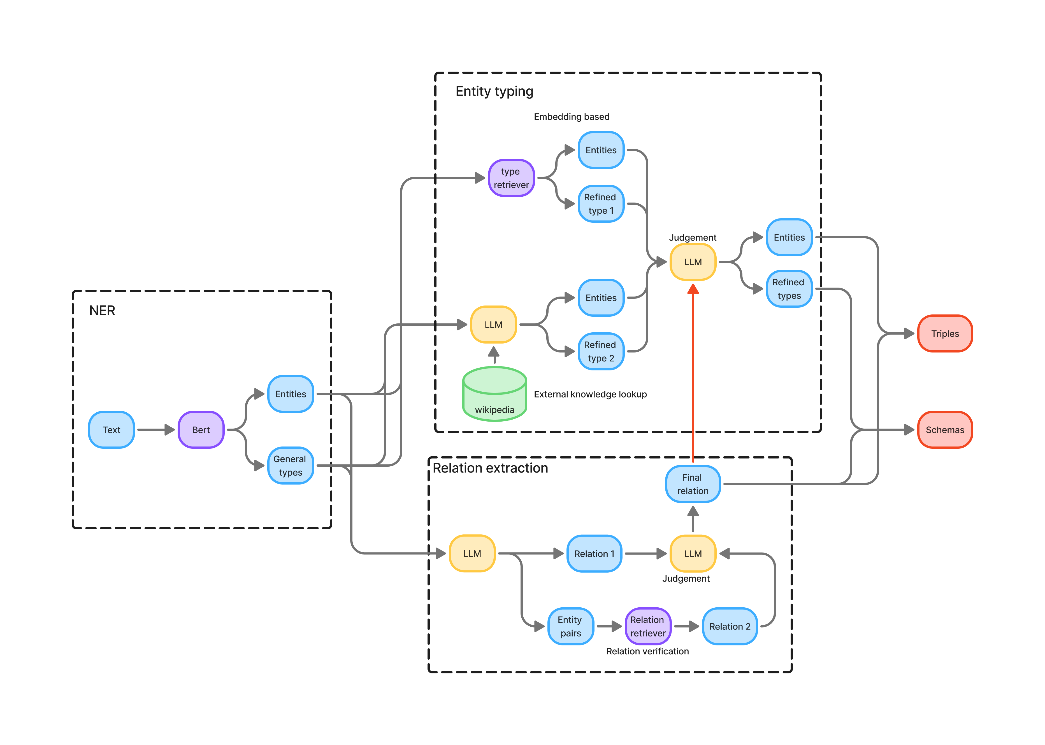
Overview of Attempt 2
Incorporating the relation hint into entity type judgement
Keep the structure of entity type refinement unchanged

Slide 10
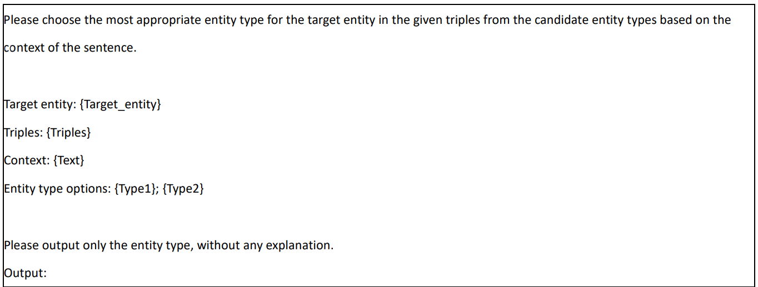
Prompt for Attempt 2
Incorporating the relation hint into entity type judgement
Introduce the relation hint in the form of triples
They are respectively the refined types output by RAG-based typing and embedding-based typing, and the LLM is asked to choose one of the two

Slide 11
Experimental results of Attempt 2
Model | Llama3-8b |  |  |  | Phi-3-small |  |  |  | Qwen2.5-7b |  |  |  | Mistral-7b
setting | latest | last | pipline | joint | latest | last | pipline | joint | latest | last | pipline | joint | latest | last | pipline | joint
precision↑ | 0.652 | 0.644 | 0.464 | 0.392 | 0.572 | 0.562 | 0.349 | 0.485 | 0.708 | 0.676 | 0.544 | 0.572 | 0.611 | 0.589 | 0.464 | 0.479
recall↑ | 0.861 | 0.846 | 0.683 | 0.815 | 0.822 | 0.803 | 0.685 | 0.812 | 0.881 | 0.848 | 0.801 | 0.861 | 0.85 | 0.829 | 0.758 | 0.821
Micro F1↑ | 0.742 | 0.731 | 0.553 | 0.530 | 0.674 | 0.661 | 0.463 | 0.607 | 0.785 | 0.752 | 0.648 | 0.687 | 0.711 | 0.689 | 0.576 | 0.605
Macro F1↑ | 0.751 | 0.743 | 0.493 | 0.601 | 0.703 | 0.691 | 0.460 | 0.627 | 0.803 | 0.765 | 0.649 | 0.701 | 0.727 | 0.716 | 0.571 | 0.646
SS↑ | 0.602 | 0.575 | 0.264 | 0.228 | 0.587 | 0.562 | 0.299 | 0.423 | 0.655 | 0.632 | 0.485 | 0.440 | 0.549 | 0.534 | 0.381 | 0.471

Slide 12
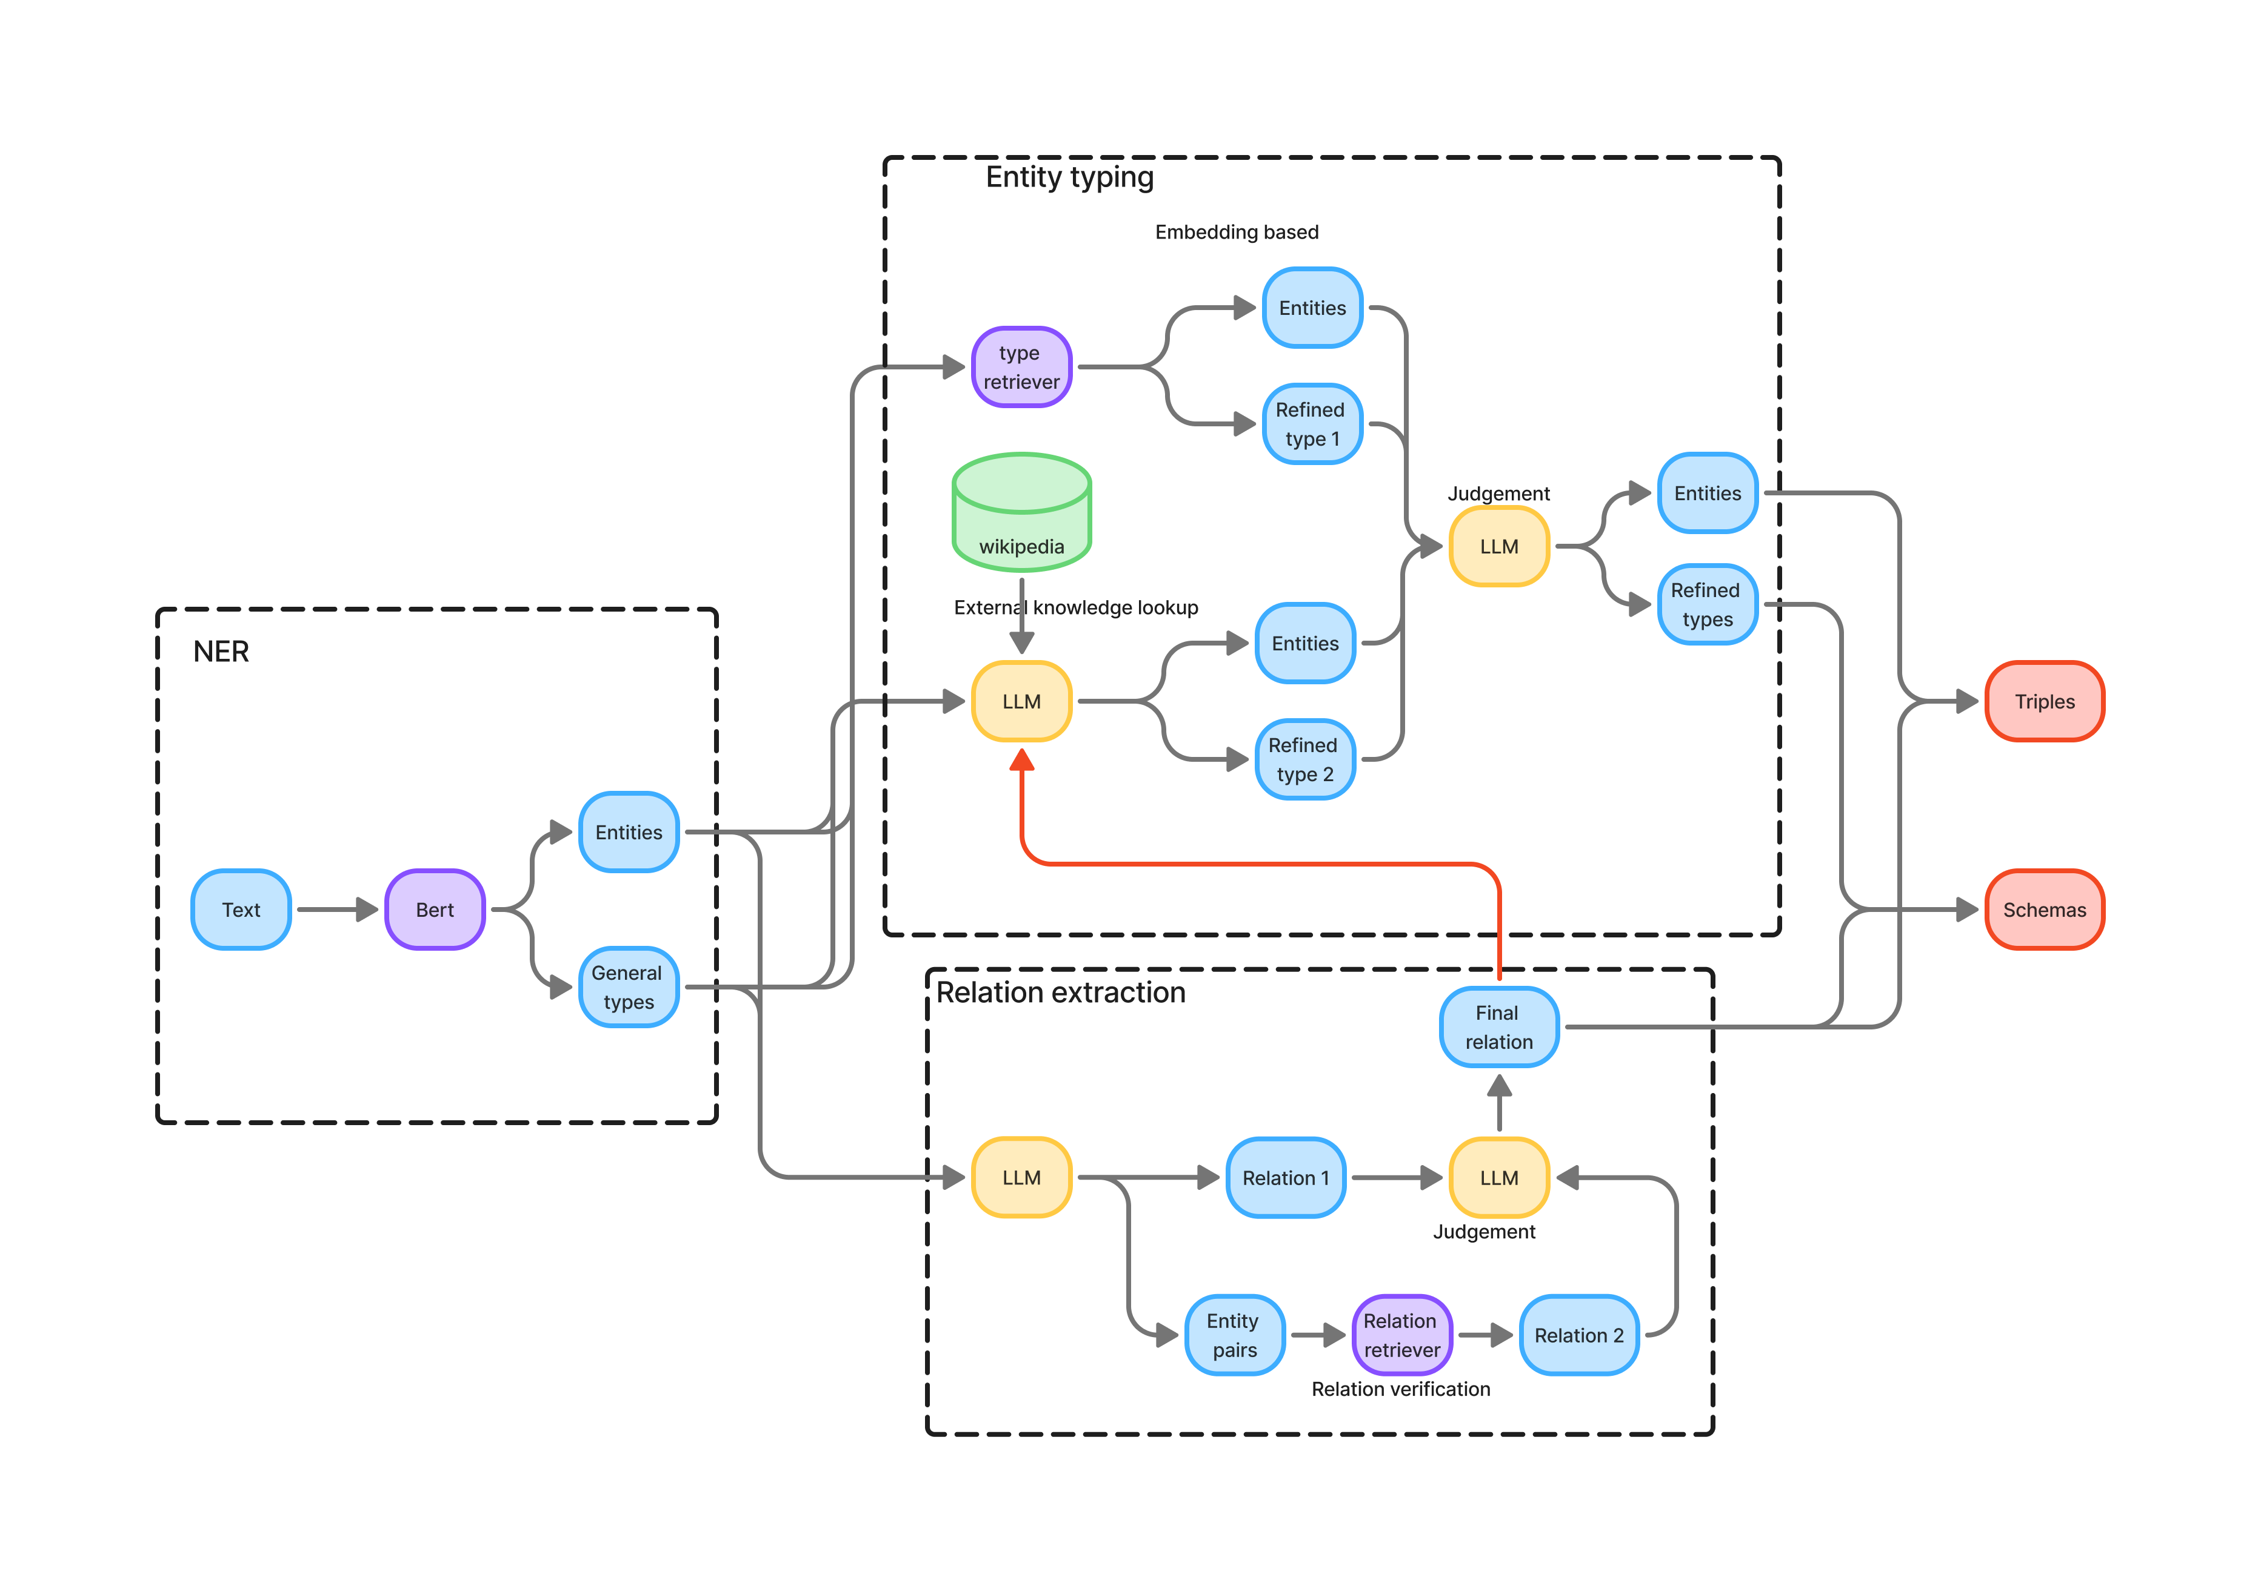
Overview of Attempt 3
Incorporating the relation hint into the RAG-based typing within entity typing refinement

Slide 13
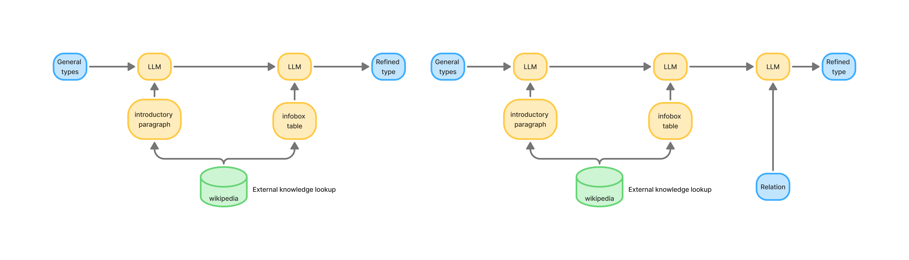
The idea of Attempt 3
In the previous framework, type verification in RAG-based typing was performed using the content from the infoboxes on Wikipedia pages
For entities whose corresponding webpages do not have an infobox, this verification step is not performed
LLMs can refine the general type based on the provided external knowledge, but it often cannot directly reach the most precise entity type in the hierarchy in a single step
Adding a verification step that allows all potentially refinable entities to be checked can improve performance
previous framework
Attempt 3

Slide 14
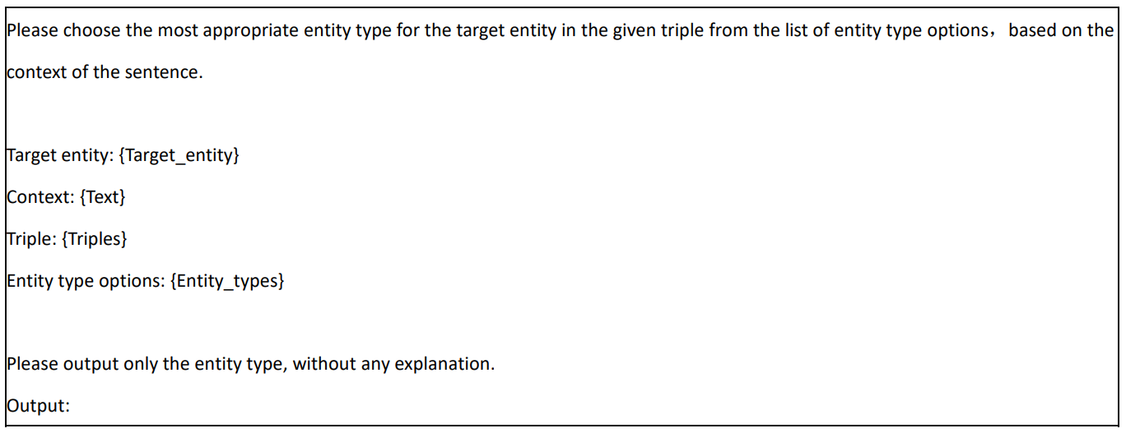
Prompt for Attempt 3
Incorporating the relation hint into the RAG-based typing
Descendant types of the target entity’s refined type in the hierarchy

Slide 15
Experimental results of Attempt 3
Model | Llama3-8b |  |  |  | Phi-3-small |  |  |  | Qwen2.5-7b |  |  |  | Mistral-7b
setting | latest | last | pipline | joint | latest | last | pipline | joint | latest | last | pipline | joint | latest | last | pipline | joint
precision↑ | 0.652 | 0.644 | 0.464 | 0.392 | 0.572 | 0.562 | 0.349 | 0.485 | 0.708 | 0.676 | 0.544 | 0.572 | 0.611 | 0.589 | 0.464 | 0.479
recall↑ | 0.861 | 0.846 | 0.683 | 0.815 | 0.822 | 0.803 | 0.685 | 0.812 | 0.881 | 0.848 | 0.801 | 0.861 | 0.85 | 0.829 | 0.758 | 0.821
Micro F1↑ | 0.742 | 0.731 | 0.553 | 0.530 | 0.674 | 0.661 | 0.463 | 0.607 | 0.785 | 0.752 | 0.648 | 0.687 | 0.711 | 0.689 | 0.576 | 0.605
Macro F1↑ | 0.751 | 0.743 | 0.493 | 0.601 | 0.703 | 0.691 | 0.460 | 0.627 | 0.803 | 0.765 | 0.649 | 0.701 | 0.727 | 0.716 | 0.571 | 0.646
SS↑ | 0.603 | 0.575 | 0.264 | 0.228 | 0.579 | 0.562 | 0.299 | 0.423 | 0.638 | 0.632 | 0.485 | 0.440 | 0.552 | 0.534 | 0.381 | 0.471

Slide 16

Overview of Attempt 4
Incorporating the relation hint into both RAG-based typing and entity type judgement

Slide 17
Experimental results of Attempt 4
Model | Llama3-8b |  |  |  | Phi-3-small |  |  |  | Qwen2.5-7b |  |  |  | Mistral-7b
setting | latest | last | pipline | joint | latest | last | pipline | joint | latest | last | pipline | joint | latest | last | pipline | joint
precision↑ | 0.652 | 0.644 | 0.464 | 0.392 | 0.572 | 0.562 | 0.349 | 0.485 | 0.708 | 0.676 | 0.544 | 0.572 | 0.611 | 0.589 | 0.464 | 0.479
recall↑ | 0.861 | 0.846 | 0.683 | 0.815 | 0.822 | 0.803 | 0.685 | 0.812 | 0.881 | 0.848 | 0.801 | 0.861 | 0.85 | 0.829 | 0.758 | 0.821
Micro F1↑ | 0.742 | 0.731 | 0.553 | 0.530 | 0.674 | 0.661 | 0.463 | 0.607 | 0.785 | 0.752 | 0.648 | 0.687 | 0.711 | 0.689 | 0.576 | 0.605
Macro F1↑ | 0.751 | 0.743 | 0.493 | 0.601 | 0.703 | 0.691 | 0.460 | 0.627 | 0.803 | 0.765 | 0.649 | 0.701 | 0.727 | 0.716 | 0.571 | 0.646
SS↑ | 0.601 | 0.575 | 0.264 | 0.228 | 0.585 | 0.562 | 0.299 | 0.423 | 0.639 | 0.632 | 0.485 | 0.440 | 0.553 | 0.534 | 0.381 | 0.471

Slide 18
Summary of experimental results
Summary of SS scores for all attempts
 | Llama3-8b | Phi-3-small | Qwen2.5-7b | Mistral-7b
Last presentation (for comparison) | 0.575 | 0.562 | 0.632 | 0.534
Attempt 1 (Relation hint as a parallel method in entity type refinement) | 0.478 (-0.097) | 0.44 (-0.122) | 0.552 (-0.08) | 0.423 (-0.111)
Attempt 2 (Relation hint is used in the entity type judgement step) | 0.602 (+0.027) | 0.587 (+0.025) | 0.655 (+0.023) | 0.549 (+0.015)
Attempt 3 (Relation hint is used in RAG based typing step) | 0.603 (+0.028) | 0.579 (+0.017) | 0.638 (+0.006) | 0.552 (+0.018)
Attempt 4 (Relation hint is used in both the rag based typing step and the entity type refinement step) | 0.601 (+0.026) | 0.585 (+0.023) | 0.639 (+0.007) | 0.553 (+0.019)

Slide 19
Summary and future work
Summary
Completed multiple attempts at incorporating extracted relations as hint into entity typing
Our work extended so far based on OSKGC:
OSKGC
baseline experiment
Benchmark dataset
Joint extraction
Pipeline
New framework
Fine tuned BERT
NER
Fine tuned e5-mistral-7b-instruct
schema retriever
External knowledge lookup
RAG based typing

Slide 20
Summary and future work
Future work
Conduct experiments on Proprietary LLMs, when the framework does not require further modifications
Consolidate the code
Distill the novel aspects of our framework into new concepts for writing a paper

Slide 21
Thanks for listening!
Q&A
Data Engineering Lab, IPS, Waseda Univ.

