Slide 1
Evaluation of ticket price and facilities
Big Mountain Resort

Slide 2
Background
Current ticket price is set to be slightly higher than the average price in Big Mountain’s market share
Current ticket price does not take into account facilities available at Big Mountain relative to other resorts
Aim: increase Big Mountain Resort net profit margin by ≥ 1 percentage point over the next ski season by re-evaluating current ticket prices and facilities provided
Notes:
Problem Identification (1-2 slides)

Slide 3
Approach
Benchmark ticket price to other resorts in market segment based on specific features or facilities available
Better understand the facilities available at Big Mountain relative to its competitors, particularly which can be eliminated without negatively impacting ticket price.
In particular, evaluate the following shortlisted scenarios:
Permanently closing down up to 10 of the least used runs. This doesn't impact any other resort statistics.
Increase the vertical drop by adding a run to a point 150 feet lower down but requiring the installation of an additional chair lift to bring skiers back up, without additional snow making coverage
Same as number 2, but adding 2 acres of snow making cover
Increase the longest run by 0.2 mile to boast 3.5 miles length, requiring an additional snow making coverage of 4 acres
Notes:
Problem Identification (1-2 slides)

Slide 4
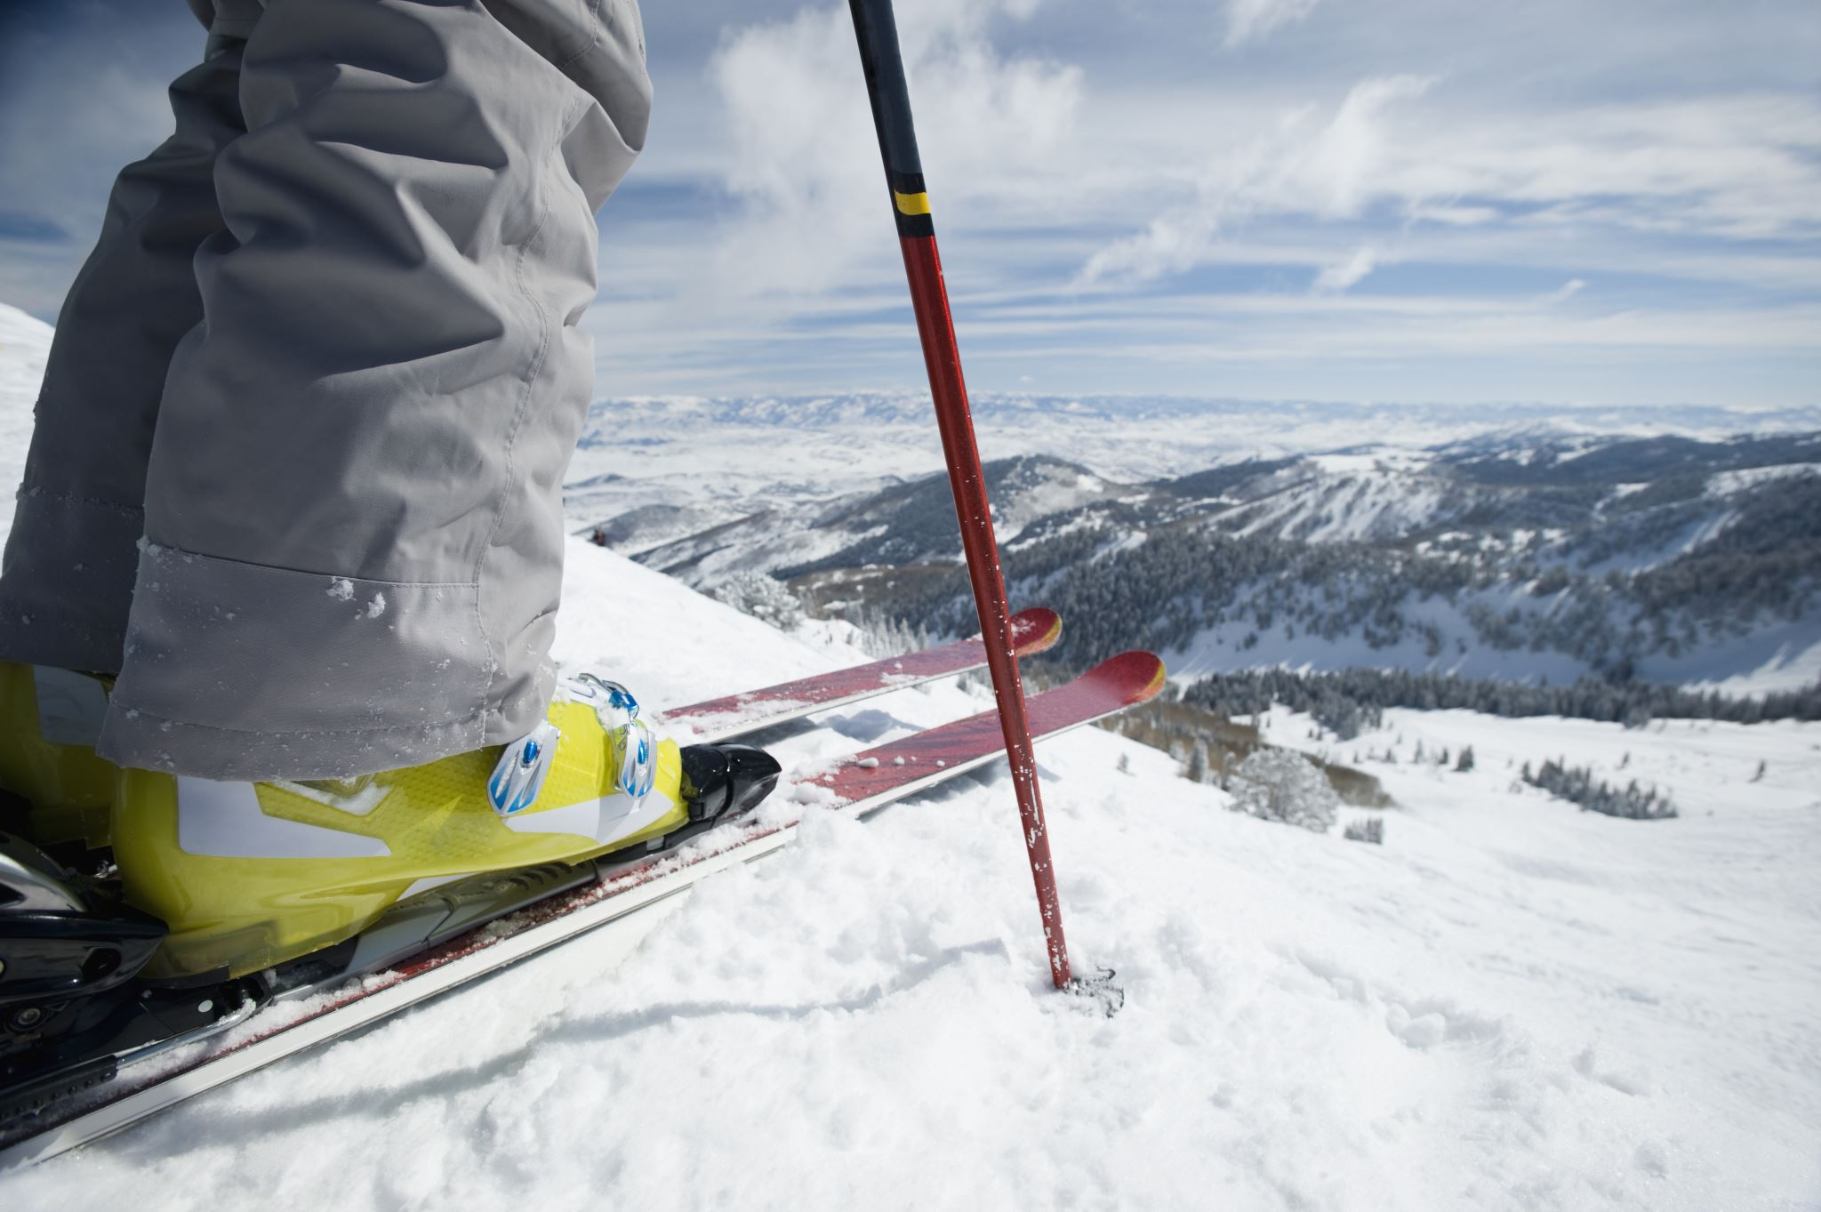
Recommendations
Shut down 1 of the least used runs (ticket price impact predicted: none)
Increase vertical drop by 150 feet with an additional run; add chair lift but no snow making (ticket price impact predicted: + $1.99/ticket)
Notes:
Recommendations – 1 slide

Slide 5
Methodology
Chosen model: random forest
missing values imputed based on median, no scaling, 69 trees
improved predictions over mean alone and linear regression
mean absolute error: $10.39, with standard deviation $1.47
Data used:
database export with information on 330 resorts nationwide in same market segment
no recommendation for additional data collection

Slide 6
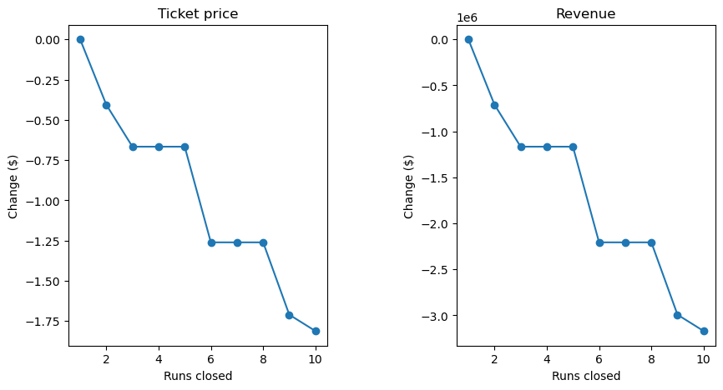
Scenario 1: Closing 1 run has no negative impact on ticket price
Notes:
Modeling results and analysis (3-4 slides)

Slide 7
Scenarios 2-4: Increase vertical drop, but no additional snow making coverage needed
Scenario | Predicted impact on ticket price
Increase vertical drop by 150 feet by adding 1 run and a chair lift to support it | + $1.99
Above scenario plus 2 acres of snow making coverage | + $1.99
Increase longest run by 0.2 miles, adding 4 acres snow making coverage to support | $0.00
Notes:
Modeling results and analysis (3-4 slides)

Slide 8
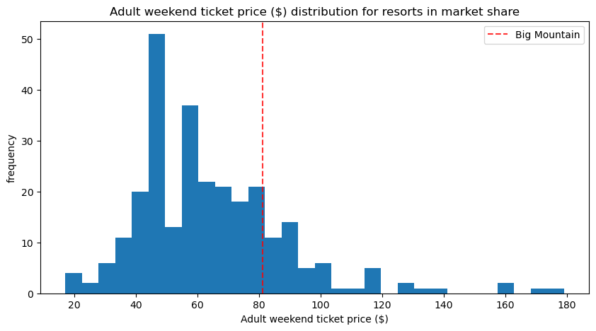
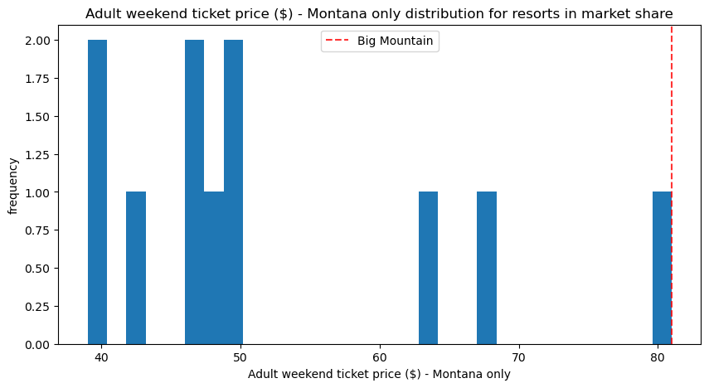
Big Mountain ticket price is towards the middle of resorts nationwide but at the higher end of Montana resorts
Notes:
Modeling results and analysis (3-4 slides)

Slide 9
Conclusions
Closing runs impacts ticket price, but it is not a linear relationship. Closing 1 run is expected to have no impact on ticket price.
Increasing the vertical drop is expected to support a higher ticket price, regardless of whether snow making coverage is increased.
The distribution of ticket prices in Montana looks quite different from that nationwide. Further characterization of resort visitors may help clarify the degree to which Big Mountain Resort can bridge that gap.
Notes:
Summary and conclusion (1 slide)

