Slide 1


Mango Drying Process & Global Food Policies

Slide 2
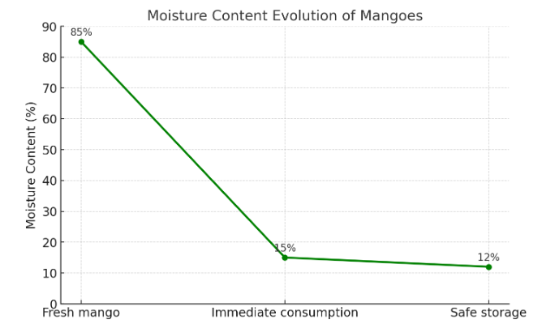
Definition of Drying
Drying is the removal of water from mangoes to safe levels (≤15% moisture).
Goals: microbial growth prevention, shelf-life extending, weight volume reduction.

Slide 3
Mango Drying Process Flow
1. Harvesting and sorting
2. Washing and sanitation
3. Peeling and slicing
4. Pre-treatments
5. Drying
6. Conditioning and cooling
7. Packaging
8. Storage and export compliance

Slide 4
Global Food Policies Relevant to Mango Drying
- Codex Alimentarius: defines moisture, contaminants, labelling.
- EU & German food laws: HACCP, traceability, hygiene standards.
- WTO-SPS Agreement: ensures safety in international trade.
- ISO 22000 / FSSC 22000: international food safety management systems.
- Import requirements: pesticide residues, aflatoxin levels, allergens.

Slide 5


