Slide 1


Ministry of Higher Education, Research and Innovation
Thesis Defense 2024
Topic:
Voice Translation Mobile App using Artificial Intelligence:
case of Mooré and English
Presented by: KONGO Hamado
Supervised by: Mme. Flora SOUDRE
Notes:
Members of the jury, dear guest, ladies and gentleman receive my distinguished greetings. It is an honor and a pleasure to have you with me today because of my thesis defense which the topic is
Voice Translation Mobile App using Artificial Intelligence case of Moore and English. I am Hamado KONGO and this work was supervised by: Mme Flora SOUDRE.

Slide 2
Content
INTRODUCTION
1
PROBLEMATIC
2
PRESENTATION OF THE SOLUTION
3
STUDY METHODOLOGIES
4
IMPLEMENTATION AND RESULTS
5
DEMONSTRATION
CONCLUSION
1
Presented by: Hamado KONGO
Supervised by: Flora SOUDRE

Slide 3
INTRODUCTION
2
Presented by: Hamado KONGO
Supervised by: Flora SOUDRE

Slide 4
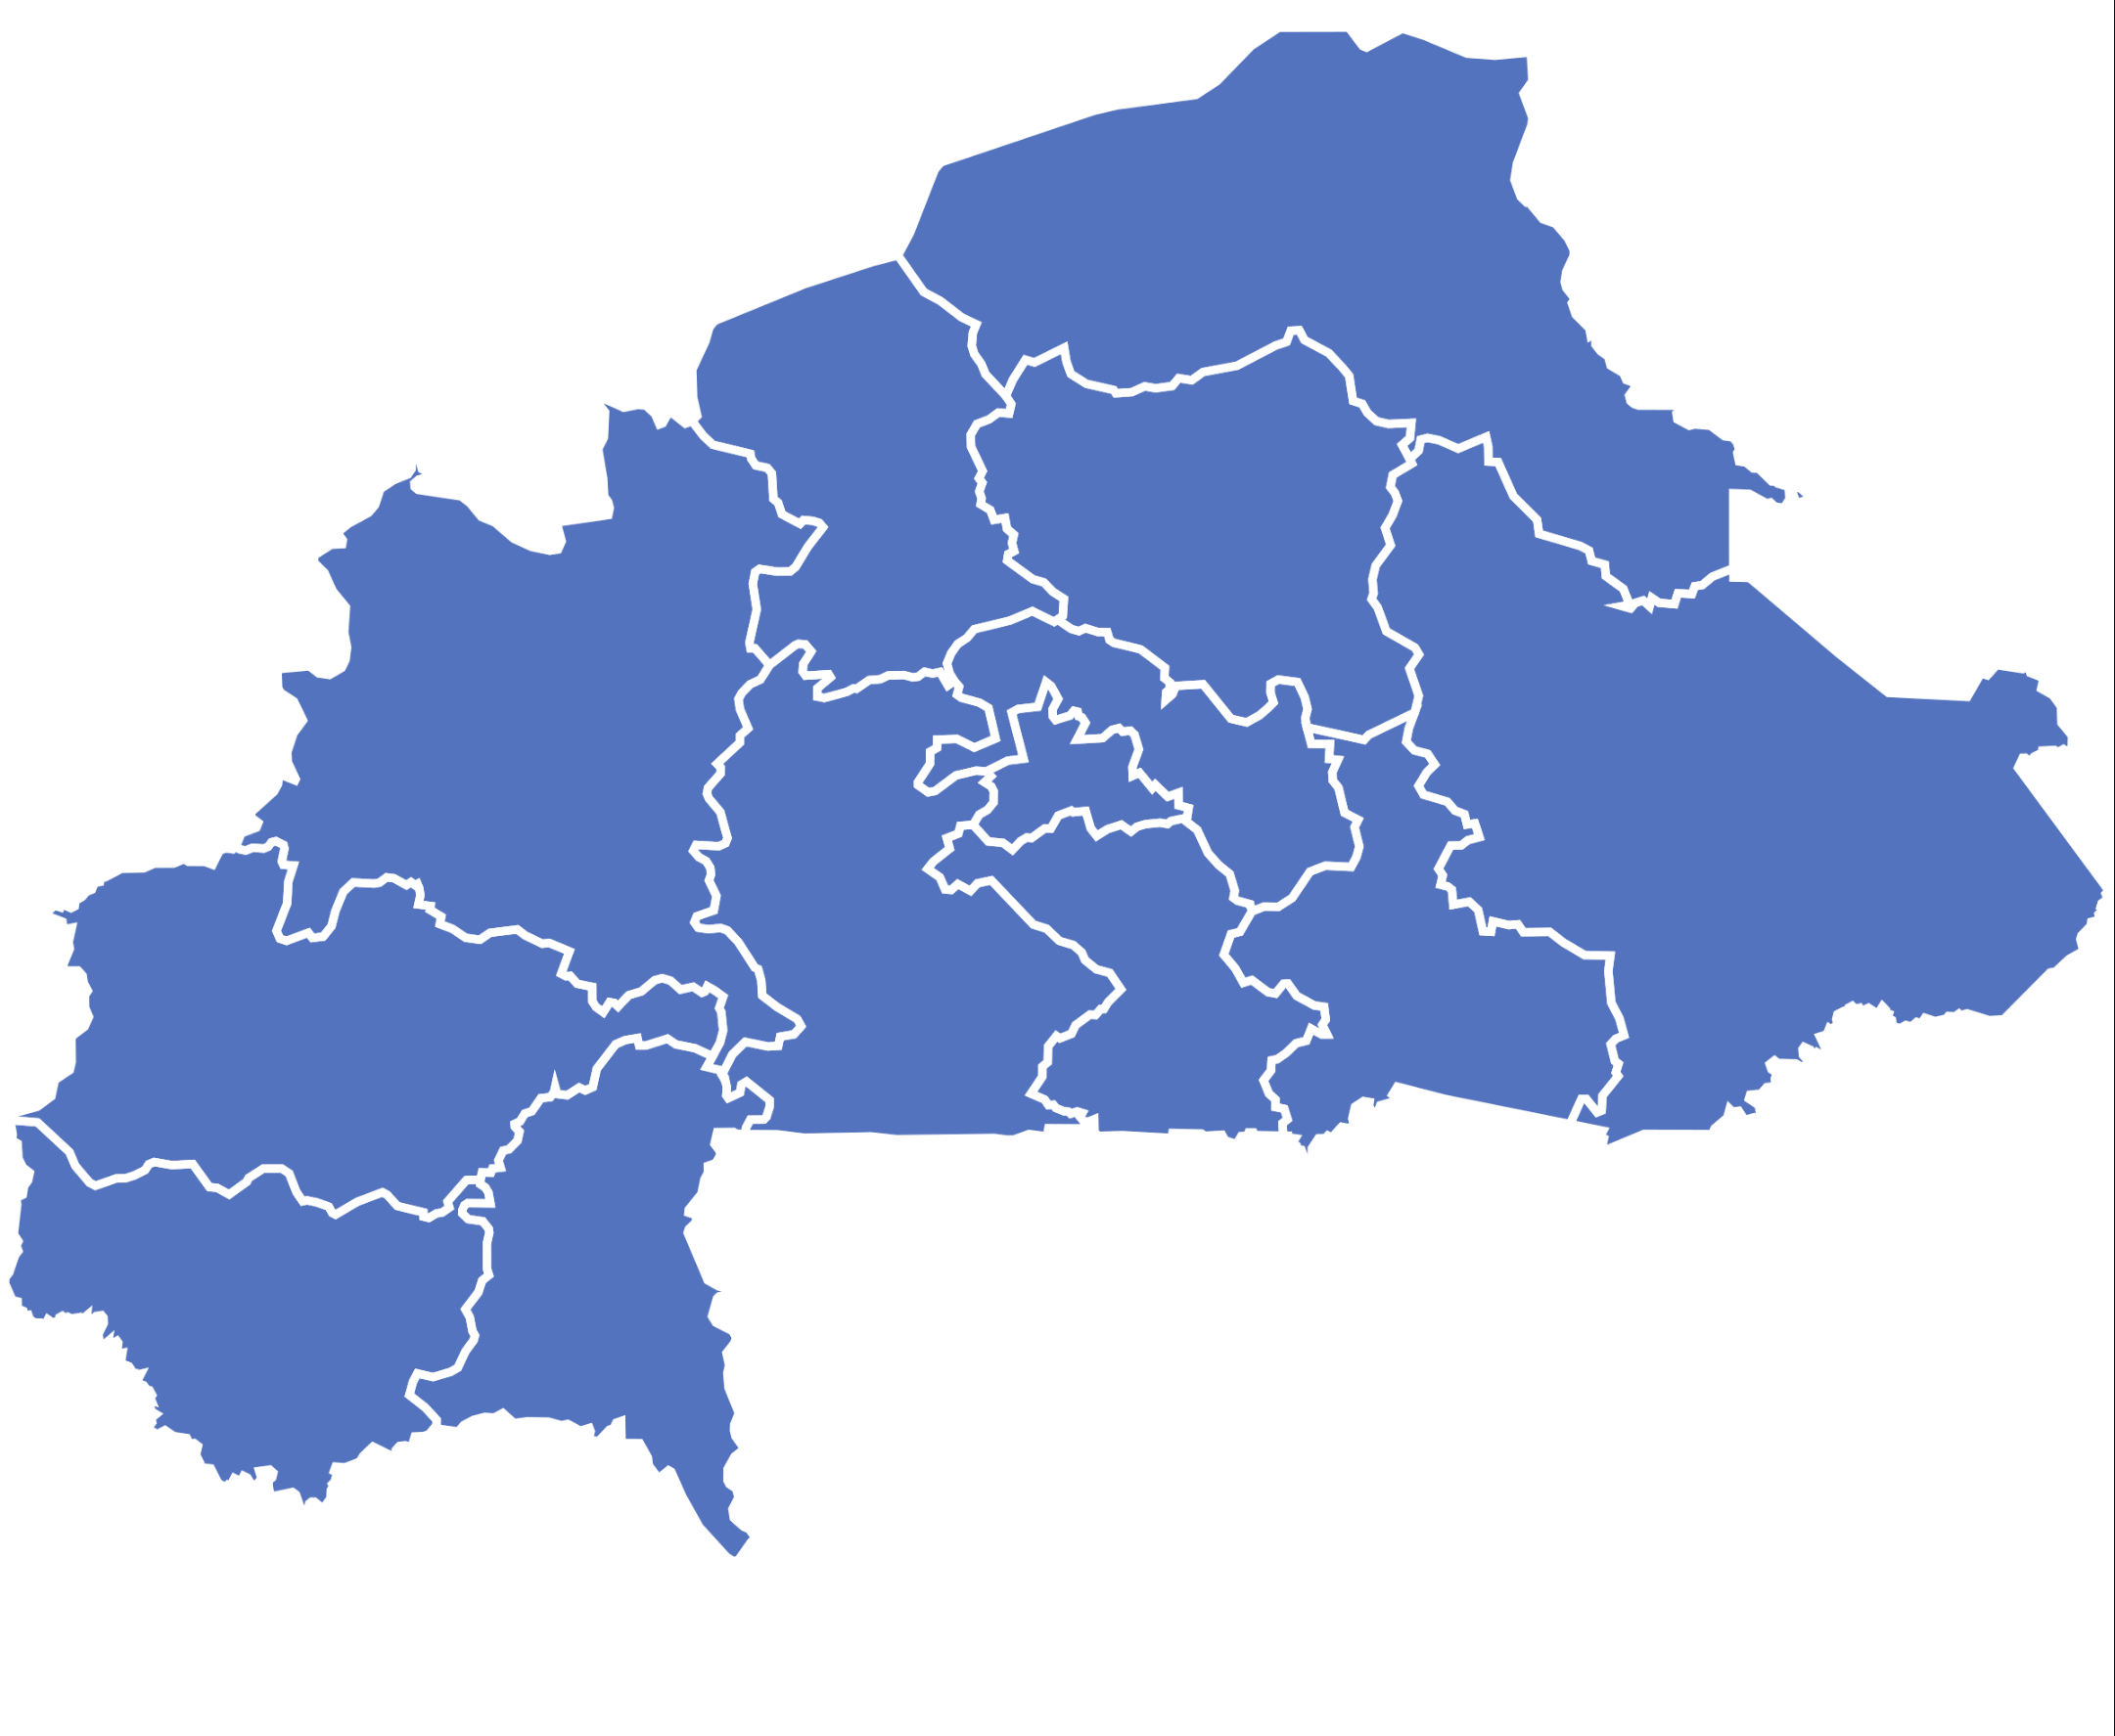
INTRODUCTION
literacy rate of people older than 15 is 29.7%, 5th PHC of 2019
70.3% did not attend school !!!
67 languages in Burkina according to
Burkina National Tourist Office
Most spoken one: Mooré language(52.9%) , 5th PHC
3
Presented by: Hamado KONGO
Supervised by: Flora SOUDRE
Notes:
Landlocked country. Huge rate. 23,662,760 pop: 16 634 920

Slide 5
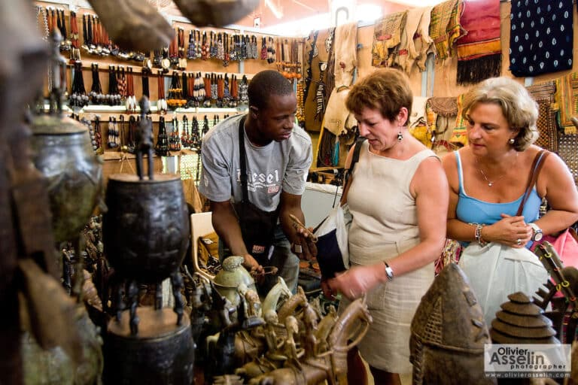
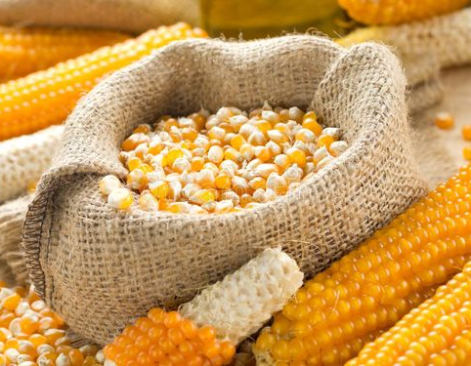
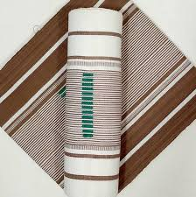

INTRODUCTION
They cannot work in public institutions , become Businessmen
International partners such us americans, chineese, germans, arabes,French, british , Italian … all of them can speak English
Traditional Crafts
Corn
Clothes
Electronics
4
Presented by: Hamado KONGO
Supervised by: Flora SOUDRE
Notes:
Traditional craft products SIAO, forum internationaux agricoles … Food and Beverage West African (Lagos, Nigeria): manufacturer meets customers from Food and Beverage industry.

Slide 6
Problematic
5
Presented by: Hamado KONGO
Supervised by: Flora SOUDRE

Slide 7

Problematic
lost a lot of money hiring people to translate for them
lose time and money to learn English before their travel
Problems
VISAs sometimes refused
business opportunities inaccessible
6
Presented by: Hamado KONGO
Supervised by: Flora SOUDRE
Notes:
All these problems are caused by language barriere.
We then need to find a solution to that

Slide 8

Problematic
How can Artificial Intelligence help to unleash language barrier between unschooled traders and their business partners?
7
Presented by: Hamado KONGO
Supervised by: Flora SOUDRE
Notes:
With the development of solutions such as Google Translate, Alexa or SIRI that help in languages translation by using AI , this raises a question for us.

Slide 9
Objectives
Optimize the cost of translation
Develop a mobile app powered by Artificial Intelligence to unleash language barrier between unschooled traders and their business partners.
Make easier the communication
Optimize the time
Set up an intuitive mobile app
8
Presented by: Hamado KONGO
Supervised by: Flora SOUDRE

Slide 10
Presentation of the Solution
9
Presented by: Hamado KONGO
Supervised by: Flora SOUDRE

Slide 11


Solution
10
Presented by: Hamado KONGO
Supervised by: Flora SOUDRE
Notes:
A Voice Translation Mobile App using Artificial
Intelligence to translate Mooré and English speeches

Slide 12
Solution
Main Features
Translate from Mooré to English
Translate from English to Mooré
Allow users to speak in Mooré, which is automatically translated to English in real time
Allow users to speak in English , which is automatically translated to Mooré
11
Presented by: Hamado KONGO
Supervised by: Flora SOUDRE

Slide 13
Study Methodologies
12
Presented by: Hamado KONGO
Supervised by: Flora SOUDRE

Slide 14


Methodologies used to build the solution
Capture of functional requirements
Functional Branch
Technical Branch
Capture of technical requirements
Analysis
Generic Design
Preliminary Design
Detailed Design
Use Case Diagram
Sequence Diagram
Class Diagram
Implementation Phase
Coding and Test
2TUP
Deployment
13
Presented by: Hamado KONGO
Supervised by: Flora SOUDRE
Notes:
UML Modeling language
2TUP as the modeling process

Slide 15
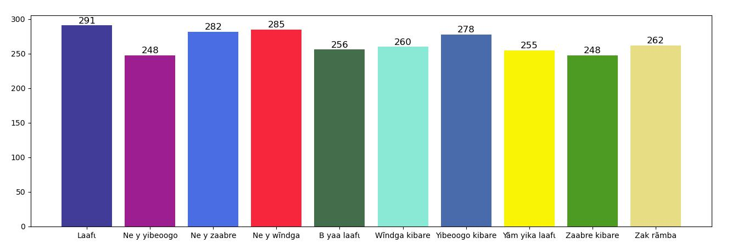
Methodologies used to build the solution
Data Collection and Processing
14
Presented by: Hamado KONGO
Supervised by: Flora SOUDRE
Notes:
Data collected on JotForm, shared with contacts, went to some universities and school this is what we got( African people think about mistics things because of voice) 10 greetings in Mooré. Listened to each submission, delete bad audios(Never Trust User Input)

Slide 16
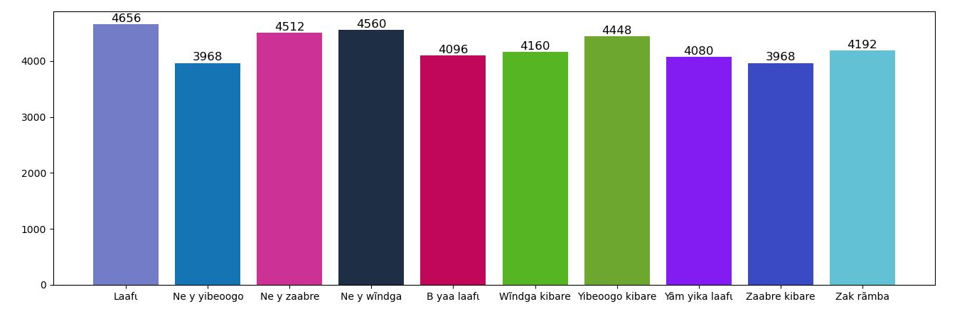
Methodologies used to build the solution
Data Augmentation
15
Presented by: Hamado KONGO
Supervised by: Flora SOUDRE
Notes:
DL algorithms need a lot of data, so we used data augmentation teckniks to increase the size of our dataset Volume addition, add_noise , time_stretch , Pitch_Shifted were used. 20times the initial dataset

Slide 17










Tools used to implement the solution
draw.io
Jupyter Notebook
Tensorflow Keras
Fast API
Android Studio
Jotform
Python
Visual Studio Code
Google TTS-STT
Flutter
16
Presented by: Hamado KONGO
Supervised by: Flora SOUDRE

Slide 18
Implementation and Results
17
Presented by: Hamado KONGO
Supervised by: Flora SOUDRE

Slide 19
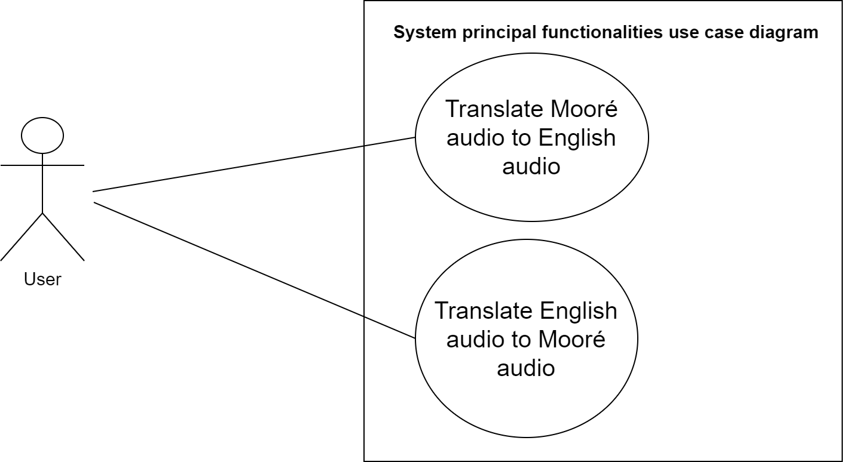
Implementation and Results
Use Case Diagram
18
Presented by: Hamado KONGO
Supervised by: Flora SOUDRE

Slide 20
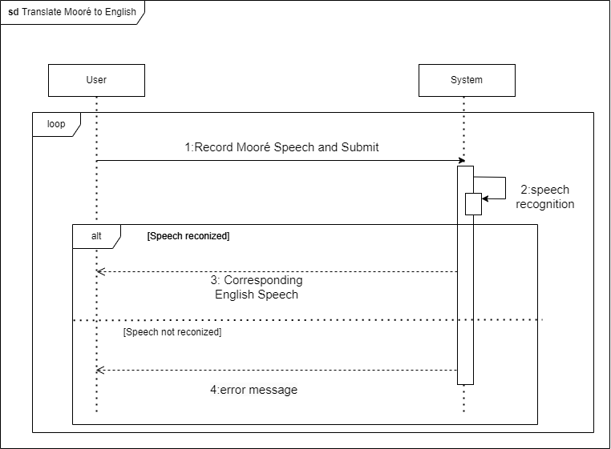
Implementation and Results
Sequence Diagram for Translate Mooré to English
19
Presented by: Hamado KONGO
Supervised by: Flora SOUDRE
Notes:
Loop meaning??? the fragment may execute multiple times, and the guard indicates the basis of iteration.
Alt meaning??? Alternative multiple fragments: only the one whose condition is true will execute.

Slide 21
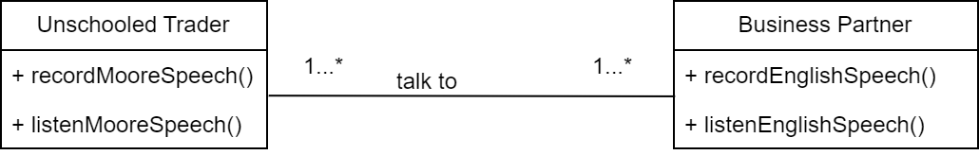
Implementation and Results
Class Diagram
20
Presented by: Hamado KONGO
Supervised by: Flora SOUDRE

Slide 22
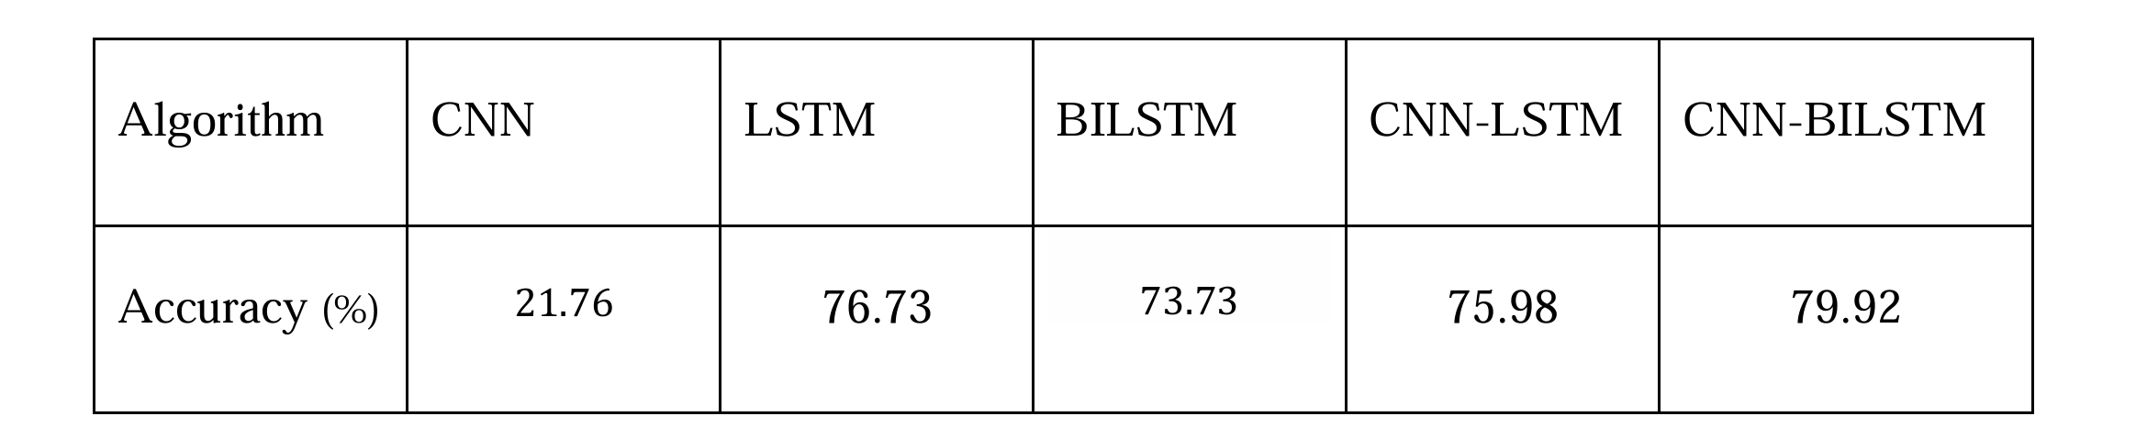
Implementation and Results
Algorithms tested
21
Presented by: Hamado KONGO
Supervised by: Flora SOUDRE

Slide 23
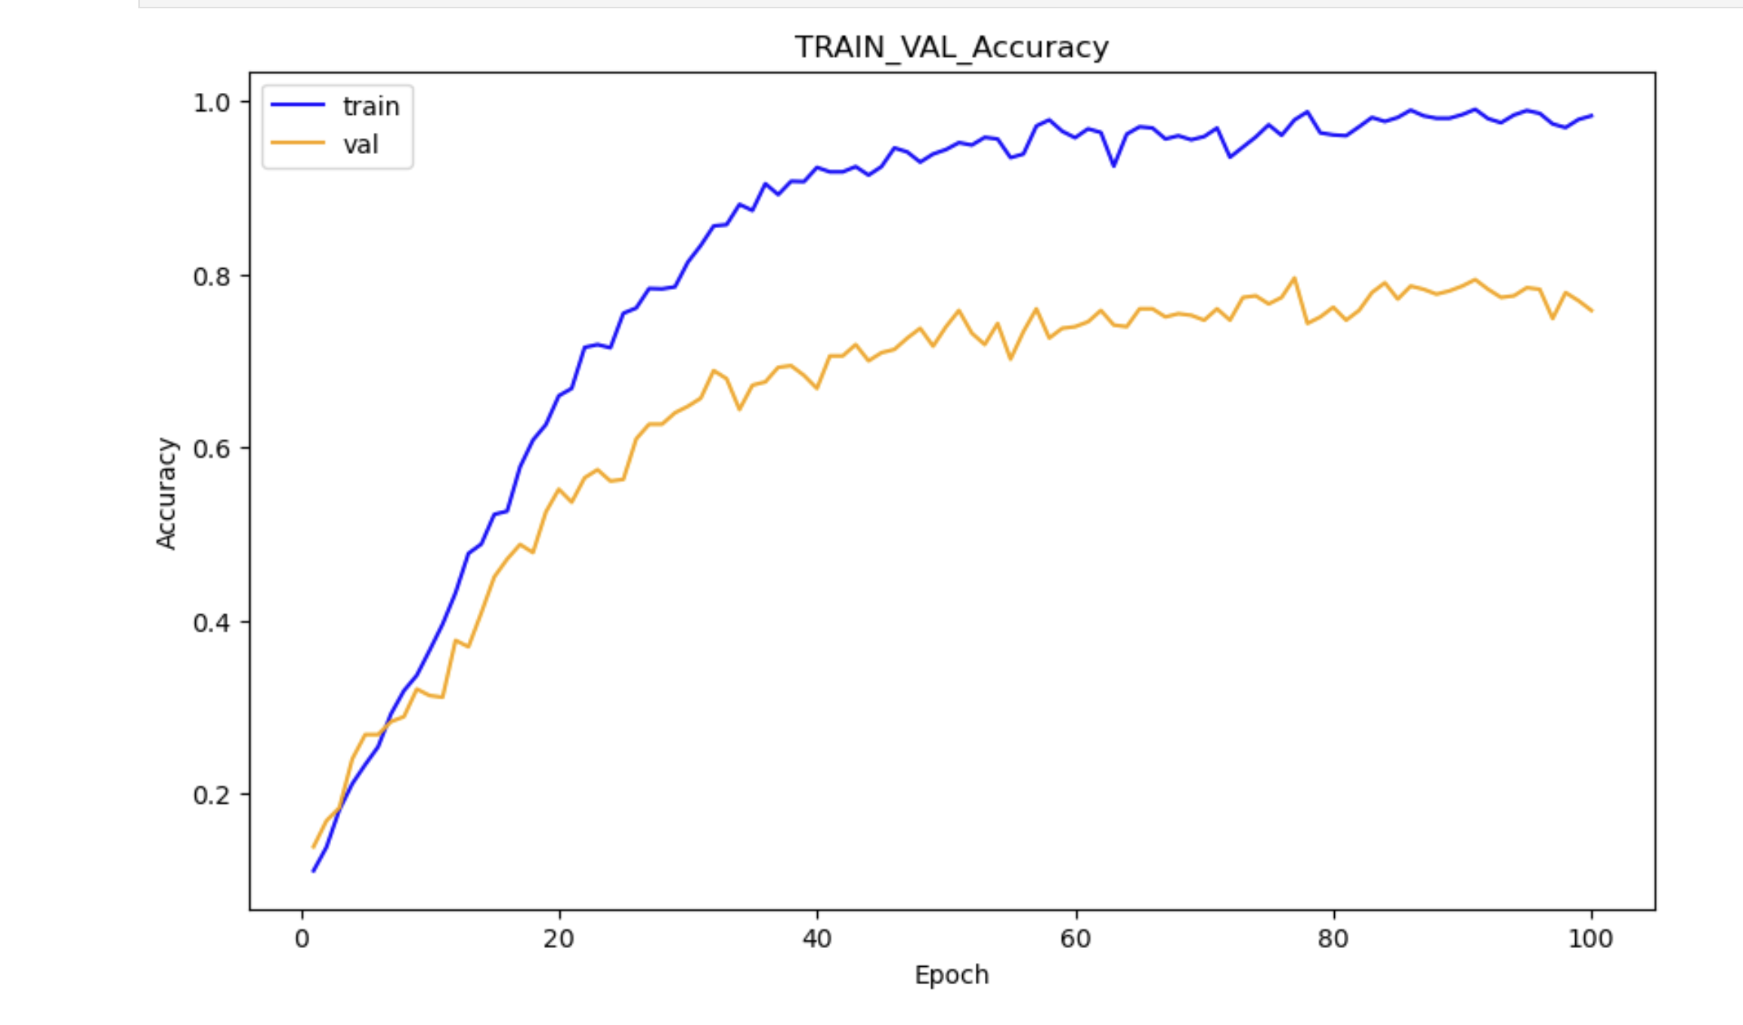
Implementation and Results
Learning curve of the model trained using initial dataset
22
Presented by: Hamado KONGO
Supervised by: Flora SOUDRE
Notes:
Overfitting: indicating that the model is learning to fit the training data too closely (memorizing) but not generalizing well to unseen data (validation data).

Slide 24
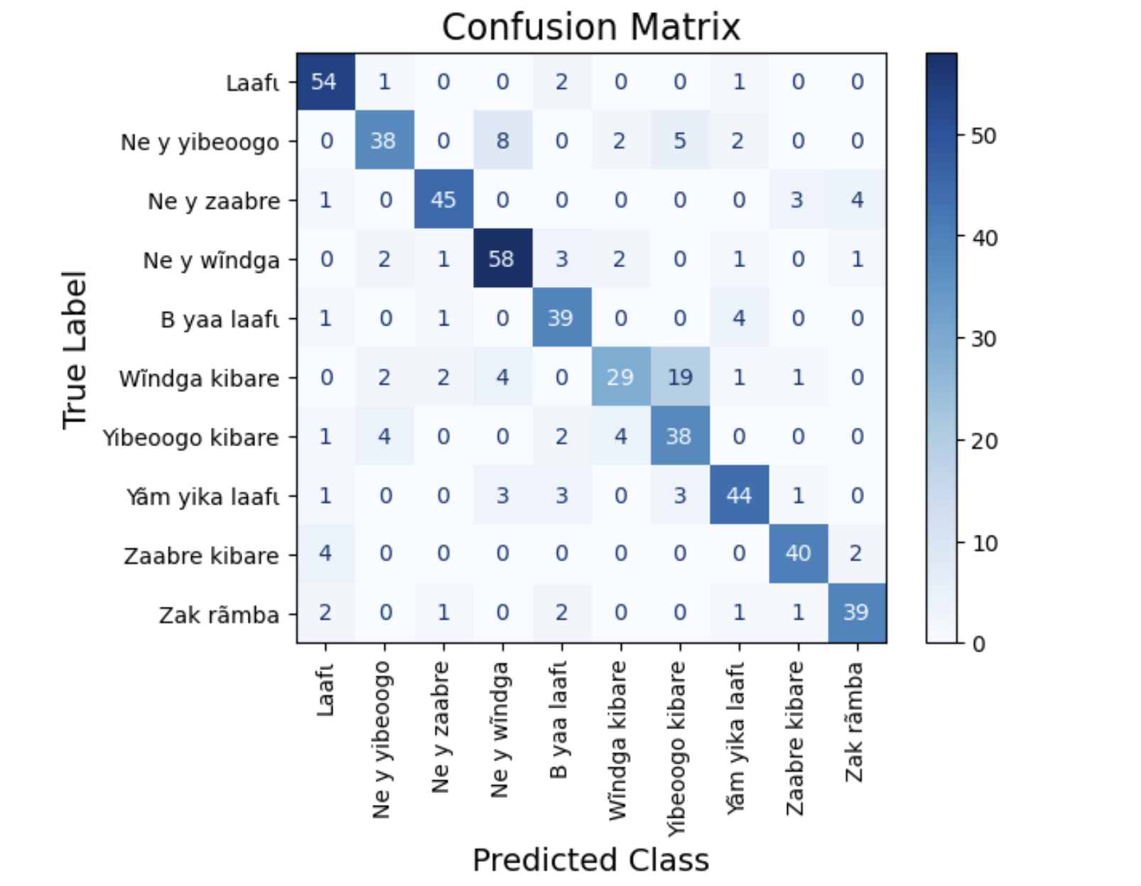
Implementation and Results
Confusion matrix of the model trained using initial dataset
23
Presented by: Hamado KONGO
Supervised by: Flora SOUDRE

Slide 25
DATA AUGMENTATION IMPACT
24
Presented by: Hamado KONGO
Supervised by: Flora SOUDRE

Slide 26
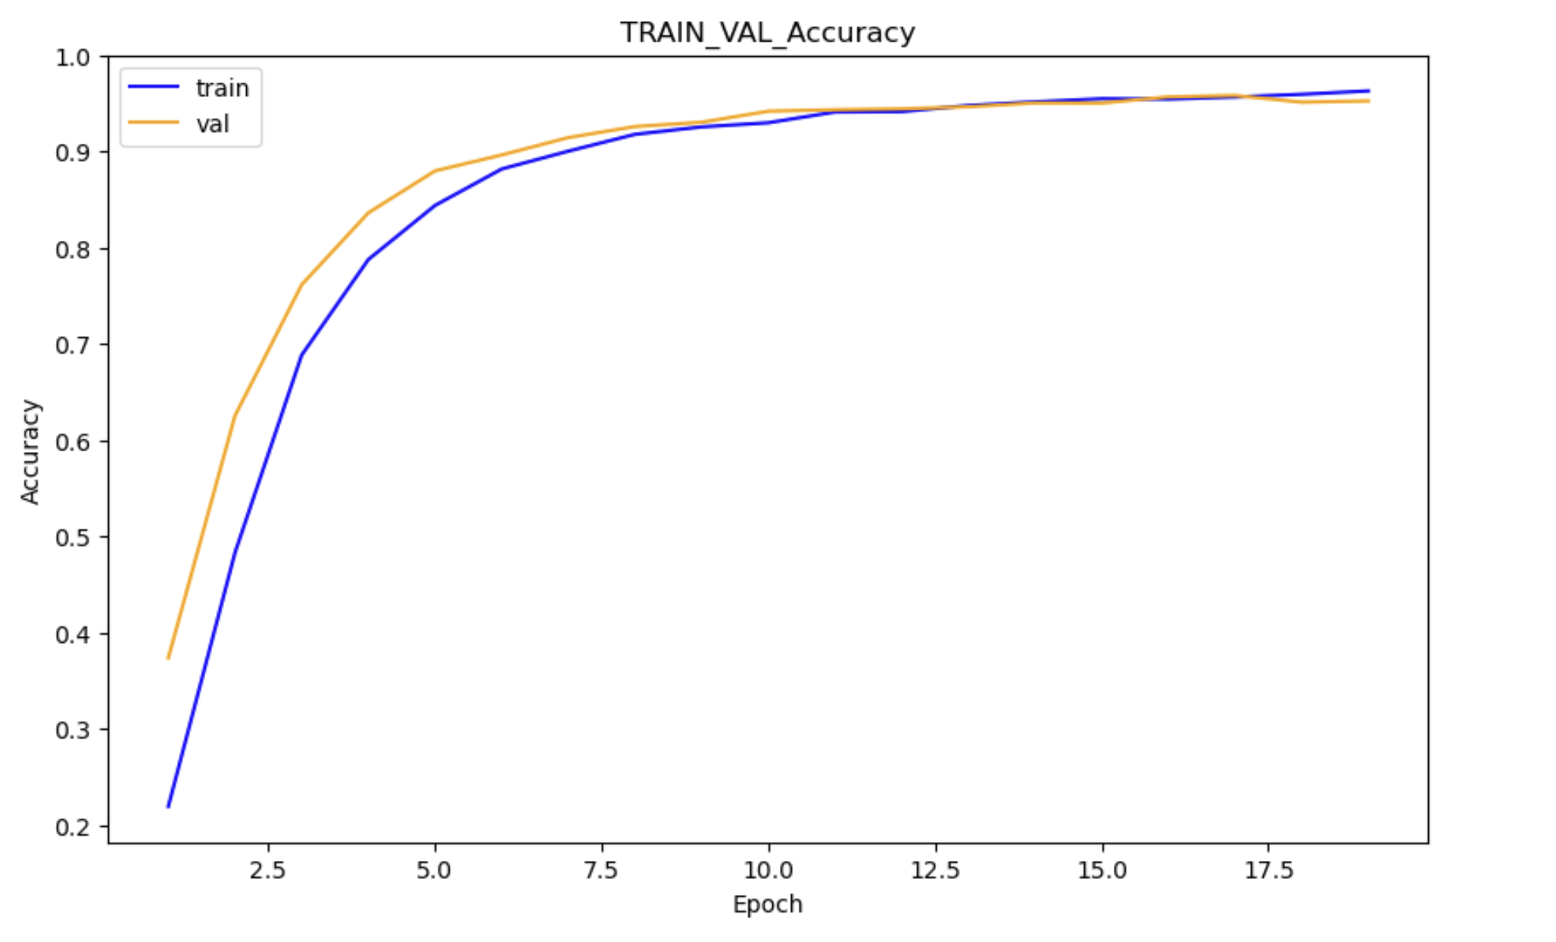
Implementation and Results
Learning curve of the model trained using augmented dataset
25
Presented by: Hamado KONGO
Supervised by: Flora SOUDRE
Notes:
Generalize well : quiet the same and are closed to one over epoches

Slide 27
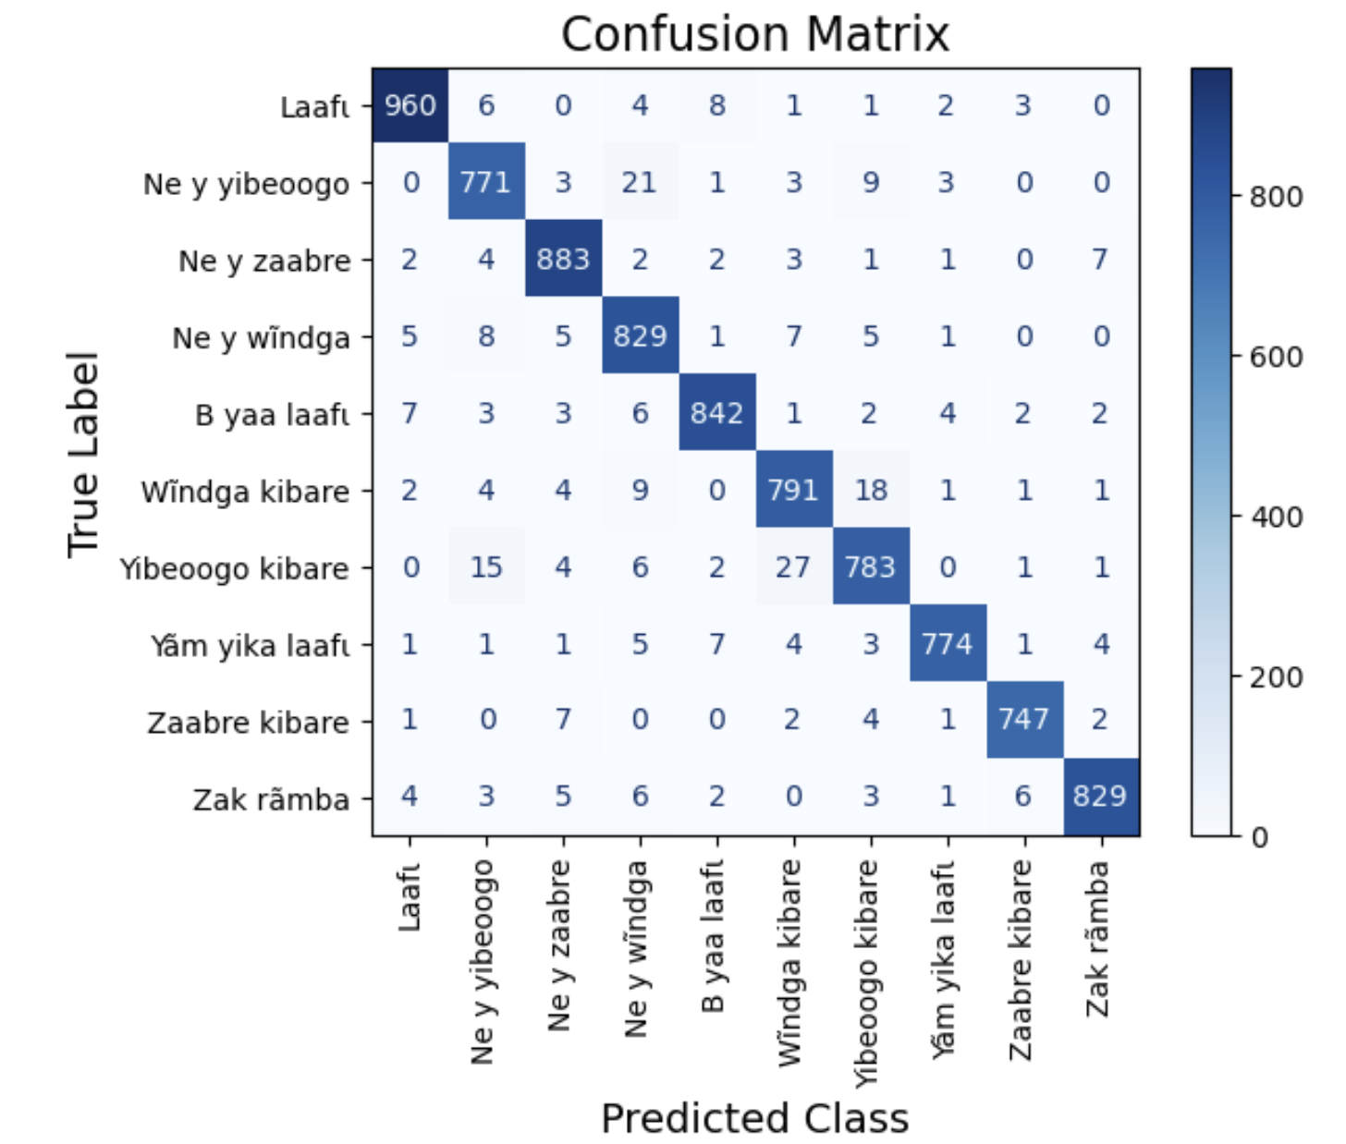
Implementation and Results
Confusion matrix of the model trained using augmented dataset
26
Presented by: Hamado KONGO
Supervised by: Flora SOUDRE
Notes:
Good confusion matrix

Slide 28
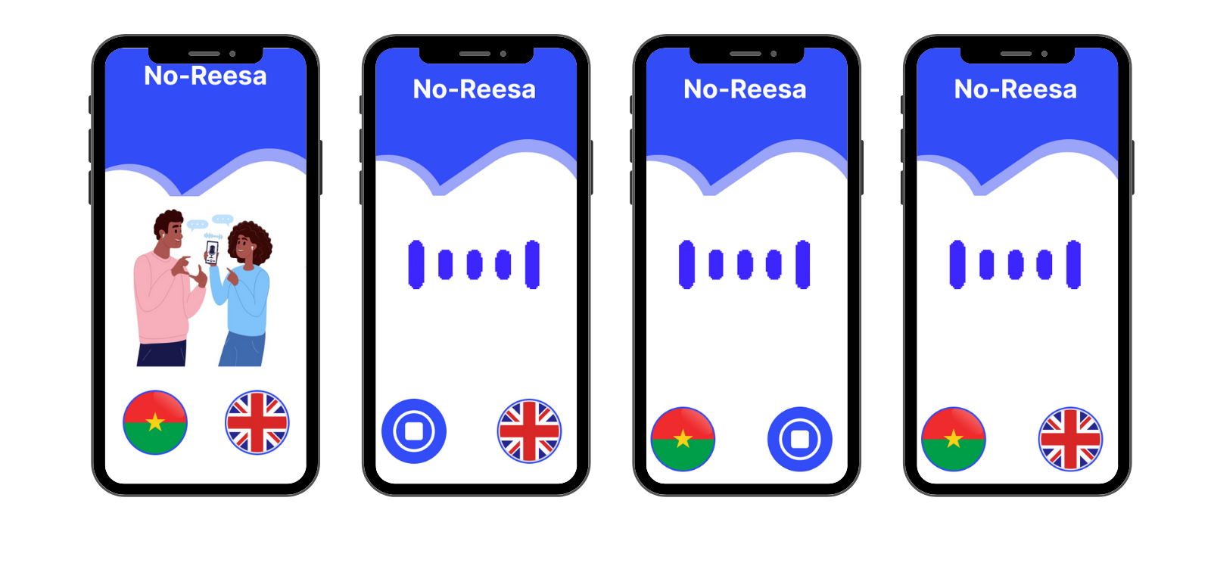
DEMONSTRATION
27
Presented by: Hamado KONGO
Supervised by: Flora SOUDRE

Slide 29
CONCLUSION
28
Presented by: Hamado KONGO
Supervised by: Flora SOUDRE

Slide 30
Conclusion
Knowledges
Difficulties
Perspectives
How to convince people, (data collection).
AI, mainly NLP algorithms.
Data augmentation technics.
The reality about Burkina traders problems.
Flutter development.
API development.
Mooré words orthograph
Lack of dataset for our local languages.
People though about mistics things during data collection.
Listen to each submission to clean the data.
Increase dataset.
Use the three-tier architecture
Add other local languages like Dioula, Fulfulde, ...
Integrate the model in earphones for automatic translation.
Build a Smart Home Voice Assistant using our local language
29
Presented by: Hamado KONGO
Supervised by: Flora SOUDRE

Slide 31

Conclusion
BARKA !
THANK YOU!
30
Presented by: Hamado KONGO
Supervised by: Flora SOUDRE
Notes:
All your suggestions and remarks are welcome

Slide 32
Ministry of Higher Education, Research and Innovation
Thesis Defense 2024
Topic:
Voice Translation Mobile App using Artificial Intelligence:
case of Mooré and English
Presented by: KONGO Hamado
Supervised by: Flora SOUDRE
Notes:
Accuracy is a metric that measures how often a machine learning model correctly predicts the outcome Accuracy dividing the number of correct predictions by the total number of predictions.
Precision is a metric that measures how often a machine learning model correctly predicts the positive class
Precision dividing the number of correct positive predictions (true positives) by the total number of instances the model predicted as positive
True Positive (TP) / True Positive (TP) + False Negative (FN)
F1 = 2 * (precision * recall) / (precision + recall).

