Slide 1


Ministry of Higher Education, Research and Innovation
Field : Computer Science
Option : Computer Science and Entrepreneurship
Face Recognition Attendance System: Case of BIT
Presented by: OUEDRAOGO Elysee Boris Alex
Supervisor by: Mme SOUDRE Flora Wendemi
Academic Year : 2023-2024

Slide 2
Outline
Introductuction
Issues and objectives
1
2
State of the art
7
3
Conclusion
6
4
Methodology
Demonstration
5
Limits and Challenges
Presented by OUEDRAOGO Elysee Boris Alex

Slide 3
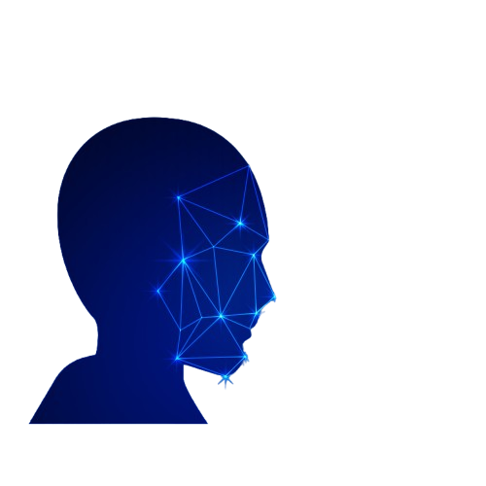
Introductuction
Facial recognition
Automation
Presence management
Speed
Presented by OUEDRAOGO Elysee Boris Alex
1

Slide 4

Issues and objectives
Issues
Fraud and identity theft
Long processing times
Inefficient storage and management
Frequent human errors
Presented by OUEDRAOGO Elysee Boris Alex
2

Slide 5




How can facial recognition improve attendance management in academic institutions?
Presented by OUEDRAOGO Elysee Boris Alex
2

Slide 6

Issues and objectives
Objectives
Automation for greater efficiency
Reduce fraud
Real-time data access
Improved accuracy
Presented by OUEDRAOGO Elysee Boris Alex
3

Slide 7
State of the art
Existing technologies
Current challenges
Light-dependent accuracy
Security and confidentiality of facial data
Machine Learning (LBPH)
Deep Learning (CNN)
Presented by OUEDRAOGO Elysee Boris Alex
4

Slide 8
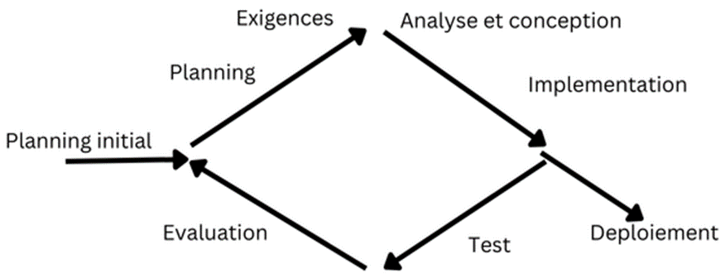
Methodology
UP
,
y
5
Presented by OUEDRAOGO Elysee Boris Alex

Slide 9
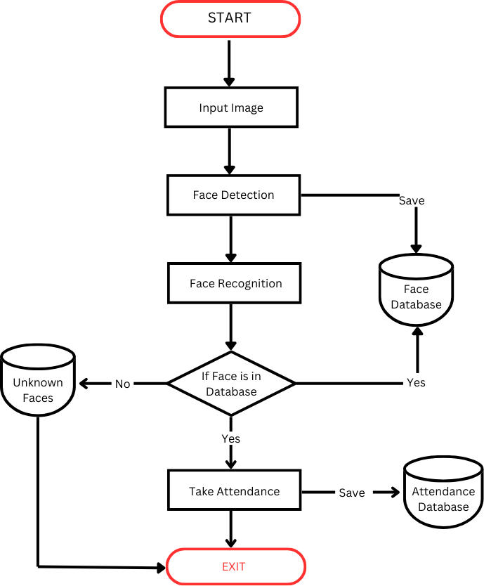
Methodology
Activity Diagram
6
Presented by OUEDRAOGO Elysee Boris Alex

Slide 10
Methodology
System architecture
1
2
3
4
Camera
Detection (OpenCV)
Recognition
Recording
7
Presented by OUEDRAOGO Elysee Boris Alex

Slide 11




Methodology
Tools and technologies
8
Presented by OUEDRAOGO Elysee Boris Alex

Slide 12


Limits and challenges
Low-light recognition
Masks
Dependence on image quality
Improved precision in difficult conditions
Spoofing protection
9
Presented by OUEDRAOGO Elysee Boris Alex

Slide 13
Demonstration
10
Presented by OUEDRAOGO Elysee Boris Alex

Slide 14
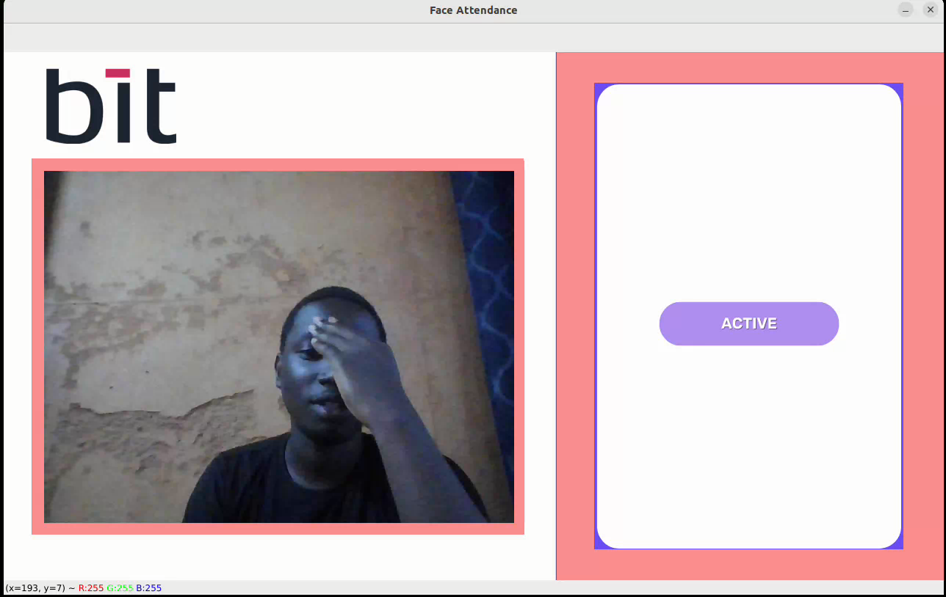

Slide 15
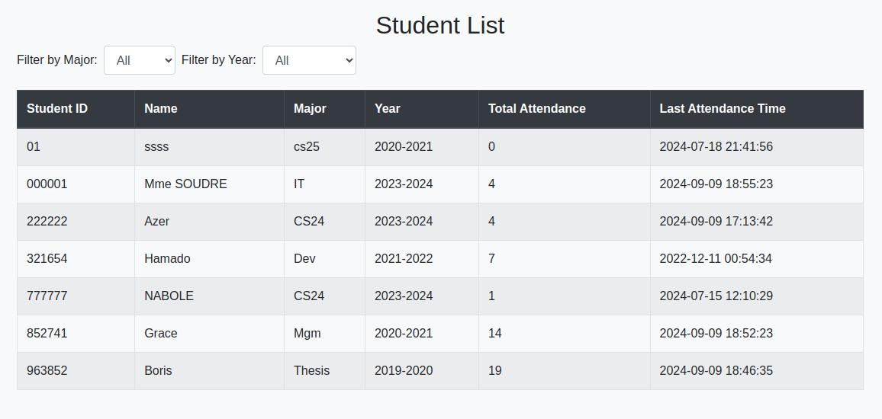

Slide 16
Conclusion
Skills acquired
Future developments
Use of CNN
Larger-scale deployment
Real-time performance enhancement
Possible applications
Security and access control
Monitoring visitor numbers in other sectors
Discovering the field of computer vision
Learn how the images processing works
Learn Flask
11
Presented by OUEDRAOGO Elysee Boris Alex

Slide 17
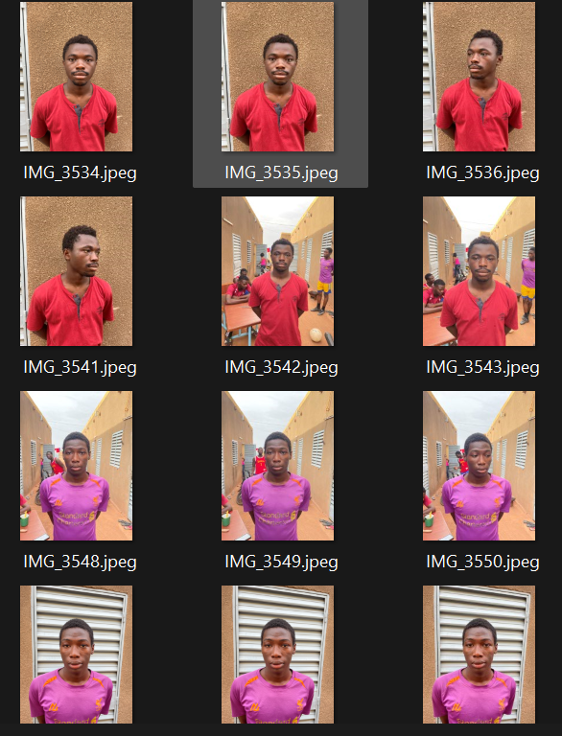
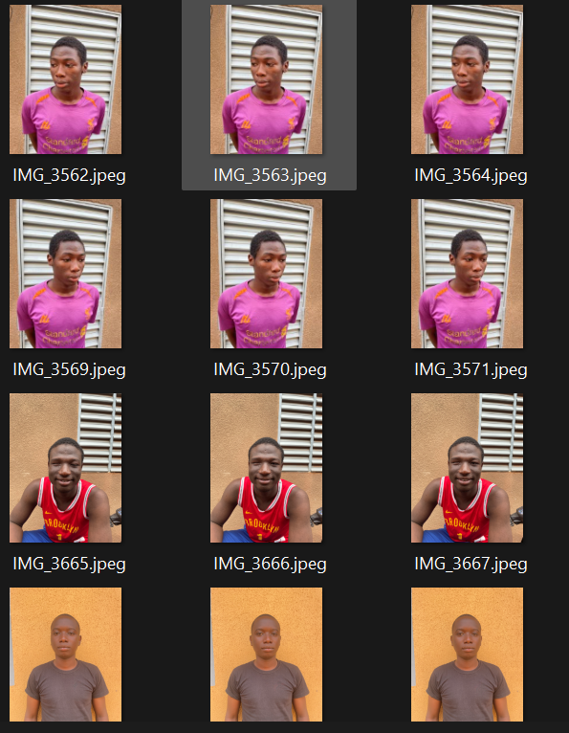
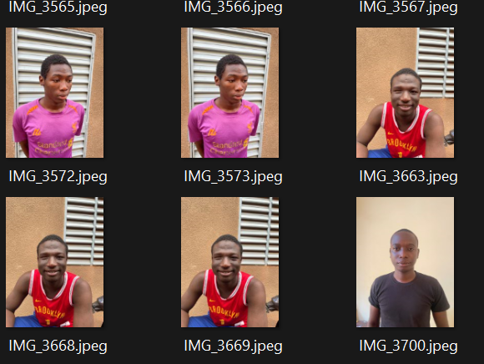
Presented by OUEDRAOGO Elysee Boris Alex

Slide 18

Presented by OUEDRAOGO Elysee Boris Alex

