Slide 1


EXCELLENCE PROGRAM
Adams KANDE
Mechanical Engineering graduate
kanadams53@gmail.com
+226 07344927

Slide 2

ABOUT ME
I am a Mechanical Engineering graduate with a passion for innovation and problem-solving. Beyond engineering, I’ve developed skills in project, program, and product management, blending technical expertise with strong leadership and organizational abilities.
Driven by a curiosity for emerging technologies, I explore robotics, automation, and artificial intelligence, aiming to create sustainable, high-impact solutions. With hands-on experience in CAD/CAM, 3D modeling, animation, simulation, and prototyping, I bring ideas to life with precision and creativity.

Slide 3
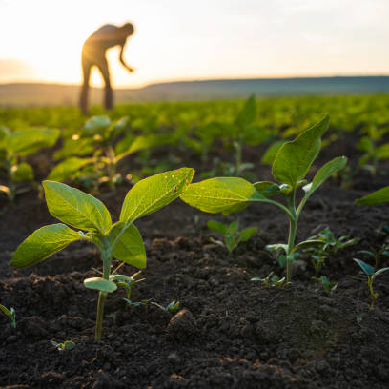
The sustainable Farm
Our farm combines renewable energy, advanced technology, and AI-driven systems to boost productivity while protecting the environment. It integrates:
Solar PV Power Plant: Clean energy supply.
Automatic Irrigation: Optimizes water use.
Smart Food Dryer: Preserves crops efficiently.
Ball Mill Grinder: Processes raw crops into flour or feed.
Solar Tracking System: Maximizes solar energy.
Visitors Management (NO-REESA): Translates Moore to
English with plant descriptions.
Fencing & Security: AI-powered face recognition for access control.
This setup ensures a sustainable, high-tech, and eco-friendly farming ecosystem.

Slide 4
What I do
My focus is on integrating a ball mill into the sustainable farm to streamline grain milling. This project aims to improve efficiency, reduce manual labor, and lower operational costs while supporting eco-friendly practices.

Slide 5
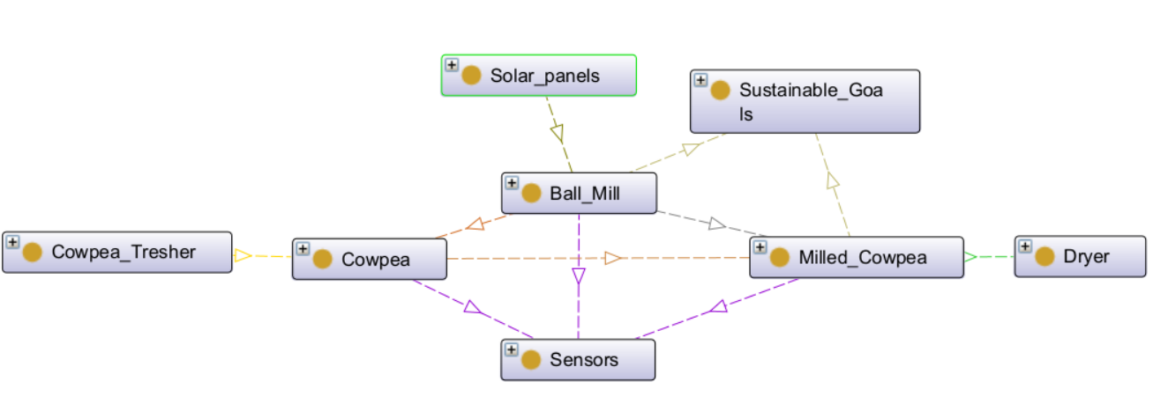
The Ontology About Ball Mill Integration

Slide 6
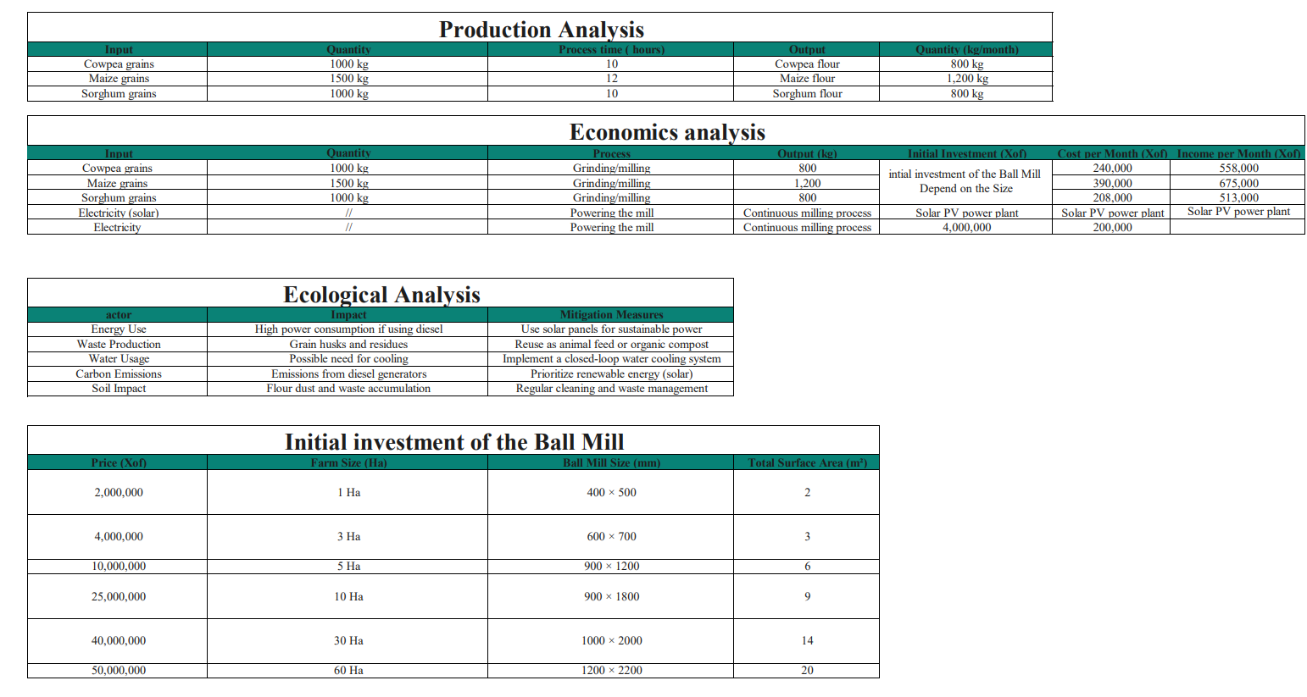
The Data (XLS) About Ball Mill

Slide 7
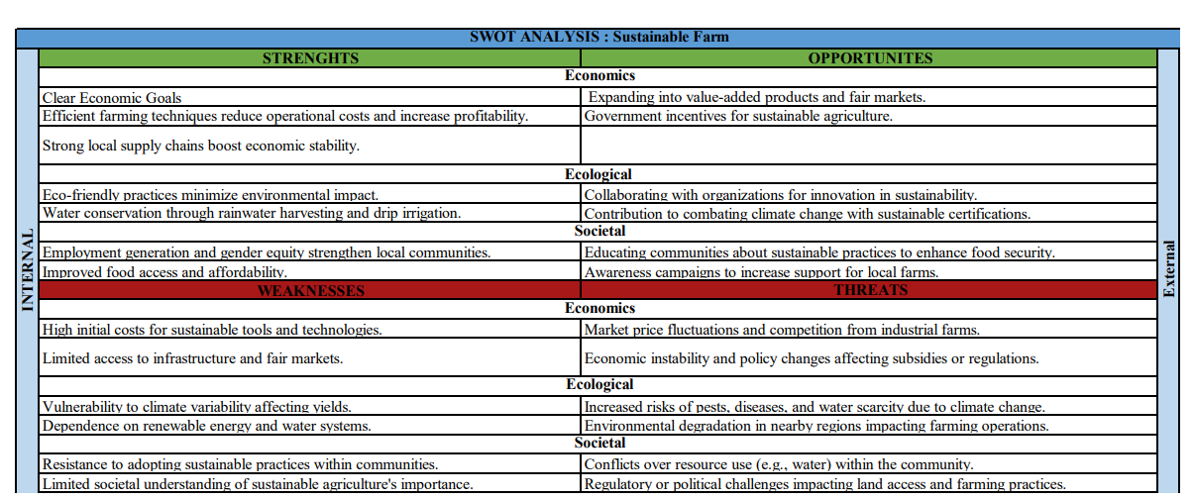
The Data (XLS) About The Farm

Slide 8
The Business Model Canvas (Ball Mill Integration)
Partners
Activities
Values
Relationships
Customers
Design adapting the ball mill for on-farm milling
Machinery parts suppliers
On-Site Grain Milling:
Personalized support
Our Farm
Consistent Quality:
Nearbyfarms/ cooperatives
NGOs and environmental programs
Resources
Increased Productivity
Channels
Sustainable agriculture enthusiasts
Technical Expertise
On-farm usage
Renewable energy providers
Energy Efficient Operation
Materials
Costs
Revenues
Initial Investment
Maintenance and repair costs
Value-Added Products
Increased farm output

Slide 9
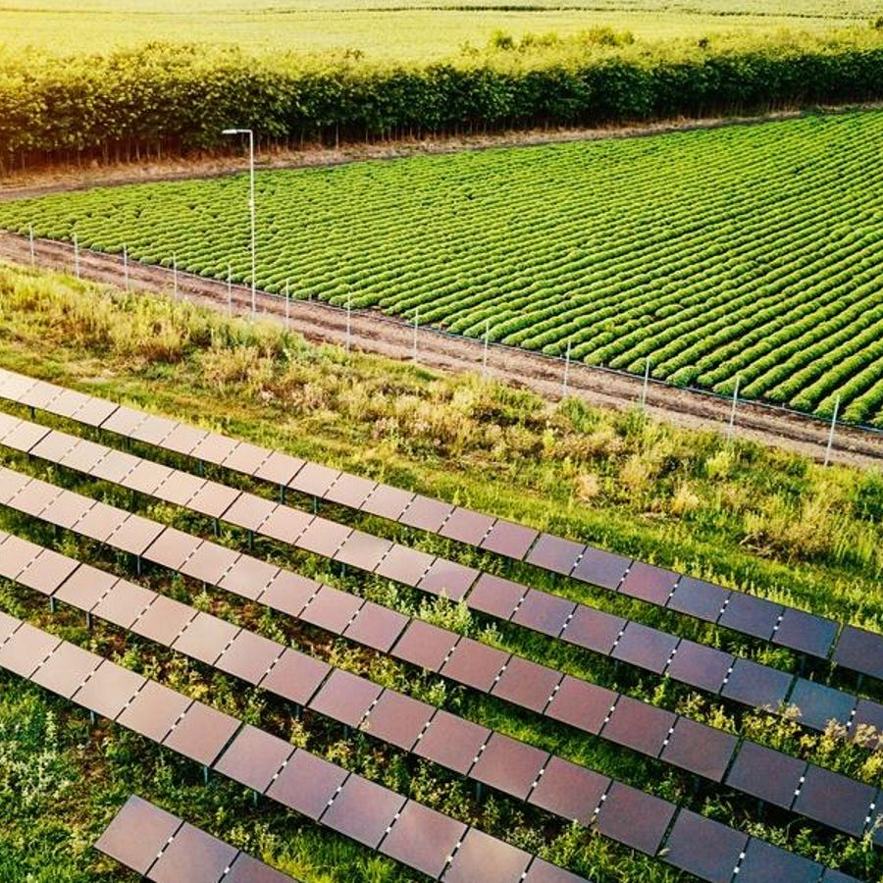
EXECUTIVE SUMMARY
The ball mill integration project is a vital addition to our sustainable farm, revolutionizing on-site grain milling. By leveraging renewable energy, it boosts productivity, reduces costs, and supports eco-friendly farming. This initiative positions our farm as a model for sustainable agriculture, proving that innovation and environmental responsibility can work hand in hand for long-term success.

Slide 10
THANK YOU!

