Slide 1
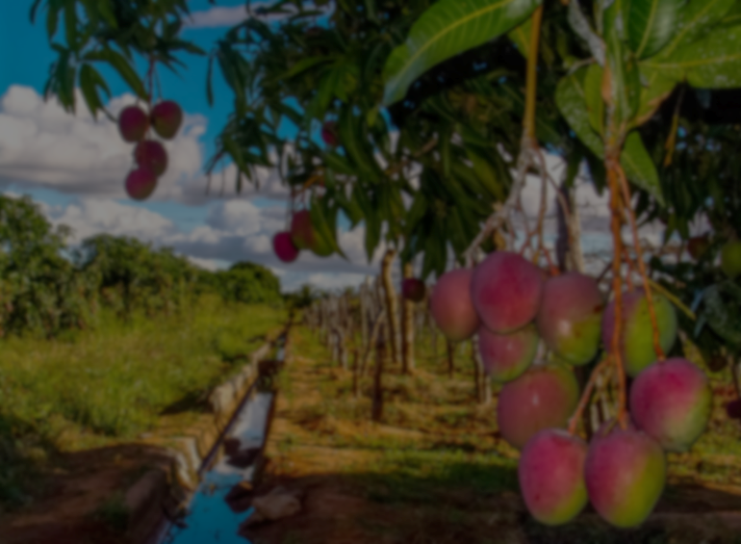
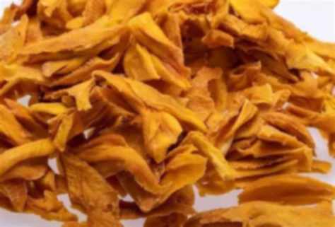
Cultivation and Harvesting Strategy for a Sustainable Mango Supply Chain

Slide 2
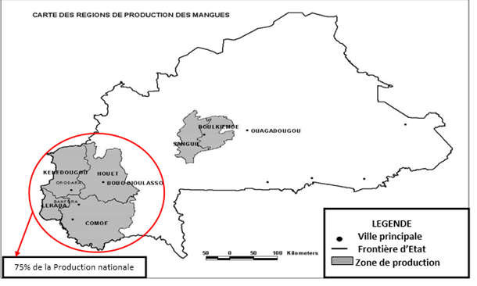

Context (Burkina Faso & Mango)
Mango production in Burkina Faso
The main mango growing area in Burkina Faso is the West and Central region (Bobo-Dioulasso, Banfora, Orodara) because the tropical climate is favorable for mango cultivation. Mango cultivation thrives in well-drained tropical ferruginous and sandy-clay soils.
Mango production area

Slide 3
Comparative study of mango varieties for drying
Variety | Advantages for drying | Disadvantages for drying
Amélie | Very sweet, not very fibrous
Kent | Yellow flesh, soft, fiber-free, good color after drying
Keitt | Large fruits, firm flesh, not very fibrous | Less abundant
Brooks | Quick drying | Late availability
Palmer | not very fibrous | Requires industrial drying
Tommy Atkins | good storage | less attractive taste
The variety is chosen based on characteristics such as :
attractive color,
sweet taste,
lack of fibers,
good shelf life
These characteristics ensure a high-quality finished product.

Slide 4
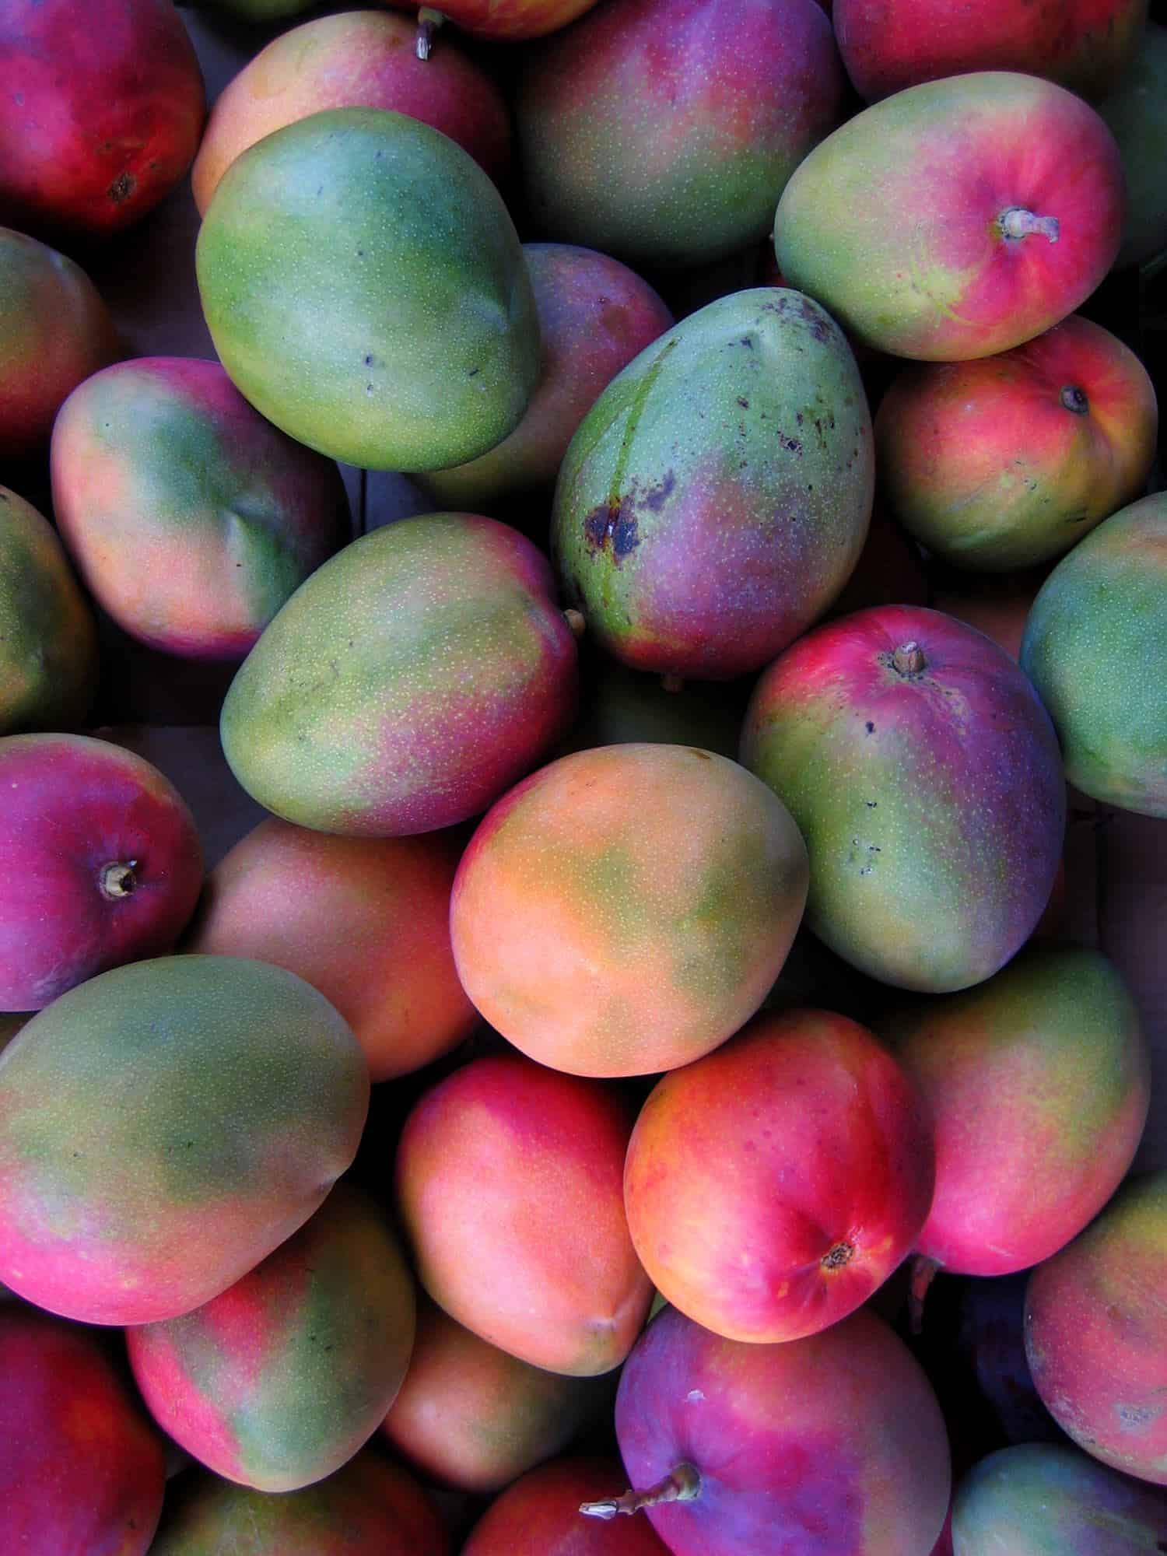
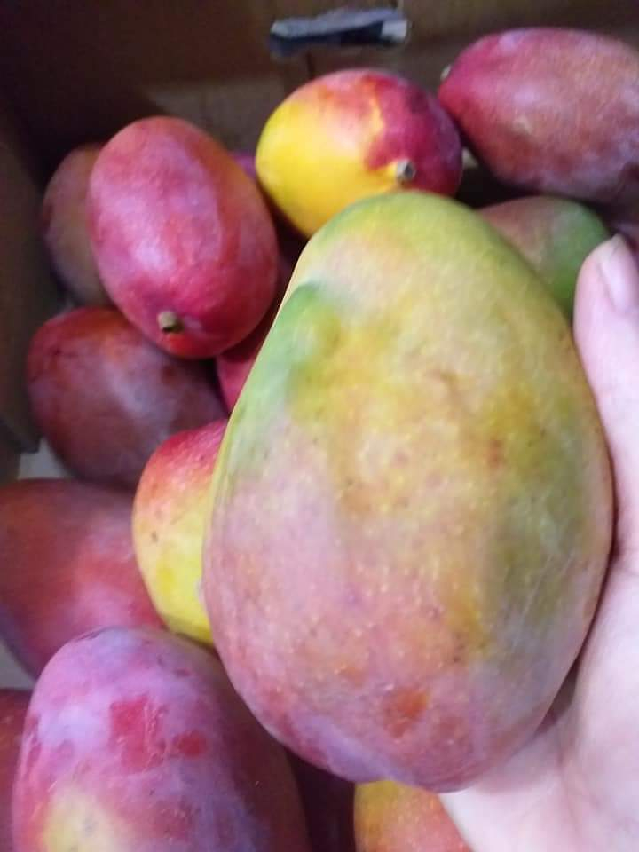
b) Variety Selection for Optimal Mango Drying
We will choose three varieties for this project: Kent, Keitt, and Amélie, which are prized for their sweet taste and texture, and are also suitable for drying and export.
Kent
Keitt
Amelie

Slide 5
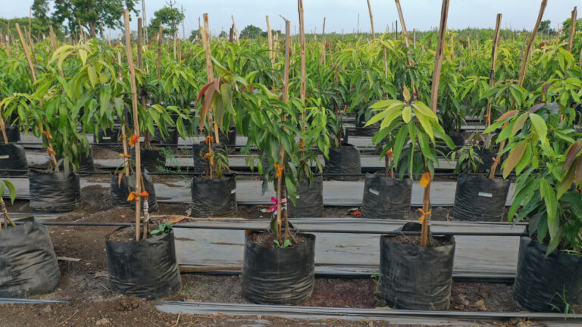
2. Cultivation Strategy
Mango plant nurseries
Bags and substrate
Bags: 25×40 or 30×50 cm
Substrate: 50% sandy soil, 30% compost, 20% manure or peat
Drainage: 2 or 3 holes in the bottom
Planting
- Seeds: soak for 24 hours and plant 1 seed per bag at a depth of 2 or 3 cm.
Growing instructions
Watering: 2 to 3 times per week with moist substrate
Exposure: full sun, protecting young plants with manure for up to 3 weeks

Slide 6
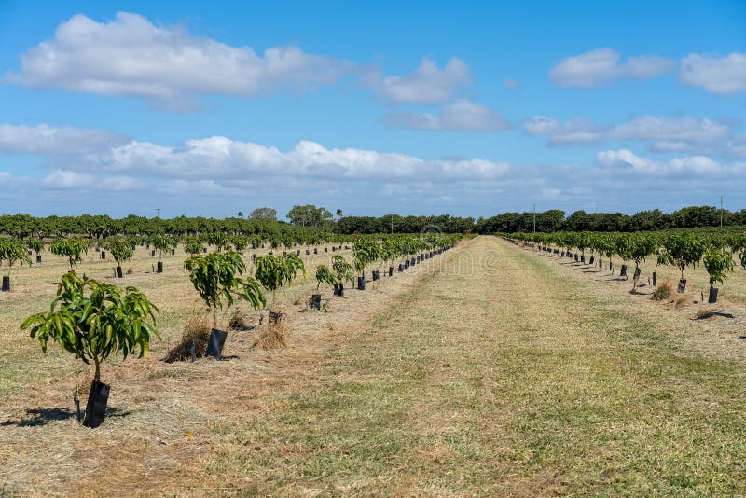
b) plant transplanting
After 6 to 8 months, depending on the root system and size(30 to 40 cm), the plants are ready to be transplanted.
Soil preparation
Dig holes measuring 40×40×40 cm
Add compost or decomposed manure to the bottom
Spacing between each tree: 7 meters
Between each row: also 7 meters

Slide 7
Mango tree production cycle
Phase 1: Nursery and transplanting (0–12 months)
Préparation des sacs et du substrat
Phase 2: Tree growth and formation
(1–4 years)
Phase 3: Flowering and fruit production (4–5 years)
Irrigation and fertilization to support flowering and fruit development
Entretien , arrosage, fertilisation organique, désherbage, protection contre insectes
Protection against insects and diseases
Fruit harvesting and regular orchard maintenance
Regular watering and fertilization
Monitoring for diseases and pests
Preparation for flowering (appropriate nutrients)

Slide 8
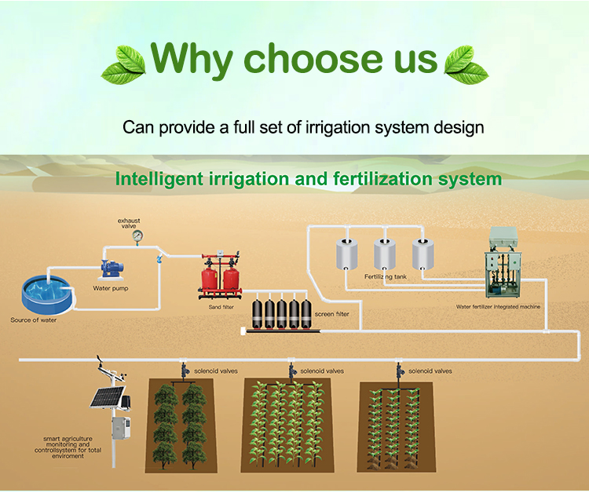
c) Irrigation and composting system
We will used a Drip irrigation with sensors integrated into the soil
Water and liquid fertilizer are delivered directly to the roots
Each plant receives the exact amount it needs each day
Delivery stops automatically once the required amount has been reached

