Slide 1
Analysis Protocols
Electrophysiology

Slide 2
Data Analysis Overview
Data Analysis
Experimental
Information
Measurement
Physics
Data
Analysis
Tasks
Analysis Methods
(Algorithms)
Experimental Information – contains details of the experiment
Measurement Physics – contains information about the underlying physics
(e.g. sources of noise, type of signal)
Data – actual data to be analysed (including metadata)
Analysis tasks – problems to be solved
Analysis methods – algorithms used to solve the problems

Slide 3
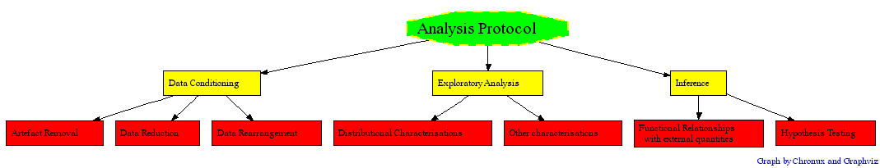
Analysis protocol
Conceptualization/organization of the analysis tasks

Slide 4
Note
Choice of tasks and the implementation is determined by the nature of the experiment (Experimental information and domain specific knowledge) i.e. the nature of the data. But there are also common themes.
Example differences: Artifacts
Eyeblinks, eye-ball movement, heart-beat, respiration, miscellaneous muscle activity contaminates EEG/MEG and Optical imaging data.
Similarly, fmri data analysis needs its own set of conditioning steps
Common theme:
All data under consideration are typically time-series, so that methods to characterize the structure in the data are common.
Thus, 60 Hz line noise potentially affects all electrical/magnetic recordings and the F-test for lines is a method for removing this noise.

Slide 5
Electrophysiological data types
Broad-band voltage traces (0-30 kHz, say)
Multiunit activity voltage traces (> 1 kHz, say)
Local field potential (voltage traces) (<300 Hz, say)
Isolated single unit activity (spike times)
Behavioral traces/events
Summary of experimental protocol, brain areas of interest
and other miscellaneous information
Note that 2,3,4 can be derived from 1. 1-3 are continuous; 4 is
a point process. 5 can be either continuous or point process,
depending on the experiment.

Slide 6
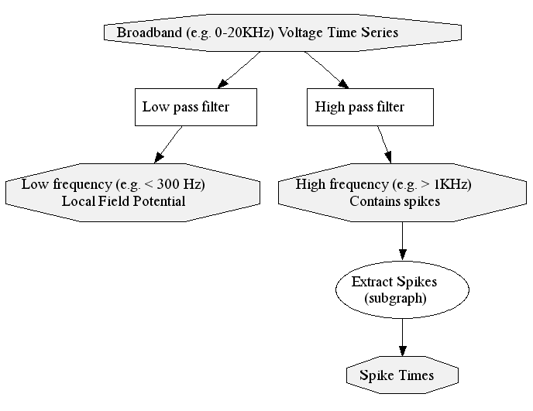
Conditioning
Data Reduction
Data type 1
Data type 4
Data type 2
Data reduction also includes various schemes of dimensionality reduction (e.g. PCA) used for multivariate data; These are discussed in the analysis of optical imaging data.
Data type 3

Slide 7
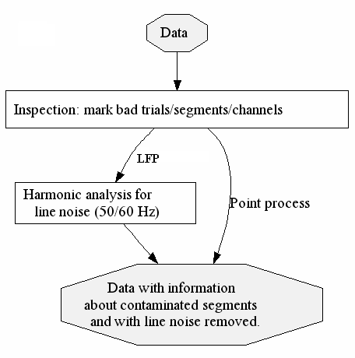
Artefact identification and removal
Note that electrophysiological recordings do not suffer from as many artefacts as other modalities (this knowledge is part. So artefact removal is simpler here than (say) in MEG (to be discussed later)
Data Rearrangement – arrange data in analysis blocks according to some experimentally motivated criterion e.g. group all trials to conditions A and B.

Slide 8
Exploratory Analysis and Inference
Exploratory analysis and inference depend greatly on the nature of the experiment, and it is not easy to provide an exhaustive description of the protocol. We consider here one typical experimental setup: a finite number of randomly interleaved experimental conditions and recordings consisting of broad-band data along with associated behavioral markers. Assume that at the end of the conditioning steps discussed previously, the broad-band data has been converted to local field potentials, that all artifacts have been removed, and data has been rearranged according to trial condition. Then, an appropriate goal of the exploratory analysis of this dataset is (i) to characterize the spiking and local field potential activity for the different conditions, (ii) to characterize the correlations between spiking and local field potential activity for these conditions. (iii) to check whether the spikes, local fields and the spike-field correlations show apparent condition dependence (frame hypotheses).
Exploratory analyses
Distributional characterization
First moment computations: e.g. spike rates, evoked LFP, spike-triggered LFP
Second moment computations: e.g. spike and LFP spectra, and spike-field coherence
for the different conditions
Inference
Functional relationship with external quantities
Tuning curves: e.g. tuning of the spike rate, tuning of the LFP spectral power in a particular frequency.
Regression: relating observed activity to continuous behavioral information (if available) e.g. Rat in maze.
Hypothesis testing
e.g. Spike rates differ significantly between a particular pair of conditions. LFP power in a particular
frequency band differs between the different conditions.

Slide 9
Example electrophysiology data set:
In the file LIPdata.mat, you are provided with the local field potential and spikes recorded from the same site. These recordings are taken from Pesaran et al (2002) and were acquired from the lateral intraparietal area (LIP) of macaque monkeys performing a memory guided saccade task. The task was as follows: At the beginning of the experiment the monkey fixated on a spot of light at the center of the screen. Once fixation was acquired, a peripheral target was flashed (for 100 ms) at one of eight locations (see Figure). The monkey was required to stay fixated at the central spot for a delay period (of around 1100ms). At the end of the delay, the central spot was turned off. This was the signal to the monkey to make a saccade to the remembered location of the target. Assume that it is known from previous work in this area of the brain that the spike rates show directional tuning i.e. the average spike rate is highest for one of the eight directions and least for the opposite direction.

Slide 10
The overall aim of this tutorial is to -
Examine the spectra of the spikes and LFPs and of the correlation between the spikes and LFPs and create appropriate hypotheses. (e.g. the spike and/or LFP spectra in a particular band of frequencies are significantly different between a pair of directions.) Test these hypotheses and draw appropriate conclusions. You also want to compare the tuning of the spike rate with that of the LFP. At the minimum,
1) Compute the spike rates (as a function of time) for each direction using Locfit. Then plot directional tuning curves based on the mean spike rate in the delay period (This should be motivated by observing the behavior of the spike rate as a function of time).
2) Compute the average LFP spectrograms for trials to each direction – using the routines mtspecgramc.m and/or mtspecgramtrigc.m.
3) You will observe that there is gamma band activity in the LFP spectra during the delay period and that this activity shows a direction dependence. Based on this observation, plot the gamma band LFP power during the delay period as a function of direction – this is the LFP tuning curve.
4) Test the hypothesis that the gamma band LFP power differs most significantly for a pair of directions – these will be the preferred and anti-preferred directions for this recording – you could use a t-test.
4) Finally, examine spike spectra and spike-field coherence for this pair of directions (or all eight directions) see whether there is similar directional tuning for these quantities. Note that in each case, you want to put error bars for comparison between directions.

Slide 11
The recordings have already been conditioned (i.e. broad-band recordings were separated in LFPs
and multi-unit traces, spikes were extracted, 60 Hz noise was removed, and recordings were
rearranged into groups corresponding to the eight directions. The data is in electrophys_tut.mat.
When this file is loaded into matlab, you should have the following variables:
dlfp – 4 channels of continuous LFP recordings (from a tetrode)
dsp – struct array of spike times for two neurons
trialtimes – start times of the trial
fixon – fixation light comes on times
fixacq – fixation acquired times
targon – target light comes on times
targoff – target light goes off times – beginning of delay
fixoff – fixation off times
saccade – saccade times
target- target directions
Fs-sampling frequency for the LFP
Note: all times are in seconds from the start of the recording session
>> load LIPdata.mat
>> whos
Name Size Bytes Class
Fs 1x1 8 double array
dlfp 755171x4 24165472 double array
dsp 1x2 163400 struct array
fixacq 80x1 640 double array
fixoff 80x1 640 double array
fixon 80x1 640 double array
saccade 80x1 640 double array
targets 80x1 640 double array
targoff 80x1 640 double array
targon 80x1 640 double array
trialtimes 80x1 640 double array
Grand total is 3041729 elements using 24334000 bytes
>>

Slide 12
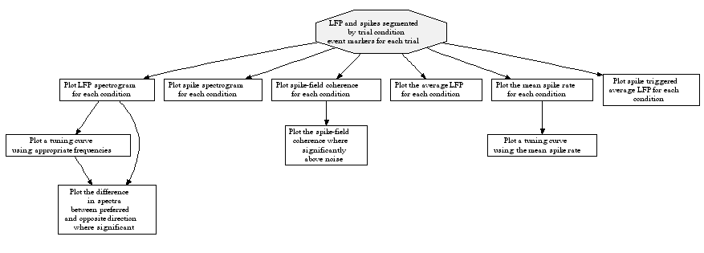
A somewhat more complete protocol
Note that these tasks essentially describe the contents of Pesaran et al (2002).

Slide 13
Chronux
Chronux offers several routines for computing spectra and coherences for both point processes and continuous processes. In addition, it also offers several general purpose routines that we have found useful such as a routine for extracting specified segments from data, or binning spike time data with bins of a specified size. Since the data can be continuous valued, point process times, or point processes that are binned, methods that apply to all these data types are given in routines whose names end with ‘c’ for continuous, ‘pb’ for binned point processes, and ‘pt’ for point process times. Thus, mtspectrumc computes the spectrum of continuous data, mtspectrumpb, and mtspectrumpt compute spectra for binned point processes and point process times. More on these later.

Slide 14
First : Segment the data in analysis blocks centered on the onset of the
delay period.
>> E=targoff; win=[2 2]; datasp=createdatamatpt(dsp(1),E,win);
>> whos datasp
Name Size Bytes Class
datasp 1x80 32984 struct array
Grand total is 3595 elements using 32984 bytes
>> datalfp=createdatamatc(dlfp(:,1),E,Fs,win);
>> whos datalfp
Name Size Bytes Class
datalfp 4000x80 2560000 double array
Grand total is 320000 elements using 2560000 bytes

Slide 15
Let us move on to spectral computations.
Basic information about Chronux can be obtained by typing “help chronux” at
the command prompt. More information is found in the documentation. We start by creating a variable params that keeps parameters commonly used by chronux in a single structure.
>> params=struct('tapers',[5 9],'pad',2,'Fs',1000,'fpass',[0 100],'err',0,'trialave',0);
>> whos params
Name Size Bytes Class
params 1x1 808 struct array
Grand total is 14 elements using 808 bytes
>> params
params =
tapers: [5 9]
pad: 2
Fs: 1000
fpass: [0 100]
err: 0
trialave: 0
>>

Slide 16
Compute spectrum for the first trial
>> [S,f]=mtspectrumc(detrend(datalfp(:,1)),params);
Compute error bars:
>>[S,f,Serr]=mtspectrumc(detrend(datalfp(:,1)),params);
??? Error using ==> mtspectrumc
When Serr is desired, err(1) has to be non-zero.
>>params.err=[1 0.05]; [S,f,Serr]=mtspectrumc(detrend(datalfp(:,1)),params);
>>plot(f,10*log10(S),f,10*log10(Serr(1,:),f,10*log10(Serr(2,:));
Compute average spectrum for trials to direction 1:
>> indx=find(targets==1);
>> datalfp1=datalfp(:,indx);
>> params.err=[1 0.05];params.trialave=1;
>> [S1,f1,Serr1]=mtspectrumc(datalfp1,params);
Another routine (similar routines available for coherence etc) –
>>E=targoff(indx);
>>[S1,f1,Serr1]=mtspectrumtrigc(dlfp(:,1),E,params);

Slide 17
Sample code to compute spectra of the LFP and spikes and the spike-field
coherence (this is in file spectraMBL2005.m) for all eight directions
[fname,pname]=uigetfile('*');
eval(['load ' pname '\' fname]);
params.tapers=[5 9]; params.pad=2; params.Fs=1000; params.fpass=[0 100]; params.trialave=1;params.err=0;
movingwin=[0.5 0.1]; % duration of moving window used to evaluate spectrograms
win=[2 2]; % window around events
fignum=[2 3 6 9 8 7 4 1]; % figure numbers for particular directions
for targ=0:7;
E=targoff(find(targets==targ));
[Ssp,tsp,fsp,R]=mtspecgramtrigpt(dsp(1),E,win,movingwin,params);
figure(1);
subplot(3,3,fignum(targ+1));
imagesc(t,f,10*log10(S)'); axis xy; colorbar;
figure(2);
subplot(3,3,fignum(targ+1));
plot(t,R);
[Slfp,tlfp,flfp]=mtspecgramtrigc(dlfp(:,1),E,win,movingwin,params);
figure(3);
subplot(3,3,fignum(targ+1));
imagesc(t,f,10*log10(S)'); axis xy; colorbar;
end;

Slide 18
Sample code to compute spike-field coherence for each of the eight directions
(file spike-field-coherencyMBL2005.m)
[fname,pname]=uigetfile('*');
eval(['load ' pname '\' fname]);
params.tapers=[5 9]; params.pad=2; params.Fs=1000; params.fpass=[0 100]; params.trialave=1;
movingwin=[0.5 0.1]; % duration of moving window used to evaluate spectrograms
win=[2 2]; % window around events
fignum=[2 3 6 9 8 7 4 1]; % figure numbers for particular directions
for targ=0:7;
E=targoff(find(targets==targ));
datasp=createdatamatpt(dsp(1),E,win);
datalfp=createdatamatc(dlfp(:,1),E,Fs,win);
[C,phi,S12,S1,S2,t,f,zerosp]=cohgramcpt(datalfp,datasp,movingwin,params); % Note cohgramcpt does give you % spectra but not the errors on the spectra.
subplot(3,3,fignum(targ+1));imagesc(t,f,C'); axis xy; colorbar;
end;

Slide 19
Sample code to compute spike-field coherence with error bars and confidence levels
for each of the eight directions (file significant-spike-field-coherencyMBL2005.m)
[fname,pname]=uigetfile('*');
eval(['load ' pname '\' fname]);
params.tapers=[5 9]; params.pad=2; params.Fs=1000; params.fpass=[0 100]; params.trialave=1;params.err=[2 0.05];
movingwin=[0.5 0.1]; % duration of moving window used to evaluate spectrograms
win=[2 2]; % window around events
fignum=[2 3 6 9 8 7 4 1]; % figure numbers for particular directions
for targ=0:7;
E=targoff(find(targets==targ));
datasp=createdatamatpt(dsp(1),E,win);
datalfp=createdatamatc(dlfp(:,1),E,Fs,win);
[C,phi,S12,S1,S2,t,f,zerosp,confC,phierr,Cerr]=cohgramcpt(datalfp,datasp,movingwin,params);
subplot(3,3,fignum(targ+1));plotsig(C,confC,t,f); axis xy; colorbar;
end;

Slide 20
Chronux routines for continuous valued data classified by task type
Conditioning – createdatamatc,extractdatac,binspikes,rmlinesc,locdetrend,spsvd,pca
First moment – evoked,psth,isi,sta,staogram.
Second Moment – mtspectrumc,mtspecgramc,mtspectrumtrigc,mtspecgramtrigc,coherencyc,cohgramc,
coherencycpb,coherencycpt,cohgramcpb,cohgramcpt, mtspectrumsegc,coherencysegc,
cohmatc, crossSpecMat.
Similar routines available for point process data (both binned spike counts and spike times)

