Slide 1
APPLIED AI SOLUTIONS DEVELOPMENT • AASD 4016 / 4017
EnergyForecast AI
Taking a trained forecasting model online — a publicly
accessible, cloud-deployed LSTM service for the oil production industry.
George Brown College – Full Stack Data Science Systems & Presenting Data Science-driven Solutions
Kourosh Shahram, PhD, PMP

Slide 2
SOLUTION
Business Pitch — Solution
Three phases: data, forecast, then plan the optimal mix
This is not a price-forecasting product. Forecasting is one step; the product is the plan — the optimal, budget-constrained combination of energy resources over a 10-year horizon.
1
PHASE 1
2
PHASE 2
3
PHASE 3
Data & Analysis
Forecasting
Optimization / Planning
IN PROGRESS
BUILT & VALIDATED
PROPOSED — NEXT
Finding and analyzing the influential data: inflation rate, available resources, historical energy prices & consumption, and available technology.
LSTM models predict energy prices, consumption, and resource availability. Proven on WTI crude: MAPE 2.97%, R² 0.928.
Takes the forecasts, an available budget, and the planning horizon, and computes the optimal resource mix — the same class of problem as capacity-expansion models (e.g. TIMES/MARKAL).
03

Slide 3
MODEL SELECTION
Why LSTM?
Oil prices are time-series data — the current price is influenced by patterns and information from previous days. LSTM is specifically designed to learn dependencies across sequences: it looks at the previous 60 days and learns which information matters, retaining what's relevant and discarding what isn't.
Sequential data
60-day memory
Selective retention
Today's price depends on recent history — not just today's inputs in isolation.
The model reads 60 consecutive days before making a single next-day prediction.
Internal gates decide what to keep, update, or forget as the sequence is processed.
02

Slide 4
FEATURE ENGINEERING
From 5 market variables to 26 LSTM features
5 raw market features + 21 engineered/derived features = 26 inputs for each day
5 RAW FEATURES
21 ENGINEERED / DERIVED FEATURES
• Oil Price
Lag features — 4
Rolling statistics — 4
Returns — 4
• Oil_Lag_1 • Oil_Lag_5 • Oil_Lag_10 • Oil_Lag_21
• RollMean_7 • RollMean_21 • RollMean_60 • RollStd_7
• Oil_LogRet • Gas_LogRet • Gold_LogRet • VIX_LogRet
• Natural Gas
• USD Index
Feature engineering
Momentum & volatility — 4
Calendar features — 3
Relationship / indicator — 2
• Momentum_7 • Momentum_21 • Volatility_21 • Volatility_60
• Month • Quarter • DayOfWeek
• Gold_Oil_Ratio • VIX_Spike
• VIX
• Gold
Calendar features come from the date; most others are derived from market variables.
For each of 60 days: 26 values → LSTM input shape = 60 × 26

Slide 5
MODEL SELECTION
LSTM Logic: Forecasting Tomorrow's Oil Price
How the model turns 60 days of oil market data into a single next-day price forecast
Cell State — the running memory of oil-market conditions, carried across all 60 days
1
Forget Gate
2
Input Gate
3
Output Gate
Looks at today's oil-market data and yesterday's summary, and decides which older price patterns are no longer useful for tomorrow's forecast.
Decides which parts of today's 26 oil-market features are worth remembering going forward.
Decides what part of the updated memory gets passed forward as the summary used to predict tomorrow's oil price.
e.g. dropping an old price trend once the market has clearly shifted
e.g. registering a sudden VIX spike or oil-price jump as significant
e.g. surfacing recent price momentum as the key signal
Inputs each day: that day's 26 oil-market features (price, gold, VIX, USD, lags...)
Passed to the next day →
This three-gate cycle repeats once per day across all 60 days of oil-market history. On day 60, the final memory — a filtered summary of what actually mattered across the sequence, not just yesterday's price — is passed to a Dense layer that outputs a single number: tomorrow's predicted WTI oil price.

Slide 6
THE MODEL
A 2-layer LSTM, trained
on 20 years of data
Architecture
LSTM(128) → Dropout(0.2) → LSTM(64) → Dropout(0.2) → Dense(32) → Dense(1)
2.97%
MAPE
Input shape
(60, 26) — 60-day lookback window × 26 engineered features
0.928
R²
Training data
4,933 daily records, 2006–2026, 80/20 chronological split
2.35
MAE (USD)
Optimizer
Adam, MSE loss, EarlyStopping + ReduceLROnPlateau callbacks
75
epochs (early-stopped)
04

Slide 7
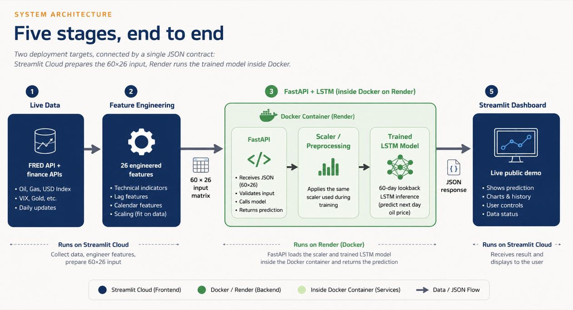
SYSTEM ARCHITECTURE
03

Slide 8
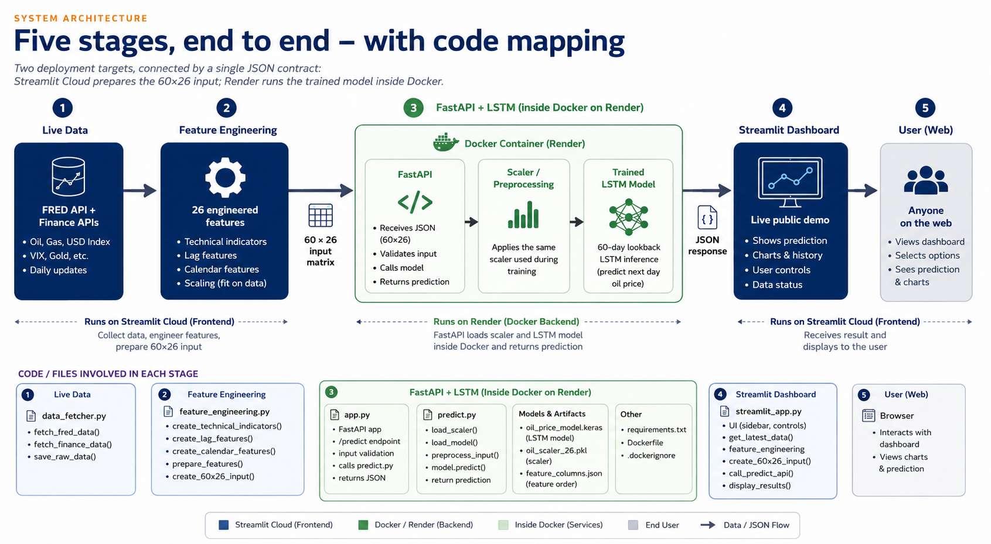
SYSTEM ARCHITECTURE
03

Slide 9
UNDER THE HOOD
Engineering, not just modeling
26 FEATURES, ONE SHARED PIPELINE
TECH STACK
Market levels
Model
TensorFlow / Keras
Oil, Gold, Natural Gas, USD Index, VIX
API
FastAPI (primary) + Flask (parallel)
Lags & momentum
1/5/10/21-day lags, 7/21-day momentum
Container
Docker, python:3.11-slim
Rolling stats
7/21/60-day rolling mean & std, volatility
API hosting
Render
Derived signals
Dashboard
Streamlit Community Cloud
Log returns, Gold/Oil ratio, VIX spike flag, calendar
feature_pipeline.py is imported by BOTH training and serving — identical scaling and windowing logic guarantees zero train/serve skew.
Live data
FRED official API + yfinance
05

Slide 10
ZERO MANUAL INPUT
The system builds its own
60-day input, on every click
1
2
3
4
Fetch
Engineer
Slice
Predict
~500 days from FRED (Oil, Gas, USD, VIX) + yfinance (Gold)
Compute all 26 features — rolling stats need history before day 1 is usable
Take the most recent 60 fully-engineered rows: .tail(60)
POST the 60×26 matrix to the deployed FastAPI model
This directly replaced an earlier version that required the user to manually paste 60 rows of market data — the fetch/engineer/slice pipeline now does it automatically, live, on every request.
06

Slide 11
CHALLENGES — DATA RELIABILITY
Three data sources failed
in three different ways
ISSUE
FIX
FRED's chart-export endpoint hung intermittently in Docker and on Streamlit Cloud — works locally, silently times out from cloud IP ranges.
Switched to FRED's official, documented REST API (api.stlouisfed.org) with a free key and explicit connect/read timeouts.
ISSUE
FIX
An unverified Gold API (xaus.com) wasn't a real stable source; the fallback (Stooq CSV) then returned a live 404 for everyone, not just this code.
Replaced both with yfinance — a maintained library, not another hand-scraped endpoint.
ISSUE
FIX
Docker's internal DNS resolver hung on lookups — a timeout value on the request never covered the DNS phase at all.
Added a global socket timeout plus explicit DNS servers (8.8.8.8 / 1.1.1.1) in docker-compose.
07

Slide 12
CHALLENGES — ENVIRONMENT & DEPLOYMENT
Getting it running was its
own engineering problem
Python 3.14 vs. TensorFlow
TensorFlow had no build for the newest Python — resolved by installing Python 3.13 alongside it in a dedicated virtual environment.
1
NumPy compiling from source
No pre-built wheel for the pinned NumPy version on 3.13 — fixed by upgrading to numpy 2.1.3 / scikit-learn 1.6.1, both with ready-made wheels.
2
Two free-tier services sleep
Streamlit Cloud and Render both idle out and “wake up” on first request — expected behavior, not a bug, but a real demo-day consideration.
3
Secrets management
FRED_API_KEY has to be set three separate places consistently — local env var, Streamlit secrets, and never hardcoded into committed code.
4
08

Slide 13
LIVE DEPLOYMENT
Two managed cloud services,
one API contract between them
STREAMLIT COMMUNITY CLOUD
RENDER
Dashboard + live data pipeline
Dockerized FastAPI inference
• Fetches FRED + yfinance data
JSON POST
/predict
• Receives the finished matrix
• Engineers 26 features
• Loads the trained LSTM once
• Builds the (60,26) input
• Runs model.predict()
• Renders the forecast chart
• Returns price as JSON
energy-price-prediction-ai.streamlit.app
oil-price-api-3-0.onrender.com
Docker never touches raw market data — it only ever sees the finished 60×26 matrix.
09

Slide 14
INSIDE THE DEPLOYMENT
What's actually running inside the container
RENDER CLOUD SERVER
DOCKER CONTAINER
Uvicorn
ASGI server
↳ FastAPI application
defines /predict, /forecast, /health
TensorFlow / Keras
ML framework running the model
Trained LSTM model (.keras)
2.97% MAPE, R² 0.928
Scaler (.pkl / .joblib)
Fitted MinMaxScaler, saved from training
Python prediction code
feature_pipeline.py + model_service.py
10

Slide 15
VERIFIED LIVE
End-to-end, on real
cloud infrastructure
NEXT-DAY FORECAST
WHAT THIS CONFIRMS
$79.54
Live data fetched with zero manual input, on demand
Feature engineering matches training exactly — no train/serve skew
USD per barrel
Dockerized model serving real predictions from a public URL
Latest market date
2026-08-11
Two independently deployed cloud services working as one system
Input window
60 days
Model features
26
11

Slide 16
From notebook to
production system
Trained model → modular scripts → dual-framework API → Docker → live cloud deployment → fully automated data pipeline.
Thank you — questions welcome.

