Slide 1
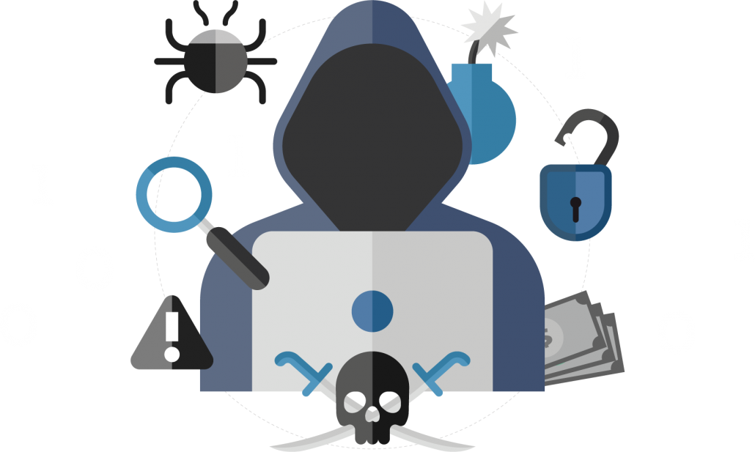
Phishing Awareness
Protecting Yourself and Your Organization

Slide 2

Introduction to Phishing
Definition: Phishing is a cyberattack that uses disguised emails or websites to steal sensitive information.
Image: Example of a phishing email
Importance: Understanding phishing is crucial to protecting personal and organizational data.

Slide 3
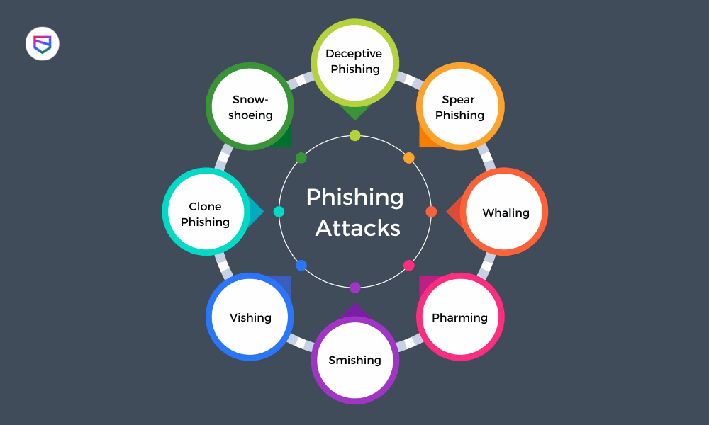
Types of Phishing Attacks

Slide 4
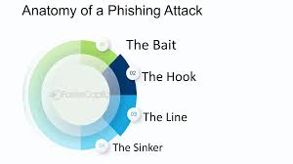
Anatomy of a Phishing Attack
Attack Vector: How the phishing message reaches the victim.
Hook: The lure used to trick the victim (e.g., urgent request, attractive offer).
Line: The method used to capture the victim's information (e.g., fake website, malicious attachment).
Sinker: The execution of the attack (e.g., stealing data, installing malware).

Slide 5
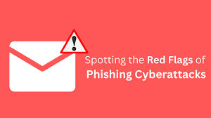
Identifying Phishing Emails
Check the sender's email address.
Look for generic greetings and poor grammar.
Be wary of urgent or threatening language.
Hover over links to see the actual URL.

Slide 6
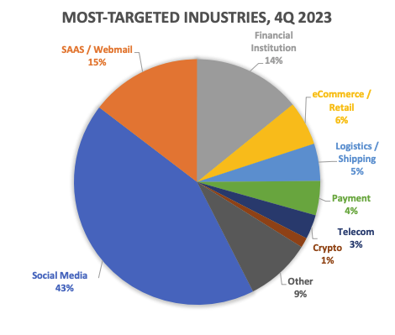
Impact of Phishing Attacks
Data Breaches: Loss of sensitive information.
Financial Loss: Direct theft or fraud.
Reputational Damage: Loss of trust from customers and partners.
Legal Repercussions: Compliance issues and fines.

Slide 7
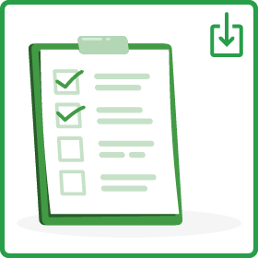
How to Protect Yourself
Use strong, unique passwords.
Enable multi-factor authentication (MFA).
Regularly update software and systems.
Be cautious with unsolicited emails and messages.

Slide 8

What to Do if You’re Targeted
Do not click on suspicious links or attachments.
Report the phishing attempt to your IT department.
Change your passwords immediately.
Monitor your accounts for suspicious activity.

Slide 9

Conclusion and Questions

Slide 10
THANK YOU

