Slide 1

Approved by AICTE , Affiliated to JNTUH
Accredited by NAAC – A Grade , NBA & ISO 9001 : 2015 Certified
PRC-3
A MINI PROJECT
ON
DETECTION AND PREVENTION OF WORKFLOW ATTRITION
BACHELOR OF TECHNOLOGY
IN
CSE – AI & ML
BY
K . KOUSHIK - 20VE1A6690
M . SANKALP - 20VE1A6691
M . HITHISHINI - 20VE1A6692
M . AKSHAYA - 20VE1A6693
Under the Guidance of
DR.K.MADAN MOHAN – ASSOCIATE PROFESSOR
ACADEMIC YEAR: (2020-2024)

Slide 2
Detection and Prevention Of Workflow attrition

Slide 3
Contents Abstract Proposed System Literature Overview Software and hardware requirements System Architecture Modules Dataset Uml Diagrams Modules Description Conclusion References Queries

Slide 4
ABSTRACT
Attrition of employees is a well-known issue that requires the correct judgments from the management to keep highly skilled employees. Excitingly, Artificial Intelligence (AI), Machine and Deep Learning were applied broadly for instance like an effective means for the prediction of employee attrition.
The aim of this study was to utilize machine and deep learning models to predict employee attrition with a high accuracy; furthermore, to identify the most influential factors affecting employee attrition.
The competition between enterprises and companies extremely dependent on the throughput of the employees therefore Constructing and preserving an appropriate atmosphere is the main key for the contributions for steady and cooperative employees.

Slide 5
PROPOSED SYSTEM
Convolutional Neural Networks (CNNs) are proven to be highly effective and often outperform traditional machine learning approaches. Deep learning approaches are far more accurate and efficient when compared to the Simple machine learning libraries . We want to build a deep learning model which also helps in prevention of attrition in large scale.
Results will be accurate and better compared to other methodologies. We want to enhance the dataset by adding other external factors of attrition added in recent times.
Algorithms:
The algorithm of the application is exploring Ensemble models of Deep learning with techniques like Bagging, boosting and stacking to overcome the overfitting of data.

Slide 6
CNN algorithm we explore is 1-D Convolutions , RNN algorithms are Bidirectional RNN and LSTM, where in LSTM (Long-Short Term Memory) we use the classic cell states and gates.
We developed a web interface, where we considered every single factor in the dataset and gave the input boxes for the users to give the input to understand how and what values of the factors are affecting the Attrition rate. This simple Web page is developed using HTML, CSS for Front-End and Python Flask for the Back-End. User can enter the values into the input boxes, submit the values and then get if Attrition is Yes or No and the accuracy of the result through the DL Algorithms.

Slide 7
LITERATURE SURVEY
Pradip Kumar Talapatra et al.[1] explored the attrition rate and the perspective of industries in India which have factors of their own. They concluded that benefits not meeting their needs is highest factor of attrition.
Fatemeh Mozaffari et al.[2] analyzed and came to a conclusion that by using the gradient boosting model ML model they could achieve their accuracy rate up to 89%.
Ali Raza et al.[3] utilized the Machine Learning Algorithms like Extra Trees Classifier (ETC), Support vector machine (SVM), Logistic Regression (LR), and Decision Tree Classifier (DTC), compared them in accuracy term and could achieve up to 90%.
Mohammed A. Abu Rumman et al.[4] explored machine learning and deep learning algorithms , he came to the conclusion that all the ML Algorithms like KNN, Random Forests (RF), and SVM using various parameters

Slide 8
Shobhanam Krishna et al.[5] explored Employee Attrition Analysis using Random Forest and he found out that the model built using Random Forest Classifier is transformed by SMOTE mechanism to improve target class imbalance. After SMOTE mechanism metrics of the training model are improved however, validation metrics are improved slightly specially sensitivity has very little impact.
Karthik Sekaran et al.[6] explored two powerful Explainable AI (XAI) models named Local Interpretable Model-Agnostic Explainer (LIME) and Shapley Additive eXplainer (SHAP) which unveiled logical insights from the data that could assist the management authorities in countermeasure the risk of employee attrition.
Md. Monir Ahammod Bin Atique et al.[7] used the method called CatBoost in which a state-of-the-art boosting method, CatBoost, and a feature engineering process have been applied for detecting and analyzing employee attrition which reveals the best recall rate of 0.89, with an accuracy of .8945.

Slide 9
Sumati Sidharth et al.[8] used Random Forest and the AdaBoost classifier to make predictions. Their paper also introduces the factors that influence employee attrition inside any organization and will provide a clear perspective to top management in making key decisions regarding the retention of most of the workforce in the organization.
Hamamache Kheddouci et al.[9] explains the prediction systems are not generic and are specific to each company and a generic attrition model based on bipartite graph properties and machine learning algorithms is developed.
Sini Raj Pulari et al.[10] analyzes Employee Attrition Using Machine Learning and Deep Learning Techniques where the analysis of data have used deep learning methodologies and machine learning techniques to gather more valuable insights than using the traditional methods.
Samer m. arqawi et al.[11] in their paper, predicting employee attrition and performance using deep learning explored the possibility of deep learning algorithm giving more accuracy than machine learning and this is our basepaper.

Slide 10

SOFTWARE REQUIREMENTS
Operating System: Windows 10/11, Linux, IOS
Programming Language: Python 3.7-3.11,HTML,
CSS, Python Flask.
HARDWARE REQUIREMENTS
Processor: Intel i3 or higher
RAM: 4GB RAM and higher

Slide 11
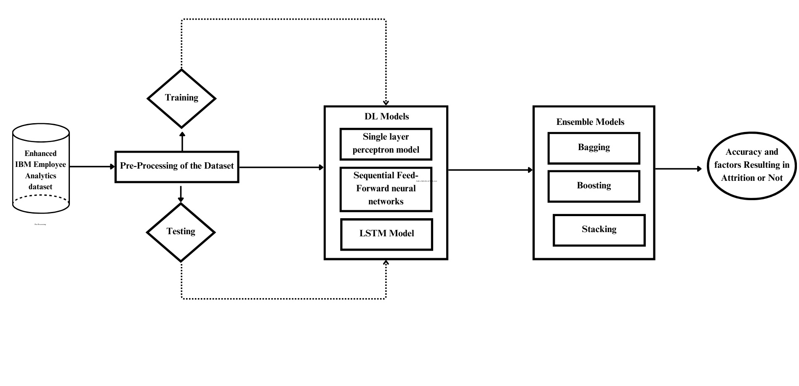
SYSTEM ARCHITECTURE

Slide 12
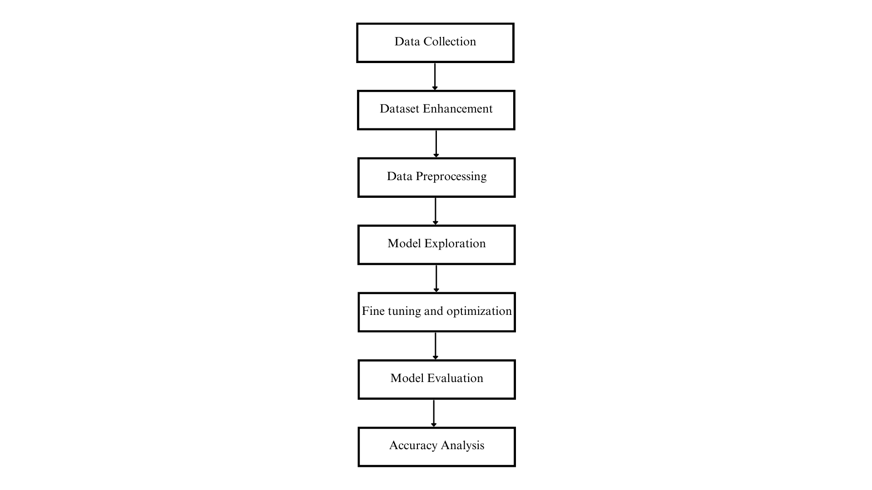
MODULES
Data Collection: Collected the dataset from Kaggle.
Dataset Enhancement: Enhancement of dataset is done By adding few more attributes leading to Attrition, to the existing dataset.
Data Preprocessing: Dividing the dataset into multiple training and testing data for different models put to analyze.
Model Exploration: Various Deep learning and Neural Network Models that fit to our criteria and algorithms are explored and put to test.
Fine tuning and Optimization: The process and algorithms are kept on trained and tested to improve the accuracy and other factors for each model.
Model Evaluation: After multiple optimization rounds, The best model is found by evaluating the factors.
Accuracy Analysis: Accuracies of models are analyzed and a conclusion is made.

Slide 13
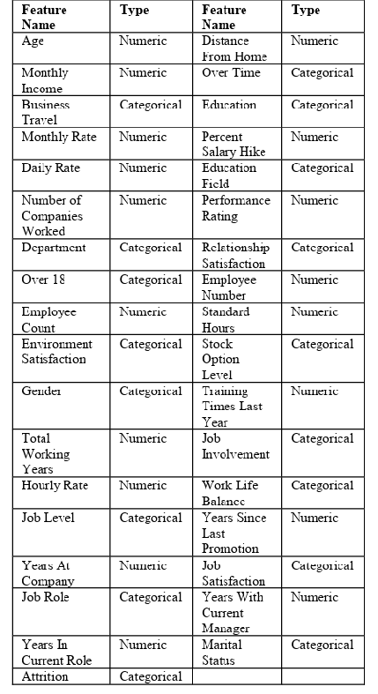
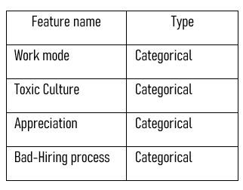
DATASET
The initial Dataset taken is the ‘IBM HR Analytics Employee attrition and performance’ that is taken from Kaggle.
We further enhanced the dataset by adding four more factors of recent times that might affect the attrition: 1.Work mode 2.Appreciation/Recognition 3.Bad Hiring process 4.Toxic culture
The proposed system is trained on:
Dataset: The enhanced Version of above dataset.
No.of samples: 900 samples per model per iteration.
The proposed system is tested on:
Dataset: The enhanced Version of above dataset.
No.of samples: 400 samples per model per iteration.

Slide 14
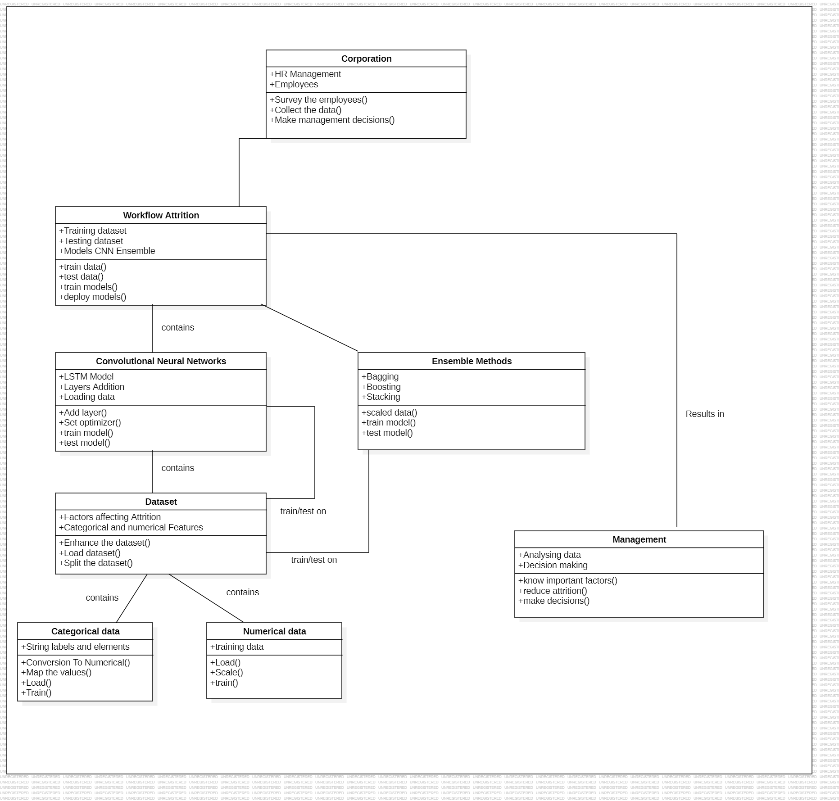
UML DIAGRAMS -
CLASS DIAGRAM

Slide 15
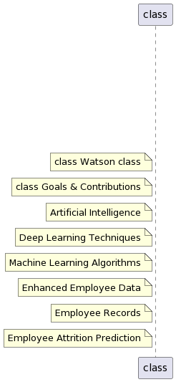
COMPONENT DIAGRAM

Slide 16
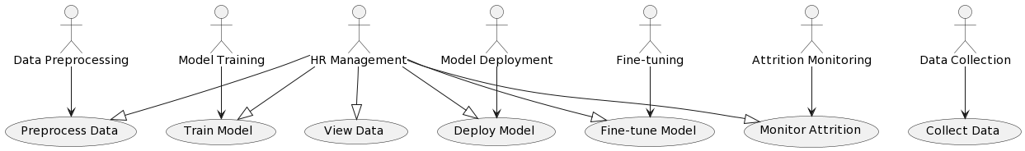
USE-CASE DIAGRAM

Slide 17
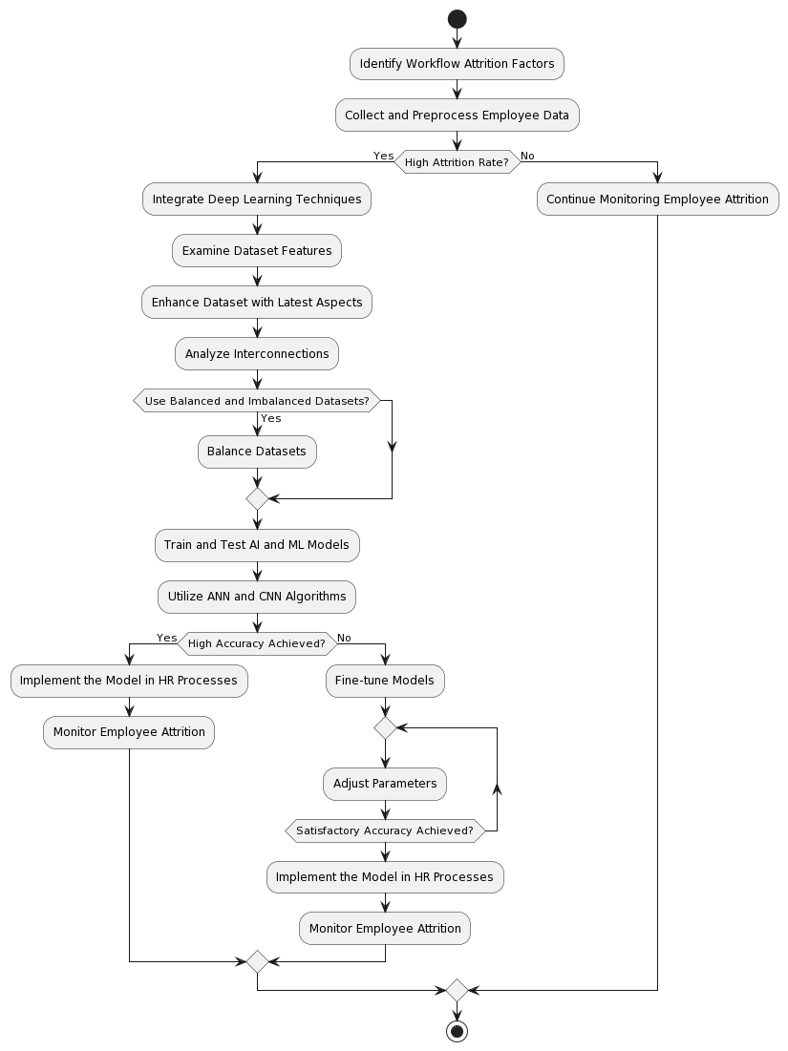
ACTIVITY DIAGRAM

Slide 18
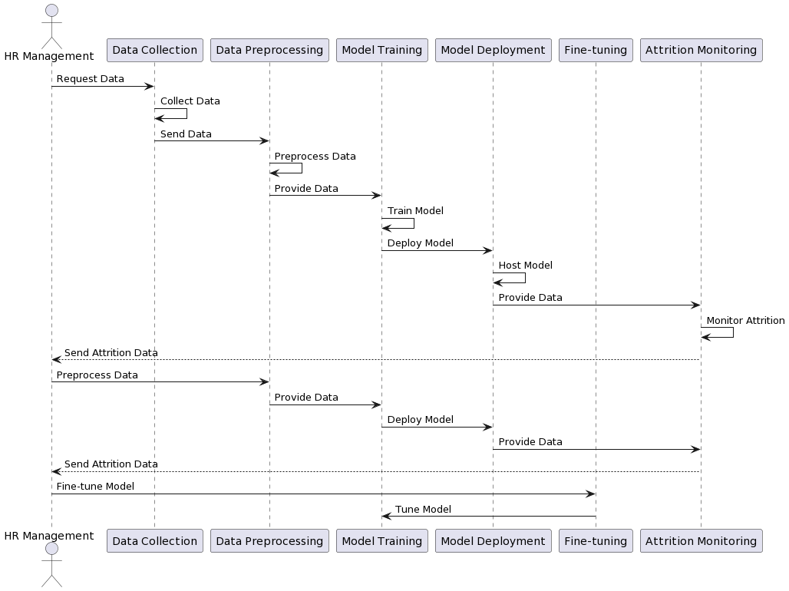
SEQUENCE DIAGRAM

Slide 19
MODULE DESCRIPTION
Data Collection: The initial Dataset ‘IBM HR Analytics Employee attrition and performance’ is taken from Kaggle.
Dataset Enhancement: The dataset initially has 35 features from 1,470 workers. We have enhanced the dataset by adding 4 more categorical features which are apt features for the present working conditions. We used pandas DataFrame methods to add and enhance the data.
Data Preprocessing: Pre-processing is an important step in machine and deep learning that significantly improves model performance. Pre-processing includes normalizing, cleaning, and categorizing data encoding. The dataset has been cleaned and standardized by using scalars. Some of the attributes found in this data set are categorical rather than numerical. Most ML and DL algorithms do not support categorical features right away. The original data includes multiple type categorical variables such as (Business Travel, Departments, Education Field, Gender, Job Role, Marital Status, and Over Time).

Slide 20
This type of feature should be associated with numerical numbers. To convert them, "one hot encoding" and “Label Encoding” came into play. Missing values are dealt with ML imputation. The most crucial dataset attributes are found for Attrition analysis.
Model Exploration: Various Deep learning and Neural Network Models that fit to our criteria and algorithms are explored and put to test. We used 4 models:
Long-Short Term Memory Algorithm (LSTM)
Sequential Feed-Forward Neural Network
Single Layer Perceptron Model
Ensemble Methods(Bagging, Boosting and Stacking)
Fine tuning and Optimization: The process and algorithms are kept on trained and tested to improve the accuracy and other factors for each model. We performed Multiple Iterations of every algorithm until we reached the highest accuracy and optimized the code like removing data overfitting etc.

Slide 21
Model Evaluation: After multiple optimization rounds, The best model is found by evaluating the factors.
All the 4 models are evaluated by testing for test loss and accuracy and also cross-validation.
Accuracy is seen in percentages
Accuracy Analysis: Accuracies of models are analyzed and a conclusion is made. The model that achieves the highest accuracy is concluded as the best model. Also by comparison we see how many models have the similar level of accuracy metric to them.

Slide 22
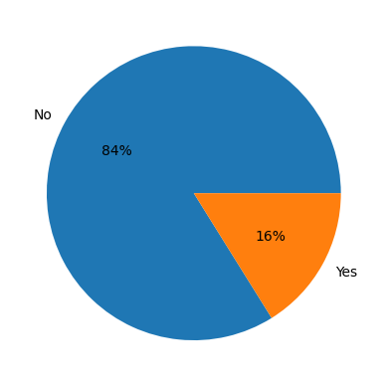
RESULT
The goal is to find a model that can detect whether attrition is present or not, and the result is the percentage by which the proposed models correctly predict the presence of attrition. After the initial dataset analysis and EDA methods, we can conclude that the Attrition rate is 16% and 84% No Attrition. This conclusion is now put to test by how correctly the models developed detect the attrition rate as Yes or No.

Slide 23
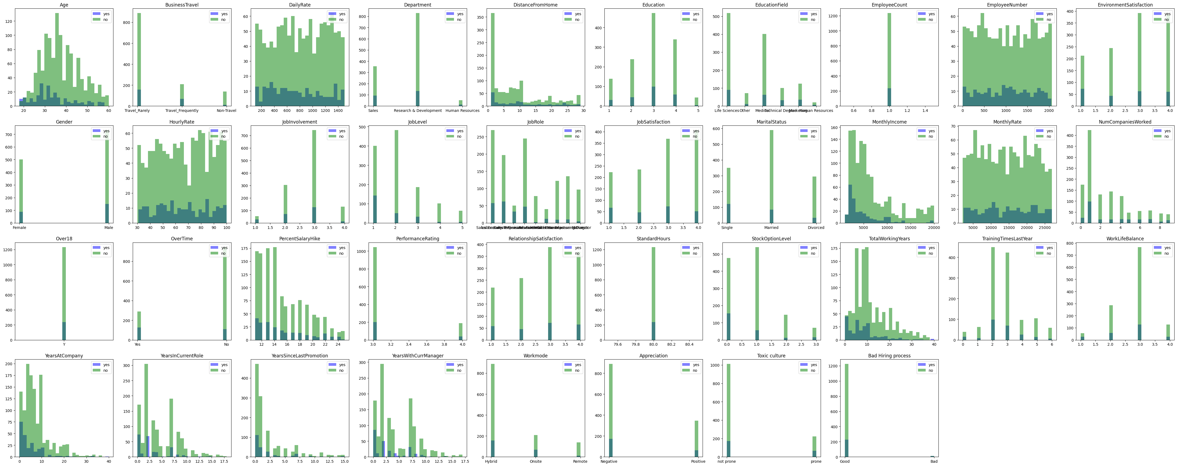
The above graphs show the Attrition rate WRT every factor of Attrition present in the Dataset. The Attrition rates are hence analyzed by the models. We now see the models and their accuracies of if they can show this accurately.

Slide 24
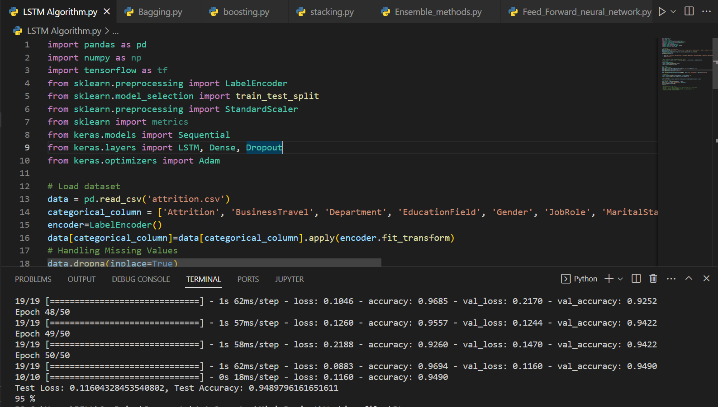
LSTM Algorithm
Achieving a 95% accuracy using LSTM Algorithm signifies a highly effective model for identifying potential turnover, facilitating proactive HR management.

Slide 25
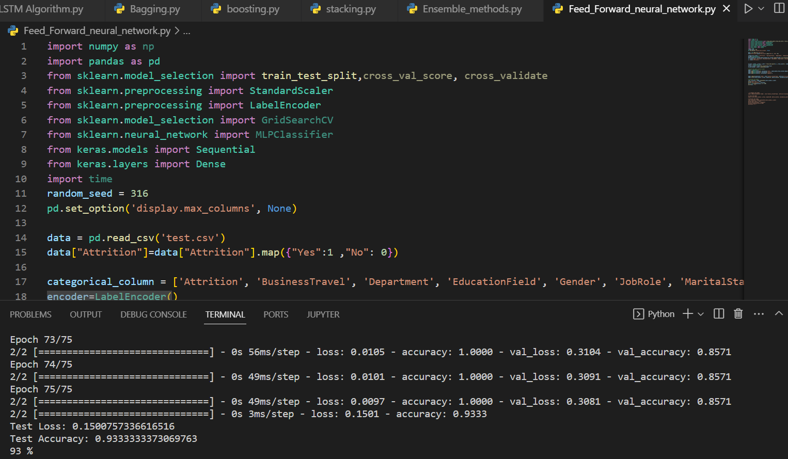
Sequential Feed-Forward NN Algorithm
Attaining a 93% accuracy using a Sequential Feedforward Neural Network Algorithm demonstrates a robust model for identifying turnover risks, aiding proactive HR strategies.

Slide 26
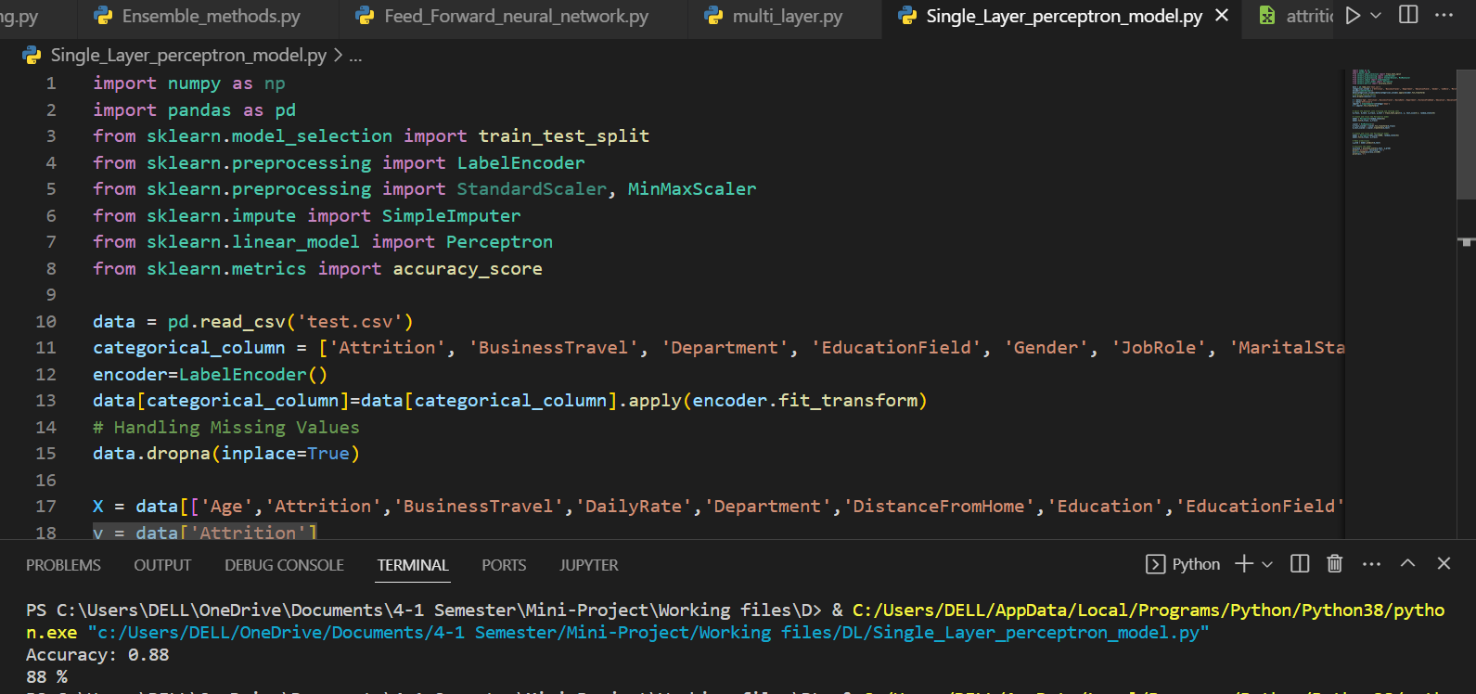
Single-Layer Perceptron Model
Obtaining an 88% accuracy using Single-Layer Perceptron Model indicates moderate success in identifying turnover trends but may benefit from more complex models for improved accuracy.

Slide 27
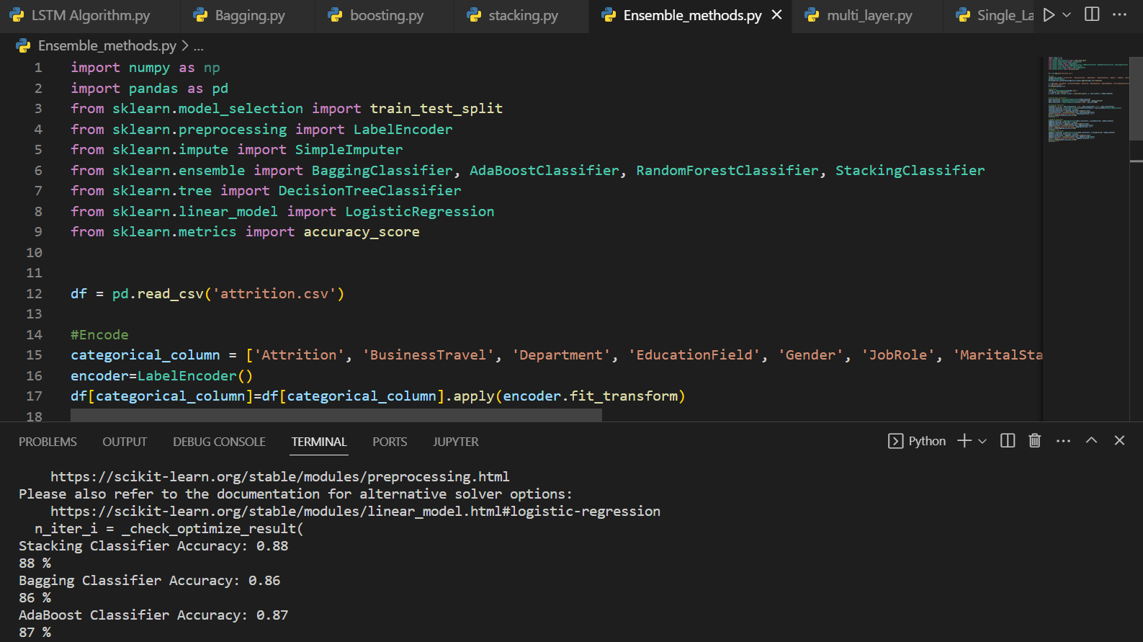
Ensemble Methods
Reaching an 87% accuracy using Ensemble Model suggests a good predictive performance, leveraging multiple models to effectively identify turnover risks.

Slide 28
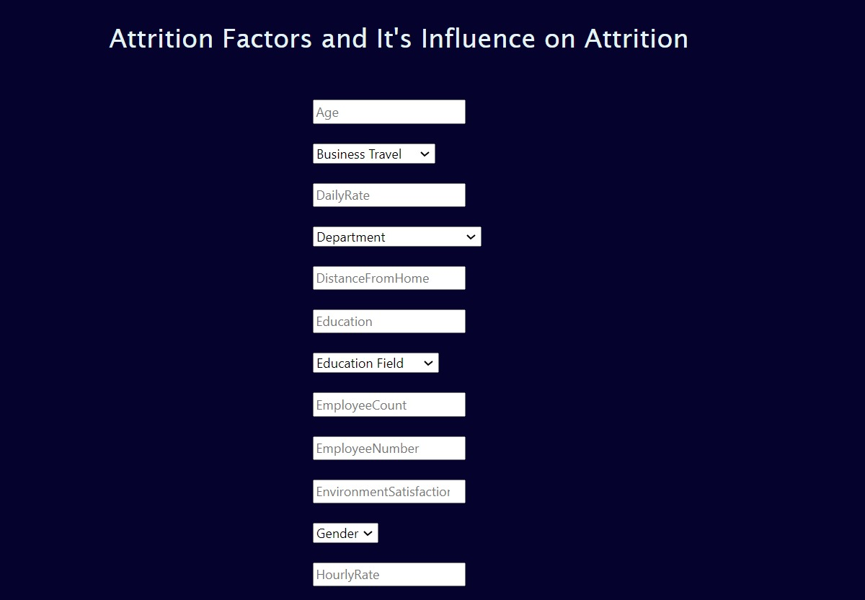
Web Interface
we considered every single factor in the dataset and gave the input boxes for the users to give the input to understand how and what values of the factors are affecting the Attrition rate.

Slide 29
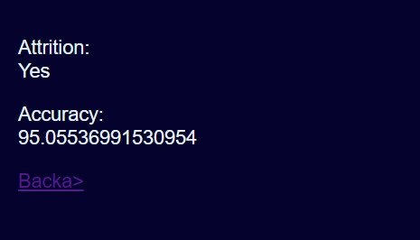
Output
In the web interface when the inputs are given by the user, then the output is given as Yes or No for Attrition and the percentage of Accuracy with which the result is Correctly detected. The maximum Accuracy by which the Attrition is detected is up to 95%.

Slide 30
CONCLUSION
In conclusion, this project utilized deep learning and machine learning algorithms to improve the prediction accuracy of employee attrition. The results demonstrate the potential of advanced AI techniques like deep learning to extract meaningful patterns from complex employee data. By leveraging these insights, organizations can better understand factors influencing attrition and proactively develop targeted retention strategies. The models developed in this project achieve improved predictive performance compared to traditional approaches. With further refinement, these models could become a valuable tool for HR departments to identify flight risks early and take preventive actions. Overall, this project highlights the viability of AI and machine learning for addressing real-world business challenges like employee turnover. Further research could explore additional algorithms and data sources to further boost the predictive accuracy.

Slide 31
REFERENCES
[1] vsrd journal employee attrition and strategic retention challenges in indian manufacturing industries : a case study 1Pradip Kumar Talapatra*, 2Saket Rungta and 3A.Jagadeesh.11/06/2020
[2] Employee attrition prediction in a pharmaceutical company using both machine learning approach and qualitative data Fatemeh Mozaffari, Marzieh Rahimi, Hamidreza Yazdani, Babak Sohrabi. 11/06/2020
[3] Predicting Employee Attrition Using Machine Learning Approaches by Ali Raza 1ORCID,Kashif Munir ,Mubarak Almutairi,Faizan Younas 1 andMian Muhammad Sadiq Fareed.12/02/2021
[4] predicting employee attrition and performance using deep learning samer m. arqawi1 , mohammed a. abu rumman, eman akef zitawi.03/04/2021
[5] HR Analytics: Employee Attrition Analysis using Random Forest Shobhanam Krishna and Sumati Sidharth.20/07/2021

Slide 32
[6] Interpreting the Factors of Employee Attrition using Explainable AI by Karthik Sekaran;
Shanmugam.07/01/2022.
[7] Employee Attrition Analysis Using CatBoost Md. Monir Ahammod Bin Atique, Md. Nesarul Hoque & Md. Jamal Uddin.10/03/2022.
[8] Analyzing Employee Attrition Using Machine Learning: the New AI Approach Shobhanam Krishna; Sumati Sidharth.14/05/2022.
[9] A New Approach for Employee Attrition Prediction Lydia Douaidi & Hamamache Kheddouci.
13/07/2022.
[10] A Comparative Study of Employee Attrition Analysis Using Machine Learning and Deep Learning Techniques Sini Raj Pulari, A. Punitha, S. Raja Varshni Meenachi & Shriram Vasudevan.26/07/2022.

Slide 33
Thank You

Slide 34
Queries??

