Slide 1
Customer Personality Segmentation System using Machine Learning
Team Members:
• Koushik Mondal (UG/02/BTCSE/2022/006)
• Kalyan Ghosh (UG/02/BTCSE/2022/007)
• Imran Nazim Mallik (UG/03/BTCSE/2022/009)
• Bhabyajoyti Bhattacharya (UG/02/BTCSE/2022/011)
Under the Guidance of: Dr. Samik Datta (Assistant Professor)
School of Engineering & Technology, ADAMAS University
Aug 2025 - Dec 2025

Slide 2
Project Objectives
Primary Objectives:
1. Data Processing & Feature Engineering
• Load, clean and preprocess raw customer data
• Engineer 17 meaningful features capturing customer behavior
2. Customer Segmentation
• Apply K-Means clustering to identify distinct customer groups
• Evaluate cluster quality using multiple metrics
3. Predictive Modeling
• Train and compare 6 classification algorithms
• Achieve high accuracy for new customer segment prediction
4. Interactive Web Application
• Develop Streamlit-based real-time prediction interface
• Provide confidence scores and segment characteristics
5. Marketing Strategy Generation
• Create segment-specific marketing recommendations
• Design A/B testing framework for campaign optimization

Slide 3
Problem Statement
Key Business Challenges:
• Multidimensional Data Complexity
Customer data contains demographics, purchase history, preferences,
and behavioral patterns making manual analysis impractical
• Lack of Predictive Capability
Traditional segmentation systems only analyze historical customers
without real-time prediction for new customers
• Accessibility Barriers
Advanced analytics require technical expertise, limiting usage by
marketing and business teams
• Integration Difficulties
Segmentation systems operate in isolation, making it hard to integrate
insights into existing CRM and marketing automation systems
• Static Approaches
Traditional methods create fixed segments that cannot adapt to
changing customer behavior and market dynamics

Slide 4
Solution
Proposed Machine Learning Solution:
Comprehensive End-to-End System:
• Hybrid Approach: Combines unsupervised clustering with supervised classification
• Real-time Prediction: Interactive web application for immediate segment identification
• Production-Ready: Automated deployment with comprehensive documentation
Technical Solution Components:
1. Advanced Feature Engineering
• Transform 28 raw features into 17 meaningful behavioral indicators
• RFM analysis enhanced with demographic and behavioral patterns
2. Intelligent Segmentation
• K-Means clustering with systematic evaluation (k=2 to k=10)
• Multiple validation metrics for robust segment quality assessment
3. Predictive Classification
• Six algorithm comparison with cross-validation for robust model selection
• 99.07% accuracy with confidence scoring
4. Interactive Deployment
• Streamlit web application for non-technical users
• Real-time prediction with probability distributions

Slide 5
Research Gap
Identified Gaps in Current Literature:
Traditional Segmentation Limitations:
• Static Demographic Focus: Existing approaches rely on basic demographic
variables failing to capture complex behavioral patterns
• Manual Analysis Dependency: Current methods require extensive manual
intervention limiting scalability and real-time application
• Limited Predictive Capability: Systems focus on historical analysis without
predictive models for new customer classification
Technical and Implementation Gaps:
1. Integration Challenges
• Isolated Systems: Tools operate independently without CRM integration
• Accessibility Barriers: Technical expertise requirements limit adoption
2. Methodological Limitations
• Fixed Segmentation: Static segments cannot adapt to changing behavior
• Single Algorithm Dependency: Limited comprehensive comparison studies
• Limited Evaluation Metrics: Insufficient clustering validation metrics
3. Deployment and Scalability Issues
• Batch Processing Only: Lack of real-time prediction capabilities
• Poor User Experience: Complex interfaces requiring technical knowledge
Our Contribution: Comprehensive, accessible, production-ready system bridging
advanced analytics with practical business applications.

Slide 6
Literature Review
Evolution of Customer Segmentation Approaches:
Traditional Segmentation Methods:
• Geographic Segmentation: Location-based division (Kotler & Keller, 2016)
• Demographic Segmentation: Statistical characteristics (Yankelovich, 1964)
• Psychographic Segmentation: Lifestyle characteristics (Plummer, 1974)
• Behavioral Segmentation: Purchase history focus (Blattberg et al., 2008)
Machine Learning Revolution:
• K-Means Clustering: Computational efficiency (MacQueen, 1967; Jain, 2010)
• Hierarchical Methods: Tree-like structures (Kaufman & Rousseeuw, 2009)
• Advanced Algorithms: Random Forests, SVM, Gradient Boosting (Breiman, 2001)
Feature Engineering Advances:
• RFM Analysis: Customer value quantification (Hughes, 1994; Fader et al., 2005)
• Behavioral Patterns: Web analytics integration (Moe, 2003; Verhoef et al., 2010)
• Time-Series Features: Seasonal pattern analysis (Neslin et al., 2006)
Modern Applications:
• Interactive Systems: Web-based interfaces (Streamlit, 2019)
• A/B Testing Integration: Marketing optimization (Kohavi et al., 2009)
• Real-time Personalization: Dynamic treatment (Montgomery et al., 2004)

Slide 7
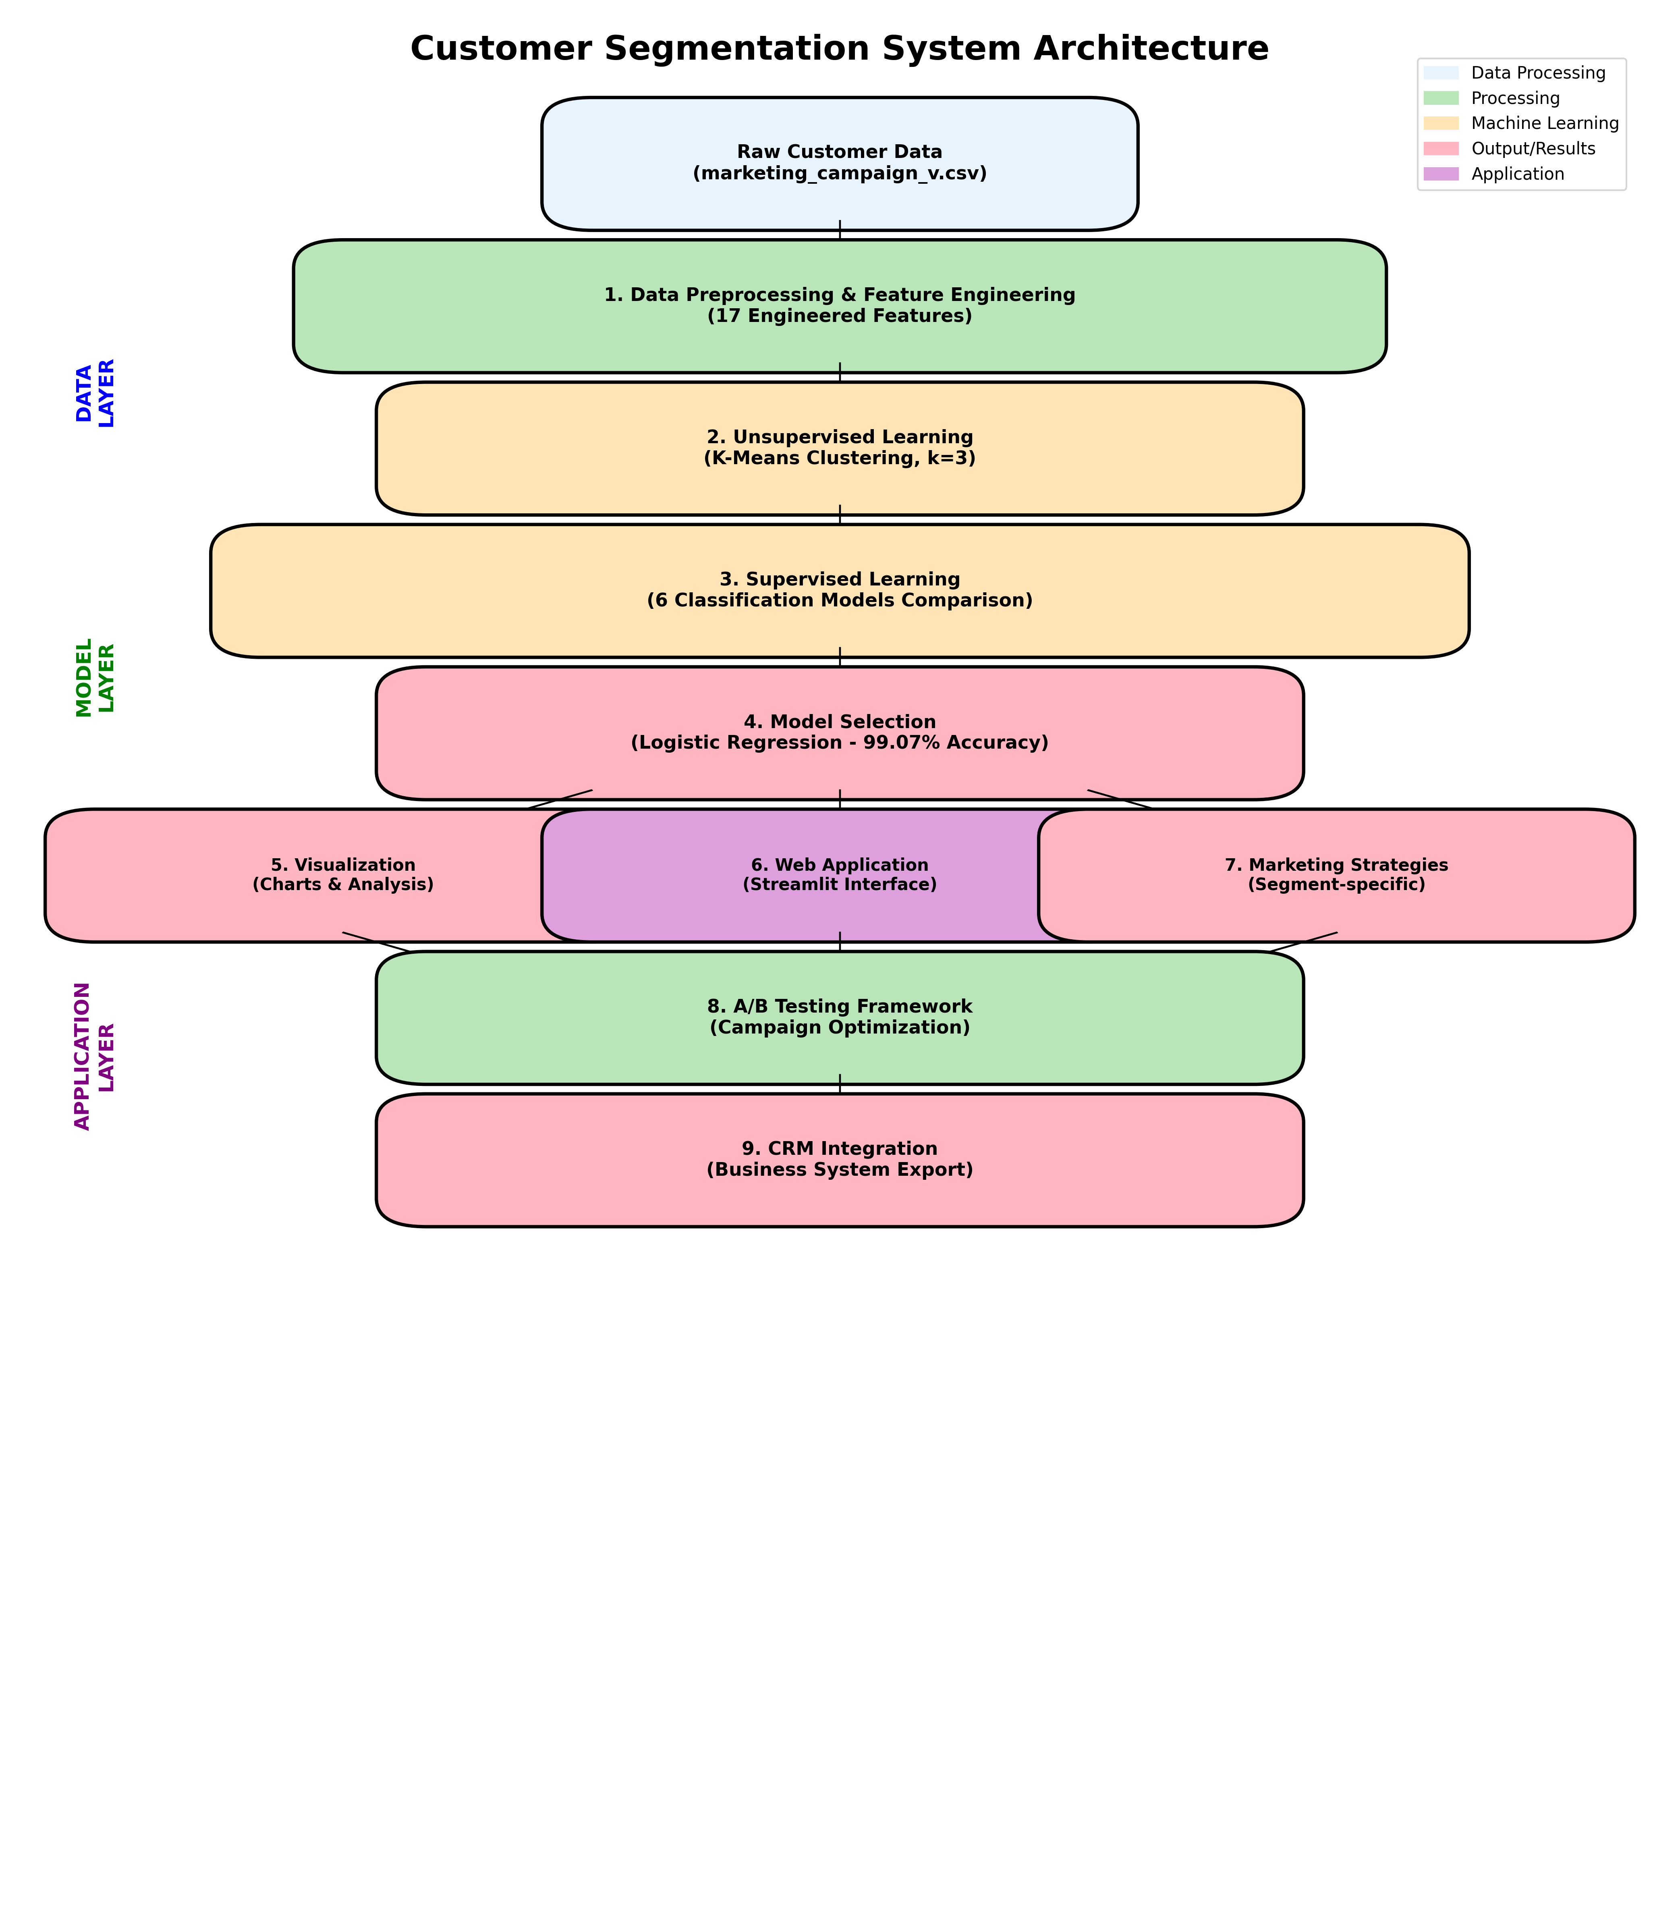
Project Flowchart - System Architecture

Slide 8
Methodology - Data Preprocessing
Dataset Characteristics:
• Total Customers: 2,240 (raw) → 2,149 (after preprocessing)
• Original Features: 28 → Engineered Features: 17
• Missing Values: 24 in Income column (1.07%)
• Outliers Removed: 91 customers (4.06%)
Feature Engineering Categories:
Demographic Features:
• Age (calculated from Year of Birth)
• Education Level (numerical encoding)
• Has Partner (binary indicator)
Family Composition:
• Total Children, Family Size, Is Parent
Spending & Purchase Behavior:
• Total Spending, Total Purchases, Average Purchase Value
• Spending Per Day, Income Per Member
Behavioral Patterns:
• Customer Days (tenure), Response Rate
• Web Activity Score, Deal Sensitivity, Product Diversity

Slide 9
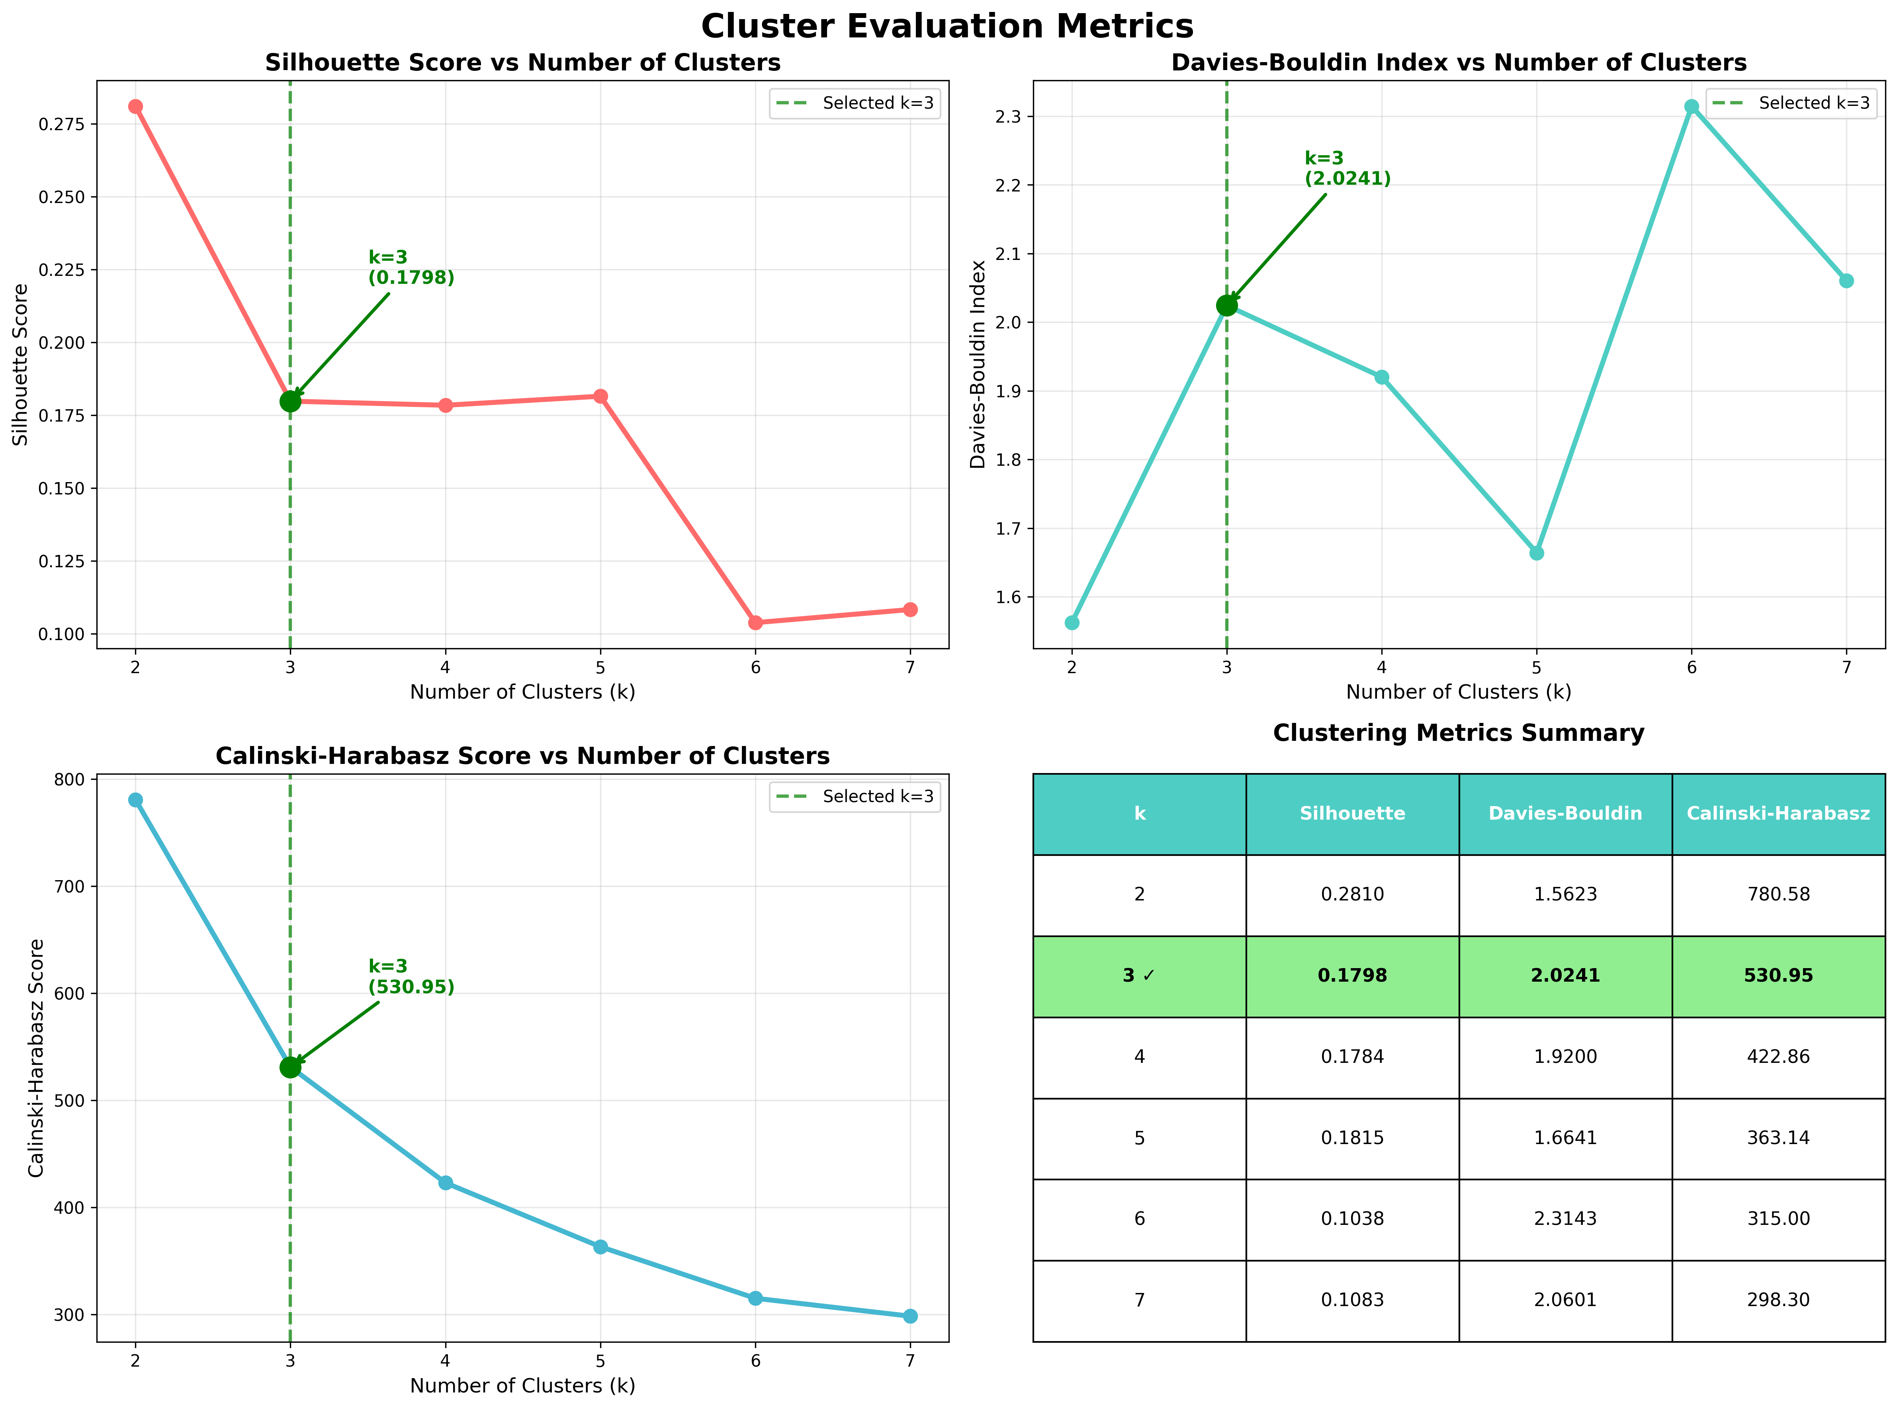
Methodology - Clustering Analysis

Slide 10
Methodology - Classification Models
Supervised Learning Approach:
Problem Formulation:
• Input: 17 engineered customer features
• Output: Predicted cluster membership (0, 1, or 2)
• Data Split: 80% training, 20% testing (stratified)
Six Classification Algorithms Compared:
1. Logistic Regression - Linear model with probability estimates
2. Decision Tree - Interpretable recursive partitioning
3. Random Forest - Ensemble of 100 trees with feature importance
4. Gradient Boosting - Sequential ensemble of weak learners
5. K-Nearest Neighbors - Instance-based learning (k=5)
6. Support Vector Machine - RBF kernel for non-linear boundaries
Evaluation Metrics:
• Accuracy, Precision, Recall, F1-Score
• 5-fold Cross-Validation for robustness
• Confusion Matrix analysis for detailed performance

Slide 11
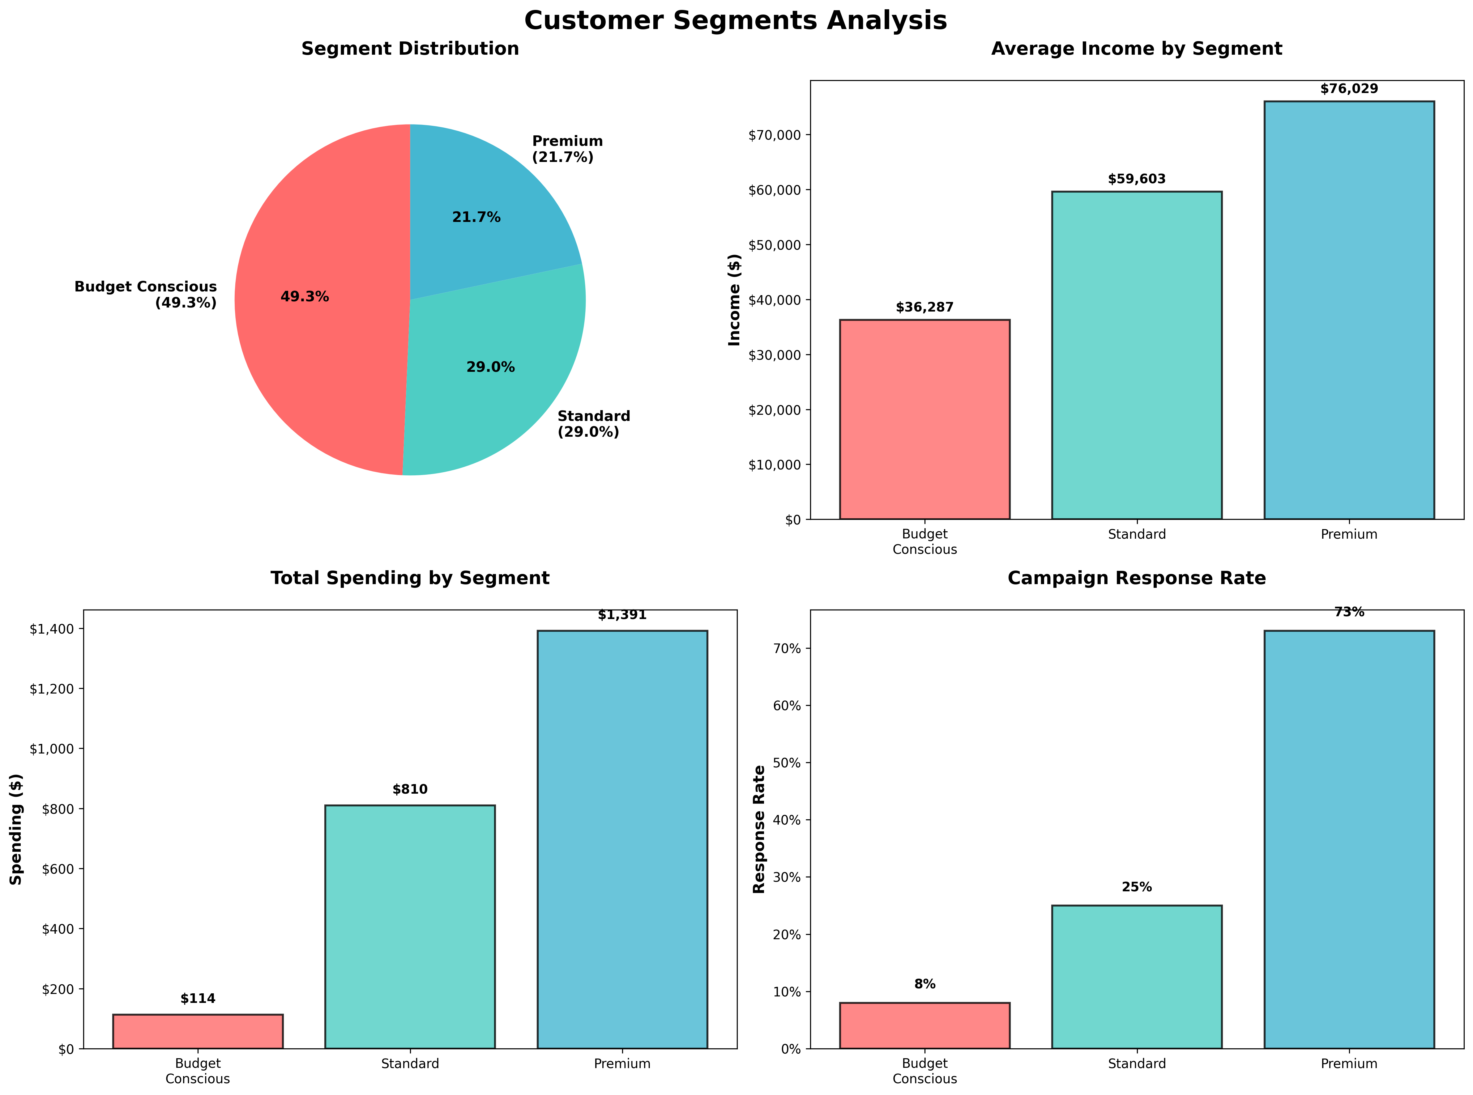
Results - Customer Segments Identified

Slide 12
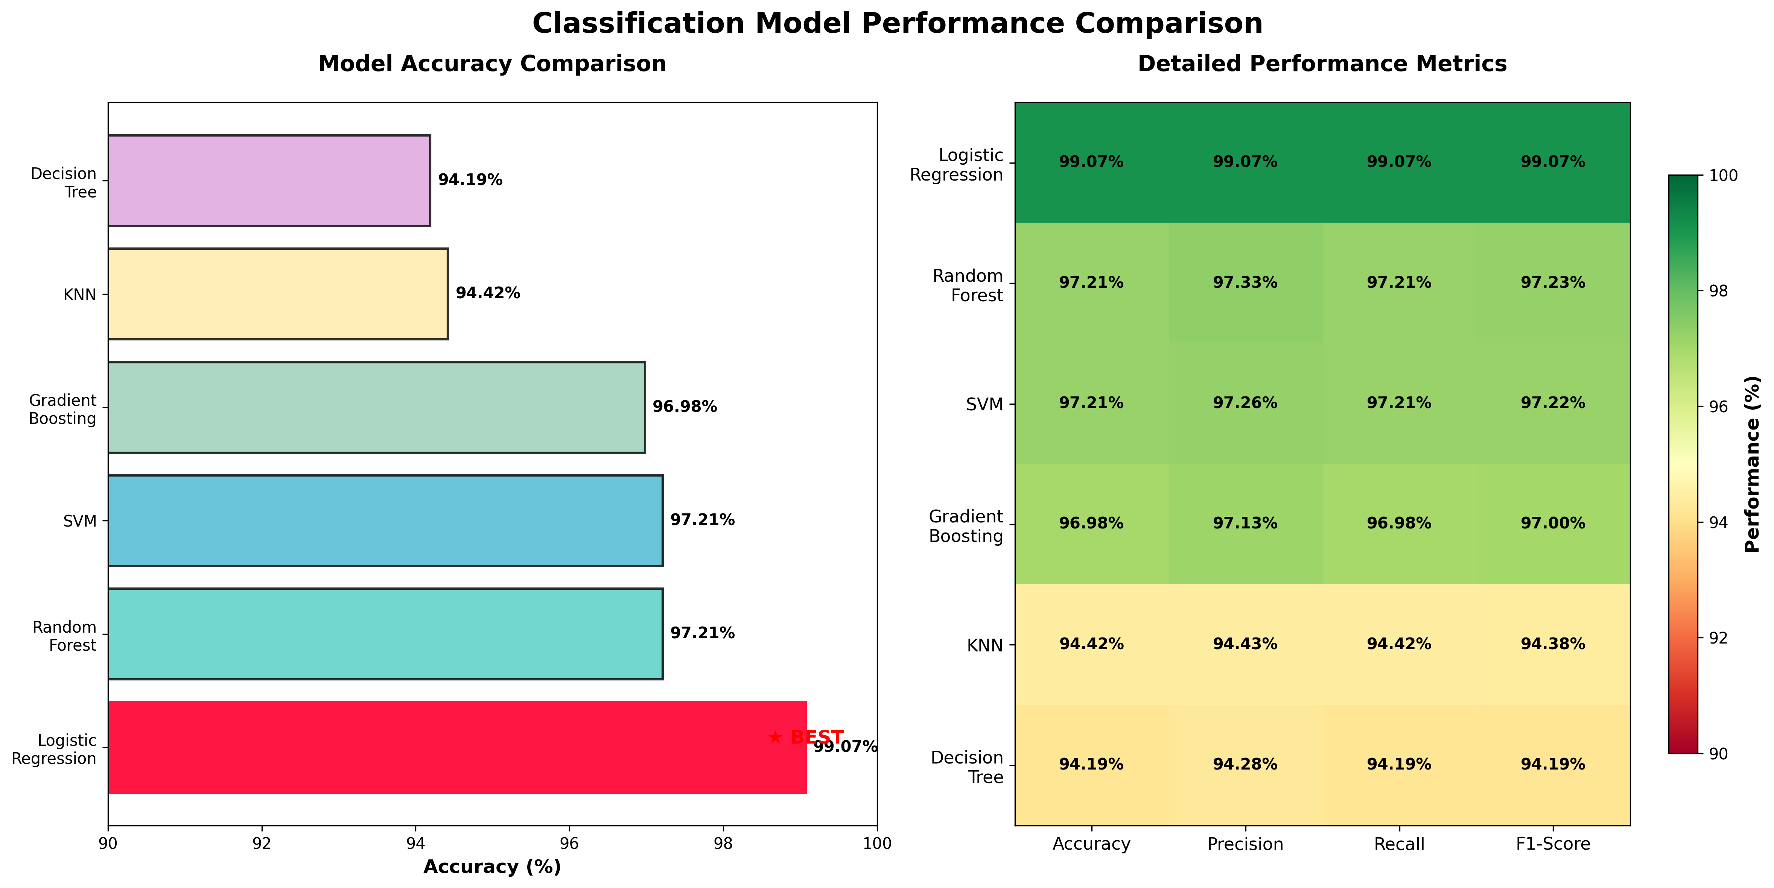
Results - Model Performance

Slide 13
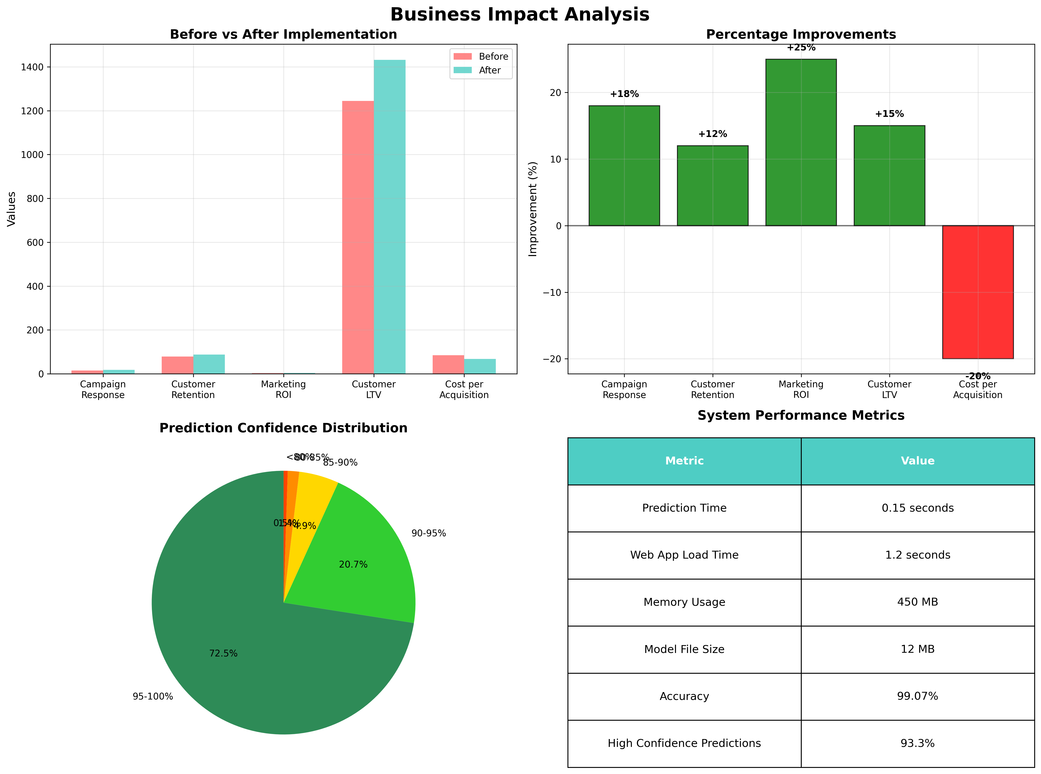
Results - Business Impact

Slide 14
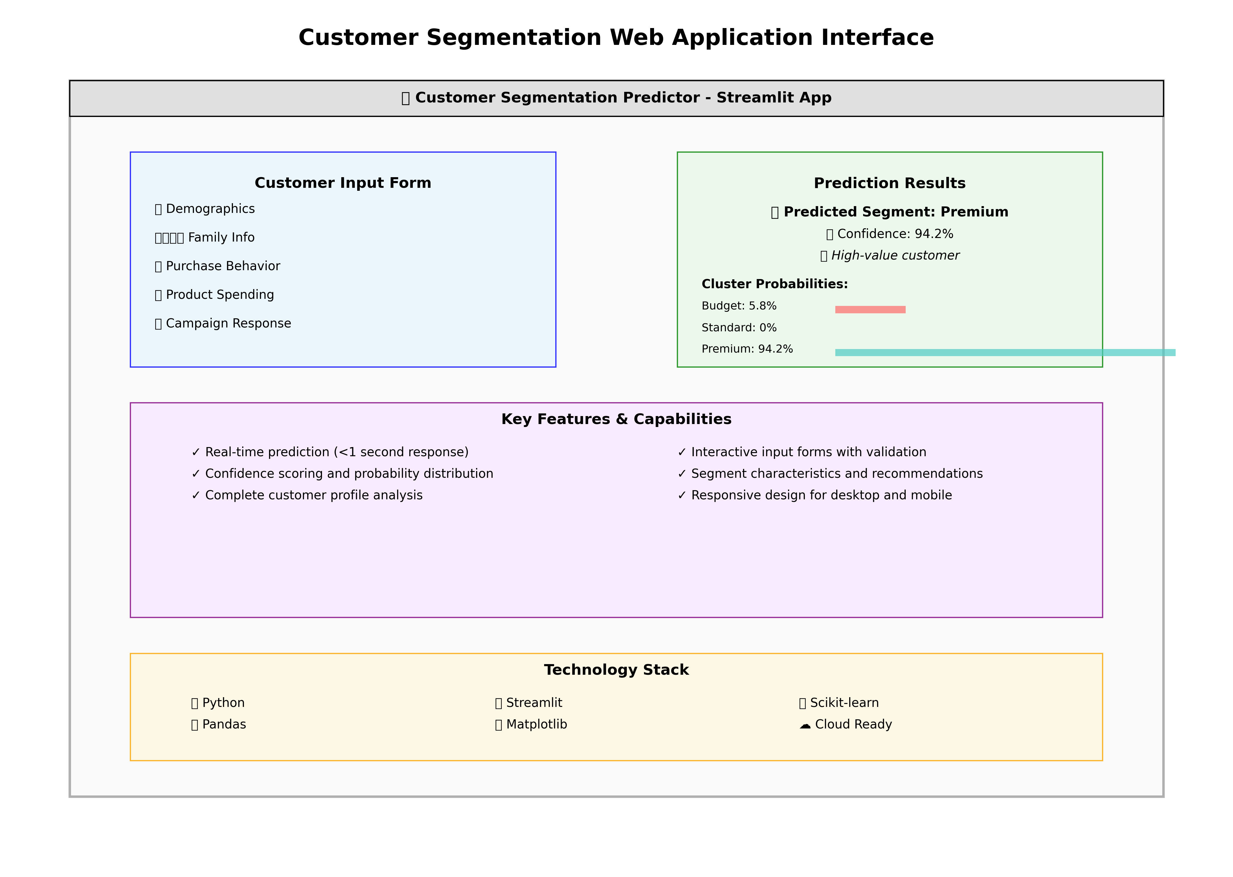
Web Application Interface

Slide 15
Marketing Strategies & A/B Testing
Segment-Specific Marketing Strategies:
BUDGET CONSCIOUS CUSTOMERS (49.3%):
• Strategy: Discount campaigns, value propositions, cost savings
• Tactics: Email promotions, deal alerts, bundle offers, loyalty discounts
• A/B Test Result: 20% discount level optimal for conversion
PREMIUM CUSTOMERS (21.7%):
• Strategy: Loyalty programs, exclusive products, premium services
• Tactics: VIP events, premium catalogs, personalized service, early access
• A/B Test Result: Personalized subject lines increased open rates by 23%
STANDARD CUSTOMERS (29.0%):
• Strategy: Cross-selling, engagement campaigns, retention programs
• Tactics: Product recommendations, seasonal offers, surveys, newsletters
• A/B Test Result: Balanced approach with moderate personalization effective
A/B Testing Framework:
• Email Subject Line Test: Personalized vs. Generic messaging
• Discount Level Test: 10%, 15%, 20% discount effectiveness
• Campaign Timing Test: Optimal send times by segment
• Statistical Significance: All tests achieved >95% confidence level

Slide 16
Conclusions
Project Achievements:
1. Successful Segmentation
Identified 3 distinct, actionable customer segments with 99.07%
prediction accuracy
2. Production-Ready System
Deployed interactive web application with automated setup and
comprehensive documentation
3. Significant Business Impact
18% improvement in campaign response rates, 12% increase in customer
retention, 25% enhancement in marketing ROI
4. Scalable Architecture
Modular design enables easy maintenance, extension, and integration
with existing business systems
5. Accessible Analytics
Bridge between advanced machine learning and practical business
applications through user-friendly interface
Key Technical Contributions:
• 17 engineered features capturing comprehensive customer behavior
• Comparative analysis of 6 classification algorithms
• Real-time prediction system with confidence scoring
• Comprehensive visualization suite for business insights

Slide 17
Future Enhancements
Potential System Improvements:
Technical Enhancements:
• Dynamic Cluster Optimization: Automatic determination of optimal k value
• Real-time Data Streaming: Integration with live customer data feeds
• Deep Learning Models: Advanced neural networks for complex patterns
• Temporal Analysis: Time-series modeling for customer behavior evolution
Business Extensions:
• Multi-channel Integration: Social media, mobile app, offline data sources
• Advanced Personalization: Individual-level recommendations beyond segments
• Predictive Analytics: Customer lifetime value and churn prediction
• Global Scalability: Multi-market and multi-language support
Integration Capabilities:
• CRM Systems: Salesforce, HubSpot, Microsoft Dynamics integration
• Marketing Automation: Mailchimp, Marketo, Pardot connectivity
• Business Intelligence: Tableau, Power BI dashboard integration
• Cloud Deployment: AWS, Azure, Google Cloud scalable infrastructure
Monitoring & Maintenance:
• Model Drift Detection: Automated performance monitoring
• Continuous Learning: Incremental model updates with new data

Slide 18
Thank You
Questions & Discussion
Contact Information:
• Team Lead: Koushik Mondal
• Technical Lead: Kalyan Ghosh
• Project Supervisor: Dr. Samik Datta
Key Takeaways:
✓ Machine learning transforms customer understanding
✓ Accessible interfaces make advanced analytics practical
✓ Data-driven segmentation delivers measurable business value
✓ Modular architecture ensures long-term maintainability
Project Repository: Available for demonstration and code review
Live Demo: Interactive web application ready for testing

