Slide 1
Azure FunctionApp

Slide 2
Azure FunctionApp
What is it?
Azure Functions is a solution for easily running small pieces of code, or "functions," in Azure
When to use?
Event processing – mostly asynchronous
Trigger and rethrow new events

Slide 3
Azure FunctionApp
Serverless Implementations patterns are seen when
Applications does not need heavy weight backend
Large set of small size applications, which need to work together – Microservices
Unpredictable workload on the services, scale from 1 → unlimited (200)
Scaling of stateless applications is needed
Notes:
https://docs.microsoft.com/en-us/azure/azure-functions/functions-scale#service-limits

Slide 4
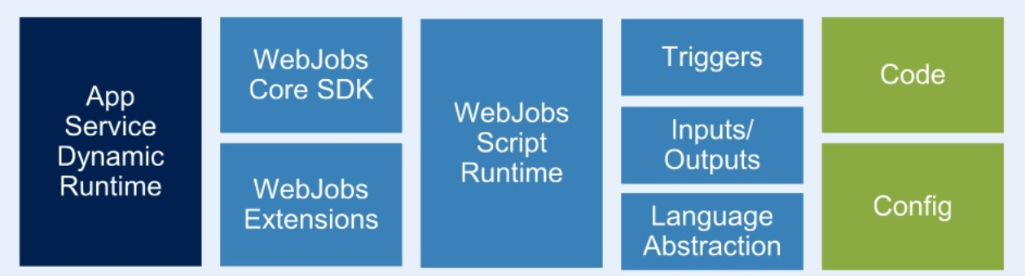
Azure FunctionApp
Architecture
Notes:
Azure Functions are built on top of AppService and WebJobs SDK

Slide 5
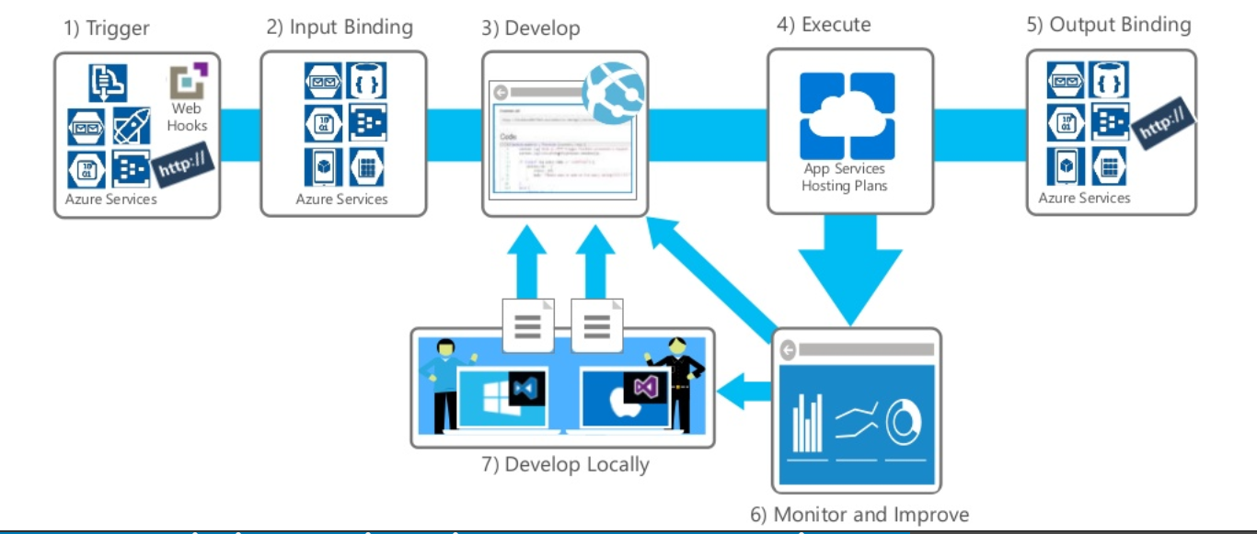
Azure FunctionApp
Notes:
https://docs.microsoft.com/en-us/azure/azure-functions/functions-scale#service-limits

Slide 6
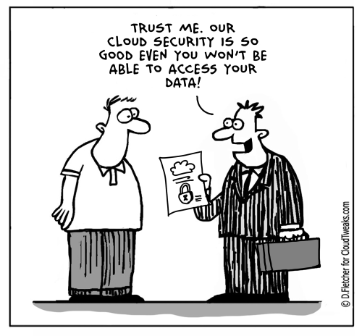
Azure FunctionApp
Security
Notes:
https://docs.microsoft.com/en-us/azure/azure-functions/functions-scale#service-limits

Slide 7

Azure FunctionApp
Pricing
Notes:
https://docs.microsoft.com/en-us/azure/azure-functions/functions-scale#service-limits

Slide 8

Azure FunctionApp
Tooling
Tools | Windows | Linux | MacOS
Portal with KUDU
Visual Studio
Visual Studio Code
Function Core Tools

Slide 9
Azure FunctionApp
Features
Supporting languages
C#
JavaScript
F#
Java
PowerShell
Python
TypeScript
Bash
Batch
PHP
Pricing plan
Consumption
App Service Plan
Security
OAuth – Google/Facebook/AAD/Twitter
Dependency import
NuGet
NPM
Modules
Maven
Development
Cloud Shell
Kudu Server
Azure DevOps
Local Git
External Git

Slide 10

Azure FunctionApp
Disaster Recovery
Notes:
https://docs.microsoft.com/en-us/azure/azure-functions/functions-scale#service-limits

Slide 11
Azure FunctionApp : Bindings

Slide 12
Azure FunctionApp : Lab01

Slide 13
Azure FunctionApp Config
Compiled Code – Config file generated from Annotations
Scripted Code – Config file should be included
function.json
{
"disabled":false,
"bindings":[
// ... bindings here
{
“datatype": “string", //stream, binary(javascript)
"type": "bindingType", //timetrigger, queuetrigger, eventhubtrigger, etc
"direction": "in", // out, inout (not all bindings support inout)
"name": "myParamName", // C#: Argument name, JS: KeyValue list
// ... more depending on binding
}
]
}

Slide 14
Azure FunctionApp: Durable Function
Durable Functions is an extension of Azure Functions that lets you write stateful functions in a serverless environment. The extension manages state, checkpoints, and restarts for you.
Notes:
https://docs.microsoft.com/en-us/azure/azure-functions/durable/durable-functions-instance-management

Slide 15
Stay in touch
Koushik Aravalli
Application Developer, DevOps Engineer,
Twitter: @koushikaravalli
LinkedIn: https://nl.linkedin.com/in/koushik-aravalli
Notes:
https://docs.microsoft.com/en-us/azure/azure-functions/durable/durable-functions-instance-management

