Slide 1
Azure FunctionApp

Slide 2
Azure FunctionApp
What is it?
Azure Functions is a solution for easily running small pieces of code, or "functions," in Azure
When to use?
Event processing – mostly asynchronous
Trigger and rethrow new events

Slide 3
Azure FunctionApp
Serverless Implementations patterns are seen when
Applications does not need heavy weight backend
Large set of small size applications, which need to work together – Microservices
Unpredictable workload on the services, scale from 1 → unlimited (200)
Scaling of stateless applications is needed
Notes:
https://docs.microsoft.com/en-us/azure/azure-functions/functions-scale#service-limits

Slide 4
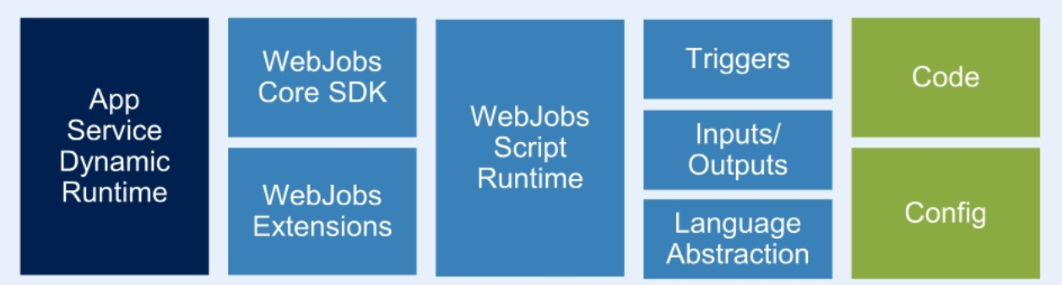
Azure FunctionApp
Architecture
Notes:
Azure Functions are built on top of AppService and WebJobs SDK

Slide 5
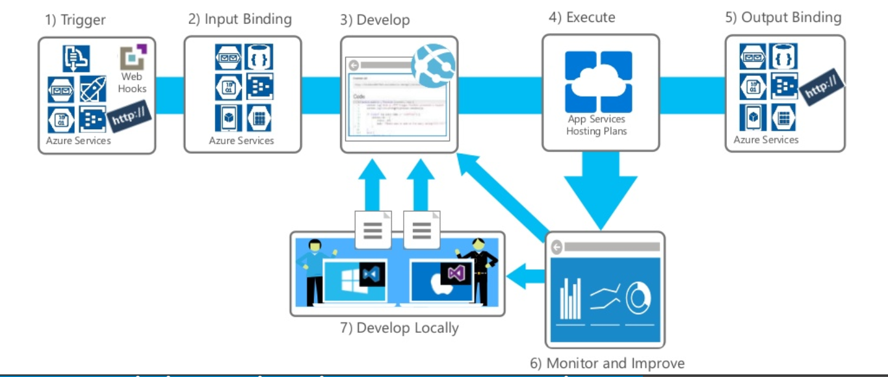
Azure FunctionApp
Notes:
https://docs.microsoft.com/en-us/azure/azure-functions/functions-scale#service-limits

Slide 6
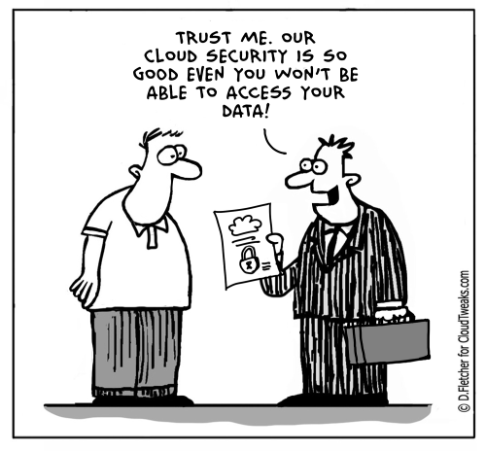
Azure FunctionApp
Security
Access with AAD
Backend storage account – azurewebjobhosts and azurewebjobsecrets
KUDU/AppServiceEditor
Notes:
https://docs.microsoft.com/en-us/azure/azure-functions/functions-scale#service-limits

Slide 7

Azure FunctionApp
Pricing
Consumption: Pay-as-you-go
Premium Plan
AppService Plans
Notes:
https://docs.microsoft.com/en-us/azure/azure-functions/functions-scale#service-limits

Slide 8

Azure FunctionApp
Tooling
Tools | Windows | Linux | MacOS
Portal with KUDU
Visual Studio
Visual Studio Code
Function Core Tools

Slide 9
Azure FunctionApp
Features
Supporting languages
C#
JavaScript
F#
Java
PowerShell
Python
TypeScript
Bash
Batch
PHP
Pricing plan
Consumption
App Service Plan
Security
OAuth – Google/Facebook/AAD/Twitter
Dependency import
NuGet
NPM
Modules
Maven
Development
Cloud Shell
Kudu Server
Azure DevOps
Local Git
External Git

Slide 10
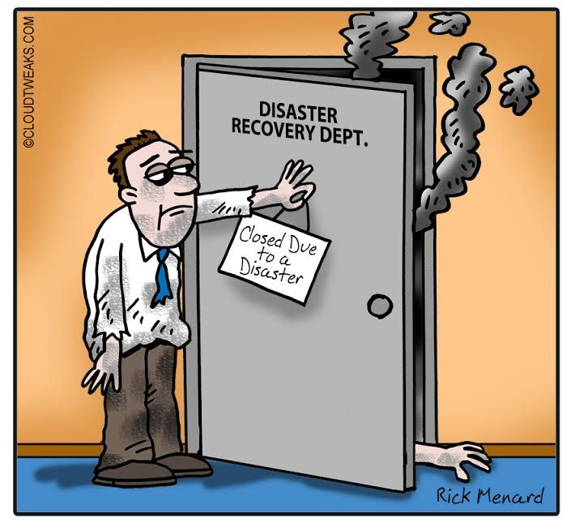
Azure FunctionApp
Disaster Recovery
Not by default, up to the teams to replicate ResourceGroup
Notes:
https://docs.microsoft.com/en-us/azure/azure-functions/functions-scale#service-limits

Slide 11
Azure FunctionApp : Triggers and Bindings

Slide 12
Azure FunctionApp : Lab – Let me do a trace
Objective
Calculate Proximity of a vehicle and send out alerts to a user

Slide 13
Azure FunctionApp : Lab : What could be a solution

Slide 14
Azure FunctionApp Config
Compiled Code – Config file generated from Annotations
Scripted Code – Config file should be included
function.json
{
"disabled":false,
"bindings":[
// ... bindings here
{
“datatype": “string", //stream, binary(javascript)
"type": "bindingType", //timetrigger, queuetrigger, eventhubtrigger, etc
"direction": "in", // out, inout (not all bindings support inout)
"name": "myParamName", // C#: Argument name, JS: KeyValue list
// ... more depending on binding
}
]
}

Slide 15
Azure FunctionApp: Durable Function
Durable Functions is an extension of Azure Functions that lets you write stateful functions in a serverless environment. The extension manages state, checkpoints, and restarts for you.
Notes:
https://docs.microsoft.com/en-us/azure/azure-functions/durable/durable-functions-instance-management

Slide 16
Stay in touch
Koushik Aravalli
Application Developer, DevOps Engineer,
GitHub LinkedIn Twitter: @koushikaravalli

