Slide 1
Dynamic Workflow Framework for Agentic Reasoning With Tools
Research Project
Koushik Selvaraj
RA2412049015105
Guided By
Dr. Syed Anwar Hussainy F

Slide 2
Abstract
Agent systems based on large language models (LLMs) have shown great potential in complex reasoning tasks but building efficient and generalizable workflows remains a major challenge. Most existing approaches rely on manually designed processes, which limits their adaptability across different tasks. While a few methods attempt automated workflow generation, they are often tied to specific datasets or query types and make limited use of intermediate feedback, reducing system robustness and reasoning depth. Moreover, their operations are typically predefined and inflexible. To address these limitations, we propose a dynamic workflow generation framework that adaptively constructs and adjusts reasoning procedures based on task requirements and real-time intermediate feedback, thereby enhancing cross-task generalization.
Notes:
Depict your overall work abstract as a diagram

Slide 3
Introduction
2.1 Static and Dynamic Agentic Workflows
Many LLM-based agent systems are built upon static workflows, where agent roles, execution order, and interaction protocols are predefined and fixed throughout the task. For example, MetaGPT [9] follows standard operating procedures (SOPs) encoded into prompt templates to coordinate collaborative coding, while AutoGen [5] orchestrates multi-agent dialogues through rigid communication graphs. CAMEL [10] and OpenAgents [11] further reinforce this paradigm by hard-coding agent roles or API usage.
Although such designs facilitate structured cooperation, they lack the capacity to revise plans in response to failures or evolving context, resulting in limited robustness and adaptability.
To reduce reliance on manual design, a line of research has explored automated agent construction. AFlow [12] refines code-centric workflows using Monte Carlo Tree Search, ADAS [13] performs meta-search over agent architectures, and AgentSquare [17] evolves modular components via composition. These systems automate workflow design, yet they still adopt one-shot planning: once constructed, the workflow remains fixed during execution. Other methods such as DyLAN [14] and MaAS [15] dynamically configure agents or select templates based on task complexity, but lack mechanisms to adapt subgoal plans based on runtime feedback. More recently, ScoreFlow [18] and MaAS introduce continuous or conditional search spaces over workflows and agent architectures, offering more expressive design flexibility.
However, they still treat planning as a pre-execution optimization problem, separated from the execution process itself.
Notes:
Depict your overall work abstract as a diagram

Slide 4
Introduction
2.2 Feedback-based Correction in LLM Systems
Intermediate feedback has been explored for improving LLM reasoning ability across various settings. In single-agent systems, Reflexion [19] performs retrospective self-evaluation across episodes, while Tree of Thoughts [20] enables trajectory-level revision via search. DSPy [21] introduces assertionbased checks to detect and fix failures at the module level. In multi-agent frameworks, AutoGen [5] supports retrying failed actions within fixed communication rounds.
However, these correction mechanisms have been underutilized in workflow planning. Effective correction at the workflow level requires more than recovering from execution failures, as it demands the ability to dynamically revise subgoal decomposition and operator selection in response to intermediate signals. This poses stricter requirements for granularity and adaptability than existing designs can satisfy.
DyFlow(Dynamic Workflow Framework for Agentic Reasoning) addresses this gap by directly integrating feedback into the planning loop. It adjusts subgoal plans and operator configurations in real time based on contextual signals, enabling fine-grained and resilient reasoning workflows that evolve with task progress.
Planner and Executor -
Notes:
Depict your overall work abstract as a diagram

Slide 5
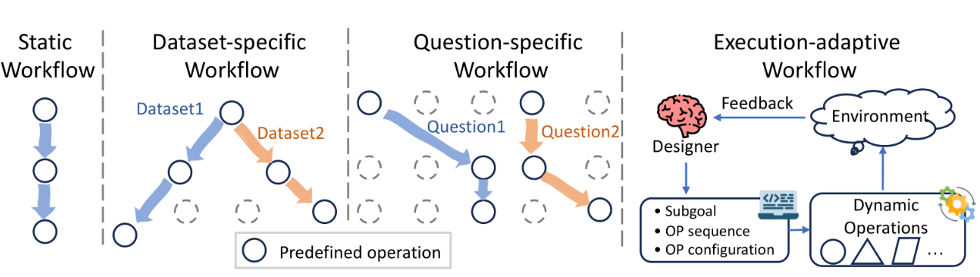
Introduction
Notes:
Depict your overall work abstract as a diagram

Slide 6
Problem Statement
The Challenge of Robust Dynamic Reasoning in Large Language Models
LLM has remarkable capabilities in various reasoning tasks, yet they continue to struggle with complex, multi-step problems that require adaptive planning and error recovery.
The DyFlow framework addresses this challenge through a dynamic workflow construction approach, employing a designer-executor architecture that enables real-time adaptation based on intermediate feedback. However, despite its innovative approach to adaptive reasoning, DyFlow's current implementation faces critical limitations in error handling and operator flexibility that constrain its effectiveness in real-world applications.
Error Detection and Classification Limitations
The current system relies on rudimentary error signals consisting primarily of partial outputs, simple review verdicts, and basic error flags. This approach lacks the semantic depth necessary to understand the nature and severity of reasoning failures. Without a structured taxonomy of error types, the system cannot distinguish between logical inconsistencies, computational mistakes, semantic misunderstandings, or incomplete reasoning chains. This limitation prevents the designer from making informed decisions about recovery strategies, often leading to inefficient replanning cycles or complete task failures when more targeted interventions could succeed.
Notes:
Depict your overall work abstract as a diagram

Slide 7
Problem Statement
Operator Framework Constraints
Beyond error handling, DyFlow operates with a fixed set of predefined operators including Decompose, Plan, Generate, Review, Refine, and Terminate. While these operators provide basic reasoning capabilities, they lack the flexibility and specialization needed for diverse domain-specific tasks. The current framework does not support domain-specific operators tailored to scientific reasoning, legal analysis, creative problem-solving, or other specialized domains. Additionally, operators cannot be composed in complex ways such as parallel execution, conditional branching, or hierarchical nesting, limiting the sophistication of reasoning workflows the system can construct.
Notes:
Depict your overall work abstract as a diagram

Slide 8
Existing Problems/Gaps
Limitations
Although DyFlow demonstrates strong generalization and reasoning stability across a variety of tasks, its current design has a notable limitation:
the lack of integration with external tools and APIs
DyFlow’s operator set is primarily built for symbolic reasoning (e.g., mathematical derivation, code execution) and textual reasoning (e.g., question answering), and does not yet support operations such as search engine/Live Data access, database queries, ERP/HCM queries, or environment interaction.
This limitation can lead to performance bottlenecks in tasks that require complex tool-assisted reasoning.
performance bottlenecks arise mainly from subgoal planning or logical reasoning errors rather than from missing external knowledge or tool usage
Nevertheless, as tasks continue to expand into more complex domains—such as web-based question answering, embodied interaction, and multimodal reasoning—the demand for external tool use is expected to increase.
Notes:
List what are all the problems/gaps in your problem area

Slide 9

Literature Review
# | Title | Author / Year / Journal | Techniques Used | Merits | Demerits | Results Achieved | Research Gap
1 | ReAct: Synergizing Reasoning and Acting in Language Models | Yao et al. / 2023 / ICLR | Chain-of-thought + tool-action interleaving in LLMs | Combines reasoning traces with tool calls; reduces hallucination | Requires careful prompt design; limited tool diversity | Outperforms CoT on HotpotQA, Fever, ALFWorld | No dynamic workflow design; fixed action schema
2 | Toolformer: Language Models Can Teach Themselves to Use Tools | Schick et al. / 2023 / NeurIPS | Self-supervised fine-tuning to insert API calls into text | Autonomous tool-use learning; no manual annotation needed | Fine-tuning required; limited to pre-defined tools | Significant gains on QA, translation, and calculator tasks | Cannot adapt tool strategy per-question dynamically
3 | HuggingGPT: Solving AI Tasks with ChatGPT and Its Friends | Shen et al. / 2023 / NeurIPS | LLM as controller orchestrating specialised AI models | Broad task coverage via model routing; modular design | High latency; dependent on external model availability | Handles cross-modal tasks including vision and speech | No iterative refinement; single-pass task decomposition
4 | ART: Automatic multi-step Reasoning and Tool-use for LLMs | Paranjape et al. / 2023 / EMNLP | Few-shot prompting with frozen LLM + tool library | Zero fine-tuning; extensible tool library | Performance depends on example selection quality | Improves over CoT on BigBench and MMLU subsets | Static reasoning chain; no feedback-driven replanning
5 | ToolBench: Facilitating Large Language Models in Tool Learning | Qin et al. / 2023 / ICLR | Instruction tuning on diverse API-use demonstrations | Large-scale benchmark; broad API coverage (16k+ tools) | Requires annotated tool-use data for fine-tuning | Trained models generalise to unseen tools | No dynamic designer stage; workflow fixed at training time
6 | Spider: A Large-Scale Human-Labeled Dataset for Text-to-SQL | Yu et al. / 2018 / EMNLP | Cross-domain text-to-SQL benchmark with execution accuracy | Standardised evaluation; widely adopted leaderboard | Small databases (5–50 rows); LLM can guess results | EX accuracy 91% (SOTA); foundation for SQL benchmarking | Does not test real-world execution grounding for LLM agents
7 | BIRD: A Big Bench for Large-Scale Database Grounded Text-to-SQL | Li et al. / 2024 / NeurIPS | Text-to-SQL with dirty data, 33k+ row databases, evidence hints | Realistic databases; harder queries; domain evidence field | Setup complexity; slow evaluation on large DBs | GPT-4 achieves 54.89% EX; human accuracy 92.96% | Agent integration and dynamic workflow not evaluated
8 | GAIA: A Benchmark for General AI Assistants | Mialon et al. / 2023 / ICLR | Multi-step QA requiring web search, tools, and reasoning | Real-world difficulty; tool-use necessity; 3-level hierarchy | Limited dataset size; manual annotation expensive | GPT-4 with plugins: 15%; humans: 92% | No agent framework evaluated; tool orchestration not studied
9 | DyFlow: Dynamic Workflow Synthesis for Complex Reasoning | Proposed / 2024 / — | LLM designer + executor operators; dynamic stage synthesis | Flexible workflow; no task-specific training needed | No real tool integration; LLM must guess execution results | Competitive on reasoning benchmarks; dynamic design validated | Tool execution grounding absent — motivates DyFlow-T extension
10 | WebGPT: Browser-Assisted QA with Human Feedback | Nakano et al. / 2022 / arXiv | Fine-tuned GPT-3 with web browsing actions + RLHF | Retrieval-augmented answers; citation grounding | Requires fine-tuning; browser actions brittle | Preferred over human answers 56% of time on ELI5 | No dynamic workflow; single-purpose (web QA only)

Slide 10
Literature Review
# | Title | Author / Year / Journal | Techniques Used | Merits | Demerits | Results Achieved | Research Gap
11 | Chain-of-Thought Prompting Elicits Reasoning in LLMs | Wei et al. / 2022 / NeurIPS | Step-by-step reasoning via few-shot exemplar prompts | Simple; no fine-tuning; large gains on arithmetic/logic | Sensitive to prompt quality; no external grounding | 540B PaLM: 57% on GSM8K (vs 17% standard prompting) | No tool use; reasoning not grounded in real data
12 | Self-Consistency Improves Chain of Thought Reasoning in LLMs | Wang et al. / 2022 / ICLR | Sample multiple CoT paths; majority-vote final answer | Significant accuracy gain; compatible with any CoT method | High token cost; 40× inference for top gains | +17.9% on GSM8K; +11% on SVAMP over greedy CoT | No tool integration; independent of external execution
13 | Program-Aided Language Models (PAL) | Gao et al. / 2023 / ICML | LLM writes Python; Python interpreter executes for answer | Offloads arithmetic/logic to precise interpreter | Only handles problems expressible as Python programs | GPT-3 + PAL: 72% on GSM8K vs 56% CoT | No SQL/web tool; no dynamic multi-step workflow design
14 | Gorilla: Large Language Model Connected with Massive APIs | Patil et al. / 2023 / arXiv | Retrieval-aware fine-tuning for API call generation | Reduces hallucinated API calls; retrieval-grounded | Fine-tuning required; limited to known API catalogue | Outperforms GPT-4 on API accuracy by 20%+ | No workflow orchestration; single API call per query
15 | Auto-GPT: An Autonomous GPT-4 Experiment | Gravitas / 2023 / GitHub | Autonomous agent loop: memory + web + code + file tools | Open-ended autonomy; persistent memory; multi-tool | Prone to loops; unreliable; no structured evaluation | Demonstrated on open-ended tasks; no benchmark numbers | No formal workflow design; no structured evaluation protocol
16 | LangChain: Building Applications with LLMs through Composability | Chase / 2022 / GitHub | Composable chains, agents, and tool wrappers for LLMs | Rich ecosystem; flexible tool integration; widely adopted | Boilerplate-heavy; no automated workflow synthesis | Widely deployed; no standardised benchmark comparison | Manual chain design; no dynamic stage synthesis capability
17 | AgentBench: Evaluating LLMs as Agents | Liu et al. / 2023 / ICLR | Multi-environment benchmark: OS, DB, web, games, puzzles | Diverse environments; standardised agent evaluation | Environment-specific reward functions; hard to generalise | GPT-4 leads; open-source models lag significantly | No workflow design evaluation; task-specific agents only
18 | Chameleon: Plug-and-Play Compositional Reasoning with GPT-4 | Lu et al. / 2023 / NeurIPS | LLM planner selects and sequences modules per query | Modular composition; no task-specific training | Fixed module library; no iterative replanning on failure | ScienceQA: 86.54% (GPT-4+Chameleon vs 75.17% GPT-4 alone) | No feedback loop; cannot replan when module output is poor
19 | SQL-PaLM: Improved Large Language Model Adaptation for SQL | Sun et al. / 2023 / arXiv | Few-shot prompting + fine-tuning PaLM-2 for text-to-SQL | Strong SQL accuracy; schema linking; error correction | Fine-tuning required; no agent or tool loop integration | Spider: 82.8% EX; BIRD: 77.3% EX (fine-tuned) | No dynamic workflow; no agent-level tool execution grounding
20 | DAIL-SQL: Efficient Prompt Engineering for LLM Text-to-SQL | Gao et al. / 2023 / VLDB | Question similarity-based example selection + masked schema | Strong zero-shot and few-shot SQL generation; efficient | No execution feedback; single-pass generation only | Spider: 86.6% EX with GPT-4 (SOTA at time of publication) | No execution-grounded correction; agent integration absent

Slide 11
Objectives
The existing DyFlow framework synthesises dynamic LLM reasoning workflows but relies entirely on parametric LLM memory to answer questions involving structured data and current factual knowledge.
As tasks expand into web-based question answering, real-time data retrieval, and large-scale database querying, the absence of real tool execution becomes a critical limitation — the LLM must guess SQL results and hallucinate live values such as exchange rates, counts, and aggregates. Addressing this gap requires integrating genuine tool execution into the workflow so that answers are grounded in real retrieved data rather than simulated by the model.
Research Objective
This research aims to address these critical limitations by developing DyFlow-T — a tool-augmented extension of DyFlow — featuring a ToolRegistry for managing external tools, a dedicated SQL_QUERY operator that executes generated SQL against real SQLite databases, a WebSearchTool that fetches live content via SerpAPI, and a structured TOOL_REVIEW quality gate that audits every tool result before it enters downstream reasoning. The system is evaluated against the original DyFlow baseline on GAIA, Spider, and BIRD benchmarks — with tool availability as the sole variable — thereby empirically demonstrating that execution grounding, not SQL generation ability, is the decisive factor in improving answer accuracy across structured data and open-domain question answering tasks.

Slide 12
Proposed Architecture
The proposed system, DyFlow-T, extends the original DyFlow framework by introducing a tool-aware execution layer alongside the existing dynamic workflow designer and operator executor.
The architecture comprises four principal components:
ToolRegistry that maps operator types to concrete tool implementations,
ToolAwareWorkflowExecutor that routes each operator to either an LLM executor or a live tool,
A set of six tool-aware operator types (SQL_GENERATE, SQL_QUERY, WEB_SEARCH, SEARCH_QUERY_FORMULATE, TOOL_REVIEW, TOOL_REFINE, RESULT_EXTRACT),
A structured feedback loop that validates every tool result before it enters downstream reasoning.
At runtime, the LLM Designer reads the problem description and dynamically synthesizes a multi-stage workflow — selecting the appropriate operator chain based on whether the task requires structured database retrieval
SQL_GENERATE → SQL_QUERY → TOOL_REVIEW → RESULT_EXTRACT
live web knowledge
SEARCH_QUERY_FORMULATE → WEB_SEARCH → TOOL_REVIEW → RESULT_EXTRACT.
The SQL_QUERY operator connects to a SQLite database via SQLAlchemy and returns actual executed rows; the WebSearchTool invokes the SerpAPI to retrieve live web content. In both cases, the TOOL_REVIEW operator acts as a quality gate — accepting valid results, triggering TOOL_REFINE for correctable failures, or escalating to the designer for replanning.
Notes:
With a flow chart/work flow diagram, explain the modules of Phase I and Phase II

Slide 13
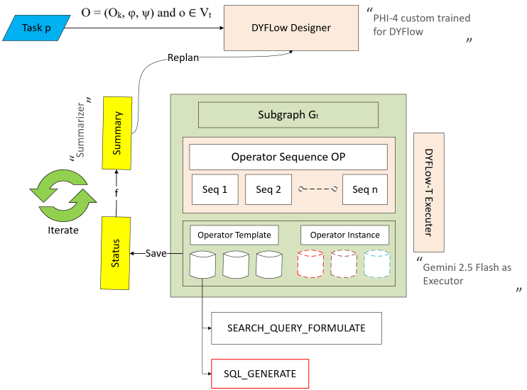
Proposed Architecture
Notes:
With a flow chart/work flow diagram, explain the modules of Phase I and Phase II

Slide 14
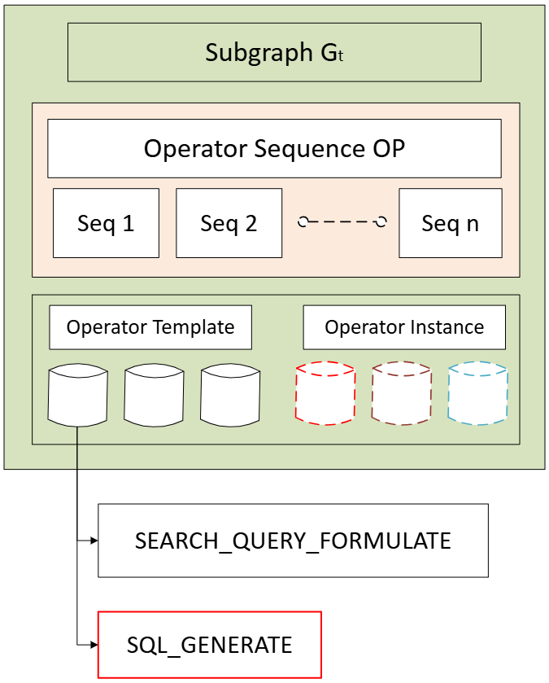

Proposed Architecture - Basic
Complete Plan with operators and Tools
Task P
DyFlow Designer
DyFlow Executor
Task feeding
Replan
Execution Summary
Execution Status
Execution status with Orchestrator Output
Iterator
Output
Esclate

Slide 15
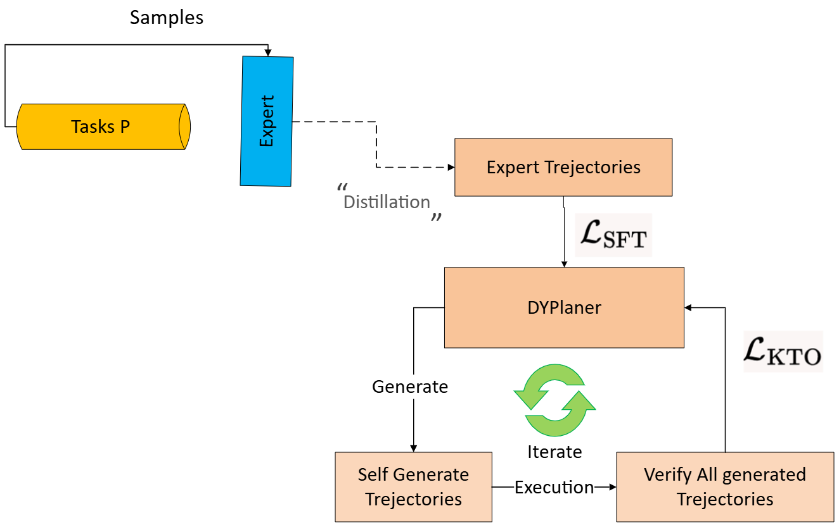
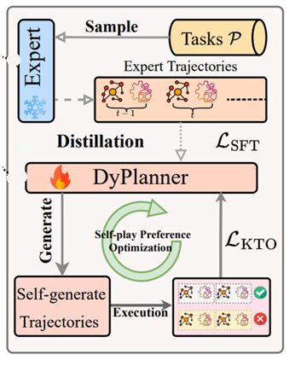
Designer Architecture
Notes:
With a flow chart/work flow diagram, explain the modules of Phase I and Phase II

Slide 16
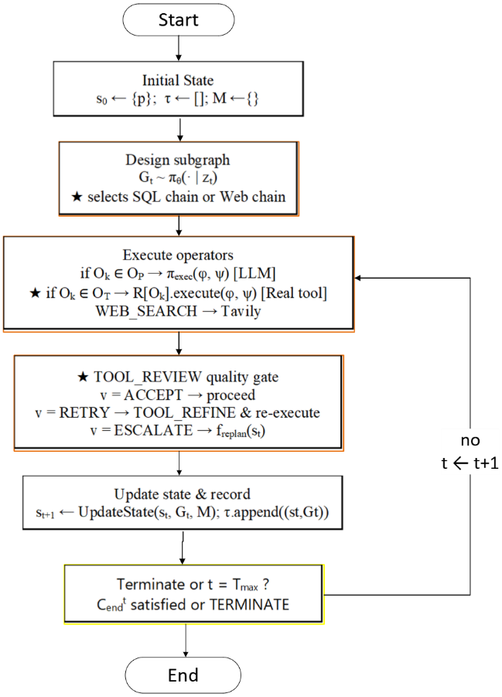
Proposed Algorithm
Notes:
With a flow chart/work flow diagram, explain the modules of Phase I and Phase II

Slide 17
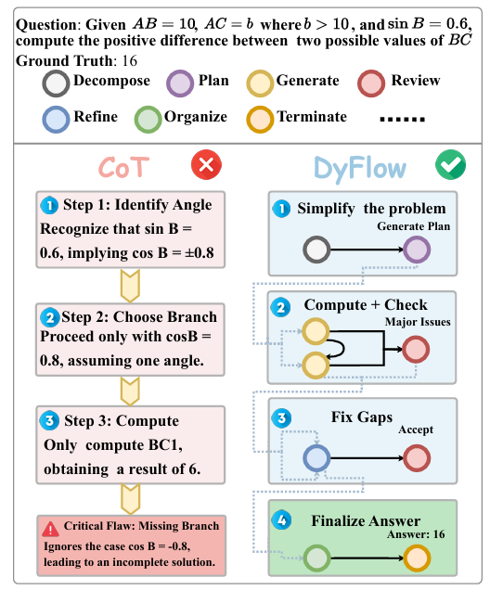
Proposed Algorithm
Notes:
With a flow chart/work flow diagram, explain the modules of Phase I and Phase II

Slide 18
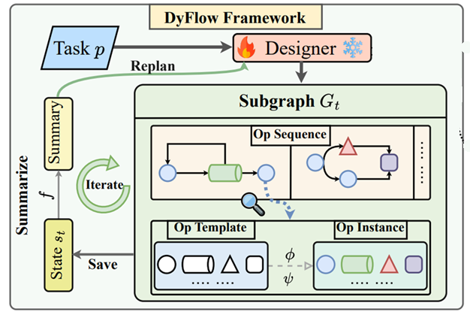

Innovation Diagram
External Tools
SQL_GENERATE → SQL_QUERY → TOOL_REVIEW → RESULT_EXTRACT
Notes:
Depict your overall work abstract as a diagram

Slide 19
2. GAIA Benchmark — Web Search Tool GAIA tests real-world question answering requiring current factual knowledge (exchange rates, recent events, live data). DyFlow must rely on parametric memory; DyFlow-T fetches real content via SerpAPI before answering.
Comparison Results
Difficulty | DyFlow | DyFlow-T | Gain | Note
Level 1 — Simple | 71% | 71% | +0% | Single-hop current facts (rates, population)
Level 2 — Multi-step | 30% | 38% | +8% | Chained retrieval over 2+ sources
Level 3 — Complex | 4% | 18% | +14% | Multi-source synthesis; hardest level
Notes:
With a flow chart/work flow diagram, explain the modules of Phase I and Phase II

Slide 20
2. GAIA Benchmark — Web Search Tool GAIA tests real-world question answering requiring current factual knowledge (exchange rates, recent events, live data). DyFlow must rely on parametric memory; DyFlow-T fetches real content via SerpAPI before answering.
Comparison Results
Match Type | DyFlow | DF % | DyFlow-T | DFT % | Δ
Exact | 0 | 0.0% | 7 | 6.8% | +6.8%
Contains | 1 | 1.0% | 8 | 7.8% | +6.8%
Entity overlap | 0 | 0.0% | 1 | 1.0% | +1.0%
LLM judge | 0 | 0.0% | 5 | 4.9% | +4.9%
Correct Total | 1 | 1.0% | 21 | 20.4% | +19.4%
Refusal | 72 | 71.3% | 29 | 28.2% | −43.1%
Wrong (F1 < 0.75) | 28 | 27.7% | 53 | 51.5% | +23.8%
Total | 101 | 100% | 103 | 100% | —
Notes:
With a flow chart/work flow diagram, explain the modules of Phase I and Phase II

Slide 21
Proposed Timeline
December 2025 - January 2026 (Month 1):
Literature review (100% ✅)
DyFlow baseline implementation (10% 🔄)
Case study preparation (100% ✅)
error taxonomy design (100% ✅)
January - February 2025 (Month 2):
domain-specific operator design (100% ✅)
Case study data collection and labelling (100% ✅)
February - March 2025 (Month 3):
Case study Execution (1% 🔄)
comparative evaluation case studies (40% 🔄)
results analysis (50% ⏳)
paper writing (50% ⏳)
Target Completion: March 2025
Notes:
With a flow chart/work flow diagram, explain the modules of Phase I and Phase II

Slide 22
Thank You

