Slide 1
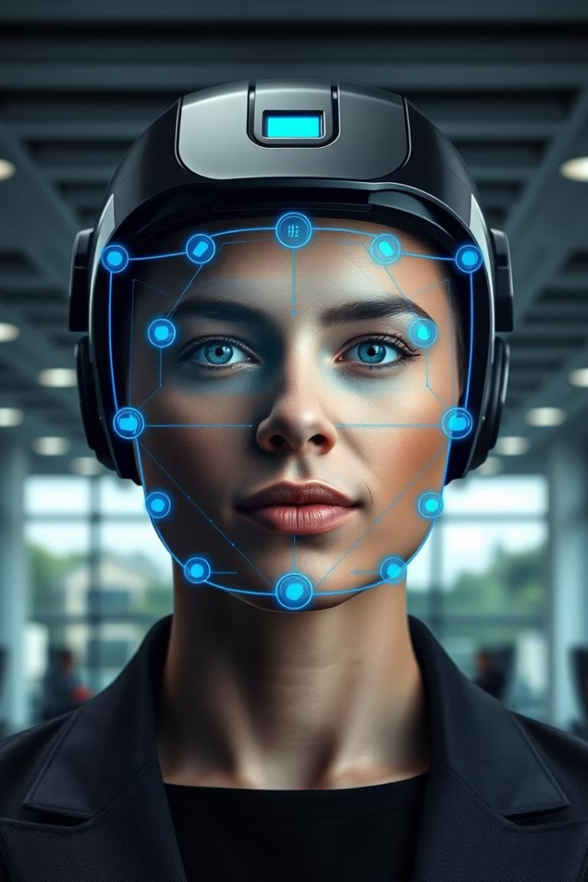
Automated Attendance System Using Face Recognition
A zero-touch, AI-driven attendance solution that ensures trust and efficiency through advanced face recognition technology.

Slide 2

Introduction
Slow Process
Inaccurate Data
Manual attendance wastes time and delays lessons or meetings.
Errors and manipulation reduce trust in attendance records.
Security Concerns
No real-time tracking or strong identity verification for safety.

Slide 3




The Big Idea
Zero-touch
AI-Driven
Trust & Efficiency
Hands-free attendance recording with no manual input needed.
Uses advanced face recognition to identify users precisely.
Ensures reliable tracking with seamless user experience.

Slide 4
Technology Stack
Face Recognition
OpenCV with CNNs & ArcFace
Software Frameworks
Python backend
Flask/Streamlit UI
Data & Security
SQLite or Firebase database
Facial feature encryption & hashing

Slide 5





System Architecture
Face Capture
Cameras capture live face images automatically.
Identity Matching
AI matches faces against the database swiftly.
Verification
System detects liveness to prevent spoofing.
Attendance Marking
Presence recorded instantly without manual input.
Data Sync
Information updates in real-time to dashboards.

Slide 6




Core Features
Automatic Attendance
Liveness Detection
Unknown Face Alerts
Reports & Analytics
Prevents fake images or videos from being accepted.
Instant notifications for unrecognized individuals.
Visual summaries and history for easy tracking.
No manual input; attendance is recorded automatically.

Slide 7








Competitive Advantages
Safer
Faster
Encrypted storage protects biometric data securely.
Recognition under 1 second per face.
Smarter
Scalable
Machine learning improves accuracy over time.
Supports thousands of users easily.

Slide 8
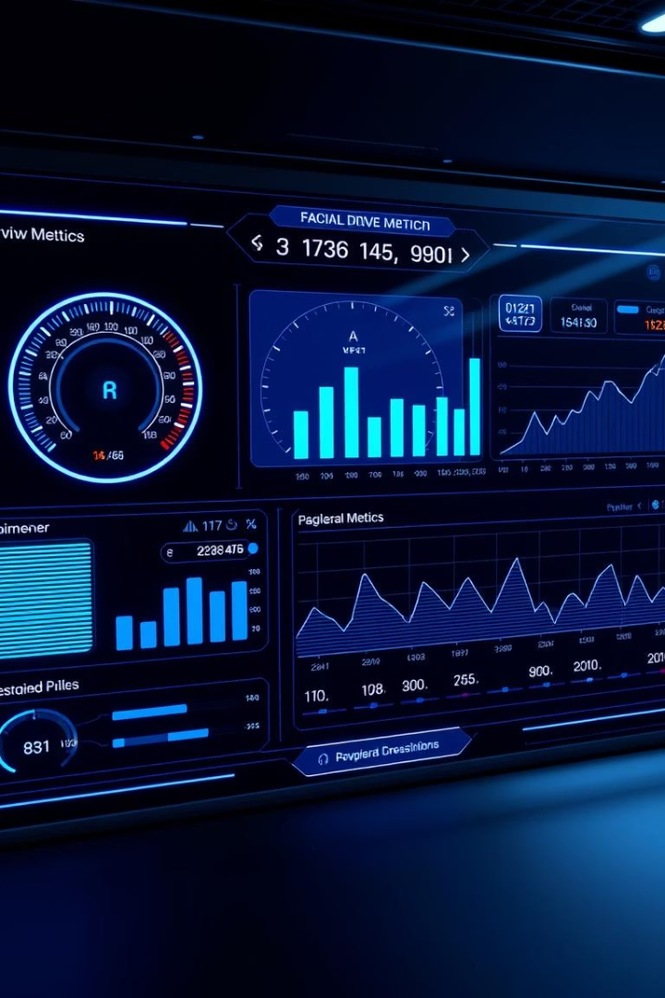
Performance Metrics
99%
Recognition Accuracy
500ms
Processing Time
Per image
98%
Liveness Detection
Accuracy rate
99.9%
System Uptime

Slide 9
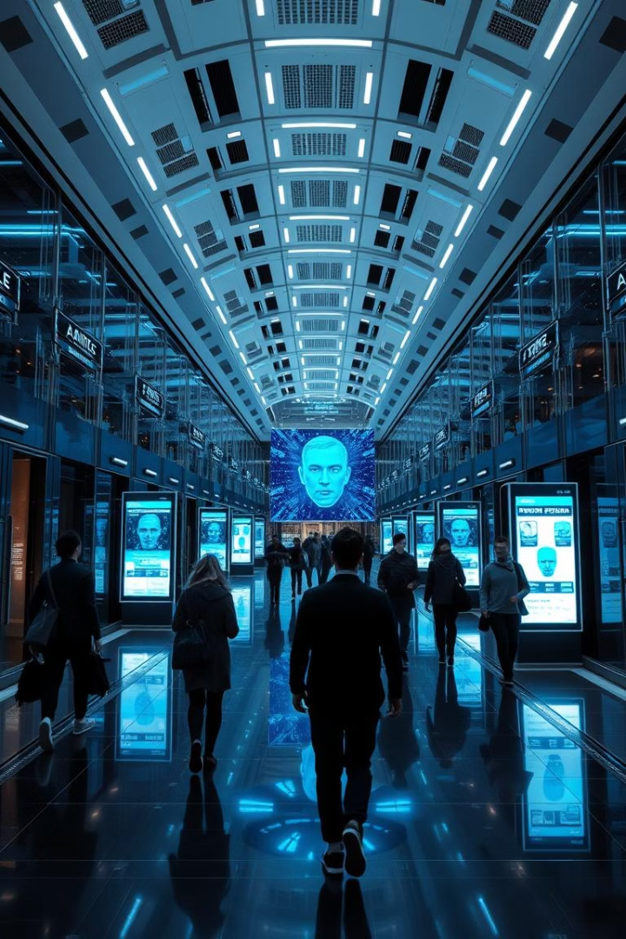
Future Enhancements
Predictive Attendance
Using schedules and location data to predict attendance patterns.
Multi-factor Authentication
Integration with biometric ID cards for enhanced security.
Behavior Analysis
AI-driven emotion analysis for educational insights.
IoT Integration
Full smart campus environments with connected devices.

Slide 10






Conclusion
Smart
AI-powered intelligence
Secure
Protected biometric data
Seamless
Effortless user experience
Automated Attendance System transforms presence tracking for education and businesses. Embrace the future with trust and efficiency.

