Slide 1
AI-Driven Churn Prediction
& Retention Strategy
Table of Contents
1. Current State of the Telecom Industry
2. Prediction Using Machine Learning
A Data-Driven Business Proposal for Company A
3. Our Business Proposal
GCI World 2026 April | Matsuo-Iwasawa Lab, The University of Tokyo

Slide 2




Current State of the Telecom Industry
Wireless operators face intensifying competition and rising customer churn.
5–10×
1.5–3%
ARPU ↓
Acquiring a new customer costs 5–10× more than retaining an existing one.
Typical monthly churn rate for wireless operators in competitive markets.
Industry ARPU is declining, making retention of existing high-value subscribers critical.
The Opportunity for Company A
Company A has accumulated extensive customer data (usage, billing, service quality, handset info) but lacks an in-house analytics capability to predict and prevent churn. By building an AI churn-risk model, we can identify at-risk customers early enough for targeted retention, reducing revenue loss and improving campaign ROI.
Sources: Investopedia (ARPU & Telecom KPIs), TM Forum (ODA), Bain & Company (Retention Economics)

Slide 3
Prediction Using
Machine Learning Models
1. Current State of the Telecom Industry
2. Prediction Using Machine Learning Models
3. Our Business Proposal

Slide 4

Introduction of Data
Company A provided historical customer data across two linked tables totaling ~100,000 records.
Client.csv
Dataset at a Glance
100,000 rows × 50 columns
Account demographics, handset info, household attributes, credit class, geographic area
Total Customers
100,000
Total Features
~100 columns
Record.csv
Target Variable
churn (31–60 days)
100,000 rows × 51 columns
Usage, billing, call quality, dropped/blocked calls, overage, roaming, churn label
Joined on Customer_ID (1:1 inner merge)

Slide 5



Data Visualization
We conducted exploratory data analysis across 100,000 customers to identify the key churn patterns.
Device Age Is the #1 Separator
Churn Risk Pockets
Equipment age (eqpdays) has the strongest effect (Cohen's d = 0.23). Churn rises from 40.7% for newest devices to 55.7% for oldest. Cheap handsets also increase risk.
When features combine, risk amplifies:
Feature Combination | Churn %
Low usage + High bill | 58.6%
Cheap device + Low usage | 59.6%
Low usage + High drops | 63.7%
High usage + High bill | 42.3%
Premium device + High usage | 38.8%
Usage Decline Signals Disengagement
Churners average 483 minutes vs 543 for non-churners. Recent usage change (change_mou) is more predictive than demographics. Trend features outperform static attributes.
Surprise: Support Calls ≠ Churn Risk
The naive "more complaints = more churn" hypothesis is contradicted. Churners actually make fewer customer-care calls on average (1.60 vs 1.98). Support contact alone is not a risk signal.
Individual features are weak separators. Combined risk pockets reach 60%+ churn, making multivariate models essential.
5

Slide 6

Overview of the Machine Learning Model
From customer behavior, device, and service data, we predict the probability of churn within 31–60 days.
Raw Data
100K × 100
→
Missing Value
Treatment
→
Feature
Engineering
→
Selection
227 → 61
→
LightGBM
+ Optuna
→
Churn
Risk Score
Final Tuned Model
LightGBM + Optuna (100 trials)
ROC-AUC
0.695
Accuracy
63.9%
Precision
63.3%
Recall
64.5%
F1 Score
63.9%
LightGBM selected as the best-performing model with the lowest generalization gap.
Evaluation
5-Fold Stratified CV
6

Slide 7
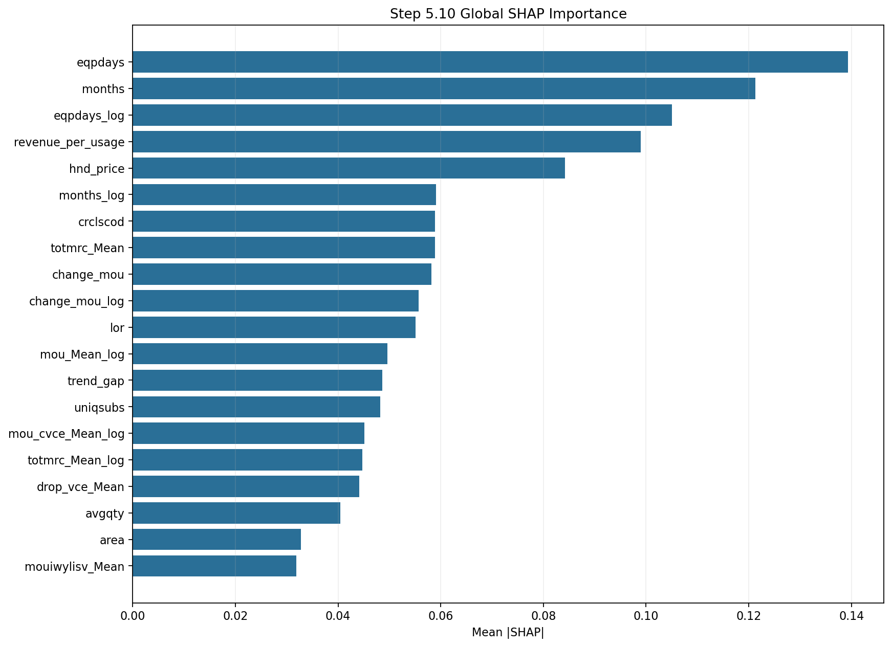
Important Features for Prediction
SHAP analysis reveals how each feature contributes to individual churn predictions.
Top Churn Drivers
months
Short tenure → high risk
0.121
hnd_price
Cheap handset → high risk
0.084
totmrc_Mean
Low recurring charge
0.059
change_mou
Usage decline
0.058
drop_vce_Mean
Dropped calls
0.044
Top Retention Drivers
eqpdays
Newer equipment
0.139
crclscod
Better credit class
0.059
uniqsubs
Larger household
0.048
The model is nonlinear and segmented — device lifecycle, tenure, and usage trends dominate over demographics. See dependence plots for detailed feature behavior.
7

Slide 8
Our Business Proposal
1. Current State of the Telecom Industry
2. Prediction Using Machine Learning Models
3. Our Business Proposal

Slide 9


Our Business Proposals
Two data-driven proposals to reduce avoidable churn and protect Company A's recurring revenue.
Proposal 1
Proposal 2
AI Churn Risk Scoring
Segment-Based Proactive Retention
Deploy the LightGBM model to score every customer monthly on churn probability. Retention teams receive a ranked risk list instead of treating all customers equally.
Use SHAP-identified risk segments to design specific interventions: handset upgrade offers for old-device customers, plan adjustments for high-bill/low-usage users, and service follow-ups for drop-call victims.
Target: Focus retention budget on the top 20% highest-risk customers
Target: Match the right retention action to each risk profile
Long-Term Support
Model retraining on fresh data quarterly • Seasonal churn pattern analysis • Dashboard integration for retention teams • A/B testing retention offer effectiveness
9

Slide 10



Proposal 1: AI Churn Risk Scoring
Score every customer monthly and route high-risk accounts to the retention team.
YES →
Retention Outreach
→
Saved Customer
Customer
Data
→
LightGBM
Risk Score
→
High
Risk?
NO →
Standard Service
Overview
Novelty
Expected Effects
Score every customer monthly on churn probability using the tuned LightGBM model (ROC-AUC 0.695).
The model uses 61 features covering device age, usage trends, billing, and service quality to produce a 0–100 risk score.
Replaces broad, untargeted retention campaigns with data-driven prioritization.
Current approach: spend equally on all customers. New approach: concentrate 80% of budget on the top 20% risk customers where save probability is highest.
For customers: proactive service before frustration leads to churn.
For Company A: focused spend on high-risk accounts, higher save rate, lower cost-per-save, and improved campaign ROI.
10

Slide 11
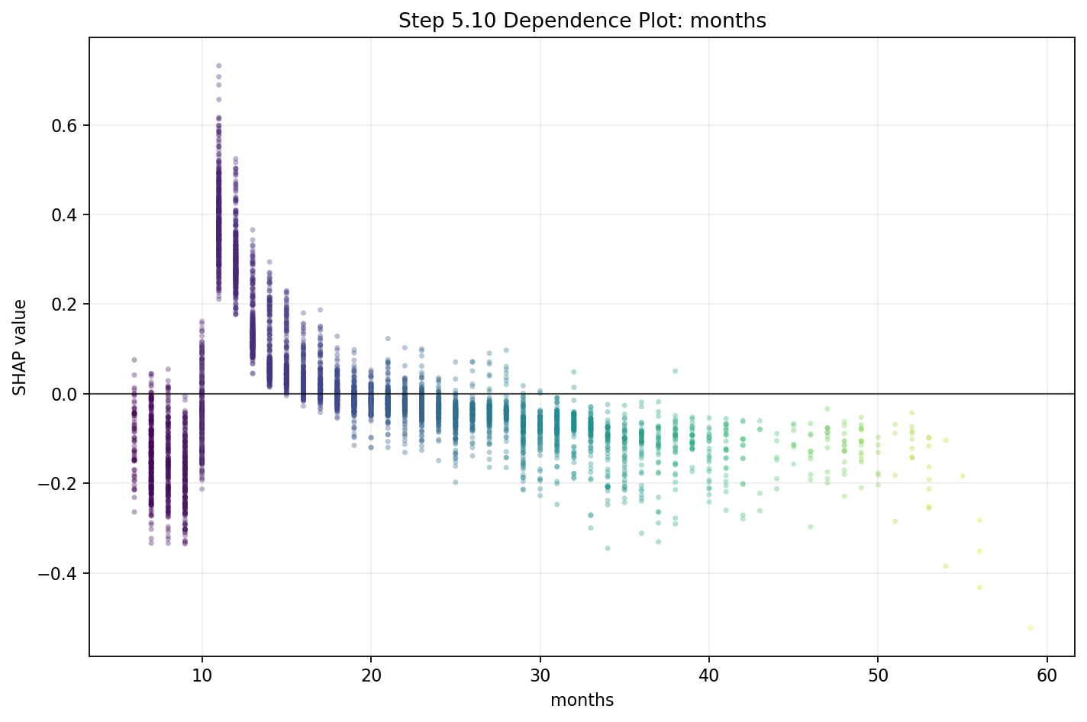
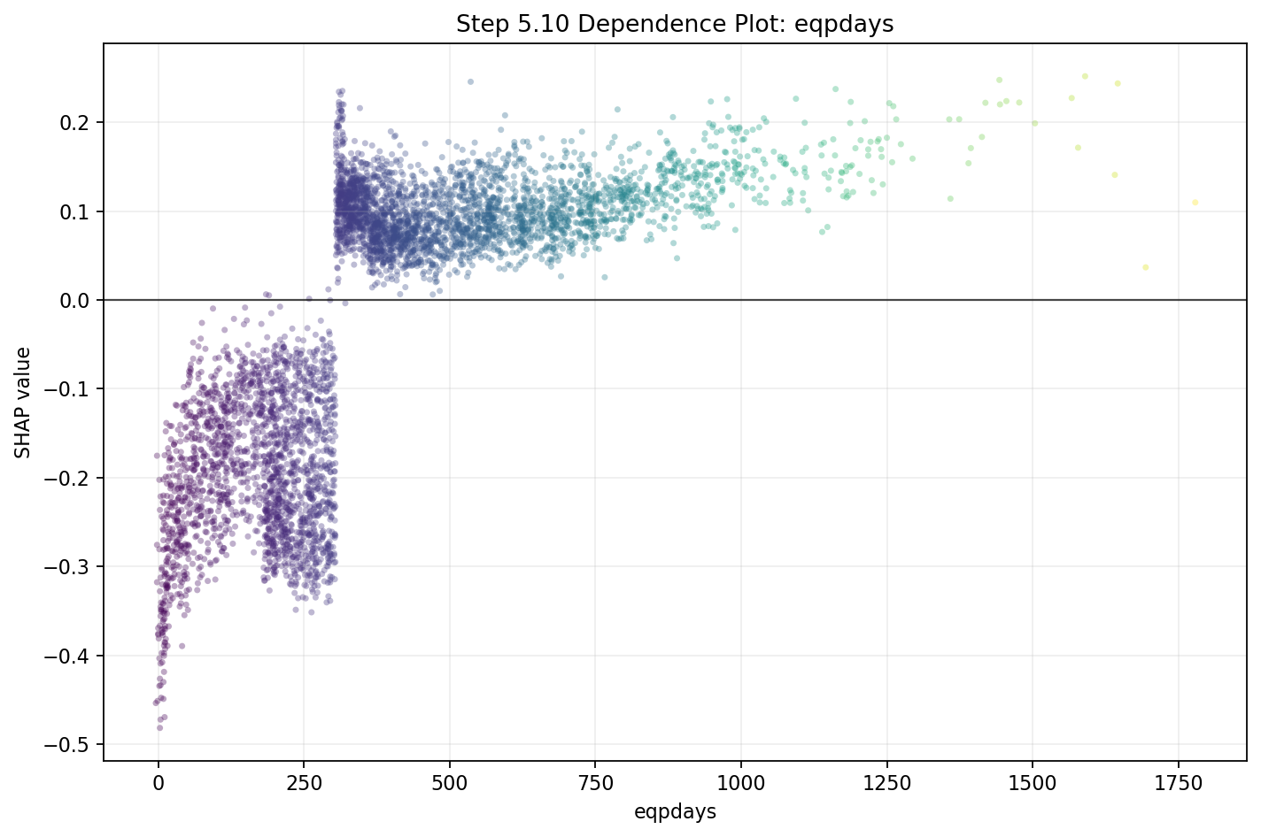
Validity of the Churn Risk Score
SHAP dependence plots confirm the model captures meaningful, nonlinear customer behavior patterns.
ROC-AUC
Accuracy
Precision
Recall
F1 Score
0.695
63.9%
63.3%
64.5%
63.9%
5-Fold Stratified CV
validation
validation
validation
validation
Short tenure (6–12 mo) = highest churn risk zone
Newer equipment (<300 days) = strong retention signal
11

Slide 12
Revenue Impact Quantification
Estimating the financial benefit of AI-driven targeted retention versus untargeted campaigns.
Assumptions
Projected Annual Impact
Parameter | Value
Total customers | 100,000
Observed churn rate | 49.6%
Est. monthly ARPU | $55
Annual revenue per customer | $660
Model targets top-risk % | Top 20%
Customers targeted | ~9,912
Save rate (targeted intervention) | 15%
Cost per intervention | $30
Customers Saved
~1,487
Revenue Protected
$981K
Intervention Cost
–$297K
Net Annual Benefit
$684K
ROI: ~230% return on retention investment
Based on rev_Mean ≈ $58, industry save rates 10–20%, and standard telecom retention offer costs.
12

Slide 13
Proposal 2: Segment-Based Proactive Retention
SHAP analysis identifies three actionable customer risk segments, each with a tailored intervention.
Segment A
Segment B
Segment C
Old Device, Low Engagement
High Bill, Low Usage
Service Quality Issues
Trigger
eqpdays > 400 days + declining mou_Mean
Action
Subsidized handset upgrade offer tied to contract renewal
Expected Outcome
Re-engage customer with new device lock-in; reset eqpdays to 0
Trigger
High totmrc_Mean + low mou_Mean (bill-to-usage mismatch)
Action
Plan right-sizing or loyalty discount to reduce bill shock
Expected Outcome
Reduce churn from 58.6% risk pocket; improve perceived value
Trigger
Elevated drop_vce_Mean + declining change_mou
Action
Priority service follow-up + network team escalation in affected area
Expected Outcome
Fix root cause before customer leaves; reduce 63.7% risk pocket
13

Slide 14
Implementation Roadmap
A phased rollout to minimize risk and maximize learning at each stage.
Phase 1
Month 1–2
Phase 2
Month 3
Phase 3
Month 4–6
Phase 4
Ongoing
Setup
Pilot
Rollout
Optimize
• Data pipeline integration
→
• Score 10% of customer base
→
• Full 100K customer scoring
→
• Quarterly model retraining
• Feature store deployment
• A/B test vs control group
• Segment-specific interventions
• Seasonal churn analysis
• Model packaging & API
• Measure save rate & ROI
• Retention dashboard live
• Offer effectiveness tracking
• Retention team onboarding
• Calibrate risk threshold
• Weekly risk list delivery
• Feature drift monitoring
Commitment: We provide end-to-end support from data integration to model monitoring. Company A's retention team receives actionable risk lists — no ML expertise required.
14

Slide 15
Summary
Company A can reduce annual churn-related revenue loss by ~$684K through AI-driven risk scoring and targeted, segment-specific retention actions.
Model Performance
Feature Engineering
Net Annual Benefit
ROC-AUC 0.695
61 Features
$684K
LightGBM + Optuna tuned
from 227 → compact & interpretable
~230% ROI on retention spend
Thank You
GCI World 2026 April | Matsuo-Iwasawa Lab, The University of Tokyo

