Slide 1


AI-MANIAC 2023
REPRESTED BY-
PINGILLI KOUSHIK (TL)
AYUSH TIKALE
KHUHSI GUPTA
SAI KRISHNA
K.PREM

Slide 2

CREATING AN INTELLIGENT SYSTEM USING AI-ML PHISHING DOMAIN WHICH IMITATE LOOK AND FEEL OF GENUINE DOMAIN

Slide 3
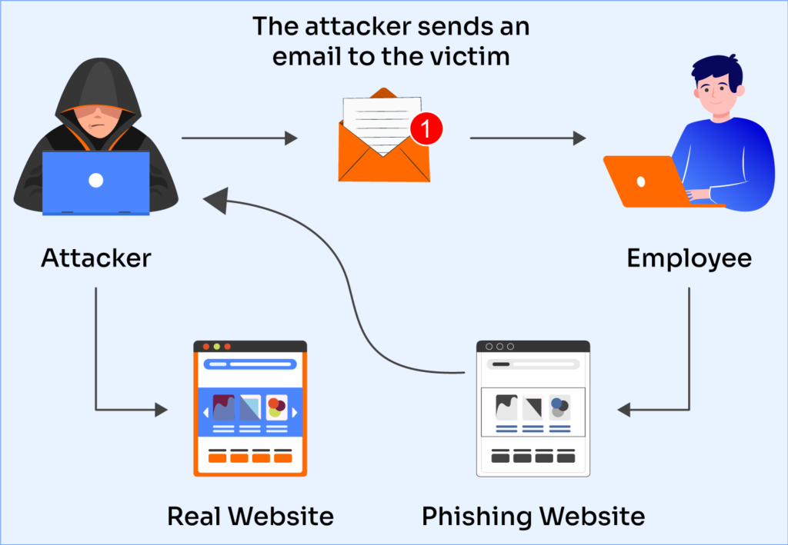
Phishing domain DETection
Phishing is a form of fraud in which the attacker tries to learn sensitive information such as login credentials or account information by sending a reputable entity or person in email or other communication channels.
Phishing domains pose a
significant threat by
impersonating legitimate
websites, leading to identity
theft, financial fraud, and data breaches.

Slide 4
Attackers manipulate human psychology in various ways to deceive victims in phishing attacks. Here's an overview of some common psychological tactics used:
1. **Trust and Authority**: Phishers often impersonate trusted entities, like banks, government agencies, or well-known brands. They exploit the trust people have in these institutions to gain credibility.
2. **Social Proof**: Phishers use social proof by making victims believe that others have already taken the desired action. For instance, they might claim that "many of your colleagues have already signed up.
3. **Personalization**: Attackers may personalize their messages with the victim's name or other information, making it appear more legitimate and relevant.
4. **Emotional Appeals**: Phishers appeal to emotions, such as sympathy or greed, to manipulate victims. They might present a story about someone in need or offer an enticing reward.
5. **Spoofing Sender Identities**:By spoofing sender email addresses or phone numbers, attackers make it seem like the message is coming from a known contact or trusted source.

Slide 5
DOMAIN
Internet domains are essential for users to access web content easily and are managed by the Domain Name System (DNS), which translates human-readable domain names into numerical IP (Internet Protocol) addresses used by computers to locate each other on the internet.
A domain name is a human-readable, text-based address used to identify and locate resources on the internet. It serves as a more user-friendly alternative to numerical IP addresses, which computers use to identify each other on the internet.
For example, in the domain name "www.example.com":
"www" is a subdomain (optional).
"example" is the second-level domain (SLD).
"com" is the top-level domain (TLD).

Slide 6
A domain name consists of several parts:
Sub-domain: This is an optional prefix to the main domain and is separated by a dot. For example, "www" in "www.example.com" is a subdomain.
Second-Level Domain (SLD): This is the core part of the domain name and is directly to the left of the top-level domain (TLD). In "example.com“,"example" is the SLD.
Top-Level Domain (TLD): This is the rightmost part of the domain name, usually denoting the type or category of the website or organization. Common TLDs include
“.com”, “.org”, “.net”, and country-code TLDs like ".uk" for the United Kingdom.

Slide 7
Example of real and a replica domain: real domain: www.onlinesbi.sbi.com replica domain: www.onlinesbi.digital.com real domain contains of: protocol/domain name/path/sub-domain1/sub-domain2

Slide 8
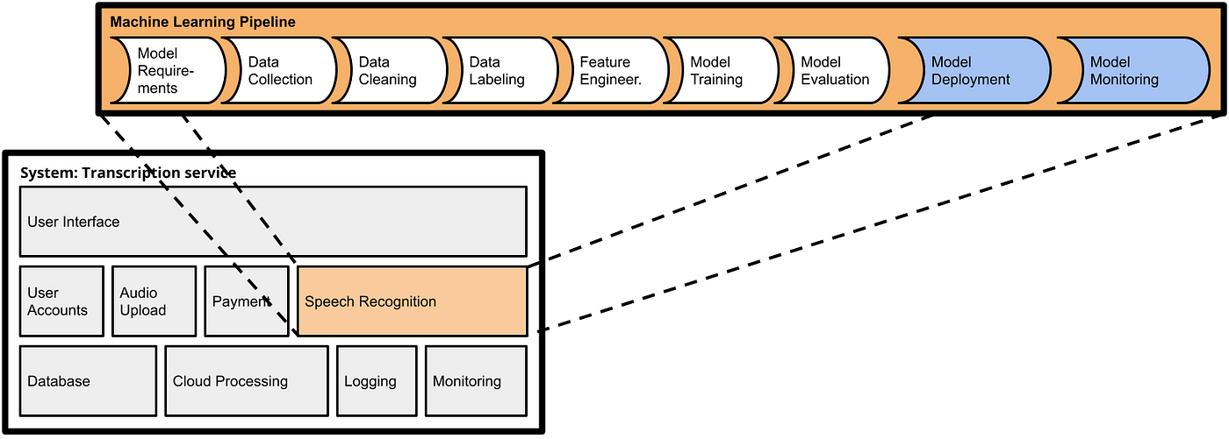
how ARE WE DOING this: -MODEL REQUIREMENTS -data collection -data cleaning -data labelling -feature engineer -model training -model evaluation -model DEPLOYMENT -model monit0ring

Slide 9
Data collection: We have collected our data from Kaggle, which sources its data from Mendeley. Kaggle is a popular platform for data scientists and machine learning practitioners to find, share, and work with datasets for various purposes, including research, analysis, and machine learning projects.

Slide 10
DATA CLEANING OR PRE-PROCESSING:
Data cleaning (also known as data preprocessing or data preparation) is a crucial step in the data analysis and machine learning pipeline. It involves the process of identifying and correcting errors, inconsistencies, and inaccuracies in your dataset to ensure that it is of high quality and suitable for analysis or model training. Here are some key steps and techniques involved in data cleaning and preprocessing:
1.Handling Missing Data 2.Removing Duplicate Data.
3. Handling Outliers. 4. Data Transformation.
5. Feature Selection. 6. Handling Imbalanced Data.
7. Handling Text Data. 8. Handling Date and Time Data.
9. Dealing with Noisy Data 10. Data Integration

Slide 11
DATA CLEANING: IT IS A DATA SET AND IT ALSO CONTAINS A LABEL COLUMN WHICH SHOWS WhEThER A DOMAIN IS A GENUINE OR A PHISHING DOMAIN 1-PHISHING DOMAIN 0-GENUINE DOMAIN REMOVING ADDITIONAL FEATURES WHICH ARE UNNECESSARY FOR TRAINING A MODEL WE HAVE HANDELED NULL & MISSING VALUES AND REMOVED DUPLICATE ROWS AND ENTRIES.

Slide 12
MODEL TRAINING: Model training is a fundamental step in the development of machine learning models. During this process,a machine learning algorithm learns from a labeled dataset to make predictions or perform a specific task. WE HAVE TRAINED THREE MODELS: 1.DECISION TREE CLASSIFIER 2.RANDOM FOREST CLASSIFIER 3.EXTREME GRADIENT BOOSTER[XGB]CLASSIFIER

Slide 13
Decision Trees: Supervised learning algorithm for classification and regression tasks. Learns a tree-like structure where each node represents a feature and each leaf node represents a class or regression value. Trained by recursively splitting data to maximize information gain (classification) or minimize mean squared error (regression). Prone to overfitting, so tree pruning and limiting depth are common techniques.

Slide 14
Random Forest: Ensemble learning method based on decision trees. Constructs multiple decision trees and combines their predictions through voting (classification) or averaging (regression). Helps reduce overfitting and improves model robustness. Parallelizable and suitable for large datasets.

Slide 15
XGB CLASSIFIER: The "XGB Classifier" typically refers to a classifier model built using the XGBoost (Extreme Gradient Boosting) algorithm. XGBoost is a popular and powerful machine learning algorithm known for its effectiveness in both classification and regression tasks. It is an ensemble learning method based on the gradient boosting framework. When used for classification, it's often referred to as the "XGB Classifier."

Slide 16
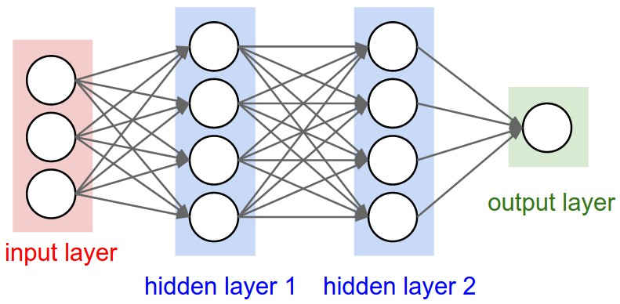
XGB CLASSIFIER MODEL:

Slide 17
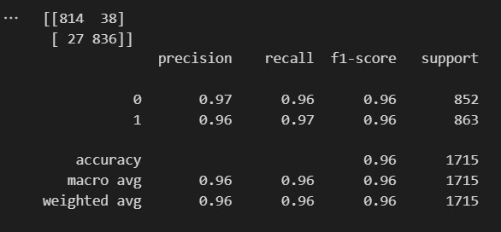
The best model that fits the training set achieves a high level of accuracy of 96% of training accuracy and 98% of testing accuracy using extreme gradient boosting classifier the data set is as follows:

Slide 18
MODEL EVOLUTION:
Model evolution refers to the process of improving or updating a machine learning or AI model over time. It involves making iterative changes to the model to enhance its performance, accuracy, and ability to handle new data or tasks. Model evolution can include various activities such as fine-tuning hyperparameters, incorporating more training data, adjusting the model architecture, and implementing advanced techniques like transfer learning or ensemble methods.

Slide 19
How can we be aware of phishing: Use of Secure Connections: Always use secure, encrypted connections (HTTPS) when entering sensitive information online. Look for the padlock icon in the address bar. Double-Check URLs: Hover over links in emails to see the actual URL before clicking. Ensure the URL matches the legitimate website. Beware of Email Requests: Becautious about unsolicited emails requesting sensitive information or urgent actions, especially if they contain spelling errors or unusual sender addresses. Keep Software Updated Regularly update your operating system, web browsers, and security software to patch vulnerabilities that could be exploited by phishing attacks.

Slide 20
Acknowledgement we thank code-hub and sih for providing us this wonderful opportunity to take part in smart innovation hackathon 2023. we want to express our heartfelt gratitude to all the teachers who have inspired and guided us to take part in this.we will always remember the lesson you’ve imparted.

Slide 21

TEAM AI-MANIAC

