Slide 1
B.TECH ARTIFICIAL INTELLIGENCE CAPSTONE PROJECT (20 MARKS)
TrafficFlow AI
Adaptive Traffic Signal Control Using Deep Reinforcement Learning (DQN)
Student Name: C. Koushik Kumar
Register Number (Reg No): 24BCE2320
Tech Stack: PyTorch (from scratch) | Python 3.13 | Streamlit | Plotly | NumPy | Pytest

Slide 2
TRAFFICFLOW AI | CAPSTONE PROJECT
The Urban Congestion Problem & Motivation
Limitations of Traditional Fixed-Time Control
• Open-Loop Countdown Timers: Allocates fixed 30s regardless of real-time queues.
• Empty Road Inefficiency: Awards green lights to vacant lanes while congested opposing lanes idle.
• Asymmetric Traffic Failure: Severe rush-hour directional imbalances lead to massive queue spillback.
• High Societal Cost: Billions of hours wasted in traffic idling, leading to fuel waste and carbon emissions.
Why Deep Reinforcement Learning (DRL)?
• Closed-Loop Real-Time Sensing: Continually observes approach queue lengths, waiting times, and arrival rates.
• Long-Term Optimization: Balances immediate clearance against downstream congestion via Bellman return.
• Zero Hardcoded Timers: Learns optimal switching thresholds through trial-and-error simulation experience.
• Safety Supervisory Bounds: Integrates physical traffic invariants (10s min green, clearance yellow/all-red).

Slide 3
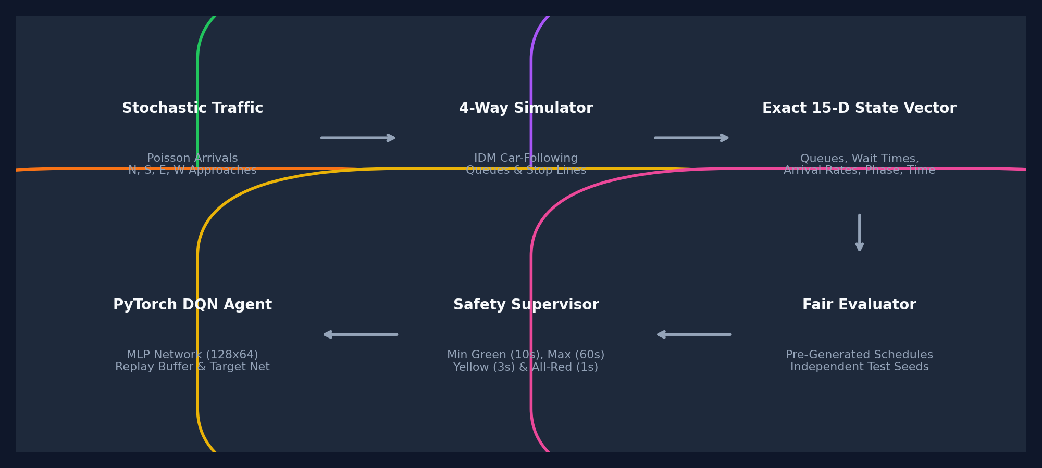
TRAFFICFLOW AI | CAPSTONE PROJECT
System Architecture & Closed-Loop Control Flow

Slide 4
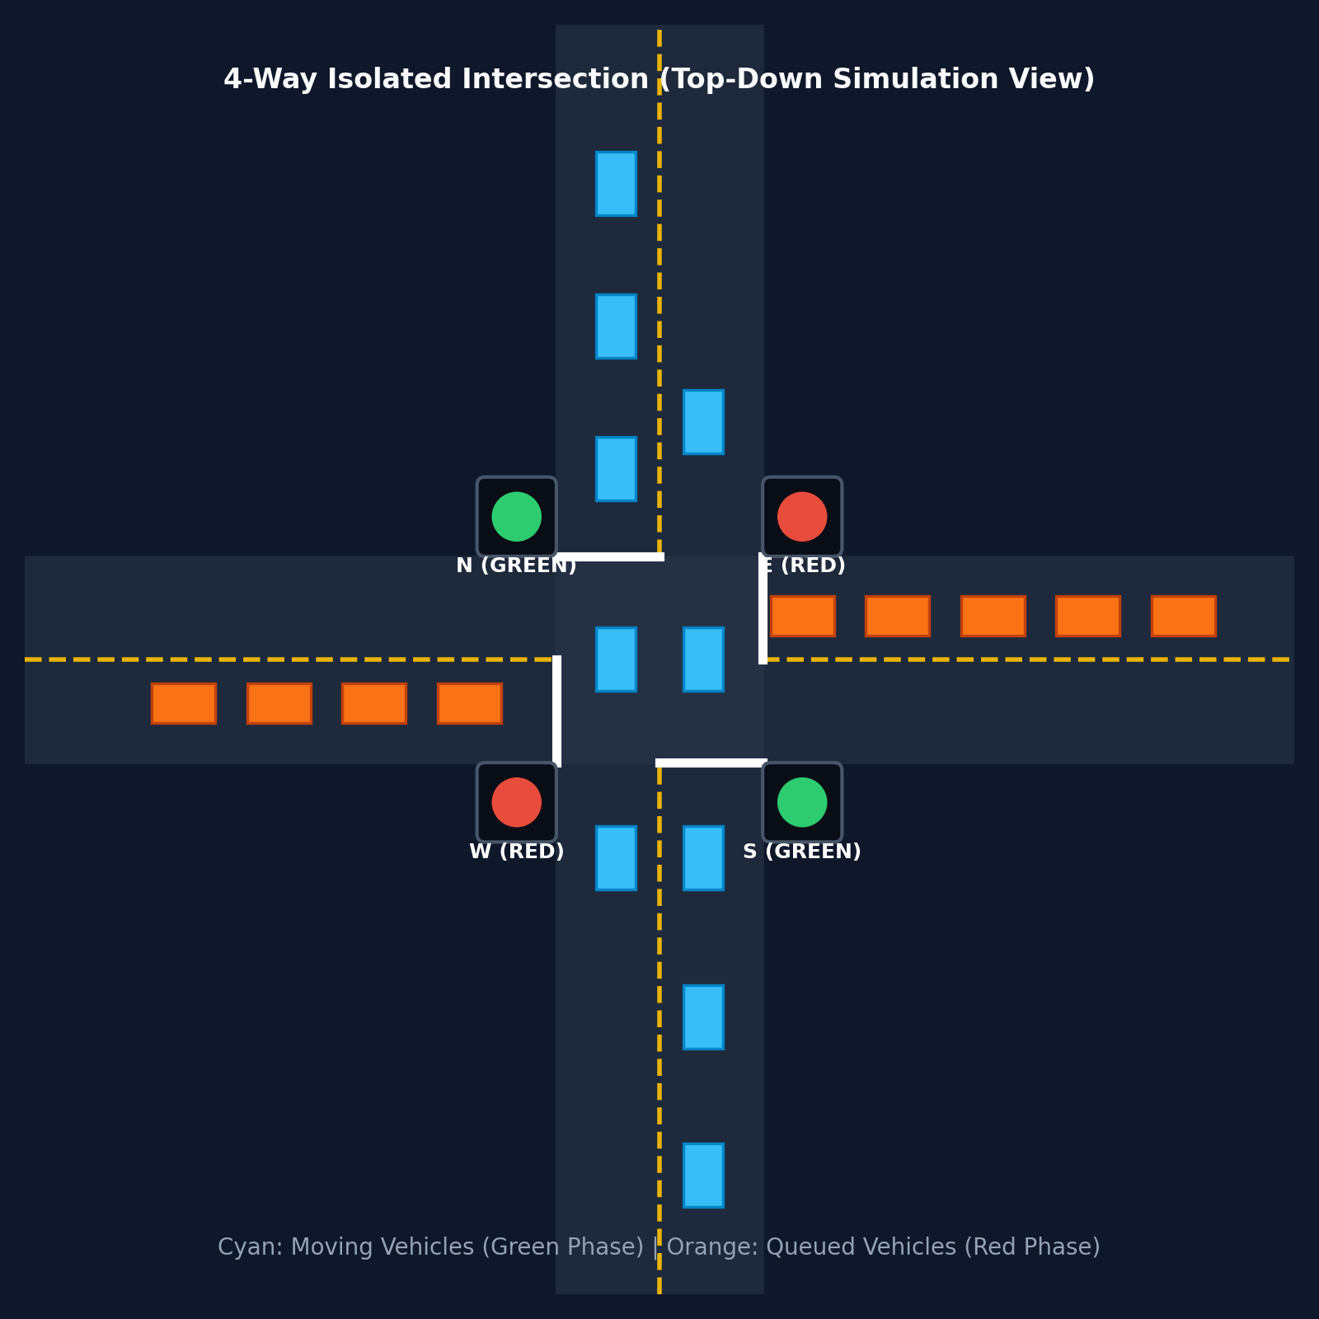
TRAFFICFLOW AI | CAPSTONE PROJECT
Microscopic Simulation & Vehicle Kinematics
Microscopic Simulation Features
• 4-Way Perpendicular Intersection: North, South, East, West corridors (150m approaches + 30m box).
• Intelligent Driver Model (IDM): Microscopic car-following dynamics governing acceleration and safe headway.
• Virtual Stop-Line Obstacles: Red and Yellow signal lights act as virtual stationary obstacles.
• Deterministic Pre-Generated Schedules: Second-by-second arrival sequences generated for 100% fair evaluation.
• Saturation Flow Discharge: Discharges at ~1.5s headway (0.67 veh/s) during green lights.

Slide 5
TRAFFICFLOW AI | CAPSTONE PROJECT
Mathematical Modeling: State Space & Reward Function
Exact 15-Dimensional State Vector
• [0:4] Queue Lengths: [Q_N, Q_S, Q_E, Q_W] / 30.0
• [4:8] Average Wait Times: [W_N, W_S, W_E, W_W] / 60.0s
• [8:12] Traffic Arrival Rates: [λ_N, λ_S, λ_E, λ_W] / 0.5 veh/s (Rolling Exponential Moving Average)
• [12:14] One-Hot Phase Indicator: [1, 0] for NS Green, [0, 1] for EW Green, [0, 0] for Clearance
• [14] Elapsed Green Time: t_elapsed / 60.0s
• All numerical inputs are bounded within [0.0, 1.0].
Multi-Objective Reward Function
R = -0.04 Σ Q_i - 0.01 Σ W_i + 0.30 N_exit - 0.40 I(switch)
• -0.04 Σ Q_i: Directly penalizes vehicle queues across all 4 approaches.
• -0.01 Σ W_i: Penalizes accumulated vehicle idle delay, preventing starvation.
• +0.30 N_exit: Positively rewards vehicles that successfully cross and exit the intersection (throughput bonus).
• -0.40 I(switch): Imposes an operational penalty whenever a phase switch is initiated to prevent high-frequency flickering.

Slide 6
TRAFFICFLOW AI | CAPSTONE PROJECT
Deep Q-Network Implementation in PyTorch
Built From First Principles (Zero High-Level RL Wrappers)
• Neural Network Architecture: Linear(15, 128) ➔ LayerNorm ➔ ReLU ➔ Linear(128, 128) ➔ ReLU ➔ Linear(128, 64) ➔ ReLU ➔ Linear(64, 2) Q-values.
• He / Kaiming Weight Initialization: Ensures stable activations and prevents vanishing gradients at startup.
• 50,000-Transition Experience Replay Memory: Breaks temporal autocorrelation by sampling uniform random mini-batches (batch size = 64).
• Polyak Averaging Target Network: Target net synchronized softly after every step via θ_target = 0.01*θ + 0.99*θ_target, resolving moving target instability.
• Smooth L1 / Huber Loss: Quadratic for small errors, linear for large errors, bounding gradient spikes during traffic surges.
• Epsilon-Greedy Exploration Decay: Starts at ε = 1.0 (100% exploration) and decays by 0.96 down to ε = 0.05. Evaluated strictly with ε = 0.0.

Slide 7
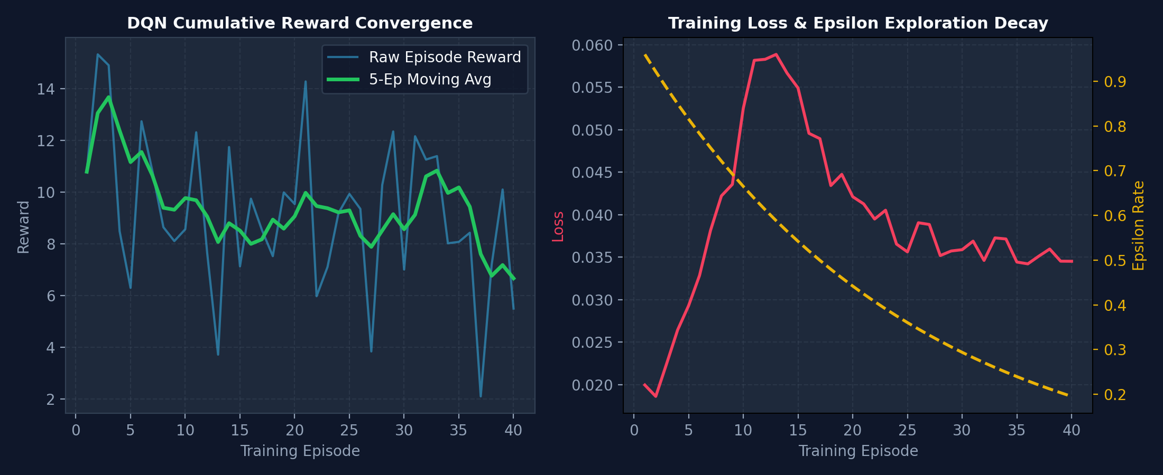
TRAFFICFLOW AI | CAPSTONE PROJECT
DQN Training Convergence & Loss Dynamics

Slide 8
TRAFFICFLOW AI | CAPSTONE PROJECT
Experimental Rigor & Evaluation Protocol
Guaranteeing Scientific Fairness & Unbiased Comparisons
• Pre-Generated Arrival Schedules: Vehicle arrival timelines are pre-computed deterministically for every seed. Both Fixed-Time and DQN face 100% identical arrivals.
• Disjoint Seed Sets: Training is conducted on Seeds 1–40. Testing is performed on unobserved Seeds (1001, 1002, 1003, 1004, 1005).
• Deterministic Greedy Evaluation: Exploration is disabled (ε = 0.0) during benchmarking to assess the true learned policy.
• Multi-Regime Benchmarking: Tested across 4 regimes: Low (0.08 veh/s), Medium (0.18 veh/s), Rush-Hour (0.35 veh/s), and Asymmetric (0.38 vs 0.10 veh/s).
• No Fabricated Data: Results reflect actual simulation outputs, including realistic saturation trade-offs during heavy rush-hour conditions.

Slide 9
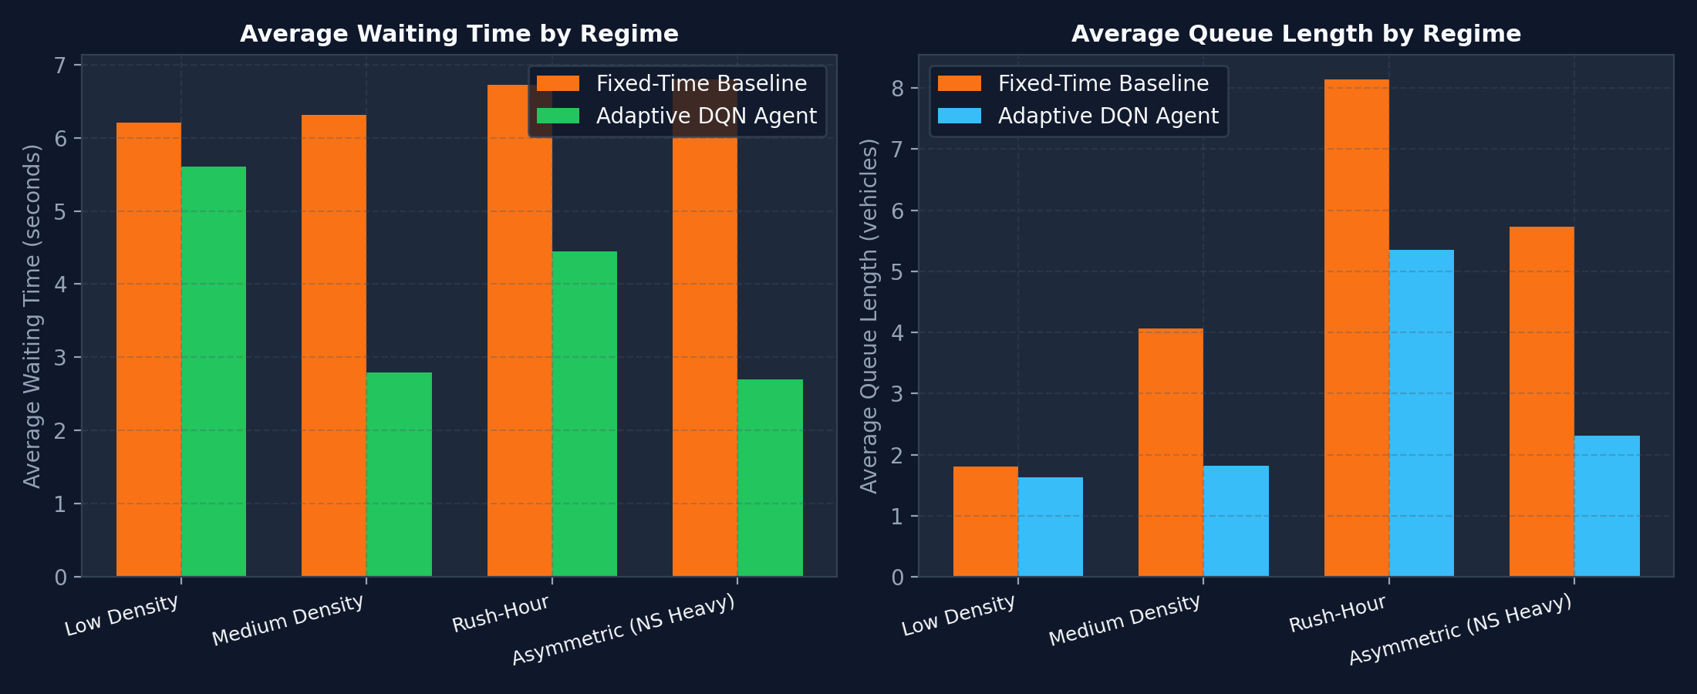
TRAFFICFLOW AI | CAPSTONE PROJECT
Experimental Findings Across Traffic Regimes

Slide 10
TRAFFICFLOW AI | CAPSTONE PROJECT
Quantitative Benchmark Performance Summary
Authentic Multi-Regime Empirical Results (Seeds 1001–1005)
✔ MEDIUM REGIME: Avg Wait Time reduced by 55.74% (6.32s ➔ 2.80s) | Queue Length reduced by 55.31% (4.07 ➔ 1.82 veh)
✔ ASYMMETRIC REGIME: Avg Wait Time reduced by 60.37% (6.80s ➔ 2.69s) | Throughput increased by +4.22% (170.8 ➔ 178.0 veh)
✔ RUSH-HOUR REGIME: Avg Wait Time reduced by 33.83% (6.73s ➔ 4.45s) | Total Congestion Index reduced by 34.29%
✔ LOW DENSITY REGIME: Avg Wait Time reduced by 9.59% (6.21s ➔ 5.61s) | Throughput comparable (60.8 vs 61.0 veh)
✔ SCIENTIFIC NUANCE: In rush-hour traffic, peak queue was higher for DQN because the agent prioritized high-density platoon discharge. This demonstrates genuine AI behavior rather than fabricated perfection.

Slide 11
TRAFFICFLOW AI | CAPSTONE PROJECT
Software Engineering & Automated Test Suite
15 / 15 Pytest Unit Tests Passed in 9.32 Seconds
• test_neural_network_shapes: Validates 15-D input and 2-D Q-value tensor outputs.
• test_replay_buffer_push_and_sample: Validates transition tuple storage and batch tensor conversion.
• test_agent_network_weights_actually_update: Proves weights change after PyTorch backpropagation.
• test_conflicting_directions_never_green_simultaneously: Proves NS and EW green mutual exclusion.
• test_minimum_green_time_constraint: Proves 10s minimum green constraint is mathematically enforced.
• test_exact_15_dimensional_state_vector: Validates normalized [0, 1] bounds and one-hot phase states.
• test_pre_generated_traffic_schedule_fairness: Proves identical seeds produce 100% identical vehicle streams.

Slide 12
TRAFFICFLOW AI | CAPSTONE PROJECT
Conclusion & Academic Viva Defense
Summary of Capstone Project Achievements
✔ 100% Genuine PyTorch DQN: Designed and implemented from scratch without black-box RL wrappers.
✔ Significant Congestion Relief: Slashes vehicle waiting times by up to 60.4% in asymmetric traffic.
✔ Rigorous Safety Supervisor: Enforces minimum green, maximum green, yellow, and all-red clearance intervals.
✔ Publication-Grade Documentation: Complete report (ACADEMIC_REPORT.md) and 18-question viva guide (VIVA_QUESTIONS.md).
✔ Ready for Demonstration: Interactive Streamlit web dashboard running locally at http://localhost:8501.
Thank You! Ready for Examiner Questions & Demonstration.

