Slide 1
WELCOME

Slide 2
Industrial Oriented Mini Project(CS704PC)
Mini Project:
Classification of garments using Fashion MNIST dataset
Name: K. Koushik
Roll No: 19261A05E2
Under the guidance of
Dr. K. Sreekala
Assistant Professor

Slide 3
Minor Project: Classification of garments using Fashion MNIST dataset ABSTRACT:
Online fashion market is constantly growing, and an algorithm capable of identifying garments can help companies in the clothing sales sector to understand the profile of potential buyers and focus on sales.
The main goal of this project is to provide future research with better comparisons between classification methods.
Different models are developed in this project to classify the clothes by using fashion MNIST dataset and calculate accuracies of each model and provide the best model to Fashion companies
Fashion-MNIST is a dataset made to help researchers finding models to classify this kind of product such as clothes
Base Paper : https://ieeexplore.ieee.org/document/9047776

Slide 4
INTRODUCTION
This project is aimed to classify the dataset into 10 different classes of various garments and also find the model which has best performance measures that can solve the classification issue of websites.
In order to achieve this, we are using fashion MNSIT dataset, where it consists of training set of 60,000 examples and test set of 10,000 examples. (Each example is a 28x28 grayscale image). Then, we used machine learning algorithms and compared them with each other.

Slide 5
Literature Survey
S.NO | Author and Year Published | ​Title | Technology/​ Algorithm Used​ | Advantages​ | Disadvantages​
1 | V.Q. Leithardt, L. Rodrigo, S. Correia 2021 | Cloth Classifying from Fashion MNIST dataset | SVM and Random Forest Classifier, Drop-out technique | This method enhance accuracy from 89.7% (using SVM) to 99.1% (using cnn) | Classification problem, due to the richness of the clothes properties and the high depth of clothes categorization
2 | M. Kayed, A. Anter, H. Mohamed 2020 | Classification of Garments Using CNN LeNet-5 Architecture | CNN based LeNet-5 Model | LeNet-5 outperforms both classical CNN and state of the art model | Challenges in training a Convolutional Neural Network is overfitting

Slide 6
3 | Greeshma K V, Sreekumar K 2019 | Fashion-MNIST Classification Based on HOG Feature Descriptor | SVM(Support Vector Machine) Classifier | Multiicalss SVM is the best method to train the images | Accuracy is not equal for each class of classification
4 | Shuning Shen 2018 | Image Classification Using Long Short-Term Memory Networks | LSTMs model, , Network Pruning and Training Pattern Reduction | Computational cost of this model is low | Performance of training pattern sets is worse when number of training patterns is reducing
5 | A. Krizhevsky, I. Sutskever, G.E. Hinton 2018 | ImageNet Classification with Deep Convolutional Neural Networks | Local Response Normalization, Training on Multiple GPUs | Non-saturating neurons of convolution operation are used. By this training is done faster | These models achieve error rate of more than 35%.

Slide 7
Design and Methodology
Steps for classification of garments
Loading the dataset
Standardizing the dataset
Training models using training dataset
Applying cross validation, to find out whether the model is overfitting or underfitting
Calculating performance measures and comparing the results of each model
Testing the dataset

Slide 8
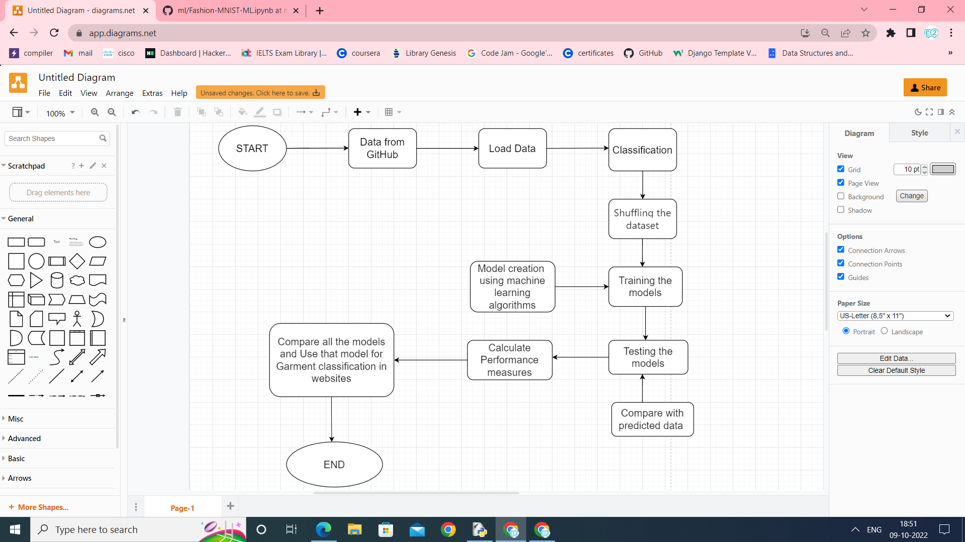
System Architecture Diagram

Slide 9
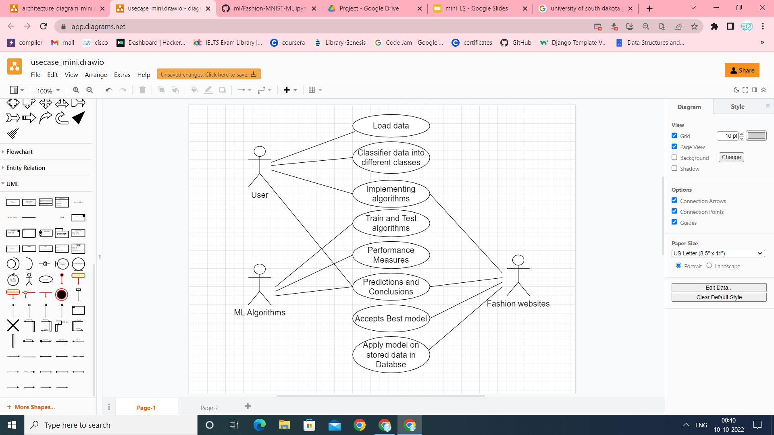
Use Case Diagram

Slide 10
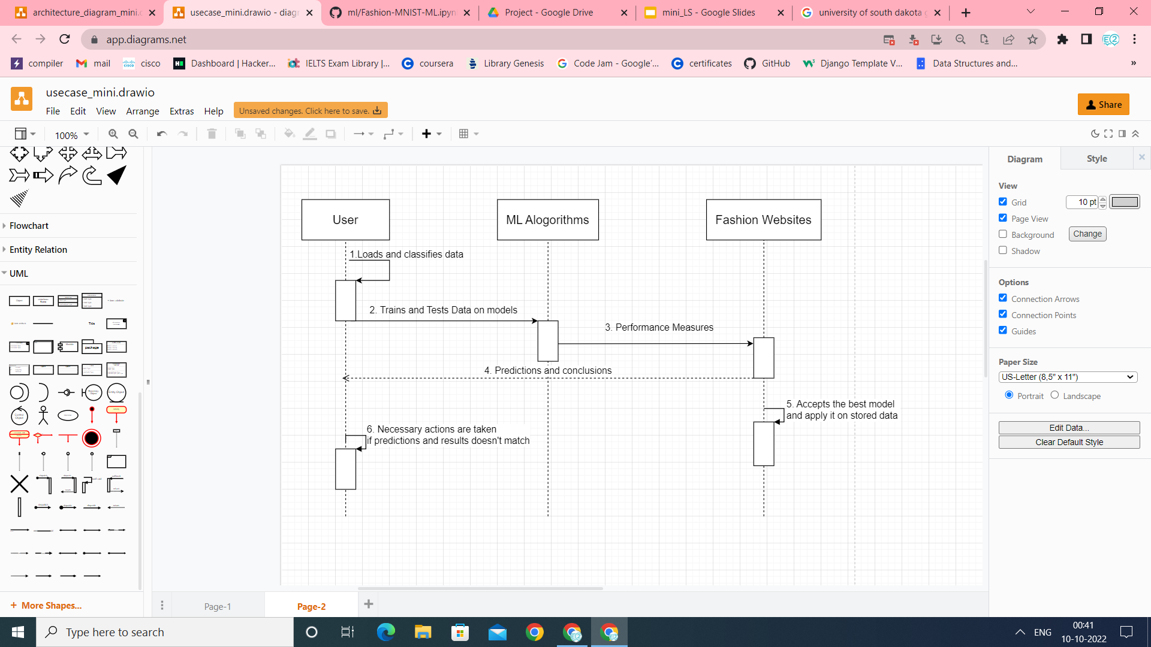
Sequence Diagram

Slide 11
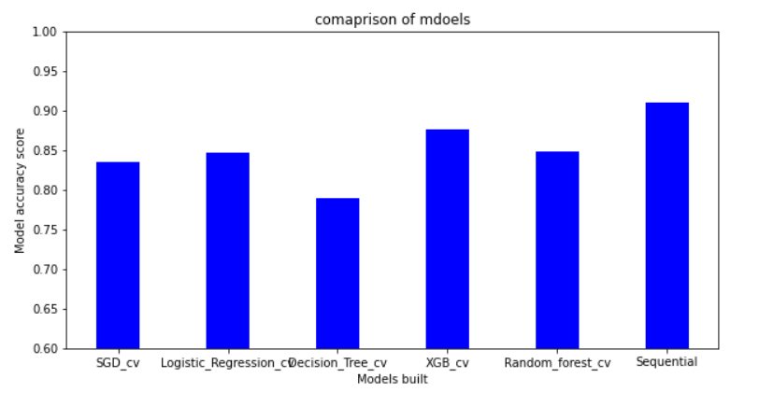
Testing and Results
Figure: Comparison of Machine learning algorithms after cross validation
As we can see from the graph that sequential model has highest accuracy, when compared to other models. So, sequential model is best

Slide 12

Improving accuracy of sequential model using epoch operation
Figure: Accuracy vs epoch
As number of epoch operations increased, the accuracy also increased

Slide 13
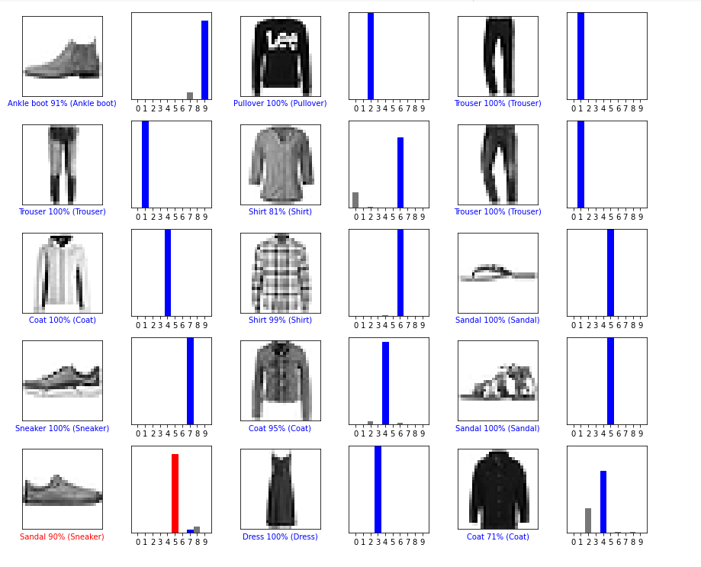
Results of Sequential model after testing the dataset
Blue color indicates the predicted output is right
Red color indicates the predicted output is wrong
There is a chance of wrong prediction if different pictures seem to be similar
From this, we can say that most of the class labels have right outcome and classification works accurately

Slide 14
CONCLUSION
This proposed system i.e., sequential model can solve the classification problem, where many companies are facing this issue.
The final accuracy of sequential model is 91 percent and it is best when compared to other.
This algorithm is easy and fast to implement and can perform epoch operation to improve accuracy of the model

Slide 15
THANK YOU

