Slide 1
TEAM MEMBERS: NARESH VEMULA (A04332886) KOUSHIK REDDY KAMBHAM (A04316083) SAI AVINASH VAGICHERLA (A04312707) JASWANTH SIRIGIRI (A04332429)
Uni-Link
Advanced Operating Systems Project Presentation

Slide 2
Addressed comments
We are implementing replication only in Cassandra, not in Reddis. We are using the Reddis cache to reduce the load on the database and reduce the search time. When we access the database we need to search the whole database but in cache, it only contains recently used data.

Slide 3
System Functions
Various services will be implemented for the users, based on the features required
User Service: The user can create an account, log in, and log out of the account. This follows authentication management
Connection service: A user can connect, view, or remove connections with other users
Interaction service: The user can interact with other users' events and posts, expressing interest in them.
Timeline service: By this, the user can perform CRUD(create, view, update, delete) operations on their tasks/events and can also view updated posts/events of other users on the homepage.
Search service: Users can use this feature to browse other users and to increase connections

Slide 4
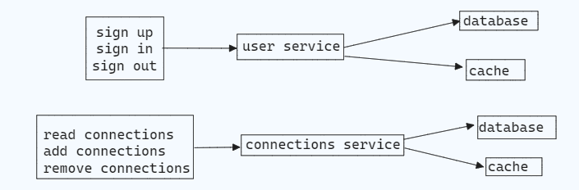
DESIGN AND ARCHITECTURE
Authentication Management and Connection service

Slide 5
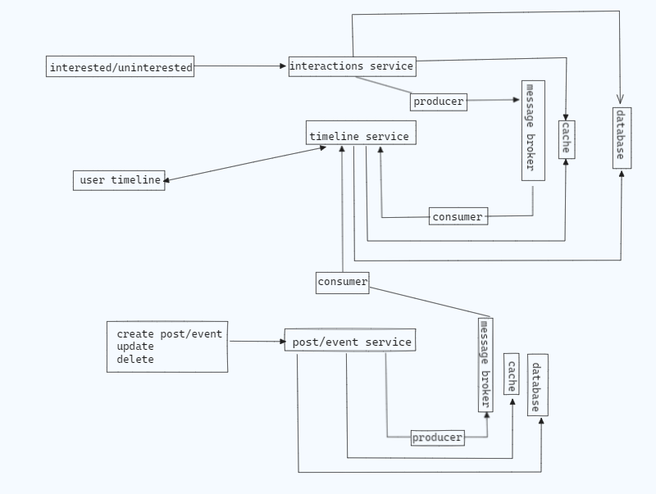
Timeline And Interaction Service

Slide 6
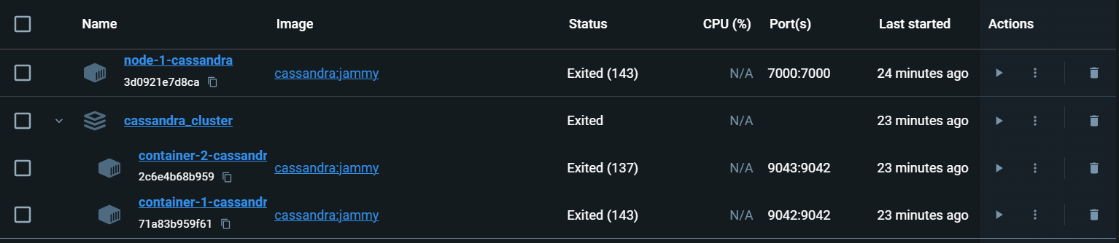
SYSTEM IMPLEMENTATION
FEATURES OF DISTRIBUTED SYSTEM
Fault Tolerance: Our fault tolerance strategy involves deploying 2 nodes in the database. In the event of one node failing, the other node seamlessly continues operations. Consequently, even if one node experiences issues, the UI remains functional, enabling users to perform various operations without disruption.
Cassandra cluster represents a network and Each Cassandra node represents an instance container that runs the Cassandra server

Slide 7
SYSTEM IMPLEMENTATION
FEATURES OF DISTRIBUTED SYSTEM
Consistency: Utilizing Kafka as a message broker, we achieved data consistency across user activities. For instance, actions such as following/unfollowing users or adding/editing/deleting posts are instantly propagated to other users. This ensures that all users have real-time visibility into user activities.
Communications and Networking: Maintaining effective communication and networking among distributed system nodes is crucial. By ensuring seamless interaction between nodes, we facilitate efficient data exchange and system functionality.

Slide 8
SYSTEM IMPLEMENTATION
FEATURES OF DISTRIBUTED SYSTEM
Security: During registration, password is hashed before adding to database. Backend will create an access token. access token is an encrypted string that stores ID of user in general such as email which can be later used to identify the user on further authenticated requests
Replication: In the distributed system, we implemented 2 containers in a Cassandra database. This setup ensures that data remains consistent across both nodes. Consequently, any CRUD operations performed via the frontend/UI result in synchronized changes reflected in both nodes of the database.

Slide 9
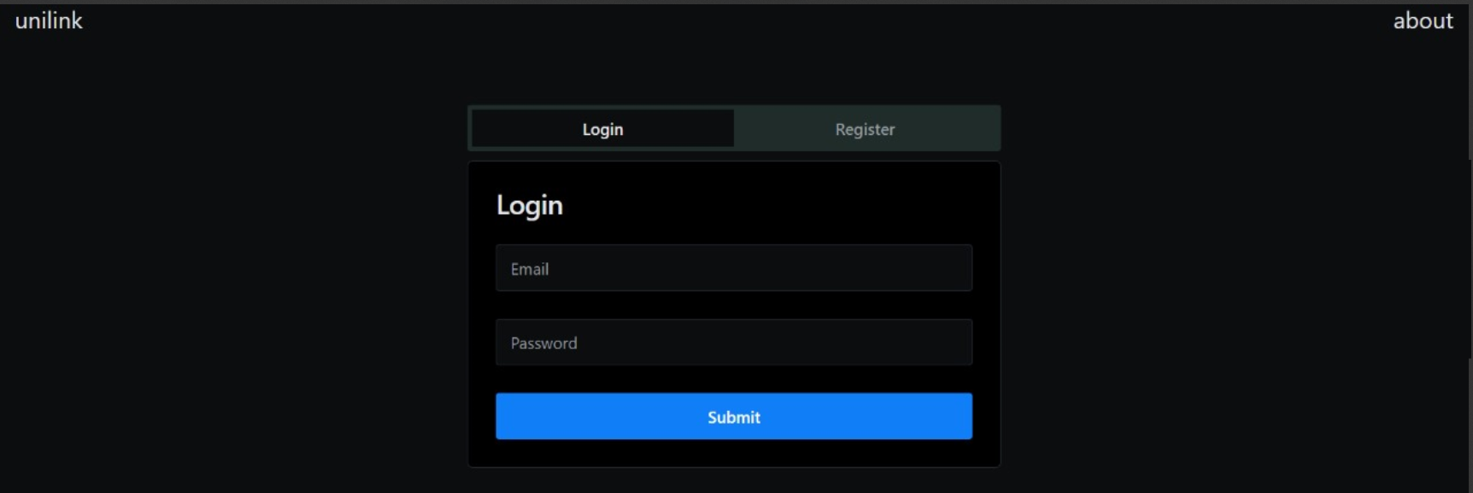
LOGIN/ REGISTER PAGE

Slide 10
SYSTEM IMPLEMENTATION
SIMPLIFIED FEATURES
User Interface (UI) Enhancement:
A more user-friendly and streamlined UI design.
A user-friendly interface and intuitive navigation make interaction simple.
Docker containers for Compatibility:
Docker containers are used to ensure simple deployment, scalability, and administration of the system components.
They are leveraged for smooth compatibility across diverse environments.
Cloud Integration for Scalability:
Taking into account cloud services like Upstash for Redis and Cassandra use.
May or may not Enables cloud-based installations with smooth scaling and effective resource management.

Slide 11
SELECTED DEVELOPMENT FRAMEWORK AND DISTRIBUTED TECHNOLOGIES
Fast API for backend server (Python):
Selected because of its asynchronous capabilities and great performance.
Facilitates the quick construction of backend functions.
Frontend Framework: Next.js:
Smooth rendering improves user experiences.
Redis & Cassandra databases:
Scalability and fault tolerance are guaranteed by Cassandra.
Redis uses caching to increase system speed.
Kafka (Message Broker):
Enables dependable event streaming and message queuing.
Facilitates easy communication between the various parts of the system.

Slide 12
WORK DISTRIBUTION
Member 1(Naresh-25%) : Handles the UI – Front end using Next JS as it is user-friendly
Member 2(Koushik-25%) : Cassandra Database is implemented as models and tables for the distributed features (Replication and Fault Tolerance)
Member 3(Jaswanth-25%) : Redis cache is implemented Lightning-Fast Data Access and implemented JWT (security)
Member 4(Avinash-25%) : Fast API is used for the concurrency and high performance for the back end

Slide 13
References
https://dev.to/lazypro/message-queue-in-redis-38dm
https://medium.com/building-the-open-data-stack/build-an-event-driven-architecture-with-apache-kafka-apache-spark-and-apache-cassandra-6f0fc0c87e42
https://github.com/pyropy/fastapi-socketio
https://docs.github.com/en/apps/creating-github-apps/authenticating-with-a-github-app/generating-a-json-web-token-jwt-for-a-github-app

Slide 14
Q & A

Slide 15
Thank You

