Slide 1
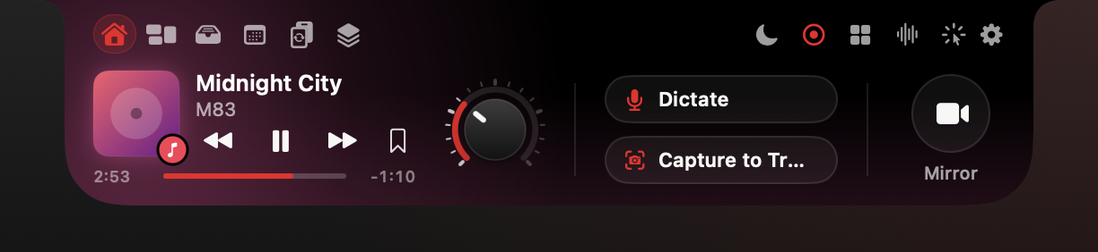
SparkV Team
Your team's notch, now an AI command center.
SparkV Team: a 30-day pilot for up to 5 seats
Dictation, meetings, search and screen help, on device · Private by default. Deploys with your MDM. · sparkv.si
Notes:
SparkV lives in the MacBook notch. Hover it and a drawer opens with media, a file tray, your day and a hub of more than 20 agents. Today we are asking for one thing: a 30-day pilot with up to five people on your team. We measure the time it saves against a baseline you set, and you decide on day 30.

Slide 2
The problem
Where the work week goes
Talking about work and looking for things crowd out the work itself
57%
19%
68%
3x
of Microsoft 365 users' time goes to communicating; 43% to creating
of interaction workers' time goes to searching for and gathering information
say they lack enough uninterrupted focus time
faster text entry by speech than a phone keyboard (English)
Microsoft Work Trend Index 2023
McKinsey Global Institute, 2012
Microsoft Work Trend Index 2023
Stanford, Baidu, UW study, 2016
Your numbers: [TBD: your team's own baseline, measured in pilot week 1]
3x compares speech with a phone keyboard, not a desktop keyboard. McKinsey figure is from 2012.
02
Notes:
Four public numbers frame the problem. Caveats to say out loud: the 3x figure compares speech with a phone keyboard, not a desktop keyboard, so the ROI model on slide 9 uses a much smaller gain. The McKinsey figure is from 2012. The pilot replaces all of these with your own baseline.

Slide 3
Market
Macs keep gaining ground
SparkV runs on Apple silicon Macs with macOS 15+, best on MacBooks with a notch
Global Mac shipments (millions of units)
25.6M
9.0%
Macs shipped worldwide in 2025 (+11.1%)
of global PC shipments, up from 8.7%
IDC preliminary, Jan 2026
IDC preliminary, Jan 2026
[TBD]
[TBD]
[TBD: Macs in your organization]
[TBD: of those, MacBooks with a notch on macOS 15+]
Source: IDC preliminary, Jan 2026 (9to5Mac, MacTech). 2024 bar derived: 25.6 / 1.111 (IDC growth rate). Omdia estimate for 2025: 27.7M (+16.4%). Total PC market 2025: 284.7M (+8.1%).
Context for fleet size, not a SparkV revenue claim.
03
Notes:
Context, not a pitch for our revenue: the Mac fleet keeps growing faster than the PC market. Omdia puts 2025 even higher, at 27.7M units. The 2024 bar is derived from IDC's growth rate (25.6 / 1.111). Ask the buyer for their own fleet numbers to fill the two TBD tiles; that also sizes the pilot.

Slide 4
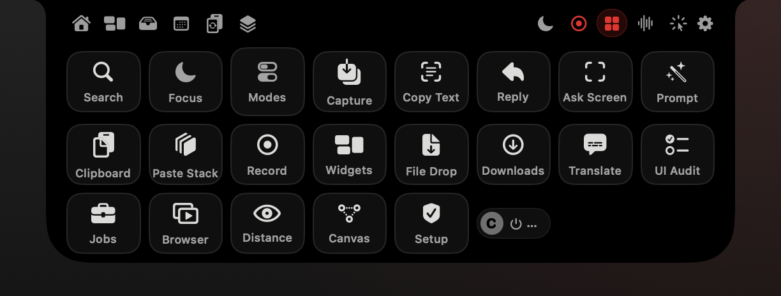
Agents hub
One notch. 20+ agents.
Hover the notch and the drawer opens. Move away and it closes.
Write: dictation, reply drafts, prompt refiner
Meet: recording, notes, live answers, translation
Find: Spaces and Universal Search (⌥Space)
See: ask about any screen, copy text from any pixel
Ship: UI Audit, Browser Flows, Flow Canvas
Real render of the current build, sample data.
04
Notes:
This is the Agents hub: 22 tiles in an 8 by 3 grid, every one wired in the current build. A tile opens its page, runs at once, or shows a menu. Hover a tile to see its shortcut. Everything in this deck is reachable from here or from a hotkey.

Slide 5

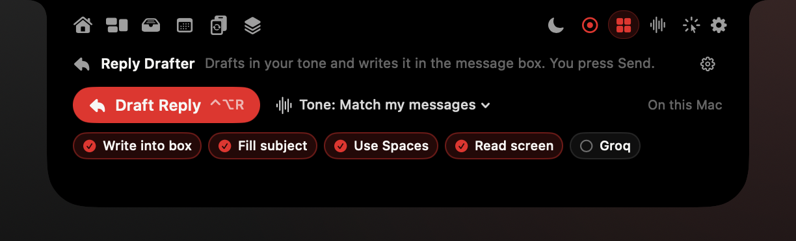
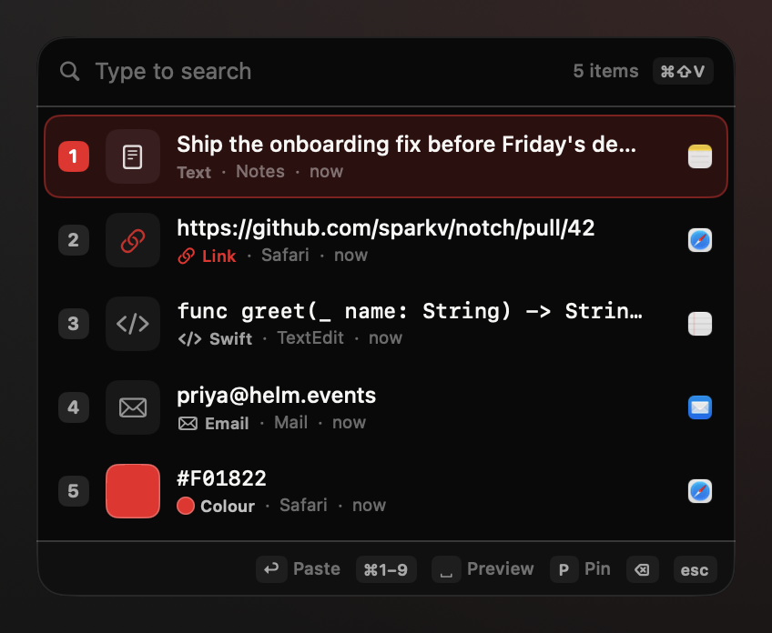
Write
Write at the speed of speech
Hold fn, talk, release. Clean text lands where the cursor is.
Dictate into any text field: filler words removed, lists formatted
⌃⌥R drafts a reply in your tone; you review and press Send
⌘⇧V opens the clipboard stack at the cursor
Clipboard history stays off until the user turns it on
Real render of the current build, sample data. Dictation and Reply Drafter need a live check.
05
Notes:
Dictation types into any app. Reply Drafter reads the thread and writes into the message box; it never sends. Clipboard history is off by default and skips passwords and private copies. Status: dictation and Reply Drafter are marked 'needs a live check' in the feature guide because they need the microphone, the fn key and other apps; the pilot is that check.

Slide 6
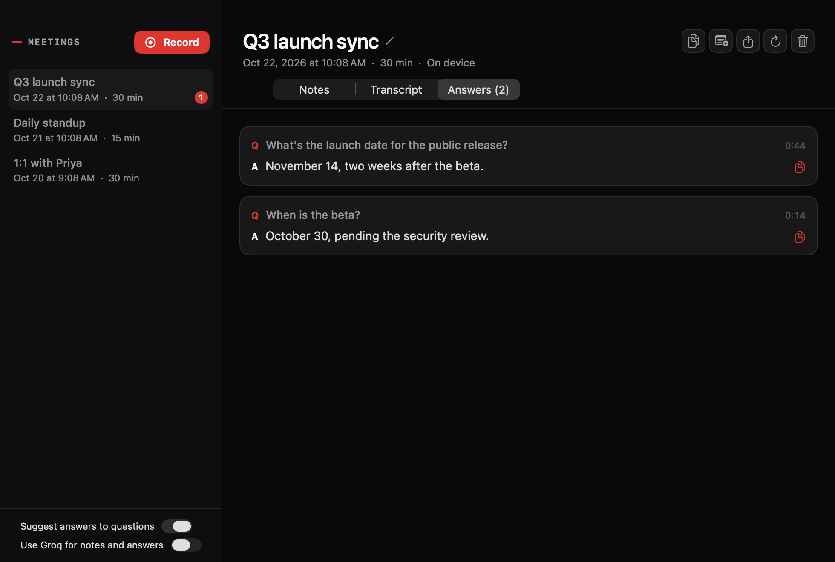
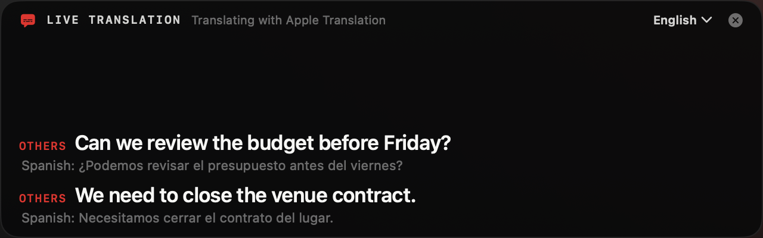
Meetings
Meeting notes, no bot in the call
One click records the mic and the call audio. Transcription runs on the Mac.
Minutes, decisions and your tasks with due days
Suggested answers when someone asks you a question
Live captions translate other speakers, on device
Filed to the right client Space automatically
Real render of the current build, sample data. Audio capture needs a live check.
06
Notes:
No bot joins the call, so there is nothing for the other side to admit. Your policy on telling participants about recording still applies: [TBD: customer's call-recording notice policy]. Live Translation uses Apple Translation on device after a one-time language download. Status: needs a live check (audio capture); notes and answers render from saved meetings.

Slide 7
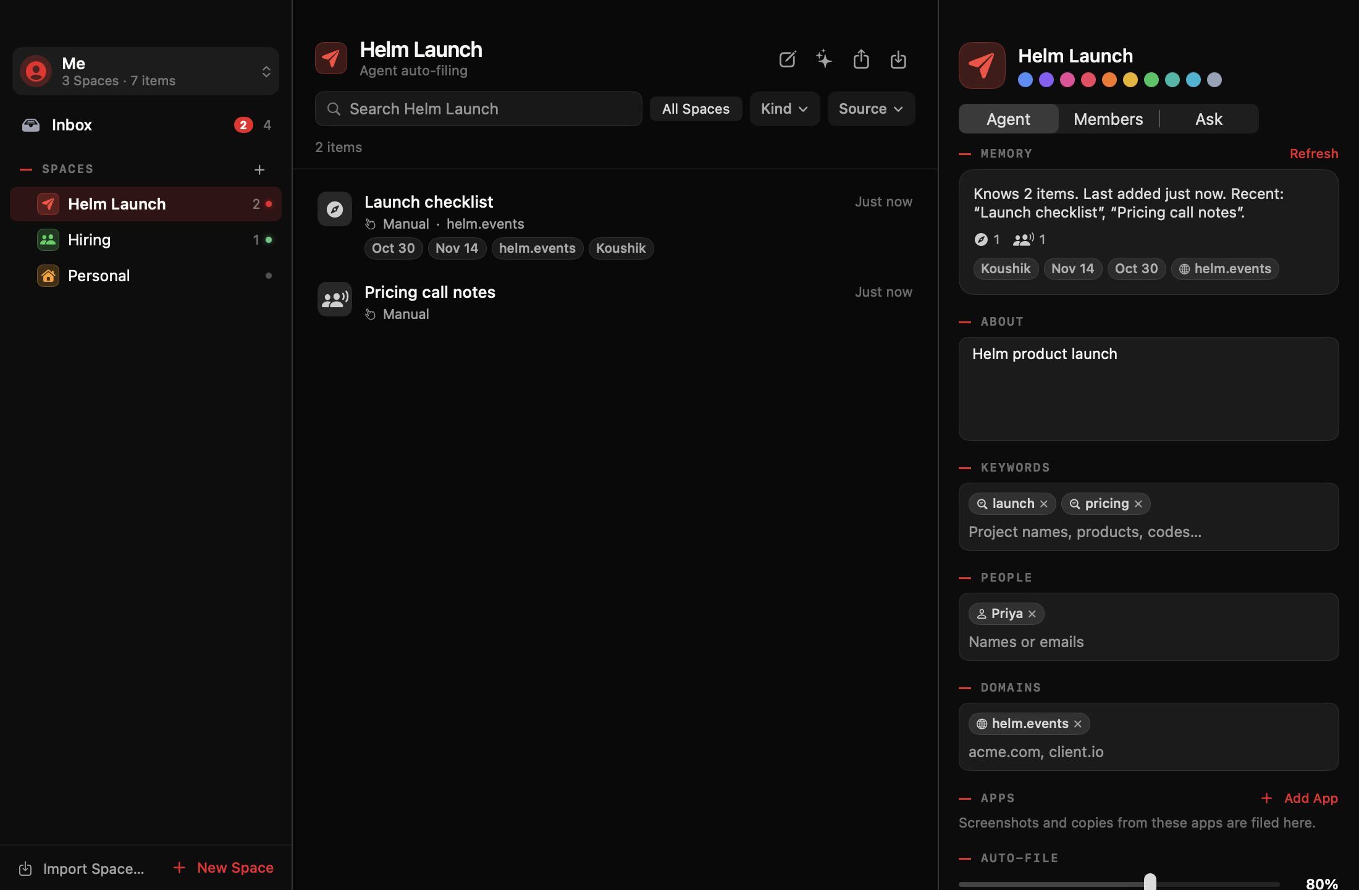
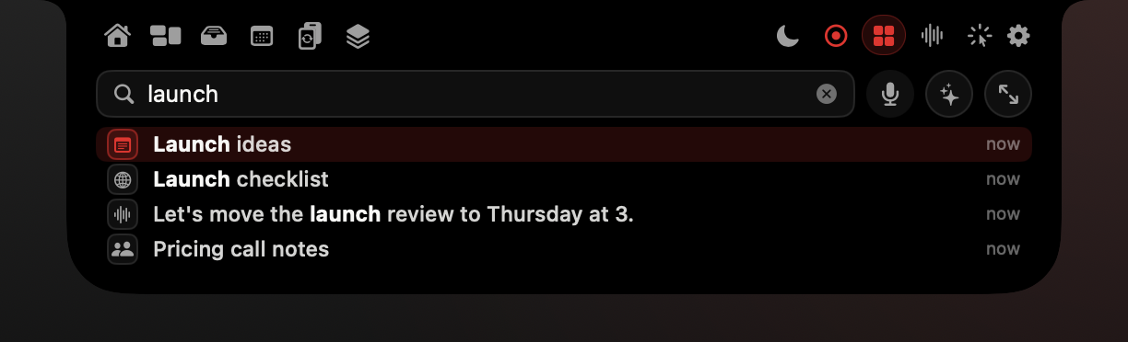

Find
Every client in its own Space
Find anything you saw, heard or copied. Ask about anything on screen.
Spaces file meetings, notes, mail, pages and screenshots per client
⌥Space searches Spaces, meetings, dictations, clipboard and Tray
Ask mode answers from your own items, with citations
Hold ⌃⌥ and ask about any app; SparkV points at the spot
Real render of the current build, sample data. The screen assistant needs a live check.
07
Notes:
Built for agencies with several clients. Be exact about sharing: a Space can be exported and shared as a .sparkvspace file package; there is no live sync between teammates today. The screen assistant points and explains; it does not click or type. Without a Groq key it reads screen text on device. Status: Spaces and Universal Search verified headless (21 results for 'launch' on sample data); the screen assistant needs a live check.

Slide 8
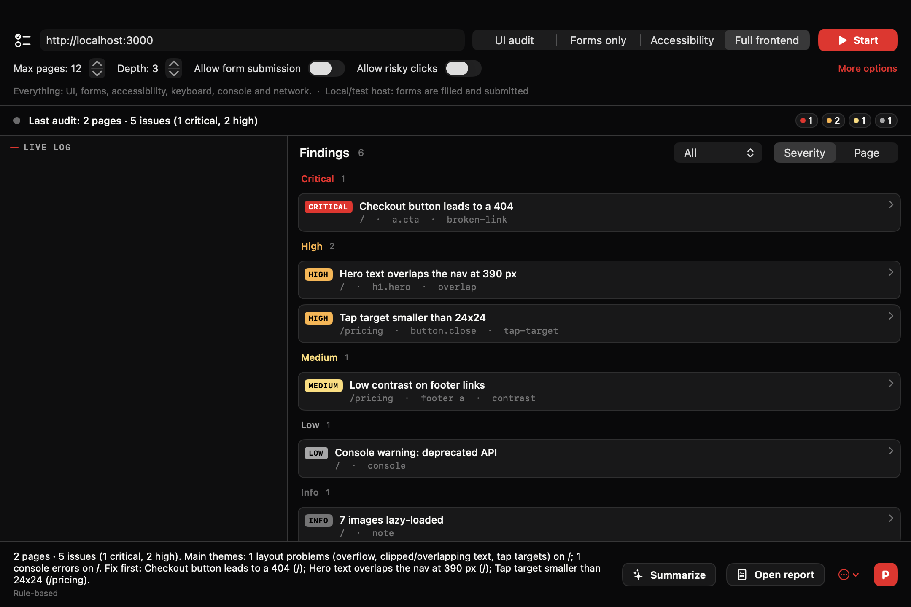
UI Audit
QA client sites before they ship
UI Audit walks your site like a tester, then writes the fix prompt
Crawls pages, fills forms on test hosts, checks 1440 px and 390 px
Accessibility (axe-core), Tab order, console errors, failed requests
Findings by severity, with screenshot and steps to reproduce
P copies a fix prompt for Claude Code, Cursor or Copilot
Verified end to end on the bundled test site on 127.0.0.1. Use only on sites you own or may test.
08
Notes:
This is the one feature verified end to end: SparkV's own controller audited the bundled planted-issue test site on 127.0.0.1 (6 pages, 69 findings: 3 critical, 15 high), Apple Intelligence wrote the summary on device, and P produced a 51,666-character fix prompt covering 60 issues. The runner self-test passed 48/48. It submits forms only on local or test hosts unless allowed and never clicks Delete or Log out unless allowed. Needs Node 20+ and Playwright's Chromium. Use only on sites you own or may test.

Slide 9
UI Audit · proof
UI Audit, verified end to end
Verified run on our test site: 6 pages, 69 findings, 3 critical, 15 high
6
69
3
15
pages crawled on the planted-issue test site
findings
critical findings
high findings
Runner self-test: 48/48 passed. P produced a 51,666-character fix prompt covering 60 issues.
SparkV's own controller on 127.0.0.1; Apple Intelligence wrote the summary on device. Needs Node 20+ and Playwright's Chromium.
09
Notes:
This is the one feature verified end to end: SparkV's own controller audited the bundled planted-issue test site on 127.0.0.1 (6 pages, 69 findings: 3 critical, 15 high), Apple Intelligence wrote the summary on device, and P produced a 51,666-character fix prompt covering 60 issues. The runner self-test passed 48/48. It submits forms only on local or test hosts unless allowed and never clicks Delete or Log out unless allowed. Needs Node 20+ and Playwright's Chromium. Use only on sites you own or may test.

Slide 10
ROI model
About 2.5 hours back per person, per week
A model to test in the pilot, not a measured result
Modeled minutes saved per person per week
Model: assumptions, not measured
150 min
modeled time saved per person per week
Model (assumptions in backup A1)
$96
Team list price per seat per year
SparkV pricing
~3 min
saved per week pays for a seat at $40/hour
Source: Model (backup A1). Dictation speed-up is half of Stanford 2016's 3x phone-keyboard result. Break-even: minutes per week = 96 / (46 working weeks x hourly rate) x 60; at $40/h, 3.1 min.
Example rate, [TBD: your loaded rate]
Assumptions are conservative and replaced by measured values in the pilot.
10
Notes:
Walk through the assumptions table, not the total. Dictation uses a 1.5x speed-up, half of the published 3x, because that study used a phone keyboard. Break-even formula: minutes per week = 96 / (46 working weeks x hourly rate) x 60. At $40 an hour that is about 3.1 minutes a week. The hourly rate is the buyer's number; $40 is only an example.

Slide 11
Privacy and security
Private by default
AI runs on the Mac. Nothing leaves unless someone turns it on.
Stays on the Mac
Leaves only by choice
Speech, meeting audio and transcripts
Groq: opt-in per feature, with your own key
Screenshots, clipboard, Spaces, camera
Sends the screenshot under the pointer and the question, only while asking
AI: Apple Intelligence, Vision, Speech, Translation
License check: key, anonymous device ID, app version to Lemon Squeezy
Keys stored in the macOS Keychain
Nothing else. No analytics.
Clipboard history off by default; passwords skipped
No meeting bot
Recorded browser passwords never saved
Face Unlock not in the sold build
Gap to disclose: [TBD: managed preference to disable Groq] org-wide.
11
Notes:
This slide is the security reviewer's summary. Default: on-device Apple Intelligence; AI cost to us is $0, so there is no reason to route data to a server. Groq is optional, per feature, and uses the customer's own key; nothing uses it unless turned on. Licensing talks to Lemon Squeezy, the merchant of record. Face Unlock is excluded from the sold build because its face model is licensed for non-commercial use only. Gap to disclose: there is no admin-enforced switch to block Groq org-wide yet [TBD: managed preference to disable Groq].

Slide 12
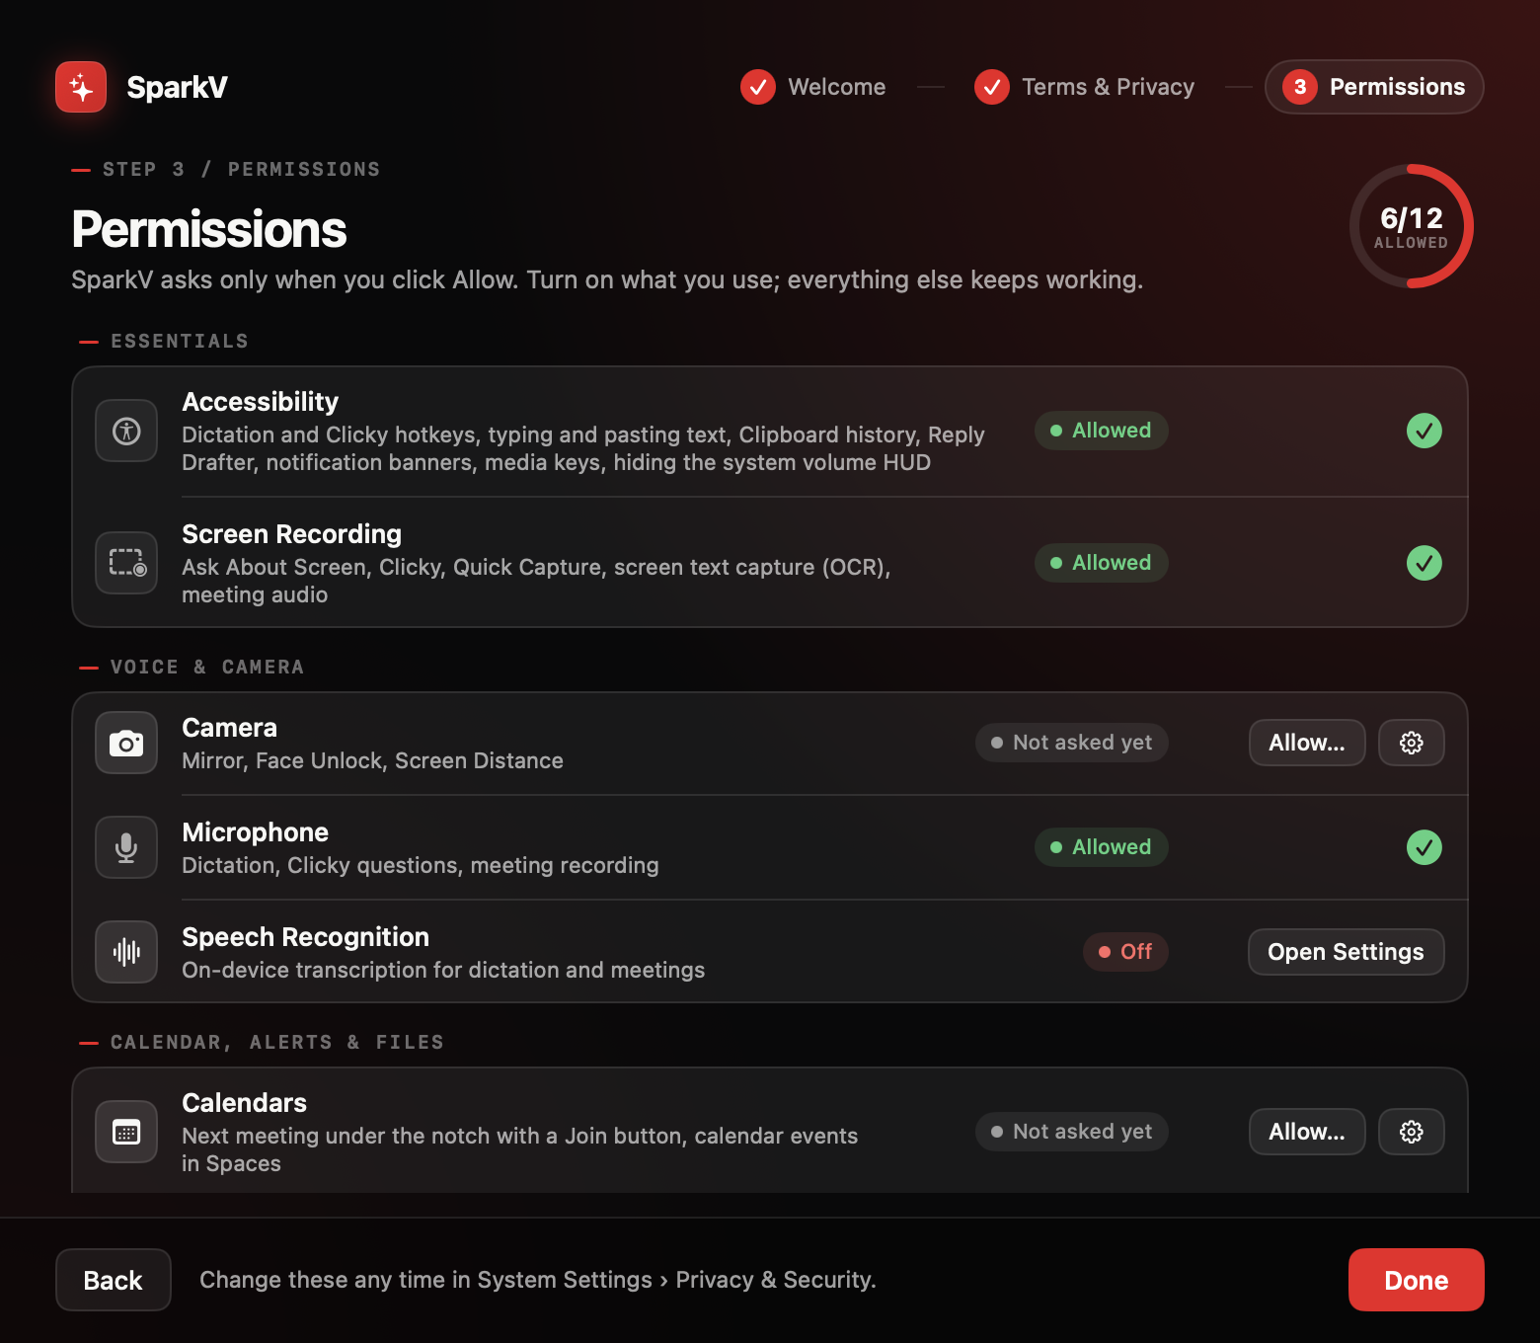
Deployment
Deploy in a day
Signed, notarized and packaged for your MDM
01
Package
Developer ID signed, notarized .pkg (com.sparkv.app)
02
Push
Install with any MDM that deploys .pkg [TBD: MDMs tested]
03
Pre-approve
PPPC profile allows Accessibility; Screen Recording, camera and mic stay user-approved
04
First launch
Setup explains each permission; nothing is asked until Allow
05
Activate
Seat key from the Team portal; 2 Macs per person
Status: signing, notarization, licensing and the .pkg are on the 1.0 checklist. The pilot runs on the notarized 1.0 build. [TBD: 1.0 date]
Requires Apple silicon and macOS 15+. Node 20+ only for UI Audit and Browser Flows.
Check PPPC behaviour against Apple's Privacy Preferences Policy Control payload docs for your macOS version.
12
Notes:
Be candid: today's build is signed with a local identity. Developer ID signing, notarization, licensing and the MDM package are tasks in the 30-day launch plan, and the pilot starts on that build. On permissions: an MDM privacy profile (PPPC) can pre-approve Accessibility; Screen Recording can at most be made approvable by standard users; camera and microphone always need the user's own approval. Verify against Apple's PPPC payload documentation for the customer's macOS version. With one stable Developer ID, grants survive updates.

Slide 13
Admin and support
Seats, admin and support
One invoice, simple seats, and a person who answers
01
02
03
04
Seats
Admin
Resilience
Support
1 seat = 1 person on 2 Macs. Minimum 3 seats. Move a Mac by deactivating it in the gear menu.
Assign and revoke seats in the Lemon Squeezy customer portal. One invoice, PO or bank transfer.
Checks the license every 7 days, 14 days offline grace. Never locks: falls back to Free and keeps data.
Priority email, 1 business day. Signed automatic updates. 30-day refund.
Not available today: SSO, SCIM, a central policy console, live Spaces sync.
13
Notes:
Disclose what does not exist: no SSO or SCIM, no central policy console beyond the seat portal, and shared Spaces are file packages without live sync. Seat management may run on Keygen instead of Lemon Squeezy if needed. Updates ship through Sparkle with EdDSA-signed feeds. Support contact: [TBD: support email].

Slide 14
Consolidation
One seat instead of five subscriptions
Overlapping tools, per seat, year one, list prices
TOOL
COVERS
LIST PRICE
Wispr Flow Teams
Dictation
from $10/user/mo
Year-one cost per seat (USD, list)
Granola Business
Meeting notes
$14/user/mo
Raycast Pro
Launcher with AI
$8/mo billed yearly
Paste
Clipboard
$29.99/yr
CleanShot X
Screenshots, recording
$29 one-time
NotchNook
Notch hub
$25 one-time
Alcove
Notch
about $13.99 one-time
SparkV Team
All of the above areas
$8/seat/mo billed yearly
Source: Stack = Wispr Flow Teams $120 + Granola Business $168 + Raycast Pro $96 + Paste $29.99 + CleanShot X $29. Monthly prices x 12. NotchNook and Alcove left out (one-time). Business plan §3.
Prices from third-party listings, Oct 2026; verify on vendor pages before external use.
Overlap in areas covered, not feature parity.
Third-party list prices, Oct 2026. Legal review required before external use.
14
Notes:
The point is consolidation: one vendor review, one invoice, one privacy story. Do not claim parity: Granola, Wispr and Raycast are deep products in their own lanes. Monthly prices are annualized x12 for year one. NotchNook and Alcove are left out of the stack bar because SparkV replaces them outright and they are one-time.

Slide 15
Pricing
Simple per-seat pricing
Start with a pilot. Keep the seats that earn their place.
Free
Pro
Team
Recommended
Annual Team cost by seat count (USD, list)
$0
$39 one-time
$8 per seat / month
Trying the notch
₹1,499 · launch $29
₹499 · billed yearly ($96)
Individual professionals
Teams of 3 or more
Notch core, clocks and gauges, clipboard (25), Copy Text, dictation without AI formatting
Everything: AI assistants, meetings, Spaces, developer tools
Everything in Pro, plus one invoice, seat portal, shared Spaces packages, priority support, MDM .pkg
1 Mac
2 Macs per person
Always free
14-day full trial, no card
2 Macs per seat
30-day pilot, up to 5 seats
Source: List-price arithmetic ($96 or ₹5,988 per seat per year); not a forecast.
List prices. [TBD: volume tiers above 50 seats]
Source: SparkV Business Plan §6a. Pro: 12 months of updates, optional renewal $19/yr.
15
Notes:
Team is the recommended column for this audience. Pro includes 12 months of updates and optional renewal at $19 a year; the app keeps working. Students get 50% off Pro. The chart is plain list-price arithmetic for common team sizes, not a forecast and not a discount offer.

Slide 16
The pilot
The 30-day pilot
Up to 5 seats. Your success criteria. A clear yes or no.
Day 0
Days 1-3
Days 1-7
Days 8-25
Days 26-30
Kickoff: pick 5 users, agree success criteria, share the security pack
Deploy the .pkg and PPPC profile; 15-minute permissions walkthrough
Baseline: users log time on writing, meeting notes and searching
Daily use; weekly 15-minute check-in; support within 1 business day
Readout: measured vs. modeled time saved; decide on Team seats
Success criteria [TBD with customer]: hours saved per user per week, zero open security findings, users who want to keep it
After day 30: seats convert to Team (minimum 3) or are removed; the app falls back to Free
Measurement method agreed on day 0: [TBD: time-log method, e.g. a short daily form].
16
Notes:
The pilot is designed to produce a yes or a no, not a slow fade. Agree the measurement method on day 0 [TBD: time-log method, e.g. a short daily form]. If the measured savings come in under the model, say so in the readout.

Slide 17
Start your 30-day pilot
Five seats. Thirty days. Your numbers.
01
02
03
Name up to 5 pilot users and a start date
We send the security pack and the signed .pkg
Day 30: readout and a decision
[TBD: sales contact email] · sparkv.si
Notes:
Close on the single ask. Leave the slide up during questions. Do not promise SSO, live Spaces sync or org-wide Groq controls; they do not exist today.

Slide 18
Appendix
ROI model assumptions
Backup for slide 10. Assumptions, not measurements.
WORKFLOW
ASSUMPTION
MINUTES PER WEEK
Dictation
120 min/week of typed prose; speech 1.5x faster (half the 3x phone-keyboard result)
40
Meeting write-ups
4 recorded meetings/week x 10 min of notes saved
40
Reply drafts
15 routine replies/week x 2 min saved
30
Finding past work
Spaces + Universal Search save 20 min/week of looking
20
Screen tools
Copy Text, clipboard stack, Converter, Ask Screen: 20 min/week
20
Total
Sum
150
Source: SparkV ROI model (enterprise blueprint, slide 9 assumptions table).
A1
Notes:
Backup for the ROI slide. Walk through the assumptions table, not the total. Dictation uses a 1.5x speed-up, half of the published 3x, because that study used a phone keyboard. Break-even formula: minutes per week = 96 / (46 working weeks x hourly rate) x 60. At $40 an hour that is about 3.1 minutes a week. The hourly rate is the buyer's number; $40 is only an example.

Slide 19
Appendix
Year-one cost per seat, by tool
Backup for slide 14.
ITEM
BASIS
USD
Wispr Flow Teams
from $10/user/mo x 12
$120.00
Granola Business
$14/user/mo x 12
$168.00
Raycast Pro
$8/mo billed yearly x 12
$96.00
Paste
$29.99/yr
$29.99
CleanShot X
$29 one-time (year one)
$29.00
Stack total
sum
$442.99
SparkV Team
$8/seat/mo billed yearly
$96.00
Source: SparkV Business Plan, section 3 (competitor prices with linked sources). Third-party listings; verify on vendor pages.
A2
Notes:
Backup for the consolidation slide. The point is consolidation: one vendor review, one invoice, one privacy story. Do not claim parity: Granola, Wispr and Raycast are deep products in their own lanes. Monthly prices are annualized x12 for year one. NotchNook and Alcove are left out of the stack bar because SparkV replaces them outright and they are one-time.

Slide 20
Appendix
Team cost by seat count and Mac shipments
Backup for slides 03 and 15.
ITEM
BASIS
VALUE
5 seats
Annual Team list price
$480 · ₹29,940
10 seats
Annual Team list price
$960 · ₹59,880
25 seats
Annual Team list price
$2,400 · ₹149,700
50 seats
Annual Team list price
$4,800 · ₹299,400
Macs 2024
derived: 25.6 / 1.111 (IDC growth rate)
23.0M units · 8.7% share
Macs 2025
IDC preliminary
25.6M units · 9.0% share
Sources: SparkV Business Plan §6a; IDC preliminary, Jan 2026.
A3
Notes:
Backup data for the pricing chart (list-price arithmetic, not a forecast) and the Mac shipments chart.

Slide 21
Appendix
Sources
Links are in the speaker notes.
SOURCE
NOTE
Microsoft Work Trend Index 2023: Will AI Fix Work?
57/43 communicate/create split and 68% focus-time figure; verify wording on Microsoft's page
McKinsey Global Institute, The social economy (2012)
19% of interaction workers' time searching and gathering information; do not convert to '1.8 hours a day'
Stanford News: speech recognition three times faster than typing (Ruan, Landay et al., 2016)
Phone keyboard comparison; English 3.0x
9to5Mac: Apple shipments unchanged as PC market grew during Q4 2025 (IDC)
IDC preliminary: 2025 Mac 25.6M (+11.1%), share 9.0% (from 8.7%), PC market 284.7M
MacTech: IDC on 2025 Mac sales
Q4 detail; Omdia 27.7M alternative reported via Cult of Mac
SparkV Business Plan, section 3 (competitor prices with linked sources)
Third-party listings; verify on vendor pages
SparkV Business Plan, section 6a (pricing)
Apple Platform Deployment: Privacy Preferences Policy Control payload
Verify which services can be pre-approved on the customer's macOS version
SparkV ROI model (this blueprint, slide 9)
Assumptions, not measurements
Verify every third-party figure on the linked page before external use.
A4
Notes:
Source links:
Microsoft Work Trend Index 2023: Will AI Fix Work?: https://www.microsoft.com/en-us/worklab/work-trend-index/will-ai-fix-work
McKinsey Global Institute, The social economy (2012): https://www.mckinsey.com/industries/technology-media-and-telecommunications/our-insights/the-social-economy
Stanford News: speech recognition three times faster than typing (Ruan, Landay et al., 2016): https://news.stanford.edu/stories/2016/08/stanford-study-speech-recognition-faster-texting
9to5Mac: Apple shipments unchanged as PC market grew during Q4 2025 (IDC): https://9to5mac.com/2026/01/13/apple-shipments-unchanged-as-pc-market-grew-during-q4-2025/
MacTech: IDC on 2025 Mac sales: https://www.mactech.com/2026/01/12/well-idc-says-global-mac-sales-only-grew-0-2-annual-as-of-the-fourth-quarter-of-2025/amp/
SparkV Business Plan, section 3 (competitor prices with linked sources): ../../SparkV-Business-Plan.md#3-comparable-products-and-prices
SparkV Business Plan, section 6a (pricing): ../../SparkV-Business-Plan.md#6a-recommended-three-plans
Apple Platform Deployment: Privacy Preferences Policy Control payload: https://support.apple.com/guide/deployment/privacy-preferences-policy-control-payload-dep38df53c2a/web
SparkV ROI model (this blueprint, slide 9): ./BLUEPRINT.md (Slide 9 assumptions table)

