Slide 1
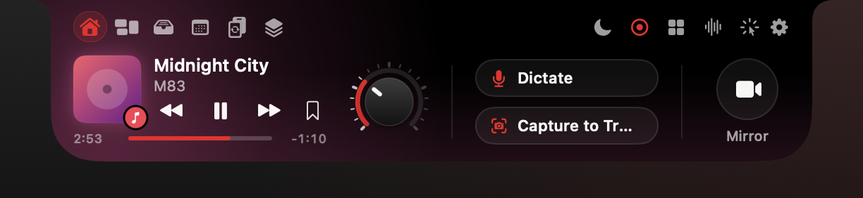
SparkV for macOS
Your notch, now an AI command center.
Dictation, meetings, screen help and 20 more tools. Private by default, pay once.
Try Pro free for 14 days · sparkv.si
Notes:
This is the MacBook notch. Most of us look straight past it. SparkV turns it into a drawer: hover, and your music, your files, your day and more than 20 AI agents slide out. The AI runs on your Mac, and Pro is a one-time purchase. Everything you will see today is the real app, not a mock-up.

Slide 2
Problem
Your Mac work lives in six apps and six bills.
And the best spot on your screen does nothing.
01
02
03
04
Dictation, meeting notes, clipboard, screenshots, a launcher, a notch app.
Bought separately: about $492 in year one.
Monthly AI fees for work your Mac can do itself.
The notch: prime screen space, zero use.
$492 = sum of year-one prices on the comparison slide; third-party listings, re-check before publishing.
02
Notes:
Think about the small tools a busy Mac user pays for: a dictation app, an AI meeting recorder, a clipboard manager, a screenshot tool, a launcher with AI, a notch app. Bought one by one, that comes to about four hundred and ninety-two dollars in the first year; slide 13 shows the breakdown. Many of those charge monthly for AI. Meanwhile, the notch sits in the middle of your screen doing nothing. [Figure = sum of year-one prices on slide 13; third-party listings, re-check before publishing.]

Slide 3
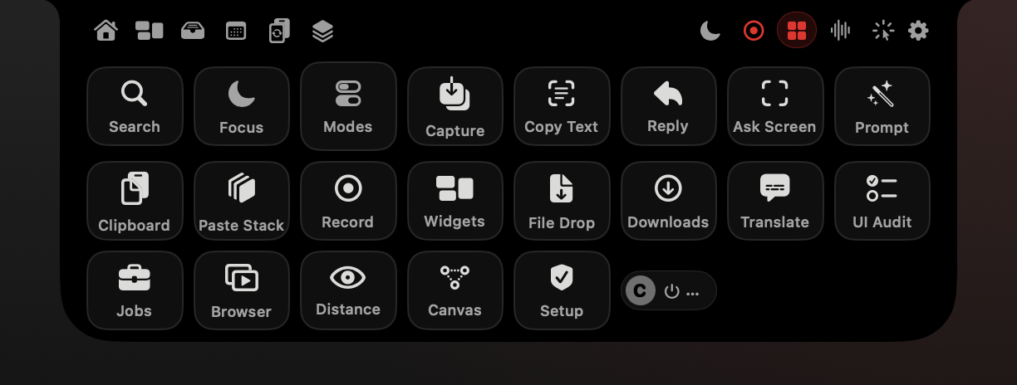
Solution
Hover the notch. Everything is there.
One black drawer: media, files, your day, and a hub of 20+ agents.
Hover to open. Move away to close.
Drop any file on the notch.
Every agent is one click or one hotkey away.
Real render of the current build, sample data
03
Notes:
Move the pointer onto the notch and the drawer opens; move away and it closes half a second later. The header switches pages: Home, Widgets, Tray, Today, Converter, Spaces. The grid icon opens the Agents hub, 22 tiles that launch every tool in SparkV. Most also have a hotkey, so you rarely need the mouse.

Slide 4
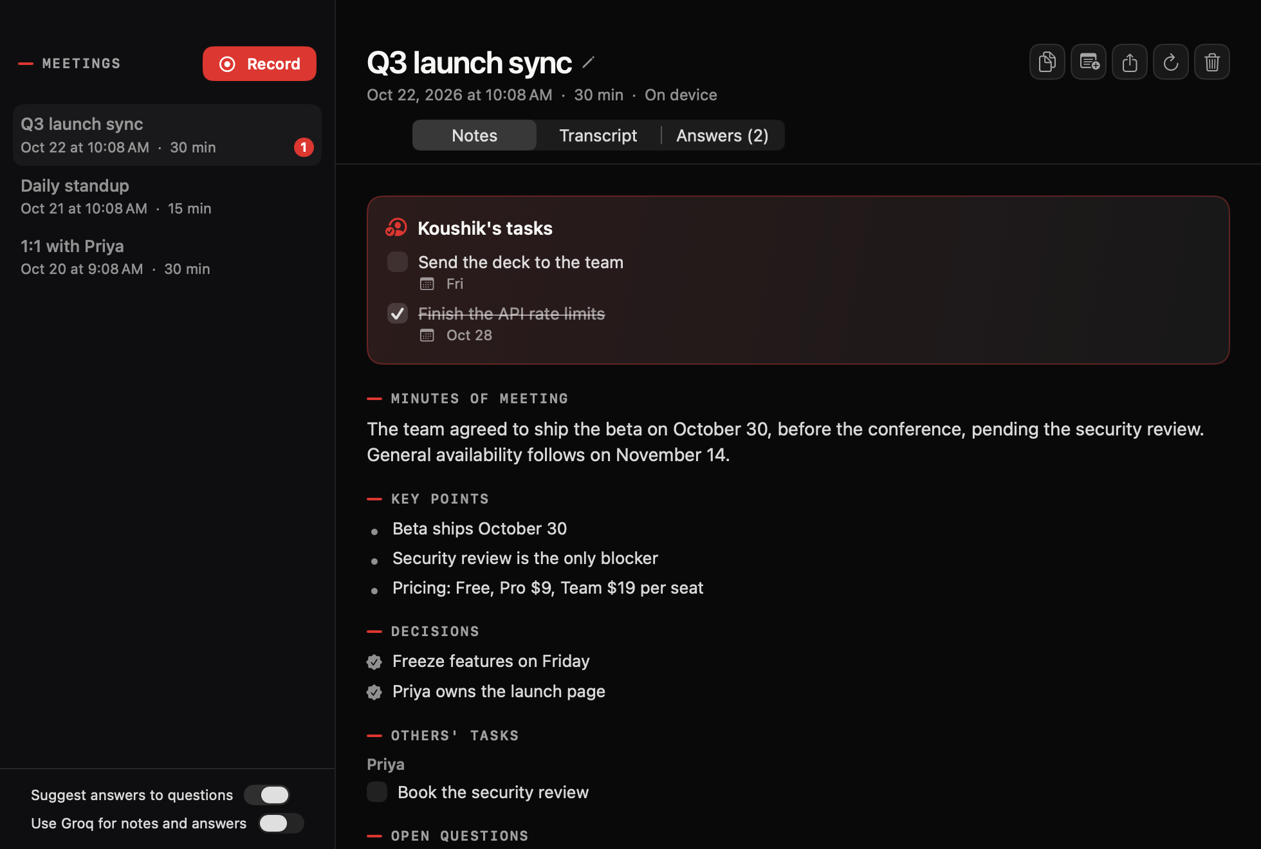
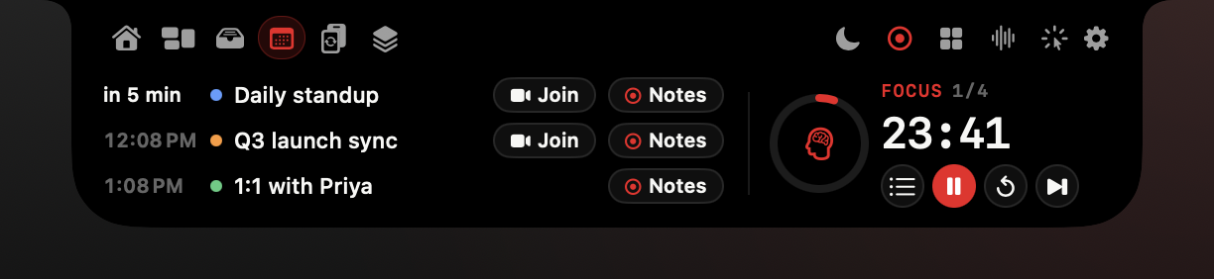
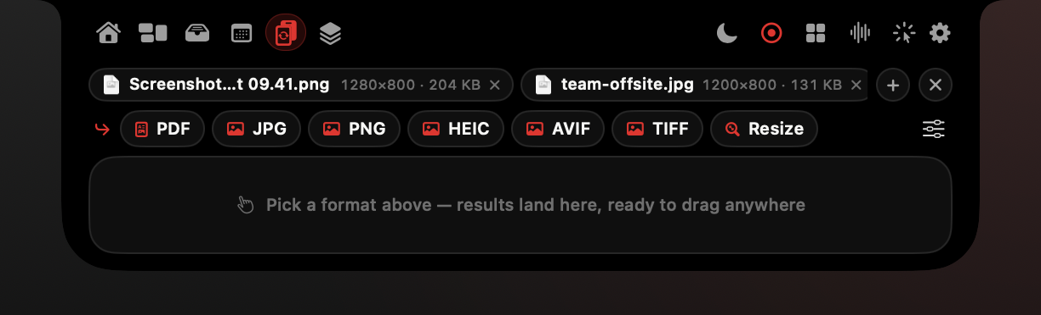
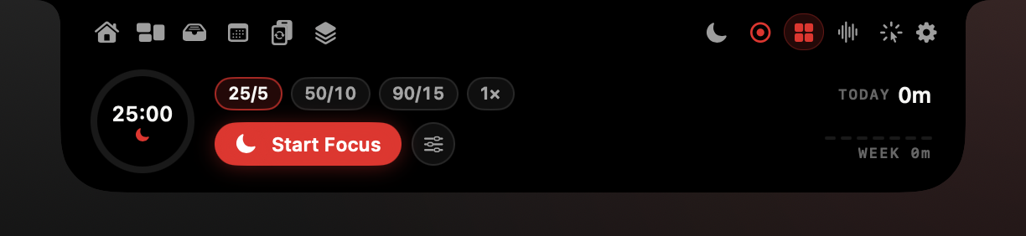

A day
A day with SparkV
One notch, every part of your day.
09:56
10:00
12:30
15:00
17:00
Meeting heads-up under the notch. ⌃⌥J joins.
One click records notes. No bot joins the call.
Hold fn, talk, release. Clean text appears.
Drop a PDF. Convert, compress or OCR it.
Focus rounds end with a recap.
Times are illustrative. Real renders of the current build, sample data.
04
Notes:
Here is what a normal day looks like. A meeting shows up under the notch ten minutes before it starts, with a Join button. One click records it; SparkV listens to your mic and the call audio, so no bot joins. At lunch you answer messages by voice. In the afternoon you convert a PDF without opening a website. You finish with focus rounds and a short recap. [Times are illustrative.]

Slide 5

Screen help · Pro
Ask about anything on your screen.
Works in any app, on any display.
Hold ⌃⌥ and ask. Clicky answers and points to the spot.
⌃⌥S: select a chart or an error, then ask about it.
⌃⌥T: copy text from images, videos and locked PDFs.
Real render of the current build, sample data. Live check required.
05
Notes:
Stuck in an app you don't know? Hold Control-Option and ask out loud. Clicky looks at the screen under your mouse, answers out loud and in the band under the notch, and flies a pointer to the right spot. It points; it doesn't click for you. Control-Option-S lets you select part of the screen and ask about it. Control-Option-T copies the text out of anything: a screenshot, a video frame, a locked PDF. [Without an optional Groq key, Clicky reads screen text on device. Live check required.]

Slide 6
Meetings · Pro
Meeting notes, no bot in the call.
One click to record. Transcribed on your Mac.
Minutes, decisions and your tasks with due days.
A suggested answer when someone asks you a question.
Live translated captions, on device.
Filed into the right Space automatically.
Real render of the current build, sample data. Live check required.
06
Notes:
Click the red button and SparkV records your microphone and the call's audio. Nothing joins the meeting. If someone asks you a question, a suggested answer appears under the notch. When you stop, you get minutes, decisions, your own tasks with due days, other people's tasks and the full transcript, filed into the right Space. Turn on Live Translation and other people's speech becomes captions in your language, translated on your Mac. [Live check required: audio capture, translation.]

Slide 7
Proof
Private by default. Tested in the real build.
Internal checks on the current build, 22 Oct 2026.
$0
50
69
cloud AI needed. Apple Intelligence, Vision, Speech and Translation run on your Mac.
real app views in this deck. No mock-ups.
issues UI Audit found on a planted-issue test site. Runner self-test: 48/48.
195 / 195
29,283
[TBD]
clipboard and paste-stack checks passed.
widget checks passed, 0 failed.
[TBD: private beta users] · [TBD: beta testimonial]
Internal tests, not customer metrics. Sources: Business Plan §9; Feature Guide §25 and Verification summary.
07
Notes:
By default, everything stays on your Mac: speech, screenshots, clipboard, meeting audio. Groq is optional and only used with your own key, only when you turn it on. Every screen in this deck is the real app rendered from the current source. Before launch we ran the test suites: UI Audit found 69 planted issues on a test site, clipboard checks passed 195 of 195, widget checks passed all 29,283. Beta numbers and quotes go here once the private beta has run. [These are internal tests, not customer metrics; keep the subtitle visible.]

Slide 8
Value
One app instead of six.
What the same jobs cost as separate apps.
TYPICAL APP
IN SPARKV
Notch hub
NotchNook · $25 one-time (or $3/mo)
Free plan
Notch island
Alcove · about $13.99 one-time
Free plan
Launcher with AI
Raycast Pro · $8/mo billed yearly ($10 monthly)
Pro: ⌥Space Universal Search + agents
AI dictation
Wispr Flow · $15/mo ($144/yr)
Pro: AI dictation
AI meeting notes
Granola Business · $14/user/mo
Pro: Meetings
Clipboard manager
Paste · $29.99/yr
Pro: unlimited history + Paste Stack
Screenshots and recording
CleanShot X · $29 one-time, then $19/yr updates (optional)
Pro: Copy Text, Quick Capture, Screen Recorder
All of the above
Separate apps, year one: about $492.
SparkV Pro: $39 once. Updates after year one are optional.
Prices: public third-party listings, Oct 2026 (Business Plan §3). Feature sets differ. Legal review required.
08
Notes:
Here is the honest maths. These are the public prices of popular single-purpose apps that do jobs SparkV also does. Bought separately, the first year is about four hundred and ninety-two dollars, and most of it repeats every year. SparkV Pro is thirty-nine dollars once, twenty-nine during launch week. These apps have features we don't have, and we don't claim otherwise; the point is the jobs most people actually use them for. [Legal review required before naming competitors. Re-check every price on vendor sites on publish day.]

Slide 9
Value
One app instead of six.
What the same jobs cost as separate apps.
JOB
TYPICAL APP
ITS PRICE
IN SPARKV
Notch hub
NotchNook
$25 one-time (or $3/mo)
Free plan
Notch island
Alcove
about $13.99 one-time
Free plan
Launcher with AI
Raycast Pro
$8/mo billed yearly ($10 monthly)
Pro: ⌥Space Universal Search + agents
AI dictation
Wispr Flow
$15/mo ($144/yr)
Pro: AI dictation
AI meeting notes
Granola Business
$14/user/mo
Pro: Meetings
Clipboard manager
Paste
$29.99/yr
Pro: unlimited history + Paste Stack
Screenshots and recording
CleanShot X
$29 one-time, then $19/yr updates (optional)
Pro: Copy Text, Quick Capture, Screen Recorder
All of the above
SparkV Pro
$39 one-time (launch $29)
Prices from public third-party listings, Oct 2026 (SparkV Business Plan §3). Feature sets differ; SparkV does not copy every feature of these apps. Re-check vendor pricing before publishing.
09
Notes:
Here is the honest maths. These are the public prices of popular single-purpose apps that do jobs SparkV also does. Bought separately, the first year is about four hundred and ninety-two dollars, and most of it repeats every year. SparkV Pro is thirty-nine dollars once, twenty-nine during launch week. These apps have features we don't have, and we don't claim otherwise; the point is the jobs most people actually use them for. [Legal review required before naming competitors. Re-check every price on vendor sites on publish day.]

Slide 10
Value
One app instead of six.
What the same jobs cost as separate apps.
What you pay (USD)
SparkV Pro: launch week $29.
Year 2: optional $19 renewal.
Excluded: Alcove (same job as NotchNook).
Source: Public prices collected in SparkV Business Plan §3, 22 Oct 2026; third-party listings.
Values are the totals in the outline's chart data table.
10
Notes:
Here is the honest maths. These are the public prices of popular single-purpose apps that do jobs SparkV also does. Bought separately, the first year is about four hundred and ninety-two dollars, and most of it repeats every year. SparkV Pro is thirty-nine dollars once, twenty-nine during launch week. These apps have features we don't have, and we don't claim otherwise; the point is the jobs most people actually use them for. [Legal review required before naming competitors. Re-check every price on vendor sites on publish day.]

Slide 11
Fit
Made for the Mac you already have.
Apple silicon · macOS 15 or later · best on a MacBook Pro with a notch.
100M+
Apple Mac shipments, 2025 (millions of units, IDC preliminary)
active Macs (Apple, Oct 2018: the latest official figure)
7.1M
Macs shipped in Q4 2025 alone (IDC, preliminary)
[TBD]
share of Macs that are Apple silicon on macOS 15+
[TBD: IDC Q3 2025 Mac shipments]
Source: IDC preliminary data as reported by AppleInsider, MacTrast and MacTech. Verify against IDC press releases before publishing.
Sources: Apple via TechCrunch (Oct 2018); IDC preliminary via AppleInsider, MacTrast, MacTech.
11
Notes:
SparkV is built for Apple silicon Macs on macOS 15 or later, and it is best on a 14 or 16-inch MacBook Pro with a notch. On other displays the island sits in the menu bar. Apple last said there were over 100 million active Macs, back in 2018, and IDC estimates Apple shipped more than seven million Macs in the last quarter of 2025 alone. This is a large and growing group of people who already own the hardware. [Do not imply all of these Macs can run SparkV.]

Slide 12
Pricing
Pay once. Keep it forever.
Start with a 14-day Pro trial. No card needed.
Free
Pro
Recommended
Team
$0
$39 one-time
$8 per seat / month
₹0
₹1,499 · launch week $29 · ₹999
₹499 · billed yearly
1 Mac
2 Macs per person · 12 months of updates
Minimum 3 seats · 2 Macs per seat
Complete notch app
Everything in Free, plus:
Everything in Pro, plus:
World Clock and gauges
AI assistants
One invoice
Clipboard (last 25), Copy Text
Meetings and translation
Seat management
Dictation
Productivity suite
Shared Spaces packages
Focus and Modes
Priority support
Developer tools
MDM package
Launch week: Pro $29 (₹999) · Students and teachers: 50% off Pro · 30-day refunds, no questions asked · 2 Macs per license
Source: SparkV Business Plan §6a, §6c. Pro updates after year one: optional $19/yr (₹799).
12
Notes:
Three plans. Free is a complete notch app. Pro is thirty-nine dollars once, or fourteen ninety-nine rupees, and includes everything plus a year of updates; after that, updates are optional and the app keeps working. Launch week, Pro is twenty-nine dollars. Teams pay eight dollars per seat per month, billed yearly, with one invoice and priority support. Every Pro feature can be tried free for fourteen days without a card; when the trial ends you simply drop to Free and keep your data. [INR launch price is ₹999 per Business Plan §6a. Team shared Spaces means file packages, not live sync.]

Slide 13
Turn on your notch.
Try every Pro feature free for 14 days.
sparkv.si
Launch price $29 for the first 7 days or first 500 buyers.
[TBD: download / checkout URL] · [TBD: QR code to checkout]
Notes:
Download SparkV from sparkv.si, start the fourteen-day trial, and see what your notch can do. Launch week, Pro is twenty-nine dollars for the first seven days or the first five hundred buyers. Students get half off. Thanks for watching. [Do not publish until Developer ID notarization and Lemon Squeezy licensing exist.]

Slide 14
Appendix
Prefer to pay for just what you use?
Feature packs (alternative model; not planned for launch).
PACK
INCLUDES
USD
INR
Notch & Media
Media extras, HUD, all Widgets, Modes, Focus, Screen Distance, unlimited Tray
$9
₹499
Productivity
Clipboard + Paste Stack, Converter, File Drop, Downloads, Quick Capture, Screenshot to Clipboard, Copy Text, Screen Recorder, Universal Search, Spaces
$15
₹799
AI Assistants
AI dictation, Clicky, Ask Screen, Reply Drafter, Prompt Refiner, Tray AI, Job Agent
$19
₹999
Meetings
Recorder, transcriber, summaries, notes, Live Translation, calendar join
$15
₹799
Developer Tools
UI Audit, Browser Flows, Flow Canvas
$19
₹999
Everything (= Pro)
All 5 packs
$39 (separately $77)
₹1,499 (separately ₹4,095)
Source: SparkV Business Plan §6b, §6d
A1
Notes:
Backup only. The business plan recommends launching with three plans, not packs. Use this if the launch audience asks for a cheaper single-purpose entry, for example Meetings only.

