Slide 1
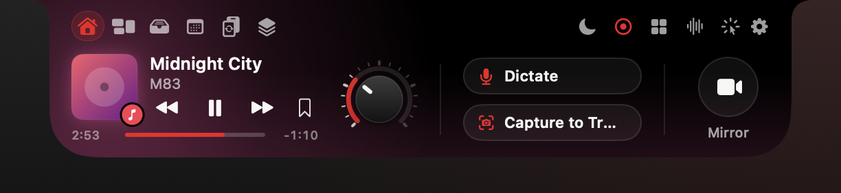
SparkV for macOS
Your notch, now an AI command center.
Dictation, meetings, screen help and 20+ tools in one Mac app. Private by default. Pay once.
Seed round · [TBD: month and year] · sparkv.si
Notes:
SparkV turns the MacBook notch into a drawer that opens when you hover it: media, a file tray, your day, a converter, knowledge Spaces and a hub of more than 20 agents. The AI runs on the Mac by default, so we pay nothing per user for AI. That is why we can sell it once instead of monthly. In two minutes I will show it working, then the numbers.

Slide 2
Problem
Mac power users rent five apps for one workflow.
Notch, clipboard, dictation, meeting notes and screenshots are sold separately, and the AI ones are subscriptions.
Year-one cost of five separate apps vs SparkV Pro (USD)
$395.99
year one, five separate apps
$312/yr
Wispr Flow + Granola, recurring
$39
SparkV Pro, once
Source: Prices from third-party listings cited in the SparkV business plan (section 3), Oct 2026. Re-check vendor pages before sending.
Five shortcuts, five windows, five bills
Year one: subscriptions for 12 months, one-time apps at their list price.
02
Notes:
This is the stack a busy Mac user ends up with: a notch app, a clipboard manager, a dictation app, a meeting-notes app and a screenshot tool. Using public list prices, year one costs about $396, and the two AI subscriptions alone are $312 a year, every year. Cloud AI has a cost on every request, and subscriptions are the norm for these tools. We do not have that cost; it is the core of our business model.

Slide 3
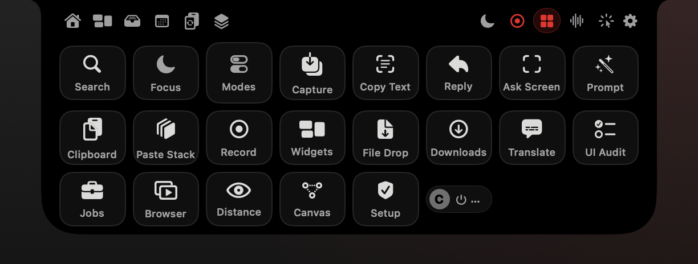
Solution
One drawer. Every tool. Right under the camera.
Hover the notch: 12 header buttons, 21 drawer pages and a 22-tile agents hub.
Notch core: media, volume and battery, tray, AirDrop, your day
Productivity: clipboard, converter, downloads, search, Spaces
AI: dictation, screen help, reply drafts, meetings, translation
Developer tools: UI Audit, Browser Flows, Flow Canvas
Real render of the current build, sample data.
03
Notes:
Everything lives in one place the user already looks at. Hover the notch and the drawer opens; move away and it closes. The header has six pages on the left and six actions on the right, and the agents hub launches every tool. When the drawer is closed, live activities such as volume, battery, AirPods, notifications, meetings and recordings show beside the camera. All 21 drawer pages render in the real app layout, and every tile and hotkey is wired.

Slide 4


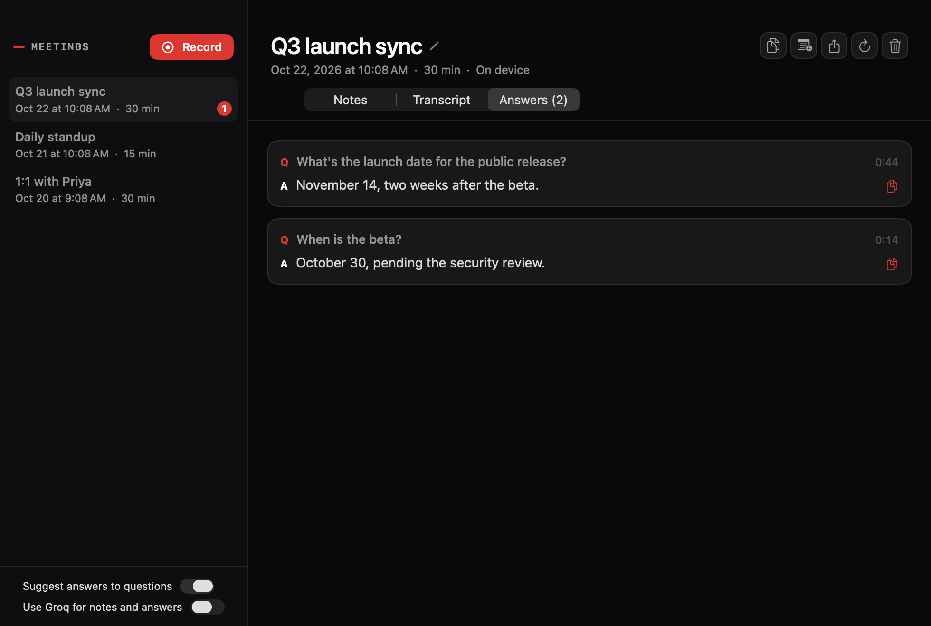
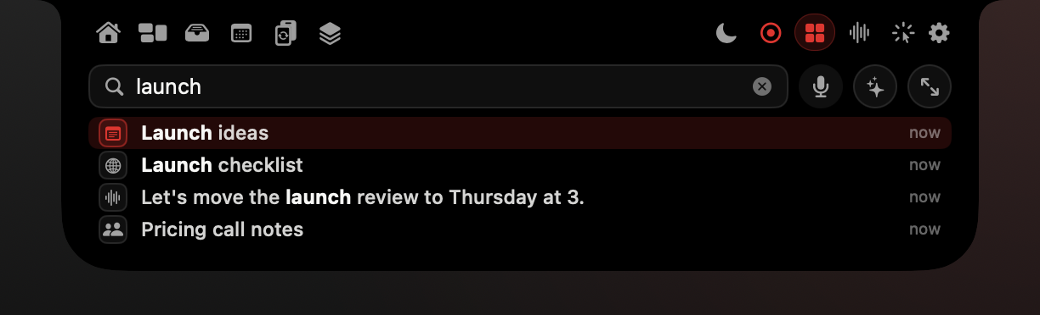
Live demo
Live demo: 90 seconds, all on the Mac.
Talk, ask, record and find, with Groq switched off.
Hold fn, speak, release: clean text is typed for you
Hold ⌃⌥ and ask: SparkV answers and points to the spot
One click records a meeting: tasks, decisions, answers
⌥Space finds anything you saw, with cited answers
Fallback stills for the live demo. Real renders of the current build, sample data.
04
Notes:
Run this live on the demo Mac; the film I03 is the backup if the room's Wi-Fi, audio or permissions fail. Order: dictation into TextEdit, the screen assistant in Preview, a short recorded meeting, then Universal Search for 'launch' and the agents hub. Say out loud that Groq is off, so everything is on-device. Do not say SparkV clicks or types through other apps on its own: the assistant points and explains; dictation types where your cursor is. The screen assistant is called Clicky in the app today and may be renamed before launch.

Slide 5
Meetings
Meeting notes without a bot in the call.
SparkV records your mic and the call audio, transcribes on device and hands you the follow-ups.
Minutes, key points, decisions and your tasks with due days
Suggested answers when someone asks you a question
Live translated captions, with the original underneath
Filed into Spaces and searchable later
Rendered from a saved meeting with sample data. Live audio capture: pre-launch live check.
05
Notes:
This is the feature people pay Granola $14 per user per month for. In SparkV it is part of Pro at one price, because transcription and summaries run on the Mac. No bot joins the call, and audio does not leave the machine unless the user turns on their own Groq key. Status: the notes and answers views render from saved meetings; live audio capture is on our pre-launch live-check list.

Slide 6
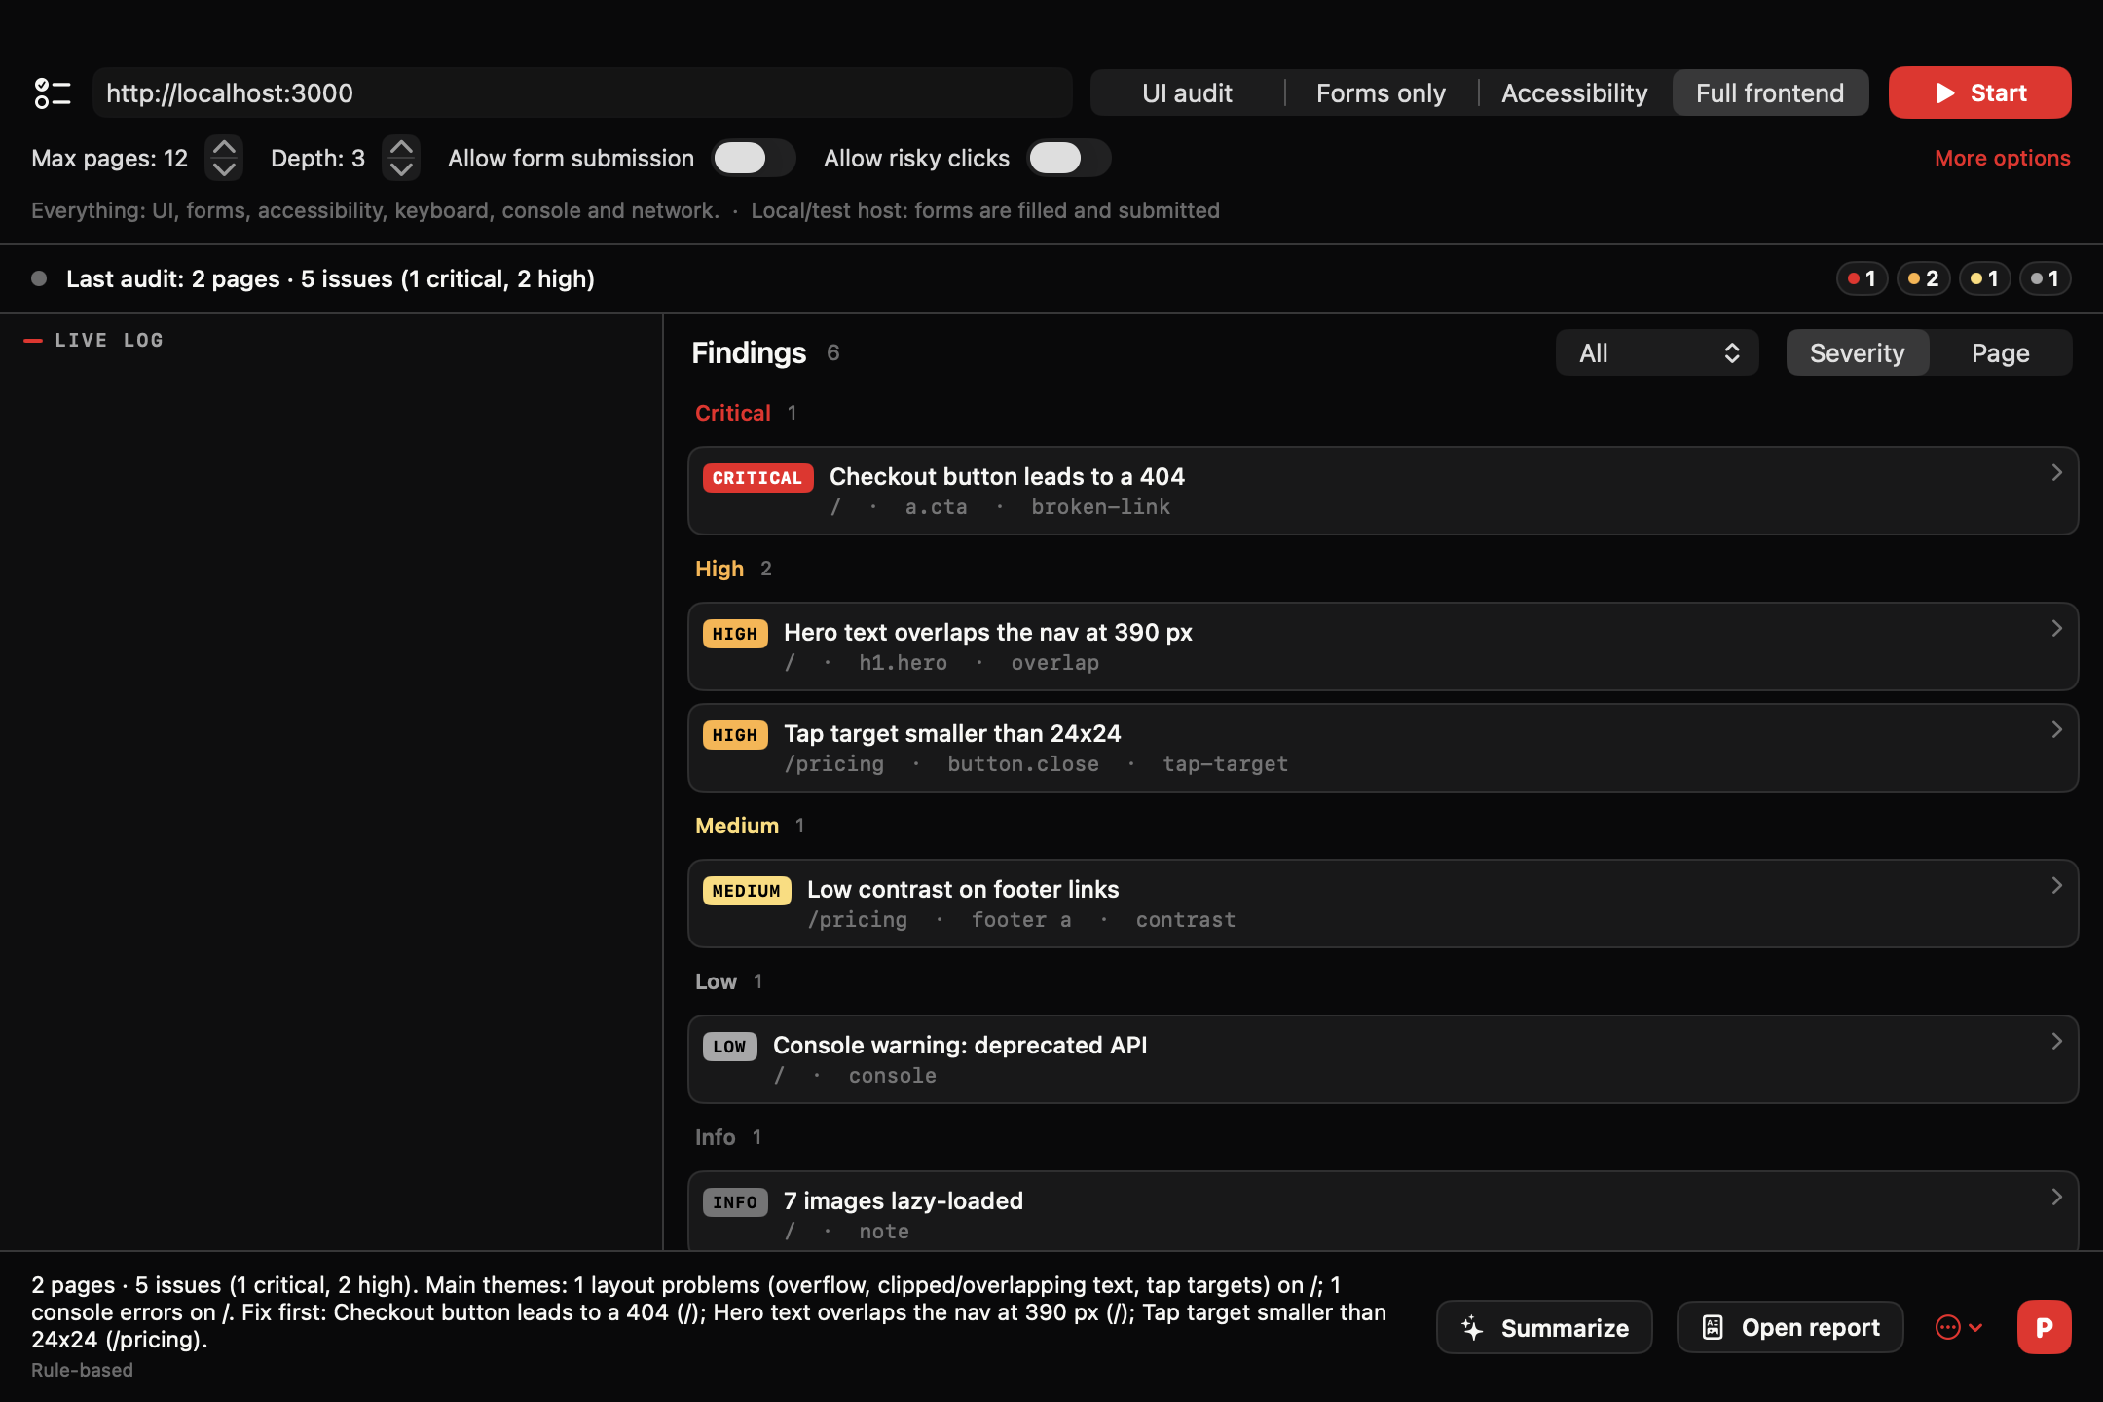
Proof
Proof it works: one real UI Audit run.
SparkV crawled a test site, found the planted bugs and wrote the fix prompt.
69
3 · 15
findings across 6 pages
critical · high severity
51,666
48/48
characters in the fix prompt (60 issues)
runner self-tests pass
Summary written on device by Apple Intelligence
Fix prompt pastes straight into Claude Code, Cursor or Copilot
Runs only on sites you own or may test
Internal test, 22 Oct 2026, planted-issue site on 127.0.0.1 (feature guide section 25).
06
Notes:
This is not a mock-up. SparkV's own UI Audit controller audited a bundled test site with planted issues on 127.0.0.1: six pages, 69 findings, three of them critical and fifteen high. Apple Intelligence wrote the summary on device, and the P button produced a 51,666-character fix prompt covering 60 issues. The runner's self-test passes 48 of 48, including never sending a form to a non-test host and never clicking logout or delete. It needs Node.js on the Mac. Its sibling, Browser Flows, is still in beta: its self-test was not clean on 22 October.

Slide 7
Why now
Why now: the AI already ships inside the Mac.
Apple silicon and Apple's on-device models make private AI with zero cost per request possible.
Oct 2021
Jun 2023
Jun 2025
2025
Next
14- and 16-inch MacBook Pro introduce the notch
Mac Pro moves to M2 Ultra: every Mac is now Apple silicon
Foundation Models framework opens Apple's on-device model to apps, 'without cloud API costs'
25.6M Macs shipped, up 11.1%
SparkV 1.0: notarized direct download [TBD: launch date]
Cloud AI apps pay for every request. SparkV pays $0.
Works offline. Audio and screens stay on the Mac.
Every MacBook Pro since 2021 has a notch to build on.
Sources: Macworld (Oct 2021); MobileSyrup (Jun 2023); TechCrunch (Jun 2025); IDC preliminary via 9to5Mac (Jan 2026); SparkV business plan.
07
Notes:
Three things lined up. The notch arrived on the MacBook Pro in 2021. Since mid-2023 every Mac Apple sells runs Apple silicon. And at WWDC 2025 Apple opened its on-device model to developers; in Craig Federighi's words, it runs without cloud API costs and works offline. That turns AI from a per-request cost into a free capability of the hardware. Competitors built on cloud models have to charge monthly. We do not.

Slide 8
Market
A big, paying, AI-curious audience.
Sized bottom-up from public Mac data. Our own funnel numbers are [TBD] until launch.
25.6M
100M+
Mac shipments worldwide (millions of units)
Macs shipped in 2025 (IDC, prelim.)
active Macs (Apple, Oct 2018)
83%
42%
of surveyed Mac users paid for software in the past month (Setapp 2023, n=1,241)
use AI apps daily (same survey)
+11.1% in 2025
Q4 2025: 7.1M, 9.3% of PCs
Source: IDC preliminary data via 9to5Mac (Jan 2026) and MacTrast (Jul 2025). 2024 bar derived from IDC's growth rate.
Setapp 2023 surveyed Setapp's own audience (n=1,241, mostly US), not all Mac owners.
08
Notes:
I will not show you a made-up market number. What is public: IDC counts 25.6 million Macs shipped in 2025, up 11 percent, and Apple last said there were 100 million active Macs, in 2018. Setapp's 2023 survey of its own audience found 83 percent had paid for Mac software in the past month and 42 percent use AI apps daily; that is a survey of Mac app buyers, not of all Mac owners.

Slide 9
Market · Sizing funnel
A big, paying, AI-curious audience.
TAM
SAM
SOM
100M+ (2018)
[TBD: count]
[TBD: target]
Active Macs
Apple-silicon MacBooks with a notch, macOS 15+
Paid Pro + Team seats in 3 years
Source: Apple, Oct 2018 event: 100 million active Macs, via TechCrunch (30 Oct 2018)
Source: [TBD: method: notched-model share of shipments 2021-2025 x survival]
Source: [TBD]
Figures and definitions from the sizing funnel; [TBD] fields stay open until sourced.
09
Notes:
The notched-MacBook share of that base is the number we still need to source, and it is marked TBD.

Slide 10
Competition
Five jobs, one app, one price.
Each rival owns one job. SparkV covers all five and charges once.
SparkV
NotchNook
Alcove
boring.notch
Paste
Wispr Flow
Granola
CleanShot X
Raycast Pro
Notch drawer and live activities
●
●
●
●
Clipboard history
●
●
AI dictation
●
●
AI meeting notes
●
●
Screenshots and recording
●
●
Search and AI answers
◐
●
Price
$39 once
$25 once or $3/mo
~$13.99 once
Free (GPL)
$29.99/yr
$15/mo
$14/user/mo
$29 + $19/yr opt.
$8-10/mo
● = the product's main job per the cited listing. ◐ = SparkV Universal Search with cited answers; not a full app launcher. Blank = not that product's main job; this is not a full feature audit.
Prices from third-party listings cited in the SparkV business plan (section 3), Oct 2026. Re-check vendor pages before sending.
10
Notes:
Read the matrix by column: every competitor is excellent at one job. Notch apps such as NotchNook are built around media and a file tray, and the free open-source one is not notarized. The AI tools, Wispr Flow, Granola and Raycast Pro, are sold as subscriptions. SparkV is the only one in this set that combines the notch with the AI jobs and charges once.

Slide 11
Competition · positioning
Five jobs, one app, one price.
Each rival owns one job. SparkV covers all five and charges once.
Positioning (qualitative)
PAY ONCE
Breadth: 20+ tools behind one hover
boring.notch (free)
Alcove
SparkV
Pay once: no AI bill to pass on
NotchNook
CleanShot X
Private by default: on-device models
POINT TOOL
SUITE
Paste
Wispr Flow
Granola
Raycast Pro
SUBSCRIPTION
Qualitative; y position from each product's price model (cited), x from its main job.
Qualitative map. Price models from the listings on the previous slide.
11
Notes:
The honest risk: any of them can add features. Our answer is breadth plus integration, because Spaces and Search tie meetings, dictation, clipboard and captures together, and the cost structure lets us stay one-time. Prices are from third-party listings; we re-check them before every send.

Slide 12
Business model
Free to start. $39 once for everything.
Sold direct, with Lemon Squeezy as merchant of record for tax and license keys.
Free
Pro
Recommended
Team
$0
$39 once
$8 per seat / month
₹0
₹1,499
₹499 · billed yearly
Free hooks users away from free notch apps
Pro is one price for every feature
Team adds recurring revenue from companies
Notch core: media, HUD, battery, tray, Today, timer
Everything: all AI assistants, meetings, dev tools
Minimum 3 seats; one invoice (PO or bank transfer)
World Clock and System Gauges
2 Macs per person, 12 months of updates
Seat management, shared Spaces packages
Clipboard history (last 25), Copy Text
Optional renewal $19/yr; the app never stops working
Priority support, 1 business day
Dictation without AI formatting
Deployment .pkg for MDM
Launch week: $29 (₹999)
14-day full Pro trial, no card · 50% student discount · 30-day refunds · Alternative held back: five feature packs at $9-19 each (all five = $39)
Source: SparkV business plan, 22 Oct 2026. INR prices as listed there.
12
Notes:
Three plans. Free is a useful notch app at zero, which competes with the free open-source option and gives reviewers something to try. Pro is $39 once, $29 in launch week, and includes every feature; buyers on r/macapps prefer one-time prices and CleanShot X shows the model works. Team is $8 per seat per month, billed yearly, minimum three seats, for companies that need invoices, seat management and an MDM package. We are not on the Mac App Store because SparkV needs Accessibility and other APIs the sandbox does not allow; Lemon Squeezy handles VAT, GST and sales tax worldwide. Shared Spaces for Team is a file package today, not live sync.

Slide 13
Unit economics
We keep about 94% of every Pro sale.
On-device AI means no inference bill. The only variable cost is the payment fee.
What we keep from one $39 Pro sale (US buyer, USD)
$0
AI cost per user
$99/yr
fixed platform cost (Apple Developer Program)
Non-US buyer: about +1.5% fee, net $35.97
Affiliate-sourced sale (30% commission): net about $24.85
$99 a year fixed (Apple Developer); no MoR monthly fee
Source: Fee schedule from the business plan section 4. Excludes refunds [TBD: refund rate], support time and DMG bandwidth (20-60 MB per download).
3 Pro sales cover the fixed Apple fee
Lemon Squeezy 5% + $0.50 per order. On-device AI; Groq optional with the buyer's own key.
13
Notes:
Our gross margin is the payment fee and nothing else. On a $39 sale Lemon Squeezy takes 5 percent plus 50 cents, so we keep $36.55; about $36 from a non-US buyer. AI runs on the Mac, and the optional Groq path uses the buyer's own key, so inference costs us nothing. Fixed costs are the $99 Apple Developer fee, a domain and static hosting for the site and update feed.

Slide 14
Unit economics · per plan
We keep about 94% of every Pro sale.
Net per sale by plan (USD)
Illustrative only: net revenue if a share of ONE year's Mac shipments bought Pro
PLAN
PRICE
NET, US BUYER
NET, NON-US BUYER
Pro
$39.00
$36.55
$35.97
Pro, launch week
$29.00
$27.05
$26.62
Pro, student
$19.50
$18.03
$17.73
Team, per seat-year (3-seat order)
$96.00
$90.55
$89.11
Basis: Lemon Squeezy 5% + $0.50 per order; +1.5% non-US; +0.5% on subscriptions (Team). Team row = (3 x $96 - 5.5% - $0.50) / 3.
Arithmetic on 25.6M (IDC 2025) x share x $36.55. Not a forecast. Our forecast: [TBD: revenue plan]
Source: IDC preliminary 2025 shipments (via 9to5Mac) and the SparkV business plan.
Illustrative arithmetic, not a forecast.
14
Notes:
The chart on the right is arithmetic, not a forecast: it shows what tiny shares of one year's Mac shipments would be worth. Our real revenue plan is marked TBD until the beta gives us a conversion rate.

Slide 15
Go to market
Go to market: waitlist to Product Hunt in 30 days.
Demo-first and creator-led. Affiliates earn 30%, only when a sale happens.
Days 1-3
Days 4-7
Days 8-12
Days 13-15
Days 16-18
Apple Developer ID, Lemon Squeezy products, domain
Legal pages; Face Unlock out of the sold build
Licensing, trial, Sparkle updates, notarization
Clean-Mac install and update test
Landing page, pricing, waitlist
Days 19-22
Days 23-25
Day 26
Day 27
Days 28-30
Demo video, 5 Shorts, keys to 10-15 creators
Private beta, 30-50 users, 5 testimonials
Ship 1.0 at the launch price
Product Hunt (Tue/Wed), r/macapps, X, LinkedIn, waitlist email
Show HN, affiliates open, retrospective
Source: SparkV business plan, 30-day launch plan.
15
Notes:
The plan is in the business plan, day by day. Days one to fifteen make the app sellable: Developer ID, notarization, licensing and a clean-Mac test. Then the landing page and waitlist, a demo video and Shorts, keys for creators, a private beta of 30 to 50 users, and launch on a Tuesday or Wednesday on Product Hunt and in the r/macapps App Pile thread.

Slide 16
Go to market · channels
Go to market: waitlist to Product Hunt in 30 days.
Product Hunt, r/macapps App Pile, Show HN
YouTube: one 2-4 min demo plus a 30 s Short per feature
Comparison pages: SparkV vs NotchNook, Alcove, boring.notch
CHANNELS
Product Hunt
r/macapps
YouTube creators (20k-300k subs)
Lemon Squeezy affiliates (30%, 30-day cookie)
Show HN / Indie Hackers
Setapp (month 3+)
TARGETS
[TBD: waitlist target]
[TBD: trial-to-paid target]
[TBD: CAC by channel]
[TBD: creator reach]
Source: SparkV business plan.
16
Notes:
Affiliates are paid only on sales. Setapp is a second channel from month three. The targets on the bottom row are TBD; we will set them from the waitlist and beta numbers.

Slide 17
Traction
Built and tested. Launch numbers come next.
Pre-revenue today. This is what is verified, and what we will report.
VERIFIED
29,283
195
63
48/48
widget checks, 0 failures
clipboard and paste-stack checks, 0 failures
OCR and screen-recorder checks, 0 failures
UI Audit runner self-tests
WHAT WE WILL REPORT
[TBD: waitlist signups]
[TBD: beta users]
[TBD: trial starts]
[TBD: paid conversions]
[TBD: revenue]
Full app compiles; every tab, tile and hotkey is wired
50 real views rendered with sample data
Open: Browser Flows self-test not clean; live hardware checks pending
Internal checks run 22 Oct 2026 against current sources (feature guide, verification summary).
17
Notes:
We are pre-revenue and pre-launch, and I will not dress that up. What exists: the full app compiles with the Command Line Tools, every drawer tab, hub tile and default hotkey is wired, 50 views were rendered from the real code, and the automated harnesses pass, about 29,000 widget checks, 195 clipboard checks, 63 OCR and recorder checks and 48 of 48 UI Audit runner tests. What is still open: the Browser Flows self-test was not clean, and features that need a microphone, camera or system permission are on a live-check list before launch. The bottom row is what we will report to you monthly.

Slide 18
Roadmap and risks
Four known blockers, all scheduled.
What stands between the build and the first sale, and what comes after.
BEFORE THE FIRST SALE
Before sale: signing, licensing, the face model, Node.js
01
02
03
04
Developer ID + notarization
Licensing, trial, paywall
Face Unlock model
Node.js for dev tools
Self-signed today; Developer ID cert, notarize and staple (days 1-3, 8-12)
Not in the app yet; Lemon Squeezy License API; about 4-6 days of work
ArcFace weights are non-commercial: Face Unlock is left out of 1.0
List as a requirement, or bundle a signed Node (+40-100 MB)
Source: SparkV business plan, launch blockers.
18
Notes:
Investors should hear the risks from us first. Four things block the first sale and all four are on the 30-day plan: proper Apple signing and notarization, licensing code, the face-recognition model's non-commercial license, which we solve by leaving Face Unlock out of 1.0, and the Node.js dependency of the developer tools. One more risk: SparkV uses private macOS paths for media and the HUD. Fallbacks already exist, and Sparkle lets us ship fixes fast.

Slide 19
Roadmap and risks
After launch ([TBD: order and dates])
AFTER LAUNCH
After launch: Setapp, packs, Team sync, reliability
01
02
03
04
05
Setapp channel
Feature packs
Team: live Spaces sync
Browser Flows reliability
Commercial face model
From month 3, once reviews exist
e.g. a Meetings-only pack as a cheaper entry
Not built; today Spaces share as a file package
Self-test must pass cleanly before it leaves beta
[TBD: licensed or replacement model]
Source: SparkV business plan.
19
Notes:
After launch, the order of Setapp, packs and Team sync is TBD and will follow what beta users ask for.

Slide 20
Team
[TBD: one line on why this team wins]
[TBD: photo]
[TBD: photo]
[TBD: photo]
[TBD: founder name]
[TBD: co-founder / first hire]
[TBD: advisor]
[TBD: role]
[TBD: role]
[TBD: role]
[TBD: one proof point]
[TBD]
[TBD]
Built at SparkV, a software studio in Telangana, India (sparkv.si)
Studio: sparkv.si, read 22 Oct 2026.
20
Notes:
[TBD: founder to write this in their own words: who built SparkV, what they shipped before, and why they will win the Mac power-user market.] The only fact from our files is the studio: SparkV is a software studio in Telangana, India, per sparkv.si.

Slide 21
The ask
Use of funds
Raising [TBD: amount] on [TBD: instrument and terms] for [TBD: months] of runway.
Milestone: [TBD: paid users or revenue] by [TBD: date]
Next step: a 20-minute live demo on your Mac
sparkv.si
[TBD: founder email]
Product and engineering
[TBD: %]
Go to market
[TBD: %]
Legal and compliance
[TBD: %]
Support and operations
[TBD: %]
[TBD: % of the round per bucket. Equal slices are placeholders, not a split.]
21
Notes:
We are raising [TBD: amount]. The money goes to four buckets, and the percentages are TBD: engineering to clear the launch blockers and harden the beta features, go to market for the launch video, creators and Product Hunt, legal for the EULA, privacy and the India DPDP rules, and support. The milestone we commit to is [TBD]. The best next step is a 20-minute demo on your own Mac.

Slide 22
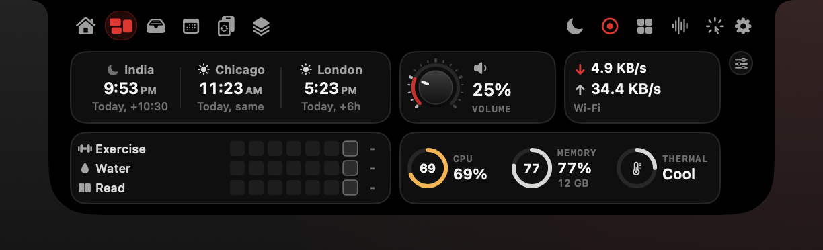
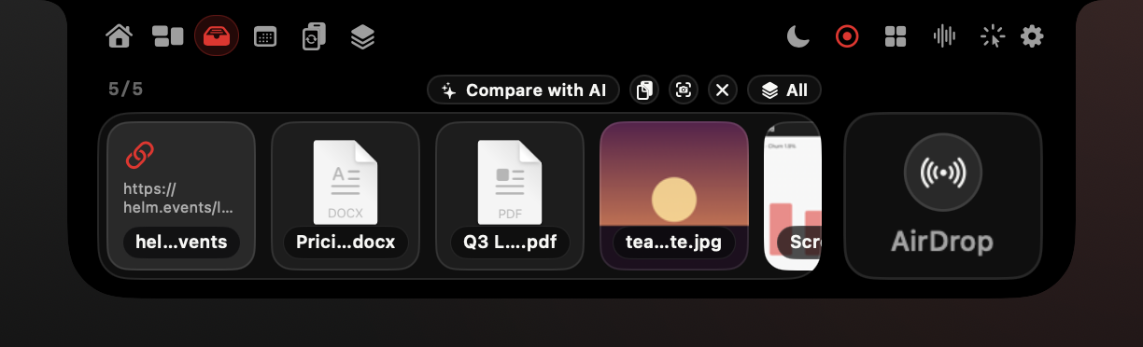
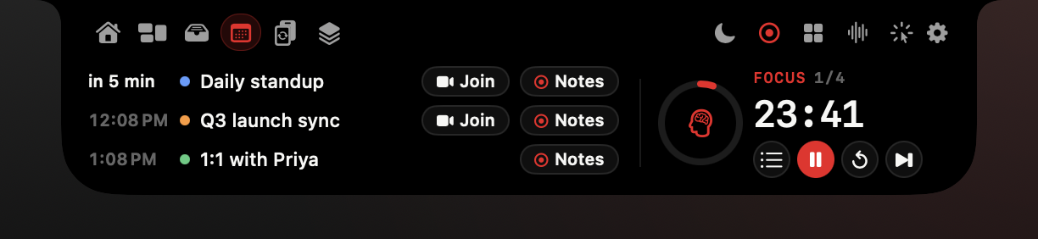
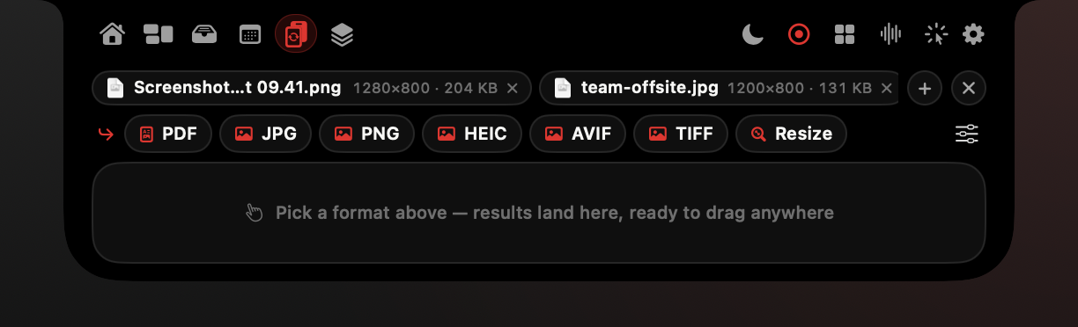
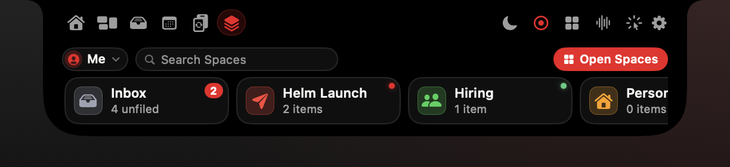
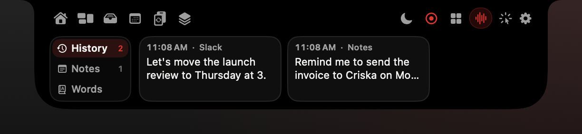
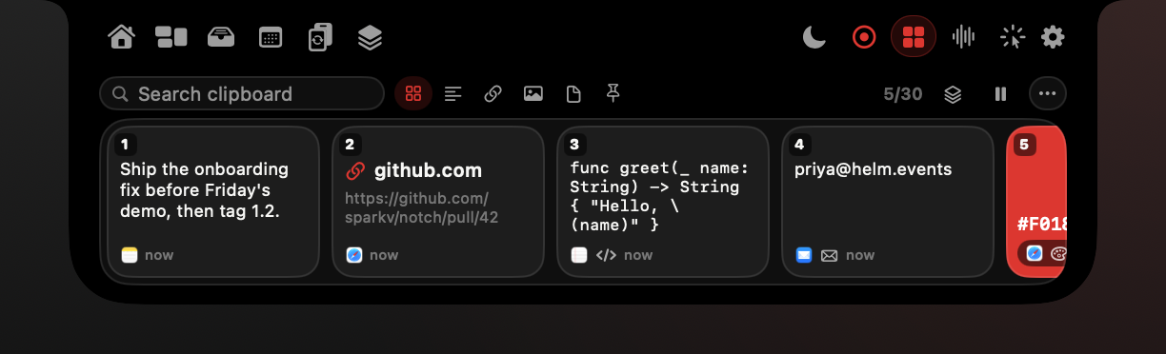
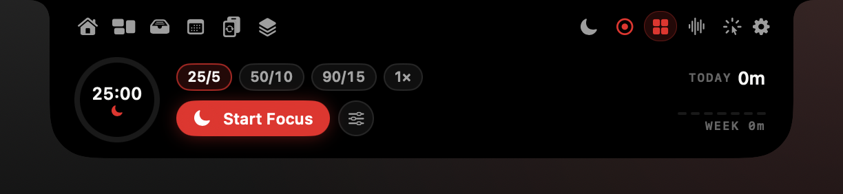
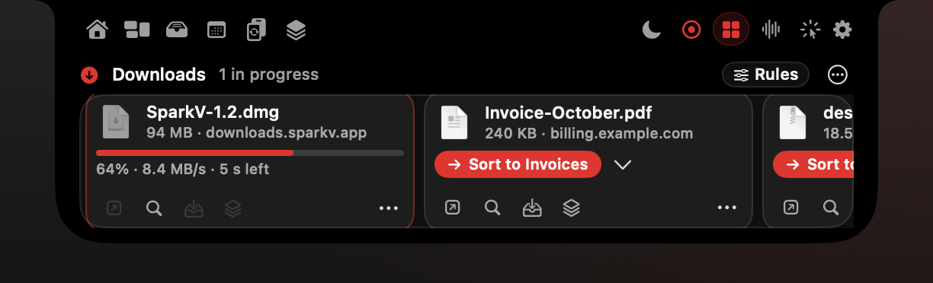
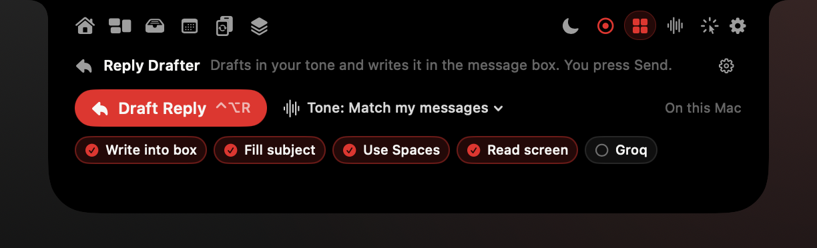
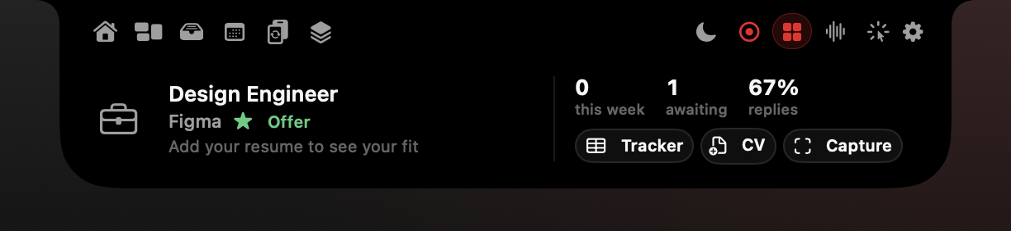
Appendix: every feature, one hover
Real renders from the current code with sample data.
Widgets
Tray
Today
Converter
Spaces
Flow
Clipboard
Universal Search
Focus
Downloads
Reply Drafter
Job Agent
Captions are the render file names.
A1
Notes:
Backup slide for questions about breadth. Every image is a real view rendered from the current source with sample data.

Slide 23
Appendix: sources
Every number in this deck, and where it comes from.
SparkV Business Plan (docs/SparkV-Business-Plan.md), researched 22 Oct 2026
Pricing, fees, competitors, GTM, launch plan, blockers
docs/SparkV-Business-Plan.md
Setapp Mac Apps Report 2023 (n=1,241, mostly US), via SecurityBrief Asia (Oct 2023)
42% use AI apps daily; 83% paid for Mac software in the past month; 70% own an M1/M2 Mac. Survey of Setapp's audience, not a census
https://securitybrief.asia/story/42-of-macos-users-use-ai-based-apps-daily-report
SparkV Feature Guide (docs/SparkV-Feature-Guide.md), checks run 22 Oct 2026
Features, verification status, test results
docs/SparkV-Feature-Guide.md
Apple Foundation Models framework, WWDC 2025, via TechCrunch (9 Jun 2025)
Federighi: on-device models run 'without cloud API costs' and work offline
https://techcrunch.com/2025/06/09/apple-lets-developers-tap-into-its-offline-ai-models/
IDC preliminary Q4/FY2025 PC tracker, via 9to5Mac (13 Jan 2026)
Apple 25.6M Macs in 2025 (+11.1%); Q4 2025 7.1M, share 9.3%. Preliminary; confirm on idc.com
https://9to5mac.com/2026/01/13/apple-shipments-unchanged-as-pc-market-grew-during-
q4-2025/
Mac Pro with M2 Ultra completes Apple silicon transition, via MobileSyrup (5 Jun 2023)
Every Mac Apple sells since June 2023 is Apple silicon
https://mobilesyrup.com/2023/06/05/apple-completes-its-transition-to-in-house-chips-with-
m2-ultra-mac-pro/
IDC preliminary Q2 2025, via MacTrast (Jul 2025)
6.2M Macs in Q2 2025 vs 5.1M in Q2 2024 (+21.4%)
https://www.mactrast.com/2025/07/new-data-released-by-idc-shows-mac-shipments-are-
continuing-to-increase/
14- and 16-inch MacBook Pro with notch, 18 Oct 2021, via Macworld
Notch introduced on MacBook Pro; 16-inch panel 3456x2234
https://www.macworld.com/article/677726/everything-apple-announced-at-its-18-october-
event.html
Apple, Oct 2018 event: 100 million active Macs, via TechCrunch (30 Oct 2018)
Latest public active-Mac figure found; dated, label it 2018
https://techcrunch.com/2018/10/30/there-are-now-100-million-macs-in-use
Public figures found by web search on 22 Oct 2026. Confirm IDC figures on idc.com.
A2
Notes:
Leave this in the PDF version sent after the meeting.

Slide 24
Appendix: sources
NotchNook price, via iMore
$25 one-time or $3/month (business plan section 3)
https://www.imore.com/apps/mac-apps/this-dollar25-app-gives-my-macbook-pro-a-
dynamic-island-and-it-was-worth-every-penny
Granola pricing, Granola blog
Business $14/user/month
https://granola.ai/blog/granola-pricing-plans-features-roi
Paste on the App Store
$3.99/month, $29.99/year or $89.99 lifetime
https://apps.apple.com/app/id967805235
Alcove price, via appgefahren
about $13.99 one-time
https://www.appgefahren.de/alcove-bringt-die-dynamic-island-auf-den-mac-394469.html
Lemon Squeezy fees, via Dodo Payments review
5% + 50c; about +1.5% non-US orders, +0.5% subscriptions
https://dodopayments.com/blogs/lemonsqueezy-review
boring.notch on GitHub
Free, GPL-3.0, not notarized
https://github.com/TheBoredTeam/boring.notch
sparkv.si (company site), read 22 Oct 2026
Software studio in Telangana, India; colour tokens
https://www.sparkv.si
Raycast Pro pricing, Raycast blog
$10/month or $8/month billed yearly
https://www.raycast.com/blog/changing-how-raycast-ai-is-priced
CleanShot X pricing, via toolradar
$29 one-time with 1 year of updates, then $19/year optional
https://toolradar.com/tools/cleanshot/pricing
Wispr Flow pricing, via getvoibe
Pro $15/month or $144/year
https://www.getvoibe.com/resources/wispr-flow-pricing/
Public figures found by web search on 22 Oct 2026. Confirm IDC figures on idc.com.
A3
Notes:
Leave this in the PDF version sent after the meeting.

