Slide 1
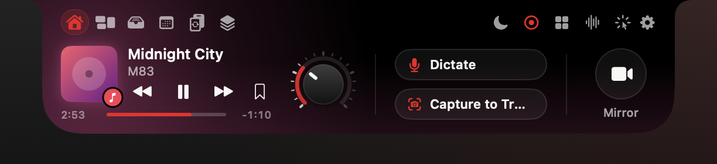
Technical briefing for developers and partners · October 2026
SparkV
The MacBook notch, rebuilt as an on-device AI runtime
Native Swift · AppKit + SwiftUI · macOS 15+ · Apple silicon
sparkv.si
Notes:
SparkV turns the MacBook notch into a control surface: hover the notch and a drawer slides out with media, a file tray, your day, converters, knowledge Spaces and a hub of more than twenty agents. This talk is about how it's built: the window, the activity engine, the on-device AI stack, the privacy model, the developer agents and how we build and ship. Every picture you'll see is a real render from the current source code, not a mock-up. Where something still needs a live check, I'll say so.

Slide 2
Codebase
The codebase at a glance
Counted from Sources/ on 22 October 2026
109,247
250
22
lines of Swift
source files
Labs feature modules
21
10
$0
drawer pages
files on FoundationModels
AI cost per user
Excludes vendored GlanceKit, the Node runners and the Now Playing adapter.
02
Notes:
About 109 thousand lines of Swift: 29 thousand in the core (window, activities, media, dictation, meetings, Clicky) and 80 thousand in 22 Labs modules. AI cost per user is zero because inference runs on the buyer's Mac; a cloud model is only used with the buyer's own key.

Slide 3
Codebase
Swift lines per Labs module
Counted from Sources/ on 22 October 2026
Source: wc -l Sources/Labs/<module>/*.swift, 22 Oct 2026
Red: UIAudit, BrowserRecorder and FlowCanvas, the developer agents in this deck. Excludes vendored GlanceKit, the Node runners and the Now Playing adapter.
03
Notes:
Line counts are a size signal, not a quality claim; the quality evidence is on the testing slide. The three highlighted modules (UIAudit, BrowserRecorder, FlowCanvas) are the developer agents shown later in the deck.

Slide 4
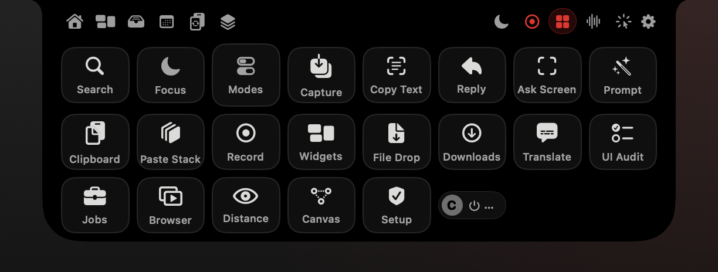
Architecture
One panel, thirty-one feature objects
How a non-activating NSPanel becomes a command center
NotchPanel: borderless, non-activating, .statusBar level, on every Space
Click-through at rest; becomes key only when a control needs it
NotchWindowController owns the controllers and one shared ActivityCenter
Features live in Sources/Labs/<Feature>/ with DESIGN.md and INTEGRATION.md
Real offscreen renders from current source, sample data.
04
Notes:
The whole app is one borderless, non-activating panel at status-bar level. It joins every Space, including full-screen apps, never steals focus, and lets clicks fall through while the island is closed. AppKit normally pushes windows below the menu bar, so the panel overrides constrainFrameRect to sit at the absolute top edge.

Slide 5
One panel, thirty-one feature objects
NotchPanel
NotchWindowController
NSPanel · .borderless + .nonactivatingPanel · level .statusBar · canJoinAllSpaces + fullScreenAuxiliary · ignoresMouseEvents at rest
owns 31 feature objects
ActivityCenter
shared live-activity queue
NotchHostingView
acceptsFirstMouse
Core controllers
MediaEngine, DictationController, ClickyController, HUDController, TimerController, MeetingsController, MeetingAssistant
NotchNookLayoutView
header icons · 21 drawer pages (NotchState.Tab)
Labs modules (22)
Converter, Spaces, UIAudit, BrowserRecorder, FlowCanvas, Clipboard, ...
AgentsHubView
22 tiles, 8x3
Labs contract
DESIGN.md → INTEGRATION.md → cp line in build.sh → lead wires shared files
Object graph from NotchPanel.swift and NotchWindowController.swift. Red outline: the panel every feature lives in.
05
Notes:
The window controller owns 31 long-lived feature objects plus the shared ActivityCenter. New features are built in isolation in a Labs folder: a DESIGN.md with the research and decisions, an INTEGRATION.md with exact wiring steps, then one copy line in build.sh. Only the lead touches the four shared files, which is what let us build features in parallel without merge fights.

Slide 6

Live activities
Live activities with Dynamic Island rules
A priority queue that never covers your work
Compact wings grow sideways inside the menu bar, 30–112 pt per side
Alerts of 8 s or less queue by priority; time runs only on screen
Preempted alerts resume; anything waiting 12 s is dropped
Persistent activities peek for 4 s, then rest in the wings
Bands render from source; key interception, banners and Bluetooth need a live check.
Real offscreen renders from current source, sample data. Shown: compact wings.
06
Notes:
The closed island follows Dynamic Island rules. Compact activities grow sideways inside the menu-bar height, so nothing below the menu bar is covered. Short alerts go into a priority queue whose clock only runs while they're visible, so a notification can't eat the charging alert. Volume and brightness are live feedback: newest wins and they're never replayed. Long-running things like a timer, a meeting or a recording peek in the band for four seconds and then tuck into the wings.

Slide 7





Live activities · band states
Live activities with Dynamic Island rules
wings · persistent
volume · live
battery · alert
AirPods · alert
notification · alert
recording · persistent
Real offscreen renders from current source, sample data. Bands cropped to the island.
07
Notes:
All of this is one ActivityCenter, and every feature posts a LiveActivity with a priority, an optional compact form and a tab to open on hover. Honest status: the bands render from source, but key interception, banners and AirPods need the running app to confirm.

Slide 8
On-device AI
The on-device AI stack
Apple frameworks first; the network is opt-in
FoundationModels
Vision
Speech
dictation cleanup, summaries, replies, prompts, plans
OCR everywhere, face landmarks for Screen Distance
SpeechAnalyzer on macOS 26+, SFSpeechRecognizer fallback
Translation
ScreenCaptureKit
NaturalLanguage
TranslationSession cached per language pair
stills for Ask Screen, SCStream audio for meetings
language ID and entities for Spaces
SparkV · Technical briefing
08
Notes:
One constraint shaped the code: we build with the Command Line Tools only, and the @Generable macro plugin isn't part of them, so guided generation uses DynamicGenerationSchema built at runtime. The model has a 4096-token context, so meeting transcripts are chunked. Speech uses the new SpeechAnalyzer and SpeechTranscriber on macOS 26 and falls back to SFSpeechRecognizer. ScreenCaptureKit gives us stills with SparkV's own windows excluded, and an SCStream with capturesAudio for meeting audio, which is why no bot has to join a call.

Slide 9
On-device AI
Source files importing each framework
Apple frameworks first; the network is opt-in
Source: grep -l "^import <Framework>$" over Sources/, 22 Oct 2026
Red: FoundationModels. Ink: the other on-device AI frameworks. Grey: system frameworks.
09
Notes:
Ten files use the on-device Apple Intelligence model through FoundationModels: Tray AI, Clicky, dictation formatting, meeting summaries and answers, Reply Drafter, Prompt Refiner, Live Translation's fallback, Ask Screen, Flow Canvas and Downloads.

Slide 10

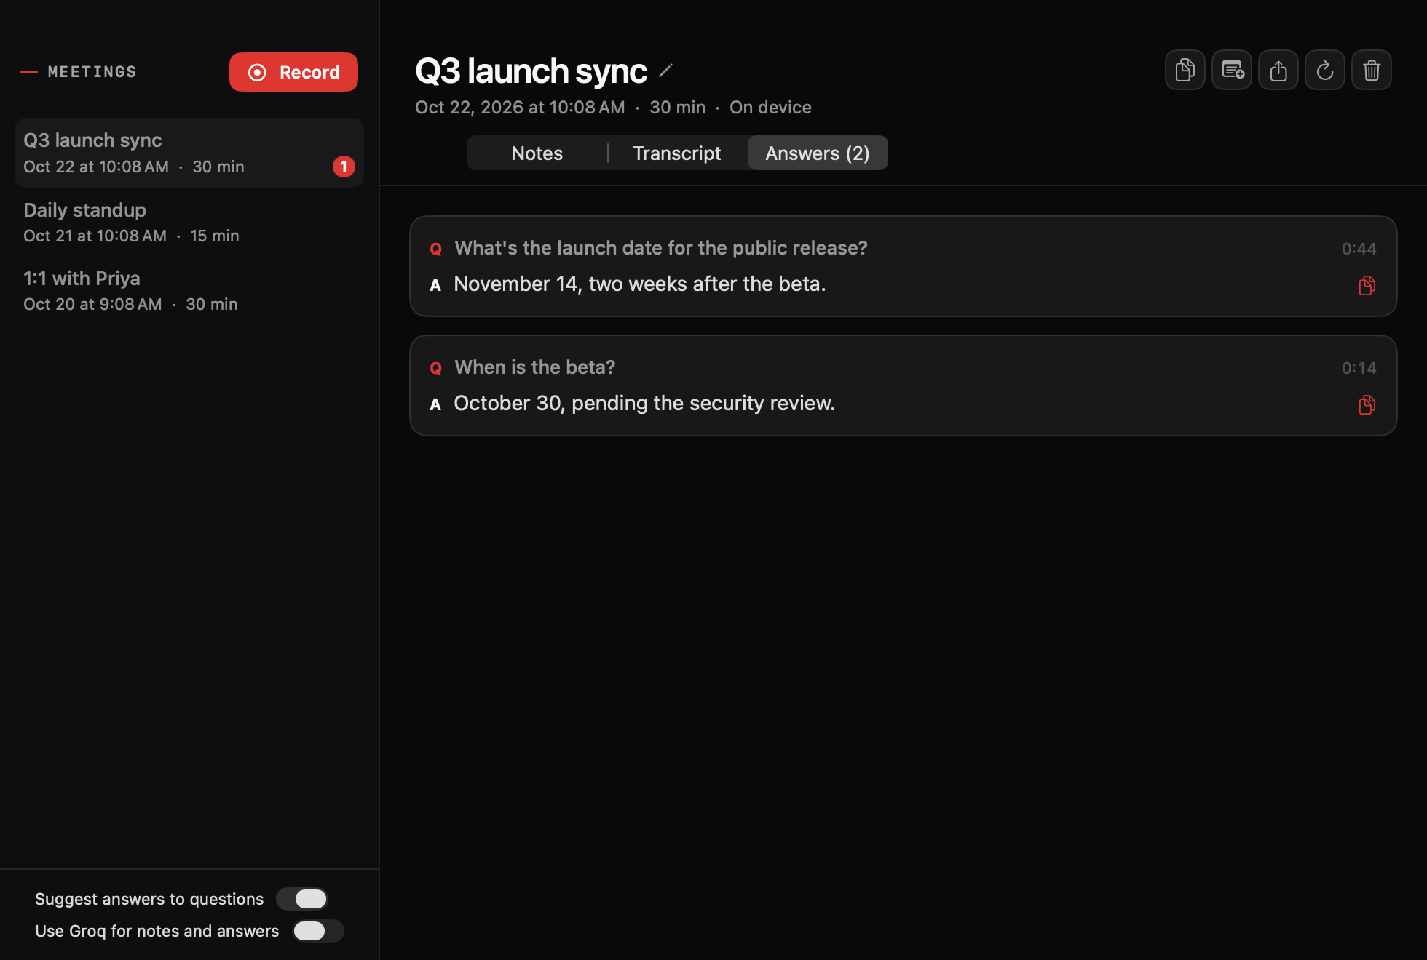
Dictation · Meetings
AI in the loop
Speech in, structured text out, on the Mac
Dictation: hold fn → on-device transcript → cleanup → typed at the cursor
Meetings: mic plus system audio, no bot joins, guided JSON summaries
Audio capture and the fn key need a live check; views render from saved data.
Real offscreen renders from current source, sample data.
10
Notes:
Three pipelines share one pattern: capture on device, recognise on device, structure with the on-device model. Dictation formats text with a prewarmed LanguageModelSession so the cleanup is fast when you release fn. Meetings record your mic and the meeting's audio through ScreenCaptureKit, transcribe on device and produce minutes, decisions and your tasks as guided JSON.

Slide 11
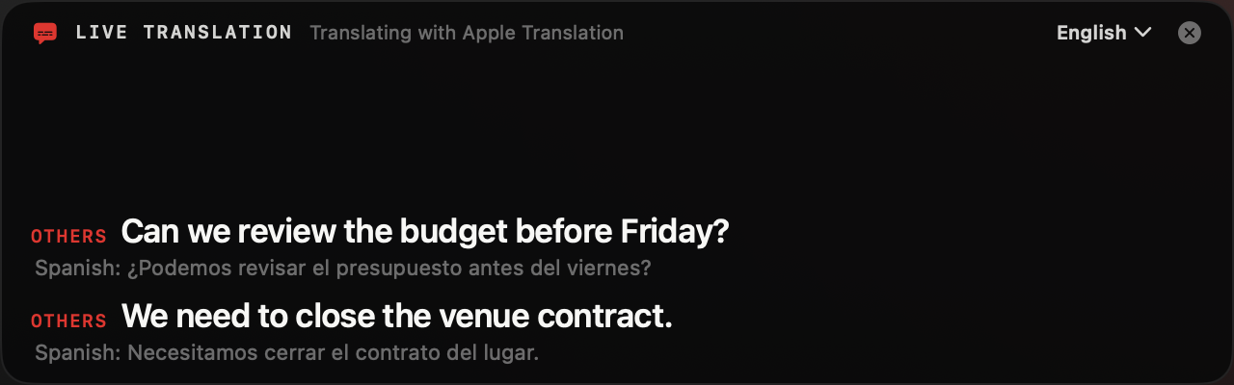
Live Translation
AI in the loop
Translation order: Apple Translation → on-device model → Groq if allowed
Warm translation: 0.33–0.8 s per caption
Apple Translation latency, measured on macOS 27 (seconds)
Sources/Labs/LiveTranslation/DESIGN.md, measured on the development Mac
Real offscreen renders from current source, sample data. Bars span the measured low–high range.
11
Notes:
Live Translation tries Apple Translation first, falls back to the on-device model when a language pair isn't downloaded, and uses Groq only if the user turned on that specific toggle. Cold sessions take two to three seconds; warm ones under a second per caption, which is why sessions are cached per pair.

Slide 12
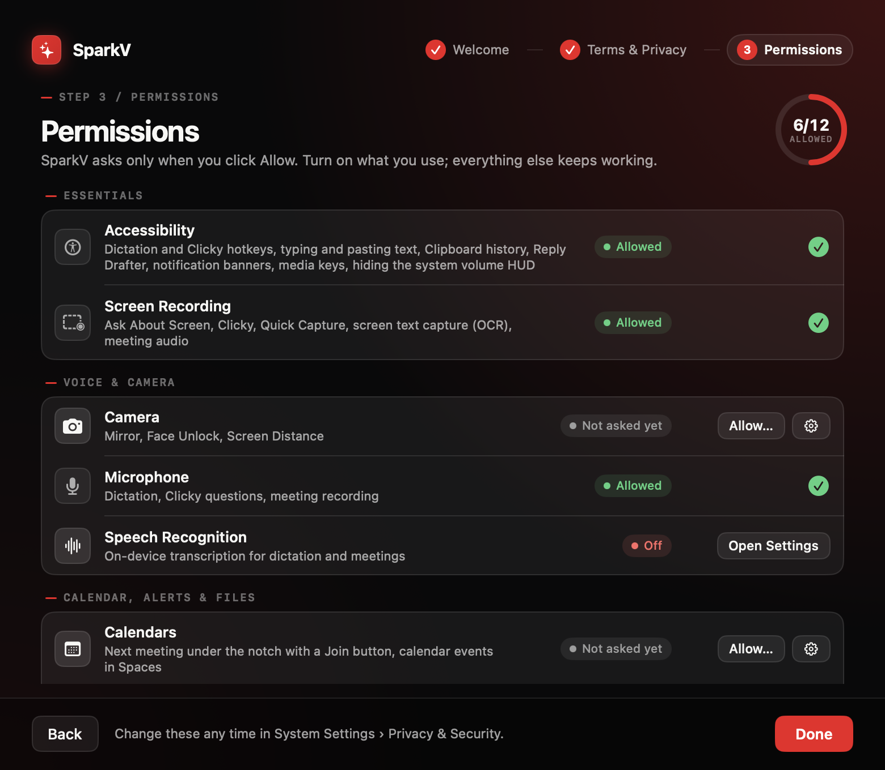
Private by default
Nothing leaves the Mac unless the user brings a key
On device: speech, camera, screenshots, clipboard, Spaces, meeting audio
Groq: per-feature toggle, off by default, the buyer's own key
While a toggle is off, the keychain is never read
Clipboard history starts off; concealed and transient copies are skipped
12 permissions, each asked only when the user clicks Allow
Real offscreen renders from current source, sample data.
12
Notes:
The privacy model is simple to state and easy to audit. Speech, camera, screen captures, clipboard, Spaces and meeting audio stay on the Mac. Groq is the only cloud path, and it's opt-in per feature: Clicky, Tray AI, meetings, Live Translation, Flow Canvas and UI Audit summaries each have their own switch, default off, using the buyer's own key. When a switch is off the code doesn't even read the keychain item. Clipboard history is off until you turn it on, and it honours the pasteboard conventions password managers use to mark concealed or transient copies. Setup asks for nothing up front: each of the 12 permissions is requested only when you click Allow, and every feature works in a reduced way without it. License checks, when they ship, will send the key, an anonymous device ID and the app version to Lemon Squeezy, and nothing else. There are no analytics.

Slide 13
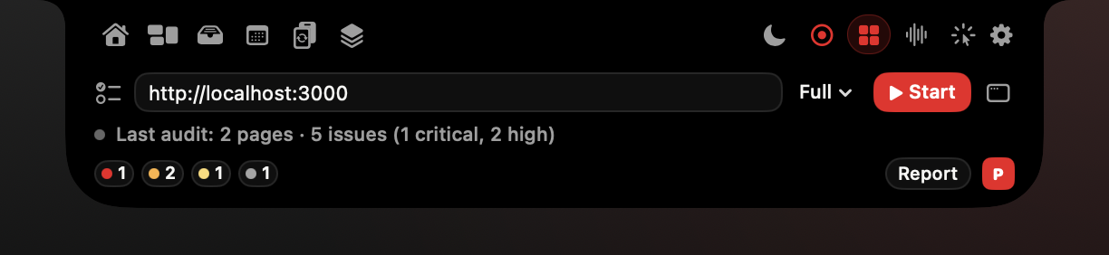
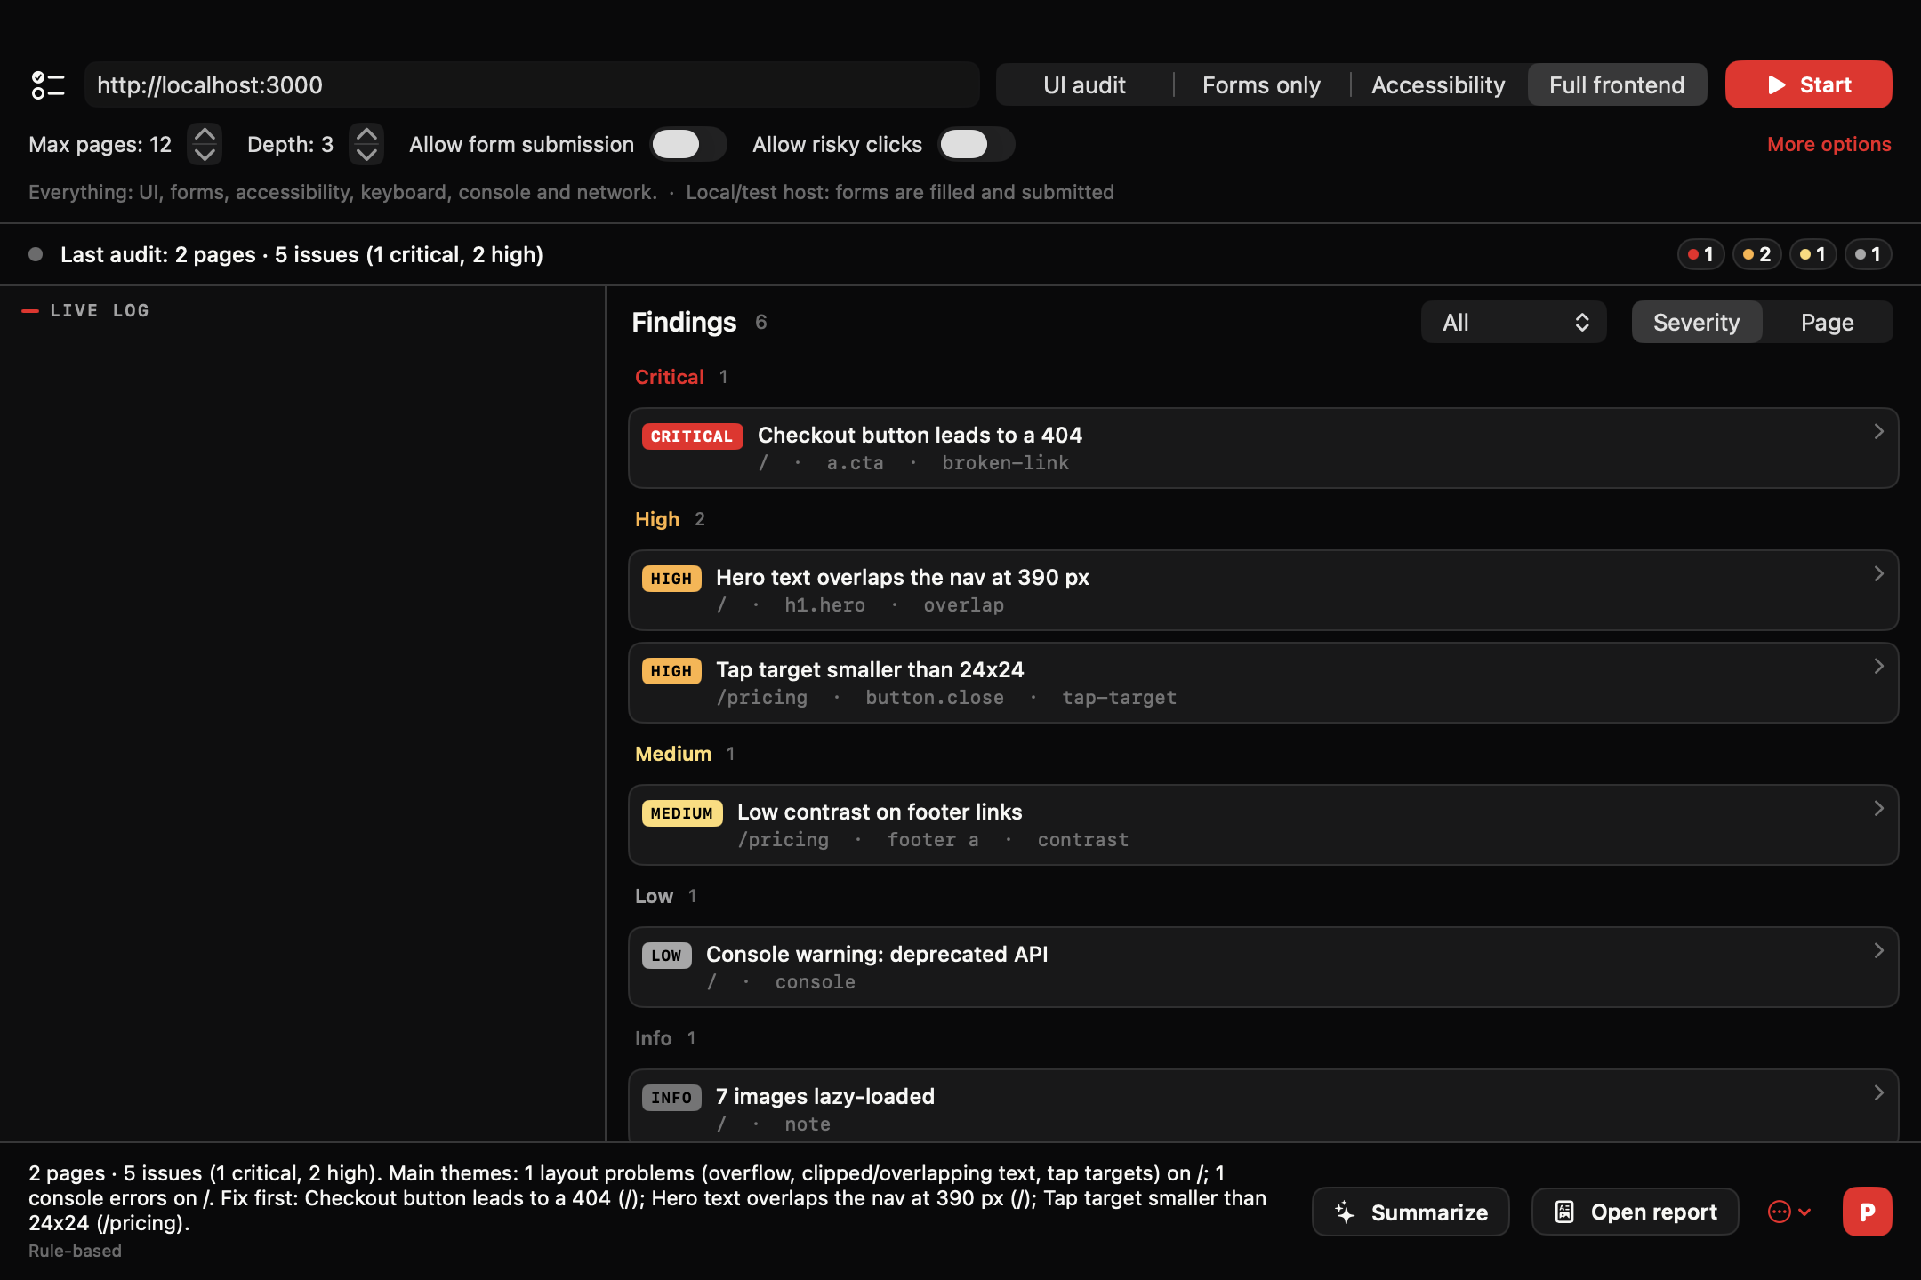
Developer agent · UI Audit
UI Audit: a QA agent for your own site
Started from the notch
Playwright and axe-core, started from the notch
Swift spawns node audit.mjs: JSON lines out; pause, resume, stop in
Crawl, forms, axe-core WCAG 2.2 AA, 1440/390 px layout, Tab order
Origin allow-list; writes blocked off test hosts; risky clicks skipped
P copies a fix prompt for Claude Code, Cursor or Copilot
Real offscreen renders from current source, sample data.
13
Notes:
UI Audit audits websites you own. The Swift controller writes a run config, starts a Node runner with Playwright and axe-core, and talks to it over JSON lines: plan, page, step and finding events come out; pause, resume and stop go in. If the app dies, stdin closes and the runner stops, so you never leak a crawler. The runner crawls, checks layout at 1440 and 390 pixels, walks the Tab order, runs axe-core for WCAG 2.2 A and AA, and fills forms with type-correct test data. The safety model is strict: navigation outside the allowed origins is aborted, every non-GET request is blocked unless the host is local or test or you opt in for this run, and anything that looks like pay, delete or log out is never clicked. It needs Node 20 and Playwright's Chromium on the machine today.

Slide 14
Developer agent · UI Audit
Findings by severity, planted-issue test site
6
69
51,666-char
48/48
pages
findings
fix prompt
self-test
Source: Feature Guide §25 end-to-end run (6 pages, 69 findings); medium/low split from the run's status badges in 22-ui-audit-window.png
Planted-issue test site on 127.0.0.1. Severity colours are the app's own.
14
Notes:
The numbers are from a real end-to-end run against our planted-issue test site: 69 findings, an on-device summary, and a 51,666-character fix prompt. The runner's own self-test passes 48 of 48, including the checks that it never hit the logout or delete URLs.

Slide 15
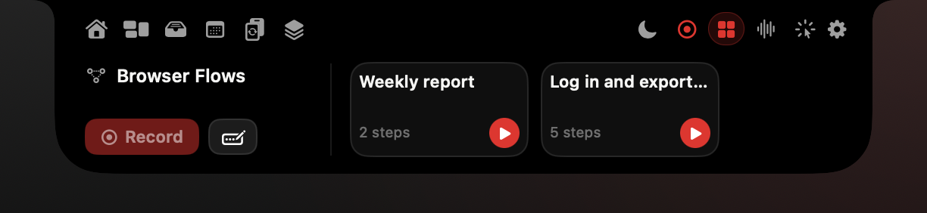
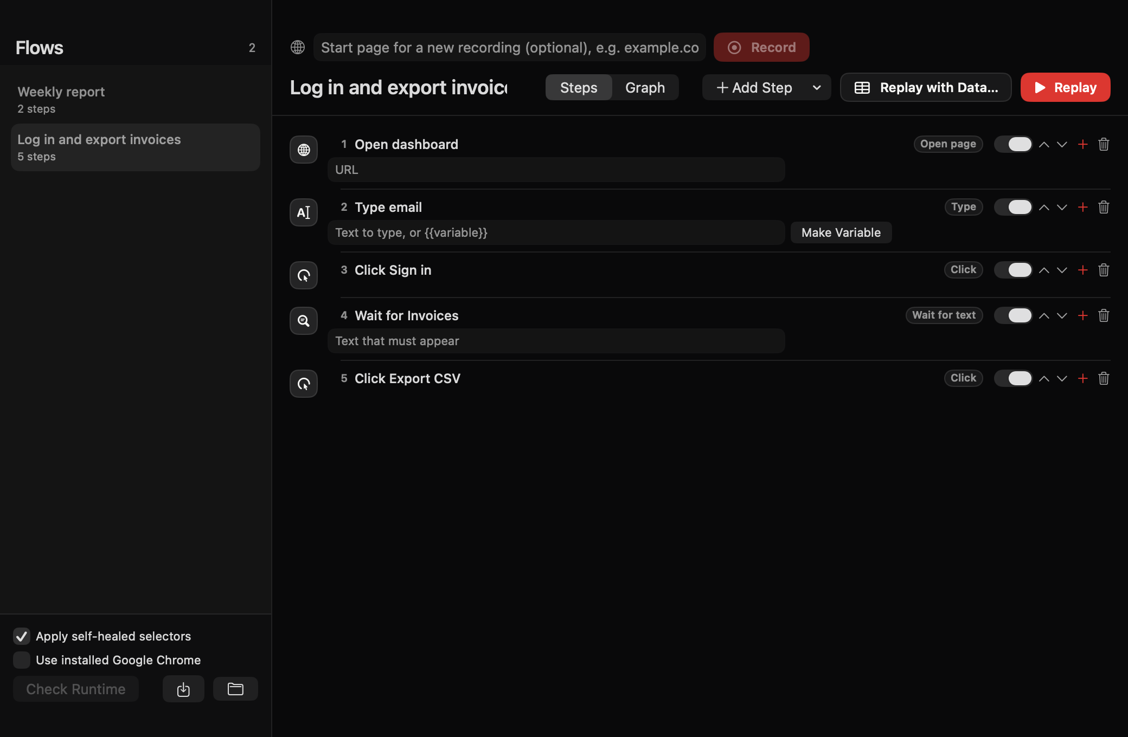
Developer agent · Browser Flows
Browser Flows: record once, replay with data
Self-healing selectors; secrets are never stored
Each step stores ranked selectors and an element fingerprint
Healing accepts a match of 0.6 or more that clearly beats the runner-up
Passwords become {{password}}, asked at replay, sent over stdin
CSV loop: one replay per row, up to 500 rows
Self-test not yet clean under load: one replay timed out, one CSV loop hung. Fix before launch.
Real offscreen renders from current source, sample data.
15
Notes:
Browser Flows records a browser task once and replays it. Each recorded step keeps an ordered list of selectors, in the spirit of Selenium IDE's targets list, plus a fingerprint of the element: tag, role, accessible name, text, attributes and ancestor path. When every selector fails, the runner scores all elements against the fingerprint and accepts the best one only if it scores at least 0.6 and clearly beats the runner-up, then writes the healed selector first. Password, card, CVV, OTP and SSN fields are never read: they become variables and are passed over stdin at replay, never on the command line. Flows that mention purchase, payment or delete need an explicit confirmation. Honest status: the recorder self-test isn't clean yet; under heavy load one replay timed out and a CSV loop hung. That's on the roadmap before launch.

Slide 16
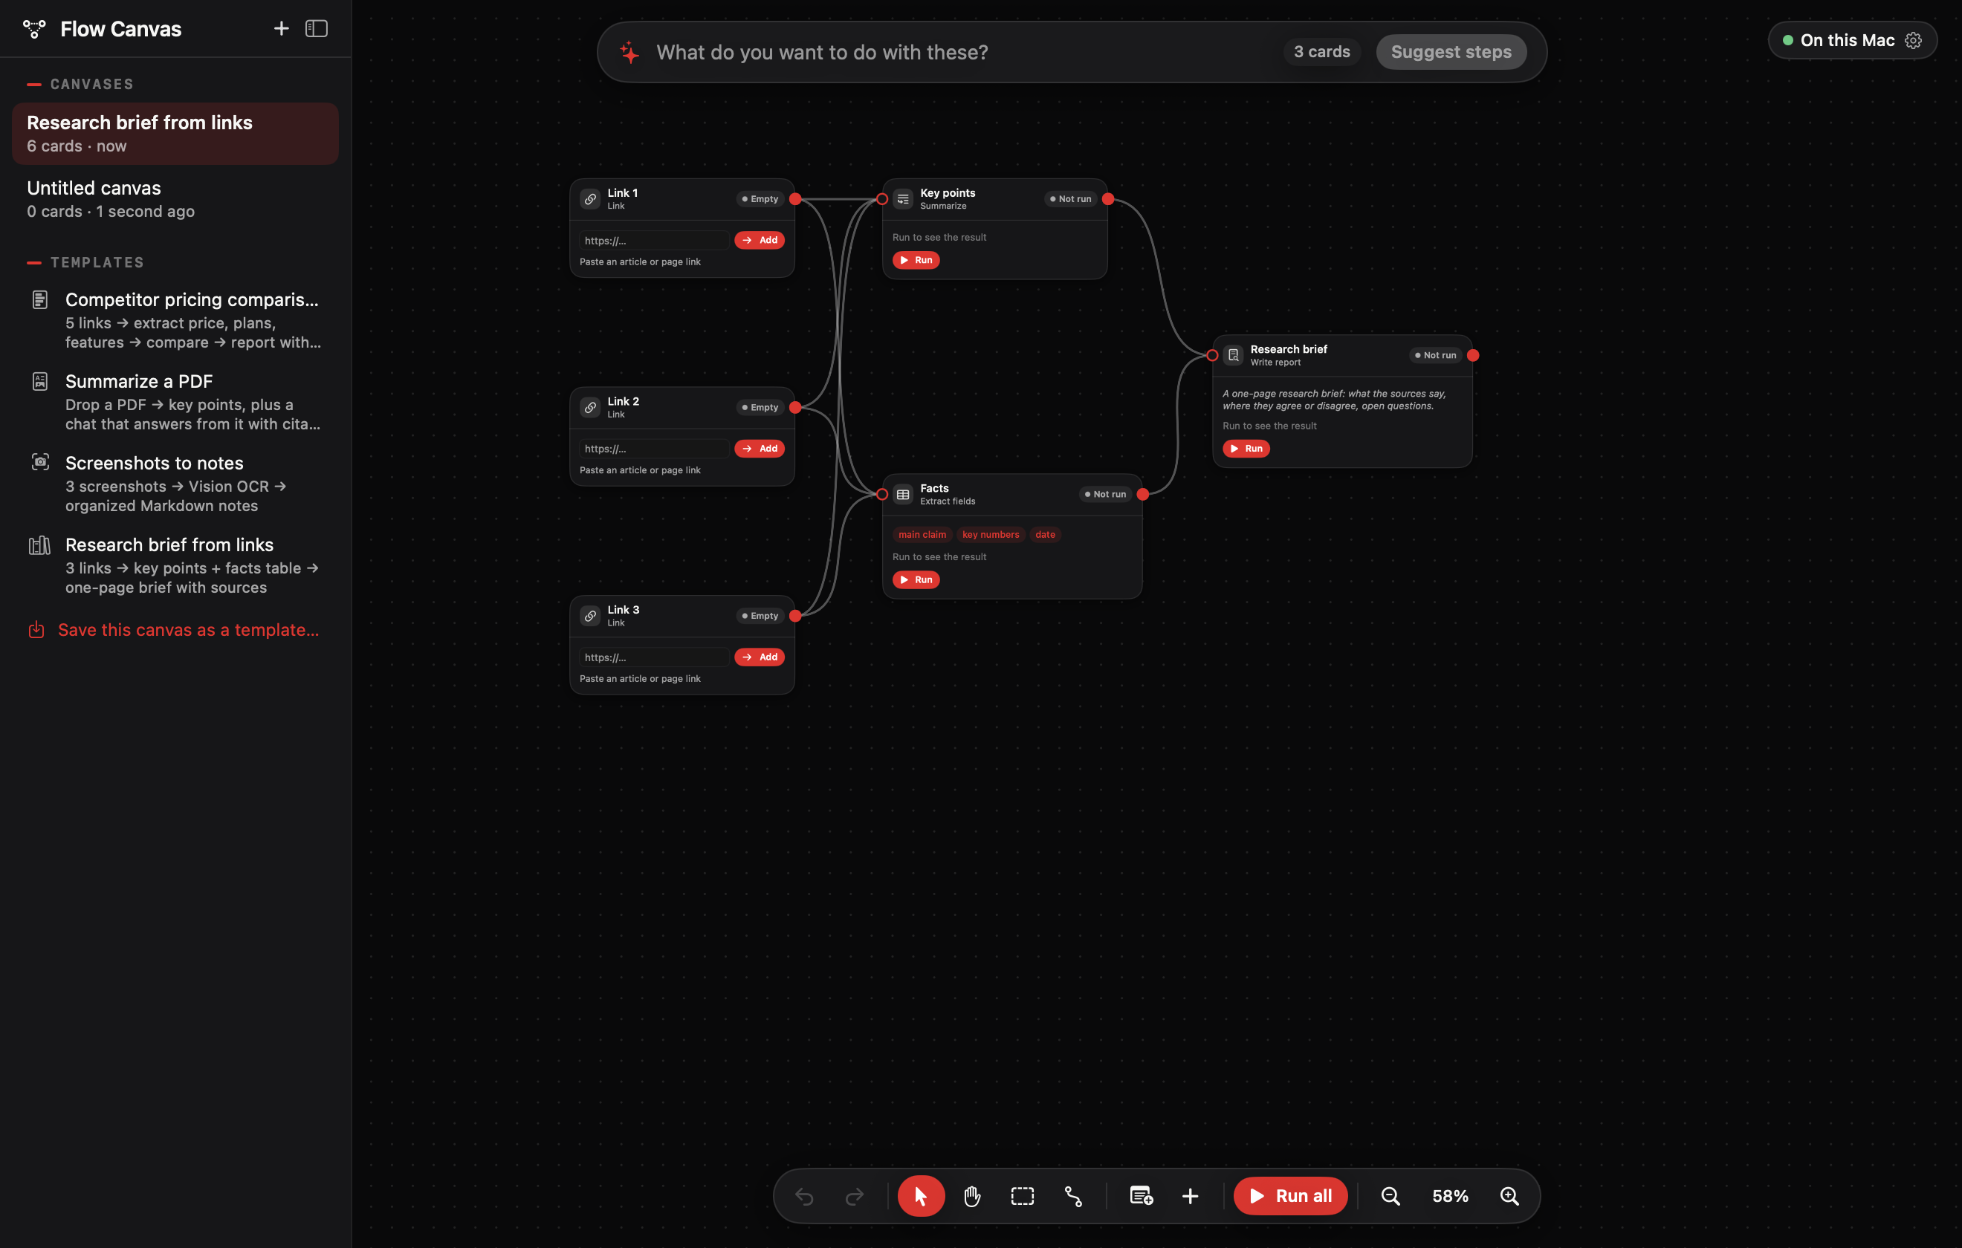
Developer agent · Flow Canvas
Flow Canvas: workflows as a graph
Sources in, actions chained, run on this Mac
Drop links, PDFs, screenshots and notes as source cards
Chain extract, compare, summarize, report and chat-with-sources
"Suggest steps" plans the chain from one sentence
Export to Markdown, PDF, CSV, Tray, Notes or a Space
Real offscreen renders from current source, sample data.
16
Notes:
Flow Canvas is a whiteboard for AI workflows. Source cards hold links, PDFs, screenshots or notes; action cards extract fields, compare, summarize or write a report; edges carry data between them, and Run all executes the graph. You can also describe the goal in one sentence and Suggest steps builds the chain. It ships with four templates, including the competitor pricing comparison you see here. The engine indicator top right says 'On this Mac': FoundationModels, Vision OCR and Apple Translation do the work. Groq is a separate opt-in for this feature only. Canvases are plain versioned JSON in Application Support, and dropped files are copied into the canvas's assets folder; originals are never moved.

Slide 17
Engineering
Engineering practices
A small toolchain and strict habits
CLT-only
No macro plugins
Temp-dir builds
one zsh build script, no Xcode project required
no @State, #Preview, @Entry, @Generable
iCloud can't modify files mid-compile
Stable signing
Hardened Runtime
Real-source harnesses
permission grants survive every rebuild
explicit camera, mic, calendar, Apple Events entitlements
Swift 5 and 6, private pasteboards
Build details: build.sh and NotchIsland.entitlements.
17
Notes:
We build with the Command Line Tools only. build.sh copies sources into a temp folder, compiles GlanceKit as a static library with its own concurrency settings, compiles the app, builds the Now Playing adapter framework with clang, signs nested code first and then the app with the Hardened Runtime. The temp folder exists because the project lives on iCloud Desktop, which touches files mid-build and adds Finder attributes codesign rejects. No Xcode means no macro plugins, so the code avoids @State, #Preview, @Entry and @Generable. A stable self-signed identity, 'NotchIsland Developer', gives every build the same designated requirement, so Accessibility and Screen Recording grants survive rebuilds.

Slide 18
Engineering
Harness checks passing on 22 Oct 2026
A small toolchain and strict habits
Log scale. The widget harness sweeps time zones and has far more checks than the others; don't read it as a coverage ranking.
Browser Flows recorder self-test: not clean, so no bar is drawn.
Source: Feature Guide, Verification summary
SparkV · Technical briefing
18
Notes:
Tests are harnesses that compile the real app sources, for example the clipboard harness runs against private named pasteboards, never the general one, in both Swift 5 and Swift 6 modes. The log scale is there because the widget harness sweeps time zones and has far more checks than the others; don't read it as a coverage ranking.

Slide 19
Distribution
Shipping outside the Mac App Store
What the sandbox blocks, and the release pipeline we're adding
WHY NOT THE APP STORE
DEVELOPER ID PIPELINE (PLANNED)
Accessibility APIs don't work in the App Sandbox
01
Developer ID Application cert replaces the local identity
Event taps and CGEvent.post for fn, media keys and paste
02
Sign nested code with --options runtime --timestamp
Private DisplayServices and MediaRemote (via /usr/bin/perl)
03
notarytool submit --wait, then stapler staple
04
Sparkle 2 updates with an EdDSA-signed appcast
Spawning Node, Playwright and /usr/bin/shortcuts
05
Lemon Squeezy License API: activate, validate, deactivate
Sandbox constraints: Business Plan §5.
19
Notes:
SparkV can't be sandboxed. Apple's DTS says Accessibility APIs aren't compatible with the App Sandbox, and we also need event taps for the fn key, posted key events for paste, private DisplayServices for the HUD, the MediaRemote adapter for Now Playing, and child processes for Node and Shortcuts. NotchNook stays off the App Store for the same MediaRemote reason. So we ship direct: a Developer ID certificate replaces today's local identity, every nested binary is signed with the Hardened Runtime and a secure timestamp, the DMG is notarized and stapled, and Sparkle 2 delivers updates from a signed appcast. Since Sequoia, an un-notarized app can't be opened with right-click Open, so notarization isn't optional for a paid product. The local identity stays for development builds. Sources for the sandbox constraints are in the business plan, section 5.

Slide 20
Pricing built on zero AI cost
One-time Pro, because inference runs on the buyer's Mac
FREE
PRO (RECOMMENDED)
TEAM
Price
$0
$39 one-time · launch $29
$8 per seat per month, billed yearly
India
₹0
₹1,499 · launch ₹999
₹499 per seat per month
Updates
—
12 months included, optional $19/yr renewal
included
Notch core
Media, HUD, battery, tray, timer, Today
Everything
Everything
AI assistants
Dictation without AI formatting
Dictation with AI, Clicky, Ask Screen, Reply Drafter, Prompt Refiner, Tray AI, Job Agent
Everything
Developer tools
—
UI Audit, Browser Flows, Flow Canvas
Everything
Extras
—
14-day trial, no card · 2 Macs
Invoice, seat management, MDM .pkg · min 3 seats
Source: Business Plan §6a. Per-pack pricing ($9–$19 per pack, 'Everything' = Pro) is designed but not launched (Business Plan §6b).
20
Notes:
For partners, the business model matters because it's shaped by the architecture. We pay nothing per user for AI, so we can charge once instead of monthly. Pro is $39 one-time with a $29 launch price, 1,499 rupees in India. Team is $8 per seat per month billed yearly. Developer tools sit in Pro.

Slide 21
Pricing
Net per sale after merchant-of-record fees (USD)
One-time Pro, because inference runs on the buyer's Mac
YEAR-ONE REVENUE SCENARIO
Pro units × $36.55 + Team seats × $90.22
Pro units
[TBD]
Team seats
[TBD]
Year-one revenue
[TBD]
Do not draw this chart with invented values: it stays a table until real sales exist.
Source: Derived from Business Plan §4 Lemon Squeezy fees (5% + 50¢; +0.5% on subscriptions). Excludes ~1.5% non-US surcharge and payout fees.
Revenue scenario stays a placeholder until there are sales.
21
Notes:
After merchant-of-record fees we keep about $36.55 of a $39 sale. We don't have sales yet, so there's no revenue chart with numbers; the scenario row stays a placeholder until we do.

Slide 22
Value
One app, not a six-app stack
Comparable tools, and the platform SparkV runs on
First-year cost of comparable tools (USD)
$491.99
Comparable-tool stack, year one
$39
SparkV Pro, one-time
Source: Business Plan §3 and §6a
Overlap is by category, not feature parity. Prices are third-party listings (Business Plan §3); check vendor pages before quoting publicly.
22
Notes:
A buyer who wants what SparkV does would otherwise assemble a stack: a notch app, a clipboard manager, dictation, meeting notes, a launcher with AI and a screenshot tool. Year one of that stack is about $490; SparkV Pro is $39. That's a category comparison, not a claim that every feature matches.

Slide 23
Platform
Apple's active installed base
MAC-SPECIFIC FIGURES
Active Apple devices (billions, all products)
Mac active base
100M+ (Apple, October 2018; latest Mac-only figure)
Notched Apple-silicon MacBooks on macOS 15+
[TBD: sourced estimate]
SparkV waitlist / users
[TBD: monthly active users]
Source: Apple earnings calls via 9to5Mac and supportplan.com; AppleInsider
Apple has not published a Mac-only active base since 2018.
23
Notes:
On the right, platform context: Apple reports 2.5 billion active devices across all products. Apple hasn't published a Mac-only figure since 'over 100 million' in 2018, so the number we actually need, notched MacBooks on macOS 15 or later, is marked to be sourced. We have no user numbers to show yet.

Slide 24
Roadmap
From a local build to a notarized 1.0 in 30 days
Day 1 = [TBD: launch kickoff date]
Days 1–3
Developer ID cert, Lemon Squeezy products, domain
Days 4–7
Face Unlock out of the sold build (ArcFace is non-commercial); acknowledgements; legal pages
BLOCKER
Days 8–12
Licensing, trial and gating in Labs/Licensing; Sparkle; notarized DMG
Days 13–15
Clean-Mac test: Gatekeeper, onboarding, trial, key, 1.0 → 1.0.1 update
Days 16–25
Landing page, demo video, private beta of 30–50 users
Days 26–27
Ship 1.0, launch price on, Product Hunt
Days 28–30
1.0.1 through Sparkle, Show HN, affiliates
SparkV · Technical briefing
24
Notes:
The launch plan is thirty days. The engineering-heavy parts are days 8 to 15: licensing with Lemon Squeezy's License API, Keychain-stored trial dates, a 14-day offline grace window, gating at the window controller so locked features never even instantiate, Sparkle, and a notarized DMG, then a clean-Mac test on a fresh user account. Two known blockers are explicit: Face Unlock comes out of the commercial build because of the ArcFace licence, and UI Audit and Browser Flows currently need Node on the buyer's Mac.

Slide 25
Roadmap
After 1.0
01
Fix the Browser Flows self-test
02
Decide: bundle a signed Node (+40–100 MB) or require it
03
Feature packs
04
Setapp (month 3+)
05
Spaces live sync (not built; today Spaces share as .sparkvspace packages)
SparkV · Technical briefing
25
Notes:
After 1.0 the first engineering item is making the Browser Flows self-test pass reliably. Shared Spaces today is a file package; live sync doesn't exist and we don't advertise it.

Slide 26

Build on the notch with us
Early access for developers and technical partners
Beta: run UI Audit and Browser Flows against your own staging sites
Partners: [TBD: partnership tracks]
sparkv.si
[TBD: contact email]
Notes:
If you build websites, the fastest way to judge SparkV is to point UI Audit at your own staging site and read the fix prompt it produces. We're looking for beta testers for the developer tools and for partners; the specific partnership tracks and the contact address are being finalised. Questions.

Slide 27
Backup
Comparable-tool prices behind the stack chart
Stack total of the six tools, year one: $491.99
PRODUCT
CATEGORY
FIRST-YEAR COST
BASIS
SOURCE
Granola Business
Meeting notes
$168.00
$14/user/mo x 12
granola.ai
Wispr Flow Pro
Dictation
$144.00
$144/yr
getvoibe.com
Raycast Pro
Launcher + AI
$96.00
$8/mo billed yearly
raycast.com
Paste
Clipboard
$29.99
$29.99/yr
apps.apple.com
CleanShot X
Screenshots
$29.00
one-time, 1 yr updates
toolradar.com
NotchNook
Notch hub
$25.00
one-time
imore.com
SparkV Pro
All of the above categories
$39.00
one-time (launch $29)
Business Plan §6a
Business Plan §3 and §6a. Overlap is by category, not feature parity. Prices are third-party listings (Business Plan §3); check vendor pages before quoting publicly.
A1
Notes:
Backup for the stack-cost slide. Full source links: Granola Business: https://granola.ai/blog/granola-pricing-plans-features-roi; Wispr Flow Pro: https://www.getvoibe.com/resources/wispr-flow-pricing/; Raycast Pro: https://www.raycast.com/blog/changing-how-raycast-ai-is-priced; Paste: https://apps.apple.com/app/id967805235; CleanShot X: https://toolradar.com/tools/cleanshot/pricing; NotchNook: https://www.imore.com/apps/mac-apps/this-dollar25-app-gives-my-macbook-pro-a-dynamic-island-and-it-was-worth-every-penny; SparkV Pro: Business Plan §6a. Overlap is by category, not feature parity. Prices are third-party listings (Business Plan §3); check vendor pages before quoting publicly.

Slide 28
Backup
Net per sale after merchant-of-record fees
ITEM
LIST PRICE
FEE
NET TO SPARKV
Pro, student (50% off)
$19.50
$1.48
$18.03
Pro, launch
$29.00
$1.95
$27.05
Pro
$39.00
$2.45
$36.55
Team, per seat-year
$96.00
$5.78 (5% + $0.50 + 0.5% subscription surcharge)
$90.22
Derived from Business Plan §4 Lemon Squeezy fees (5% + 50¢; +0.5% on subscriptions). Excludes ~1.5% non-US surcharge and payout fees.
A2
Notes:
Backup for the net-per-sale chart. Derived from Business Plan §4 Lemon Squeezy fees (5% + 50¢; +0.5% on subscriptions). Excludes ~1.5% non-US surcharge and payout fees.

Slide 29
Backup
Apple installed-base figures and sources
DATE
FIGURE
SOURCE
NOTE
Jan 2024
2.20 B
supportplan.com
prior-year figure cited on Apple's FQ1 2025 call
Jan 2025
2.35 B
supportplan.com
Jan 2026
2.50 B
9to5mac.com
Oct 2018
Mac active base: 100M+
forums.appleinsider.com
Notched Apple-silicon MacBooks on macOS 15+: [TBD: sourced estimate]
SparkV users: [TBD: monthly active users]
Apple earnings calls via 9to5Mac and supportplan.com; AppleInsider
A3
Notes:
Backup for the installed-base slide. Full links: Jan 2024: https://supportplan.com/apple-has-more-than-2-35-billion-active-devices-up-550-million-since-2022; Jan 2025: https://supportplan.com/apple-has-more-than-2-35-billion-active-devices-up-550-million-since-2022; Jan 2026: https://9to5mac.com/2026/01/29/apple-reveals-it-has-2-5-billion-active-devices-around-the-world/; Mac active base: https://forums.appleinsider.com/discussion/208001.

