Slide 1
PAPER PRESENTATION TOWARDS FOG-DRIVEN IOT EHEALTH: PROMISES AND CHALLENGES OF IOT IN MEDICINE AND HEALTHCARE Team Koushik Pabbathireddy – 801203319 Poojith Chandra Borra - 801197162 Kushal Guduru Venkateshgupta Mahika SareenMahika Sareen

Slide 2


Introduction to IoT
IoT system consists of sensors, interfaces for communication, advanced algorithms, and cloud interface.
Types of IoT Devices
Smart wearable devices.
Sensors can detect the changes in temperature, air-conditioning systems can be monitored.
Home security cameras.
Traffic and transport systems.
Supply chain system.

Slide 3
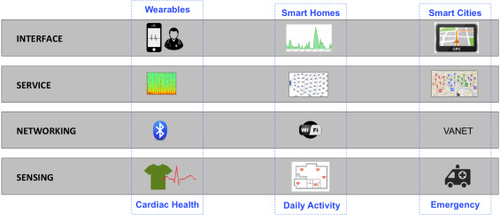
Introduction
IoT follows a multi-layer architecture to communicate and is applicable to healthcare technologies and services
IoT eHealth can work seamlessly with security. Since it is a challenge to retain a high level of security and privacy for healthcare sector.

Slide 4
Introduction
Sensing Layer
Networking Layer
Service Layer
Interface Layer

Slide 5
Promises and visions of IoT in healthcare
Limited time and prospective: increasing population with illnesses and disabilities limits the physicians to check each patient with a quality time.
Adherence monitoring: physicians are not better equipped to check if their patients are adhering to prescribed treatment that may include medications, rehabilitation exercises, and some preventive activities such as avoiding some diet.
Shortage of healthcare workforce: as the demand for healthcare services increases, it equally increases the demand for healthcare workers including physicians, surgeons, dentists, nursing staff, nurse assistants, professional caretakers, and laboratory staff who could enhance the healthcare ecosystem in urban and rural areas.

Slide 6
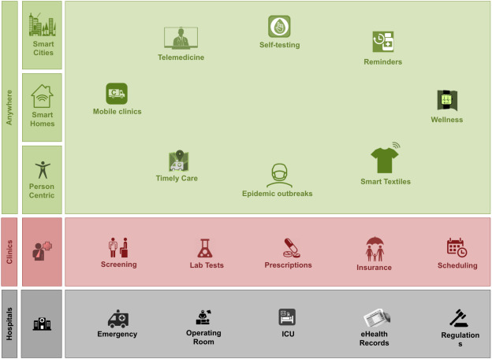
IoT-driven healthcare: transitioning from hospital-centric to patient-centric
In the IoT aspect of monitoring a patient health it follows all the above given layers of communication.
From the figure we can see that IoT has changed a systematic approach of getting treated.
This system always monitors the patient's overall health.

Slide 7

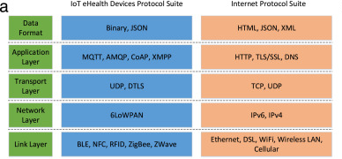
IoT eHealth Devices Protocol

Slide 8
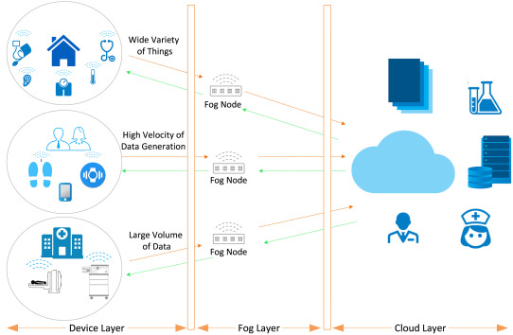
IoT eHealth ecosystem
The IoT eHealth ecosystem consists of the following layers that are handling the whole communication between the patients and the healthcare service providers.
Device Layer
Fog layer
Cloud layer

Slide 9
eHealth Fog Layer
Problem:
eHealth is among those critical IoT applications which cannot afford latency.
Therefore, based on the traditional model depending on the cloud computing model is not feasible and efficient. A new approach to avoid latency is introduced which is called fog computing.
Solution:
The most efficient approach to tackle this issue is using fog or edge computing to take the cloud computing and services to the next level. A fog node is defined as a device with computing, storage, and network connectivity. In the proposed eHealth platform, we analyze the time-sensitive data, and make the extremely time-sensitive decision on the fog nodes. These nodes are placed closest to the medical devices that produce the data.

Slide 10
eHealth Fog Layer
Problem:
Another main issue with IoT eHealth is to conserve the network bandwidth.
Solution:
Lots of data is sent to the cloud from the patient's dictionary which is also including some duplicate data is not efficient. As a result, fog nodes are reasonable to process, filter, and compress the data traveling between the medical devices and the cloud that are available within the point of communication.

Slide 11
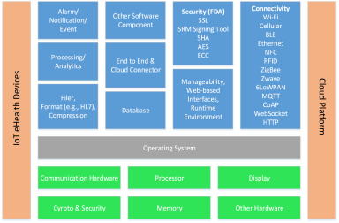
eHealth IoT Fog Layer
Architecture of Fog Computing Layer

Slide 12
Features of Fog Computing
Connectivity: fog nodes support wide-range of hardware interfaces and protocols.
Two-way data exchange: fog nodes involve a bi-directional data flowing.
Flexible integration: fog nodes receive, collect and capture patient’s data from sensors and medical devices in real-time.
Protocol translation: similar to devices, there is a wide variety of protocols.
Interoperability at network layer
Interoperability at messaging layer
Interoperability at data annotation layer
Data aggregation, filtering, formatting, and encoding/decoding.
Short-time database
Security and data protection
Assessment and notification
Local processing

Slide 13
Case study 1 - Smart Eyeglasses
Monitoring continuous heart rate.
This device consists of amplified pulse sensor with green LED light.
Microcontroller will amplify the output signal of the heart rate to the nearby fog node.
Fog node is responsible to aggregate the HR values from the smart glasses, convert them to XML format.
Fog node used in this case study is based on Qualcomm Snapdragon.

Slide 14
Case study 2 - Smart glove with fog-driven IoT
Monitoring Parkinson's disease
The smart glove is stitched with flex sensors on the pointing finger and the thumb to detect the motor symptoms in the hand such as tremors, rigidity, and slowness of movements
The Smart Glove uses Bluetooth low energy for communication with local network.
The data collected from the Smart Glove is stored into a text file. The embedded fog computer (Edison or Raspberry Pi) acts as a gateway to the cloud as well as a platform for processing the data.

Slide 15

Thank you

