Slide 1

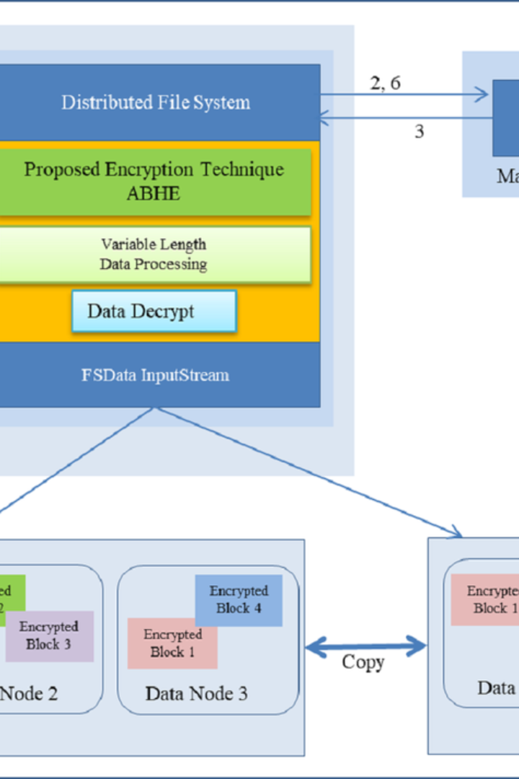


Hadoop Storage File System
The Hadoop Storage File System (HDFS) is a distributed file system designed to store vast amounts of data reliably and efficiently. It provides high-throughput access to application data and is suitable for applications with large data sets. HDFS is the primary storage system used by Hadoop applications.
By Guru koushik

Slide 2
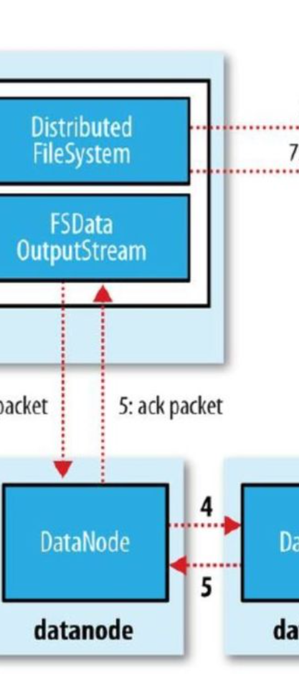
Creating Directory Structure in HDFS
1
Step 1: Run the Command
Use the command hdfs dfs -mkdir /6779 to create a directory structure in HDFS. This will create a directory named "6779" in the root directory ("/") of HDFS.
2
Step 2: Verify the Creation
After running the command, you can verify the creation of the directory by listing the contents of the root directory using hdfs dfs -ls /.

Slide 3
Moving Files to HDFS
From Local to HDFS
Verification
Use the command hdfs dfs -put <local_file_path> <hdfs_directory_path> to move a file from the local Unix/Linux machine to HDFS. Replace <local_file_path> with the path to the file on your local machine and <hdfs_directory_path> with the path to the destination directory in HDFS.
Once the file has been moved to HDFS, you can verify the successful transfer by using the command hdfs dfs -ls <hdfs_directory_path> to see the contents of the HDFS directory.

Slide 4
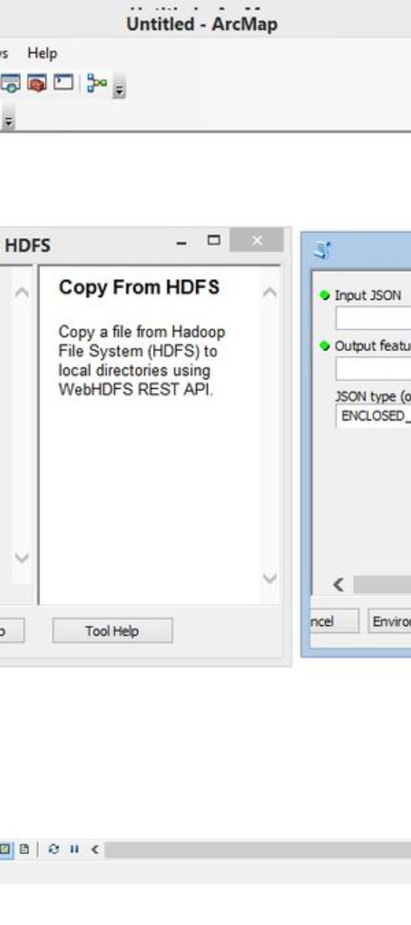
Viewing Data in HDFS
1
Viewing Contents of Files
2
Browsing Directory Contents
To see the contents of files in HDFS, use the command hdfs dfs -cat <hdfs_file_path>. Replace <hdfs_file_path> with the path to the file in HDFS.
If you want to see the contents of files in a directory in HDFS, you can use the command hdfs dfs -ls <hdfs_directory_path>. Replace <hdfs_directory_path> with the path to the directory in HDFS.

Slide 5

Retrieving Files from HDFS
Copy to Local File System
When you need to get files from HDFS to the local file system, use the command hdfs dfs -get <hdfs_file_path> <local_destination_path>. Replace <hdfs_file_path> with the path to the file in HDFS, and <local_destination_path> with the path to the destination on your local machine.

Slide 6
To delete files or directories in HDFS, you can use the following commands:
Command to delete a file from HDFS:
hdfs dfs -rm <hdfs_file_path>
Replace <hdfs_file_path> with the path to the file in HDFS that you want to delete.
2. Command to delete an empty directory from HDFS:
hdfs dfs -rmdir <hdfs_directory_path>
Replace <hdfs_directory_path> with the path to the empty directory in HDFS that you want to delete.
3 . Command to delete a directory and its contents from HDFS:
hdfs dfs -rm -r <hdfs_directory_path>
Replace <hdfs_directory_path> with the path to the directory in HDFS that you want to delete along with its contents.
These commands will help you manage and clean up data in HDFS as needed.

