Slide 1
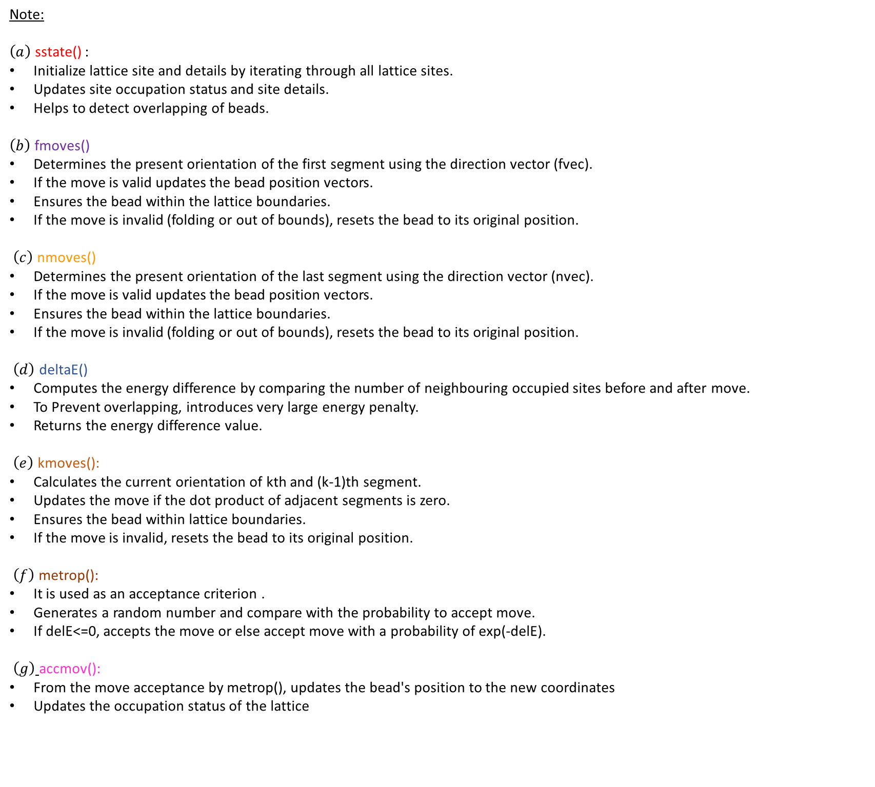
Note:
$\left(a\right)$ sstate() :
Initialize lattice site and details by iterating through all lattice sites.
Updates site occupation status and site details.
Helps to detect overlapping of beads.
$\left(b\right)$ fmoves()
Determines the present orientation of the first segment using the direction vector (fvec).
If the move is valid updates the bead position vectors.
Ensures the bead within the lattice boundaries.
If the move is invalid (folding or out of bounds), resets the bead to its original position.
$\left(c\right)$ nmoves()
Determines the present orientation of the last segment using the direction vector (nvec).
If the move is valid updates the bead position vectors.
Ensures the bead within the lattice boundaries.
If the move is invalid (folding or out of bounds), resets the bead to its original position.
$\left(d\right)$ deltaE()
Computes the energy difference by comparing the number of neighbouring occupied sites before and after move.
To Prevent overlapping, introduces very large energy penalty.
Returns the energy difference value.
$\left(e\right)$ kmoves():
Calculates the current orientation of kth and (k-1)th segment.
Updates the move if the dot product of adjacent segments is zero.
Ensures the bead within lattice boundaries.
If the move is invalid, resets the bead to its original position.
$\left(f\right)$ metrop():
It is used as an acceptance criterion .
Generates a random number and compare with the probability to accept move.
If delE<=0, accepts the move or else accept move with a probability of exp(-delE).
$\left(g\right)$ accmov():
From the move acceptance by metrop(), updates the bead's position to the new coordinates
Updates the occupation status of the lattice

