Slide 1
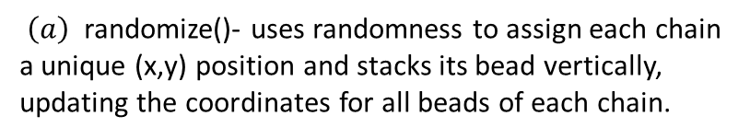
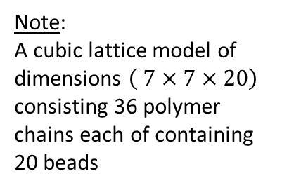

Flow diagram for lattice chain initiation
Note:
A cubic lattice model of dimensions $\left( 7×7×20\right)$ consisting 36 polymer chains each of containing 20 beads
start
Initialize chain and
bead index (i,j)
Create chains.csv file
Call randomize() to organize chains randomly on xy plane
$$\left(a\right)$$
write bead coordinates to chains.csv file
Close chains.csv file
end
$\left(a\right)$ randomize()- uses randomness to assign each chain a unique (x,y) position and stacks its bead vertically, updating the coordinates for all beads of each chain.

