Slide 1

SER 502 – Team 16
Tarun Kolla – 1213401629
Naga Ravi Teja Thoram – 1212933421
Koushik Kotamraju – 1213181383
Pranav Mandadi - *
GitHub repo - https://github.com/tarunkolla/SER502-Spring2018-Team16

Slide 2
FISH
FISH is a simple programming language designed using JAVA, inspired by Python and Standard ML
Parse tree and Intermediate byte code is generated using ANTLR
Runtime written in JAVA
Language Design:
Every program must lie between “startFISH” and “endFISH”
Input program should have .fish file extension
Intermediate code generated as <program_name.fish.ic>
This intermediate code is processed by runtime to generate program output

Slide 3
FISH Grammar
grammar FishLanguage;
program : mainBlock (functions)*;
mainBlock : 'startFISH' statements+ 'endFISH';
statements : (assignmentStatement
| ifStatement
| loopStatement
| writeStatement
| declarationStatement
| readStatement
| functionCallStatement
| returnStatement);
declarationStatement : DOLLAR IDENTIFIER;
functions : 'fun' FUNCNAME LBRACE parameters RBRACE ':' statements+ 'endfun';
parameters : (DOLLAR IDENTIFIER) (',' parameters)?;
functionCallStatement : FUNCNAME LBRACE arguments RBRACE;
arguments : (expression) (','arguments)?;
returnStatement : 'return' expression;
assignmentStatement : IDENTIFIER ASSIGNMENT expression;

Slide 4
ifStatement : ifBlock (elseBlock)? 'endif';
ifBlock : 'if' LBRACE booleanExpression RBRACE ':' statements+ ;
elseBlock : 'else' ':' statements+;
loopStatement : 'loop' LBRACE booleanExpression RBRACE ':' statements+ 'endloop';
writeStatement : 'write' expression
| 'write' STRING
| 'write' booleanExpression;
readStatement : 'read' IDENTIFIER;
booleanExpression: expression EQUALS expression
| expression GTE expression
| expression LTE expression
| expression NE expression
| expression GT expression
| expression LT expression
| expression AND expression
| expression OR expression
| BOOLEAN;
expression : expression (MULTIPLY|DIVIDE|MOD) expression
| expression (ADD|SUBTRACT) expression
| NUMBER
| BOOLEAN
| STRING
| IDENTIFIER
| REAL
| functionCallStatement
| LBRACE expression RBRACE;

Slide 5
BOOLEAN : 'True’
| 'False';
SUBTRACT : '-';
NUMBER : [-]?[0-9]+;
REAL : [-]?[0-9]+[.][0-9]+;
IDENTIFIER : [a-z]+;
DOLLAR : '$';
ASSIGNMENT : '=';
MULTIPLY : '*';
DIVIDE : '/';
MOD : '%';
ADD : '+';
LBRACE : '(';
RBRACE : ')';
EQUALS : '==';
GTE : '>=';
LTE : '<=';
NE : '!=';
GT : '>';
LT : '<';
AND : '&&';
STRING : ["][ a-zA-Z:=><+*/%!\-]+["];
OR : '||';
FUNCNAME : [A-Z]+;
NEWLINE : [ \n\t\r] -> skip;

Slide 6
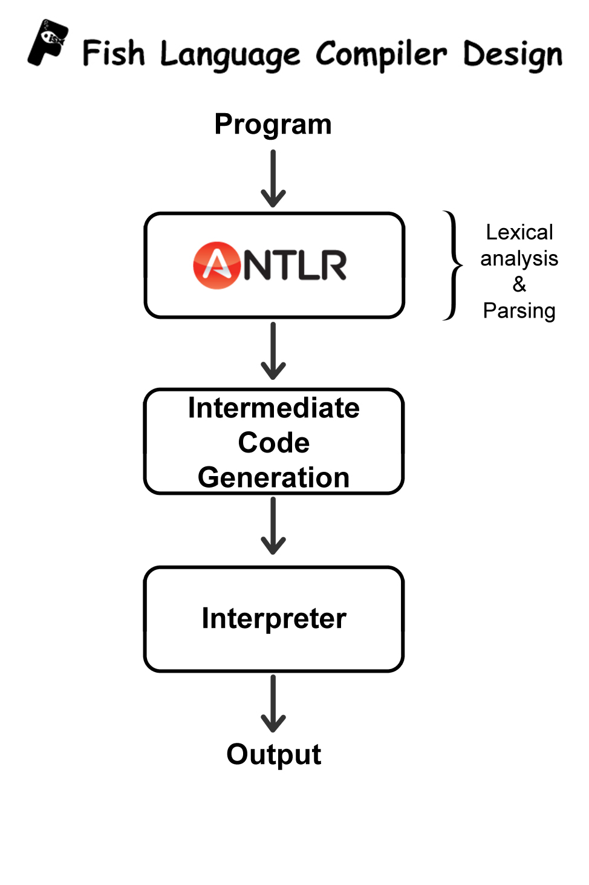
Language Design:

Slide 7
Tools:
Compiler:
Based on JAVA Environment
ANTLR4 used to generate Lexer and Parser
Run Time:
JAVA : Used to build the entire project JDK 1.8
Eclipse : Used as IDE

Slide 8
Features of FISH:
Datatypes:
Arithmetic Operations:
Relational Operations:
Integer Numbers
Real Numbers
BOOLEAN
Add +
Subtract -
Multiply *
Divide /
Mod %
Equals ==
NotEqualTo !=
LessThan <
LessThanEqualTo <=
GreaterThan >
GreaterThanEqualTo >=
Logical Operations:
AND &&
OR ||

Slide 9
Statements
General Statements
Conditional Statement
Iterative Statement
Assignment Statement “=”
Declaration Statement “$”
Read “read f”
Write “write “result = ””
If (condition):
<statements>
<optional else>:
<statements>
endif
loop (condition):
<statements>
endloop

Slide 10
Execution Flow:
Compiler
Runtime Interpreter
Source code program.fish
Intermediate Code
Output

Slide 11
Byte Code Instructions:
PUSH
ASSIGN
PARAMASSIGN
DECLARE
DISPLAY
READ
WRITE
ADD/SUBTRACT/MULTIPLY/DIVIDE/MOD
AND/OR
BASIC INSTRUCTIONS
ARITHMETIC OPERATIONS
LOGICAL OPERATIONS
DECLARE
PUSH
ASSIGN
PARAMASSIGN
DISPLAY
READ
WRITE
ADD
SUBTRACT
MULTIPLY
DIVIDE
MOD
AND
OR
RELATIONAL OPERATIONS
GREATERTHAN
LESSTHAN
GREATERTHANEQUAL
LESSTHANEQUAL
NOTEQUAL
EQUALS
CONTROL OPERATIONS
GOTO
FAILGOTO
RETURNTO
ENDIFGOTO

Slide 12
Sample Program:
Input Code
Intermediate Byte Code
startFISH
$a
$b
$c
a=3
b=5
if (a % 2 == 0):
c=10
else:
c=a+b
endif
write c
endFISH
1 START FISHING
2 DECLARE a
3 DECLARE b
4 DECLARE c
5 PUSH a
6 PUSH 3
7 ASSIGN
8 PUSH b
9 PUSH 5
10 ASSIGN
11 STARTIF
12 PUSH a
13 PUSH 2
14 MOD
15 PUSH 0
16 EQUALS
17 FAILGOTO 22
18 PUSH c
19 PUSH 10
20 ASSIGN
21 ENDIFGOTO 29
22 STARTELSE
23 PUSH c
24 PUSH a
25 PUSH b
26 ADD
27 ASSIGN
28 ENDELSE
29 PUSH c
30 DISPLAY
31 END FISHING

Slide 13
Run Time and Execution
Instructions to install Fish Programming Language:
-Download the install folder present in the reposority
-The folder consistes of .jar file for compiler and runtime.
-The 2 .bat files are used to execute the compiler and runtime
Instructions to build and execute the program:
-Write the Input program snippet with the file name <FileName>.fish within the same folder of the .jar files
if not give the absolute path to the program file.
Command to Execute the compiler and the runtime:

Slide 14
For Windows:
-Execute using the given .bat commands to run the .fish file.
To Compile:
fishCompile <FileName>.fish if in same folder
fishCompile "absolute path" \<FileName>.fish for different folder
Output: <FileName>.fish.ic
To generate output:
fish <FileName>.fish.ic if in same folder
fish "absolute path" \<FileName>.fish.ic for different folder
output: Generates the program output on to the command prompt

Slide 15
For OSX:
Navigate to the install folder or use absolute path and then
To Compile:
java -jar compile.jar <FileName>.fish
Output: <FileName>.fish.ic
To generate output:
java -jar runtime.jar <FileName>.fish.ic
Output: Generates the progrma output on to the command prompt

Slide 16
Run Time and Execution
Instructions to install Fish Programming Language:
-Download the install folder present in the reposority
-The folder consists of .jar file for compiler and runtime.
-The 2 .bat files are used to execute the compiler and runtime
Instructions to build and execute the program:
-Write the Input program snippet with the file name <FileName>.fish within the same folder of the .jar files
if not give the absolute path to the program file.
Command to Execute the compiler and the runtime:
For Windows:
-Execute using the given .bat commands to run the .fish file.
To Compile:
fishCompile <FileName>.fish if in same folder
fishCompile "absolute path" \<FileName>.fish for different folder
Output: <FileName>.fish.ic
To generate output:
fish <FileName>.fish.ic if in same folder
fish "absolute path" \<FileName>.fish.ic for different folder
output: Generates the program output on to the command prompt
For OSX:
Navigate to the install folder or use absolute path and then
To Compile:
java -jar compile.jar <FileName>.fish
Output: <FileName>.fish.ic
To generate output:
java -jar runtime.jar <FileName>.fish.ic
Output: Generates the progrma output on to the command prompt

