Slide 1
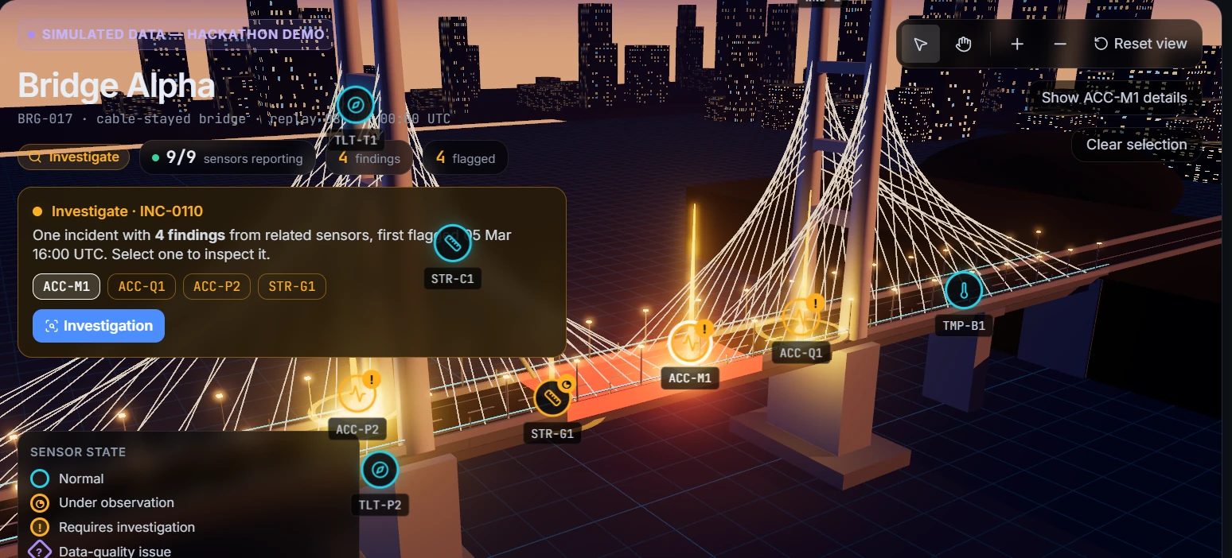
AGENTOPS HACKATHON · MIT BENGALURU · TEAM AKINATORS
TRANSPORT
InfraGuard
AI early warning and accountability for transport infrastructure
From a sensor signal to a human-approved, evidenced, audited job.
All data shown is simulated. Decision support, not a safety certification.
Notes:
Open with the one-liner. Stress: simulated data, decision support, humans decide.

Slide 2
Transport structures are inspected on a calendar, not on condition
1
Signals exist, decisions lag
Bridges, flyovers, viaducts, rail structures
Sensor data sits in dashboards. No one owns the step from “something looks off” to a qualified decision.
Failures such as Genoa (2018) and Morbi (2022) are reminders of what late action costs.
2
Alarm fatigue
A heavy truck, a frozen sensor and a real structural change look alike to simple thresholds.
3
No chain of custody
The gap is not data. It is a governed path from signal to action.
Who approved the work, who did it, and what evidence was accepted lives in emails and spreadsheets.
Notes:
Problem framed for transport operators. Keep the incidents factual; no casualty figures needed.

Slide 3
InfraGuard: one governed pipeline from signal to closed job
INVESTIGATION (five agents, one stage at a time)
Sentinel
Investigator
Risk Prioritiser
Response Planner
Human decision
Detects persistent change against each sensor’s own baseline
Gathers evidence, ranks cited hypotheses
Rule-based priority with stated uncertainty
Drafts the work order and report
Engineer approves, edits or rejects
ACCOUNTABILITY (work orders, stage by stage)
Engineer approves
Officer accepts
Evidence submitted
Evidence approved
Audit trail
Instructions frozen, report issued
Declines go back to the engineer
Completion note and PDF report
Job and investigation close
Every step, actor and time recorded
Agents propose. Humans decide. InfraGuard never declares a structure safe.
Notes:
Walk left to right. Top row is detection to decision; bottom row is decision to closed, evidenced job.

Slide 4
A digital twin that shows what is flagged, and exactly where
Related alarms become one incident, not four noisy alerts
The affected component turns red; the panel shows the reading against its own baseline and why it was flagged
Strain, tilt and wind are context sensors: they support, they cannot alert alone
Heavy-vehicle spikes are logged as transients and never alert
9
4 → 1
1
sensors on the model (simulated)
findings grouped into one incident
structural component highlighted
Notes:
Show the live 3D model. Select a flagged sensor; the real component lights up.

Slide 5
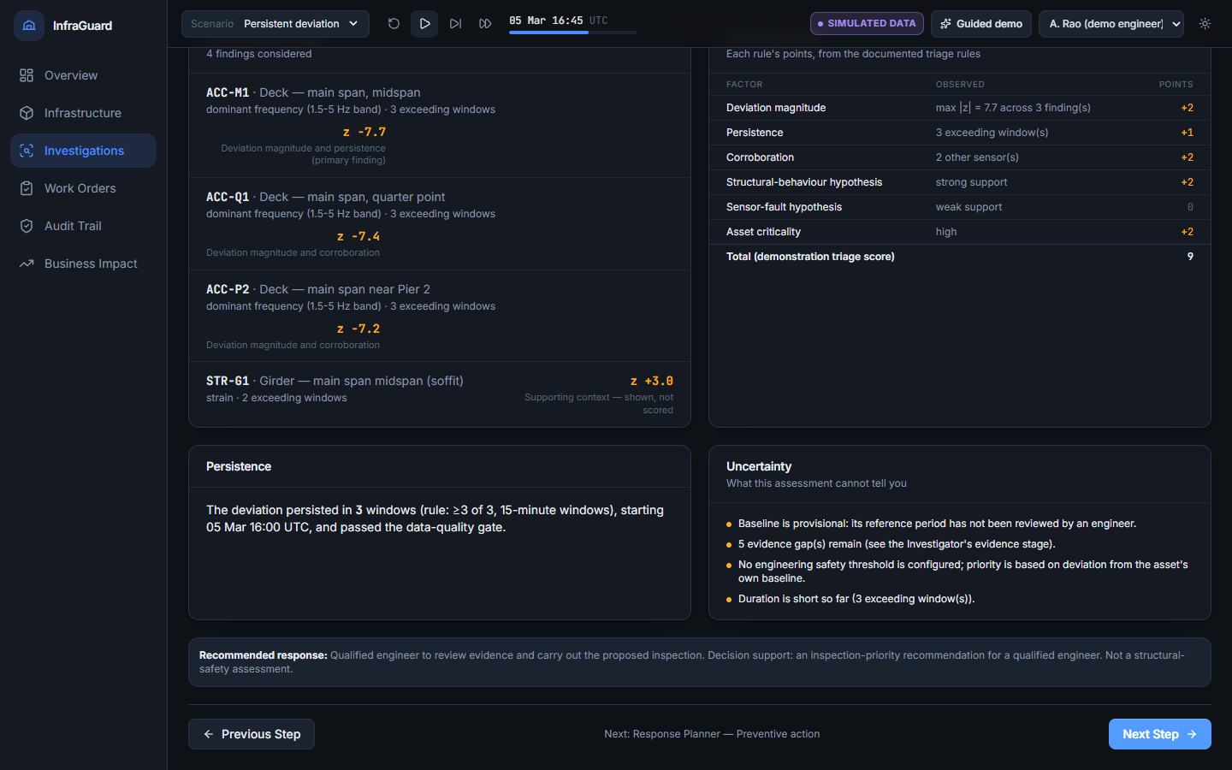
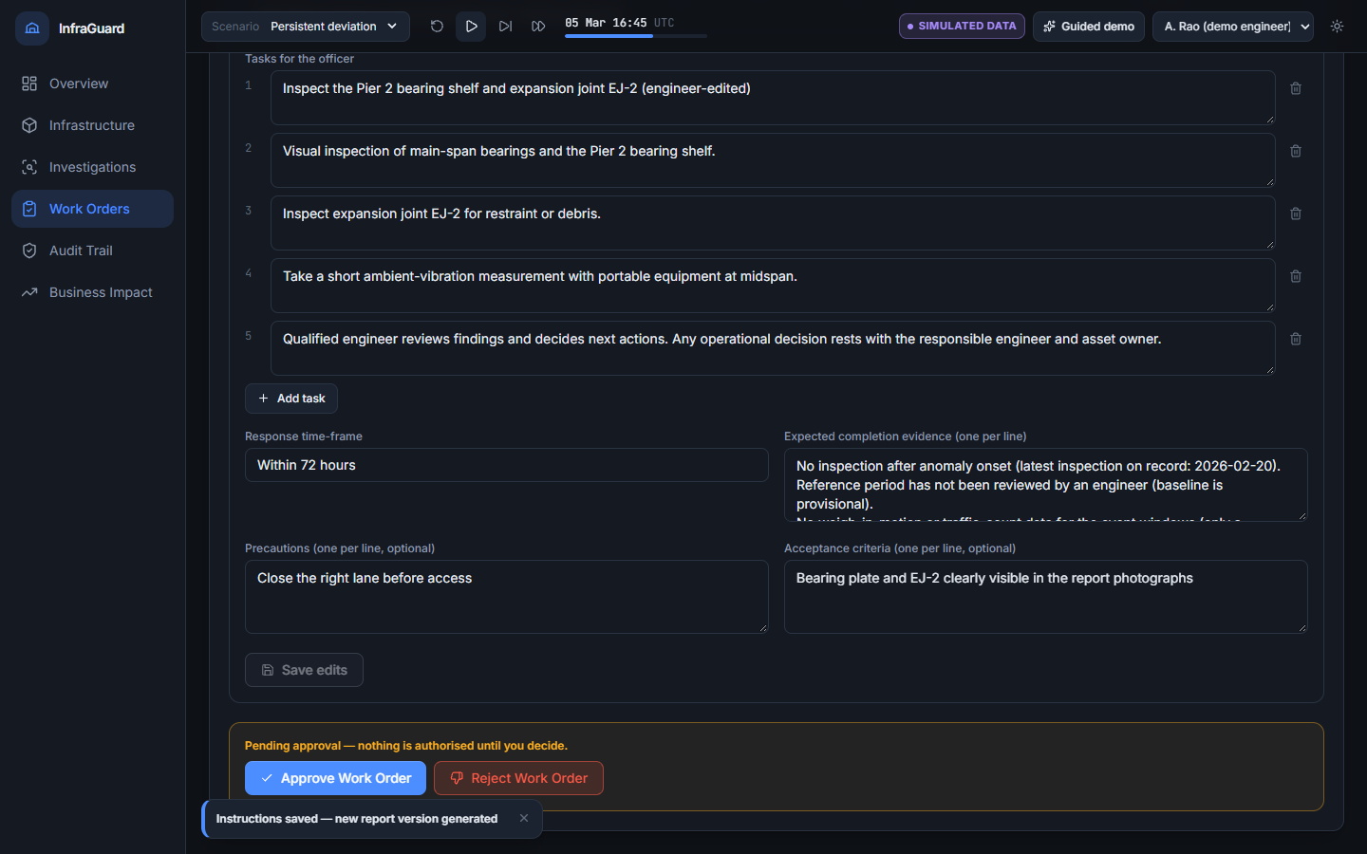
Explainable investigation, then an engineer-approved work order
Risk Prioritiser: every contributing finding, rule factors, persistence and uncertainty
Resource Planner report: versioned, editable by the engineer, printable to PDF
No black box: every claim points to evidence, and nothing is authorised until an engineer approves it.
Notes:
Left: assessment stage. Right: engineer review with the generated report. Edits create new report versions.

Slide 6
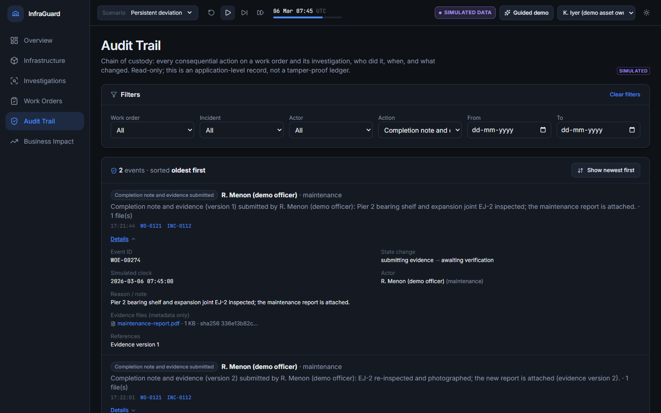
Seven stages of accountability and one audit trail
1
Engineer review and approval
2
Assignment: team, officer, due date
3
Officer accepts or declines
4
Work execution and progress
5
Evidence: note and PDF attachment
6
Engineer approves the evidence
7
Job and investigation completed
Chain of custody: who, what, when, state before and after, report and evidence references
Officers cannot approve their own work. Roles are enforced by the backend, and the log is read-only.
Notes:
Decline returns to the engineer; further work returns to execution. Audit survives refresh and restart.

Slide 7
Built for transport networks, reusable by configuration
WORKING IN PROTOTYPE
NEXT
Road bridges and flyovers
Rail bridges and viaducts
A cable-stayed bridge with 9 simulated sensors: accelerometers, tilt, strain, wind, temperature.
Same sensor families and the same investigation-to-evidence chain.
DEFINED, SWITCHED OFF
DEFINED, SWITCHED OFF
Retaining walls and embankments
Buildings and stations
A wall asset already exists in configuration and can be enabled without new UI.
A building asset (tilt and temperature) also exists in configuration.
A new asset needs a sensor configuration and a baseline. The agents, workflow, report and audit trail stay the same.
Notes:
Reusability: configuration-driven. Only the bridge is active in the demo; wall and building configs exist but are off.

Slide 8
Business value: faster decisions, fewer wasted callouts, less downtime
1
Engineer time
≈ ₹31 L / yr
HOW WE SIZE IT
Triage, investigation and report drafting automated
Annual benefit = sum of (volume × effect × unit cost) across the five levers. Amounts shown: base case for a 10-structure network
2
Fewer unnecessary callouts
≈ ₹12 L / yr
Persistence rule and quality gate filter spikes
3
Less unplanned closure
≈ ₹22 L / yr
Break-even: pays back if it avoids a set number of closure-hours or callouts a year
Earlier, prioritised intervention
4
Condition-based inspection
≈ ₹7 L / yr
Measured in the prototype: 4 findings become 1 incident, and every step is timestamped and audited
Crews go where the data points
5
Audit readiness
≈ ₹2 L / yr
Chain of custody produced as a by-product
Illustrative estimates with stated assumptions (next slide), not measured savings. A pilot replaces them with the operator’s own data.
Notes:
The amounts are an illustrative base case for a 10-structure network. Say so out loud, then show the assumptions on the next slide.

Slide 9
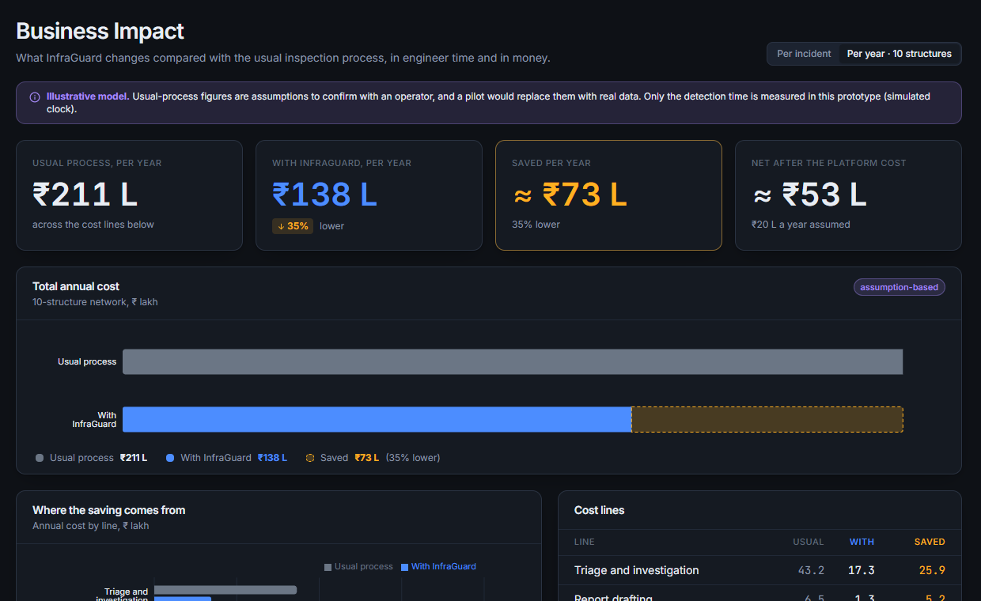
Usual process vs InfraGuard: time and money, live in the product
PER REAL INCIDENT
Engineer effort
9 h → 3 h
Cost
₹13,500 → ₹4,500
Saved
≈ ₹9,000
False alarm
≈ ₹34,000 → filtered
Time to flag
45 min (measured)
PER YEAR · 10-STRUCTURE NETWORK
₹211 L → ₹138 L
saves ≈ ₹73 L (35%), ≈ ₹53 L after a ₹20 L platform cost
Business Impact page in the prototype (illustrative model)
Range: conservative ≈ ₹37 L a year, optimistic ≈ ₹95 L. Illustrative assumptions, not measured savings; a pilot replaces them.
Notes:
Show the Business Impact page. Per incident: engineer effort 9h to 3h. Per year: 211 lakh to 138 lakh for a 10-structure network. Say 'illustrative' out loud; time to flag is the only measured number.

Slide 10
How InfraGuard ticks every judging criterion
Reusability
Configuration-driven assets: the same agents, workflow, report and audit trail serve bridges, viaducts, walls and buildings
Governance and responsibility
Humans approve every consequential step, roles enforced by the backend, read-only audit trail, never certifies safety
ROI and business value
Five value levers and an illustrative model (about ₹0.7 crore a year for a 10-structure network, assumptions shown); a pilot replaces it with real data
MVP readiness
Runs offline end to end; 70 tests and a 126-check browser journey; state, files and audit survive a restart
Originality and innovation
Findings grouped into one incident and linked to 3D components; evidence-cited agent stages; detection-to-closure chain of custody
Notes:
Spend the most time on ROI. The other four are shown live in the demo.

Slide 11
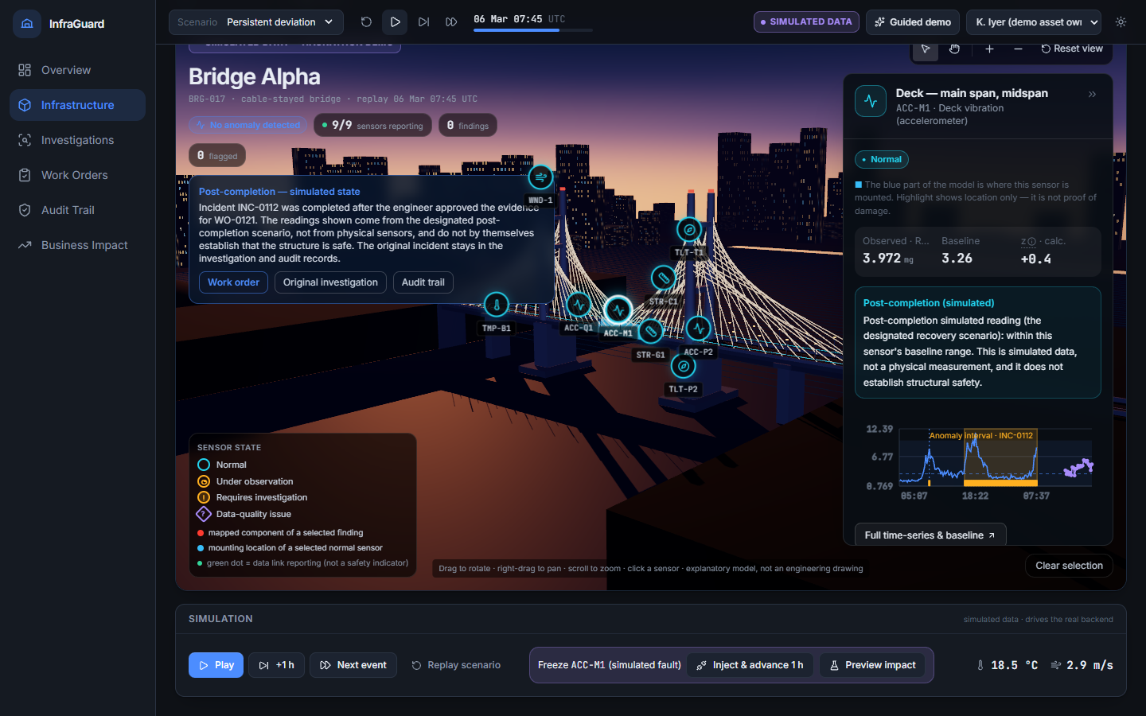
Working today, ready for a pilot
WORKING TODAY
Detection, four-stage investigation, 3D twin
Seven-stage work orders with PDF evidence
Versioned reports, audit trail, Business Impact page
Runs fully offline; survives restarts
70 backend tests, 126-check browser journey
After approval: a labelled, simulated post-completion state
HONEST LIMITS
NEXT STEP
Data is simulated; financials are illustrative until a pilot. Not a safety certification.
Pilot on one real structure with the operator’s sensor feed; measure the KPIs.
Notes:
Close: Sensors tell you something changed. InfraGuard makes sure the right person acts, and can prove it.

