Slide 1

Embedded System Internship
On
Microwave Oven
Presented by : CH. Koushik Reddy
Department : ECE
College: Vaagdevi College of
Engineering
Internship Organization : Emertxe
Information Tehconlogies Pvt.Ltd

Slide 2
Internship Contents
C Programming Concepts
Embedded Systems Introduction
Memory Concepts
Microcontroller Basics
Peripheral Interfacing
Embedded Project Design & Implementation
Microwave Oven Project

Slide 3
C Programming
C is a high-level, structured programming language widely used in embedded systems due to its efficiency and hardware-level control.
Role of C in this Project:
Used to program the microcontroller
Controls keypad, display, timer, fan, and buzzer
Ensures fast and reliable real-time operation

Slide 4
Topics Covered in C Programming
Structure of C Program
Datatypes and Variables
Operators (Arithmetic, Logical, Bitwise, Relational)
Conditional Statements
Loops
Arrays and Strings
Functions
Pointers
Storage Classes
Macros and Preprocessor Directives

Slide 5
Embedded Systems
An embedded system is a special-purpose computer system designed to perform a specific function within a larger system.
Key Features:
Dedicated functionality
Real-time operation
Hardware and software integration
Used in appliances like microwave ovens, washing machines, and TVs

Slide 6
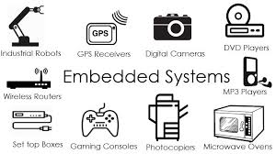
Examples of Embedded Systems
Microwave Oven
Washing Machine
Air Conditioner
Digital Camera
Elevator Control System
Traffic Light Controller

Slide 7
Embedded System Used in Project
Microcontroller as the core controller
Matrix keypad for user input
CLCD for user interface
Timer for cooking duration
Fan for indication
Complete menu-driven embedded application

Slide 8
Project Overview
Objective:
To design and implement a menu-driven microwave oven application using embedded systems concepts.
Application Type:
Real-time embedded system
User-interactive application

Slide 9
Project Objective
Simulate the working of a microwave oven
Provide multiple cooking modes
Accept user input through keypad
Display real-time status on CLCD
Implement pause, resume, and stop operations

Slide 10
Need for Microwave Oven System
Automates cooking operations
Provides accurate time control
Enhances user convenience
Demonstrates real-time embedded system behavior
Common real-world household application

Slide 11
Hardware Components Used
Microcontroller Development Board
Matrix Keypad
Character LCD (CLCD)
Fan
Power Supply

Slide 12
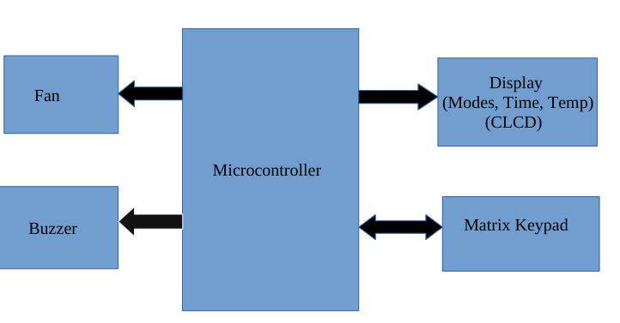
Block Diagram
This block diagram shows the interaction between microcontroller, keypad, display, and output devices.”

Slide 13
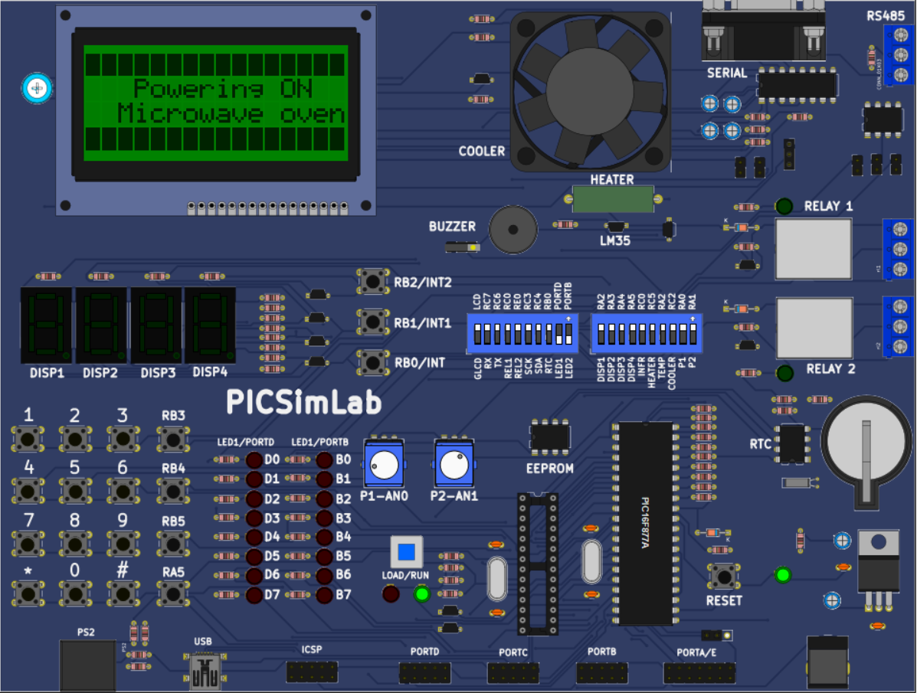
PIC16F877A Microcontroller Development Board (PICSimLab)
Based on PIC16F877A 8-bit microcontroller
Operates at 5V with 20 MHz crystal oscillator
Provides 40 I/O pins for peripheral interfacing
Supports Timers, Interrupts, ADC, EEPROM
Includes CLCD, Matrix Keypad, LEDs, Buzzer on
board
Supports Relay, Fan, Heater control for real-
time applications
Used for embedded system learning and
simulation in PICSimLab
Programmed using MPLAB X IDE and XC8
compiler

Slide 14
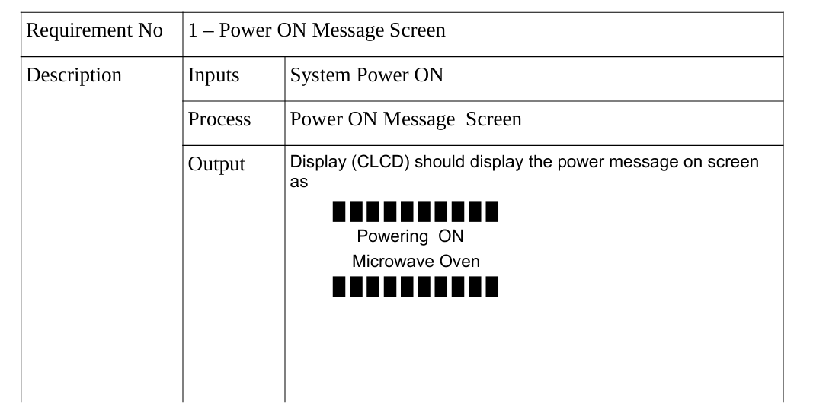

Slide 15
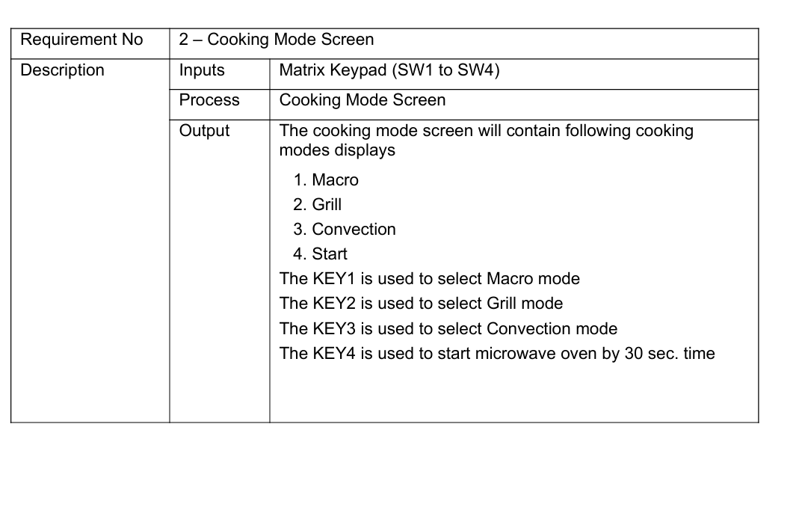

Slide 16
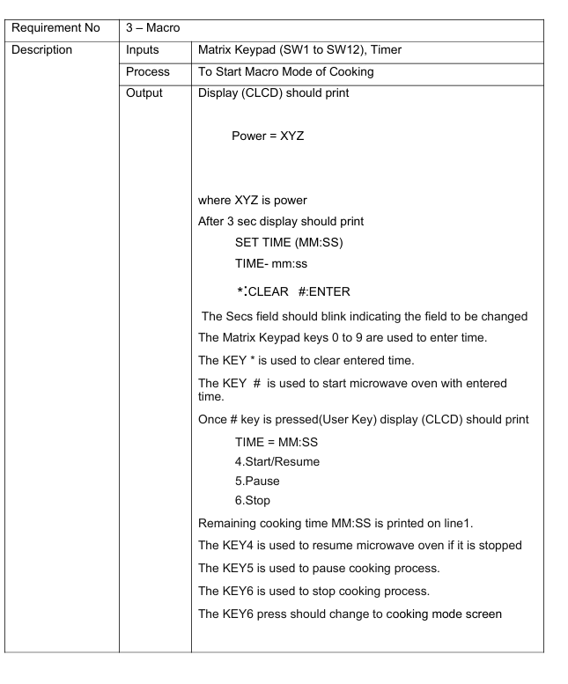
Macro Mode
User sets cooking time
Power level displayed
Timer countdown shown on CLCD
Supports:
Start
Pause
Resume
Stop

Slide 17
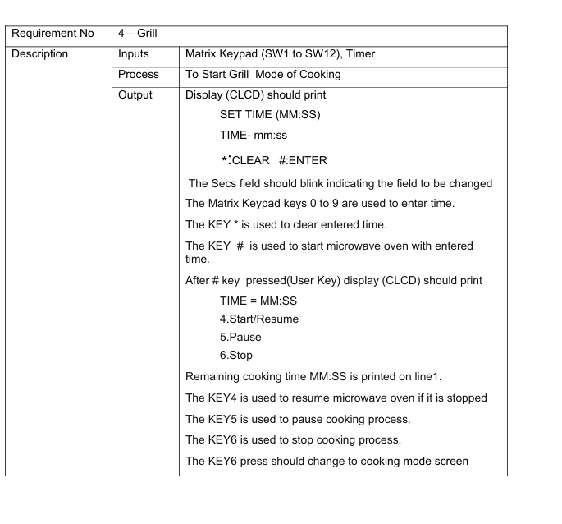
Grill Mode
Time-based cooking mode
User enters cooking time
Remaining time displayed
Same controls as Macro mode

Slide 18
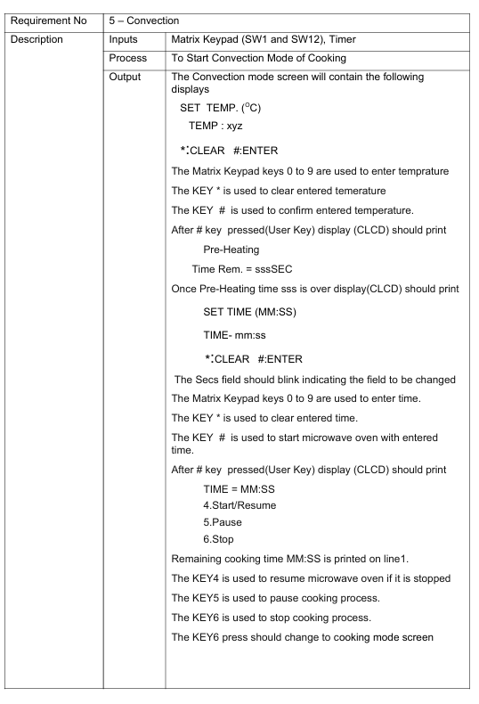
Convection Mode
User sets temperature first
Pre-heating phase starts
After pre-heating, cooking time is set
Full cooking control using keypad

Slide 19
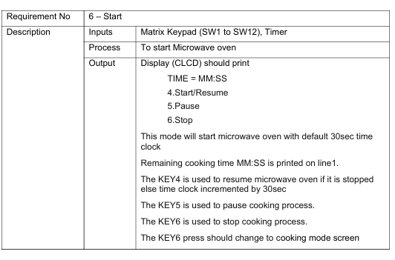
Start Mode
Quick cooking mode
Default time: 30 seconds
Each press adds 30 seconds
Supports pause, resume, and stop

Slide 20
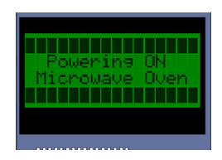
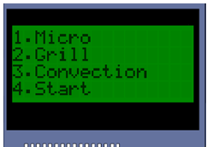
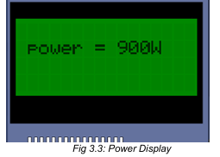
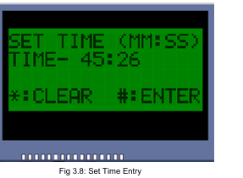
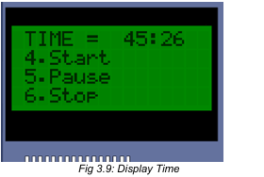
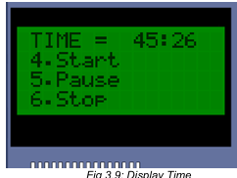
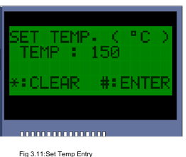
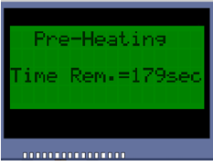
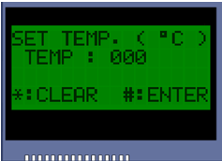
User Interface
CLCD displays:
Power ON message
Cooking modes
Time and temperature
Status messages
Blinking fields guide user
input

Slide 21
Learning Outcomes
Strong foundation in Embedded C
Hands-on microcontroller experience
Understanding of real-time systems
Requirement-based development exposure
Improved debugging skills

Slide 22
Conclusion
Successfully implemented Microwave
Oven application
Integrated C programming with
embedded hardware
Demonstrated real-time system behavior
Internship strengthened embedded
systems knowledge

Slide 23
Thank You

