Slide 1


APPLE STOCK PRICE PREDICITON

Slide 2
Mentor and team members :
Mentor : Sadiya Ansari
Group Members:
Koushik
Mohith
Jaideep
Sudeep
Indrajeet
Venkateswarlu

Slide 3


Objectives :
The primary objectives of this project are as follows:
To analyze historical Apple (AAPL) stock price data using exploratory data analysis techniques in order to understand trends, volatility, and market behavior.
To apply classical time-series forecasting models such as ARIMA and SARIMA for baseline prediction.
To implement machine learning and deep learning models including Random Forest, XGBoost, and LSTM for improved forecasting accuracy.
To evaluate and compare all models using performance metrics such as RMSE and MAPE.
To identify the best-performing model based on predictive accuracy and reliability.
To forecast Apple stock prices for the next 30 trading days using the optimal model.

Slide 4

Dataset Details :
The dataset used in this project consists of historical stock market data for Apple Inc. (AAPL). It contains daily trading information collected from publicly available financial sources. The dataset represents real-world financial time-series data and captures the price movement and trading activity of Apple stock over a long period.
The dataset includes the following attributes:
Date – Trading date of the stock
Open – Opening price of the stock on a given day
High – Highest price reached during the trading day
Low – Lowest price reached during the trading day
Close – Closing price of the stock
Adj Close – Adjusted closing price accounting for dividends and stock splits
Volume – Total number of shares traded on that day
The Date column was converted into datetime format and set as the index to maintain the temporal sequence of the data. Since this is time-series data, chronological order was strictly preserved throughout the analysis. The dataset provides sufficient historical depth to analyze trends, volatility, and patterns required for forecasting future stock prices.

Slide 5
Data Preprocessing :
Data preprocessing is a critical step in time-series analysis. The Date column was converted into a datetime format and set as the index. The data was sorted chronologically to preserve temporal order. Additional features such as moving averages, volatility, and daily returns were created to enhance model performance.

Slide 6
Exploratory Data Analysis (EDA):
Exploratory Data Analysis was performed to understand overall price trends, volatility, and distribution of stock prices. Visualizations helped identify upward and downward trends, sudden spikes, and periods of high volatility, providing insights into market behavior before applying forecasting models.

Slide 7
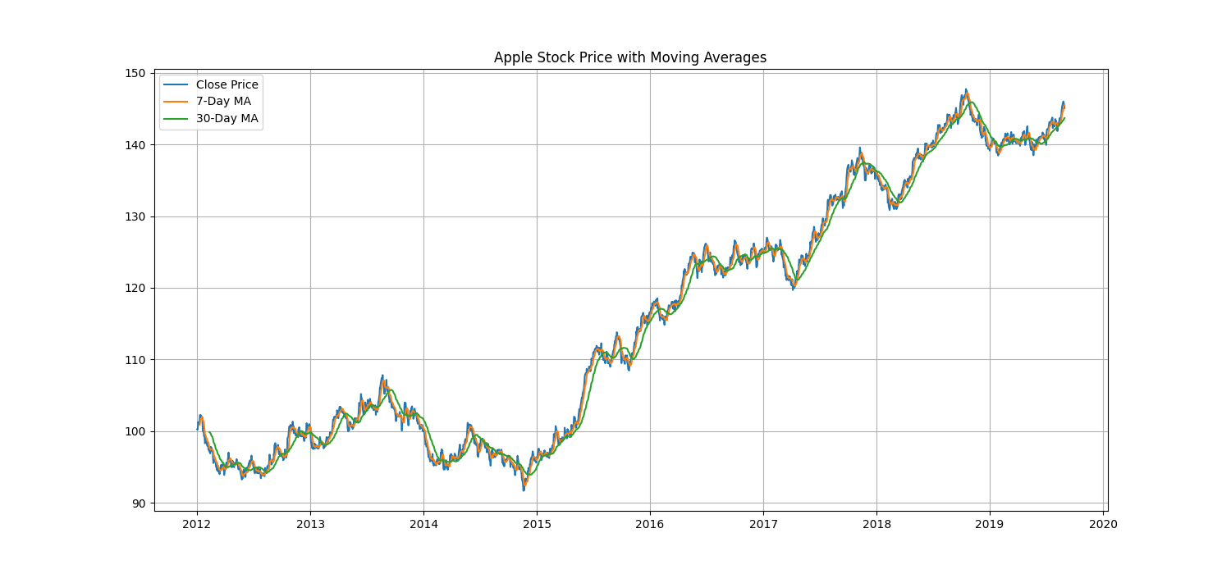
Moving Average Analysis:
Moving averages were used to smooth short-term fluctuations and highlight long-term trends. A 7-day moving average captures short-term market movement, while a 30-day moving average represents long-term price trends. Crossovers between these averages often indicate potential bullish or bearish signals.

Slide 8
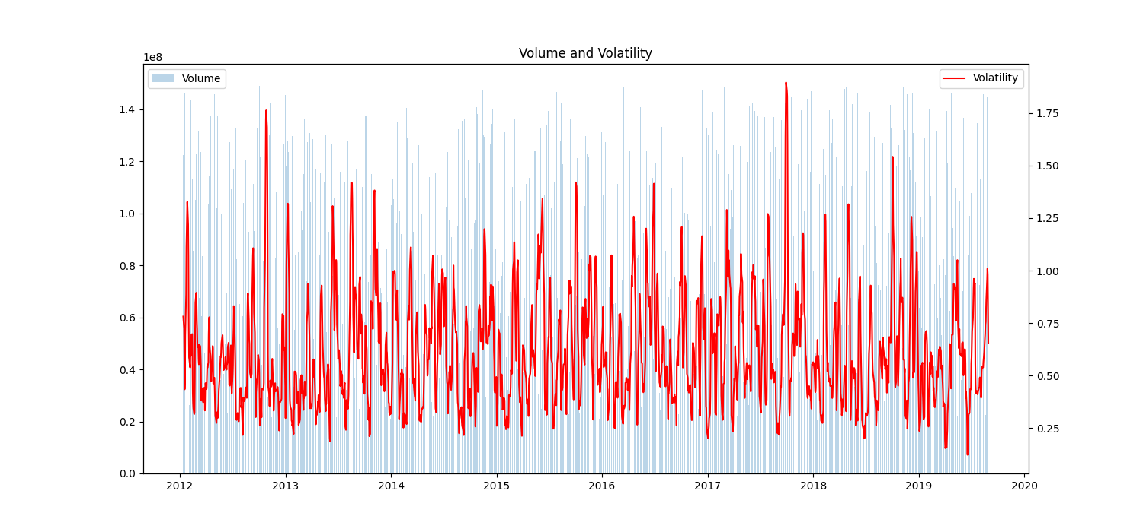
Volume & Volatility Analysis
Trading volume and price volatility were analyzed together to understand market activity. High volume combined with high volatility often indicates strong market reactions, whereas low volume periods suggest stable or inactive trading phases. This analysis helps in understanding risk levels in stock movements.

Slide 9
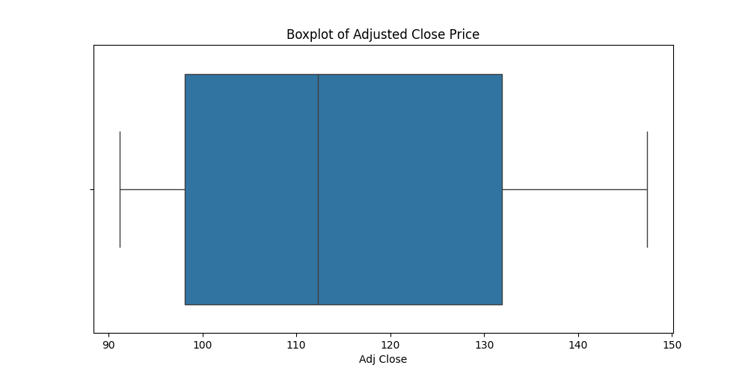
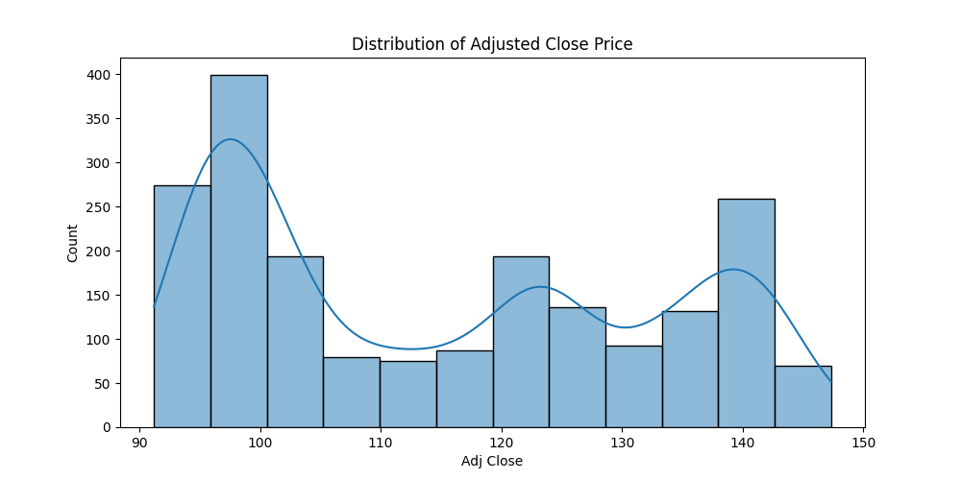
Distribution Analysis:
Histogram and boxplot analysis were used to examine the distribution of stock prices. These plots revealed skewness, outliers, and price spread over time. Understanding distribution helps assess whether assumptions of statistical models are valid.

Slide 10
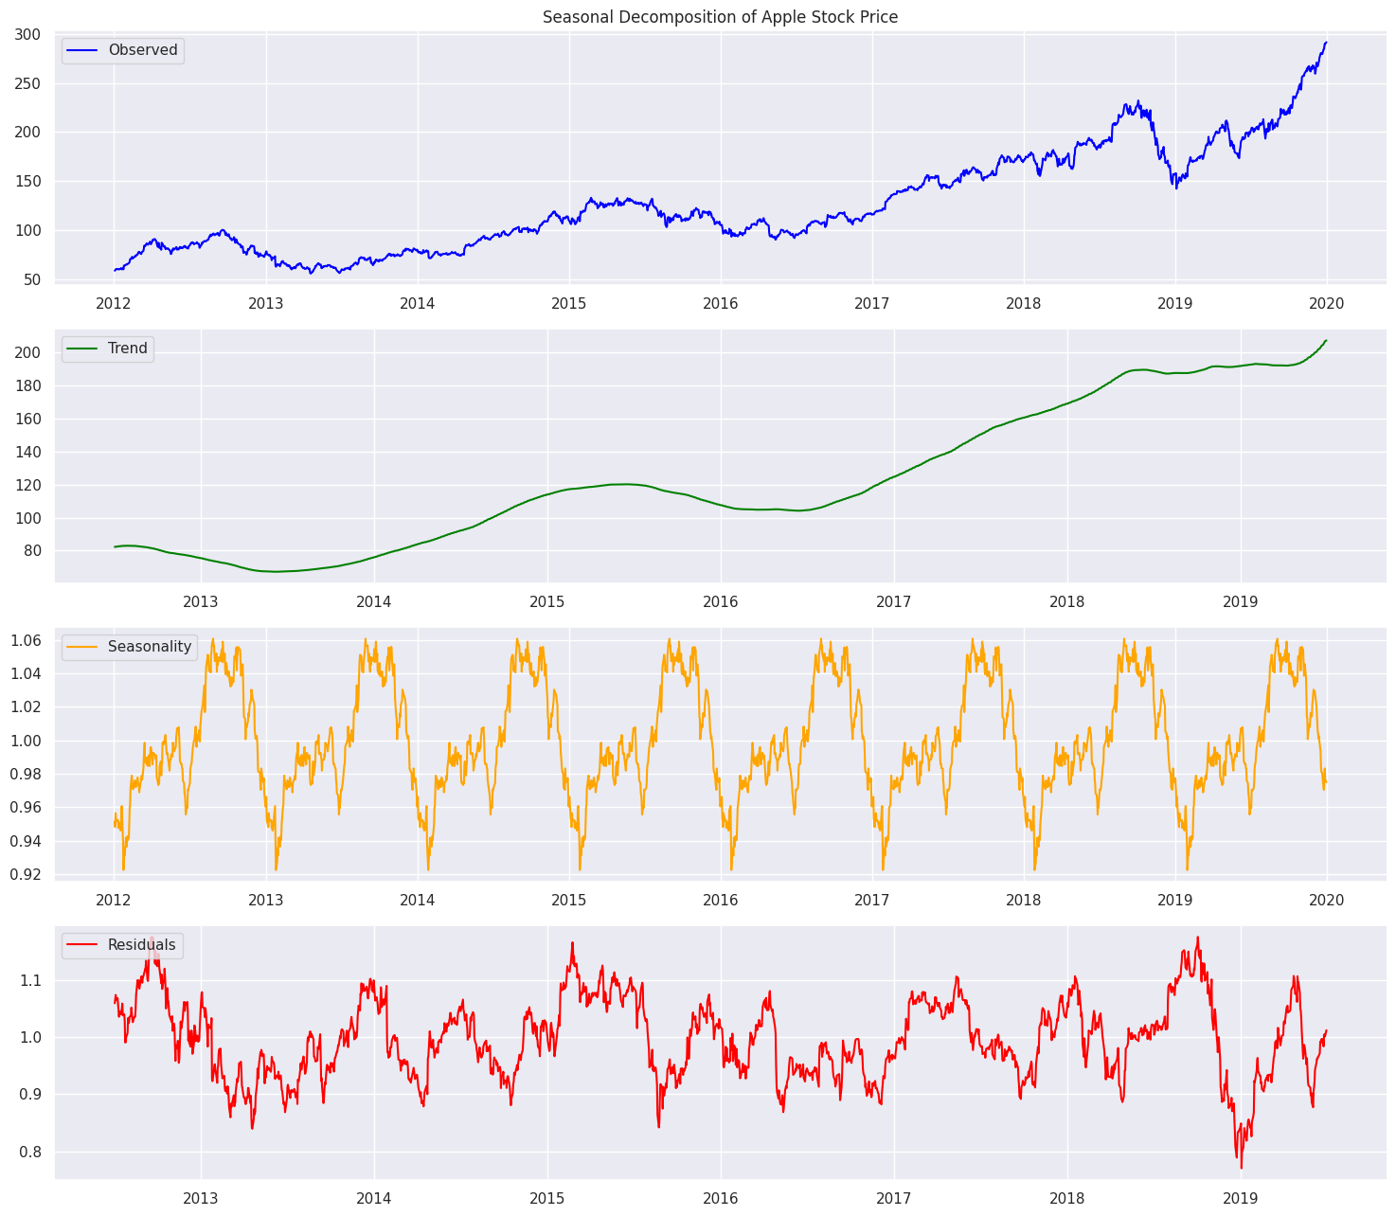
Seasonal Decomposition :
Seasonal decomposition was applied to break the time series into trend, seasonal, and residual components. The analysis showed a dominant long-term trend, weak seasonality, and residual noise. This insight guided the selection of appropriate forecasting models.

Slide 11
Stationarity Test (ADF):
The Augmented Dickey-Fuller (ADF) test was used to check stationarity. The original stock price series was found to be non-stationary, indicating that statistical models like ARIMA cannot be directly applied without transformation.
Differencing for Stationarity:
To make the series stationary, first-order differencing was applied. After differencing, the ADF test confirmed stationarity. This step is essential for time-series models to produce meaningful forecasts.

Slide 12
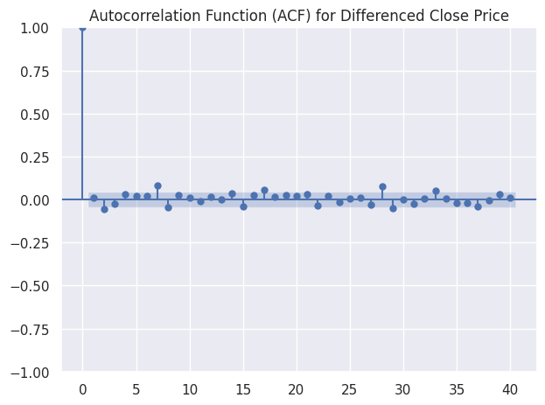
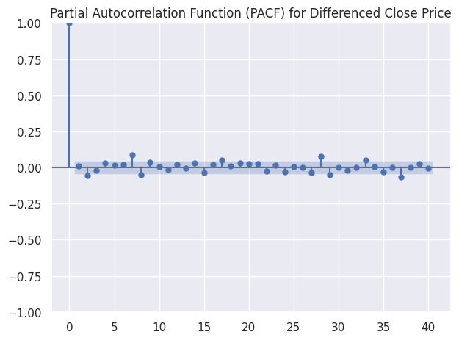
ACF and PACF Analysis
Autocorrelation Function (ACF) and Partial Autocorrelation Function (PACF) plots were used to identify appropriate AR and MA parameters. These plots help in selecting the optimal order for ARIMA and SARIMA models.

Slide 13
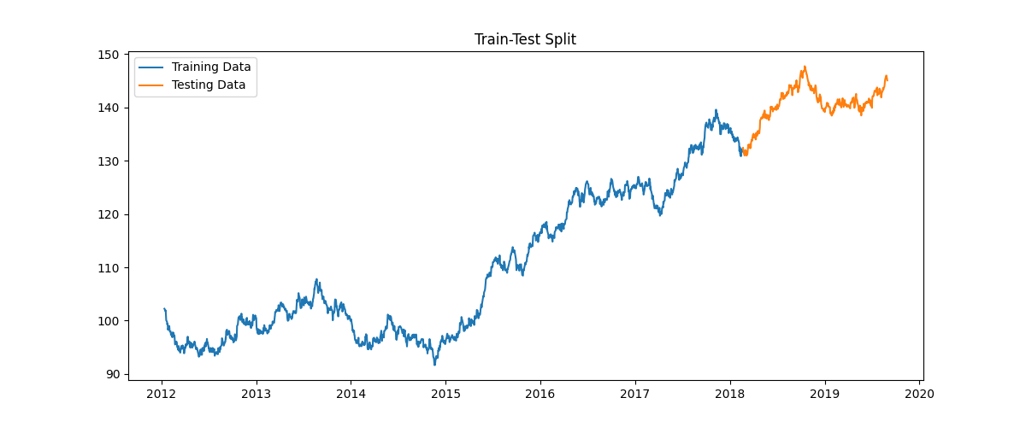
Train-Test -Split
The dataset was divided into training and testing sets using an 80-20 time-based split. Shuffling was avoided to preserve the temporal sequence. The training set was used to build models, while the test set was used for performance evaluation.

Slide 14
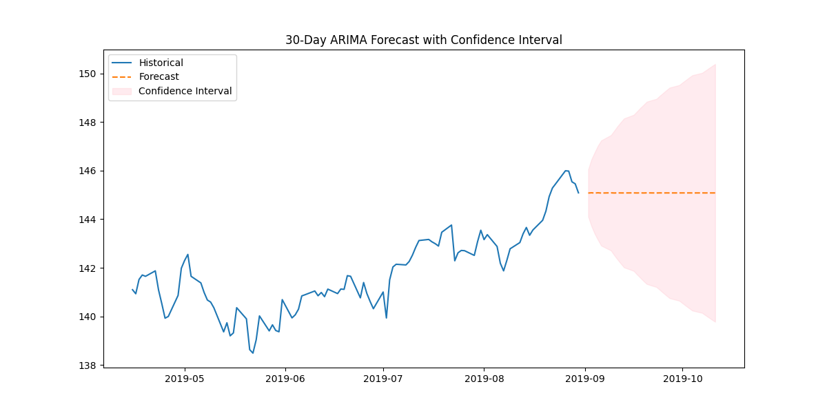
ARIMA Model :
ARIMA is a classical statistical forecasting model that combines autoregression, differencing, and moving average components. It is effective for linear time-series data but struggles with complex nonlinear patterns commonly seen in stock prices.

Slide 15
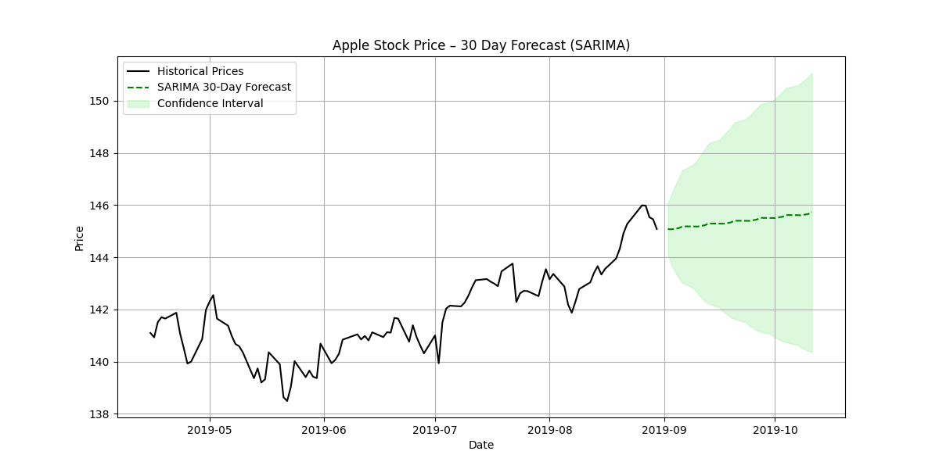
SARIMA Model :
SARIMA extends ARIMA by incorporating seasonality. It accounts for repeating patterns in time series data. Although SARIMA improved results slightly compared to ARIMA, it still showed limitations in capturing sudden price fluctuations.

Slide 16
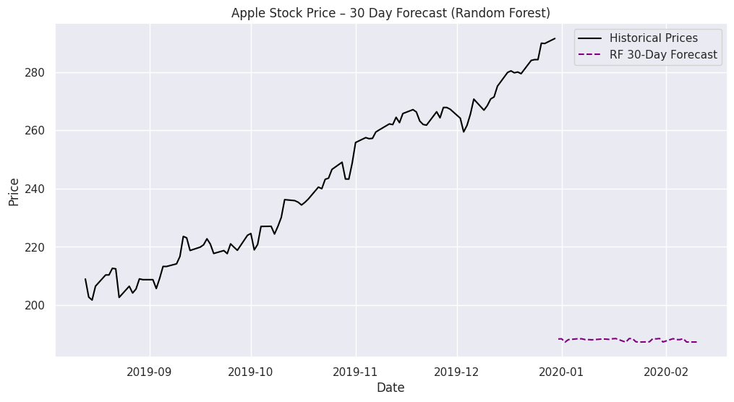
Random Forest Model :
Random Forest is an ensemble machine learning algorithm that uses multiple decision trees. It captures nonlinear relationships and interactions between features. However, it relies heavily on feature engineering and cannot naturally model long-term sequential dependencies.

Slide 17
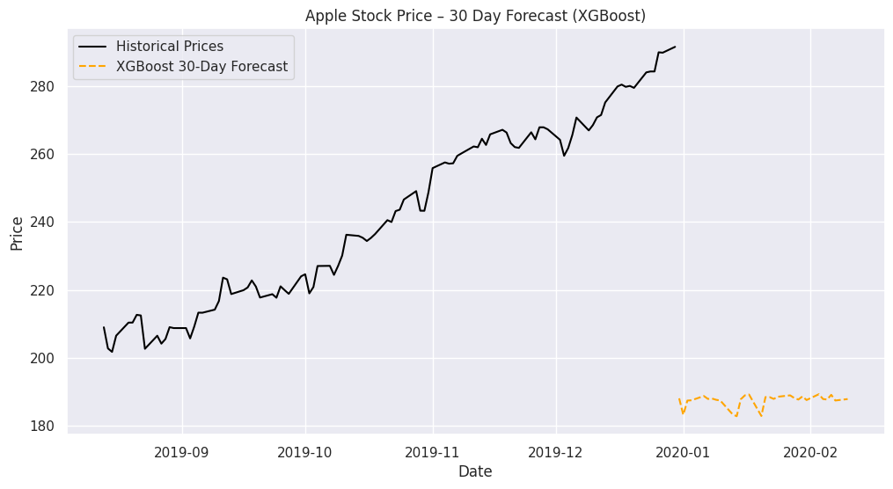
XGBoost Model :
XGBoost is a powerful gradient boosting algorithm known for high predictive accuracy. It outperformed Random Forest in this project due to better handling of complex feature interactions, but it still lacks direct temporal memory.

Slide 18
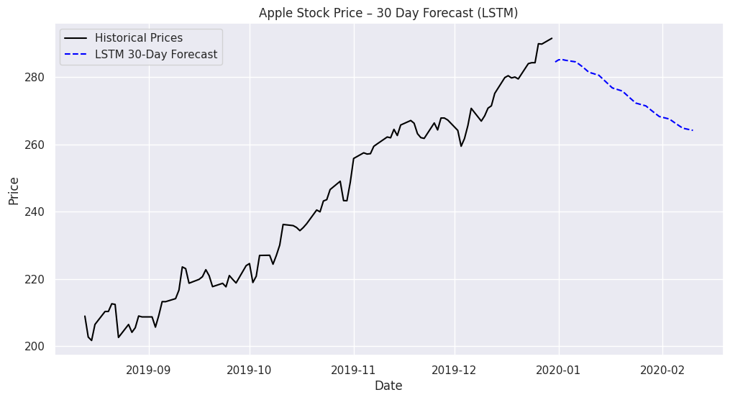
LSTM Model :
Long Short-Term Memory (LSTM) is a deep learning model designed specifically for sequential data. It can learn long-term dependencies and temporal patterns, making it highly suitable for stock price forecasting where historical context is important.

Slide 19
Model Evaluation Metrics :
Model performance was evaluated using Root Mean Squared Error (RMSE) and Mean Absolute Percentage Error (MAPE). These metrics quantify prediction accuracy and allow fair comparison across all models.

Slide 20
Model Comparison & Ranking:
Based on evaluation metrics, LSTM achieved the lowest RMSE and MAPE, followed by XGBoost and Random Forest. Classical models like ARIMA and SARIMA showed comparatively lower performance. Overall ranking confirms deep learning as the most effective approach.

Slide 21
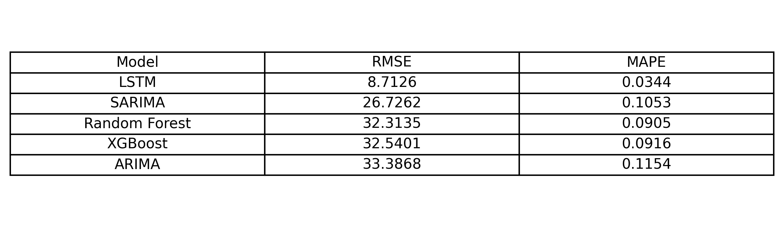
Model Comparison & Ranking:

Slide 22
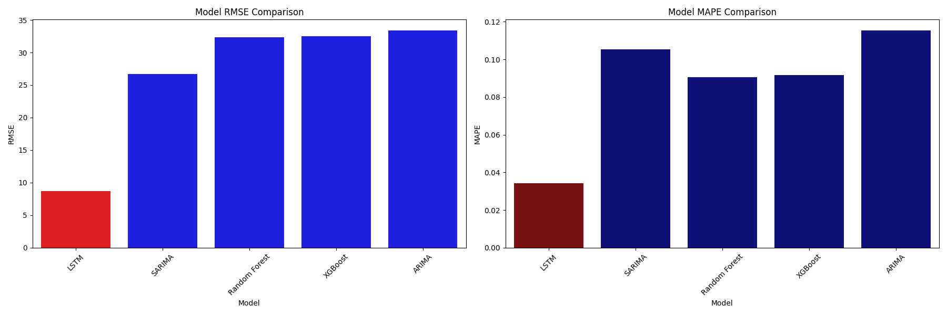
Model Comparison & Ranking:

Slide 23
Why LSTM is Best?
LSTM outperforms other models because it captures long-term dependencies, adapts to nonlinearity, and handles volatility effectively. Unlike ARIMA-based models, LSTM does not rely on strict statistical assumptions, making it more robust for real financial data.

Slide 24
30-Day Future Forecast:
Using the trained LSTM model, stock prices were forecasted for the next 30 trading days. The forecast indicates a continuation of the existing trend with smoother transitions, providing a realistic outlook for short-term investment analysis.

Slide 25
App deployment images

Slide 26
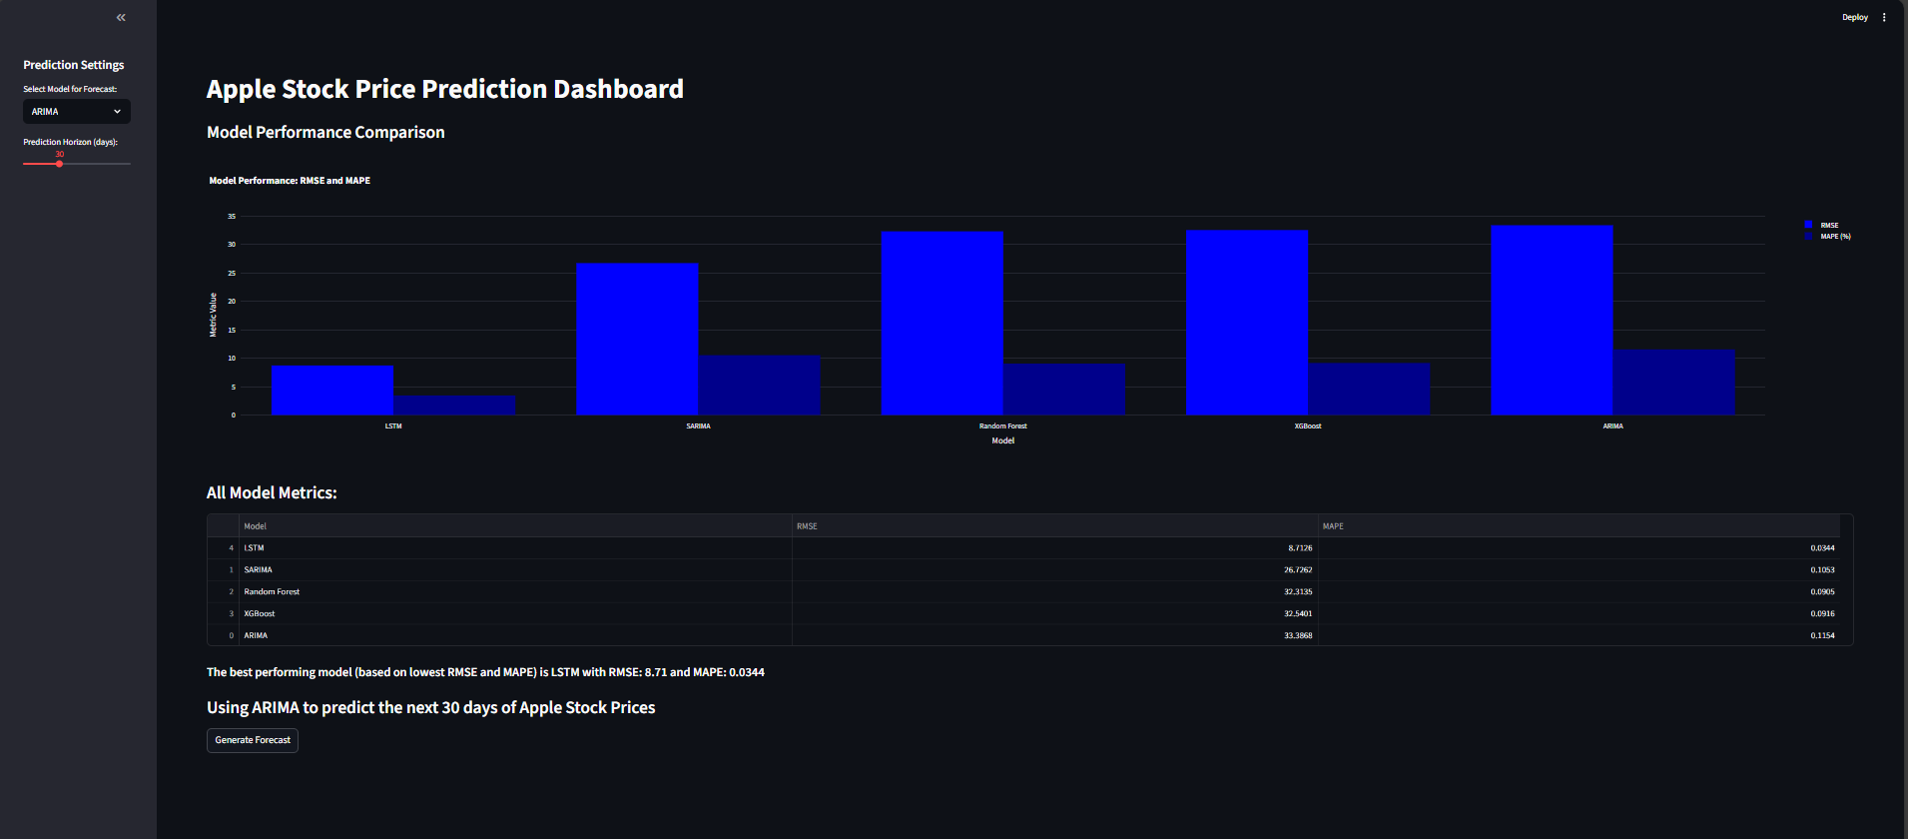

Slide 27
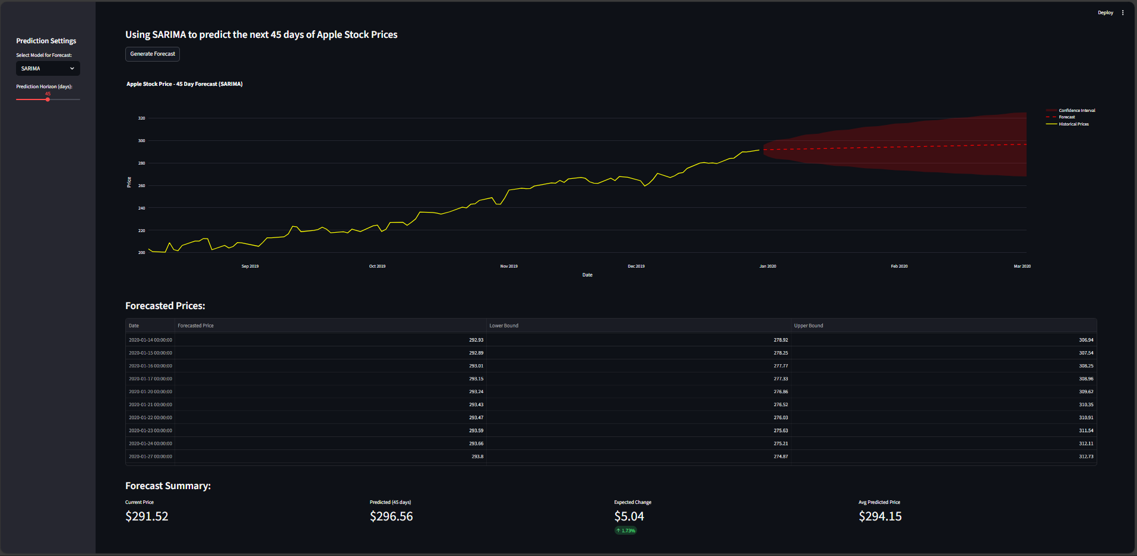

Slide 28
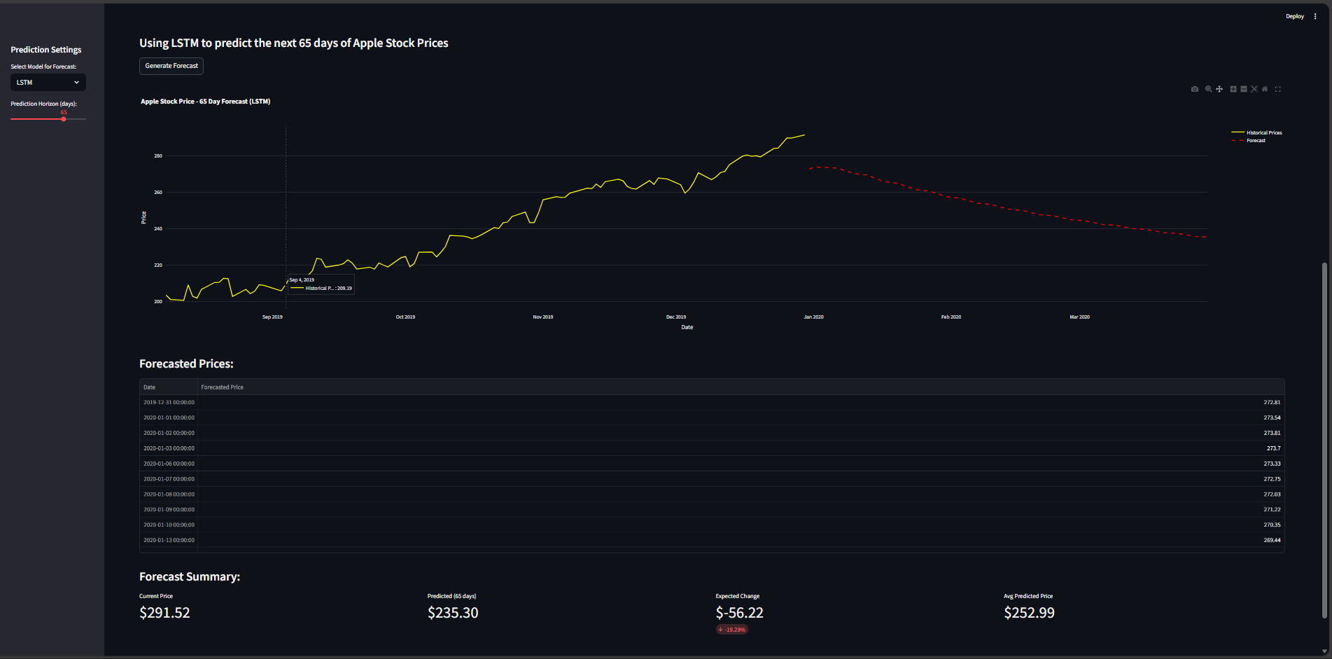

Slide 29
Conclusion:
Multiple models were evaluated for Apple stock price forecasting.
SARIMA performed well by capturing trend and seasonality, making it a strong statistical baseline model.
LSTM achieved the best accuracy with the lowest error values by learning long-term and non-linear patterns.
Overall, SARIMA is good, but LSTM is the best model for reliable stock price prediction.

Slide 30
Thank you

