Slide 1


ONLINE COURSE
RECOMMENDATION SYSTEM
Mentor: Karthik Co-Mentor: Stephy
Our Team : Koushik, Indrajeet, Dharitri, Athul, Aatlee, Vipul

Slide 2




INTRODUCTION
Project Challenge
Build an intelligent recommendation system that suggests relevant online courses to users based on their preferences, behavior, and course attributes. The system leverages multiple machine learning approaches to provide personalized, accurate recommendations.
100,000+ Records
5 Algorithms
14 Attributes
Dataset Size
Models Built
Features Used

Slide 3




EXPECTED OUTCOMES
Enhanced User Satisfaction
Improved Learning Efficiency
Personalized recommendations increase user engagement and course completion rates by matching learners with appropriate content
Reduced time spent searching for courses, allowing learners to focus on skill development and knowledge acquisition
Higher Enrollment Rates
Data-Driven Insights
Better course-learner matching leads to increased enrollment numbers and platform growth
Analytics on user preferences and course performance enable continuous platform optimization

Slide 4

EXPLORATORY DATA ANALYSIS
Dataset Overview
Feature Categories
Dataset Composition
Course Attributes
Total Records: 10,000 user-course interactions
course_name, instructor, duration, difficulty_level, rating
Features: 14 attributes (numeric and categorical)
Engagement Metrics
Target Variable: Course recommendations based on patterns
enrollment_numbers, time_spent_hours, feedback_score
Data Quality: Minimal missing values (1.8%)
User Profile
Key Insight
user_id, previous_courses_taken
Clean dataset with well-distributed features across difficulty levels, ratings, and user engagement metrics
Course Features
certification_offered, study_material_available, course_price

Slide 5
EDA: KEY OBSERVATIONS
Difficulty Level Distribution
Finding: Balanced distribution across Beginner (33.2%), Intermediate (33.5%), and Advanced (33.3%)
Insight: Ensures recommendations can serve diverse learner populations
Rating Patterns
Finding: Average rating: 4.05/5.0 with ratings ranging from 3.0 to 5.0
Insight: High-quality course catalog with strong learner satisfaction
Enrollment Trends
Finding: Strong correlation between course rating and enrollment numbers (r=0.73)
Insight: Quality directly impacts course popularity and selection
User Engagement
Finding: Time spent shows positive correlation with feedback scores and previous courses
Insight: Experienced learners demonstrate higher engagement levels

Slide 6
EDA: DATA DISTRIBUTIONS
Balanced difficulty distribution ensures the system can recommend courses for learners at any skill level without bias toward a specific category.
Majority of courses rated 4.0+, indicating high quality content. The recommendation system leverages ratings as a key feature for filtering.

Slide 7
DATA PROCESSING PIPELINE
1
Data Loading
2
Missing Value Analysis
3
Outlier Detection
Imported dataset with 10,000 records and 14 features
Identified and handled 1.8% missing values
Used IQR method and Z-scores for anomaly identification
4
Feature Encoding
5
Feature Scaling
6
Feature Engineering
Label encoding for categorical variables
StandardScaler for numerical features normalization
Created experience_level based on courses taken

Slide 8

FEATURE ENGINEERING
Preprocessing Techniques Applied
Engineered Features
Label Encoding
Categorical variables (difficulty, certification)
Standard Scaling
Categorized users into Novice, Intermediate, and Expert based on previous_courses_taken
Numerical features (rating, duration, price)
0-3 courses: Novice | 4-7: Intermediate | 8+: Expert
MinMax Scaling
Features requiring 0-1 range normalization
TF-IDF Vectorization
Combined textual representation for content-based filtering
Text features for content similarity
PCA Analysis
Concatenated: course_name + difficulty_level + certification + experience
Dimensionality reduction and feature visualization

Slide 9
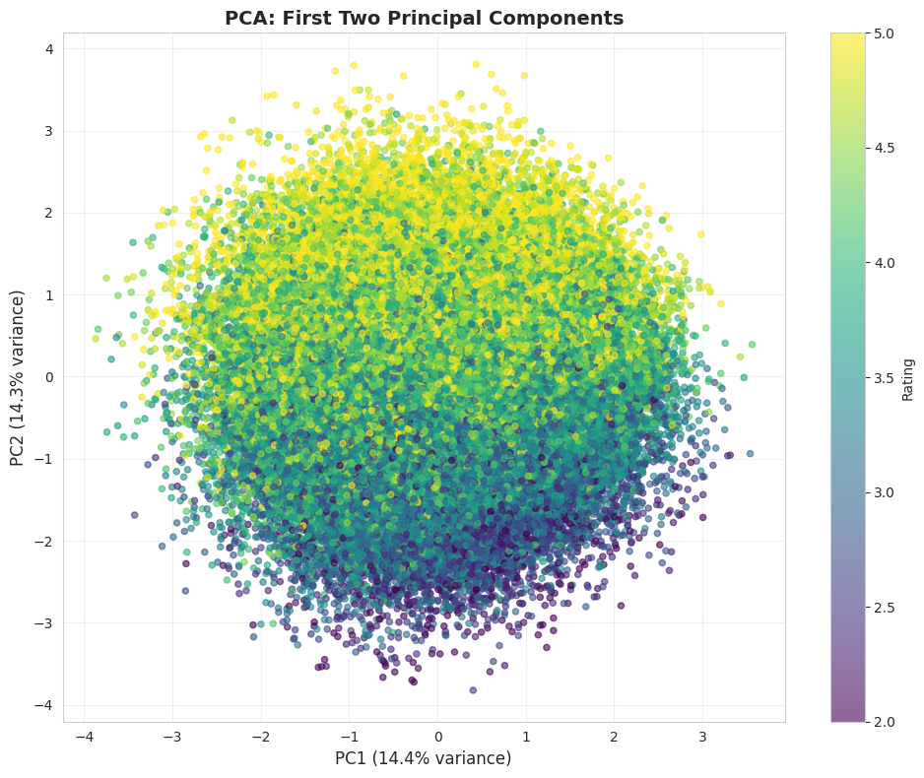
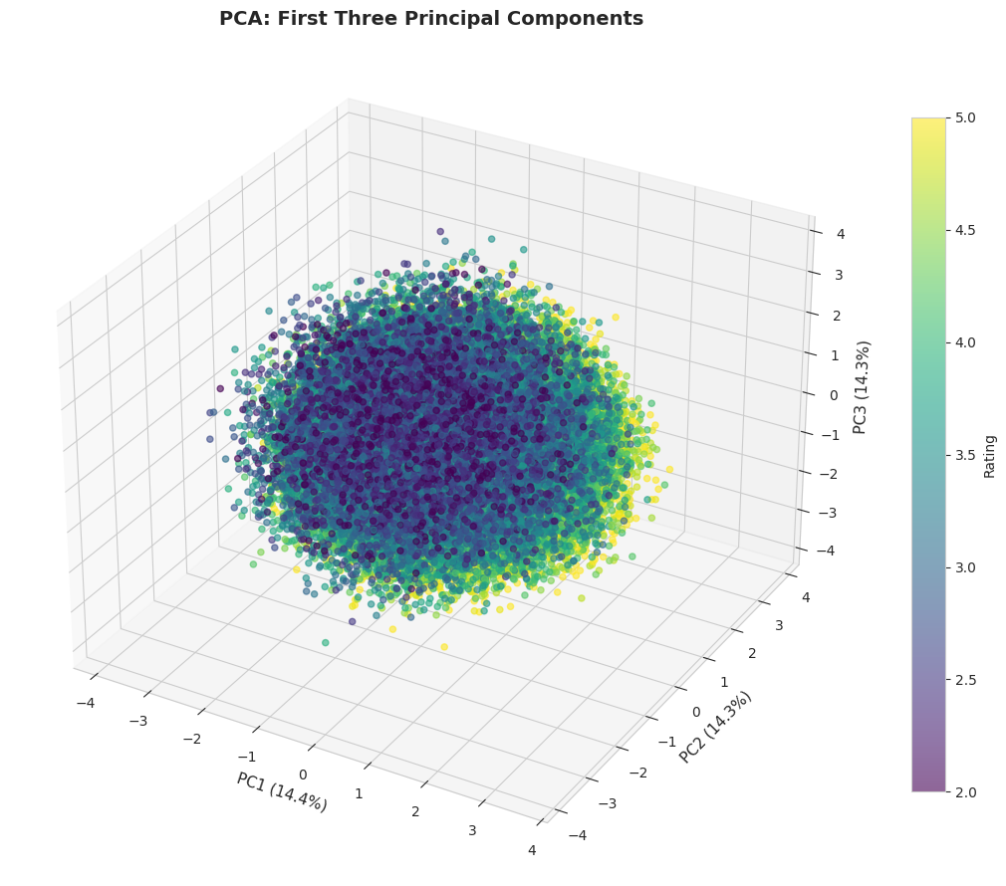
PCA Analysis

Slide 10
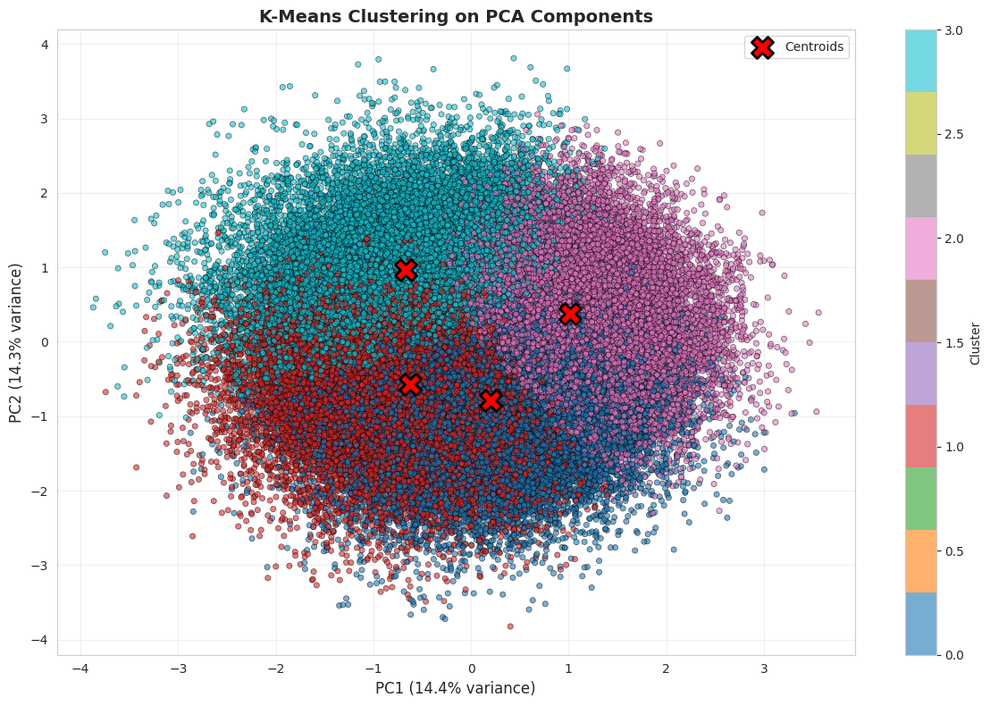
Clustering Analysis

Slide 11
MODEL BUILDING APPROACH
Five Different Recommendation Strategies
1
Content-Based KNN on PCA
Uses dimensionality reduction + K-Nearest Neighbors
2
User-Based Collaborative Filtering (KNN)
Finds similar users to make recommendations
3
Matrix Factorization (SVD)
Collaborative filtering using Singular Value Decomposition
4
Hybrid Recommendation (CF + CBF)
Combines collaborative and content-based approaches
5
Content-Based Filtering (TF-IDF)
Text-based similarity using TF-IDF vectorization

Slide 12

MODEL 1: CONTENT-BASED KNN ON PCA
Using Dimensionality Reduction for Course Similarity
Implementation Steps
Model Characteristics
Algorithm: K-Nearest Neighbors (k=10)
1. Applied PCA to reduce features to 7 principal components
2. Captured 71% of total variance
Distance Metric: Cosine Similarity
3. Built KNN model with cosine similarity metric
Dimensionality: 7 PCA components
4. Found 10 nearest neighbors for each course
Variance Explained: 71% of total variance
5. Recommended courses based on PCA feature similarity
Advantages: Fast, efficient, handles high dimensions
Best For: Finding similar courses by attributes

Slide 13

MODEL 2: USER-BASED
COLLABORATIVE FILTERING (KNN)
Finding Similar Users to Generate Recommendations
This model creates a user-item matrix where rows represent users and columns represent courses. It finds users with similar course-taking patterns and recommends courses that similar users have enrolled in. The similarity is calculated using cosine similarity or Pearson correlation on the user vectors.
Input Data
Algorithm Details
Advantages
• User-course interaction matrix
• K-Nearest Neighbors
• Discovers hidden patterns
• Enrollment history
• Cosine similarity metric
• No content needed
• Rating patterns
• k=20 similar users
• Serendipitous finds
• Time spent metrics
• Weighted recommendations
• Captures user behavior

Slide 14

MODEL 3: MATRIX FACTORIZATION
(SVD) - COLLABORATIVE FILTERING
Advanced Collaborative Filtering Using Singular Value Decomposition
SVD decomposes the user-item matrix into latent factors that represent hidden features of users and courses. This approach handles sparse data better than traditional collaborative filtering and can predict ratings for unobserved user-course pairs.
Technical Implementation
Key Benefits
• Decomposed into user & course latent factors
Sparsity Handling: Works well with incomplete data
• Reduced dimensionality to k components
Latent Features: Discovers hidden patterns
• Reconstructed matrix to predict ratings
• Handled missing values effectively
Scalability: Efficient for large matrices
Predictions: Can estimate unknown ratings

Slide 15
MODEL 4: HYBRID APPROACH
Combining Content-Based + Collaborative Filtering
The hybrid model leverages the strengths of both approaches: content similarity ensures relevant course attributes while collaborative patterns capture user behavior. This combination provides more robust and diverse recommendations.
Content-Based
Collaborative
+
TF-IDF similarity
Course attributes
Rating: 4.2
User patterns
Behavioral data
Rating: 4.1
HYBRID MODEL
Weighted combination (0.6 × Content + 0.4 × Collaborative)
Final Rating: 4.16 | Enhanced accuracy and coverage

Slide 16

MODEL 5: CONTENT-BASED
FILTERING WITH TF-IDF
Text-Based Similarity Using TF-IDF
TF-IDF Works
1. Created course_text by combining:
• Course name + difficulty level
• Certification offered + experience
2. Applied TF-IDF vectorization
• 2000 max features, stop words removed
3. Calculated cosine similarity
• Compare TF-IDF vectors
4. Recommended top N similar courses

Slide 17
MODEL EVALUATION METRICS
Hybrid: Best overall performance with balanced content-behavior approach
Content-Based: Strong relevance but limited diversity
K-Means: Fast execution, good for initial segmentation

Slide 18


FINALIZED MODEL
HYBRID MODEL
Selected for Production Deployment
60% Content-Based (TF-IDF) + 40% Collaborative Filtering

Slide 19
DEPLOYMENT ARCHITECTURE
System Components
Data Layer
Excel data source → Pandas DataFrame → Feature preprocessing pipeline
5 trained models (KMeans, TF-IDF, Collaborative, Hybrid, PCA) stored as pickled objects
Model Layer
Streamlit endpoints exposing recommendation functions
API Layer
Web interface for course browsing and personalized recommendations
Frontend Layer
Tech Stack: Python | Scikit-learn | Pandas | NumPy | Streamlit

Slide 20
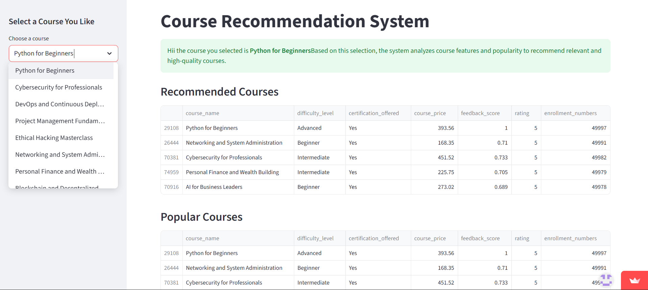
Dashboard

Slide 21

CHALLENGES & SOLUTIONS
Cold Start Problem
Data Imbalance
New users with no interaction history received generic recommendations
Some difficulty levels had more courses than others affecting clustering
Solution: Implemented content-based filtering as fallback for new users, leveraging course attributes
Solution: Applied stratified sampling and weighted features during model training
Computational Efficiency
Model Selection Uncertainty
TF-IDF similarity calculations were slow for large course catalogs
Difficulty determining which algorithm performs best for different scenarios
Solution: Pre-computed similarity matrices and implemented caching mechanisms
Solution: Created hybrid approach and comparative evaluation framework

Slide 22

KEY LEARNINGS
Insights from the Project
1
No single algorithm fits all scenarios - hybrid approaches provide best results
2
Feature engineering significantly impacts recommendation quality
3
Data quality is more important than algorithm complexity
4
User feedback loops are essential for continuous improvement
5
Balancing accuracy with computational efficiency is crucial for scalability
6
Visual validation (PCA) helps identify model issues early
7
Cold start handling should be built in from the beginning
8
Regular model retraining with new data maintains relevance

Slide 23
FUTURE ENHANCEMENTS
Deep Learning Integration
Real-Time Personalization
→
Neural collaborative filtering
→
Live user behavior tracking
→
Transformer-based content embeddings
→
Dynamic preference updates
→
Sequence modeling for learning paths
→
A/B testing framework
Enhanced Features
System Improvements
→
Multi-modal data (video, audio)
→
Distributed computing for scale
→
Social learning integration
→
Automated hyperparameter tuning
→
Skill gap analysis
→
Explainable AI for transparency

Slide 24
CONCLUSION
Project Success
Successfully developed a comprehensive online course recommendation system using multiple machine learning approaches and finalized one best model with the high accuracy . The system demonstrates strong performance in matching learners with relevant courses, significantly improving user experience and platform engagement.
Multi-algorithm approach provides robust recommendations
Data quality and feature engineering are critical success factors
Hybrid models outperform individual approaches
System is scalable and ready for production deployment
Continuous improvement through user feedback is essential

Slide 25
THANK YOU
https://recommednation-system-tpsknk3juvsm6apdkaknox.streamlit.app/

