Slide 1
M-Tech (CDS) Final Presentation
Analysis and Improvement of I/O Performance of Large-Scale Climate Scientific Application
Presented By : Koushik Sen
M.Tech , CDS
Guided by : Dr. Sathish Vadhiyar
Date: 02/07/2020

Slide 2
OBJECTIVE
Huge Gap between computational power and I/O performance of HPC systems.
Many large-scale scientific applications do not adequately optimize the I/O operations.
Aim of this project is to analyze the I/O bottlenecks and minimize them to improve the I/O performance provided by the underlying parallel HPC systems.
a).Regional Ocean Modeling System(ROMS) model is used for analyzing the I/O performance issues.
b).Based on the analysis results, the improvement strategies are implemented in the ROMS model for improving the I/O performance.
Notes:
Just mention Initial I/O Analysis and then I/O Improvement

Slide 3
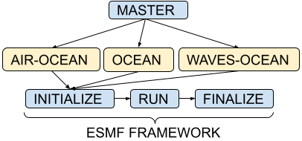
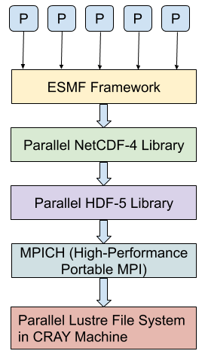
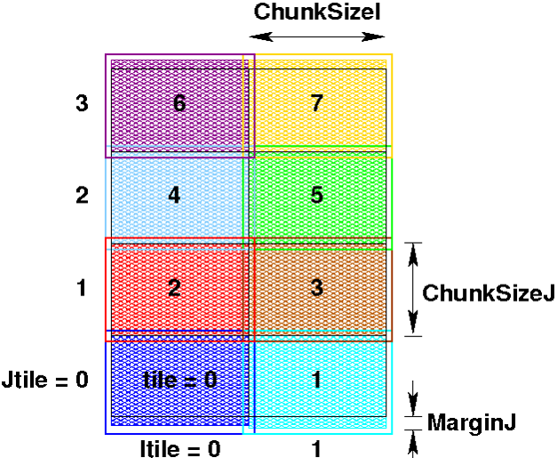
ROMS Model
Fig 1. ROMS Model
Fig 2. Parallel I/O Framework in ROMS
Fig 3. Parallel tiled partitions in ROMS
Reference – https://www.myroms.org/wiki/
Notes:
So, briefly I will introduce the ROMS model.
1.The roms model can work standalone ocean model or coupled with atmosphere/waves.
2.The grid is partitioned into multiples tiles. One tile allocated to each process.
Data exchange is done at the boundary to support independent computation.
3. The computation is always in parallel. It is the I/O that is Serial /Parallel.
Now the I/O is completely done using NetCDF library.
The parallel NetCDF works on top of HDF5. It combines both the advantages!

Slide 4
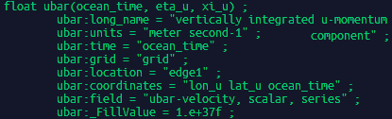
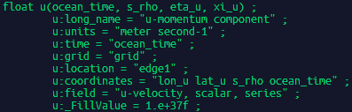
Why NetCDF-4 is important for Climate Models?
Fig a. 2d variable
Fig b. 3d variable
NetCDF Data Format
Self-Describing ⇒ Variables and their attributes stored together
Subset of a large dataset may be accessed efficiently
Appendable
Supports Unlimited Dimensions
Easy post-processing Quick visualization along different dimension
Filter Support ⇒ Different levels of compression-decompression
Works on top of HDF-5 library
In-Memory Support ⇒ Diskless File Open , Diskless File Create
References – https://www.unidata.ucar.edu/software/netcdf/
Notes:
Why NetCDF is used for climate models like in the ROMS model
Self-describing, read a subset of data efficiently, unlimited dimensions, appendable , easy post processing -- directly data can be plotted along different dimensions using Ncviewer!

Slide 5
Project Outline
I/O Analysis
Scalability Studies
Load Imbalance Studies
Bottleneck function Studies (includes MPI calls comparison)
I/O Improvement strategies proposed
Load Imbalance reduction
Selective writing strategy
Lustre Striping technique
Combining all 3 I/O Improvement strategies
(Combining all 3 strategies gave around 60% reduction in overall execution time)
Notes:
My mid-term work was mainly upto detecting the issues in the ROMS model i.e. the I/O analysis part.
The later works are on I/O improvement based on the analysis results and some other strategies to be discussed in I/O improvement section.

Slide 6
Work Plan Submitted
I/O Analysis phase
Further experiments based on bottlenecks found from I/O Analysis using Scalability Studies , Load Imbalance Studies , Bottleneck functions, Message passing communications, I/O breakup -- DONE
I/O Improvement phase
Solve the time imbalance issue in case of parallel NetCDF to bring down the overall I/O time -- DONE (Strategy 1)
Lower I/O time for selective writing approach by solving the initial implementation limitations -- DONE (Strategy 2)
Reduce the time taken by the bottleneck functions -- DONE (Strategy 1 + 2 + 3 combined)

Slide 7
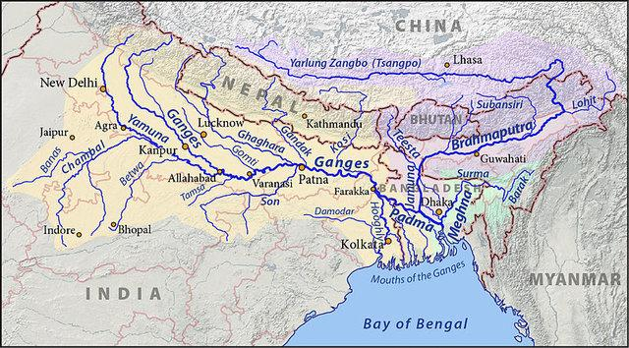
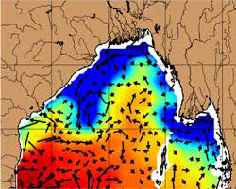
Experimental Setup
Objective | To analyze the I/O characteristics of ROMS model
Model | ROMS -- Ganga-Brahmaputra Plume in BOB
Cores | 48 to 1440 PEs (2 to 60 nodes) in Cray XC40
Compiler | INTEL
Profiler | Cray PAT
Source – https://en.wikipedia.org/wiki/Ganges_Basin
Table 1 : Overall Setup
System | Cray XC40:Intel Haswell 2.5 GHz based CPU cluster
Nodes | 1376 nodes
Cores | 24 cores per node (Total 33024 cores)
Memory | 128 GB per node (Total RAM 172 TB)
Network | Cray Aries Interconnect with Dragonfly topology
Storage | Cray's Parallel Lustre File System (2 PB usable space)
Source – https://meetings.aviso.altimetry.fr/
Domain Partitions - X*Y | Total Cores | Nodes in CRAY
8*6 | 48 | 2
16*15 | 240 | 10
32*30 | 960 | 40
40*36 | 1440 | 60
Table 2 : The Cray XC40 system
Table 3 : Domain Partitioning
Notes:
1.ROMS Model setup is for BOB region. (The Bay of Bengal receives large amounts of freshwater from the Ganga‐Brahmaputra (GB) river during the summer monsoon.)
2.All exp are done in Cray XC40 machine. (24 cores used per node)
3.The tilings used are shown in Table 3. 48,240,960 and 1440.

Slide 8
Experimental Setup (cont.)
Application | Ganga-Brahmaputra Plume in BOB
Grid Size | 899*629*40 (40 is the depth)
Time Step size | 240 secs
Number of Time Steps | 500 steps (50 total records, 5 files , 10 records per file)
I/O | Serial NetCDF and Parallel NetCDF-4 (works on top of HDF-5)
File Types | Quick(Most time consuming), Average, Diagnostic, History
Table 4: The ROMS model setup
File Types | Writing Frequency | Total Files | File Size(in GB) | Total Size(in GB)
Quick | 1 | 30 | 0.93 | 27.9
Average | 30 | 1 | 1.1 | 1.1
History | 30 | 1 | 1.1 | 1.1
Diagnostic | 30 | 1 | 1.1 | 1.1
Table 5: Output file types, writing frequency and storage space (30 days simulation)
Notes:
4. Grid size Latitude / Longitude / depth
3 days of simulation
5, Quick files are most time -consuming. Hence, used for all experiments.

Slide 9
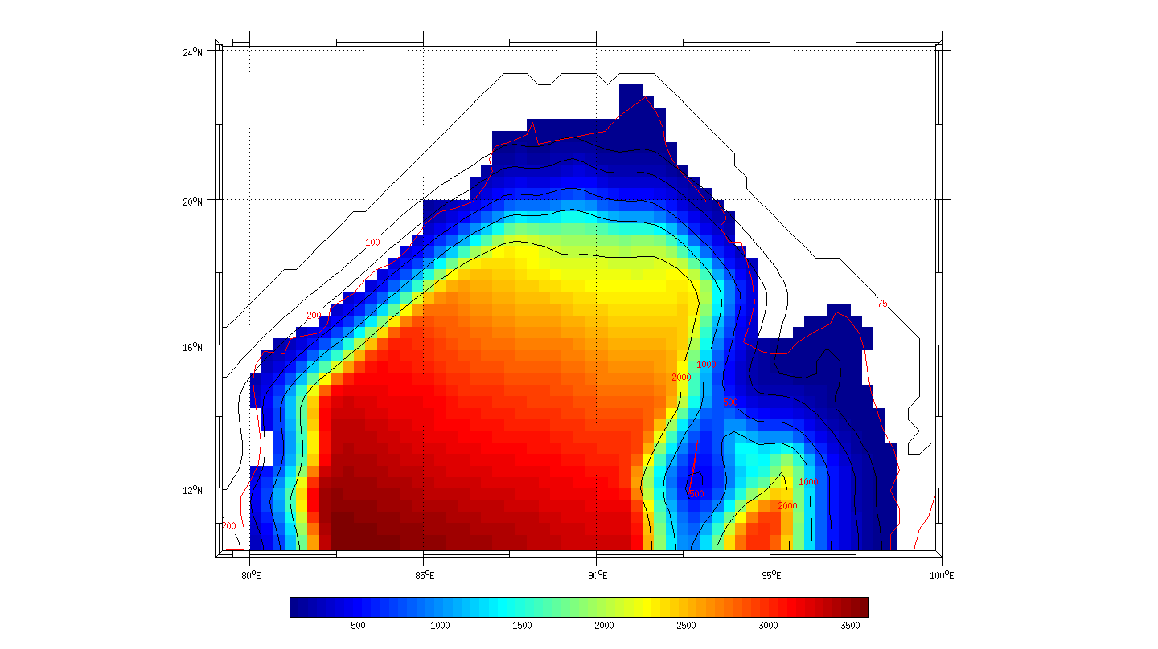
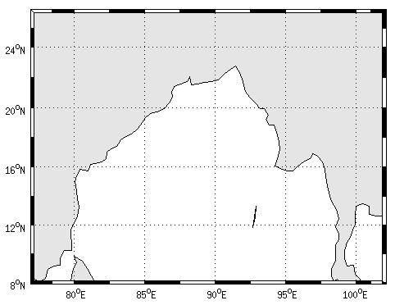
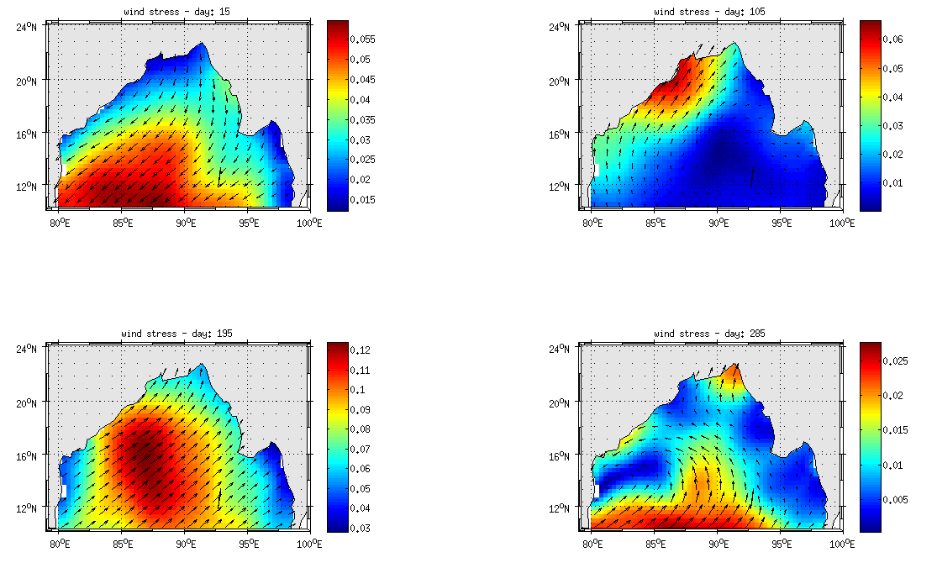
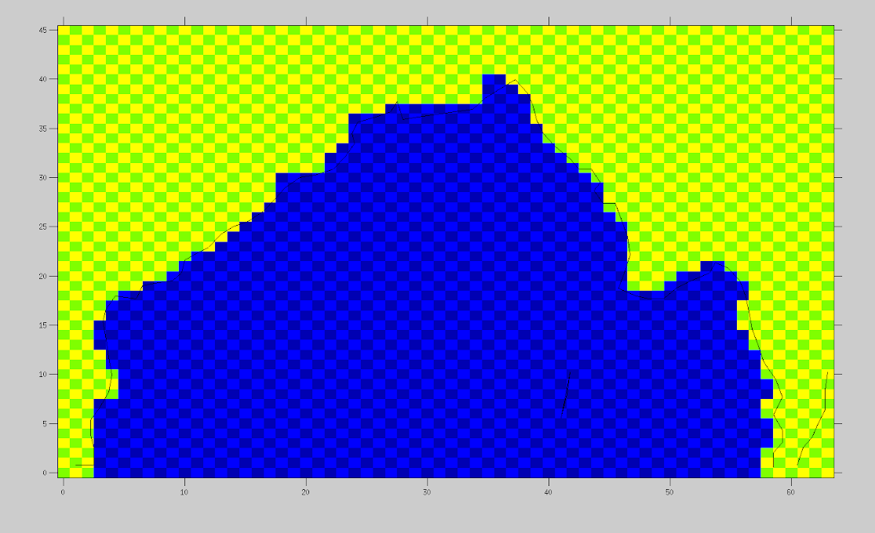
Fig 1. Initial Input Data using MATLAB
Fig 2. Before manual editing step
Fig 3. Land parts edited manually
Fig 4. Final Input Data
Input Dataset for the ROMS Model
Preprocessing steps for ROMS Input Data (Region shown is Bay of Bengal)
Notes:
The preprocessing is done in Matlab for the input to the ROMS model.
This shows the BOB region .

Slide 10
I/O Analysis of the ROMS Model

Slide 11
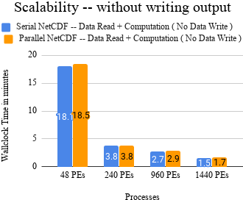
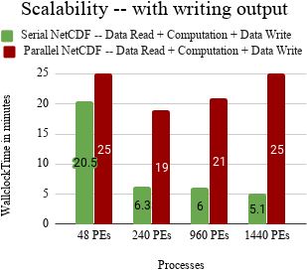
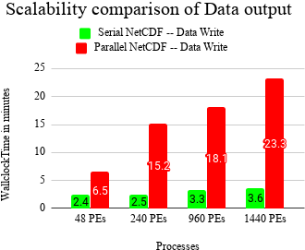
1.ROMS Model Scalability (Serial vs Parallel NetCDF)
Fig A.
Fig B.
Fig C.
Fig A + Fig C = Fig B
Observations:
Computation is scaling well (from A)
I/O write is not scaling (From C)
Model scaling up to around 240 PEs
only for parallel NetCDF (from B)
Parallel NetCDF write is taking more time than serial NetCDF (from C)
Notes:
A and B are the experimental results.
C is the diff between B and A.
So, the users in CAOS department uses serial NetCDF for I/O in the ROMS model.
Reasons for updating --
NetCDF version was updated in Cray.
The length of runs, the variables and the frequency used were different. So to make things consistent, it is updated.

Slide 12
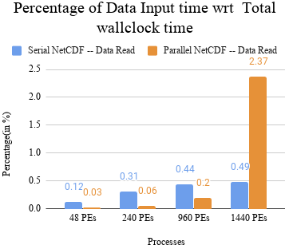
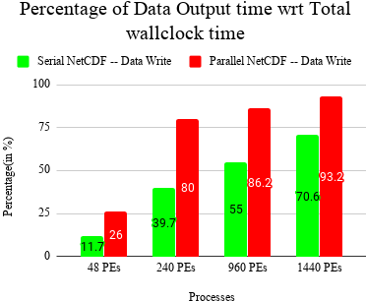
1.ROMS Model Scalability (Serial vs Parallel NetCDF)
Fig D. Data File Reading (in %)
Fig E. Data File Writing (in %)
Observations:
Parallel read time is quite small
(< 2.5%) as data read only once at the beginning
Observations:
Parallel write time is large as it is written multiple times
Notes:
Start --- One of the feedback I got during my mid-term presentation was to get the IO input and output timings as percentage of the total execution time.
At last ---- So, our improvement strategies are on the I/O write part of the ROMS model.

Slide 13
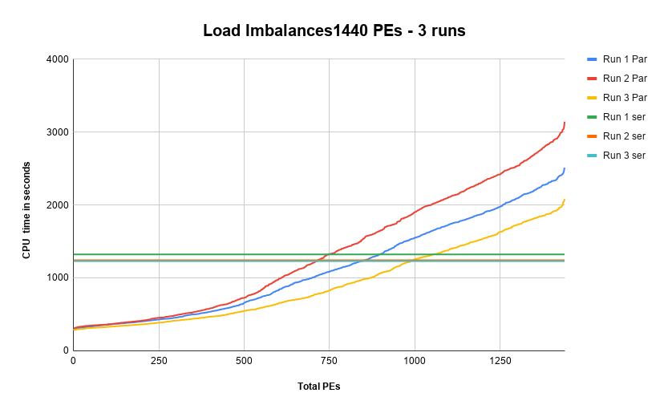
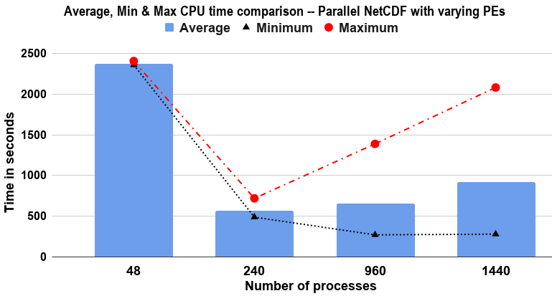
2.Load Imbalance (Parallel NetCDF with varying PEs)
Fig A. Parallel NetCDF with varying PEs
Fig B. Parallel NetCDF multiple runs at 1440 PEs
Observations:
Parallel NetCDF is load imbalanced
(It is increasing with more PEs)
After 240 PEs, the min CPU time is decreasing as lesser data to be transferred per PE but the max CPU time is increasing
Observations:
Serial NetCDF model is load balanced
(Found consistent across multiple runs)
CPU time variation is continuously increasing
for Parallel NetCDF

Slide 14
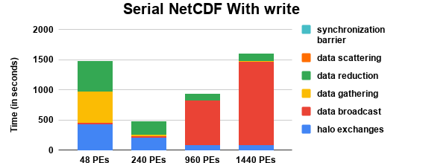
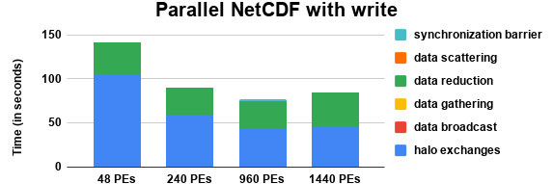
3.Bottleneck function Studies (MPI calls comparison)
Fig A.
Fig B.
Observations:
For Serial NetCDF, Broadcasting time is increasing with increasing number of PEs.
For Parallel NetCDF, MPI communications are not responsible for the imbalance.
Notes:
It is because more number of processes need to send their data and then wait for the master process to complete the data
write. They proceed for the next computations once "No Error" is broadcast by the master to all leading to an implicit barrier.
Total MPI timings are not increasing with increasing number of processes for parallel NetCDF.
The parallel NetCDF values are within 150 sec whereas it is 1500 sec in case of serial NetCDF for same experimental setup.
It means the imbalance is not due to MPI communications in case of parallel NetCDF.

Slide 15
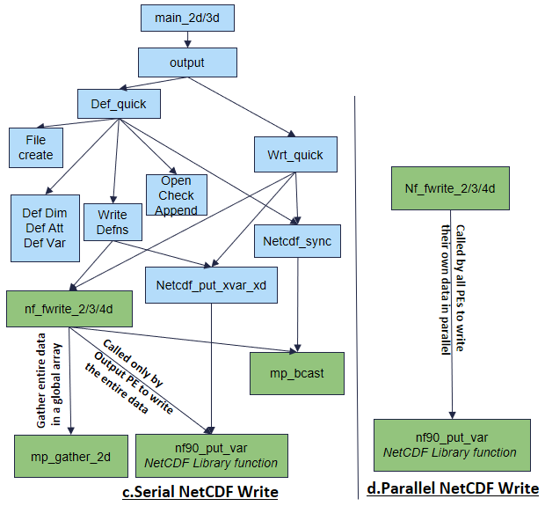
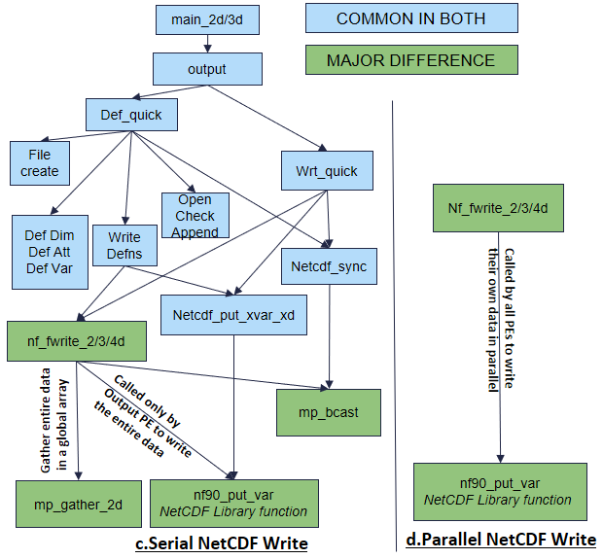
4.ROMS I/O writing into output NetCDF files
Fig A. Serial NetCDF Write
Fig B. Parallel NetCDF Write
Notes:
Mention gather
nf_90_put_var
In case of serial NetCDF, The master gathers the data from all the processes using MPI Gather and then writes the complete data using nf_90_put_var call.
It is not required in parallel as they write their own part of the data.

Slide 16
I/O Improvement of the ROMS Model

Slide 17
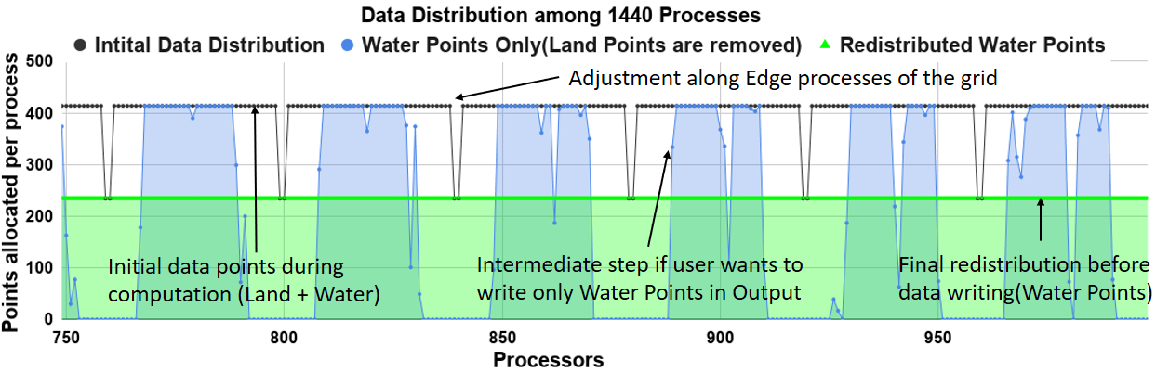
1.Load Imbalance Reduction -- Setup and Data Distribution
Processes | 1440 processes
Variables written | u(2D),v(2D),u(3D),v(3D)
Output Files | Quick Files(Data Snapshots)
Length of Run | 500 time-steps
Write Frequency | 10 time-steps(50 records)
File creation Frequency | 100 time-steps(5 output files)
Table 1. Experimental Setup for I/O Imbalance Improvement
Fig 1. Data Distribution in the ROMS model for 1440 Processes
Notes:
Points allocated per process is shown here partially for clarity…
2 cases
If user wants to write all points -- same as initial data dist (adjustments in edge tiles along latitude and longitudes)
Then only water points -- intermediate processing step of removing land points (blue) and then redistribution (green)

Slide 18
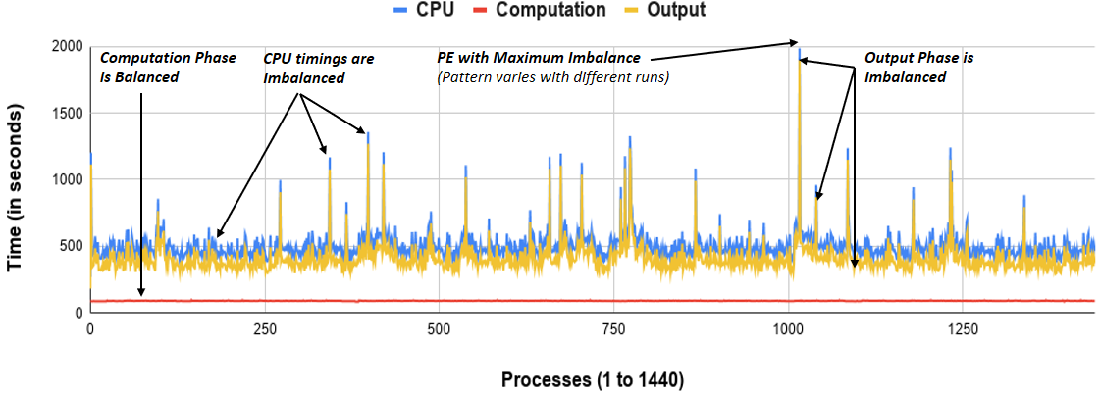
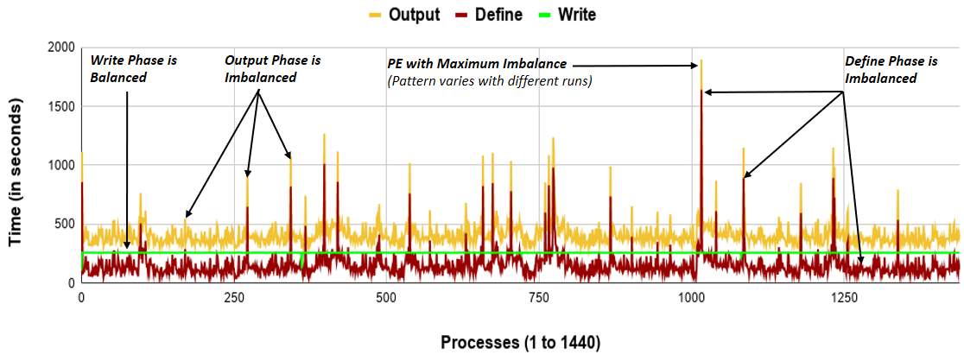
1.Load Imbalance Reduction -- Imbalance Flow
Fig 2. CPU (Imbalanced) = Computation (Balanced) + Output (Imbalanced)
Fig 3. Output (Imbalanced) = Define Files (Imbalanced) + Write into files (Balanced)
Notes:
Output -- define and write
Define -- Variables and their attributes
Write -- write the actual data
Details in next slides

Slide 19
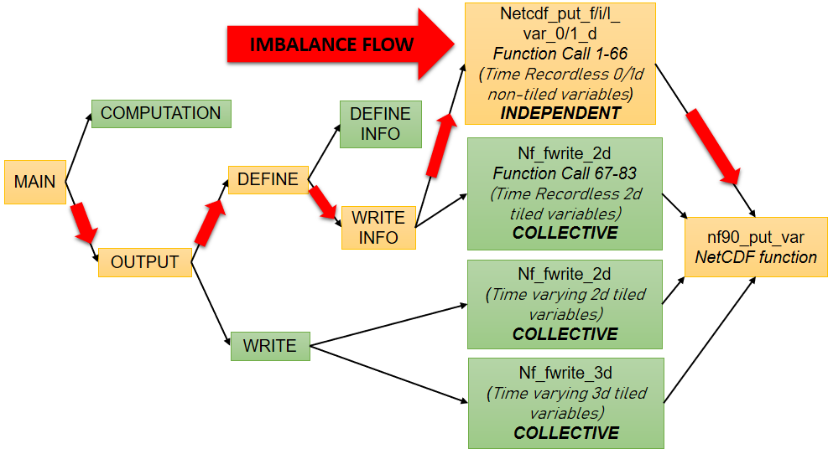
1.Load Imbalance Reduction -- Complete Imbalance Flow
Fig 4. Imbalance Flow Diagram
Notes:
define info -- vars and their dimensions..
write info -- write time recordless like latitude , longitude
write -- write time varying like vel, temp , salinity
upper one non-tiled → Independent
lower three are tiled → Collective
For the non-tiled variables i.e in those those 66 function calls all processes involved in parallel NetCDF call are sending an independent write request to the same portion of the file as the data is not distributed for these variables,. So, there is I/O contention due to file locking by multiple write requests leading to imbalance although independent calls help to minimize global synchronization overhead. It is found that the imbalance is increasing with increase in number of processes.
Whereas for tiled-variables, i.e lower three boxes , all processes involved in parallel NetCDF call are sending I/O write requests collectively. Hence, it merges the separate requests as the entire grid data is written by all the processes making the I/O write efficient.
The imbalance is solved after those function calls were changed from independent to collective. Now, the non-tiled variables make a single collective write request.

Slide 20
1.Load Imbalance Reduction -- Important Technical Terms
The non-tiled variable data is not distributed among processes as they are either single-valued variable or small vectors. Ex -- Latitude, Longitude
The tiled variable data is distributed in tiles among the processes typically the 2d or 3d variables. Ex -- Surface Velocity, 3D velocity
The time-recordless variable data → Written only once during define phase
The time varying variable data → Written at user defined frequency during write phase
Output phase further consists of two phases: define phase and write phase.
In the define phase, the NetCDF file is created and all the variables are defined.
The defining phase involve either Define Info or Write Info.
Define Info (It involves creating a NetCDF file, defining dimensions, attributes, and variables)
and Write Info (It involves writing time-recordless non-tiled as well as tiled 2D, information variables) or appending into an existing NetCDF file).
In the write phase, the data for the time-varying tiled 2D or 3D variables that are defined during define phase is written into the file.

Slide 21
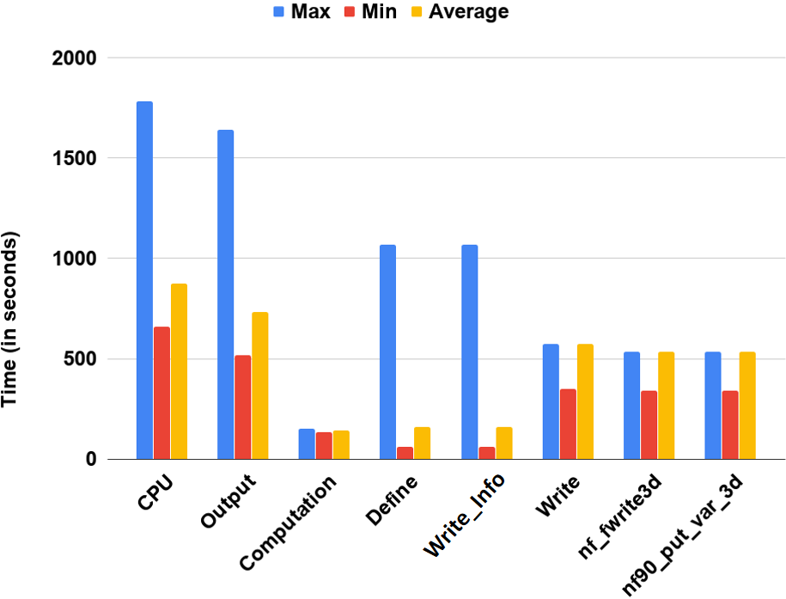
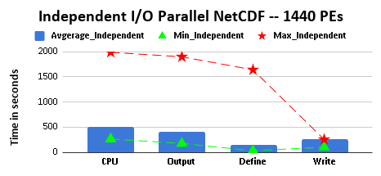
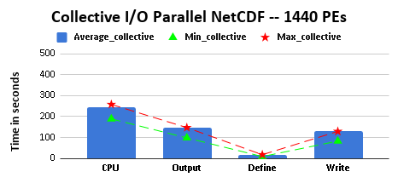
1.Load Imbalance Reduction -- Improvements with New Setup
Observations:
The Computation and Write phase are balanced
The CPU, Output, Define phase, Write_Info are imbalanced
The 3d variables in write are consuming most of the write timing
Fig 5. Min, Max and Averages times comparison for 1440 Processes
Fig 6. Default setup of the ROMS model
Fig 7. New setup of the ROMS model

Slide 22
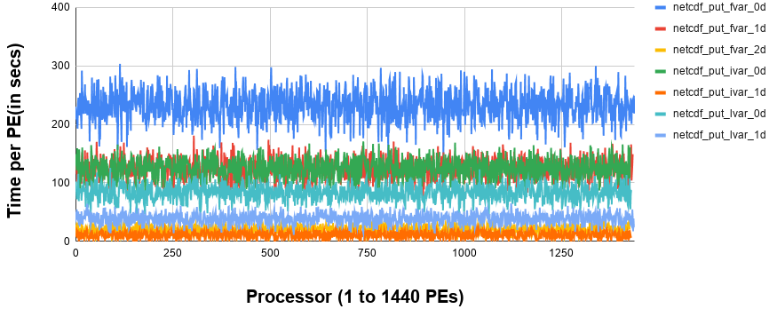
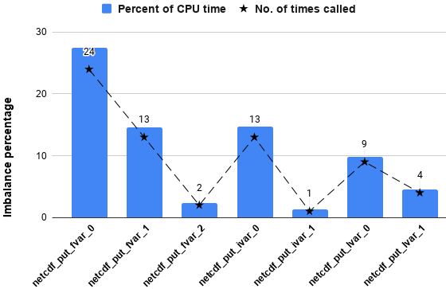
1.Load Imbalance Reduction -- Bottleneck Function Studies
Fig 8. Bottleneck in the 7 different functions
Observations:
7 different types of function are involved in those 66 function calls
Imbalance from each of those 7 types of function is proportional to the number of times they are called
All the 66 functions are equally responsible for the imbalance
Fig 9. Imbalance Contribution by different NetCDF Functions

Slide 23
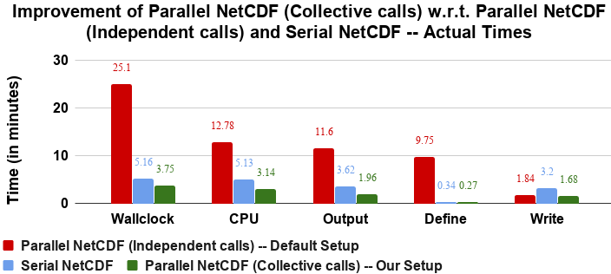
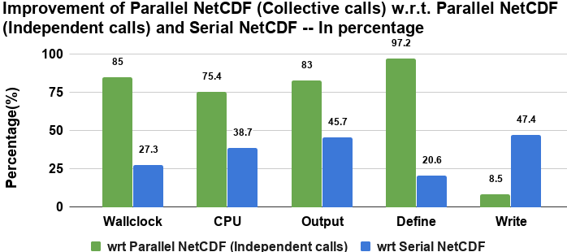
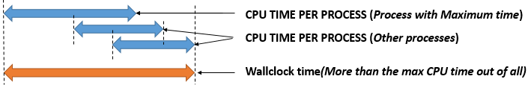
1.Load Imbalance Reduction -- Performance Improvement Results
Fig 10.
Observations:
85% Improvement in wallclock time wrt default parallel NetCDF and 27% wrt serial NetCDF
Wallclock time much higher than max of all CPU times for default parallel NetCDF
Imbalance is solved from the improvement in the define phase
Parallel Write phase performing better than serial write phase
Fig 11.
Fig 12. Non-overlapping CPU time imbalance contributed by different processes
Notes:
Non-overlapping, as file is not locked for all the processes at the same time. Moreover, the process which completes one function and move to next might need to wait if some other process has already locked the file making the imbalance pattern different in different experimental runs.

Slide 24
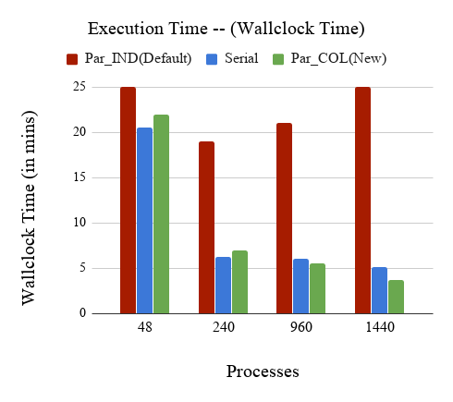
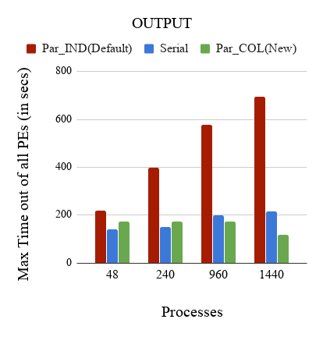
1.Load Imbalance Reduction -- New Scalability Results
Fig 13 A.
Fig 13 B.
Observations:
Par_COL (New Parallel NetCDF setup) is scaling well
Par_COL execution time lower than Par_IND (Default Parallel NetCDF setup) as well as Serial NetCDF for 960 and 1440 processes
Write time of Par_COL is lower than Serial for 960 and 1440 processes
Notes:
For define phase , more processes means more file locking and hence more imbalance.
Here output times are max of cpu times … At beginning it the actual wall-clock times…
CPU * 2 = Overall Execution, Similarly, Max of Output * 2 = Output execution time (Shown at beginning as difference of 2)

Slide 25
2.Selective writing strategy -- Motivation
Variability in Climate Output Data -- Spatial and Temporal variability
Spatial variability -- variation of a parameter across space for any given time instant.
Example - Eddies
Temporal variability -- variation of a parameter over time for any given spatial location.
Example - hourly, daily, monthly, intraseasonal (15 to 60 days), seasonal (180 days),
annual(1 year), or interannual (multiple years).
For a given writing frequency, variation in data from the last written step and the
present time-step is small compared to other time-steps.
Idea is to avoid writing the present step data again and use the previously written data for analysis to be performed on the present time-step.
Leads to the accuracy loss of the data. But, it can reduce the data write timings.
Implementable when some compromise on the accuracy loss is acceptable.
Implemented in the ROMS model within the acceptable accuracy loss constraints set separately for each parameter.

Slide 26
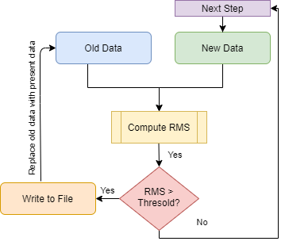
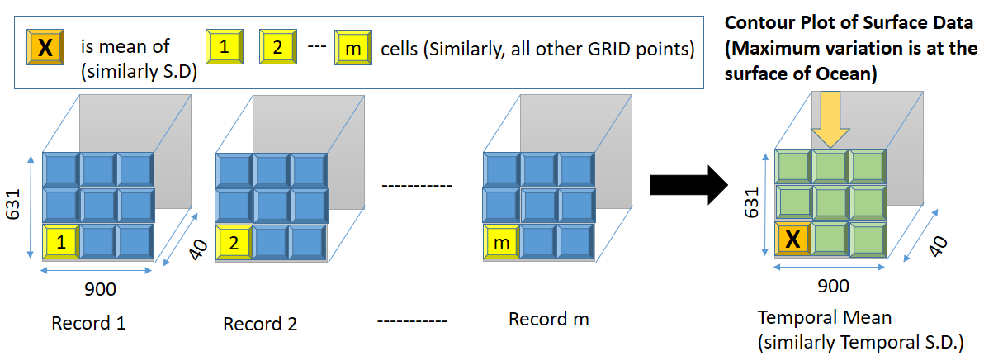
2.Selective writing strategy -- Approach
2.Selective writing strategy -- Accuracy Evaluation Method
A separate array is maintained to store the final processed data of the last step written to disk using SAVE in FORTRAN.
Before writing, RMS error between the present step data and the previous step data is compared.
If the RMS error is above a certain threshold, the data is written or else skipped.
The skipped time-step values for each parameter are approximated with the last time-step value written.
Fig 3.
Fig 4.
Notes:
Lets say we have m 3d records as shown in blue. So we calculate the temporal mean which is also a 3d data as shown in green.
Each point is the mean of m records. So it is done point-wise for each cell. Similarly we calculate Temporal SD.
Then, Difference between Temporal Mean (similarly Standard Deviation) with without selective writing (m records) and
selective writing (< m records) is calculated to check the accuracy loss due to selective writing strategy.
The quality of data is also checked from the Surface Contour Plots of the difference between Temporal Means (similarly Standard Deviation).
Close to zero is good!

Slide 27
2.Selective writing strategy -- Experimental Setup
Processes | 1440 processes
Variable type | 3D variables (time consuming variables)
Variables written | velocity (u,v,w), temperature , salinity
Output Files | Average file (Time-averaged data)
Threshold Used | Multiple Thresholds used for each variable
Write Frequency | Hourly records (15 timesteps * 240 (step-size) / 3600=1 hour)
Length of Run | 15 days (5400 timesteps * 240 (step-size) / 3600 / 24=15 days)
Table 1. Experimental Setup for Selective Writing
Variable | Thresholds
Velocity | 1, 1.5, 2, 2.5, 5 cm/sec
Temperature | 0.02 , 0.025 and 0.05 Celsius
Salinity | 0.0005 , 0.00075 and 0.001 ppt
Variable | Range | Acceptable Deviation
Velocity | +/- 100 cm/sec | +/- 7.5 cm/sec
Temperature | 20 to 35 Celsius | 0.05 Celsius
Salinity | 25 to 35 ppt | 0.005 ppt
Table 2. Thresholds used
Table 3. Range of variation and acceptable A.L.
Notes:
CAOS -- Centre for Atmospheric and Oceanic Sciences
with discussion with Prof VInay from CAOS dept of IISc. They uses this ROMS model for their experiments.

Slide 28
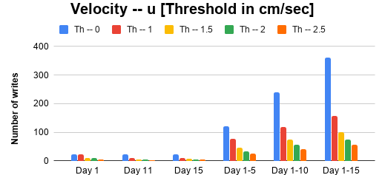
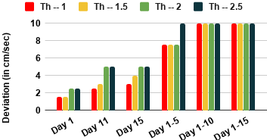
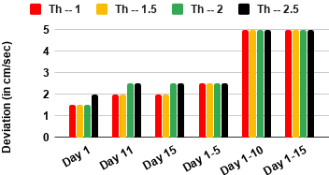
2.Selective writing strategy -- Reduction vs Accuracy Loss(Velocity)
Observations:
Threshold of upto 1.5 cm/sec limits the difference in temporal mean and S.D. to <5 cm/sec for single day analysis and <7.5cm/sec for 5 days analysis.
Steep jump in A.L. for changing the threshold from 1.5 to 2 cm/sec.
Hence, 1.5 cm/sec is selected.
60% reduction in number of writes for 5 days of run.
Fig 5a. Write Reduction
Fig 5b. Accuracy Loss in Temporal Mean
Fig 5c. Accuracy Loss in Temporal S.D.
Notes:
Fig a shows reduction in writes with increasing Threshold.
Fib b shows increase in AL using difference in Temporal Mean between non-sel and sel output data.
SImilarly for temporal SD in fig c.

Slide 29
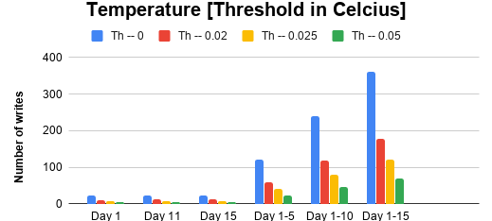
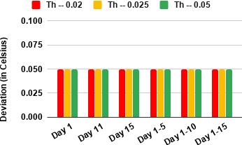
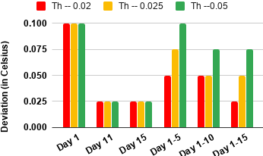
2.Selective writing strategy -- Reduction vs Accuracy Loss(Temperature)
Observations:
All thresholds are meeting the difference in temporal means constraint of 0.05 Celsius.
Upto threshold of 0.02 Celsius is meeting the constraint of S.D. A.L. of 0.05 Celsius up to 15 days.
Hence, 0.02 Celsius is selected.
50% reduction in number of writes for 5 days of run.
Fig 6a. Write Reduction
Fig 6b. Accuracy Loss in Temporal Mean
Fig 6c. Accuracy Loss in Temporal S.D.
Notes:
Day 1 is high as the model builds up in first few steps..So it is not stable..

Slide 30
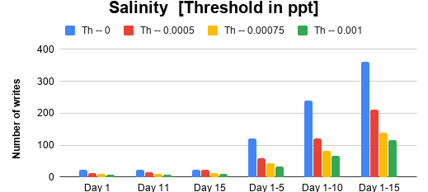
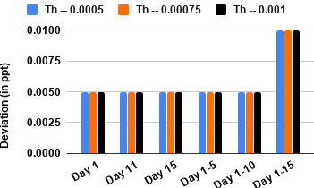
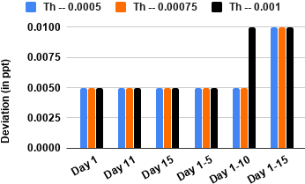
2.Selective writing strategy -- Reduction vs Accuracy Loss(Salinity)
Observations:
All thresholds are meeting the difference in temporal means constraint of 0.005 ppt.
Upto threshold of 0.00075 ppt is meeting the constraint of difference in temporal S.D. of 0.005 ppt for up to 10 days.
Hence, 0.00075 ppt is selected.
65% reduction in number of writes for 5 days of run.
Fig 7a. Write Reduction
Fig 7b. Accuracy Loss in Temporal Mean
Fig 7c. Accuracy Loss in Temporal S.D.

Slide 31
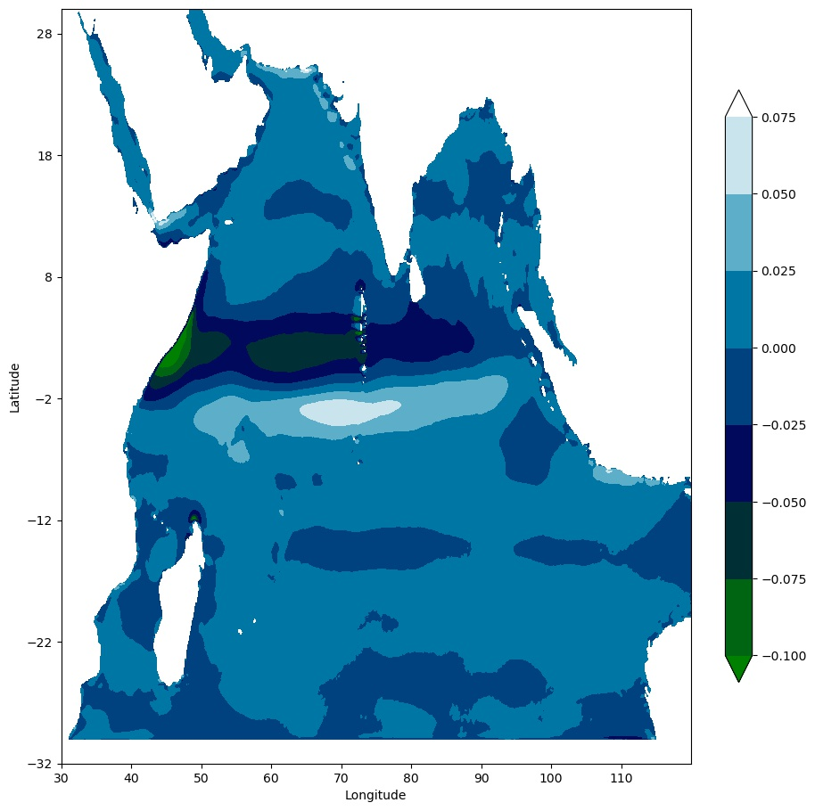
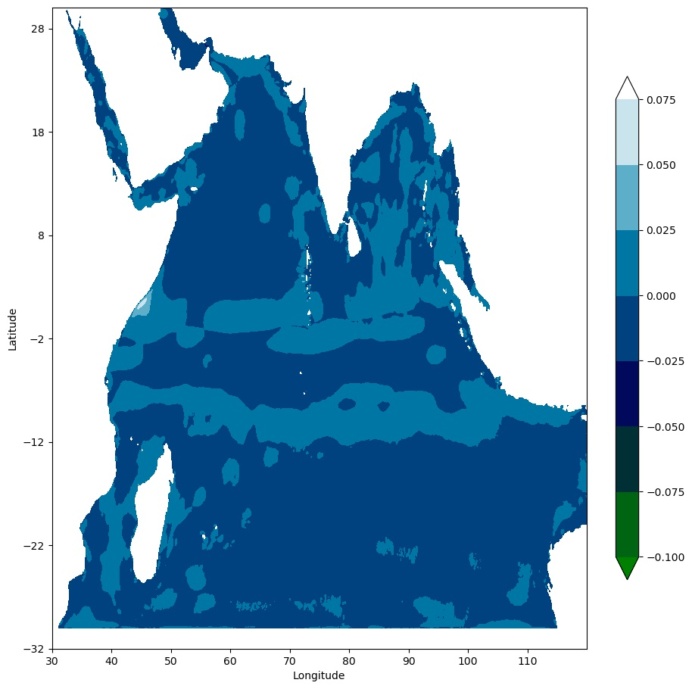
2.Selective writing strategy -- Surface Contour Plot(Velocity)
Fig 8a. Accuracy Loss in Temporal Mean
Fig 8b. Accuracy Loss in Temporal S.D.
Observations:
The difference in temporal means is also found maximum in the high velocity regions.
So, those regions are primarily constrained within the allowed threshold of 7.5 cm/sec using a threshold of 1.5 cm/sec.
Notes:
Results for selected threshold based on acceptable deviation.

Slide 32
2.Selective writing strategy -- Improvement Results
2.Selective writing strategy -- Conclusion
Type | Execution Time | Output | nf fwrite 3d function
Non-Selective i.e. Default | 24.36 mins | 14.2 mins | 12.98 mins
Selective (Reduction in %) | 16.66 mins (31.6%) | 6.83 mins (51.87%) | 5.26 mins (59.43%)
Table 4. Selective Writing Time Reduction Results for 5 days of run
Variation in the velocity variable is more as compared to temperature and salinity.
Maximum variation is present at the surface. So, it is better to write all the 2D variables.
Ocean prediction systems are good for 5 days. The quality of forecast degrades as a function of time and beyond 5 days the quality becomes poor. Hence, this method is suitable for ocean forecast systems.
Daily means and S.D. are acceptable for all single day analysis.
So, this method can be useful for experiments where analysis is done based on daily data.

Slide 33
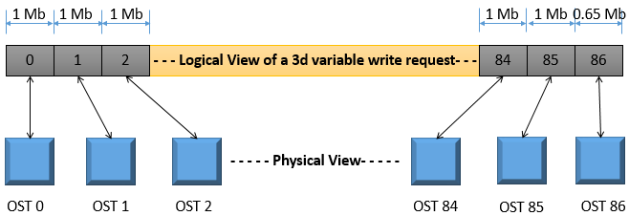
3.Lustre Striping technique -- Illustration
3.Lustre Striping technique -- Experimental Setup
Fig1. Physical and Logical views of each write request of 3d variables (86.65 Mb) for
stripe size of 1 Mb and Stripe count of -1 (i.e. maximum 96 in CRAY Lustre le system)
Processes | 48, 240, 960, 1440
Stripe Count | 1 OST, 4 OSTs , 16 OSTs, 96 OSTs(set as -1 for max)
Stripe Size | 1Mb, 4Mb, 16Mb, 32Mb
Number of records | 20 records each with 5 3D variables (100 3D write requests)
Table 1. Lustre Striping Setup
Notes:
File striping is a technique to distribute the data of a single file across multiple OSTs.
A proper striping can increase the bandwidth to read or write in a file. It also increases the upper
limit of file size as multiple OSTs are used.
But it also leads to extra overhead due to increased network contention in I/O servers.
So there is a trade-off involved.
Hence, optimizing the Lustre parameters help in the improvement of the I/O performance.
Depends on number of parallel processes, write data size, how it is stored in the file.
Default stripe size is 1 Mb and stripe count is 4 OSTs.
Basically, the number of OSTs which each process needs to access should be minimized by stripe alignment.

Slide 34

3.Lustre Striping technique -- Improvement Results
Fig2. Write Timing improvement results using Lustre Striping [Default Combination is
Stripe Size 1 Mb , Stripe Count 4 OSTs and for Best Combination refer Table 2]
Processes | Stripe Size | Stripe Count
48 | 32 Mb | 1
240 | 1 Mb | 96
960 | 1 Mb | 96
1440 | 1 Mb | 96
Table 2. Lustre Striping - Best Combinations of Stripe Size and Stripe Count
Notes:
For a small number of processes, the benefit of using multiple
OSTs is lost because of dominating I/O contention for using multiple OSTs.

Slide 35


4.Combining the different I/O optimization techniques
Note : Selective writing implemented on top of the load balanced ROMS model hence those performance gain is not reflected here
Fig 1. Combined improvement results - Actual Times
Observations:
The lustre striping improved the writing phase by another 10%, and the output phase by another 15% wrt the improvement gained by selective writing strategy.
Overall around 60% reduction is achieved wrt serial NetCDF combining all 3 strategies
Fig 2. Combined improvement results - In percentage
Notes:
All these results are using parallel NetCDF using 1440 processes.
It was shown earlier that the load balancing strategy improved the Parallel NetCDF performance (i.e. this Balanced + Non-selective) by 27% wrt serial NetCDF.
So, the overall improvement of parallel NetCDF is around 60% wrt the serial NetCDF used presently for 1440 processes.
(As, serial NetCDF was used as it was faster than default parallel NetCDF earlier)

Slide 36
Conclusion
The computation was scaling but the issue was in the I/O for parallel NetCDF was not scaling.
The load balancing strategy helped in improving the define phase performance (it improved the execution time by 85% wrt parallel NetCDF and 27.3% wrt serial NetCDF).
The selective writing strategy implemented on top of the load-balanced model setup improved the write phase performance. (it improved the execution time by 30% wrt non-selective writing).
The lustre striping strategy further improved the write phase performance by 41%.
The balanced + selective + lustre striped strategies together improved the execution time by 40% wrt the balanced + non-selective default striping case.
Combining all the 3 strategies gave around 60% reduction in execution time in parallel NetCDF wrt the serial NetCDF version used presently.
Future Work
Methods to perform selective writing strategy on a region basis need to be examined. The sub-filing technique can be used for implementing region basis selective writing.
Implementation of collective I/O with space as well as time can be implemented.
Topology aware I/O also needs to be studied as resource contention may happen from network topology in the CRAY machine.

Slide 37
References
Wikiroms. URL https://www.myroms.org/wiki/Documentation_Portal.
Netcdf, . URL https://www.unidata.ucar.edu/software/netcdf/
Hdf5. URL https://www.hdfgroup.org/
Craypat. URL https://docs.nersc.gov/programming/performance-debugging-tools/craypat/
Lustre. URL https://www.nics.tennessee.edu/computing-resources/file-systems/io-lustre-tips
Zhuo Liu, Bin Wang, Teng Wang, Yuan Tian, Cong Xu, Yandong Wang, Weikuan Yu, Carlos A Cruz, Shujia Zhou, Tom Clune, et al. Proling and improving i/o performance of a large-scale climate scientific application. In 2013 22nd International Conference on Computer Communication and Networks (ICCCN), pages 1{7. IEEE, 2013.
Jay F Lofstead, Scott Klasky, Karsten Schwan, Norbert Podhorszki, and Chen Jin. Flexible io and integration for scientific codes through the adaptable io system (adios). In Proceedings of the 6th international workshop on Challenges of large applications in distributed environments, pages 15{24. ACM, 2008.
Houjun Tang, Xiaocheng Zou, John Jenkins, David A Boyuka, Stephen Ranshous, Dries Kimpe, Scott Klasky, and Nagiza F Samatova. Improving read performance with online access pattern analysis and prefetching. In European Conference on Parallel Processing, pages 246{257. Springer, 2014.
Kui Gao, Wei-keng Liao, Alok Choudhary, Robert Ross, and Robert Latham. Combining i/o operations for multiple array variables in parallel netcdf. In 2009 IEEE International Conference on Cluster Computing and Workshops, pages 1{10. IEEE, 2009. 6
Jianwei Li, Wei-keng Liao, Alok Choudhary, Robert Ross, Rajeev Thakur, William Gropp, Robert Latham, Andrew Siegel, Brad Gallagher, and Michael Zingale. Parallel netcdf: A high-performance scientic i/o interface. In SC'03: Proceedings of the 2003 ACM/IEEE conference on Supercomputing, pages 39{39. IEEE, 2003.
Yuichi Tsujita, Atsushi Hori, Toyohisa Kameyama, Atsuya Uno, Fumiyoshi Shoji, and Yutaka Ishikawa. Improving collective mpi-io using topology-aware stepwise data aggregation with i/o throttling. In Proceedings of the International Conference on High Performance Computing in Asia-Pacic Region, pages 12{23, 2018.
Russell K Rew, B Ucar, and EJ Hartnett. Merging netcdf and hdf5. In 20th Int. Conf. on Interactive Information and Processing Systems, 2004. 6

Slide 38
Thank You

