Slide 1
Greenspin Video Feedback

Slide 2

How the site looks like

Slide 3
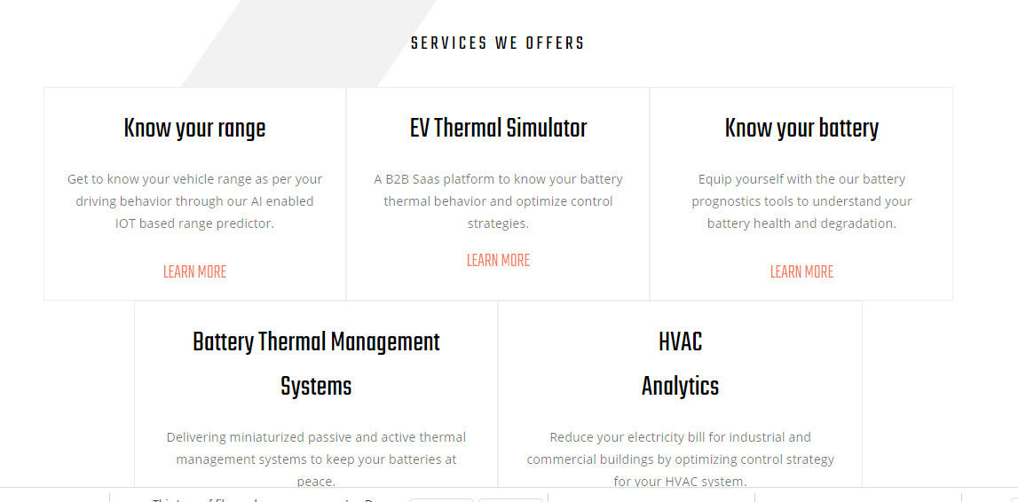
Once we click know your range then there shall be login credentials asked and once those have been approved then client shall witness the front end GUI
EV Performance Simulator

Slide 4
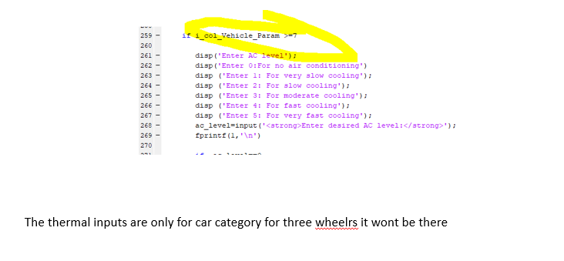
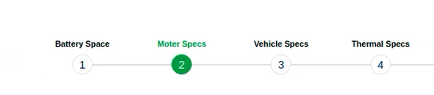
Inputs
Two Wheeler-E rickshaw-Three Wheeler(L5M-Passenger)-Three Wheeler(L5N-Cargo, Passenger Cars, Pickup Trucks, Buses)
Drop Down
Step1:
Enter Company Name: Grevolve
Enter Vehicle Category: Three Wheeler Cargo
Step 2:
Lookup tables
4
The input methodology is fine for now, later once the platform is functional we shall make the interactive GUI
Note: Remove the orange colored inputs highlighted in the excel as they shall be asked at the end

Slide 5
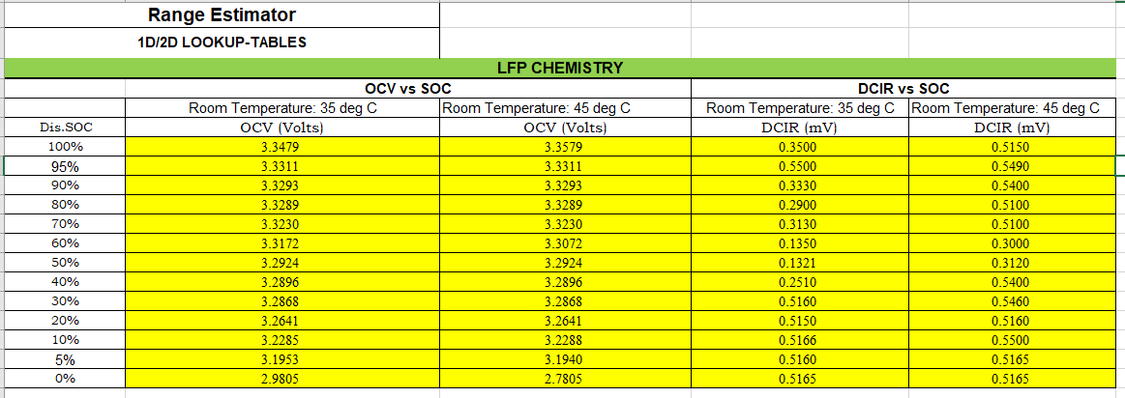
Inputs: Lookup tables
The excel sheet has been attached
to directly paste these values
The lookup table heading which was missing in the earlier subheadings is attached. There are too many values here
So its better of you can have a excel sheet kind of structure in the lookup table so that we can enter all these values.
This values are for Grevolve, for different client this values shall be different which we shall enter in the lookup table heading

Slide 6
So at the backend input stage all the values mentioned have been entered. And now the front end inputs shall be asked

Slide 7
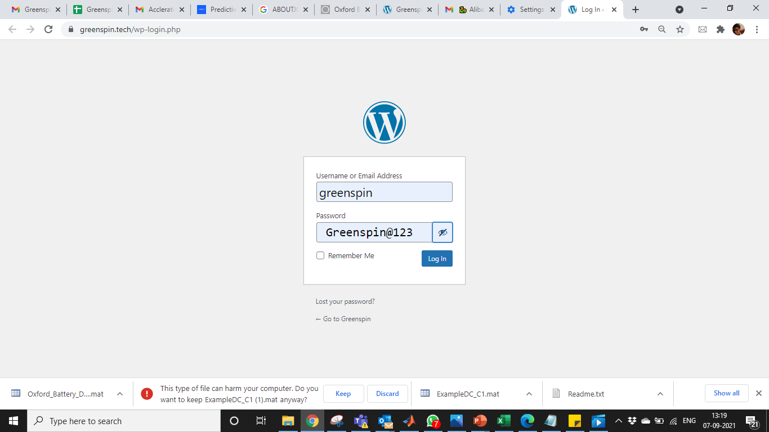
https://greenspin.tech/
Greenspin@123 --Password
https://greenspin.tech/wp-login.php

Slide 8
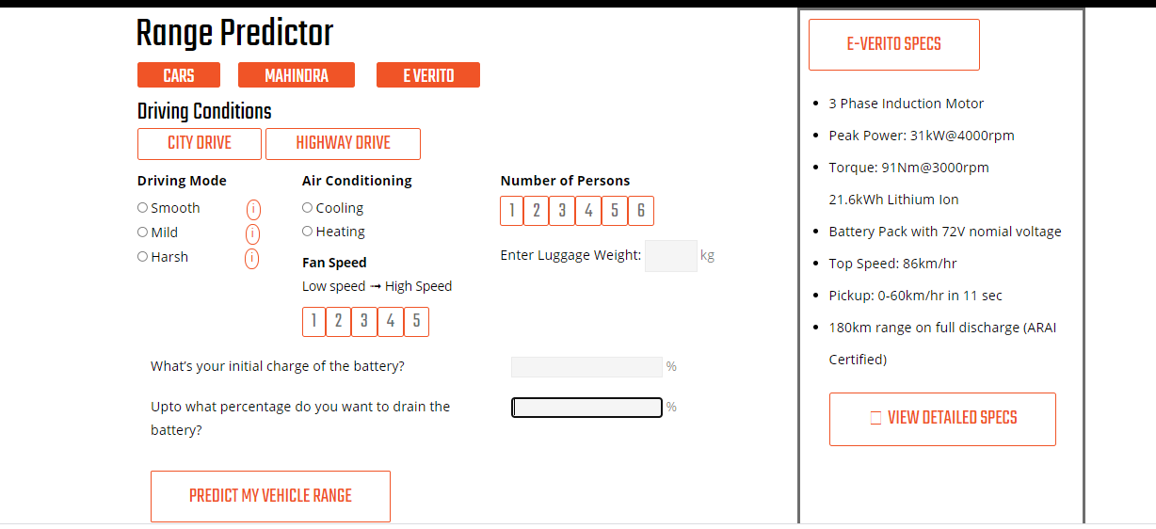
Range Predictor heading shall be replaced by Electric Vehicle Simulator
Select Drive Cycle
This section shall be there only for cars an buses
Top level
Specs of the vehicle
Three Wheelers
Grevolve
Gvolve
Start Simulation Button

Slide 9
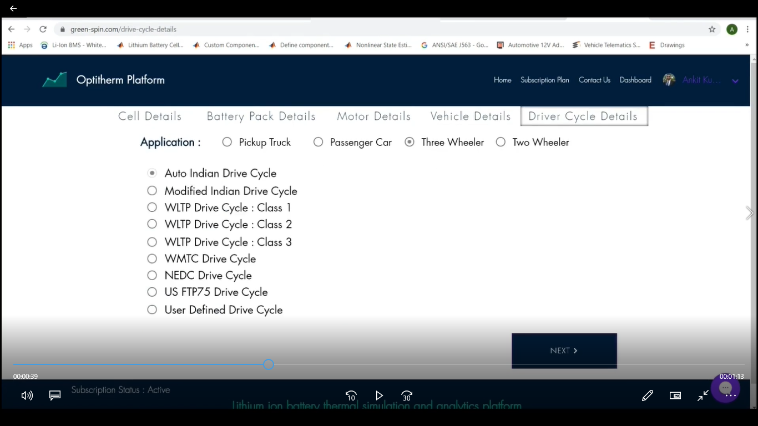
Constant Speed

Slide 10
Once the client clicks start my simulation then the code is simulated and the output shall be displayed
Details of output GUI shall be provided

Slide 11
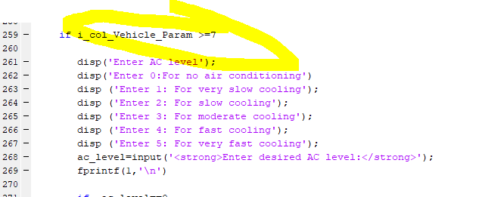
The thermal inputs are only for car category for three wheelrs it wont be there

Slide 12
The End

