Slide 1
PHP SCRIPTING LANGUAGE
Koushik Govind Raju
9740294141
koushikgraj@gmail.com

Slide 2
PHP BASICS
  Basic Syntax
    <?php
    // PHP code goes here
    ?>
  File extension is “.php”
  Single line comment
  <?php
    // This is a single-line comment
    # This is also a single-line comment
    ?>
  Multiline comments
  <?php
    /*
    This is a multiple-lines comment block
    that spans over multiple
    lines
    */
    ?>

Slide 3
PHP BASICS
VARIABLES
  Variables starts with $ sign
  must start with a letter
  cannot start with a number
  can only contain alpha-numeric characters and underscores (A-z, 0-9, and _ )
  It is case-sensitive

Slide 4
PHP BASICS
SUPER GLOBAL VARIABLES
  Some predefined variables in PHP are "superglobals“
  Regardless of scope - and you can access them from any function, class or
  Some PHP super global variables are,
    $GLOBALS
    $_SERVER
    $_REQUEST
    $_POST
    $_GET
    $_FILES
    $_ENV
    $_COOKIE
    $_SESSION

Slide 5
PHP BASICS
FUNCTIONS
  More than 1000 built-in functions
  Simple user defined function syntax
    function functionName() {
    code to be executed;
    }
  Function name must start with a letter or an underscore
  NOT case-sensitive

Slide 6
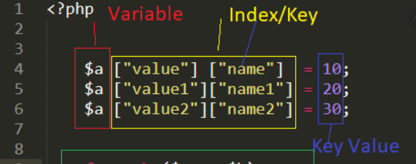
ARRAYS IN PHP
  An array is a data structure that stores one or more similar type of values in a single variable.
  Three kinds of array
    Numeric Array
    Associative Array
    Multi dimensional array
    Ref: https://www.php.net/manual/en/ref.array.php

Slide 7
NUMERIC ARRAY
  An array with a numeric index.
  Arrays can store numbers, strings and any object but their index will be represented by numbers.
  By default array index starts from zero.
  Eg: $arr_sample[6] = “Any Text”;

Slide 8
ASSOCIATIVE ARRAY
  They are different in terms of index.
  String as a index
  Strong association between key & value.
  Eg: $salaries[‘ram'] = 2000;

Slide 9
MULTIDIMENTIONAL ARRAY
  Each array element in main array can also be an array.
  Value can be access using multiple indexes
  Eg: $marks[‘ramesh'][‘physics’] = 89;
  $marks[‘ramesh'][‘maths’] = 75;

Slide 10
ARRAY EXERCISES
  Create an array which contains 'white', 'green', 'red', 'blue', 'black‘. And display the array values in descending order
  Write a php script which display sum & average value from below array.
  $arr["ram"] = array(
  "physics" => 68,
  "chemistry" => 75,
  "maths" => 94
  );
  $arr["raj"] = array(
  "physics" => 56,
  "chemistry" => 48,
  "maths" => 62
  );

Slide 11
HTTP REQUEST METHODS
  Hypertext Transfer Protocol (HTTP)
  Enable communications between clients and servers
  HTTP Methods
    GET
    POST
    PUT
    HEAD
    DELETE
    PATCH
    OPTIONS

Slide 12
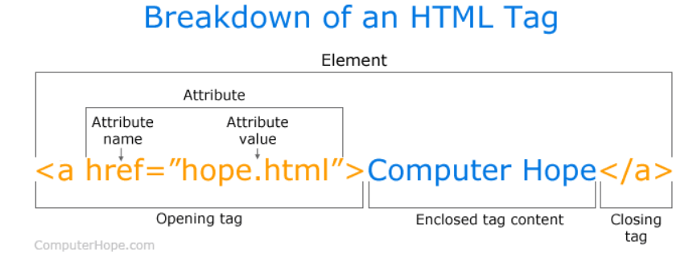
PHP FORM DATA
SUPER GLOBAL VARIABLES
  The PHP super global $_GET and $_POST are used to collect data
  Think SECURITY when processing PHP forms!
  Form will be in HTML format
  Simple understanding of HTML tag is

