Slide 1
PHP SCRIPTING LANGUAGE
Koushik Govind Raju
9740294141
koushikgraj@gmail.com

Slide 2
PHP BASICS
  Basic Syntax
    <?php
    // PHP code goes here
    ?>
  File extension is “.php”
  Single line comment
  <?php
    // This is a single-line comment
    # This is also a single-line comment
    ?>
  Multiline comments
  <?php
    /*
    This is a multiple-lines comment block
    that spans over multiple
    lines
    */
    ?>

Slide 3
PHP BASICS
VARIABLES
  Variables starts with $ sign
  must start with a letter
  cannot start with a number
  can only contain alpha-numeric characters and underscores (A-z, 0-9, and _ )
  It is case-sensitive

Slide 4
PHP BASICS
SUPER GLOBAL VARIABLES
  Some predefined variables in PHP are "superglobals“
  Regardless of scope - and you can access them from any function, class or
  Some PHP super global variables are,
    $GLOBALS
    $_SERVER
    $_REQUEST
    $_POST
    $_GET
    $_FILES
    $_ENV
    $_COOKIE
    $_SESSION

Slide 5
PHP BASICS
FUNCTIONS
  More than 1000 built-in functions
  Simple user defined function syntax
    function functionName() {
    code to be executed;
    }
  Function name must start with a letter or an underscore
  NOT case-sensitive

Slide 6
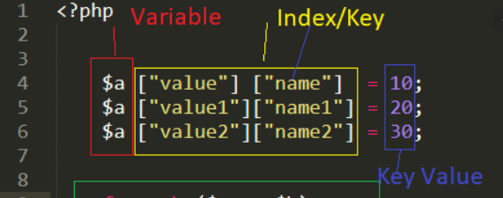
ARRAYS IN PHP
  An array is a data structure that stores one or more similar type of values in a single variable.
  Three kinds of array
    Numeric Array
    Associative Array
    Multi dimensional array
    Ref: https://www.php.net/manual/en/ref.array.php

Slide 7
NUMERIC ARRAY
  An array with a numeric index.
  Arrays can store numbers, strings and any object but their index will be represented by numbers.
  By default array index starts from zero.
  Eg: $arr_sample[6] = “Any Text”;

Slide 8
ASSOCIATIVE ARRAY
  They are different in terms of index.
  String as a index
  Strong association between key & value.
  Eg: $salaries[‘ram'] = 2000;

Slide 9
MULTIDIMENTIONAL ARRAY
  Each array element in main array can also be an array.
  Value can be access using multiple indexes
  Eg: $marks[‘ramesh'][‘physics’] = 89;
  $marks[‘ramesh'][‘maths’] = 75;

Slide 10
ARRAY EXERCISES
  Create an array which contains 'white', 'green', 'red', 'blue', 'black‘. And display the array values in descending order
  Write a php script which display sum & average value from below array.
  $arr["ram"] = array(
  "physics" => 68,
  "chemistry" => 75,
  "maths" => 94
  );
  $arr["raj"] = array(
  "physics" => 56,
  "chemistry" => 48,
  "maths" => 62
  );

Slide 11
HTTP REQUEST METHODS
  Hypertext Transfer Protocol (HTTP)
  Enable communications between clients and servers
  HTTP Methods
    GET
    POST
    PUT
    HEAD
    DELETE
    PATCH
    OPTIONS

Slide 12
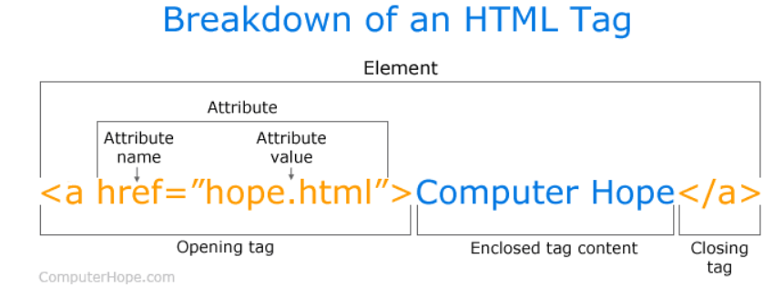
PHP FORM DATA
  The PHP super global $_GET and $_POST are used to collect data
  Think SECURITY when processing PHP forms!
  Form will be in HTML format
  Simple understanding of HTML tag is

Slide 13
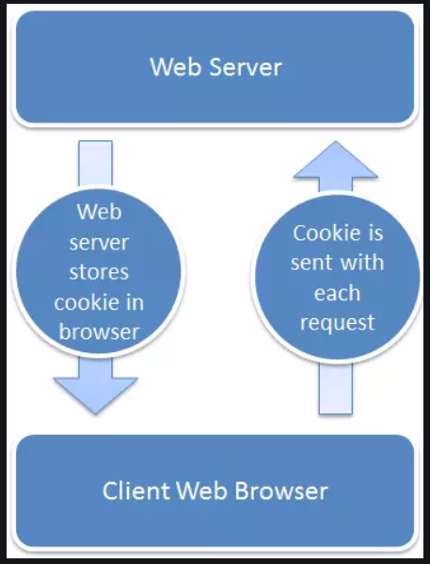
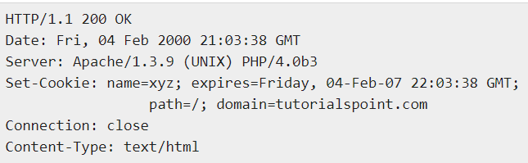
COOKIES
  Cookies are text files stored on the client computer
  Cookies are usually set in an HTTP header
  Sample PHP set cookie header
  setcookie() is a PHP function.
  Delete cookie by setting with a date that has already expired

Slide 14
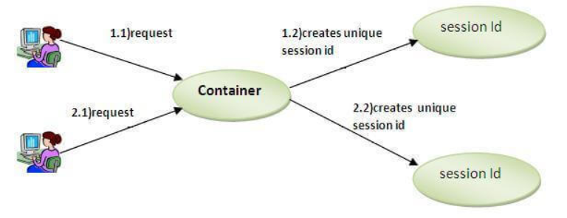
SESSIONS
  Alternative way to make data accessible across the pages
  Creates files in temporary directory
  (session.save_path in php.ini)
  can set session.auto_start variable to 1 in php.ini file
  Sessions are more secured compare to cookies
  session_id() is used to get or set the session id for the current session.
  PHPSESSIONID is a cookie

Slide 15
SECURITY IN PHP
  Avoid hackers to access unauthorised data
  SQL injection is harmful code to SQL statements
  Cross Site Scripting attack through JavaScript
  PHP Application Security Best Practices
  PHP strip_tags to remove HTML, Javascript tags
  filter_var function is used to validate and sanitize data.
  mysqli_real_escape_string function to secure SQL query
  PHP Md5 and PHP sha1

Slide 16
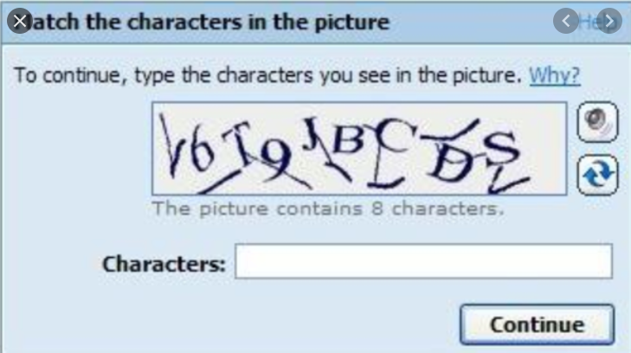
WHAT IS CAPTCHA?
  CAPTCHA stands for the Completely Automated Public Turing test to tell Computers and Humans Apart.
  Are used to differentiate between real users and automated users
  Requires PHP GD2 library

Slide 17
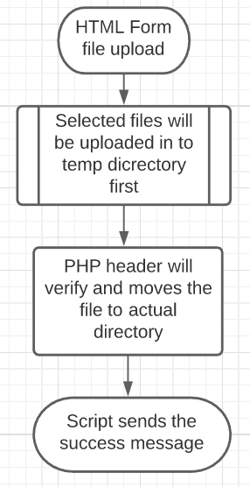
FILE UPLOAD
  File can be upload from HTML forms
  Enctype attribute is set to multipart/form-data
  File will be uploaded in to server
  Default upload_max_filesize is 2 MB
  $_FILE variable
    $_FILES['file']['tmp_name'] − the uploaded file in the
    temporary directory on the web server.
    $_FILES['file']['name'] − the actual name of the uploaded file.
    $_FILES['file']['size'] − the size in bytes of the uploaded file.
    $_FILES['file']['type'] − the MIME type of the uploaded file.
    $_FILES['file']['error'] − the error code associated with

Slide 18

SEND EMAIL
  Sending email is very common in web application
  PHP built-in mail() function for creating and sending email messages
  mail(to, subject, message, headers, parameters)
  PHP can send simple text email & HTML format emails
  To send HTML format email need to provide additional email headers
  A mail server should be used to send emails(SMTP)
  SMTP stands for Simple Mail Transfer Protocal

Slide 19
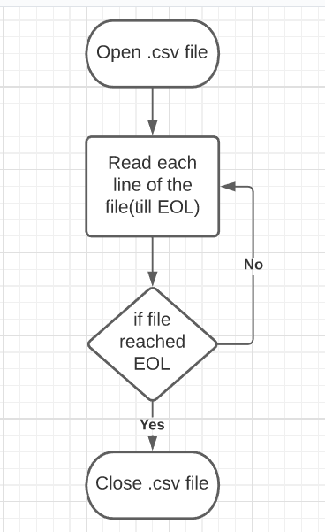
CREATE CSV
  CSV stands for comma-separated values.
  CSV file is a text file with .csv extension
  To write a line to a CSV file, you use the fputcsv()
  To read a CSV file, you use the fgetcsv() function

Slide 20
DATABASES
  A database is an organized collection of structured information, or data, typically stored electronically in a computer system.
  PHP can connect with multiple databases like MySQL, PostGreSQL, Oracle, Sybase, SQLite, MongoDB

Slide 21
MAGIC QUOTES
  Magic quotes would automatically escape risky inputs form the users
  It is useful to protect SQL injections
  Special characters from the user input will be escaped by \(back slashes)
  get_magic_quotes_gpc() will check magic is enables in php.ini
  Enable magic_quotes_gpc in php.ini to make use

Slide 22
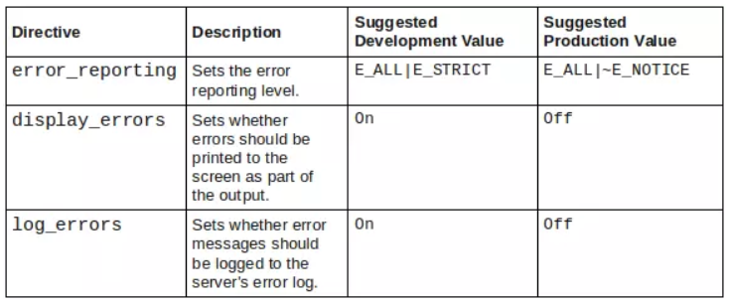
ERROR HANDLING
  Errors are the most common event a developer faces when programming
  Errors can be categorized
    Syntactical - missing the semicolon
    run-time - trying to connect to a database when the server is down
    Logical - providing incorrect data
  All errors and warnings should be logged
  Few PHP error configurations are

Slide 23
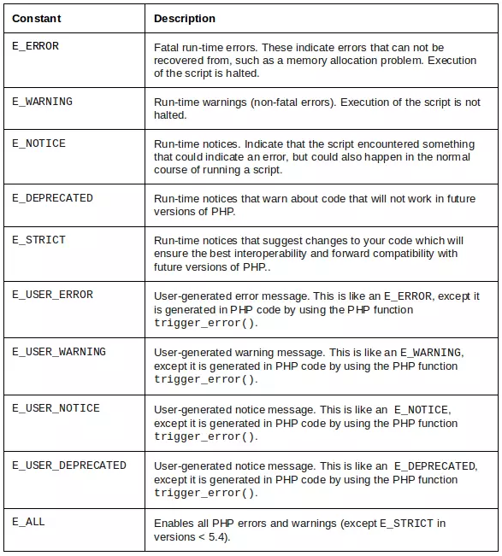
DIFFERENT TYPE OF PHP ERRORS

Slide 24
EXCEPTION HANDLING IN PHP
  What is an Exception?
  Exceptions are used to change the normal flow of a script if a specified error occurs.
  Important keywords in exception handling are
    Try
    Catch
    Through
    Finally
    (finally block is also used for clean-up activity)

Slide 25
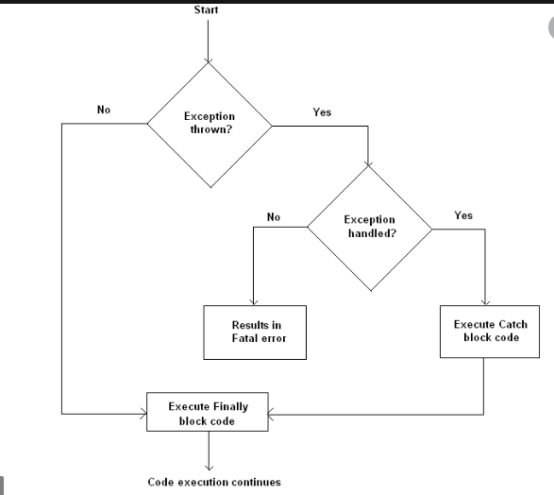
EXCEPTION HANDLING FLOW

Slide 26
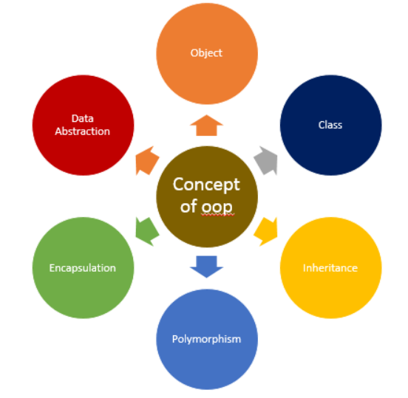
OOPS IN PHP
  PHP was initially developed as a procedural language and only later extended to OOP
  PHP can be designed & developed using procedure oriented & object oriented concepts till date
  In OOPS group all of the variables and functions of a particular topic into a single class
  Most basic terms
    classes
    objects
    methods
    properties

Slide 27
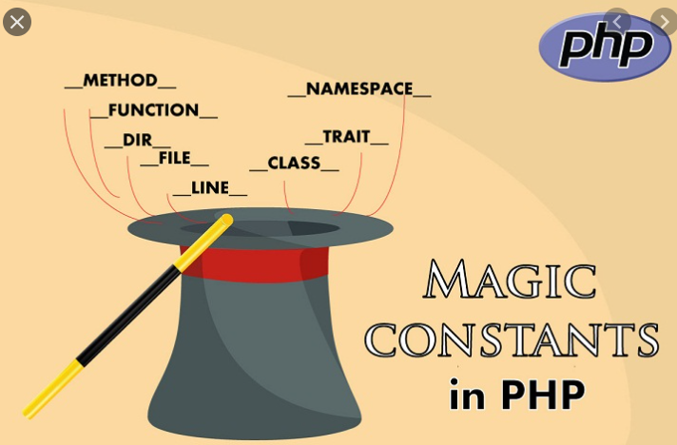
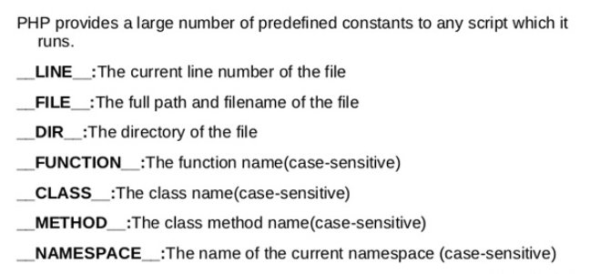
OOPS IN PHP –MAGIC CONSTANTS
  PHP magic constants are compile time constants
  Stats and ends double underscore (__)

Slide 28
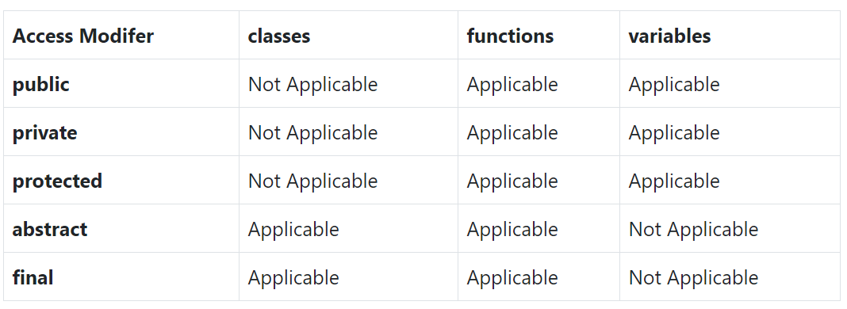
OOPS IN PHP –ACCESS MODIFIERS
  Public: are accessible from anywhere, even from outside of the class scope.
  private: only be accessed from within the class itself.
  protected: accessed from its subclass & parent class.
  abstract: This keyword is only used for PHP classes and its member functions
  final: can not be changed or overridden by any subclass.

Slide 29

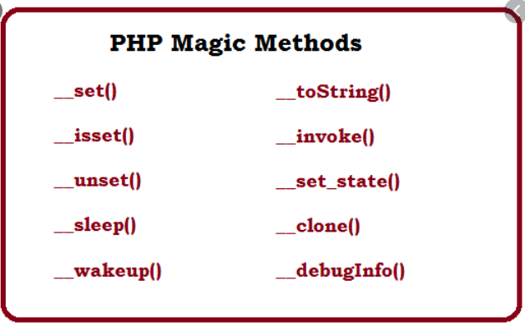
OOPS IN PHP – MAGIC METHODS
  Magic methods in PHP are special methods that are automatically called when certain conditions are met
  named with double underscore (__) as prefix
  __construct() & __destruct()

Slide 30
OOPS IN PHP –MAGIC METHODS
  __set() :- when you try to set data to inaccessible or non-existent object properties. The purpose of this method is to set extra object data for which you haven’t defined object properties explicitly.
  __get() :- when you try to read data from inaccessible or non-existent object properties. The purpose of this method is to provide values to such properties.
  __toString() :- Whenever an object is treated as a string, the __toString() method is called. This method should return a string representation of the class.
  __call() :- If __get() and __set() methods are called when you’re dealing with non-existent properties, the __call() method is called when you’re trying to invoke inaccessible methods

Slide 31
OOPS IN PHP –MAGIC METHODS
  __isset() :- when you call the isset() method on inaccessible or non-existent object properties.
  __unset() :- method called when you call the unset() method on inaccessible or non-existent object properties
  __invoke() :- When object treated as a function
  __clone() :- invoked by use of the clone keyword. It is used to manipulate object state upon cloning, after the object has been actually cloned.
  __sleep() :- is called when you serialize() an object
  __wakeup() :- after you unserialize() an object

Slide 32
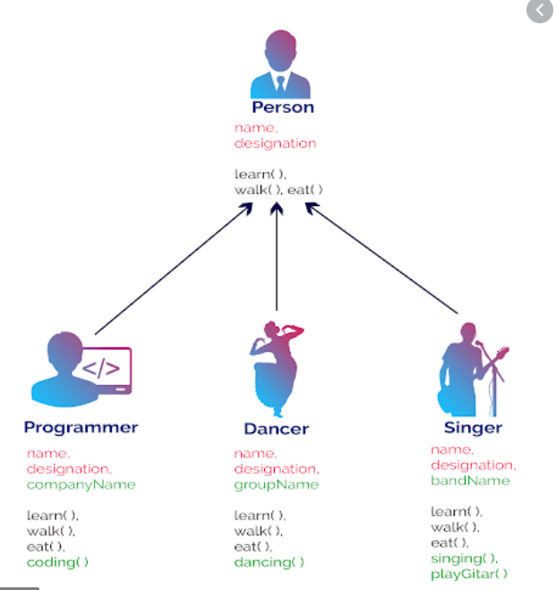
OOPS IN PHP – INHERITANCE
  The ability to reduce code duplication
  we have a parent class with its own methods and properties, and a child class (or classes) that can use the code from the parent
  we use the extends
  The child class can make use of all the
  non-private methods and properties

Slide 33
OOPS IN PHP – STATIC
  In certain cases, it is very handy to access methods and properties in terms of a class rather than an object
  Any method declared as static is accessible without the creation of an object.
  The static keyword is used in the context of variables and methods that are common to all the objects of the class.
  Any logic which can be shared among multiple instances of a class should be extracted and put inside the static method.
  A static class in PHP is a type of class which is instantiated only once in a program. It must contain a static member (variable) or a static member function (method) or both. The variables and methods are accessed without the creation of an object, using the scope resolution operator(::)

Slide 34
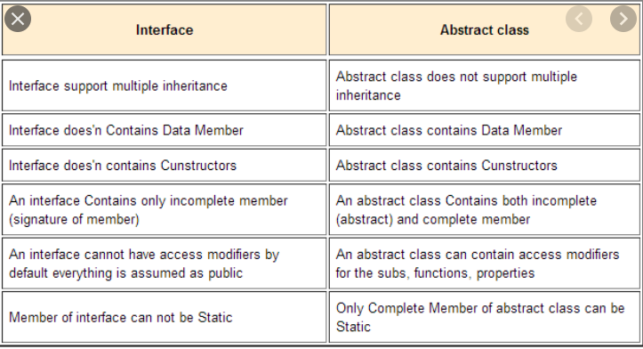
OOPS IN PHP – ABSTRACT & INTERFACE

Slide 35
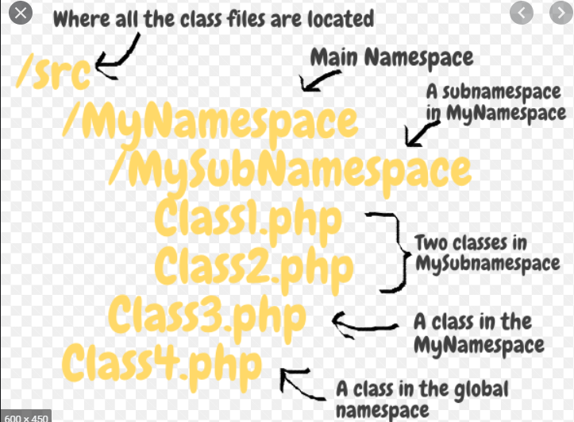
OOPS IN PHP – NAMESPACES
  To prevent name collisions
  a way to group related items together, avoiding any potential name collisions
  You can’t have two files with the same name in the same directory, but you can have files with the same name in different directories. Namespaces mimic the same principle in PHP!

Slide 36
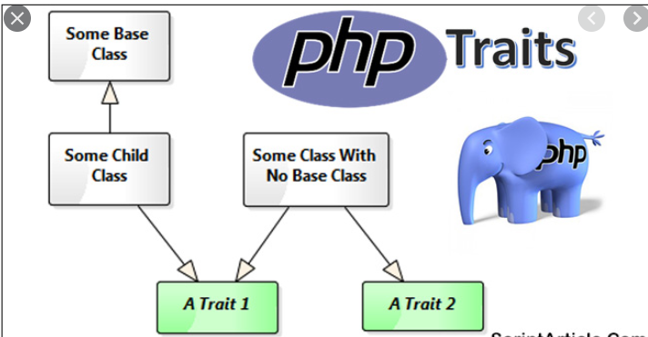
OOPS IN PHP – TRAITS
  PHP only supports single inheritance: a child class can inherit only from one single parent.
  Traits are used to declare methods that can be used in multiple classes
  Traits are declared with the trait keyword:
  To use a trait in a class, use the use keyword:

Slide 37

CODEIGNITER
  CodeIgniter is a powerful PHP framework with a very small footprint, built for developers who need a simple and elegant toolkit to create full-featured web applications.
  It is an Open Source framework
  It has a very rich set of functionality, which will increase the speed of website development work.
  Model-View-Controller basics

Slide 38

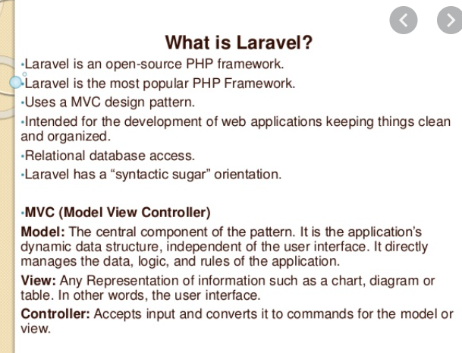
LARAVEL

Slide 39
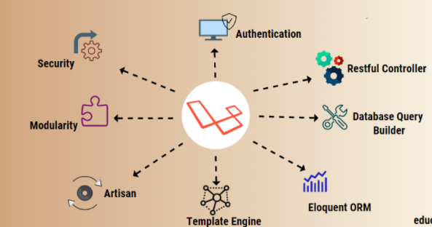
LARAVEL

Slide 40
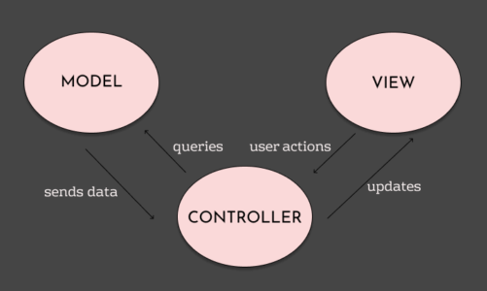
MVC

Slide 41

COMPOSER
  Composer is a tool for dependency management in PHP. It allows you to declare the libraries your project depends on and it will manage (install/update) them for you.

Slide 42
FLODERS
  App:
  The app directory contains the core code of your application. We'll explore this directory in more detail soon; however, almost all of the classes in your application will be in this directory.
  Boostrap:
  The bootstrap directory contains the app.php file which bootstraps the framework.
  This directory also houses a cache directory which contains framework generated files for performance optimization such as the route and services cache files. You should not typically need to modify any files within this directory.
  Config:
  contains all of your application's configuration files. It's a great idea to read through all of these files and familiarize yourself with all of the options available to you.

Slide 43
FLODERS
  Database:
  The database directory contains your database migrations, model factories, and seeds. If you wish, you may also use this directory to hold an SQLite database.
  Public:
  The public directory contains the index.php file, which is the entry point for all requests entering your application and configures autoloading.
  Resource:
  The resources directory contains your views as well as your raw, un-compiled assets such as CSS or JavaScript. This directory also contains all of your language files.

Slide 44
FLODERS
  Routes:
  The routes directory contains all of the route definitions for your application. By default, several route files are included with Laravel: web.php, api.php, console.php, and channels.php.
  Storage:
  The storage directory contains your logs, compiled Blade templates, file based sessions, file caches, and other files generated by the framework. This directory is segregated into app, framework, and logs directories. The app directory may be used to store any files generated by your application. The framework directory is used to store framework generated files and caches. Finally, the logs directory contains your application's log files

Slide 45
FLODERS
  Tests:
  The tests directory contains your automated tests. Example PHPUnit
  Vendor:
  The vendor directory contains your Composer dependencies.

Slide 46
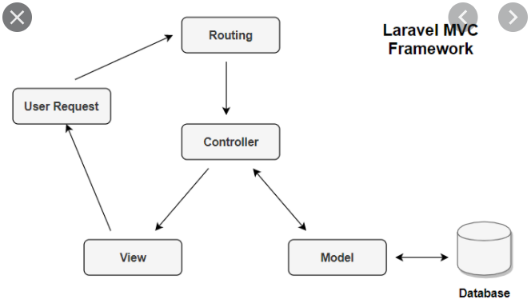
LARAVEL - ROUTING
  What is Laravel Routing?
  Using Routing you can create a request URL for your application. you can design set of HTTP request like POST Request, GET Request, PUT Request and DELETE Request using routing in laravel 8.
  You can easily create route in web.php file inside a routes folder.
  Artisan command to list routes
  php artisan route:list

Slide 47
LARAVEL - CONTROLLERS
  A Controller is that which controls the behaviour of a request. It handles the requests coming from the Routes.
  Controllers can group related request handling logic into a single class.
  For example, a UserController class might handle all incoming requests related to users, including showing, creating, updating, and deleting users.
  By default, controllers are stored in the app/Http/Controllers directory.

Slide 48
LARAVEL - MODELS
  Model are means to handle the business logic in any MVC framework based application.
  In Laravel, Model is a class that represents the logical structure and relationship of underlying data table.
  Laravel includes Eloquent, an object-relational mapper (ORM) that makes it enjoyable to interact with your database.
  When using Eloquent, each database table has a corresponding "Model" that is used to interact with that table.
  In addition to retrieving records from the database table, Eloquent models allow you to insert, update, and delete records from the table as well.

Slide 49
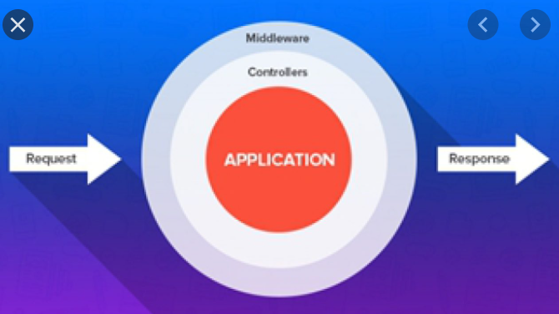
LARAVEL - MIDDLEWARE
  Middleware provide a convenient mechanism for inspecting and filtering HTTP requests entering your application.
  For example, Laravel includes a middleware that verifies the user of your application is authenticated. If the user is not authenticated, the middleware will redirect the user to your application's login screen.

Slide 50
LARAVEL - MIDDLEWARE
  Three types of middleware
Global Middleware
Route Middleware
Middleware Groups
The Global Middleware will run on every HTTP request of the application,
Route Middleware will be assigned to a specific route.
Sometimes you may want to group several middleware under a single key to make them easier to assign to routes. You may accomplish this using the $middlewareGroups property of your HTTP kernel.

Slide 51
LARAVEL – DB MIGRATION
  To control your database in Laravel is by using migrations. Create migration with artisan: DB table creation, alteration.
  php artisan make:migration create_first_table --create=first_table
  Some artisan migration commands
  php artisan migrate
  php artisan migrate:rollback - Rollback the last database migration
  php artisan migrate:reset - Rollback all database migrations
  php artisan migrate:refresh - Reset and re-run all migrations
  php artisan migrate:status - Show the status of each migration
  $table->renameColumn('email', 'username');
  $table->dropColumn('username');

Slide 52
LARAVEL – DB SEEDING
  Laravel comes with the very great & popular package named – Faker
  We can generate multiple database table records using seeder.
  php artisan make:seeder {Seeder_name}
  php artisan db:seed --class={seeder_class_name} – Runs single seeder
  php artisan db:seed – Runs all seeder
  use Faker\Factory as Faker;
  public function run()
  {
  $faker = Faker::create();
  foreach (range(1,10) as $index) {
  DB::table('users')->insert([
  'name' => $faker->name,
  'email' => $faker->email,
  'password' => bcrypt('secret'),
  ]);
  }
  }

Slide 53
LARAVEL - MIDDLEWARE
  How to work with middleware?
Step1: Create middleware
Using command php artisan make:middleware CheckStatus
Step2: Register in Kernal
Go to app/http/kernel.php and register your custom middleware
Step3: Implement logic in middleware
After successfully register your middleware in laravel project, go to app/http/middleware and implement your logic here
Step4: Add route
create a laravel route and use custom middleware

Slide 54
LARAVEL - AUTHENTICATION
  Steps
  Step 1: Create Laravel App
  Step 2: Connect to Database
  Step 3: Set Up Auth Controller
  Step 4: Create Auth Routes
  Step 5: Create Auth Blade View Files
  Step 6: Run Laravel Development Server

Slide 55
LARAVEL - COMMANDS
  composer create-project --prefer-dist laravel/laravel laravel_demo_app
  cd laravel_demo_app
  php artisan migrate
  php artisan make:controller CustomAuthController
  php artisan serve

